Slide 1
The Google File System
Sanjay Ghemawat, Howard Gobioff, Shun-Tak Leung
Google
SOSP '03
July 20, 2011
Presented by Hye Chan, Bae

Slide 2
Contents
Introduction
Design
Measurements
Conclusion

Slide 3

Amount of processing data
Google currently processes over 20 PB/day
20 PB = 20,000 TB = 20,000,000 GB
Google processes its data on a cluster node consisting
2 * 2 GHz Intel Xeon processors
4 GB memory
2 * 160 GB HDD
Notes:
2008년 자료 기준

Slide 4
Processing solution
How can these clusters process
the tremendous data?
Distributed File System
Distributed Processing Algorithm
Notes:
Distributed file system -> Google file system
Distributed processing algorithm -> mapreduce

Slide 5
GFS (Google File System)
A scalable distributed file system
Shares many same goals as previous distributed file systems
Performance
Scalability
Reliability
Availability
However, its design has been driven by key observations of
Google's application workloads
Technological environment

Slide 6
Contents
Introduction
Design
Measurements
Conclusion

Slide 7
Assumptions
Component failures are the norm
A machine is inexpensive commodity component
2 GHz Xeon, 4 GB Memory, 160 GB HDD, …
Failure causes
Application bugs
Operating system bugs
Human errors
Failures of disks, memory, connectors, networking, power supplies
…
The system must monitor, detect, tolerate, and recover from failures

Slide 8
Assumptions (cont.)
The system stores a modest number of large files
A few million files
Multi-GB files are the common case
I/O operation & block sizes have to be revisited
Most reads are large streaming reads
Individually, read hundreds of KBs, 1MB, or more
same client often reads through a contiguous region of a same file
Most writes are large & sequential append writes
Rather than overwriting existing data
Once written files are seldom modified again

Slide 9
Assumptions (cont.)
Concurrent appending has to be considered
It must efficiently implement well-defined semantics for multiple clients
Atomicity with minimal synchronization overhead is essential
High sustained bandwidth is more important than low latency

Slide 10
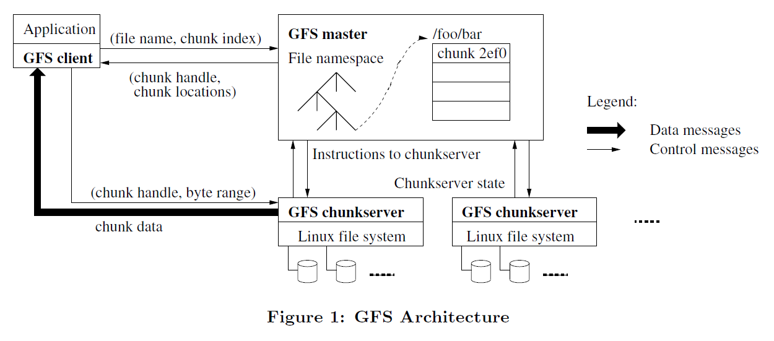
GFS Architecture
A GFS cluster components
File processing unit
Notes:
A GFS cluster consists of a single master and multiple chunkservers and is accessed by multiple clients.
It is easy to run both a chunkserver and a client on the same machine

Slide 11
Chunk
Files are divided into chunks
Chunk handle
unique 64bit Assigned by the master at chunk creation
1 File
25 chunks

Slide 12
Chunk (cont.)
Stored in chunkservers
Each chunk is replicated on multiple chunkservers for reliability
Chunks on local disks as Linux files
Notes:
Chunkservers store chunks on local disks as Linux files and read or write chunk data specified by a chunk handle and byte range.

Slide 13
Chunk (cont.)
Fixed-size: 64 MB (by default)
Lazy space allocation avoids wasting space due to internal fragmentation
Advantages
Reduces clients' need to interact with the master
Can perform many operation on a given chunk
Reduces the size of the metadata stored on the master
Disadvantages
Some chunkservers may become hot spots
Hot Spot!!
1 File
=
1 Chunk
request
request
Notes:
Lazy space allocation : prevents from allocating space until you've accumulated a lot
Hot spot : batch-queue system에서 발생 보고
A small file consists of a small number of chunks, perhaps just one.
(single chunk 안에 1개의 executable 파일이 존재하여 동시에 수백개의 request 발생)
-> 해결책으로 executable 파일인 경우에는 더 많은 replication을 하도록 설정
장기적으로는 client <-> client 간 통신을 통해 data를 읽어올 수 있도록

Slide 14
Master
Maintains all file system metadata
file & chunk namespaces
Mapping from files to chunks
Locations of each chunk's replicas
Periodically communicates with each chunkserver
HeartBeat message (giving instructions & collecting state)
HeartBeat
Notes:
Metadata는 뒷부분에 다시 설명

Slide 15
Master (cont.)
Single master
Simplifies design
Can make chunk placement & replication decisions easily
Communicates only metadata with clients
For avoiding the bottleneck
Clients cache metadata
Notes:
그럼 client는 실제 file data를 통신은?
: 원하는 chunk의 location을 metadata를 통해 얻어오면 해당 location의 chunkserver와 직접 통신한다. 이때 client는 metadata를 cache하여 다음 operation때의 master와의 통신은 생략할 수 있다.

Slide 16
Client
Is linked into each application
Implements the file system API
Communicates with the master and chunkservers

Slide 17
Interactions for a simple read
①
(file name, byte offset)
②
④ caching
③
⑤
⑥
Notes:
First, using the fixed chunk size, the client translates the file name and byte offset specified by the application into a chunk index within the file.
Then, it sends the master a request containing the file name and chunk index.
The master replies with the corresponding chunk handle and locations of the replicas.
The client caches this information using the file name and chunk index as the key.
The client then sends a request to one of the replicas, most likely the closest one. The request specifies the chunk handle and a byte range within that chunk.
Receive the chunk data from one of replicas.
Further reads of the same chunk require no more client-master interaction until the cashed information expires or the file is reopened.

Slide 18
Metadata
Major types
File & chunk namespaces
Mapping from files to chunks
Locations of each chunk's replicas
Namespace & mapping types are kept persistent
Operation log
Recovery, checkpoint, …
Stored on the master's local disk & replicated on remote machines
Chunk location type is not kept persistent
The problem of sync with chunkserver
HeartBeat messages
Notes:
초기에는 chunk location을 영구 저장하도록 설계했으나 동기화 문제를 없애기 위해 저장하지 않는 것으로 변경되었다.

Slide 19
Metadata (cont.)
It is stored in memory
Operations are fast
Master periodically scans through entire state
Garbage collection
Re-replication
Chunk migration to balance load &disk space usage
Notes:
Garbage collection
Application이 파일을 삭제하면 master는 즉시 deletion에 대한 log를 기록한다. 하지만 바로 리소스를 해제하지 않고 hidden file로 이름을 변경한다.
Master가 regular scan을 하게 되면 숨김 파일이 삭제된다.
파일이 삭제되면, master의 metadata 또한 삭제된다.
Re-replication
Chunkserver가 더 이상 사용불가능(unavailable)한 경우
Replica가 corrupt 되는 경우
에러로 인하여 disk 자체의 사용이 불가능한 경우
Replication goal이 상향된 경우
여러가지 요인을 고려하여 우선순위에 따라 처리

Slide 20
System interactions
Lease
Use leases to maintain a consistent mutation order across replicas
Primary : master grants a chunk lease to one of the replicas
Picks a serial order for all mutations to the chunk
All replicas follow this order when applying mutations
is designed to minimize management overhead at the master.

Slide 21
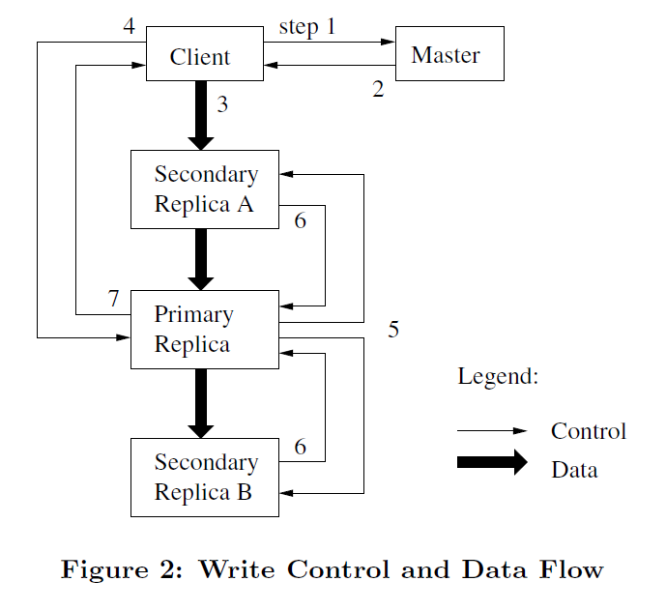
System Interactions (cont.)
Notes:
client가 master에게 어느 chunkserver가 current lease를 가지고 있는지 & 다른 replica들의 위치를 물어봄. lease가 없으면 마스터가 하나 골라서 부여.
master는 primary와 secondary replicas의 위치를 알려준다. client는 이를 cache해두고 사용. primary가 unreachable 또는 더 이상 primary가 아닌 경우에만 다시 master와 연결.
client가 모든 replica에게 데이터 push. 데이터는 primary부터 보낼 필요 없이 보내는 순서는 아무렇게나 해도 됨. 성능 향상을 위해 network topology 상 가까운 곳부터.
Data flow와 control flow를 분리하여 네트워크 효율성을 향상 (regardless of which chunkserver is the primary)
Pipeline으로 전송
Topology 상 가까운 곳은 IP 주소를 통해 거리를 유추
replica가 모두 ack를 보내면 client는 write요청을 primary에게 보냄. primary는 여러 clients로 부터 받은 mutation들에 serial order를 부여한다. 그런 후 primary 스스로 local에 mutation을 반영.
primary는 secondary에게 write요청을 보내고 secondary도 같은 순서로 mutation을 반영.
sencodary들은 operation이 끝나면 primary에게 끝났다고 ack을 보냄
primary가 client에게 reply. 에러가 발생한 경우, primary & 일부 secondary에만 mutation이 성공한 상태임. (primary가 실패하면 여기까지 못 옴) 그러면 client request는 실패한 것으로 간주. 수정된 영역은 inconsistent 상태가 됨. client가 retry 처리해야 함.

Slide 22
Fault tolerance
High availability
We keep the overall system highly available
Fast recovery
Master and chunkserver are designed to restore and start in seconds
Chunk replication
Each chunk is replicated on multiple chunkservers
Master Replication
Operation log is replicated on multiple machines for reliability
If fails, monitoring infrastructure starts a new master process with the replicated operation log
Shadow master
Provides read-only access to the file system
Not mirror

Slide 23
Fault tolerance (cont.)
Data integrity
Detecting corruption
Comparing replicas is impractical
Independently verify the integrity by maintaining checksums
Checksum
A chunk is broken up into 64 KB blocks
A block can use 32 bit checksum
Error case scenario
A block does not match the recorded checksum
Chunkserver returns an error to the requestor
Chunkserver reports the mismatch to the master
Requestor reads from other replicas
Master clones the chunk from another replica
Master instructs the mismatch-chunkserver to delete its replica

Slide 24
Guarantees by GFS
File namespace mutations are atomic
e.g. file creation
Namespace locking guarantees atomicity and correctness by master
State of a file region
It depends on
Type of mutation
Whether it succeeds or fails
Whether there are concurrent mutations
Consistent
If all clients will always see the same data
Regardless of which replicas they read from
Defined
If it is consistent
Clients will see what the mutation writes in its entirety
Notes:
When a mutation succeeds without interference from concurrent writers, the affected region is defined (and by implication consistent): all clients will always see what the mutation has written.
Concurrent successful mutations leave the region undefined but consistent: all clients see the same data, but it may not reflect what any one mutation has written. Typically, it consists of mingled fragments from multiple mutations.
A failed mutation makes the region inconsistent (hence also undefined): different clients may see different data at different times.

Slide 25
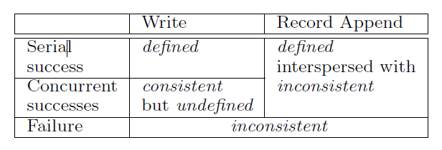
Guarantees by GFS (cont.)
State of a file region
A mutation succeeds without interference from concurrent writers
Defined & consistent
All clients will always see what the mutation has written
Concurrent successful mutations
Undefined but consistent
All clients see the same data, but it may not reflect what any one mutation has written
A failed mutation
Undefined & inconsistent
Different clients may see different data at different times
Notes:
When a mutation succeeds without interference from concurrent writers, the affected region is defined (and by implication consistent): all clients will always see what the mutation has written.
Concurrent successful mutations leave the region undefined but consistent: all clients see the same data, but it may not reflect what any one mutation has written. Typically, it consists of mingled fragments from multiple mutations.
A failed mutation makes the region inconsistent (hence also undefined): different clients may see different data at different times.

Slide 26
Guarantees by GFS (cont.)
A record append
GFS provides an atomic append operation
GFS chooses an offset
Successful Mutated file region is guaranteed to be defined & contain the data written by the last mutation by
Applying mutations to a chunk is the same order on all its replicas
Lease mechanism
Using chunk version numbers to detect any replica that has become stale
Caching chunk locations
May read from stale replica
Timeout
For corrupt or destroy data
Detects data corruption by checksumming

Slide 27
Contents
Introduction
Design
Measurements
Conclusion

Slide 28
Real world clusters
Cluster A
Used for research & development
Used by over hundred engineers
A typical task is initiated by a human user & runs up to several hours
Reads through a few MBs to a few TBs of data
Transforms or analyzes the data, and writes the results back to the cluster
Cluster B
Used for production data processing
Tasks last much longer than Cluster A
Continuously generates and processes multi-TB data sets
Human users are rarely involved

Slide 29
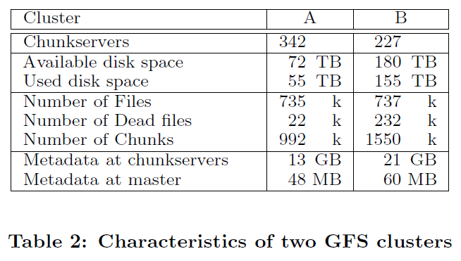
Real world clusters (cont.)
Metadata at master is very small
The size of the master's memory does not limit the system's capacity
Each individual server, total metadata has only 50~100 MB
Recovery is fast

Slide 30
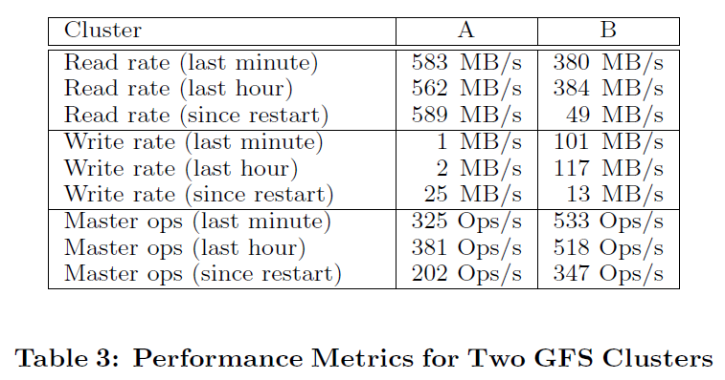
Real world clusters (cont.)
Rate of operations sent to the master
Around 200 ~ 500 operations per second
Can easily keep up with this rate
Not a bottleneck

Slide 31
Contents
Introduction
Design
Measurements
Conclusion

Slide 32
Conclusion
GFS demonstrates the qualities essential for supporting large-scale data processing workloads
Treats component failures as the norm
Optimizes for huge files that are mostly appended to and then read
Provides fault tolerance
Constant monitoring
Replicating data
Fast and automatic recovery
Delivers high aggregate throughput to many concurrent readers and writers
By separating control flow & data flow
Minimizes the master involvement
GFS has successfully met storage needs and is widely used within Google

