Slide 1
DIGTOBI: A Recommendation System for Digg Articles using Probabilistic Modeling
Younghoon Kim et al., Seoul National Univ.
WWW 2013
21 June 2013
Hyunwoo Kim

Slide 2
Outline
Introduction
Generative Model for Digg
Experiments
Conclusion

Slide 3
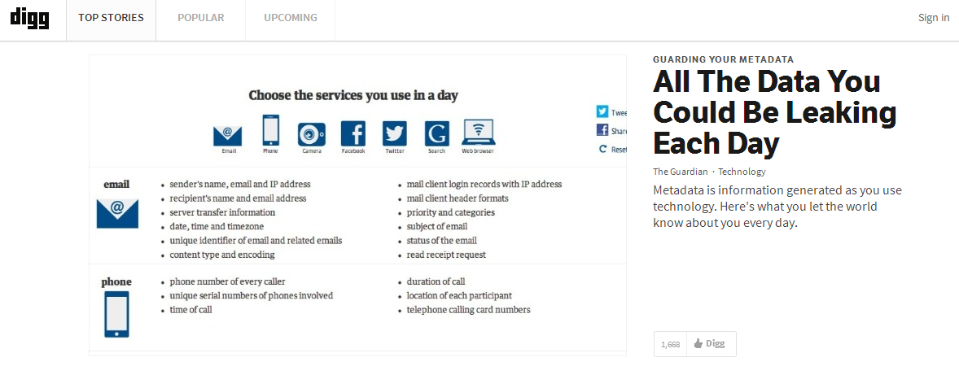
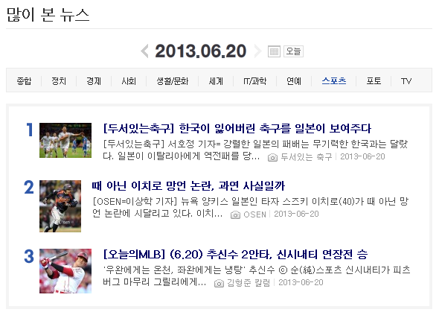
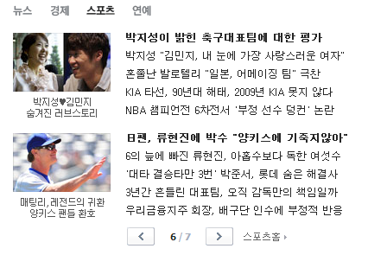
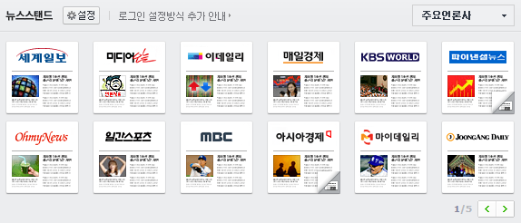
Introduction [1/5]
Digg, http://www.digg.com
Social news website
People submit articles for sharing their favorite web pages
People vote the articles posted by others

Slide 4
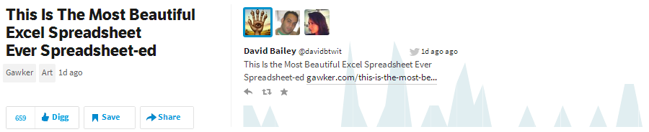
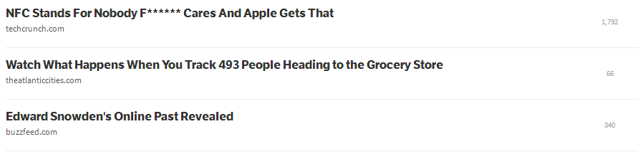
Introduction [2/5]
Voting
Thumbs up (also called digging)
Thumbs down (also called burying)

Slide 5
Introduction [3/5]
Components in a Digg submission
User id, title, description, and link
Digg score = digging - burying

Slide 6
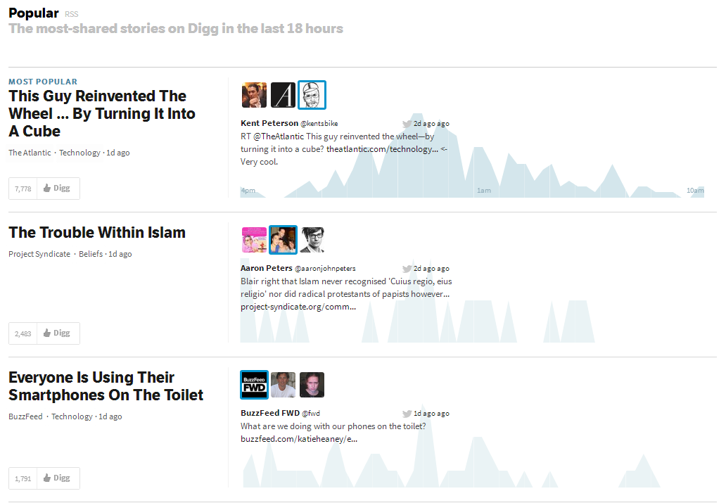
Introduction [4/5]
Limitations of current Digg.com
No personalization
Problem of cold-start recommendation

Slide 7
Introduction [5/5]
DIGTOBI
Personalized recommendation for DIGg arTicles using prObaBIlistic modeling
Probabilistic model
Generalization of the probabilistic latent semantic indexing (PLSI)
Considering the relevance articles with low Digg scores to be important

Slide 8
Outline
Introduction
Generative Model for Digg
Experiments
Conclusion

Slide 9

Generative Model for Digg [1/7]
Document
Obama
Barack Obama White House USA
words
Samsung
words
Samsung Galaxy Design Electronics
topics
Apple
words
Apple OS X Mavericks
iPhone iPad
PLSI

Slide 10
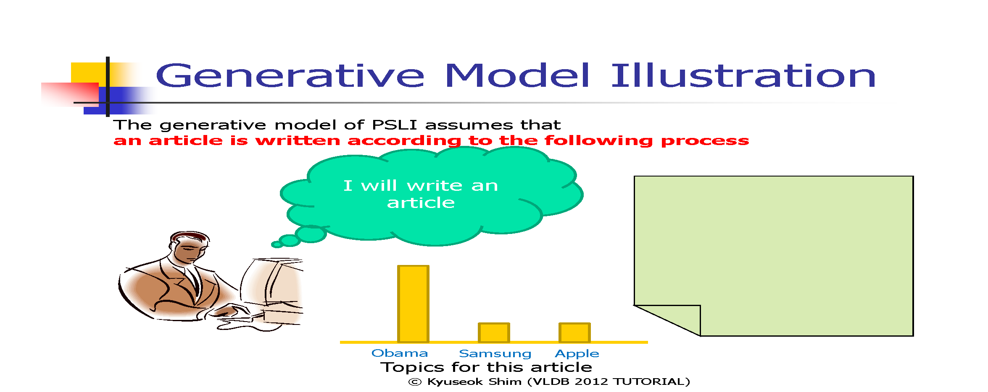

Slide 11
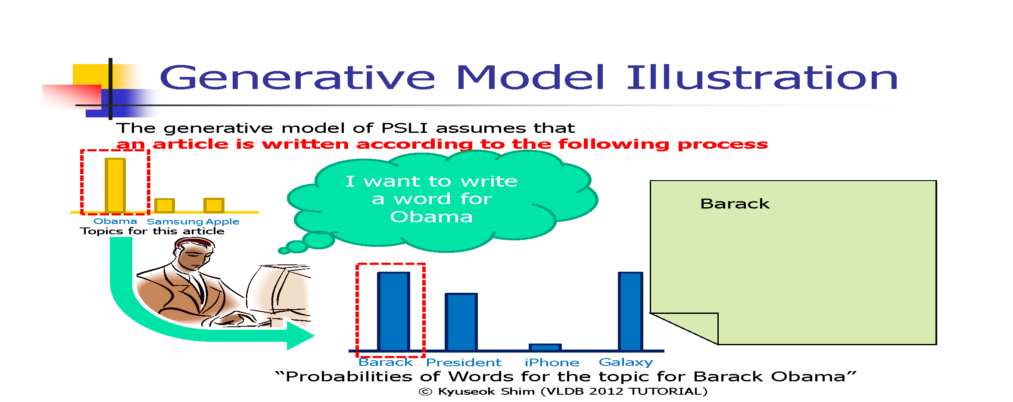

Slide 12
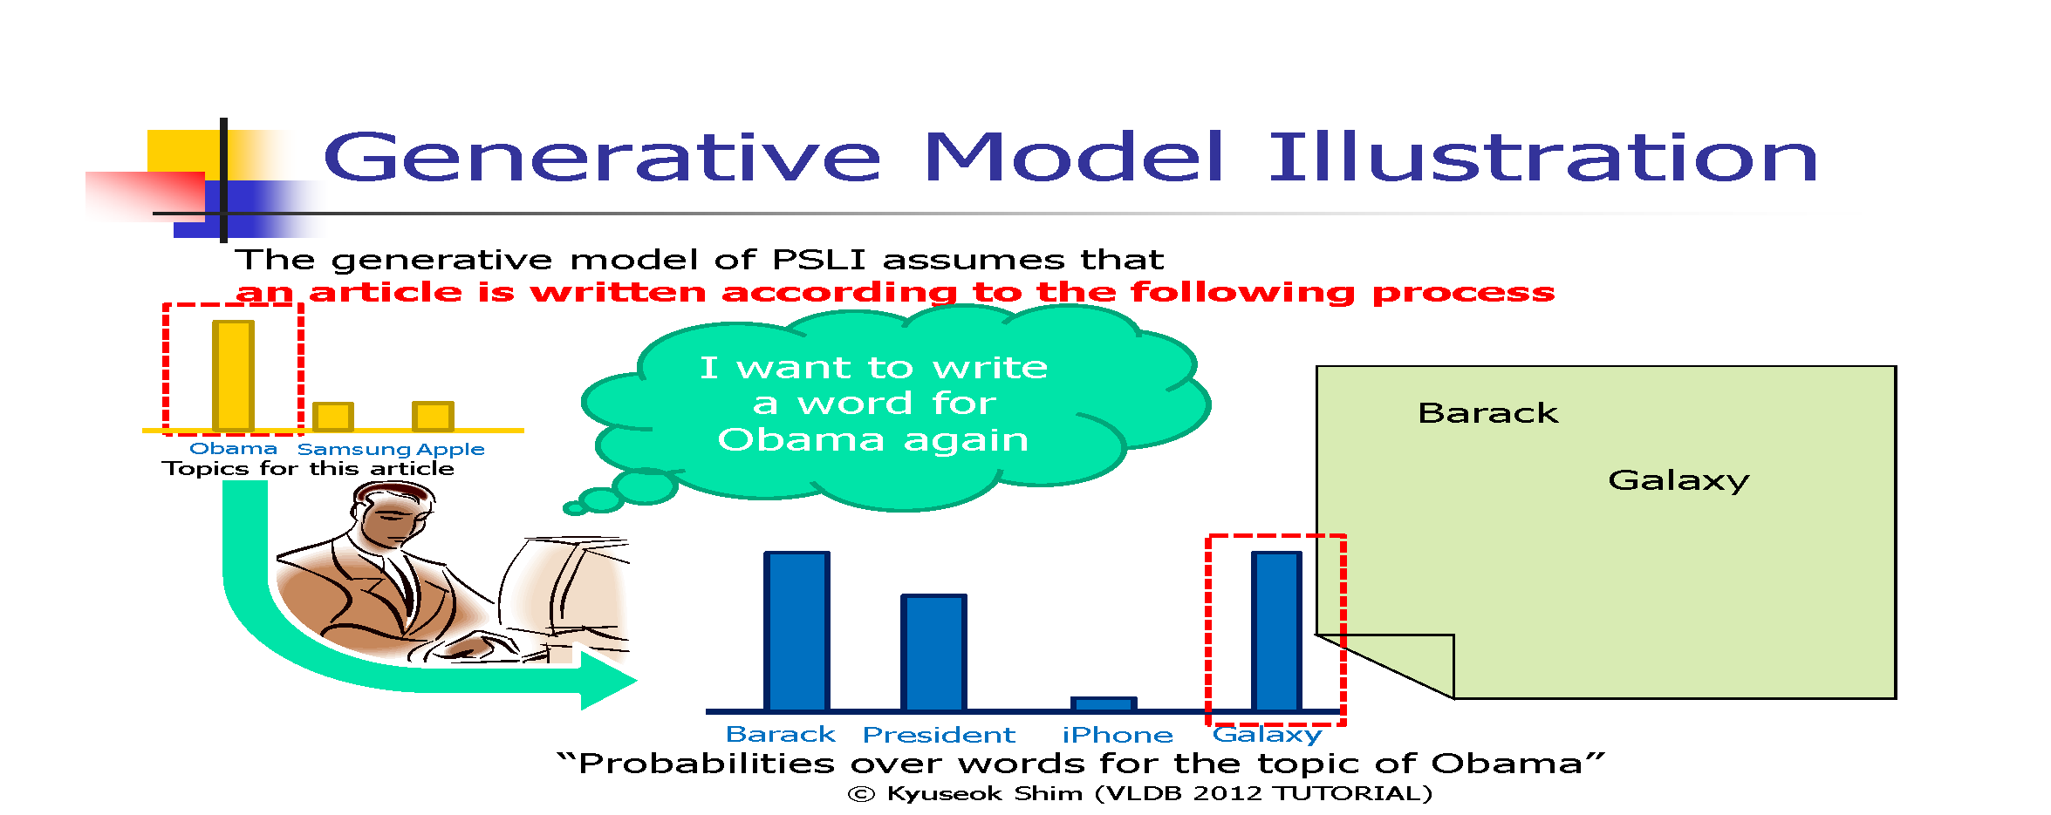

Slide 13
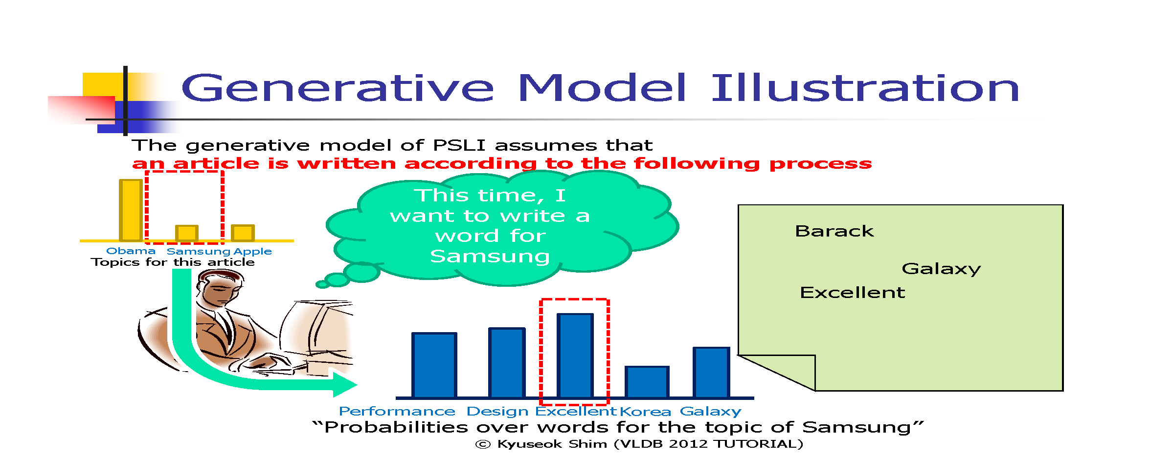

Slide 14
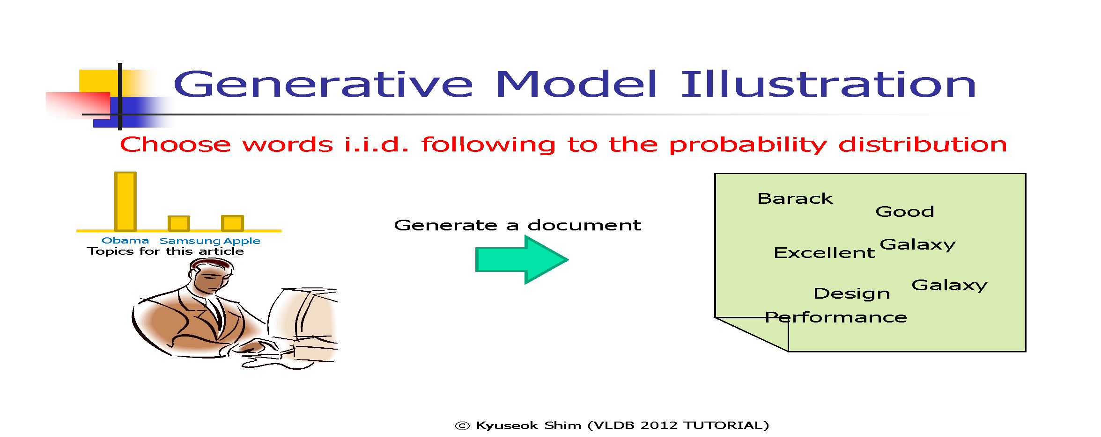

Slide 15
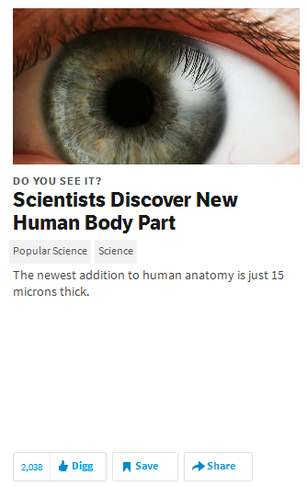
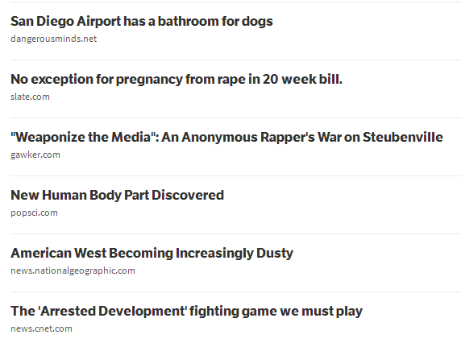
Generative Model for Digg [7/7]
Maximum Likelihood Estimation (MLE)
Probability
Likelihood
scientists
discover
new
human
body
Part
anatomy
news article
words
topics
recommendation

Slide 16
Outline
Introduction
Generative Model for Digg
Experiments
Conclusion

Slide 17
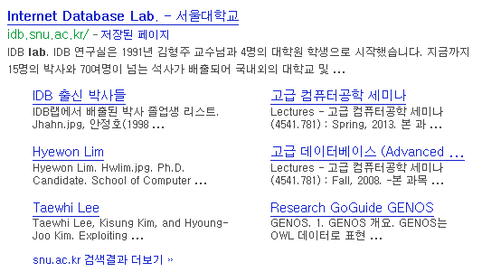

Experiments [1/3]
Quality measures
Precision and recall

Slide 18

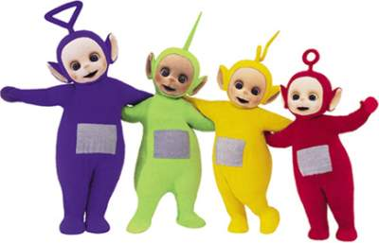


Experiments [2/3]
Quality measures
Precision and recall
# of IDB web pages in the world: 20
Retrieved pages: 10
Correct answers: 7
$$Precision= \frac{7}{10}$$
$$Recall= \frac{7}{20}$$

Slide 19
Experiments [3/3]
Results

Slide 20
Outline
Introduction
Generative Model for Digg
Experiments
Conclusion

Slide 21
Conclusion
We presented DIGTOBI
Personalized recommendation system for Digg articles
Generative model to describe the probabilistic processes of submitting and digging articles by each user
Recommendation by the relevant articles with low Digg scores
EM algorithm for learning the best model parameters
Effective warm-start and cold-start recommendation algorithms

Slide 22
Thank you

