Slide 1
The Uncracked Pieces in Database Cracking
Felix Martin Schuhknecht, Alekh Jindal, Jens Dittrich
Information System Group, Saarland University, CSAIL, MIT
VLDB, October 2013
DongHyo Kim

Slide 2
ABSTRACT
Database Cracking
Create indexes adaptively and incrementally as a side product of query process
Standard Cracking
Convergence
Projected attributes
Variance
Advanced Cracking
Hybrid Cracking
Sideways Cracking
Stochastic Cracking
Extending Cracking
Buffered-Swapping
Covered-Cracking
Coarse-
granular index

Slide 3
INTRODUCTION
Traditional Database indexing assumptions
The query workload is available
There is sufficient idle time to create the indexes
Not valid anymore in modern Applications
Workload is not known or constantly changing
Data is queried as soon as it arrives
Database Cracking has emerged for adaptive indexing in recent years
Create indexes adaptively and as a side product of query processing
Consider each incoming query as a hint for data reorganisation

Slide 4
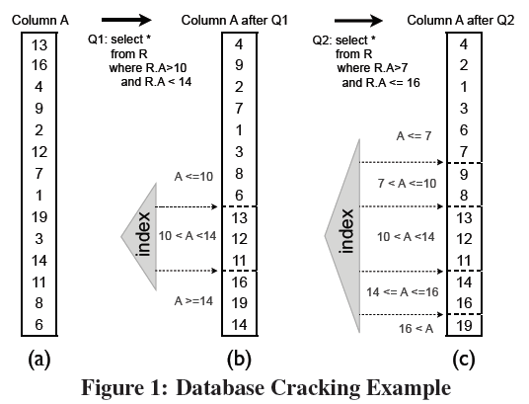
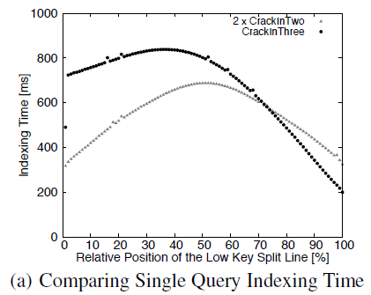
REVISITING CRACKING (1)
Crack-in-two vs Crack-in-three
Crack-in-two : partition the index column into two pieces
Crack-in-three : partition the index column into three pieces

Slide 5
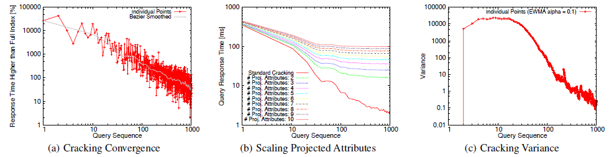
REVISITING CRACKING (2)
Standard Cracking Algorithm
incrementally and adaptively sort the index column using crack-in-three when both ends of a range query fall in the same partition and crack-in-two otherwise
★★ Key Concerns in Standard Cracking ★★

Slide 6
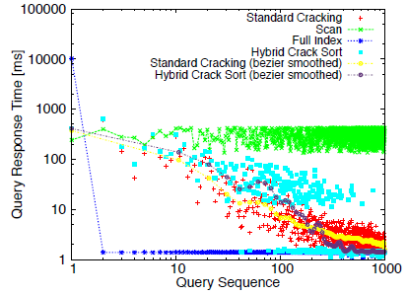
Advanced Cracking Algorithms (1)
Hybrid Cracking
Improving the convergence of standard cracking to a full index
Create unsorted initial runs which are physically reorganized and then adaptively merged for faster convergence

Slide 7
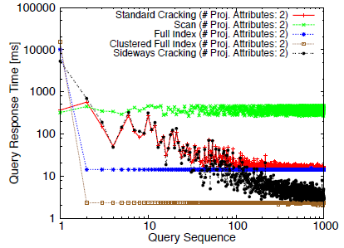
Advanced Cracking Algorithms (2)
Sideways Cracking
Adaptively create, align, and crack every accessed selection-projection attribute pair for efficient tuple reconstruction
Cracker map : keep the projection attributes aligned with the selection attributes
Log : recording the state of each cracker map

Slide 8
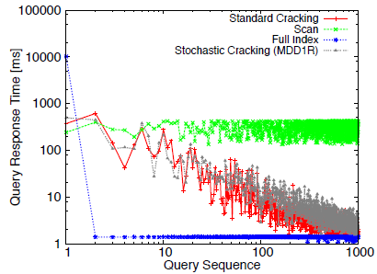
Advanced Cracking Algorithms (3)
Stochastic Cracking
Create more balanced partitions using auxiliary random pivot elements for more robust query performance
Introduces additional cracks apart from the query-driven cracks at query time
By varying the amount of auxiliary work and the crack positions, introduce a trade-off situation between variance and cracking overhead

Slide 9
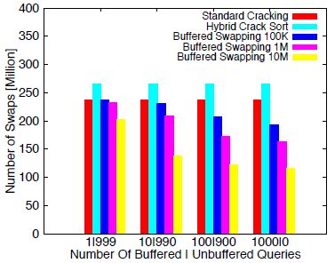
Extending Cracking Algorithms (1)
Improving Cracking Convergence : Buffered Swapping
Instead of swapping elements immediately after identification by the cracking algorithm, insert them into heaps and flush them back into the index as sorted runs
By adjusting maximal heap size, we can tune convergence speed of the cracked index

Slide 10
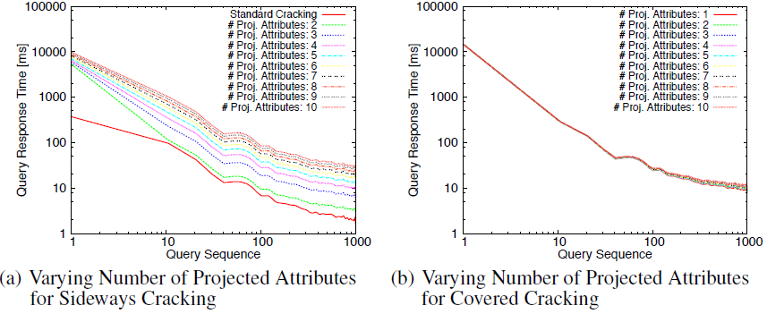
Extending Cracking Algorithms (2)
Improving Tuple Reconstruction: Covered-Cracking
Group multiple non-key attributes with the cracked column in a cracker map
At query time, crack all covered non-key attributes along with the key column
In sideways cracking : Overhead of cracking n replicas of the indexed column for n projected attributes in different cracker maps
Sol) Cover the n projected attributes in a single cracker map
Choosing a suitable set of covered attributes is crucial

Slide 11
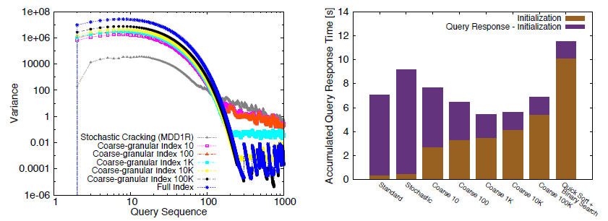
Extending Cracking Algorithms (3)
Improving Tuple Reconstruction: Coarse-granular Index
Create balanced partitions using range partitioning upfront for more robust query performance. Apply standard cracking later on
Pre-partition data into smaller range partitions
By varying the number of initial partitions, we can trade the initialization time for more robust query performance (we need to pick the partition size)

Slide 12
Conclusions
Database cracking is repeatable
Lot of potential to improve database cracking
Database cracking depends heavily on the query access pattern
Database cracking needs to catch up with modern indexing trends
Different indexing methods have different signatures

