Slide 1
MapReduce-based Closed Frequent Itemset Mining with Efficient Redundancy Filtering
Su-Qi Wang∗, Yu-Bin Yang∗, Guang-Peng Chen∗, Yang Gao∗ and Yao Zhang†
∗State Key Laboratory for Novel Software Technology, Nanjing University Nanjing, China
†JinLing College, Nanjing University, Nanjing, China
ICDMW 2012
11 July 2014
SNU IDB
Hyesung Oh

Slide 2
Introduction
Closed frequent itemset
Proposed in 1999 by Pasquier et al*
Alternative of the frequent itemset mining(FIM)
Has the same power of FIM, reduce redundancy
Existing CFI mining algorithms
Candidate generate-and-test approach
Pattern growth approach
Limitations of data size
memory use and communication costs
Some algorithms using PC clusters
Workload balancing, …
* N. Pasquier, Y. Bastide, R. Taouil, and L. Lakhal, “Discovering frequent closed itemsets for association rules,” Database Theory–ICDT’99, pp. 398–416, 1999.

Slide 3
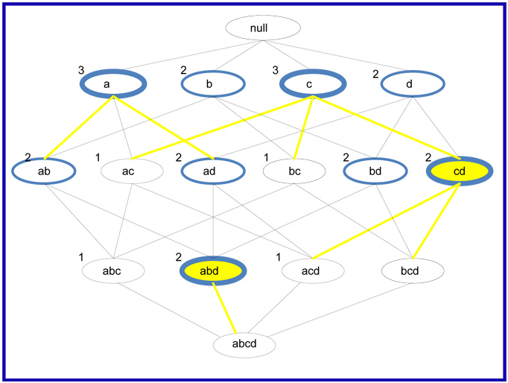
Closed frequent itemset
Frequent itemset
Closed, greater than or equal to minsup
minsup = 2

Slide 4
Parallelized AFOPT-close algorithm
4 steps
Step 1: Parallel counting. (MR pass)
Count the support of each item
Step 2: Constructing the global F-list.
Sort the items by their frequency desc order
Exclude items of which sup is lower than minsup
Step 3: Parallel mining closed frequent itemset. (MR pass)
Mining locally closed frequent itemset
Step 4: Parallel filtering the redundant itemsets. (MR pass)
Filter itemset which is locally closed but not globally closed

Slide 5
Example
TID | Transactions
1 | fmghab
2 | pcbamfd
3 | hmafb
4 | cbpamf
5 | cbpfsr
Word | Sup
a | 4
b | 5
c | 3
d | 1
f | 5
g | 1
h | 2
m | 4
p | 3
r | 1
s | 1
Word | Sup
f | 5
b | 5
a | 4
m | 4
c | 3
p | 3
h | 2
d | 1
g | 1
r | 1
s | 1
Result of Step3
fpcb 3
mab 3
fma 4
fm 4
fpc 3
fp 3
f 5
Minsup = 3
Word count
Sort desc order:
F-list
{ fm 4}, { fpc 3}, { fp 3} are closed locally but not in global

Slide 6
Detail of Step 3
TID | Trans
1 | fmghab
2 | pcbamfd
3 | hmafb
4 | cbpamf
5 | cbpfsr
TID | Trans
1 | fmab
2 | pcbamf
3 | mafb
4 | cbpamf
5 | cbpf
Key | Value
f | 1
f | 1
f | 1
… | …
fpcb | 1
Key | Value
5 | f 5
3 | fpcb 3
Word | Sup
f | 5
b | 5
a | 4
m | 4
c | 3
p | 3
Key | Value
b | 1
b | 1
b | 1
… | 1
fm | 1

Slide 7
Efficient Redundant itemsets Filtering
Mapper Output
Reducer
Reducer Output
Key | Value
3 | fpcb 3
3 | mab 3
4 | fma 4
4 | fm 4
3 | fpc 3
3 | fp 3
5 | f 5
Key | Value
3 | fpcb 3
 | mab 3
 | fpc 3
 | fp 3
4 | fma 4
 | fm 4
5 | f 5
Key | Value
3 | fpcb 3
 | mab 3
4 | fma 4
5 | f 5

Slide 8
Experimental Results - 1
Two real datasets
“connect”
contains game state information
8.8 Megabytes
“webdocs”
1,692,082 taransactions with 5,267,656 distinct items
Max length of a transaction is 71,472
1.4 Gigabytes
6 nodes with Hadoop 0.21.0
Each node
4 Intel Core processors
4GB RAM
500G HDD
Ubuntu 10.10
Java openjdk-6-jdk

Slide 9
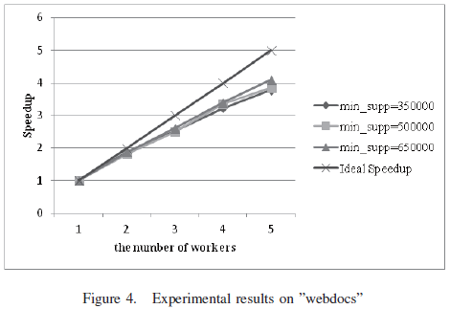
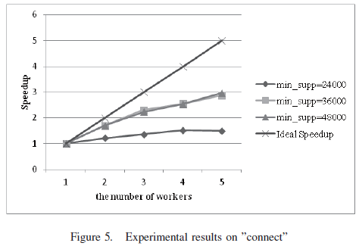
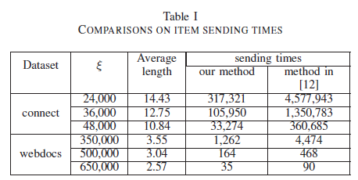
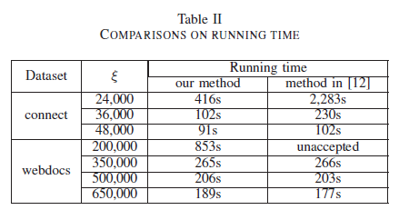
Experimental Results - 2
[12] G. Chen, Y. Yang, Y. Gao, and L. Shang, “Mining closed
frequent itemset based on mapreduce,” in Proceedings of the
4th China Conference on Data Mining. CCDM, 2011.
Notes:
Minsup이 크면 step 3과 step 4의 시간이 짧아진다.
작은 데이터는 통신 비용 > 계산 비용이기 때문에 우리의 알고리즘은 작은 데이터에 적합하지 못하다.
Average length -> Step 3에서 만드는 itemset의 평균 길이
350,000 ~ 작은 수 의 Step 3에서 나오는 … 이라 우리가 느리다 하지만 200,000 에서는 이겼다.

Slide 10
Conclusion
Good scalability on large-scale datasets
When locally closed frequent itemset is large
Communication cost becomes an important factor

