Slide 1
Optimizing the Incremental Maintenance of Multiple Join Views
Ki Yong Lee, Myoung Ho Kim
KAIST
DOLAP 2005
SNU IDB Lab.
Hyewon Lim
October 10th, 2008

Slide 2
Contents
Introduction
Related work
Preliminaries
Maintaining A Single View
Maintaining Multiple views
Experiment
Conclusions

Slide 3
Introduction
Materialized view
  Generally defined over several base relations
  When base relations are changed, the materialized views must also be updated.
  Maintenance
    Recomputation
    Incremental maintenance
      amount of changes << size of base relations and views
Intermediate results can be reused to maintain other views, we may significantly reduce the overall cost.

Slide 4
Related work (1/3)
J. A. Blakeley, P. A. Larson, F. W. Tompa, Efficiently Updating Materialized Views, SIGMOD 1986
  For an n-way join view V = R₁ R₂ … R_{n,}
  ∆V = (∆R₁ R₂ … R_{n})
  U (R₁ ∆R₂ … R_{n})
  U …
  U (∆R₁ ∆R₂ … ∆R_{n})
  (2^{n}-1) terms
a | c
1 | 5
2 | 7
3 | 5
b | c
4 | 8
9 | 5
2 | 5

Slide 5
Related work (2/3)
A. Gupta, I. S. Mumick, V. S. Subrahmanian, Maintaining views incrementally, SIGMOD 1993
  ∆V = (∆R₁ R₂ … R_{n})
  U (R₁’ ∆R₂ … R_{n})
  U …
  U (∆R₁’ ∆R₂’ … ∆R_{n}’)
  R_{i}’ = R_{i}’ U ∆R_{i}’
  Equivalent to previous expression, but has only n terms.
  Each base relation R_{i} (or R_{i}’) appears in (n-1) terms repeatedly.
    Needs to be accesses (n-1) times to evaluate expression

Slide 6
Related work (3/3)
K. Y. Lee, J. H. Son, M. H. Kim, Efficient Incremental View Maintenance in Data Warehouses, CIKM 2001
  The delta propagation strategy
    Computes the change of a view in a recursive manner
    Consider V =R₁ R₂ R₃ R₄
  ∆V = (∆(R₁ R₂) R₃ R₄)
  U (R₁’ R₂’ ∆(R₁ R₂))
  U …
  U (∆R₁’ ∆R₂’ … ∆R_{n}’)
    ∆(R_{i} R_{j}) = (∆R₁ R₂) U (R₁’ ∆R₂)

Slide 7
Preliminaries
- View Definition Model
A materialized view can be variously defined over base relations or other materialized views or both.
In this paper
  Materialized views defined by the join of base relations.
  A join view V over n base relations R₁, R₂, … , R_{n}:
  V = R₁ R₂ … R_{n}
  ∆R: The change of R
  R’: the relation R to which ∆R is propagated (R’=RU∆R)

Slide 8
Preliminaries
- Cost Model
The linear work metric
  W. J. Labio et al., Shrinking the Warehouse Update Window, SIGMOD 1999
  Simple but effectively estimates the cost
  Cost of processing a maintenance expression
    Sum of costs of each term of the expression
      Cost of a term = sum of sizes of the operands of the term
  Cost(∆V) (∆V= (∆R₁ R₂) U (R₁’ ∆R₂))
  = Cost((∆R₁ R₂) U (R₁’ ∆R₂)
  = Cost(∆R₁ R₂) + Cost(R₁’ ∆R₂)
  = c(|∆R₁|+|R₂|) + c(|R₁’|+|∆R₂|)

Slide 9
Maintaining A Single View
- Delta Propagation Strategy (1/4)
The delta expression
  ∪_{i=1 to m} P_{i} = {R₁, R₂, …, R_{n}}
  P_{i} ∩ P_{j} = ø (1≤ i≠j ≤ m), and P_{i} ≠ ø (1≤ i ≤ m)
R₁ R₂ … R_{n}
{R₁, R₂} | {R₃, R₆} | … | {R_{n-4}, R_{n-1}, R_{n}}
P₁
P₂
…
P_{n}

Slide 10
Maintaining A Single View
- Delta Propagation Strategy (2/4)
∆V = (∆( P₁) ( P₂) … ( P_{m}))
U (( P₁’) ∆( P₂) … ( P_{m}))
U …
U (( P₁’) ( P₂’) … ∆( P_{m}))
  P_{i} = R_{s} R_{t} … R_{u}
  1. Computes ∆( P₁), ∆( P₂), …, ∆( P_{m}) first
  2. finally computes overall change of V by using the results of ∆( P₁), ∆( P₂), …, ∆( P_{m})

Slide 11
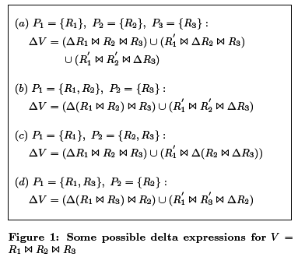
Maintaining A Single View
- Delta Propagation Strategy (3/4)
Depending on the choices of P₁, P₂, …, P_{m}, there can be many delta expressions for a view.

Slide 12
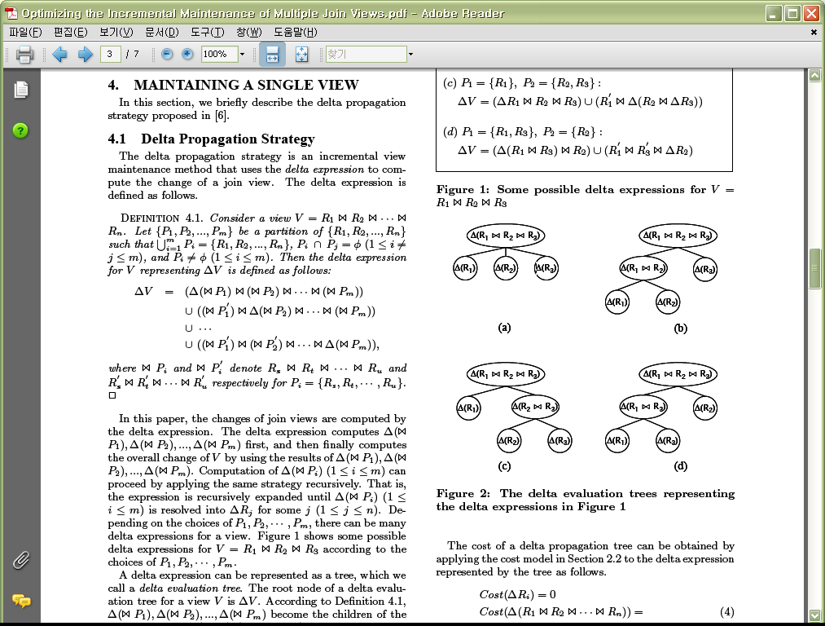
Maintaining A Single View
- Delta Propagation Strategy (4/4)
A delta evaluation tree
  Represents a delta expression
  ∆V: Root node

Slide 13
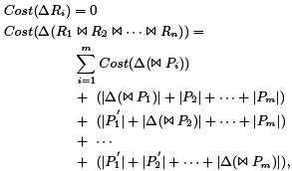
Maintaining A Single View
- Optimal Plan for a Single View
Optimal delta propagation tree
  Delta expression has the minimal cost with respect to the cost model
Cost of a delta propagation tree

Slide 14
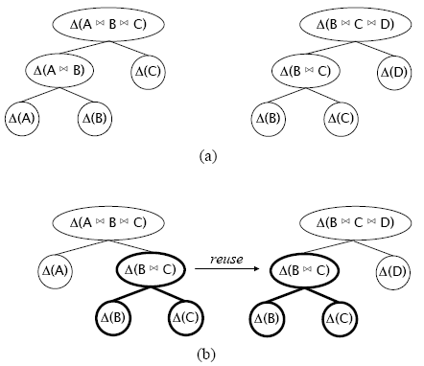
Maintaining Multiple Views
Locally optimal trees
Globally optimal trees
Reuse ∆(B C)
Need to decide what intermediate results should be materialized and reused.
⇒ The multiple view maintenance problem

Slide 15
Maintaining Multiple Views
- Problem Formulation
If we do not reuse any intermediate result
  TotalCost(V) = ∑MinCost(∆V_{i}), V_{i}∈V
    MinCost(∆V_{i}): cost of the optimal delta evaluation tree
Total cost of computing ∆V₁, ∆V₂, …, ∆V_{n} using S
  TotalCost(V|S) = ∑MinCost(S_{i}|S-{S_{i}}) + ∑MinCost(∆V_{i}|S)
    S: a set of the intermediate results
    MinCost(∆V_{i}|S): The cost of the optimal delta evaluation tree for V_{i} given that the expressions in S are already computed and materialized
    MinCost(∆V_{i}|S) ≤ MinCost(∆V_{i})

Slide 16
Maintaining Multiple Views
- The Greedy Algorithm (1/2)
The multiple view maintenance problem has the same form as the traditional multiple query optimization problem.
  Aim: exploit common sub-expressions to reduce overall evaluation cost
  The multiple query optimization problem is NP-hard.
    Most work has concentrated on heuristic algorithm
Develop a heuristic algorithm that selects a set S to be materialized in a greedy manner.

Slide 17
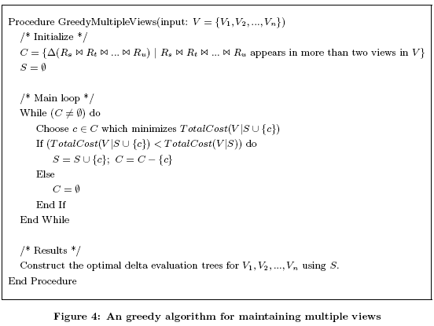
Maintaining Multiple Views
- The Greedy Algorithm (2/2)

Slide 18
Experiment (1/2)
Environment
  Oracle8i database system
  256MB RAM
  TPC-R benchmark schema and data
Customer
SF*150K
Nation
25
Region
5
Order
SF*1500K
Supplier
SF*10K
Part
SF*200K
LineItem
SF*6000K
PartSupp
SF*800K
Legend:
• Arrows point in the direction of one-to-many relationships.
• The value below each table name is its cardinality. SF is the Scale Factor.

Slide 19
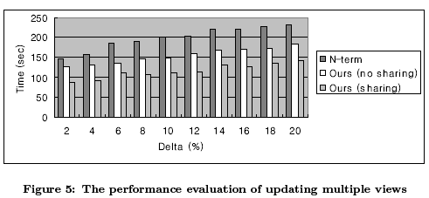
Experiment (2/2)
Time = (optimization time)
+ (total time for updating all the views)
  Optimization time: the time taken for finding delta evaluation trees for the views

Slide 20
Conclusions
When data sources change, materialized views need to be updated to reflect the changes of data sources.
The updates of views may impose a significant overhead on the warehouse.
  Very important to update the warehouse views efficiently
The delta evaluation tree with consideration of sharing intermediate results makes it possible to maintain multiple join views efficiently.

