Slide 1
MapReduce-Based Pattern Finding Algorithm Applied in Motif Detection for Prescription Compatibility Network
Yang Liu et al.
College of Computer Science, Zhejiang University
APPT(Advanced Parallel Programming Technologies) 2009
25 July 2012
Hyewon Kim

Slide 2
Outline
Introduction
MRPF
Evaluation
Conclusion
Discussion

Slide 3
Introduction (1/2) Network Motif
Connectivity-patterns (sub-graphs) that occur much more often than they do in random networks
Network motif
A
E
D
D
A
B
C
B
E
F
A
A
E
B
B
D
D
B
E
A
Network

Slide 4
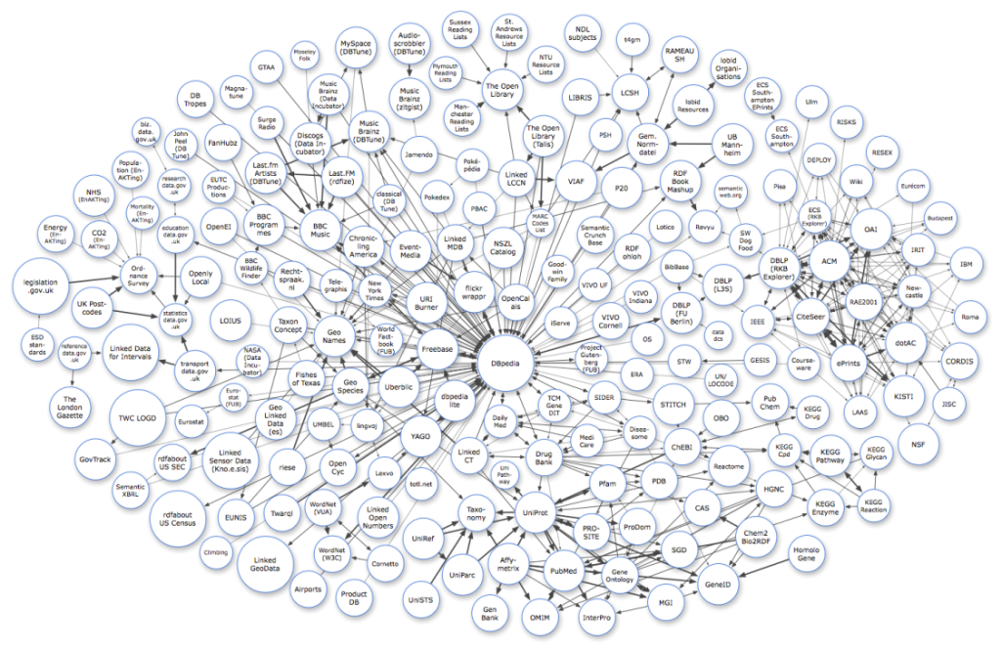



Introduction (2/2) MRPF
Pattern finding is most expensive step in the process of motif detection
A pattern finding algorithm based on MapReduce to improve the efficiency
Pattern Finding

Slide 5
Outline
Introduction
MRPF
Evaluation
Conclusion
Discussion

Slide 6
MRPF (1/4) Overview
Distributed storage
Neighbor vertices finding and pattern initialization
Adj_Table
Match_Set
Pattern_List
Pattern extension
Frequency computing

Slide 7
MRPF (2/4) Neighbor Vertices Finding and Pattern Initialization
Input
Intermediate results
Output
Adj_Table (Adjacent vertices list)
Graph
MAP
<V_{i}, V_{j}>
Reduce
<V_{j}, V_{i}>
Match_Set (Smallest patterns)
(size 2)
<Pattern2, (V_{i,} V_{j})>
Adj_Table
V_{i} | V_{j} | V_{j} | V_{i}
A | D,D | B | F
B | D | D | A,E,C,B,E,A
C | D,F | F | C
E | D,D
F | B
<V_{i}, V_{j}>
<V_{j}, V_{i}>
<Pattern2, (V_{i,} V_{j})>
A
P₁
<A,D>
<E,D>
<C,D>
<C,F>
<F,B>
<B,D>
<E,D>
<A,D>
<D,A>
<D,E>
<D,C>
<F,C>
<B,F>
<D,B>
<D,E>
<D,A>
< P₁,(A,D)>
< P₂,(E,D)>
< P₃,(C,D)>
< P₁,(C,F)>
< P₃,(F,B)>
< P₂,(B,D)>
< P₂,(E,D)>
< P₁,(A,D)>
P₂
D
P₃
C
P₁
E
F
E
P₂
B
P₃
D
P₂
A
P₁
Match_Set
Pattern | Edge
P₁ | (A,D), (C,F), (A,D)
P₂ | (E,D), (B,D), (E,D)
P₃ | (C,D), (F,B)

Slide 8
MRPF (3/4) Pattern Extension
Adj_Table
Pattern_List
Input
Intermediate results
Output
Match_Set
(Match_{i})
MAP
Reduce
<Match_{i+1}, Pattern_{i+1}>
<Pattern_{i+1}, Match_{i+1}>
Pattern_{i} , Match_{i}
Adj_Table
A
P₁
D
P₃
C
A
P₁
V_{i} | V_{j} | V_{j} | V_{i}
A | D,D | B | F
B | D | D | A,E,C,B,E,A
C | D,F | F | C
E | D,D
F | B
<Pattern 1, >
D
P₃
C
P₁
E
P₂
A
D
P₁
P₂
D
A
A
<Pattern 2, >
E
P₁
P₂
D
E
D
B
P₂
P₂
Match_Set
A
P₁
E
D
<Pattern 3, >
Pattern | Edge
P₁ | (A,D), (C,F), (A,D)
P₂ | (E,D), (B,D), (E,D)
P₃ | (C,D), (F,B)
A
P₁
A
P₁
P₂
D
P₃
C
P₁
E
F
B
D
P₂
P₂
P₃
<Pattern 4, >
E
D
B
A
P₁
P₂
A
P₁
Pattern_List

Slide 9
MRPF (4/4) Frequency Counting
Input
Intermediate results
Output
Patterns
Matches
MAP
Reduce
<C(Pattern), 1>
<C(Pattern), COUNT>
A
P₁
<Pattern 1, >
<Canonical label (Pattern 1), 1>
D
P₃
C
A
P₁
<Pattern 2, >
<Canonical label (Pattern 2), 1>
<Canonical label 1), 1>
P₂
D
E
<Canonical label 2, 2>
E
P₂
D
<Canonical label (Pattern 3), 1>
<Canonical label 3, 1>
<Pattern 3, >
A
P₁
D
B
P₂
<Pattern 4, >
<Canonical label (Pattern 4), 1>
A
P₁
Pattern_List

Slide 10
Outline
Introduction
MRPF
Evaluation
Conclusion
Discussion

Slide 11
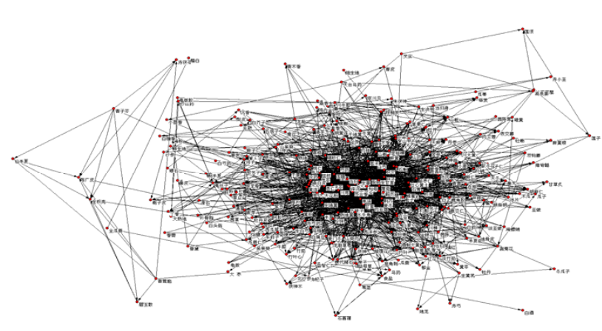
Evaluation (1/3) Experiment
Environment
Intel (R) Xeon (TM) CPU 2.80 GHZ
1GB memory
Cluster with 48 nodes
Prescription compatibility network
300 vertices
2000 edges

Slide 12
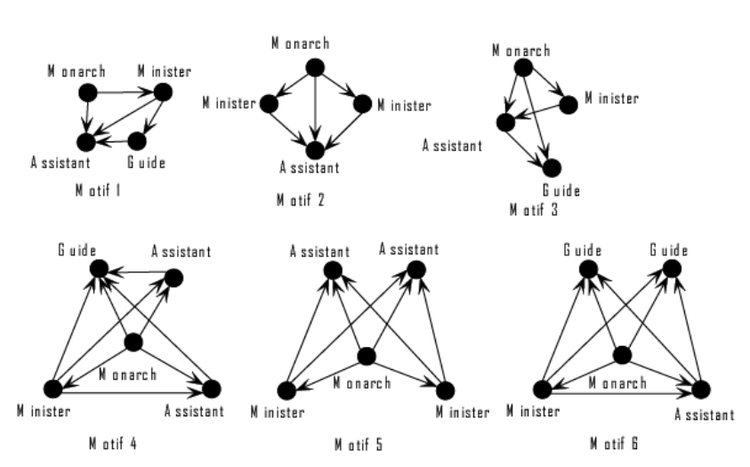
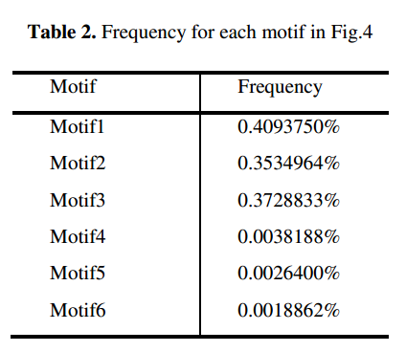
Evaluation (2/3) Motifs Detection Results
We apply MRPF in the prescription network
A number of motifs of prescription network
Size 4
Size 5

Slide 13
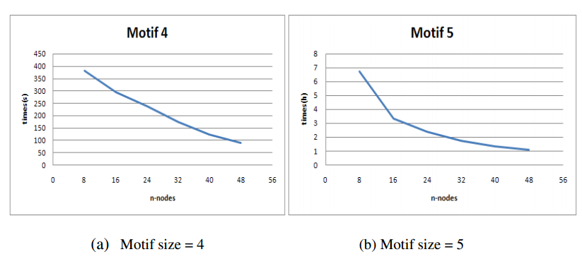
Evaluation (3/3) Performance
We run the algorithm to do the same task on cluster of varying nodes
Execution time decreases quickly while the cluster nodes increase
The speedup might be degraded due to the increasing overhead

Slide 14
Outline
Introduction
MRPF
Evaluation
Conclusion
Discussion

Slide 15
Conclusion
We desing a MapReduce-based pattern finding algorithm (MRPF) for analyzing the complex network
We applied the complex network analysis method to the prescription compatibility network
Using MRPF to find the commonly used compatibility structure

Slide 16
Outline
Introduction
MRPF
Evaluation
Conclusion
Discussion

Slide 17
Discussion
Strong point
A description of MapReduce code is easy to understand
Weak point
Short explanation about implementation details
Duplicate computation

