Slide 1
Signal/Collect: Graph Algorithms for the (Semantic)Web
Philip Stutz¹, Abraham Bernstein¹, and William Cohen²
1 DDIS, Department of Informatics, University of Zurich, Zurich, Switzerland
2 Machine Learning Department, Carnegie Mellon University, Pittsburgh, PA
ISWC '10
November 24, 2011
Sengyu Rim

Slide 2
Contents
Introduction
The Signal/Collect Programming Model
Related Work
Algorithms in Signal/Collect
The Signal/Collect Framework — An Implementation
Evaluation
Conclusion

Slide 3

Introduction
DATA
How to deal with increasing data set sizes in Semantic Web ?

Slide 4


Introduction
We hope for the computational capabilities of computers to grow faster than the datasets
Moore's Law
Impractical
dataset
Moore’s Law
Impractical !

Slide 5

Introduction
Many researchers have tried to use parallelism
Distributed computing models —MapReduce
Mapping to key/value-pair is inconvenient
Low-level distributed primitives —message passing interfaces, clusters

Slide 6

Introduction
Signal/Collect programming model
Signal: some kind of information is sent by vertexes along the property –defined edges
Collect: gathers the incoming signals at vertexes
S

Slide 7
Introduction
Signal/Collect programming model
Elegant and concise definition of programming tasks
The framework can speed up the tasks by exploiting the asynchronous execution
Can be served as an alternative to MapReduce

Slide 8
Contents
Introduction
Related Work
The Signal/Collect Programming Model
Algorithms in Signal/Collect
The Signal/Collect Framework — An Implementation
Evaluation
Conclusion

Slide 9
Related Work
Many general programming models have been presented
MapReduce
Based on parallel operations on sets of key-value pairs
Limited to synchronous execution
Pregel — most closely related to our model
Process large-scale graph
It only handles synchronous computations

Slide 10
Contents
Introduction
Related Work
The Signal/Collect Programming Model
Algorithms in Signal/Collect
The Signal/Collect Framework — An Implementation
Evaluation
Conclusion

Slide 11
The Signal/Collect Programming Model
A formal definition of the Signal/Collect structures
G =(V,E) where V is the set of vertices and E the set of edges in G
v.id a :unique id
v.state : the current vertex state
v.outgoingEdges :a list of all edges e 2 E with e:source = v
v.signalMap :a map with the ids of vertices as keys and signals as values
v.uncollectedSignals : a list of new signals
e.source :the source vertex
e.sourceId : id of the source vertex
e.targetId :id of the target vertex
collect : calculates a new vertex state
signal : calculates the signal that will be sent along an edge

Slide 12
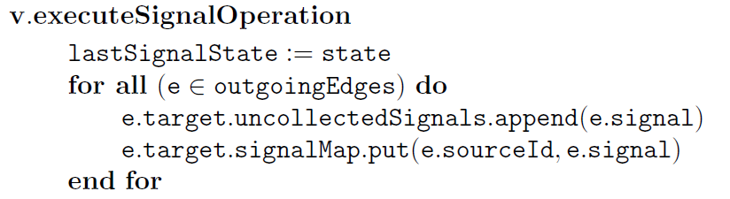
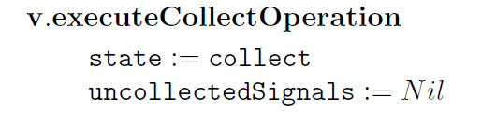
The Signal/Collect Programming Model
The computation model and extensions

Slide 13
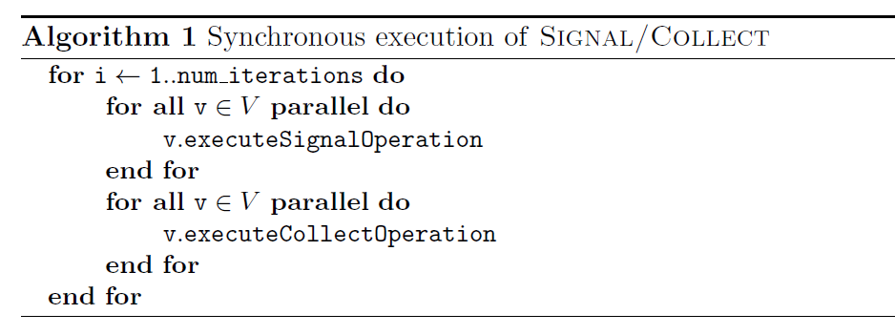
The Signal/Collect Programming Model
Synchronous execution
Everything inside the inner loops can be executed in parallel
Global synchronization exits between the signaling and collecting phases
Every vertex is equally involved

Slide 14
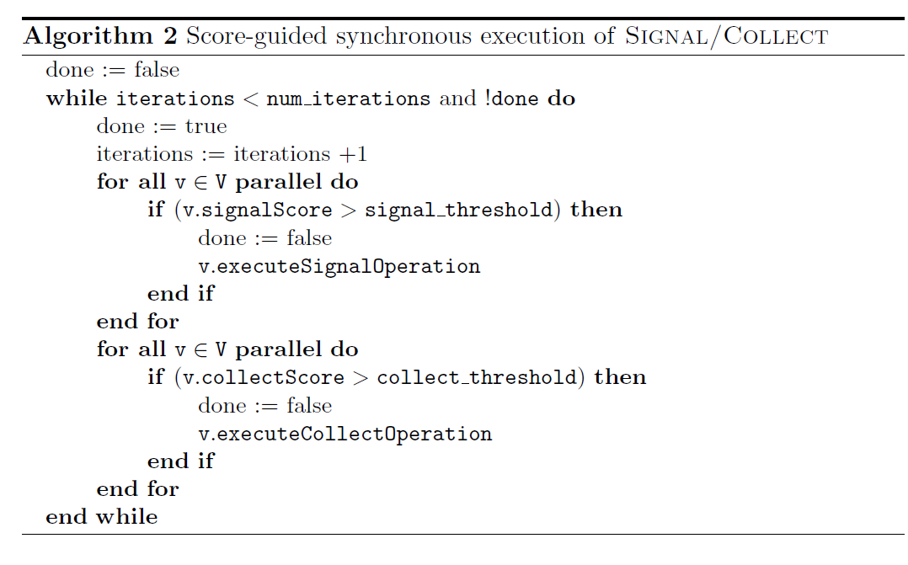
The Signal/Collect Programming Model
Scoring is used to guide the computation and give priority to operations
Extension: Score-Guided Extension
signal_threshold and collect_threshold are used to set a minimum level to be executed

Slide 15
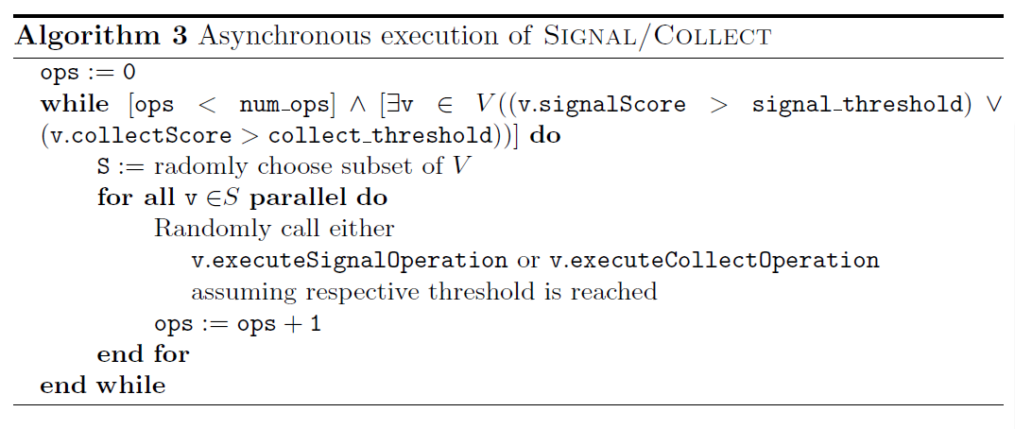
The Signal/Collect Programming Model
Asynchronous Execution —no guarantees about the order of execution

Slide 16

The Signal/Collect Programming Model
Extension : Scheduled Asynchronous Operations
Operation scheduler can optimize certain measures
Eager scheduler: execute the signal operation immediately after the collect operation
Average score scheduler: execute the signals with at least an average score

Slide 17
Contents
Introduction
Related Work
The Signal/Collect Programming Model
Algorithms in Signal/Collect
The Signal/Collect Framework — An Implementation
Evaluation
Conclusion

Slide 18
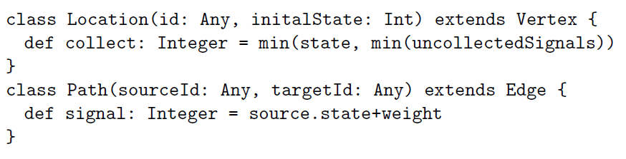
Algorithms in Signal/Collect
Single-source shortest path
Vertex state: shortest currently known path from the path-source
Signal: shortest currently known path from the path-source to e:target
Weight: distance

Slide 19
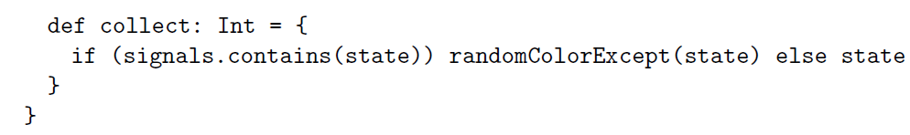
Algorithms in Signal/Collect
Vertex coloring
The vertices keep switching to different random colors wherever conflicts with neighbors remain
Edges are used to signal the color of a vertex to its neighbors

Slide 20
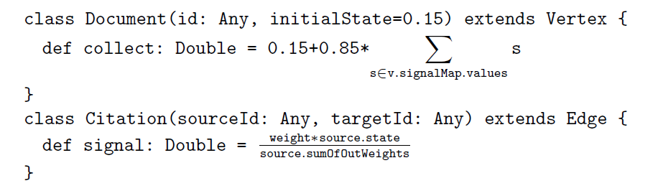
Algorithms in Signal/Collect
PageRank
Vertex state: current pagerank of a vertex
Signal: rank transferred from e.source to e.target

Slide 21
Contents
Introduction
Related Work
The Signal/Collect Programming Model
Algorithms in Signal/Collect
The Signal/Collect Framework — An Implementation
Evaluation
Conclusion

Slide 22
The Signal/Collect Framework —An Implementation
Parallel computation
The current implementation of the framework can parallelize computations exploiting multiple processors and shared memory
Vertexes are assigned to worker threads
Asynchronous scheduling
every worker has a scheduler that determines the order

Slide 23
Contents
Introduction
Related Work
The Signal/Collect Programming Model
Algorithms in Signal/Collect
The Signal/Collect Framework — An Implementation
Evaluation
Conclusion

Slide 24
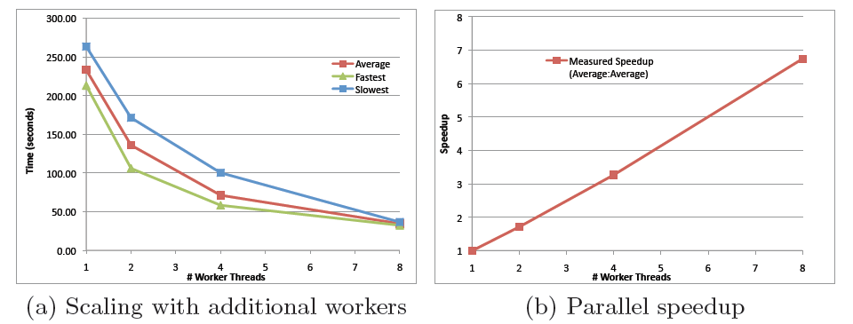
Evaluation
Scalability
Scalability of Signal/Collect: Single-source shortest path
Fig. The evaluation executed on a randomly generated graph with 1 million vertices, 94 million edges
Results of 10 executions for each number of worker threads

Slide 25
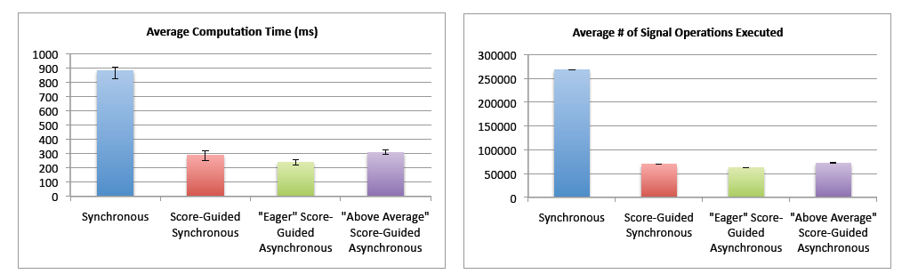
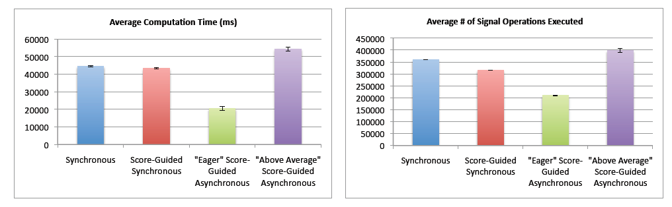
Evaluation
Score-Guided Computation
PageRank with and without score-guiding on two different graphs
Synchronous version vs. score-guided algorithms
Fig. PageRank on SwetoDblp citations, 22 387 vertices connected by 112 303 edges(less densely connected)
Fig. PageRank on a generated graph with 100 000 vertices connected by 1 284 495 edges (densely connected)

Slide 26
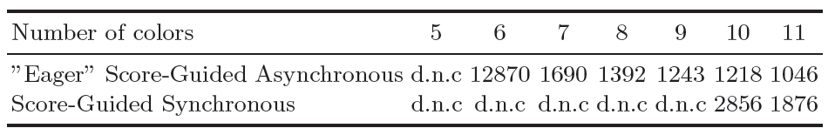
Evaluation
Asynchronous vs. Synchronous
performance of the asynchronous version is highly dependent on the scheduling
Suitable combination of computation model and scheduling algorithms is important
Vertex coloring on a generated graph
Table: The generated graph has 100 000 vertices connected by 554 118
Edges. The table shows the average time over 10 executions.
“did not converge”(d.n.c) denotes the algorithm failed to converge in less than a minute

Slide 27
Contents
Introduction
Related Work
The Signal/Collect Programming Model
Algorithms in Signal/Collect
The Signal/Collect Framework — An Implementation
Evaluation
Conclusion

Slide 28
Conclution
Contributions
An elegant and concise programming model
Execution framework is able to parallelize Signal/Collect computations
Exploitation of asynchronous execution can increase the performance and convergence
Future work
we need to find the limitations of the programming model
we need to extend the framework for distribution
we need to build a framework that provides typical middle-ware services

Slide 29
Thank you!

