Slide 1

Session 26
Modeling the Static View:
The Deployment Diagram
Written by Thomas A. Pender
Published by Wiley Publishing, Inc.
October 27, 2011
Presented by Hyewon Lim

Slide 2
Contents
Describing the Purpose and Function of the Deployment Diagram
Defining the Notation for the Deployment Diagram
Mapping Software Components to an Architecture
Applying the Combined Diagrams to the Case Study

Slide 3
Describing the Purpose and Function of the Deployment Diagram (1/2)
Deployment diagram
  Model the physical architecture of hardware
  Describes the physical resources
    C.f., A class diagram describes logical resources
Node
  A physical object that represents a processing resource
  Contains, or is responsible for, one or more software components or objects
  Can communicate across the physical associations between the nodes

Slide 4
Describing the Purpose and Function of the Deployment Diagram (2/2)
Purpose of a Deployment diagram
  Present a static view, or snapshot, of the implementation environment
A complete description of the system will contain a number of different Deployment diagrams
  Each focused on a different aspect of the system management
  i.e.,
    One might focus on how software components are distributed
    Another might model how the executable is loaded from one node to another node where it actually runs
    For a multi-tiered application,
      Model the distribution of the application layers their physical connections, and
      their logical paths of communication

Slide 5
Contents
Describing the Purpose and Function of the Deployment Diagram
Defining the Notation for the Deployment Diagram
Mapping Software Components to an Architecture
Applying the Combined Diagrams to the Case Study

Slide 6
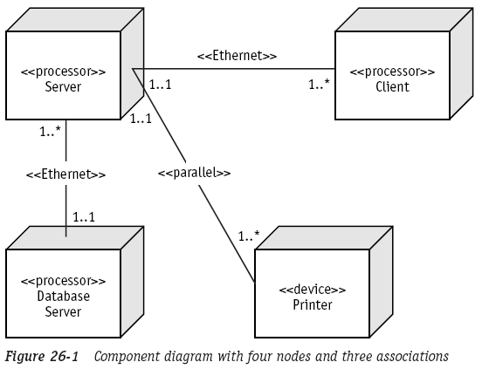
Defining the Notation for the Deployment Diagram (1/2)
The Deployment diagram has two types of elements
  Nodes (resources) and associations (connections)
    Node icon is drawn as a 3D box
    Physical association is represented as a solid line
      “connects to” or use stereotypes
    Use multiplicity to define the number of nodes on each end of the associations

Slide 7
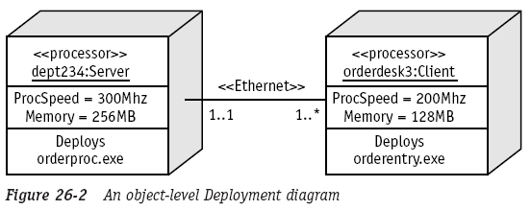
Defining the Notation for the Deployment Diagram (2/2)
An object-level view of a Deployment diagram
  Can function like network diagrams
  Can function as a requirements specification for each node

Slide 8
Contents
Describing the Purpose and Function of the Deployment Diagram
Defining the Notation for the Deployment Diagram
Mapping Software Components to an Architecture
Applying the Combined Diagrams to the Case Study

Slide 9
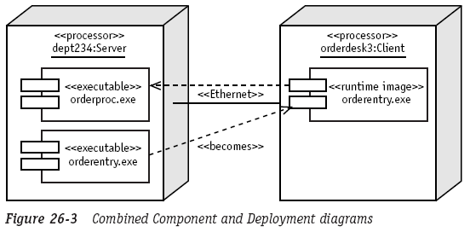
Mapping Software Components to an Architecture
Combine the two physical diagram notations
  More common technique

Slide 10
Contents
Describing the Purpose and Function of the Deployment Diagram
Defining the Notation for the Deployment Diagram
Mapping Software Components to an Architecture
Applying the Combined Diagrams to the Case Study

Slide 11
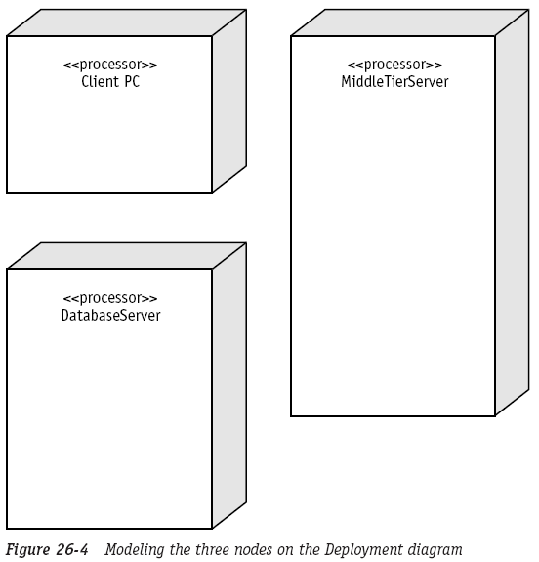
Applying the Combined Diagrams to the Case Study (1/8)
Build the combined Deployment and Component diagram
  The h/w architecture consists of three kinds of devices

Slide 12
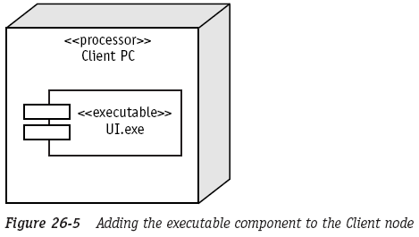
Applying the Combined Diagrams to the Case Study (2/8)
Build the combined Deployment and Component diagram
  Each client PC runs a client UI for receiving

Slide 13
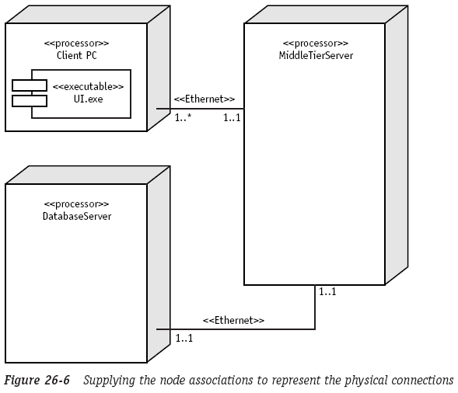
Applying the Combined Diagrams to the Case Study (3/8)
Build the combined Deployment and Component diagram
  The client-server nodes and server-DB servers are associated using an Ethernet connection

Slide 14
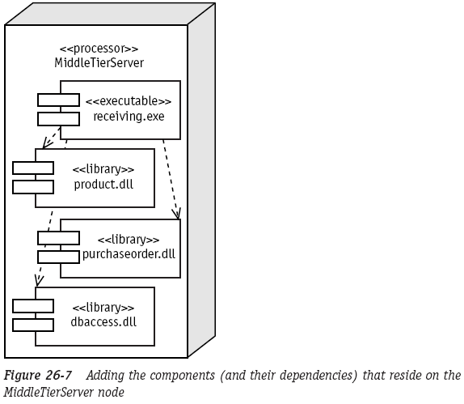
Applying the Combined Diagrams to the Case Study (4/8)
Build the combined Deployment and Component diagram
  The server application uses three resources

Slide 15
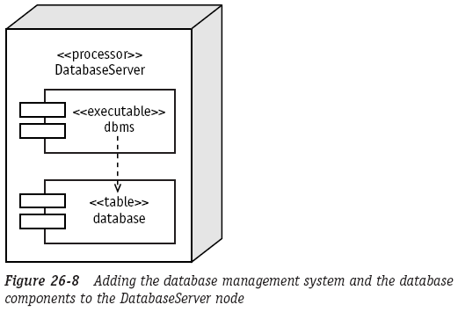
Applying the Combined Diagrams to the Case Study (5/8)
Build the combined Deployment and Component diagram
  The DB server runs the DBMS and the DB

Slide 16
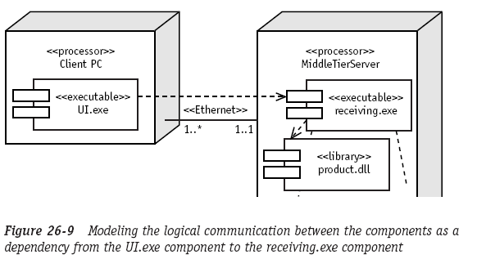
Applying the Combined Diagrams to the Case Study (6/8)
Build the combined Deployment and Component diagram
  Show the fact that the UI component needs help from the server-side application
    Draw a dashed dependency arrow

Slide 17
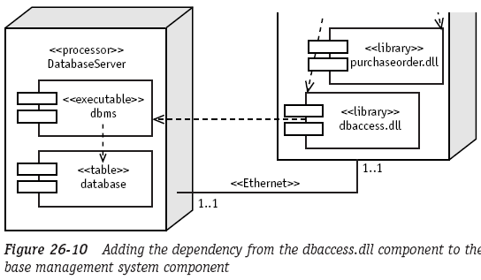
Applying the Combined Diagrams to the Case Study (7/8)
Build the combined Deployment and Component diagram
  Show the fact that the server dbaccess component needs help from the dbms on the DB server
    Draw a dashed dependency arrow

Slide 18
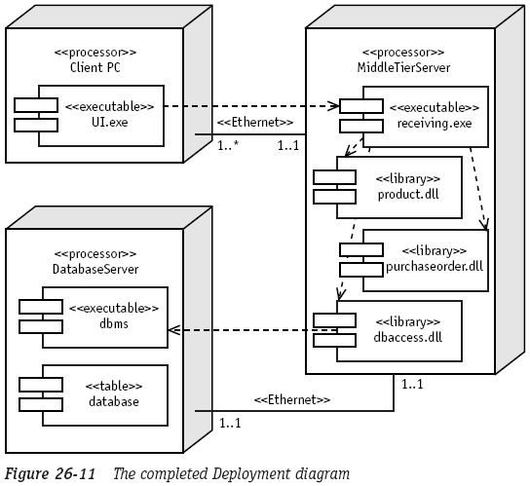
Applying the Combined Diagrams to the Case Study (8/8)
Build the combined Deployment and Component diagram
  The completed Deployment diagram

Slide 19
The End

