Slide 1

Streams and File I/O
Chapter 10

Slide 2
Objectives
Describe the concept of an I/O stream
Explain the difference between text and binary files
Save data, including objects, in a file
Read data, including objects, in a file

Slide 3
Overview: Outline
The Concept of a Stream
Why Use Files for I/O?
Text Files and Binary Files

Slide 4
The Concept of a Stream
Use of files
  Store Java classes, programs
  Store pictures, music, videos
  Can also use files to store program I/O
A stream is a flow of input or output data
  Characters
  Numbers
  Bytes

Slide 5
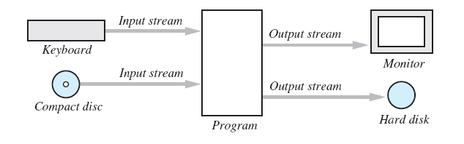
The Concept of a Stream
Streams are implemented as objects of special stream classes
  Class Scanner
  Object System.out
Figure
10.1
I/O Streams

Slide 6
Why Use Files for I/O
Keyboard input, screen output deal with temporary data
  When program ends, data is gone
Data in a file remains after program ends
  Can be used next time program runs
  Can be used by another program

Slide 7
Text Files and Binary Files
All data in files stored as binary digits
  Long series of zeros and ones
Files treated as sequence of characters called text files
  Java program source code
  Can be viewed, edited with text editor
All other files are called binary files
  Movie, music files
  Access requires specialized program

Slide 8
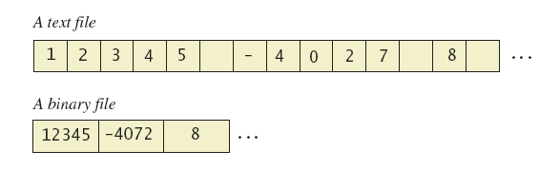
Text Files and Binary Files
Figure 10.2 A text file and a binary file containing the same values

Slide 9
Text-File I/O: Outlline
Creating a Text File
Appending to a text File
Reading from a Text File

Slide 10
Creating a Text File
Class PrintWriter defines methods needed to create and write to a text file
  Must import package java.io
To open the file
  Declare stream variable for referencing the stream
  Invoke PrintWriter constructor, pass file name as argument
  Requires try and catch blocks

Slide 11
Creating a Text File
File is empty initially
  May now be written to with method println
Data goes initially to memory buffer
  When buffer full, goes to file
Closing file empties buffer, disconnects from stream

Slide 12

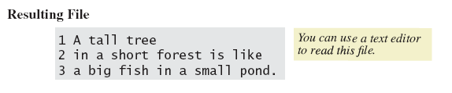
Creating a Text File
View sample program, listing 10.1
class TextFileOutput
Sample
screen output

Slide 13
Creating a Text File
When creating a file
  Inform the user of ongoing I/O events, program should not be "silent"
A file has two names in the program
  File name used by the operating system
  The stream name variable
Opening, writing to file overwrites pre-existing file in directory

Slide 14
Appending to a Text File
Opening a file new begins with an empty file
  If already exists, will be overwritten
Some situations require appending data to existing file
Command could be
outputStream =
new PrintWriter(
new FileOutputstream(fileName, true));
Method println would append data at end

Slide 15
Reading from a Text File
Note text file reading program, listing 10.2
class TextFileInputDemo
Reads text from file, displays on screen
Note
  Statement which opens the file
  Use of Scanner object
  Boolean statement which reads the file and terminates reading loop

Slide 16
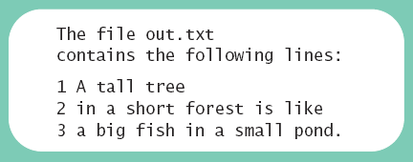
Reading from a Text File
Sample
screen output

Slide 17
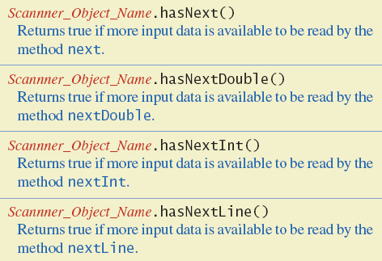
Reading from a Text File
Figure 10.3 Additional methods in class Scanner

Slide 18
Techniques for Any File
The Class File
Programming Example: Reading a File Name from the Keyboard
Using Path Names
Methods of the Class File
Defining a Method to Open a Stream

Slide 19
The Class File
Class provides a way to represent file names in a general way
  A File object represents the name of a file
The object
new File ("treasure.txt")
is not simply a string
  It is an object that knows it is supposed to name a file

Slide 20
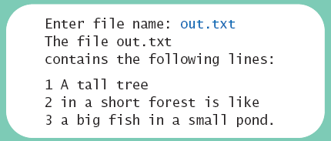
Programming Example
Reading a file name from the keyboard
View sample code, listing 10.3
class TextFileInputDemo2
Sample
screen output

Slide 21
Using Path Names
Files opened in our examples assumed to be in same folder as where program run
Possible to specify path names
  Full path name
  Relative path name
Be aware of differences of pathname styles in different operating systems

Slide 22
Methods of the Class File
Recall that a File object is a system-independent abstraction of file's path name
Class File has methods to access information about a path and the files in it
  Whether the file exists
  Whether it is specified as readable or not
  Etc.

Slide 23
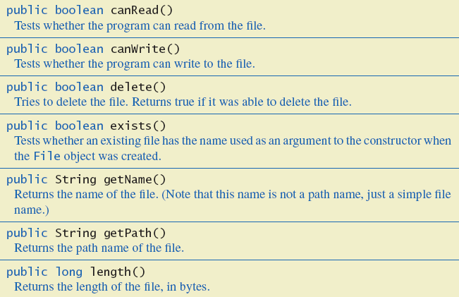
Methods of the Class File
Figure 10.4 Some methods in class File

Slide 24
Defining a Method to Open a Stream
Method will have a String parameter
  The file name
Method will return the stream object
Will throw exceptions
  If file not found
  If some other I/O problem arises
Should be invoked inside a try block and have appropriate catch block

Slide 25
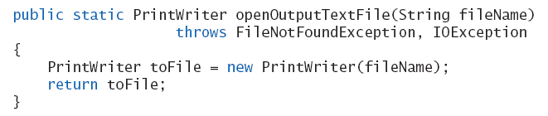
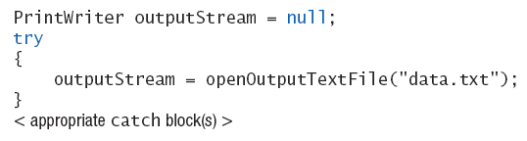
Defining a Method to Open a Stream
Example code
Example call

Slide 26
Basic Binary-File I/O
Creating a Binary File
Writing Primitive Values to a Binary File
Writing Strings to a Binary File
The Class EOFException
Programming Example: Processing a File of Binary Data

Slide 27
Creating a Binary File
Stream class ObjectOutputStream allows files which can store
  Values of primitive types
  Strings
  Other objects
View program which writes integers,
listing 10.4 class BinaryOutputDemo

Slide 28

Creating a Binary File
Sample
screen output
Note the line to open the file
  Constructor for ObjectOutputStream cannot take a String parameter
  Constructor for FileOutputSream can

Slide 29
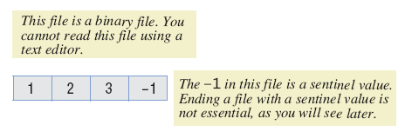
Writing Primitive Values to a Binary File
Method println not available
  Instead use writeInt method
  View in listing 10.4
Binary file stores numbers in binary form
  A sequence of bytes
  One
  immediately
  after another

Slide 30
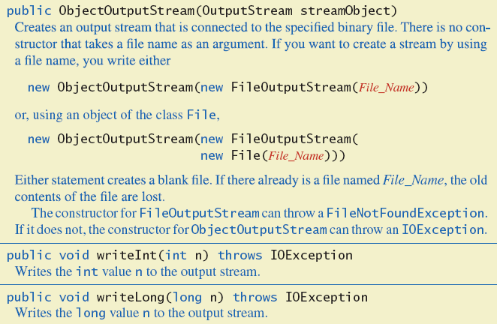
Writing Primitive Values to a Binary File
Figure 10.5a Some methods in class ObjectOutputStream

Slide 31
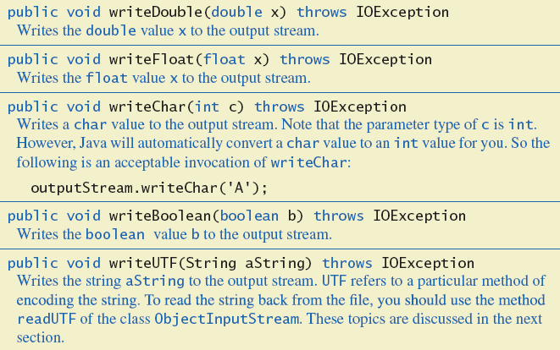
Writing Primitive Values to a Binary File
Figure 10.5b Some methods in class ObjectOutputStream

Slide 32
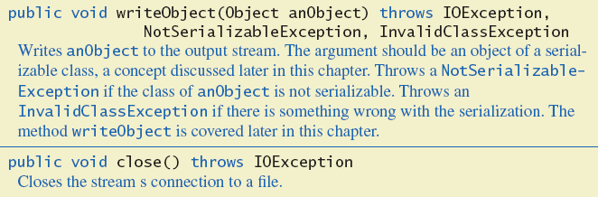
Writing Primitive Values to a Binary File
Figure 10.5c Some methods in class ObjectOutputStream

Slide 33
Writing Strings to a Binary File
Use method writeUTF
Example
outputStream.writeUTF("Hi Mom");
UTF stands for Unicode Text Format
Uses a varying number of bytes to store different strings
  Depends on length of string
  Contrast to writeInt which uses same for each

Slide 34
Reading from a Binary File
File must be opened as an
ObjectInputStream
Read from binary file using methods which correspond to write methods
  Integer written with writeInt will be read with readInt
Be careful to read same type as was written

Slide 35
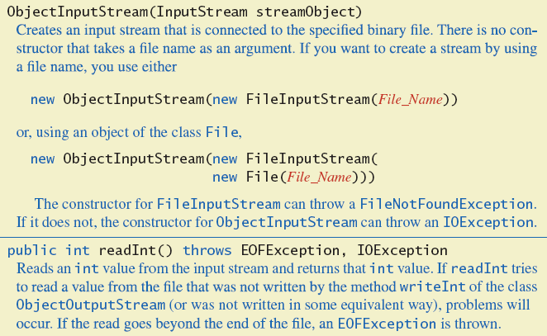
Reading from a Binary File
Figure 10.6a Some methods of class ObjectInputStream

Slide 36
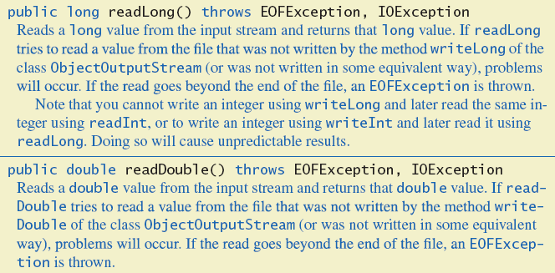
Reading from a Binary File
Figure 10.6b Some methods of class ObjectInputStream

Slide 37
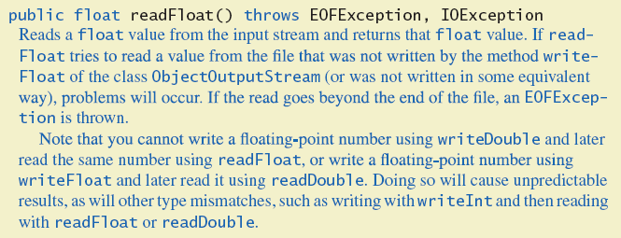
Reading from a Binary File
Figure 10.6c Some methods of class ObjectInputStream

Slide 38
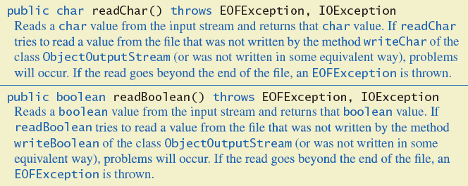
Reading from a Binary File
Figure 10.6d Some methods of class ObjectInputStream

Slide 39
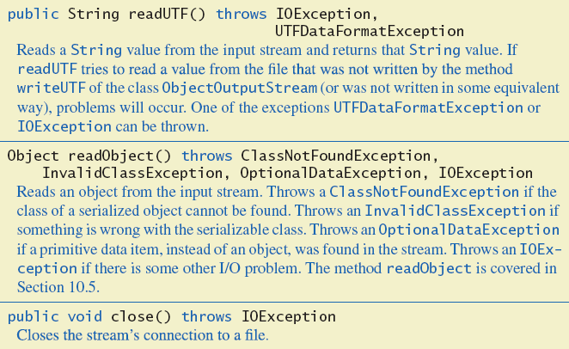
Reading from a Binary File
Figure 10.6e Some methods of class ObjectInputStream

Slide 40
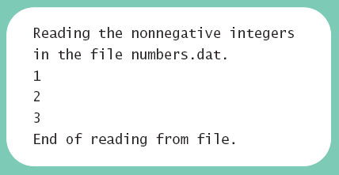
Reading from a Binary File
View program to read, listing 10.5
class BinaryInputDemo
Sample
screen output

Slide 41
The Class EOFException
Many methods that read from a binary file will throw an EOFException
  Can be used to test for end of file
  Thus can end a reading loop
View example program, listing 10.6
class EOFExceptionDemo

Slide 42
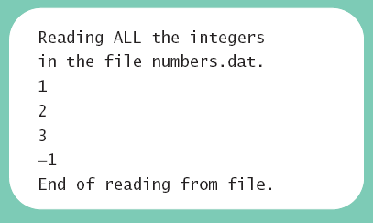
The Class EOFException
Note the -1 formerly needed as a sentinel value is now also read
Always a good idea to check for end of file even if you have a sentinel value
Sample
screen output

Slide 43
Programming Example
Processing a file of binary data
  Asks user for 2 file names
  Reads numbers in input file
  Doubles them
  Writes them to output file
View processing program, listing 10.7
class Doubler

Slide 44
Binary-File I/O, Objects & Arrays
Binary-File I/O with Objects of a Class
Some Details of Serialization
Array Objects in Binary Files

Slide 45
Binary-File I/O with Class Objects
Consider the need to write/read objects other than Strings
  Possible to write the individual instance variable values
  Then reconstruct the object when file is read
A better way is provided by Java
  Object serialization – represent an object as a sequence of bytes to be written/read
  Possible for any class implementing Serializable

Slide 46
Binary-File I/O with Class Objects
Interface Serializable is an empty interface
  No need to implement additional methods
  Tells Java to make the class serializable (class objects convertible to sequence of bytes)
View sample class , listing 10.8
class Species

Slide 47
Binary-File I/O with Class Objects
Once we have a class that is specified as Serializable we can write objects to a binary file
  Use method writeObject
Read objects with method readObject();
  Also required to use typecast of the object
View sample program, listing 10.9
class ObjectIODemo

Slide 48
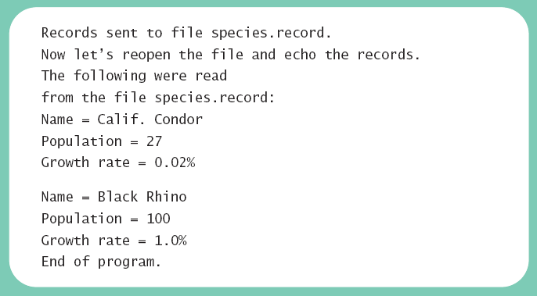
Binary-File I/O with Class Objects
Sample
screen output

Slide 49
Some Details of Serialization
Requirements for a class to be serializable
  Implments interface Serializable
  Any instance variables of a class type are also objects of a serializable class
  Class's direct superclass (if any) is either serializable or defines a default constructor

Slide 50
Some Details of Serialization
Effects of making a class serializable
  Affects how Java performs I/O with class objects
  Java assigns a serial number to each object of the class it writes to the ObjectOutputStream
  If same object written to stream multiple times, only the serial number written after first time

Slide 51
Array Objects in Binary Files
Since an array is an object, possible to use writeObject with entire array
  Similarly use readObject to read entire array
View array I/O program, listing 10.10
class ArrayIODemo

Slide 52
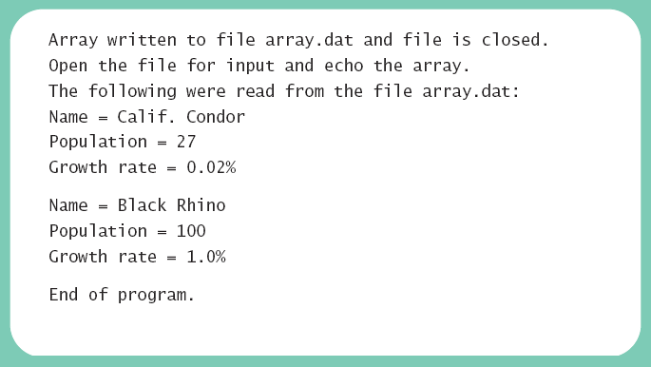
Array Objects in Binary Files
Sample
screen output

Slide 53
Graphics Supplement
Programming Example
A JFrame GUI for Manipulating Files

Slide 54
Programming Example
A JFrame GUI for manipulating files
Note buttons
  Show first line
  Remove file
  Reset
Note also the text fields
  Type in a file name
  Display first line of file

Slide 55
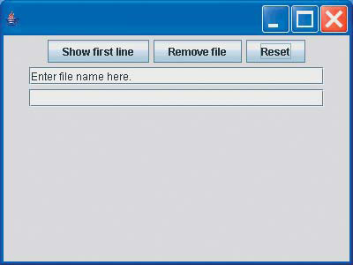
Programming Example
View JFrame program, listing 10.11
class FileOrganizer
Sample
screen output

Slide 56
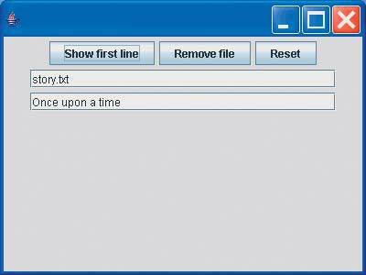
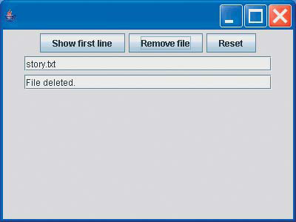
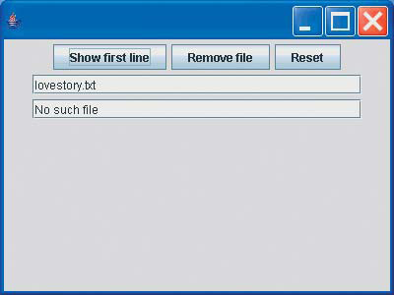
Programming Example
Sample
screen output

Slide 57
Programming Example
Note we did this with a JFrame GUI program
  Not an applet
For security reasons applets are limited in what they can do
  Designed to be embedded in a Web page, run from another computer
  Thus applets cannot manipulate files on a remote computer

Slide 58
Summary
Files with characters are text files
  Other files are binary files
Programs can use PrintWriter and Scanner for I/O
Always check for end of file
File name can be literal string or variable of type String
Class File gives additional capabilities to deal with file names

Slide 59
Summary
Use ObjectOutputStream and ObjectInputStream classes enable writing to, reading from binary files
Use writeObject to write class objects to binary file
Use readObject with type cast to read objects from binary file
Classes for binary I/O must be serializable

