Slide 1
Everyone’s an Influencer: Quantifying Influence on Twitter
Eytan Bakshy, Jake M. Hofman, Winter A. Mason, and Duncan J. Watts
WSDM 2011
30 August 2013
Hyewon Lim

Slide 2
Outline
Introduction
Related Work
Data
Computing Influence on Twitter
Predicting Individual Influence
The Role of Content
Targeting Strategies
Conclusions

Slide 3

Introduction
Word-of-mouth diffusion
Maximize the diffusion
Seeding a piece of information or a new product with “influencers”
Attributes of influencer
Personal attributes: credibility, expertise, or enthusiasm
Network attributes: connectivity or centrality

Slide 4
Introduction
Difficulties of diffusion studies
Word-of-mouth influence spreads is generally unobservable
Observational data are heavily biased towards successful events
Why Twitter?
Reconstruct the network of “who listens to whom”
Force users to communicate in roughly the same way
via tweets to their followers
Possible to measure and compare the influence of individuals
“Influencer”
User who “seed” content

Slide 5
Outline
Introduction
Related Work
Data
Computing Influence on Twitter
Predicting Individual Influence
The Role of Content
Targeting Strategies
Conclusions

Slide 6
Related Work
Early work: the lack of “ground truth” data
Infer a transmission network between bloggers
Reconstruct diffusion tress among bloggers
Recent work
Diffusion trees of fan pages on Facebook
Diffusion of “gestures” between friends in Second Life
Adoption of a mobile phone app. over the Yahoo! Messenger network
Measures of influence on Twitter

Slide 7
Related Work
Contributions
Previous Studies | Proposed Work
Measure influence in terms of network metrics or the number of RTs | Measure influence in terms of the size of the entire diffusion tree associated with each event
Largely descriptive (find the most influential one) | Consider all users (predict influence)
Attributes of individual seeds | Effects of content

Slide 8
Outline
Introduction
Related Work
Data
Computing Influence on Twitter
Predicting Individual Influence
The Role of Content
Targeting Strategies
Conclusions

Slide 9
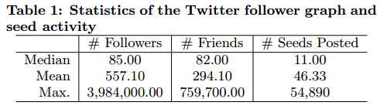
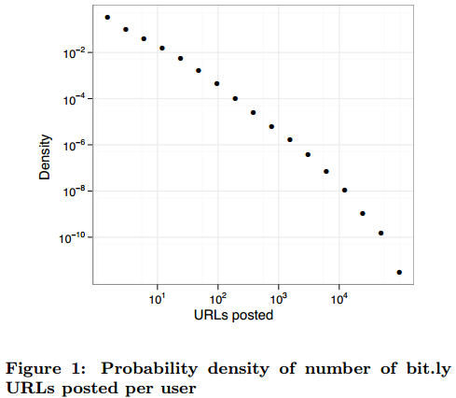
Data
Two months: Sep 13 2009 – Nov 15 2009
1.6M seed users (avg 46.33 bit.ly URLs each)
74M diffusion events

Slide 10
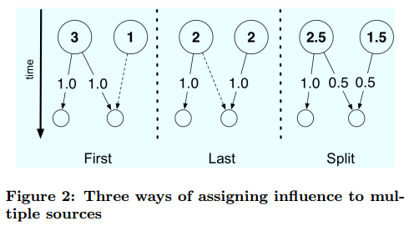
Computing Influence on Twitter
Assume B follow A
Only A posted the URL before B
More than one friend has previously posted the URL
Make different assumptions about the influence process
A
influence
B
B

Slide 11
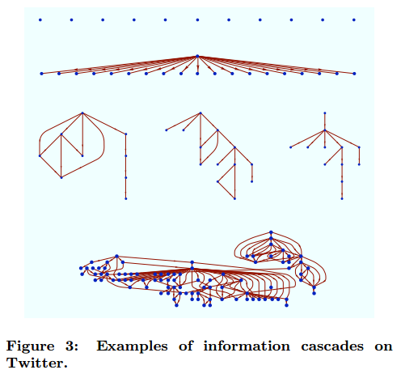
Computing Influence on Twitter
Construct disjoint influence trees
Influence score for every seed: the number of users in each trees
Identical qualitative findings across the three definitions

Slide 12
Outline
Introduction
Related Work
Data
Computing Influence on Twitter
Predicting Individual Influence
The Role of Content
Targeting Strategies
Conclusions

Slide 13
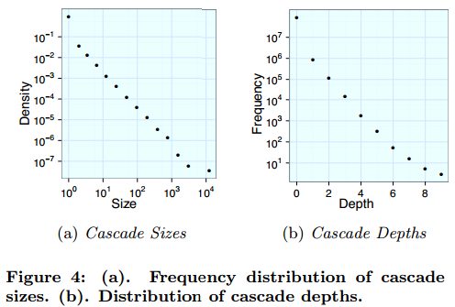
Predicting Individual Influence
Cascade
Most events do not spread at all
Even moderately sized cascades are extremely rare
Notes:
Power-law
Exponential

Slide 14
Predicting Individual Influence
To identify consistently influential individuals
Advantage of regression tree
Fit the vast majority of small cascades
Allow cascades of different sizes to bit independently
Aggregate all URL posts by user
Compute individual-level influence
Fit a regression tree model

Slide 15
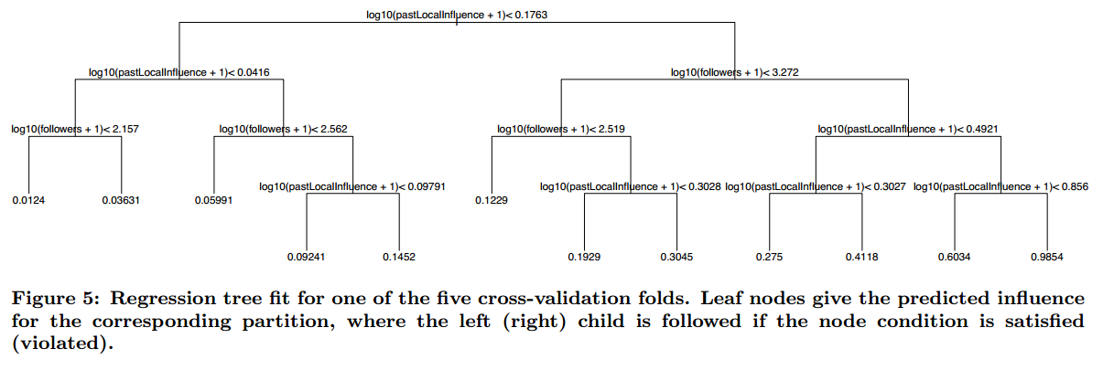
Predicting Individual Influence
Features as predictors
Seed user attributes
# followers, # friends, # tweets, date of joining
Past influence of seed users
Avg, min, and max total/local influence
Notes:
Figure 5 shows the regression tree for one of the folds.

Slide 16
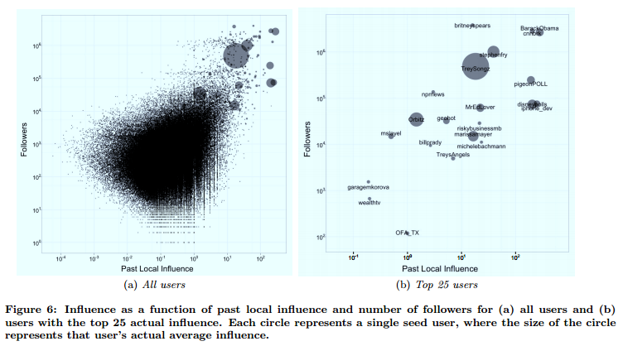
Predicting Individual Influence
Informative feature
Past performance
# followers

Slide 17
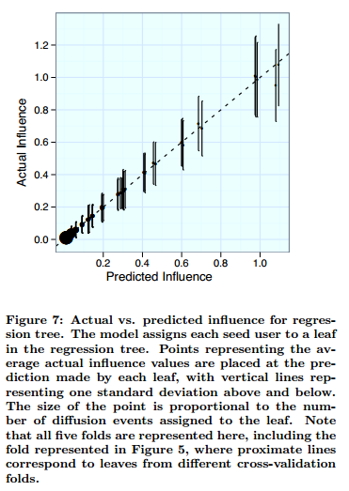
Predicting Individual Influence
The fit of the regression tree model
Five cross-validation folds

Slide 18
Outline
Introduction
Related Work
Data
Computing Influence on Twitter
Predicting Individual Influence
The Role of Content
Targeting Strategies
Conclusions

Slide 19
The Role of Content
Can it be better at predicting cascade size if also know about the content of the URL?
1000 URLs
Classify using Amazon’s Mechanical Turk
Rated interestingness
Perceived interestingness to an average person
Rated positive feeling
Willingness to share via Email, IM, Twitter, Facebook, or Digg
Indicator variables for type of URL
Indicator variables for category of content

Slide 20
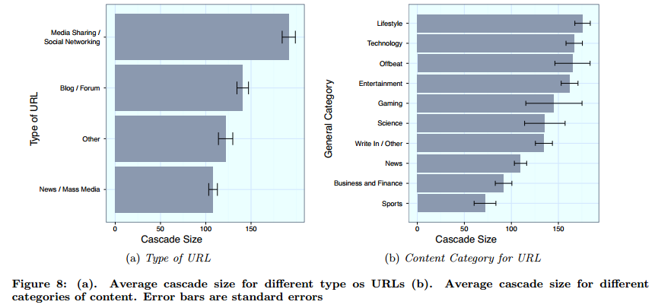
The Role of Content

Slide 21
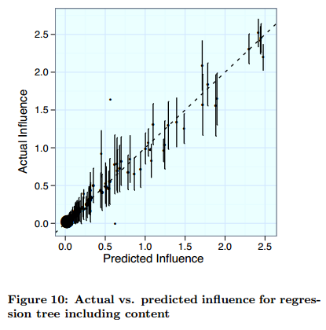
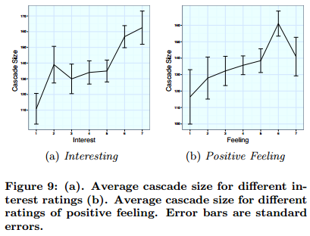
The Role of Content

Slide 22
Targeting Strategies
Acquisition cost = α x (per-follower cost)
Small α : relatively few followers, cheap, numerous
Large α : many followers, good track records
Most cost-effective category
To target the least influential individuals
Although expensive, highly influential users will be preferred
Prohibits identifying and managing large numbers of influencers

Slide 23
Outline
Introduction
Related Work
Data
Computing Influence on Twitter
Predicting Individual Influence
The Role of Content
Targeting Strategies
Conclusions

Slide 24
Conclusions
“ordinary influencers”
Under many circumstances more cost-effective
Marketers, planners, and other agents!
Adopting more precise metrics of influence
Collecting more and better data about potential influencers
over extended intervals of time
Cost function
# individuals targeted vs. their average level of influence

