Slide 1
Optimized Index Structures for Querying RDF from the Web
Andreas Harth, Stefan Decker
Digital Enterprise Research Institute (DERI)
LA-WEB(Latin American Web Congress), 2005
Aug 23, 2013
Hee-gook Jun

Slide 2
Outline
Introduction
Related Work
Index Organization
Experimental Results
Conclusion

Slide 3
Introduction
RDF
Graph-based data format
Schema-less and self-describing
Applications with RDF
Store the data persistently
Perform queries on the data set

Slide 4
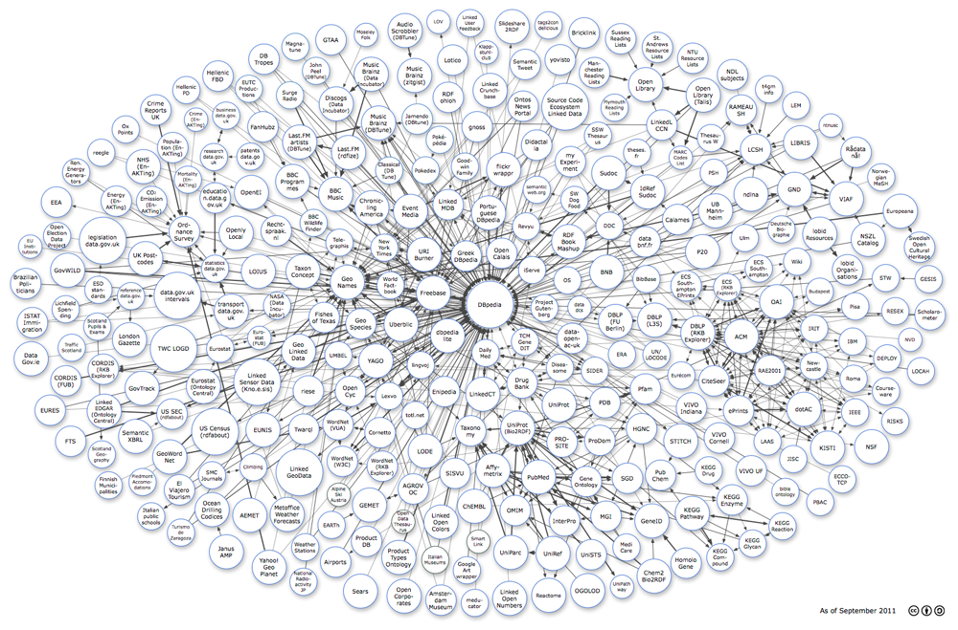
Problems
Most of the systems use an index structure
Do not support typical query scenarios for data
Results in poor query answering performance in some cases

Slide 5
Contributions
RDF data storage and indexing
Improved query answering performance and capabilities
Index structure
Full-text indexes for RDF triples with context
YARS
Implementation of the index structure

Slide 6
Outline
Introduction
Related Work
Index Organization
Experimental Results
Conclusion

Slide 7
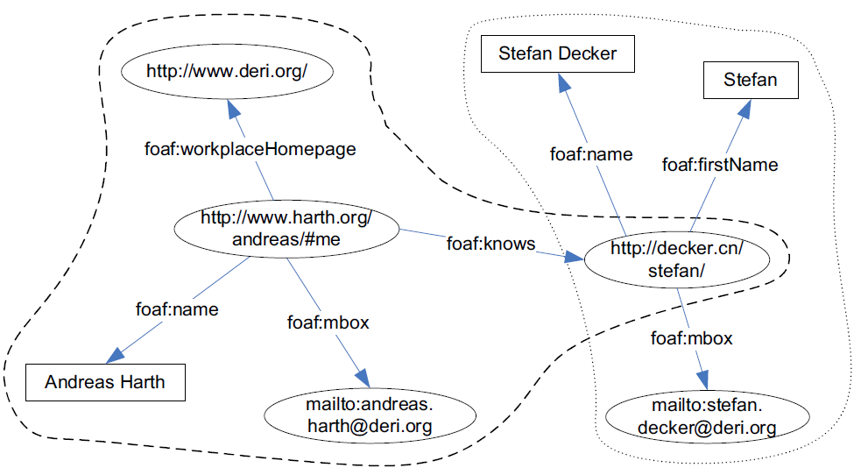
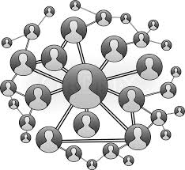

Vocabulary: FOAF
Describing people, the links between them and the things they create and do
Frequently used to describe a person’s homepage in machine-readable format

Slide 8
Data Model: Triple to Quad [1/3]
Triple
In such a triple, s is called the subject, p the predicate, and o the object
However, Usually applications require context to store various kinds of metadata for a given set of RDF statements
Subject
Object
Predicate
ah:me foaf:name “Andreas Harth” .

Slide 9
Data Model: Triple to Quad [2/3]
Quad
Suitable formalism to capture context
Triple in context (subject, predicate, object, context)
ah:me foaf:name “Andreas Harth” .
ah:me foaf:name “Andreas Harth” <http://sw.deri.org/~aharth/foaf.rdf> .

Slide 10
Data Model: Triple to Quad [3/3]
Context
URI of the file or repository from which a triple originated
<http://sw.deri.org/~aharth/foaf.rdf>
<http://www.isi.edu/~stefan/foaf.rdf>
ah:me foaf:name “Andreas Harth” <http://sw.deri.org/~aharth/foaf.rdf> .

Slide 11
Query Language: SPARQL
Person whose name is “Andreas Harth”
SELECT ?x
WHERE {
?x foaf:name “Andreas Harth” .
}

Slide 12
Query Language Extensions: ql3
ql3
Enables us to formulate queries
ql:where, ql:select
SELECT ?x
WHERE {
?x foaf:name “Andreas Harth” .
}
ql:select { ?x ?p ?z }
ql:where {
?x ?p ?z .
?x foaf:name “Andreas Harth” .
}

Slide 13
Query Language Extensions: yars [1/3]
yars:context
Enables us to express our notion of context within the RDF data model
ql:select { ?x ?p ?z }
ql:where {
{
?x ?p ?z .
?x foaf:name “Andreas Harth” .
}
} yars:context
<http://sw.deri.org/~aharth/foaf.rdf> .

Slide 14
Query Language Extensions: yars [2/3]
yars:keyword
Allows us to represent keyword-containment requirement for subjects
ql:select { ?x ?p ?z }
ql:where {
{
?x foaf:name ?n .
?n yars:keyword “Harth” .
?x ?p ?z .
}
} yars:context
<http://sw.deri.org/~aharth/foaf.rdf> .

Slide 15
Query Language Extensions: yars [3/3]
yars:prefix
specify that a variable in the subject has to match on the prefix in the object
ql:select { ?x ?p ?z }
ql:where {
{
?x foaf:name ?n .
?n yars:keyword “Harth” .
?x ?p ?z .
?p yars:prefix foaf:
}
} yars:context
<http://sw.deri.org/~aharth/foaf.rdf> .
Qname(qualified name) = prefix name : name
dc:title

Slide 16
Outline
Introduction
Related Work
Index Organization
Experimental Results
Conclusion

Slide 17
Possible quad patterns
quad (subject predicate object context)
There are 16 different patterns to cover all possible access combinations
No | Access pattern
1 | ( ? : ? : ? : ? )
2 | ( s : ? : ? : ? )
3 | ( s : p : ? : ? )
4 | ( s : p : o : ? )
5 | ( s : p : o : c )
6 | ( ? : p : ? : ? )
7 | ( ? : p : o : ? )
8 | ( ? : p : o : c )
No | Access pattern
9 | ( s : ? : o : c )
10 | ( ? : ? : o : c )
11 | ( ? : ? : o : ? )
12 | ( ? : ? : ? : c )
13 | ( s : ? : ? : c )
14 | ( s : p : ? : c )
15 | ( ? : p : ? : c )
16 | ( s : ? : o : ? )

Slide 18
Combined Indexes
To reduce the number of indexes
Leverage the fact that B+ tree provide support for range or prefix queries
spoc
( ? : ? : ? : ? )
( s : ? : ? : ? )
( s : p : ? : ? )
( s : p : o : ? )
( s : p : o : c )
spoc
poc
( ? : p : ? : ? )
( ? : p : o : ? )
( ? : p : o : c )
poc
ocs
( ? : ? : o : ? )
( ? : ? : o : c )
( s : ? : o : c )
ocs
csp
( ? : ? : ? : c )
( s : ? : ? : c )
( s : p : ? : c )
csp
cp
( ? : p : ? : c )
cp
os
( s : ? : o : ? )
os

Slide 19
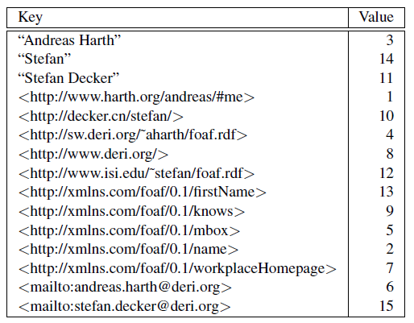
NodeOID and OIDNode Index
oidnode and nodeoid indexes
Used to map OIDs to string values of RDF nodes and vice versa
Notes:
vice versa (역으로, 반대로)

Slide 20
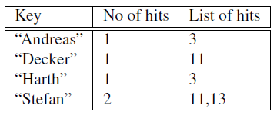
Keyword Index
Prevalent type of queries used today to explore Web data are keyword queries
To speed up keyword queries
lexicon keeps an inverted index on string literals to allow for fast full-text searches

Slide 21
Outline
Introduction
Related Work
Index Organization
Experimental Results
Conclusion

Slide 22
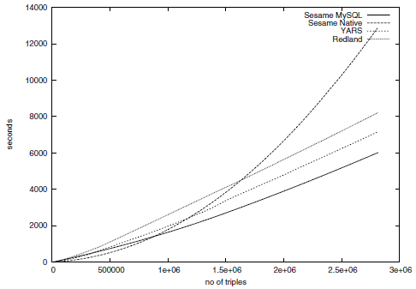
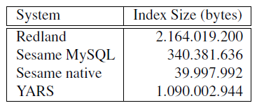
Experimental Results: Indexing Time and Size
YARS keeps the complete index
While Sesame does not include the notion of context (contains less information)
Index construction times
Index Size

Slide 23
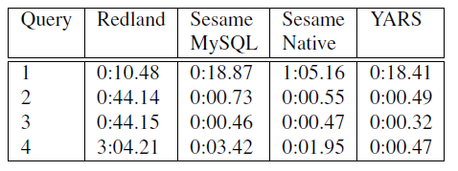
Experimental Results: Performance
Performance results for quad queries

Slide 24
Conclusion
Construct a set of indexes required for efficient RDF query processing
Provides indexes for all access patterns on RDF with context
Utilize indexes on string representations
Pros
Contain full information
Better performance
Cons
Scalability

