Slide 1

Session 18
Modeling the Dynamic View:
The Collaboration Diagram
Written by Thomas A. Pender
Published by Wiley Publishing, Inc.
October 20, 2011
Presented by So-min Kim

Slide 2
Contents
The Collaboration Diagram
Collaboration Diagram Notation

Slide 3
The Collaboration Diagram (1/2)
The Sequence and Collaboration diagram
  Similarities
    Sequence and Collaboration diagrams model messages and objects
      They provide a tool for visually assigning responsibilities to objects for sending and receiving messages
  Differences
    Collaboration diagram shows interactions relative to the structure of the objects and their relationships with one another
      To validate the associations between classes or even discover the need for the new associations
    Sequence diagram focuses on timing
      The creation and destruction of objects
      Object activation

Slide 4
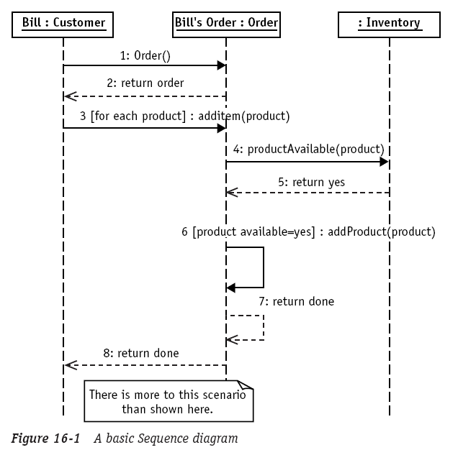
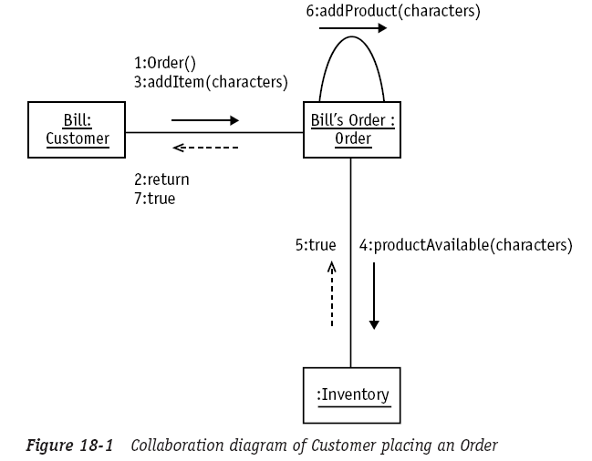
The Collaboration Diagram (2/2)
The Sequence and Collaboration diagram (cont.)

Slide 5
Contents
The Collaboration Diagram
Collaboration Diagram Notation

Slide 6
Collaboration Diagram Notation (1/4)
Steps
  1. Place the participating objects on the diagram
  2. Draw the links between the objects using the Class diagram as your guide
  3. Add each event
    Place the message arrow parallel to the link between the two objects
    Position the arrow to point from the sender to the receiver
  4. Number the messages in order of execution
  5. Repeat steps 3 and 4 until the entire scenario has been modeled

Slide 7
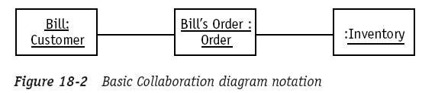
Collaboration Diagram Notation (2/4)
Collaboration Diagram
  Collaboration diagram is built on top of an Object diagram
  The objects and their links
    Add the association names if there is more than one kind of link possible between the two objects

Slide 8
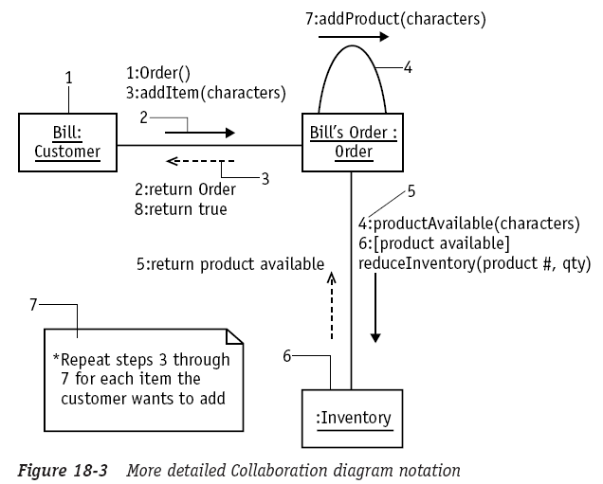
Collaboration Diagram Notation (3/4)
Collaboration Diagram (cont.)
  1 : object
  2 : synchronous event
  or procedure call
  3 : return
  4 : self-reference
  5 : sequence number
  6 : anonymous object
  7 : comment
Sequence-number Iteration : [condition] operation or return

Slide 9
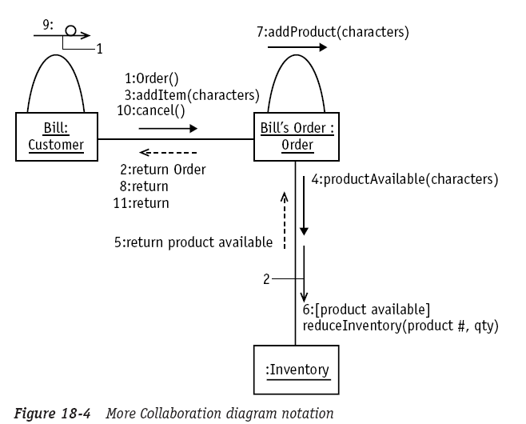
Collaboration Diagram Notation (4/4)
Collaboration Diagram (cont.)
  Timeout event
    It would be used for
    something like dialing
    into a network or polling
    a node on a network
    If you don’t get a
    response within a
    specified amount of time,
    you abandon the
    attempt and move on
  Asynchronous message
    Does not require a reply

Slide 10
The End

