Slide 1
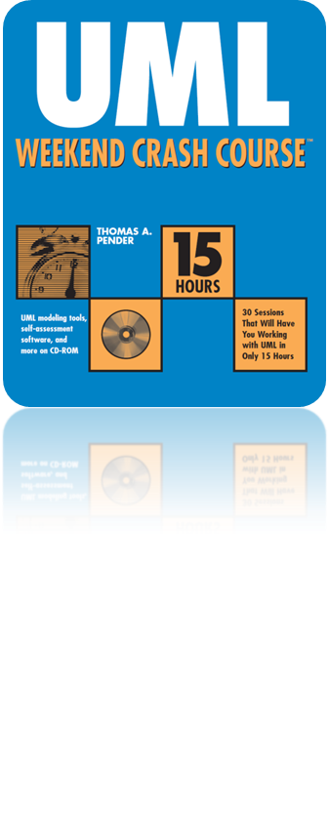
Session 6
Building the Use Case Diagram
Written by Thomas A. Pender
Published by Wiley Publishing, Inc.
October 5, 2011
Presented by Jee-bum Park

Slide 2
Contents
Step 1: Set the context of the target system
Step 2: Identify the actors
Step 3: Identify the Use Cases
Step 4: Define the associations between actors and Use Cases
Step 5: Evaluate the actors and Use Cases to find opportunities for refinement
Step 6: Evaluate the Use Cases for <<include>> dependencies
Step 7: Evaluate the Use Cases for <<extend>> dependencies
Step 8: Evaluate the actors and Use Cases for generalization

Slide 3
Step 1: Set the context of the target system
Context
  Always comes first
  Provides the frame of reference for the information
  Defines the placement of the system within the business
    The work processes
    Business plans and objectives
    Other systems
    People and their job duties
    Constraints imposed by external entities

Slide 4
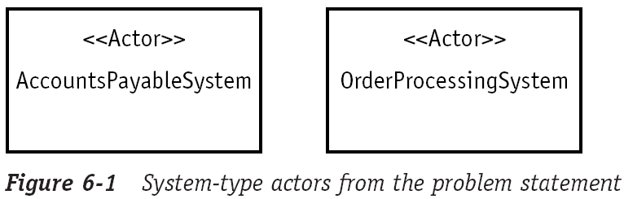
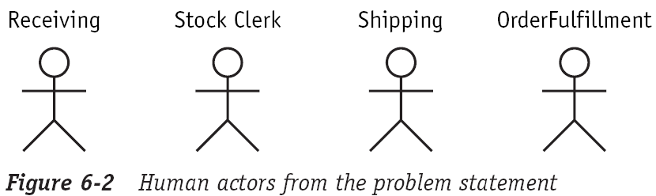
Step 2: Identify the actors
Actors
  People, systems, or devices that communicate with the system
  All these users will become your sources for finding and validating the required features (Use Cases) of the system

Slide 5

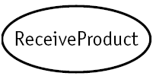



Step 3: Identify the Use Cases
Find the features or functionality that the system must provide by asking these and similar questions:
  What does the system produce for the actor?
    This question helps identify work products that the system must support, known as the critical outputs
  What does the actor help the system do?
    This question helps us know the input facilities that the system needs to support, known as the critical inputs
  What does the system help the actor(s) do?
    This question helps identify the rules that must be applied when the actors use the system

Slide 6
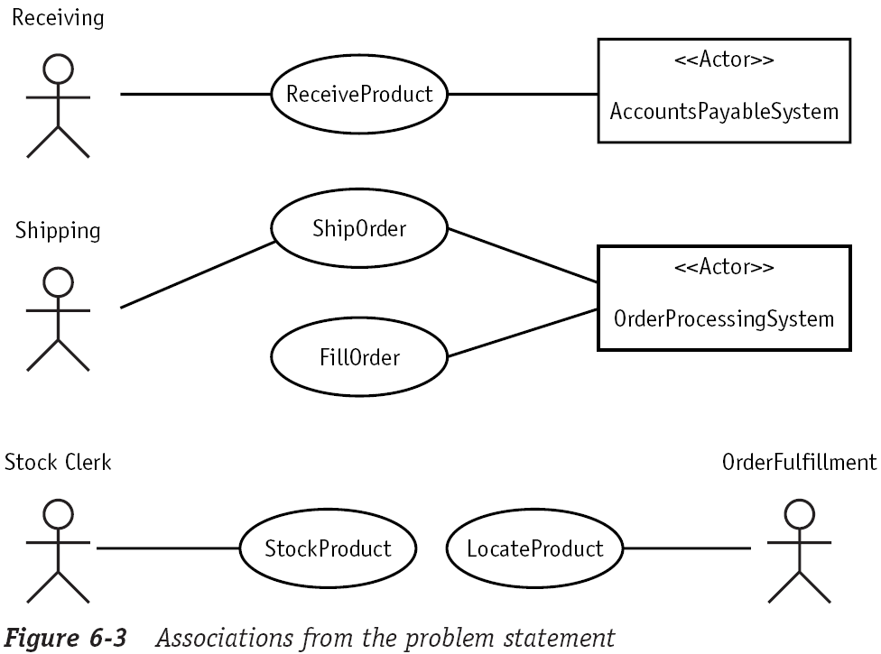
Step 4: Define the associations between actors and Use Cases
Identify the actor who need access to each Use Case of the system
  These associations are important because they tell you who the system stakeholders are

Slide 7
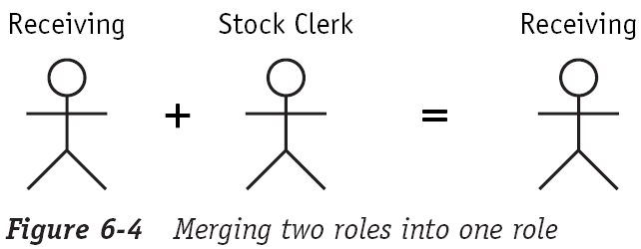
Step 5: Evaluate the actors and Use Cases to find opportunities for refinement
Rename, merge, and split actors and Use Cases as needed
  When you build your diagrams based on interviews with users, it is easy to fall into the trap of replicating the current system

Slide 8
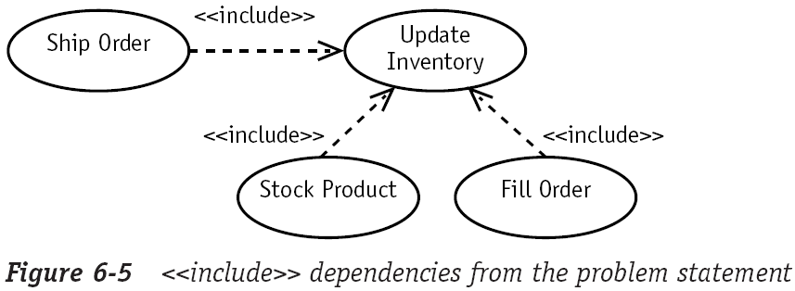
Step 6: Evaluate the Use Cases for <<include>> dependencies
Apply the <<include>> dependency between Use Cases
  When one Use Case always calls on another Use Case

Slide 9
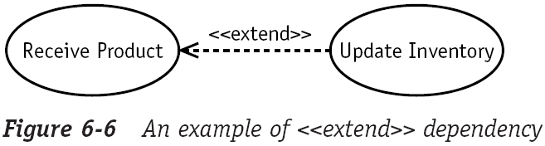
Step 7: Evaluate the Use Cases for <<extend>> dependencies
One Use Case may or may not use another Use Case depending upon a stated condition
  When the condition is met, the call is made to the other Use Case
  When the condition is not met, the call is not made

Slide 10
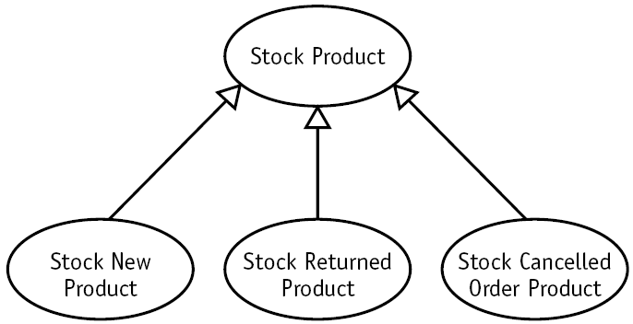
Step 8: Evaluate the actors and Use Cases for generalization
Generalization is a tool for organizing similarities and differences among a set of objects (like actors or Use Cases)

Slide 11
The End

