Slide 1
Type Less, Find More: Fast Autocompletion Search with a Succinct Index
Holger Bast, Ingmar Weber
Max-Planck-Institut für Informatik, Saarbrücken, Germany
SIGIR 2006
27 Oct 2011
Presentation @ IDB Lab Seminar
Presented by Jee-bum Park

Slide 2
Outline
Introduction
Autocompletion
Contributions
The Inverted Index
Entropy in Information Theory
Problem Definition
Analysis of Inverted Index (INV)
Analysis of New Data Structure (HYB)
Experiments
Conclusions

Slide 3
Introduction - Autocompletion
Autocompletion is a widely used mechanism to get to a desired piece of information quickly and with as little knowledge and effort
Unix Shell
$

Slide 4
Introduction - Autocompletion
Autocompletion is a widely used mechanism to get to a desired piece of information quickly and with as little knowledge and effort
Unix Shell
$ cat /p

Slide 5
Introduction - Autocompletion
Autocompletion is a widely used mechanism to get to a desired piece of information quickly and with as little knowledge and effort
Unix Shell
$ cat /p[TAB]

Slide 6
Introduction - Autocompletion
Autocompletion is a widely used mechanism to get to a desired piece of information quickly and with as little knowledge and effort
Unix Shell
$ cat /proc/

Slide 7
Introduction - Autocompletion
Autocompletion is a widely used mechanism to get to a desired piece of information quickly and with as little knowledge and effort
Unix Shell
$ cat /proc/c[TAB][TAB]

Slide 8
Introduction - Autocompletion
Autocompletion is a widely used mechanism to get to a desired piece of information quickly and with as little knowledge and effort
Unix Shell
$ cat /proc/c
cgroups cmdline cpuinfo crypto
$ cat /proc/c

Slide 9
Introduction - Autocompletion
Autocompletion is a widely used mechanism to get to a desired piece of information quickly and with as little knowledge and effort
Unix Shell
$ cat /proc/c
cgroups cmdline cpuinfo crypto
$ cat /proc/cp[TAB]

Slide 10
Introduction - Autocompletion
Autocompletion is a widely used mechanism to get to a desired piece of information quickly and with as little knowledge and effort
Unix Shell
$ cat /proc/c
cgroups cmdline cpuinfo crypto
$ cat /proc/cpuinfo

Slide 11

Introduction - Autocompletion
Search engines

Slide 12
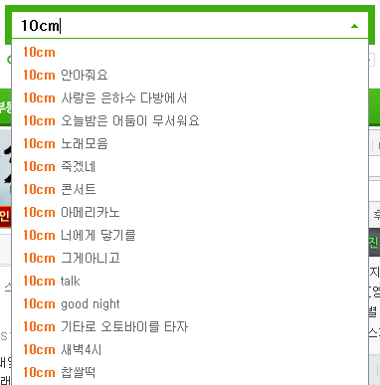
Introduction - Autocompletion
Search engines

Slide 13

Introduction - Autocompletion
User has typed,
10cm 그
Promising completions might be,
10cm 그게아니고
...
But not!
10cm 그렇고 그런 사이
In this paper, autocompletion feature is for the purpose of finding information

Slide 14
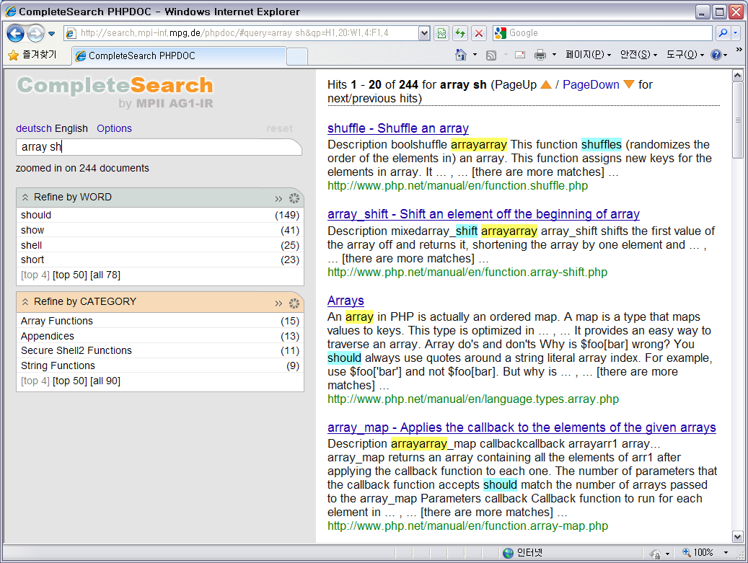
Introduction - Contributions

Slide 15
Introduction - Contributions
Developed a new indexing data structure, named HYB
Which is better than a state-of-the-art compressed inverted index
Defined a notion of empirical entropy

Slide 16
Introduction - The Inverted Index
Document # | Content
1 | apple iphone
2 | php programming
3 | apple juice
4 | iphone programming
5 | iphone galaxy tab
...
100,000,000
Find all documents that contain a word “iphone”

Slide 17
Introduction - The Inverted Index
Sorted in ascending order
Document # | Content
1 | apple iphone
2 | php programming
3 | apple juice
4 | iphone programming
5 | iphone galaxy tab
... | ...
100,000,000 | ...
Word | Document #
apple | 1, 3, ...
galaxy | 5, ...
iphone | 1, 4, 5, ...
juice | 3, ...
php | 2, ...
programming | 2, 4, ...
... | ...
Inverted Index
Find all documents that contain a word “iphone”

Slide 18
Introduction - Entropy in Information Theory
What would you guess the next character given two strings:
ㅋㅋㅋㅋㅋㅋㅋㅋㅋㅋㅋㅋㅋㅋㅋ□
ㅣㅏㅁㄴ리ㅏ오ㅣㅓㅗㅇㄹ머ㅘㅁ□

Slide 19
Introduction - Entropy in Information Theory
What would you guess the next character given two strings:
It is simpler to think entropy as degree of uncertainty
ㅋㅋㅋㅋㅋㅋㅋㅋㅋㅋㅋㅋㅋㅋㅋ□
Low uncertainty
High info
ㅣㅏㅁㄴ리ㅏ오ㅣㅓㅗㅇㄹ머ㅘㅁ□
High uncertainty
Low info

Slide 20
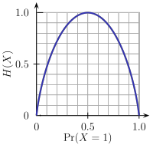
Introduction - Entropy in Information Theory
A: 00
B: 01
C: 10
D: 11
AAAAAAAAAAAA
H(x) = 0
XXXYYYXXXYYY
H(x) = 1 [bit]
AAABBBCCCDDD
H(x) = 2 [bit]

Slide 21
Outline
Introduction
Problem Definition
Analysis of Inverted Index (INV)
Analysis of New Data Structure (HYB)
Experiments
Conclusions

Slide 22
Problem Definition
In this paper, autocompletion feature is for the purpose of finding information
An autocompletion query is
A pair (D, W)
D is a set of documents (the hits for the preceding part of the query)
W is all possible completions of the last word that the user typed
To process the query means
To compute the subset W’ ⊆ W of words that occur in at least one document from D
To compute the subset D’ ⊆ D of documents that contain at least one of these words w ∈ W’

Slide 23
Problem Definition
First, the user typed “ip”
D
apple iphone
php programming
apple juice
iphone programming
iphone galaxy tab
application iphone
difference ipv4 ipv6
W
ip
iph
ipho
iphon
iphone
ipv
ipv4
ipv6

Slide 24
Problem Definition
First, the user typed “ip”
D
apple iphone
php programming
apple juice
iphone programming
iphone galaxy tab
application iphone
difference ipv4 ipv6
W
ip
iph
ipho
iphon
iphone
ipv
ipv4
ipv6
D’
apple iphone
iphone programming
iphone galaxy tab
application iphone
difference ipv4 ipv6
W’
iphone
ipv4
ipv6

Slide 25
Problem Definition
Next, the user typed “iphone app”
D
apple iphone
iphone programming
iphone galaxy tab
application iphone
difference ipv4 ipv6
W
app
appl
apple
appli
applic
applica
...
application

Slide 26
Problem Definition
Next, the user typed “iphone app”
D
apple iphone
iphone programming
iphone galaxy tab
application iphone
difference ipv4 ipv6
W
app
appl
apple
appli
applic
applica
...
application
D’
apple iphone
application iphone
W’
apple
application

Slide 27
Outline
Introduction
Problem Definition
Analysis of Inverted Index (INV)
Algorithm
Problems of INV
Space Usage
Analysis of New Data Structure (HYB)
Experiments
Conclusions

Slide 28
Analysis of Inverted Index (INV) - Algorithm
The user typed “ip”
D
apple iphone
php programming
apple juice
iphone programming
iphone galaxy tab
application iphone
difference ipv4 ipv6
W
ip
iph
ipho
iphon
iphone
Ipv
ipv4
ipv6
D’
apple iphone
iphone programming
iphone galaxy tab
application iphone
difference ipv4 ipv6
W’
iphone
ipv4
ipv6

Slide 29
Analysis of Inverted Index (INV) - Algorithm
The user typed “ip” (assume that D is not the set of all documents)
D.id | D.content
21 | apple iphone
33 | php programming
64 | apple juice
91 | iphone programming
172 | iphone galaxy tab
308 | application iphone
759 | difference ipv4 ipv6
W | Inverted Index (INV)
ip | 5, 3000, 5123, ...
iph | 900, 1000, ...
ipho | 950
iphon | NULL
iphone | 1, 5, 21, 91, 172, 300, 308, 3000, 3001, ...
ipv | 5, 6, 1100, 1200, ...
ipv4 | 759, 760, ...
ipv6 | 400, 759, 800, ...

Slide 30
Analysis of Inverted Index (INV) - Algorithm
For each w ∈ W, compute the intersections D ∩ D_{w}
D.id | D.content
21 | apple iphone
33 | php programming
64 | apple juice
91 | iphone programming
172 | iphone galaxy tab
308 | application iphone
759 | difference ipv4 ipv6
W | D_{w} : Inverted Index (INV)
ip | 5, 3000, 5123, ...
iph | 900, 1000, ...
ipho | 950
iphon | NULL
iphone | 1, 5, 21, 91, 172, 300, 308, 3000, 3001, ...
Ipv | 5, 6, 1100, 1200, ...
ipv4 | 759, 760, ...
ipv6 | 400, 759, 800, ...
W’ = NULL
D ∩ D_{w} = D’ = NULL

Slide 31
Analysis of Inverted Index (INV) - Algorithm
For each w ∈ W, compute the intersections D ∩ D_{w}
D.id | D.content
21 | apple iphone
33 | php programming
64 | apple juice
91 | iphone programming
172 | iphone galaxy tab
308 | application iphone
759 | difference ipv4 ipv6
W | D_{w} : Inverted Index (INV)
ip | 5, 3000, 5123, ...
iph | 900, 1000, ...
ipho | 950
iphon | NULL
iphone | 1, 5, 21, 91, 172, 300, 308, 3000, 3001, ...
Ipv | 5, 6, 1100, 1200, ...
ipv4 | 759, 760, ...
ipv6 | 400, 759, 800, ...
W’ = { iphone }
D ∩ D_{w} = D’ = { 21 }

Slide 32
Analysis of Inverted Index (INV) - Algorithm
For each w ∈ W, compute the intersections D ∩ D_{w}
D.id | D.content
21 | apple iphone
33 | php programming
64 | apple juice
91 | iphone programming
172 | iphone galaxy tab
308 | application iphone
759 | difference ipv4 ipv6
W | D_{w} : Inverted Index (INV)
ip | 5, 3000, 5123, ...
iph | 900, 1000, ...
ipho | 950
iphon | NULL
iphone | 1, 5, 21, 91, 172, 300, 308, 3000, 3001, ...
Ipv | 5, 6, 1100, 1200, ...
ipv4 | 759, 760, ...
ipv6 | 400, 759, 800, ...
W’ = { iphone }
D ∩ D_{w} = D’ = { 21, 91 }

Slide 33
Analysis of Inverted Index (INV) - Algorithm
For each w ∈ W, compute the intersections D ∩ D_{w}
D.id | D.content
21 | apple iphone
33 | php programming
64 | apple juice
91 | iphone programming
172 | iphone galaxy tab
308 | application iphone
759 | difference ipv4 ipv6
W | D_{w} : Inverted Index (INV)
ip | 5, 3000, 5123, ...
iph | 900, 1000, ...
ipho | 950
iphon | NULL
iphone | 1, 5, 21, 91, 172, 300, 308, 3000, 3001, ...
Ipv | 5, 6, 1100, 1200, ...
ipv4 | 759, 760, ...
ipv6 | 400, 759, 800, ...
W’ = { iphone }
D ∩ D_{w} = D’ = { 21, 91, 172 }

Slide 34
Analysis of Inverted Index (INV) - Algorithm
For each w ∈ W, compute the intersections D ∩ D_{w}
D.id | D.content
21 | apple iphone
33 | php programming
64 | apple juice
91 | iphone programming
172 | iphone galaxy tab
308 | application iphone
759 | difference ipv4 ipv6
W | D_{w} : Inverted Index (INV)
ip | 5, 3000, 5123, ...
iph | 900, 1000, ...
ipho | 950
iphon | NULL
iphone | 1, 5, 21, 91, 172, 300, 308, 3000, 3001, ...
Ipv | 5, 6, 1100, 1200, ...
ipv4 | 759, 760, ...
ipv6 | 400, 759, 800, ...
W’ = { iphone }
D ∩ D_{w} = D’ = { 21, 91, 172, 308 }

Slide 35
Analysis of Inverted Index (INV) - Algorithm
For each w ∈ W, compute the intersections D ∩ D_{w}
D.id | D.content
21 | apple iphone
33 | php programming
64 | apple juice
91 | iphone programming
172 | iphone galaxy tab
308 | application iphone
759 | difference ipv4 ipv6
W | D_{w} : Inverted Index (INV)
ip | 5, 3000, 5123, ...
iph | 900, 1000, ...
ipho | 950
iphon | NULL
iphone | 1, 5, 21, 91, 172, 300, 308, 3000, 3001, ...
Ipv | 5, 6, 1100, 1200, ...
ipv4 | 759, 760, ...
ipv6 | 400, 759, 800, ...
W’ = { iphone, ipv4 }
D ∩ D_{w} = D’ = { 21, 91, 172, 308, 759 }

Slide 36
Analysis of Inverted Index (INV) - Algorithm
For each w ∈ W, compute the intersections D ∩ D_{w}
D.id | D.content
21 | apple iphone
33 | php programming
64 | apple juice
91 | iphone programming
172 | iphone galaxy tab
308 | application iphone
759 | difference ipv4 ipv6
W | D_{w} : Inverted Index (INV)
ip | 5, 3000, 5123, ...
iph | 900, 1000, ...
ipho | 950
iphon | NULL
iphone | 1, 5, 21, 91, 172, 300, 308, 3000, 3001, ...
Ipv | 5, 6, 1100, 1200, ...
ipv4 | 759, 760, ...
ipv6 | 400, 759, 800, ...
W’ = { iphone, ipv4, ipv6 }
D ∩ D_{w} = D’ = { 21, 91, 172, 308, 759 }

Slide 37


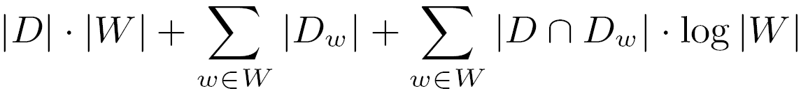
Analysis of Inverted Index (INV) - Algorithm
For each w ∈ W, compute the intersections D ∩ D_{w}
The intersections can be computed in
The union can be computed by |W|-way merge
Total time complexity
D.id | D.content
21 | apple iphone
33 | php programming
64 | apple juice
91 | iphone programming
172 | iphone galaxy tab
308 | application iphone
759 | difference ipv4 ipv6
W | D_{w} : Inverted Index (INV)
ip | 5, 3000, 5123, ...
iph | 900, 1000, ...
ipho | 950
iphon | NULL
iphone | 1, 5, 21, 91, 172, 300, 308, 3000, 3001, ...
Ipv | 5, 6, 1100, 1200, ...
ipv4 | 759, 760, ...
ipv6 | 400, 759, 800, ...
W’ = { iphone, ipv4, ipv6 }
D ∩ D_{w} = D’ = { 21, 91, 172, 308, 759 }

Slide 38
Analysis of Inverted Index (INV) - Problems of INV
The term |D| · |W| can become prohibitively large:
When |D| ≒ n, n is the number of all documents
And |W| ≒ m, m is the number of all words
The bound is on the order of O(nm)
Due to the required merging
If |W| ≒ m, O(nm log m)

Slide 39

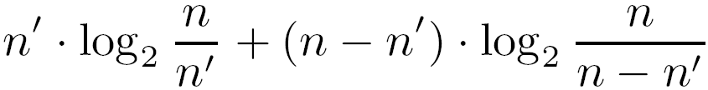
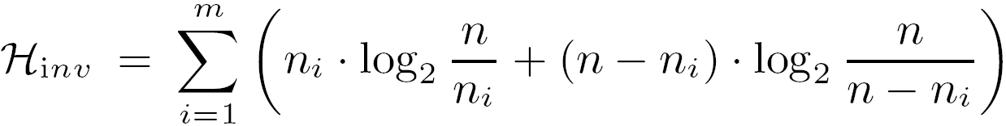
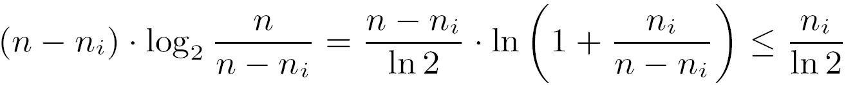
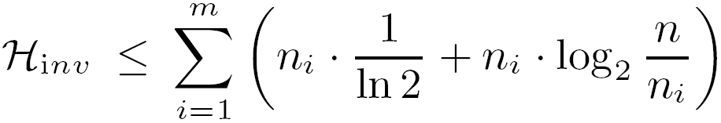
Analysis of Inverted Index (INV) - Space Usage
We define empirical entropy
For a subset of size n’ with elements from a universe of size n, the empirical entropy is , which is,
For a collection of m words with n documents, and where the i th words occurs in n_{i} distinct documents,
Because 1 + x ≤ e^{x} for any real x, It suffices to observe that,
Therefore,

Slide 40

Analysis of Inverted Index (INV) - Space Usage

Slide 41
Analysis of Inverted Index (INV) - Space Usage
n is the number of all documents
m is the number of all words
H_{inv} = 0
Word | Document #
W(1) | 1, 2, 3, ..., n
W(2) | 1, 2, 3, ..., n
W(3) | 1, 2, 3, ..., n
W(...) | 1, 2, 3, ..., n
W(m) | 1, 2, 3, ..., n

Slide 42
Analysis of Inverted Index (INV) - Space Usage
n is the number of all documents
m is the number of all words
H_{inv} >> 0
Word | Document #
W(1) | 5, 3000, 5123, ...
W(2) | 900, 1000, ...
W(3) | 950
W(4) | NULL
W(5) | 1, 5, 21, 91, 172, 300, 308, 3000, 3001, ...
W(6) | 5, 6, 1100, 1200, ...
W(...) | 759, 760, ...
W(m) | 400, 759, 800, ...

Slide 43
Outline
Introduction
Problem Definition
Analysis of Inverted Index (INV)
Analysis of New Data Structure (HYB)
Algorithm
Space Usage
Experiments
Conclusions

Slide 44
Analysis of New Data Structure (HYB) - Algorithm
The user typed “ip” (assume that D is not the set of all documents)
D.id | D.content
21 | apple iphone
33 | php programming
64 | apple juice
91 | iphone programming
172 | iphone galaxy tab
308 | application iphone
759 | difference ipv4 ipv6
W | Inverted Index (INV)
ip | 5, 3000, 5123, ...
iph | 900, 1000, ...
ipho | 950
iphon | NULL
iphone | 1, 5, 21, 91, 172, 300, 308, 3000, 3001, ...
ipv | 5, 6, 1100, 1200, ...
ipv4 | 759, 760, ...
ipv6 | 400, 759, 800, ...

Slide 45
Analysis of New Data Structure (HYB) - Algorithm
The basic idea behind HYB is simple:
Precompute inverted lists for unions of words
D.id | D.content
21 | apple iphone
33 | php programming
64 | apple juice
91 | iphone programming
172 | iphone galaxy tab
308 | application iphone
759 | difference ipv4 ipv6
W | New Data Structure (HYB)
ipho | 950(ipho) 900(iph), 1000, ... 64, 128, 256, 900(juice), 950(juice), ...
iph
juice
iphone | 1, 5, 21, 91, 172, 300, 308, 3000, 3001, ... 759(ipv4), 760, ... 400, 759(ipv6), 800(ipv6), ... 5(ipv), 6, 1100, 1200, ... 5(tab), 172, 272, 800(tab), ...
ipv4
ipv6
ipv
tab
iphon | NULL 5, 3000, 5123, ...
ip

Slide 46
Analysis of New Data Structure (HYB) - Algorithm
For each w ∈ W, compute the intersections D ∩ D_{w} ( w = ipv4 )
D.id | D.content
21 | apple iphone
33 | php programming
64 | apple juice
91 | iphone programming
172 | iphone galaxy tab
308 | application iphone
759 | difference ipv4 ipv6
W | New Data Structure (HYB)
ipho | 950(ipho) 900(iph), 1000, ... 64, 128, 256, 900(juice), 950(juice), ...
iph
juice
iphone | 1, 5, 21, 91, 172, 300, 308, 3000, 3001, ... 759(ipv4), 760, ... 400, 759(ipv6), 800(ipv6), ... 5(ipv), 6, 1100, 1200, ... 5(tab), 172, 272, 800(tab), ...
ipv4
ipv6
ipv
tab
iphon | NULL 5, 3000, 5123, ...
ip
W’ = NULL
D ∩ D_{w} = D’ = NULL

Slide 47
Analysis of New Data Structure (HYB) - Algorithm
For each w ∈ W, compute the intersections D ∩ D_{w} ( w = ipv4 )
D.id | D.content
21 | apple iphone
33 | php programming
64 | apple juice
91 | iphone programming
172 | iphone galaxy tab
308 | application iphone
759 | difference ipv4 ipv6
W | New Data Structure (HYB)
ipho | 950(ipho) 900(iph), 1000, ... 64, 128, 256, 900(juice), 950(juice), ...
iph
juice
iphone | 1, 5, 21, 91, 172, 300, 308, 3000, 3001, ... 759(ipv4), 760, ... 400, 759(ipv6), 800(ipv6), ... 5(ipv), 6, 1100, 1200, ... 5(tab), 172, 272, 800(tab), ...
ipv4
ipv6
ipv
tab
iphon | NULL 5, 3000, 5123, ...
ip
W’ = { iphone }
D ∩ D_{w} = D’ = { 21 }

Slide 48
Analysis of New Data Structure (HYB) - Algorithm
For each w ∈ W, compute the intersections D ∩ D_{w} ( w = ipv4 )
D.id | D.content
21 | apple iphone
33 | php programming
64 | apple juice
91 | iphone programming
172 | iphone galaxy tab
308 | application iphone
759 | difference ipv4 ipv6
W | New Data Structure (HYB)
ipho | 950(ipho) 900(iph), 1000, ... 64, 128, 256, 900(juice), 950(juice), ...
iph
juice
iphone | 1, 5, 21, 91, 172, 300, 308, 3000, 3001, ... 759(ipv4), 760, ... 400, 759(ipv6), 800(ipv6), ... 5(ipv), 6, 1100, 1200, ... 5(tab), 172, 272, 800(tab), ...
ipv4
ipv6
ipv
tab
iphon | NULL 5, 3000, 5123, ...
ip
W’ = { iphone }
D ∩ D_{w} = D’ = { 21, 172 }

Slide 49
Analysis of New Data Structure (HYB) - Algorithm
For each w ∈ W, compute the intersections D ∩ D_{w} ( w = ipv4 )
D.id | D.content
21 | apple iphone
33 | php programming
64 | apple juice
91 | iphone programming
172 | iphone galaxy tab
308 | application iphone
759 | difference ipv4 ipv6
W | New Data Structure (HYB)
ipho | 950(ipho) 900(iph), 1000, ... 64, 128, 256, 900(juice), 950(juice), ...
iph
juice
iphone | 1, 5, 21, 91, 172, 300, 308, 3000, 3001, ... 759(ipv4), 760, ... 400, 759(ipv6), 800(ipv6), ... 5(ipv), 6, 1100, 1200, ... 5(tab), 172, 272, 800(tab), ...
ipv4
ipv6
ipv
tab
iphon | NULL 5, 3000, 5123, ...
ip
W’ = { iphone }
D ∩ D_{w} = D’ = { 21, 172, 308 }

Slide 50
Analysis of New Data Structure (HYB) - Algorithm
For each w ∈ W, compute the intersections D ∩ D_{w} ( w = ipv4 )
D.id | D.content
21 | apple iphone
33 | php programming
64 | apple juice
91 | iphone programming
172 | iphone galaxy tab
308 | application iphone
759 | difference ipv4 ipv6
W | New Data Structure (HYB)
ipho | 950(ipho) 900(iph), 1000, ... 64, 128, 256, 900(juice), 950(juice), ...
iph
juice
iphone | 1, 5, 21, 91, 172, 300, 308, 3000, 3001, ... 759(ipv4), 760, ... 400, 759(ipv6), 800(ipv6), ... 5(ipv), 6, 1100, 1200, ... 5(tab), 172, 272, 800(tab), ...
ipv4
ipv6
ipv
tab
iphon | NULL 5, 3000, 5123, ...
ip
W’ = { iphone, ipv4 }
D ∩ D_{w} = D’ = { 21, 172, 308, 759 }

Slide 51
Analysis of New Data Structure (HYB) - Algorithm
For each w ∈ W, compute the intersections D ∩ D_{w} ( w = ipv4 )
D.id | D.content
21 | apple iphone
33 | php programming
64 | apple juice
91 | iphone programming
172 | iphone galaxy tab
308 | application iphone
759 | difference ipv4 ipv6
W | New Data Structure (HYB)
ipho | 950(ipho) 900(iph), 1000, ... 64, 128, 256, 900(juice), 950(juice), ...
iph
juice
iphone | 1, 5, 21, 91, 172, 300, 308, 3000, 3001, ... 759(ipv4), 760, ... 400, 759(ipv6), 800(ipv6), ... 5(ipv), 6, 1100, 1200, ... 5(tab), 172, 272, 800(tab), ...
ipv4
ipv6
ipv
tab
iphon | NULL 5, 3000, 5123, ...
ip
W’ = { iphone, ipv4, ipv6 }
D ∩ D_{w} = D’ = { 21, 172, 308, 759 }

Slide 52
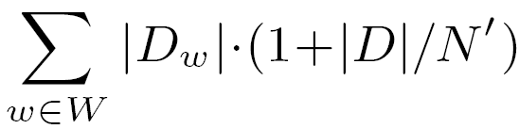
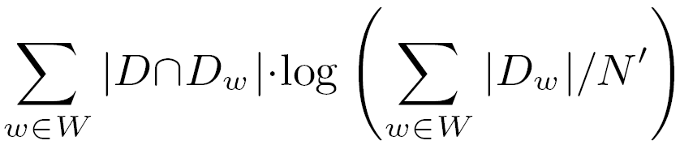
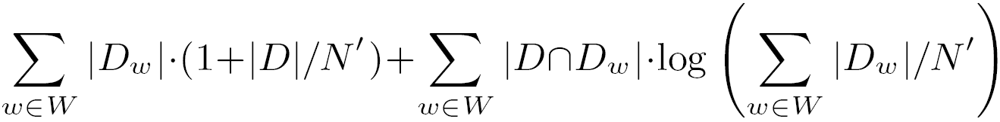
Analysis of New Data Structure (HYB) - Algorithm
For each w ∈ W, compute the intersections D ∩ D_{w}
The intersections can be computed in
The union can be computed in
Total time complexity
D.id | D.content
21 | apple iphone
33 | php programming
64 | apple juice
91 | iphone programming
172 | iphone galaxy tab
308 | application iphone
759 | difference ipv4 ipv6
W | New Data Structure (HYB)
ipho | 950(ipho) 900(iph), 1000, ... 64, 128, 256, 900(juice), 950(juice), ...
iph
juice
iphone | 1, 5, 21, 91, 172, 300, 308, 3000, 3001, ... 759(ipv4), 760, ... 400, 759(ipv6), 800(ipv6), ... 5(ipv), 6, 1100, 1200, ... 5(tab), 172, 272, 800(tab), ...
ipv4
ipv6
ipv
tab
iphon | NULL 5, 3000, 5123, ...
ip
W’ = { iphone, ipv4, ipv6 }
D ∩ D_{w} = D’ = { 21, 172, 308, 759 }

Slide 53
Analysis of New Data Structure (HYB) - Algorithm
Using HYB with blocks of volume N’, For N’ = Θ(n) and |W| ≤ mn / N, The expected processing time is bounded by O(n)
※ INV: O(nm log m)

Slide 54

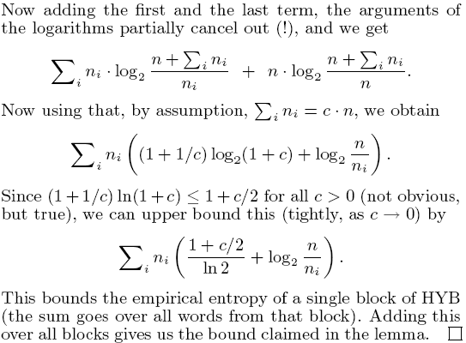
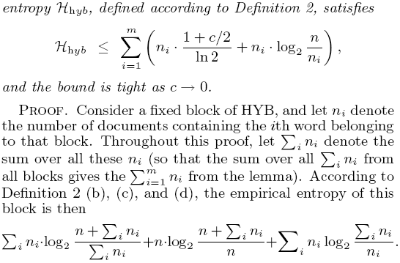
Analysis of New Data Structure (HYB) - Space Usage

Slide 55

Analysis of New Data Structure (HYB) - Space Usage

Slide 56
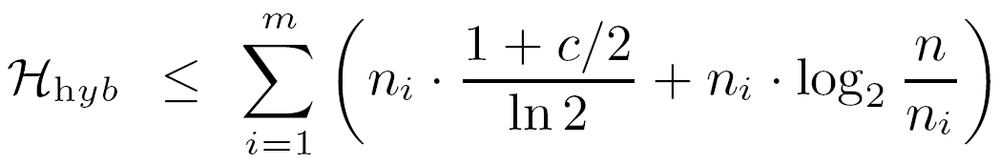
Analysis of New Data Structure (HYB) - Space Usage
The number of a block: c · n, for some c > 0

Slide 57
Outline
Introduction
Problem Definition
Analysis of Inverted Index (INV)
Analysis of New Data Structure (HYB)
Experiments
Conclusions

Slide 58
Experiments
Implemented both INV and HYB in compressed format
Compared the performance on three collections of different characteristics
A mailing-list archive + several encyclopedias on homeopathic medicine
Complete dumps of the English and German Wikipedia from Dec 2005
The large TREC Terabyte collection
Picked some maximal queries from a fixed time slice of query log for that collection

Slide 59
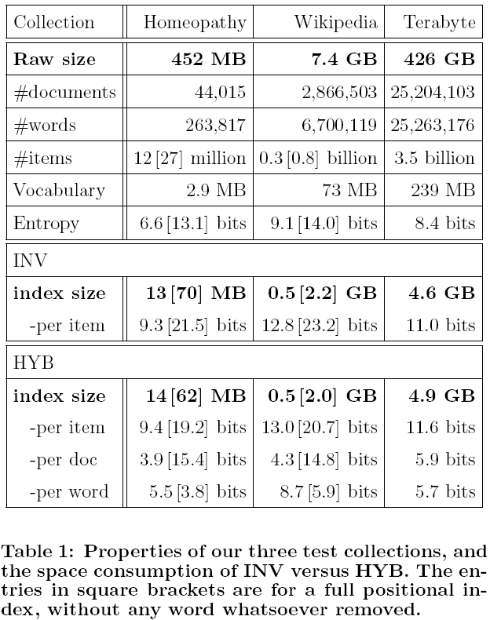
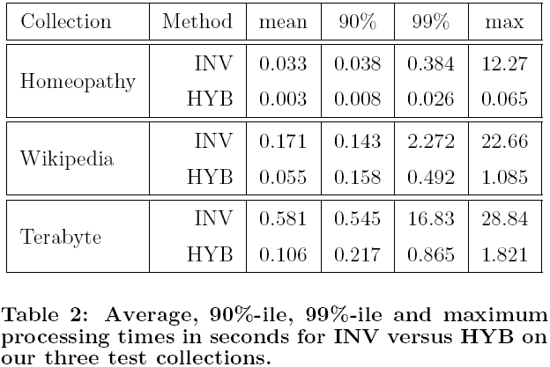
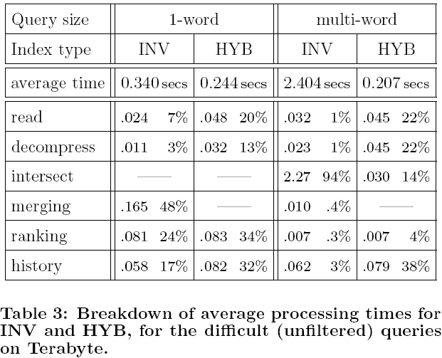
Experiments

Slide 60
Outline
Introduction
Problem Definition
Analysis of Inverted Index (INV)
Analysis of New Data Structure (HYB)
Experiments
Conclusions

Slide 61
Conclusions
Presented a new compact indexing data structure for supporting an autocompletion feature with very fast response times
Defined a notion of empirical entropy
Seen potential for a further speed-up of query processing time with using no more space than a state-of-the-art compressed inverted index

Slide 62
Thank You!
Any Questions or Comments?

