Slide 1
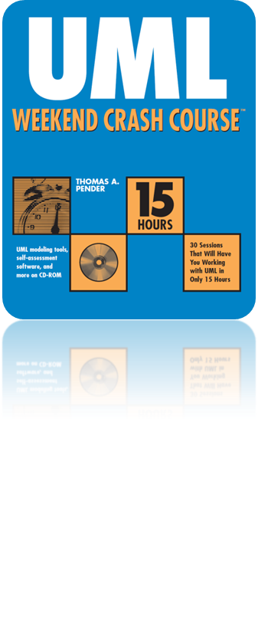
Session 7
Building the Use Case Narrative
Written by Thomas A. Pender
Published by Wiley Publishing, Inc.
October 5, 2011
Presented by Jee-bum Park

Slide 2
Contents
Audit Fields
Assumptions
Pre-conditions
Use Case Initiation
Dialog
Use Case Termination
Post-conditions

Slide 3
Audit Fields (1/3)
You typically want to keep track of
  Who is changing the document
  What they have changed
  When they changed it
To make certain that everyone is aware of the latest revisions
To prevent confusion and unnecessary delays due to misunderstandings

Slide 4
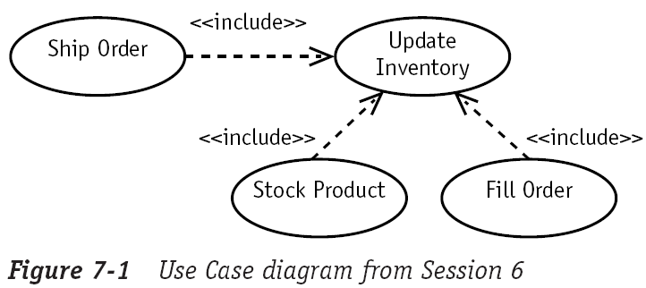

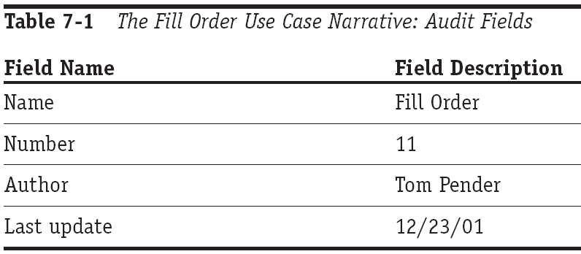
Audit Fields (2/3)

Slide 5
Audit Fields (3/3)
/*
Name: FillOrder ()
Number: 11
Author: Tom Pender
Last update: 12/23/01
*/
public function FillOrder ( $order_num )
{
...
$this->UpdateInventory ();
...
}

Slide 6
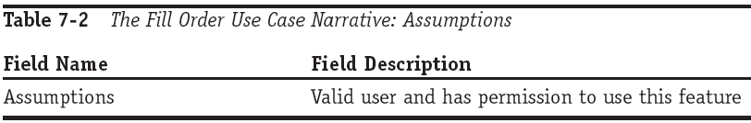
Assumptions
Describe a state of the system that must be true before you can use the Use Case
Not tested by the Use Case
...
if ( IsValid ( $user ) && HasPermission ( $user ) )
$system->FillOrder ( 5 );
...

Slide 7
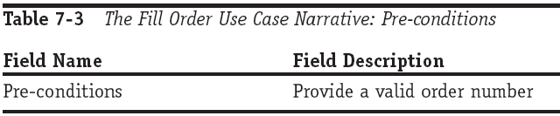
Pre-conditions
Tested by the Use Case before doing anything else
Need to be published along with the interface to your Use Case
public function FillOrder ( $order_num )
{
if ( IsValidOrderNumber ( $order_num ) === FALSE )
throw new Exception ( “$order_num is invalid!” );
...
}

Slide 8
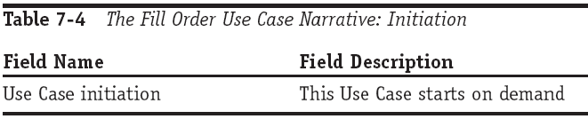
Use Case Initiation
Provides a place to think through all the possible triggers that could launch the Use Case
If five actors and/or Use Cases plan on using the same Use Case, then you need to know how each user plans to kick it off
...
if ( $NeedToFillOrder )
$system->FillOrder ( $order_num );
...

Slide 9
Dialog (1/2)
Refers to a step-by-step description of the conversation
  Between the Use Case (the system) and the user (an actor or another Use Case)
The goal of the dialog is to uncover just what really needs to happen and what variations could be valid

Slide 10
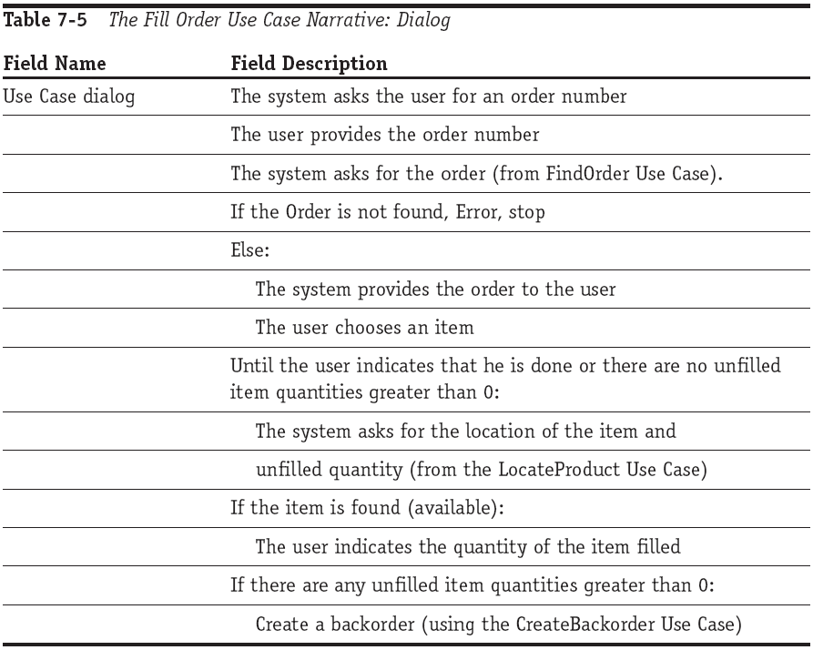
Dialog (2/2)

Slide 11
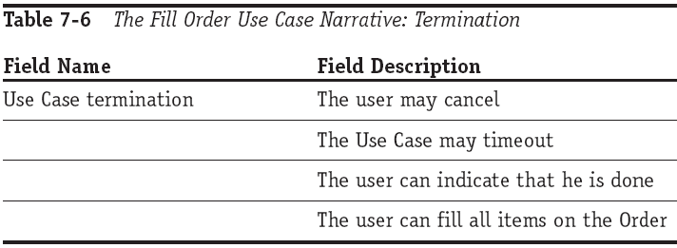
Use Case Termination
Although there is usually only one triggering event to start a Use Case, there are often many ways to end one
If things do go wrong,
  Shutting down the Use Case with an error message
  Rolling back a transaction
  Simply canceling

Slide 12
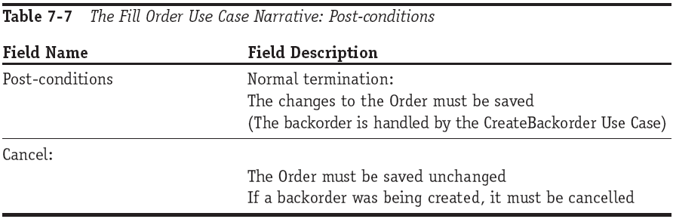
Post-conditions
Describe a state of the system that must be true when the Use Case ends
public function FillOrder ( $order_num )
{
...
if ( isset ( $this->$backorder ) )
Cancel ( $this->$backorder );
else
$this->$backorder = $this->CreateBackorder ();
}

Slide 13
The End

