Slide 1
Graph Twiddling in a MapReduce World
Jonathan Cohen
US National Security Agency
Computing in Science & Engineering, 2009
20 June 2012
SNU IDB Lab.
Min Sup Lee

Slide 2
Outline
Introduction
Preprocessing: Augmenting Edges with Degrees
Enumerating Triangles
Enumerating Rectangles
Finding Trusses
Conclusion
Discussion

Slide 3
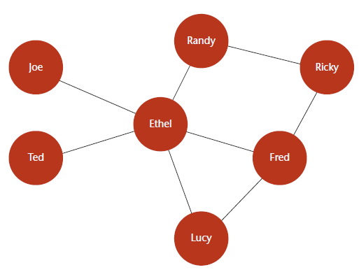
Introduction(1/2)
Relationships are well expressed as graph
Processing the large graph is impractical and too expensive
➔ Solve the problem using the power of the cloud
Notes:
이 논문은 맵리듀스 프로세스안에서 유용한 그래프 오퍼레이션의 실행가능성의 예를 보여준다.

Slide 4
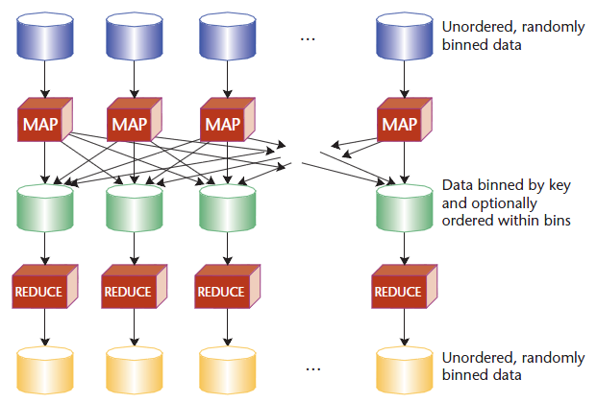
Introduction(2/2) The MapReduce Construct

Slide 5
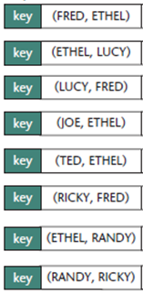
Example Graph Data
Input data records

Slide 6
Outline
Introduction
Preprocessing: Augmenting Edges with Degrees
Enumerating Triangles
Enumerating Rectangles
Finding Trusses
Conclusion
Discussion

Slide 7
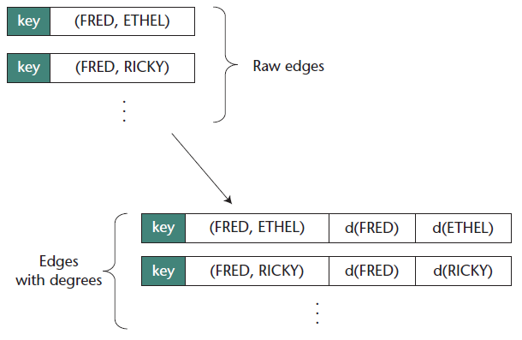
Preprocessing: Augmenting Edges with Degrees(1/2)
Augment the records with vertex-degree information
*Records for representing vertex degrees
Require two MapReduce jobs

Slide 8
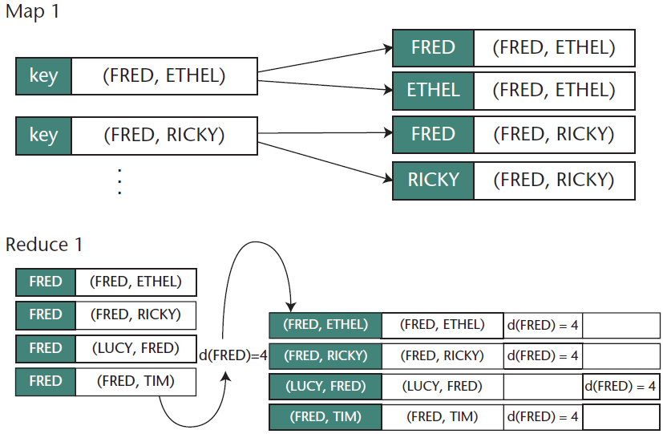
Augmenting Edges with Degrees(2/3)
Reduce
Take all edges mapped to a single vertex
Count them to obtain the degree
Emit a record for each input record
Map
For each input record, create two output records

Slide 9
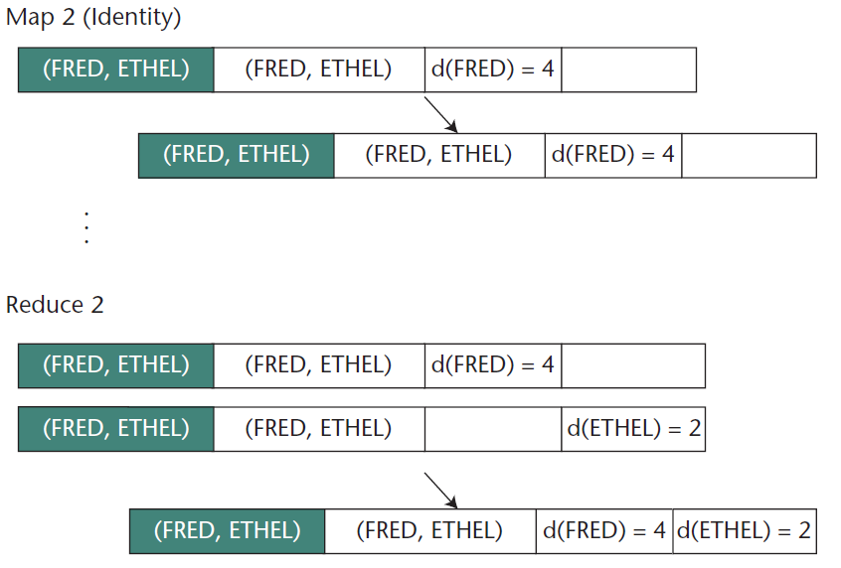
Augmenting Edges with Degrees(3/3)
Map
Preserve the records unchanged
Reduce
Combine the partial-degree information to produce a complete record

Slide 10
Outline
Introduction
Preprocessing: Augmenting Edges with Degrees
Enumerating Triangles
Enumerating Rectangles
Finding Trusses
Conclusion
Discussion

Slide 11
Enumerating Triangles(1/5)
The basis for analyzing graphs and subgraphs
Two-step approach
Enumerate open triads
e.g.) {(A, B), (B, C)}
Find an edge that closes those triads
e.g.) {(A, C)}
A
B
C

Slide 12
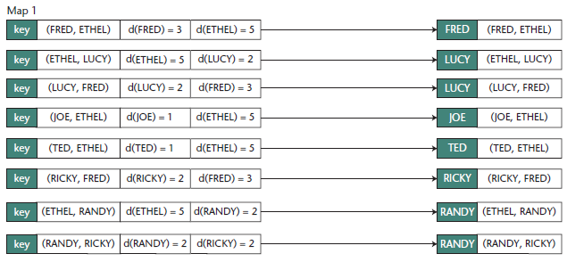
Enumerating Triangles(2/5) Map function in the First MR job
Map output key: Vertex with lower degree than the other vertex
If the two vertices have the same degree, break the tie with the vertex names
Map output value: an edge

Slide 13
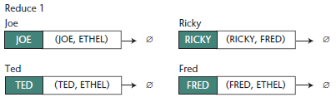
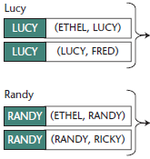
Enumerating Triangles(3/5) Reduce function in the First MR job
Each bin is labeled with a vertex and contains edges
Reduce output key: an edge that is needed to form a triangle
Reduce output value: a pair of edges that consists of an open triad

Slide 14
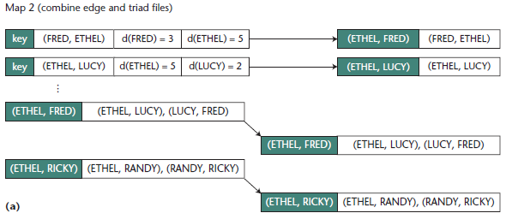
Enumerating Triangles(4/5) Map function in the Second MR job
*Example graph for finding triangles
Have two input files:
The degree-augmented edge file
The output file from the first MR job
Map function
Re-arrange the edge records’ keys in lexicographic order

Slide 15
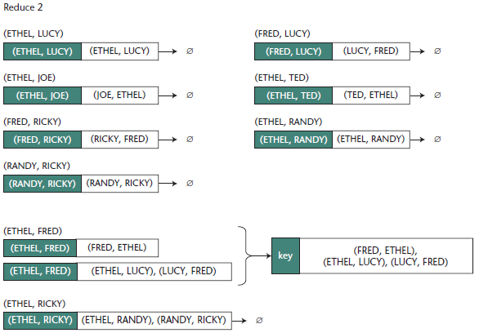
Enumerating Triangles(5/5) Reduce function in the Second MR job
Each bin corresponds with a vertex pair
Join the direct edges and triads ➔ produce a triangle

Slide 16
Outline
Introduction
Preprocessing: Augmenting Edges with Degrees
Enumerating Triangles
Enumerating Rectangles
Finding Trusses
Conclusion
Discussion

Slide 17
Enumerating Rectangles(1/4)
Similar to that of enumerating triangles
To find two open triads connecting the same pair of vertices
Their combination is a rectangle
{(A, B), (B, C)} {(A, D), (D, C)}
A
D
B
C

Slide 18
Enumerating Rectangles(2/4)
Consider the possibilities for four vertices
4! = 24 ways
1
4
3
2
4
2
3
1
2
4
1
3
3
2
1
4
1
4
3
2
2
4
1
3
4
2
3
1
3
2
1
4

Slide 19
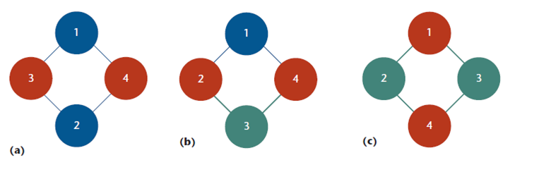
Enumerating Rectangles(3/4)
Low triad: has an apex of lower order than its neighbors
Mixed triad: has an apex whose order is between its neighbors
24/8 = 3 distinct cases
Two Low Triads
One Low Triad + One Mixed Triad
Two mixed Triads

Slide 20
Enumerating Rectangles(4/4)
A MapReduce procedure for finding all rectangles in a graph
Make enumerating low triads inexpensive
key | (FRED, ETHEL) | d(FRED)=5 | d(ETHEL)=3
key | (ETHEL, LUCY) | d(ETHEL)=2 | d(LUCY)=5
1. Marking each output record as high or low
(map1)
FRED | (FRED, ETHEL) | HIGH
ETHEL | (FRED, ETHEL) | LOW
2. Exporting every pair of distinct low records
(reduce1)
ETHEL | (ETHEL, LUCY) | LOW
LUCY | (ETHEL, LUCY) | HIGH
3. Exporting a rectangle for every triad pair
(map2 + reduce2)
(FRED, LUCY) | (FRED, ETHEL) (ETHEL, LUCY)

Slide 21
Outline
Introduction
Preprocessing: Augmenting Edges with Degrees
Enumerating Triangles
Enumerating Rectangles
Finding Trusses
Conclusion
Discussion

Slide 22
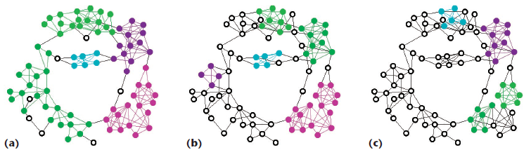
Finding Trusses(1/2)
Trusses are subgraphs of high connectivity
Suitable for recognizing clusters in social networks
k-truss is a single-component-maximal subgraph
Every edge is contained in at least k-2 triangles in the subgraph
3-trusses
4-trusses
5-trusses

Slide 23
Finding Trusses(3/3)
1. Augment the edges with vertex degrees
2. Enumerate triangles
3. For each edge, record the number of triangles containing that edge
4. Keep only the edges with sufficient support
5. If step 4 dropped any edges, return to step 1.
6. Find the remaining graph’s components; each is a truss

Slide 24
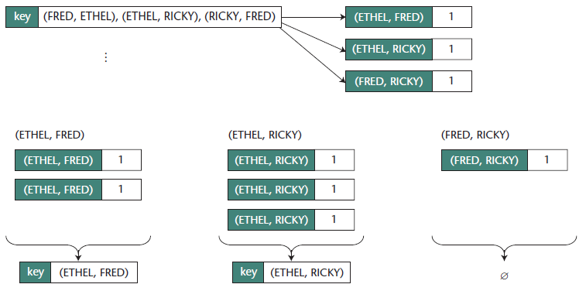
Finding Trusses(3/3)
*The case of finding 4-trusses

Slide 25
Outline
Introduction
Preprocessing: Augmenting Edges with Degrees
Enumerating Triangles
Enumerating Rectangles
Finding Trusses
Conclusion
Discussion

Slide 26
Conclusion
The feasibility of decomposing useful graph operations
MapReduce implementations of useful graph operations exist

Slide 27
Outline
Introduction
Preprocessing: Augmenting Edges with Degrees
Enumerating Triangles
Enumerating Rectangles
Finding Trusses
Conclusion
Discussion

Slide 28
Discussion
Strong points
Showed the possibility of accommodating the graph through MapReduce
Weak points
Make too much edges in some process(finding trusses step.3~4)
Wasting a map in implementing the pattern

Slide 29
Thank you

