Slide 1
Scaling Up All Pairs Similarity Search
Roberto J. Bayardo, Yiming Ma, Ramakrishnan Srikant
Google, Inc.
WWW 2009
6 December 2012
SNU IDB Lab.
Min Sup Lee

Slide 2
Outline
Introduction
Algorithms
A Basic Inverted Index-Based Approach
Exploiting the Threshold During Indexing
Exploiting a Specific Sort Order and the Threshold
Experiments
Conclusion
Discussion

Slide 3
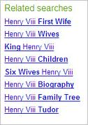
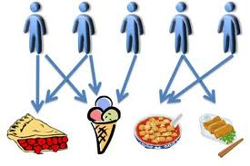
Introduction
All pairs similarity search
Algorithms for finding all similar pairs of vectors in sparse vector data
For example:
Query refinement for web search
Search engines often suggest alternate query formulations
Collaborative filtering
Make recommendations by determining which users have similar tastes
Near duplicate document detection & elimination
it is what it is
what is it
it is a car

Slide 4
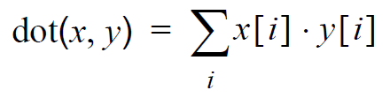
Introduction
Cosine similarity
Widely used, and produces high quality results across
Simply the vector dot product:
Inverted index
To allow fast full text searches
T₁ = “it is what it is”
T₂ = “what is it”
T₃ = “it is a car”
“a” : {3}
“car” : {3}
“is” : {1, 2, 3}
“it” : {1, 2, 3}
“what” : {1, 2}

Slide 5
Outline
Introduction
Algorithms
A Basic Inverted Index-Based Approach
Exploiting the Threshold During Indexing
Exploiting a Specific Sort Order and the Threshold
Experiments
Conclusion
Discussion

Slide 6
Algorithms A Basic Inverted Index-Based Approach
Inefficiencies to this approach
Each similar pair (x, y) generates the pair (y, x)
Build a full inverted index prior to generating any output
A better approach
Do not duplicate pairs
Build the index dynamically

Slide 7
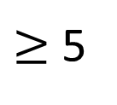
Algorithms A Basic Inverted Index-Based Approach
Example:
V = {T₁, T₂, T₃, T₄}
Threshold t = 5
T₁ = “it is what it is”
T₂ = “what is it”
T₃ = “it is a car”
T₄ = “it is what it is”
 | a | car | is | it | what
T₁ | 0 | 0 | 2 | 2 | 1
T₂ | 0 | 0 | 1 | 1 | 1
T₃ | 1 | 1 | 1 | 1 | 0
T₄ | 0 | 0 | 2 | 2 | 1
I_{a}
I_{car}
I_{is}
I_{it}
I_{what}
= { }
= { }
= { }
= { }
= { }
(T₃, 1)
(T₃, 1)
T1 | T2 | T3 | T4
(T₁, 2),
(T₂, 1),
(T₃, 1),
(T₄, 2)
2
$≥$ 5
2
4
(T₄, 2)
4
5
8
9
1
5
2
4
(T₁, 2),
(T₂, 1),
(T₃, 1),
(T₁, 1),
(T₂, 1),
(T₄, 1)
Result = { }
(T₂, T₁, 5),
(T₄, T₁, 9),
(T₄, T₂, 5)

Slide 8
Algorithms A Exploiting the Threshold During Indexing
Previous work still involves the complete inverted index
In this approach
As known as Prefix filtering
dramatically reduces the number of candidate pairs
Reduces overhead such as index construction and scanning

Slide 9

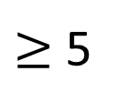
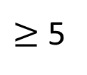
Algorithms A Exploiting the Threshold During Indexing
Example:
Reorder the dimensions
The max. of $x\left[i\right]$ over all $x∈V$ as max$i$($V$) = { 2, 2, 1, 1, 1 }
 | a | car | is | it | what
T₁ | 0 | 0 | 2 | 2 | 1
T₂ | 0 | 0 | 1 | 1 | 1
T₃ | 1 | 1 | 1 | 1 | 0
T₄ | 0 | 0 | 2 | 2 | 1
 | is | it | what | a | car
T₁ | 2 | 2 | 1 | 0 | 0
T₂ | 1 | 1 | 1 | 0 | 0
T₃ | 1 | 1 | 0 | 1 | 1
T₄ | 2 | 2 | 1 | 0 | 0
= { }
= { }
= { }
= { }
= { }
upperbound b
I_{is}
I_{it}
I_{what}
I_{a}
I_{car}
4
← b + max_{i}(V) · x[i]
$≥$ 5
(T₁, 2),
(T₄, 2)
2
9
8
4
5
4
(T₁, 1),
(T₂, 1),
(T₄, 1)
T1 | T2 | T3 | T4
$≥$ 5
(T₃, 1)
2
(T₃, 1)
3
5
Result = { }
(T₂, T₁, 5),
(T₄, T₁, 9),
(T₄, T₂, 5)
Notes:
중요!! Inverted index에 없는 벡터는 아예 계산 안함.

Slide 10
Algorithms Exploiting a Specific Sort Order and the Threshold
Guarantee any vector x that is produced after a vector y has a lower maximum weight
Maintaining an upperbound remscore on the score between x and any vector y

Slide 11






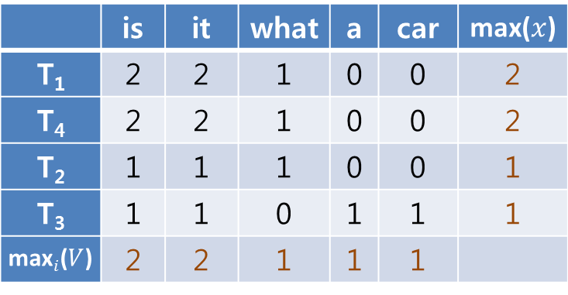

Algorithms Exploiting a Specific Sort Order and the Threshold
Example:
Sort $V$ in decreasing order of max($x$)
The max. of $x\left[i\right]$ over all $x∈V$ as max($x$)
 | is | it | what | a | car | max($x$)
T₁ | 2 | 2 | 1 | 0 | 0 | 2
T₄ | 2 | 2 | 1 | 0 | 0 | 2
T₂ | 1 | 1 | 1 | 0 | 0 | 1
T₃ | 1 | 1 | 0 | 1 | 1 | 1
max$i$($V$) | 2 | 2 | 1 | 1 | 1
 | a | car | is | it | what
T₁ | 0 | 0 | 2 | 2 | 1
T₂ | 0 | 0 | 1 | 1 | 1
T₃ | 1 | 1 | 1 | 1 | 0
T₄ | 0 | 0 | 2 | 2 | 1
 | is | it | what | a | car
T₁ | 2 | 2 | 1 | 0 | 0
T₄ | 2 | 2 | 1 | 0 | 0
T₂ | 1 | 1 | 1 | 0 | 0
T₃ | 1 | 1 | 0 | 1 | 1
= { }
= { }
= { }
= { }
= { }
I_{is}
I_{it}
I_{what}
I_{a}
I_{car}
(T₁, 2),
(T₄, 2)
(T₁, 1),
(T₄, 1)
remscore
$$\sum_{i}{x[i]}$$
T1 | T4 | T2 | T3
· max$i$($V$)
$≥$ 5
$≥$ 5
9
5
9
5
5
upperbound b
← b + min(max_{i}($V$), max($x$)) · $x$[i]
$≥$ 5
1
9
4
2
3
8
Result = { }
(T₄, T₁, 9),
(T₂, T₁, 5),
(T₂, T₄, 5)
Notes:
Sorting했기 때문에 해당 벡터의 밑에는 그 놈보다 큰 값이 없다.
이유는 max(x)의 값으로 sorting했기 때문!

Slide 12
Outline
Introduction
Algorithms
A Basic Inverted Index-Based Approach
Exploiting the Threshold During Indexing
Exploiting a Specific Sort Order and the Threshold
Experiments
Conclusion
Discussion

Slide 13


Experiment
Datasets
QSC(Query Snippet Containment)
5 million most frequent queries that were submitted to the Google search engine
Orkut
Social network
Each user is represented by a binary vector
Consist of 20 million nodes and 2 billion links
DBLP
Consist of 800,000 vectors and 14 features per vector

Slide 14
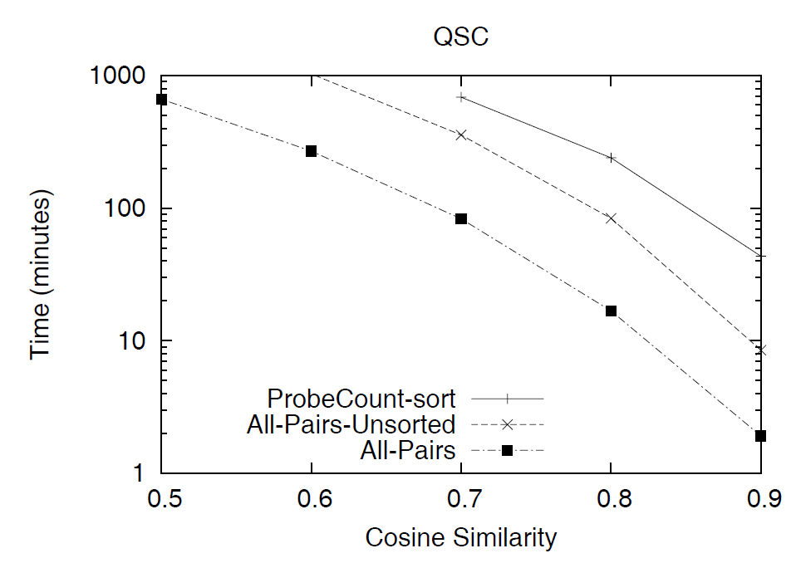
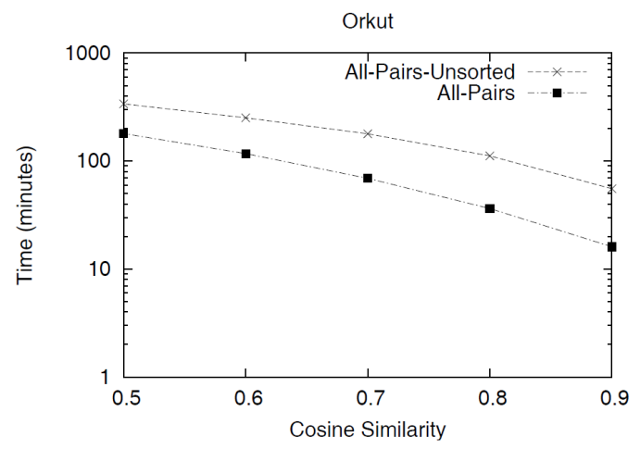
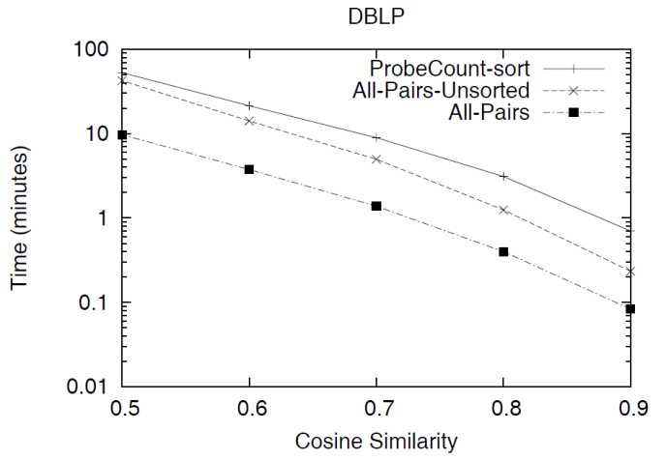
Experiment
Comparison of Inverted List-Based Approaches
ProbeOpt-sort
Another inverted-list based approach
All-Pairs-Unsorted
Do not explicitly exploit the sort order of the record
8x
2-3x
22x
2x

Slide 15
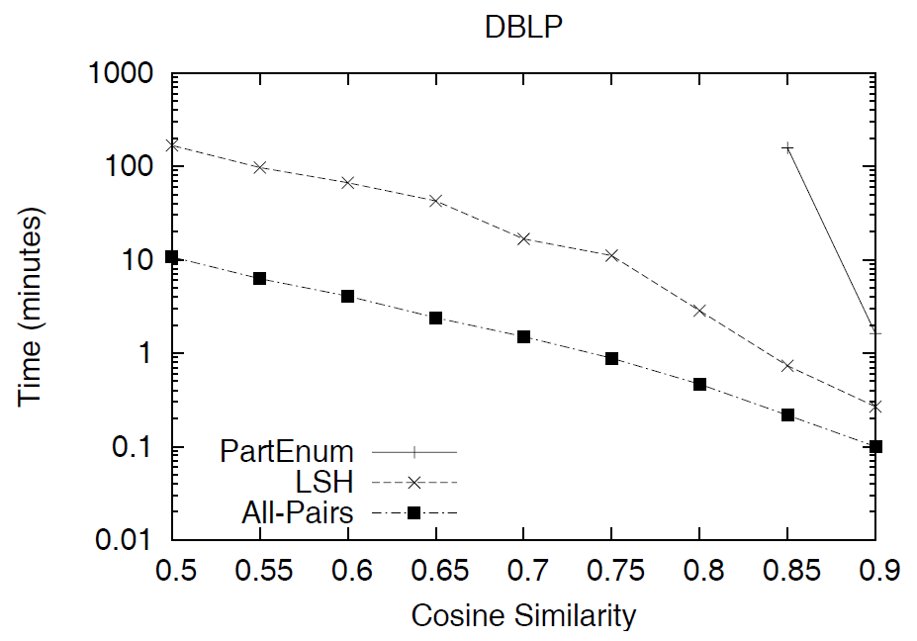
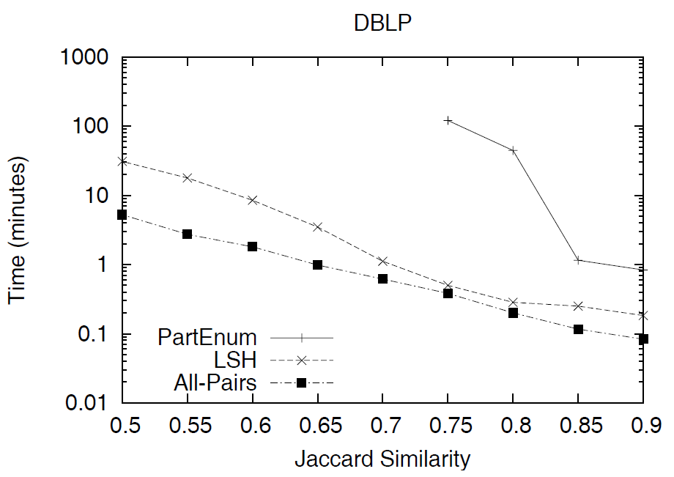
Experiment
Comparison with Signature-Based Methods
LSH and PartEnum
Signature-Based algorithms

Slide 16
Outline
Introduction
Algorithms
A Basic Inverted Index-Based Approach
Exploiting the Threshold During Indexing
Exploiting a Specific Sort Order and the Threshold
Experiments
Conclusion
Discussion

Slide 17
Conclusion
Presented two key insights
An inverted list based approach need not build a complete inverted index
Appropriately ordering the vectors can vastly reduce the search space
Easy to implement
Do not require any parameter tuning
Dramatic performance gains
Much faster than any other algorithms

Slide 18
Outline
Introduction
Algorithms
A Basic Inverted Index-Based Approach
Exploiting the Threshold During Indexing
Exploiting a Specific Sort Order and the Threshold
Experiments
Conclusion
Discussion

Slide 19
Discussion
Strong points
Easy to implement
Dramatic performance gains
Much faster than any other algorithms
Weak points
Focused primarily on scalability in sparse data

Slide 20
Thank you

