Slide 1
Parallel K-Means Clustering Based on MapReduce
The Key Laboratory of Intelligent Information Processing, Chinese Academy of Sciences
Weizhong Zhao, Huifang Ma, Qing He
CloudCom, 2009
Aug 1, 2014
Kyung-Bin Lim

Slide 2
Outline
Introduction
Methodology
Discussion
Conclusion

Slide 3
What is clustering?
Classification of objects into different groups, or more precisely, the partitioning of a data set into subsets (clusters)
The data in each subset (ideally) share some common trait – often according to some defined distance measure
Clustering is alternatively called as “grouping”

Slide 4
K-Means Clustering
The k-means algorithm is an algorithm to cluster n objects based on attributes into k partitions, where k < n
It assumes that the object attributes form a vector space
The grouping is done by minimizing the sum of squares of distances between data and the corresponding cluster centroid

Slide 5
K-means Algorithm
For a given cluster assignment C of the data points, compute the cluster means m_{k}:
For a current set of cluster means, assign each observation as:
Iterate above two steps until convergence

Slide 6
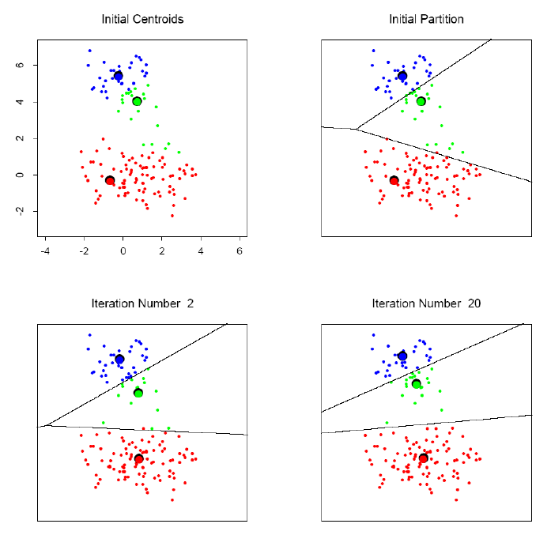
K-means clustering example

Slide 7
MapReduce Programming
Framework that supports distributed computing on clusters of computers
Introduced by Google in 2004
Map step
Reduce step
Combine step (Optional)
Applications

Slide 8

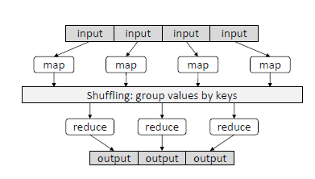
MapReduce Model

Slide 9
Outline
Introduction
Methodology
Results
Conclusion

Slide 10
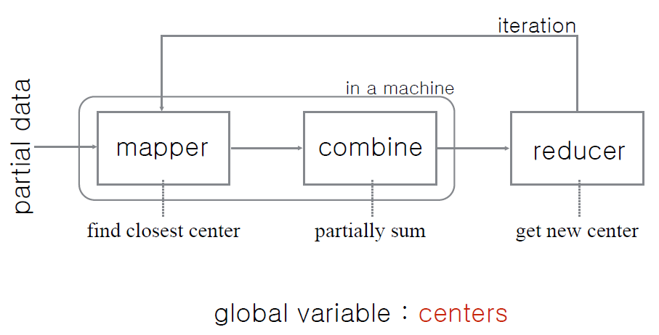
Parallel K-means Clustering Based on MapReduce

Slide 11
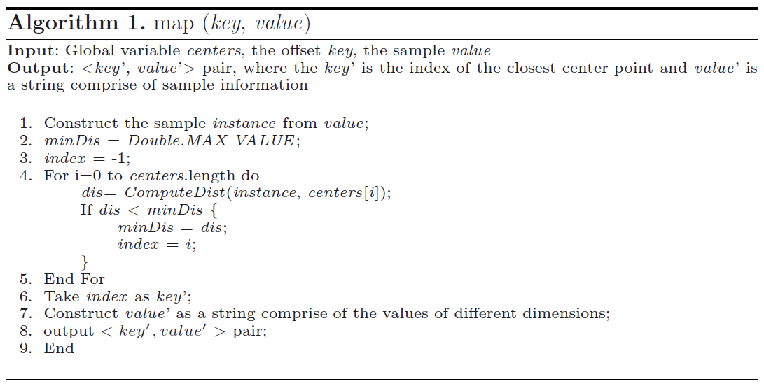
Map Function

Slide 12
Map Function
The input dataset is a sequence file of <key, value> pairs
The dataset is split and globally broadcast to all mappers
Output:
key = index of closest center point
value = string comprise of the values of different dimensions

Slide 13
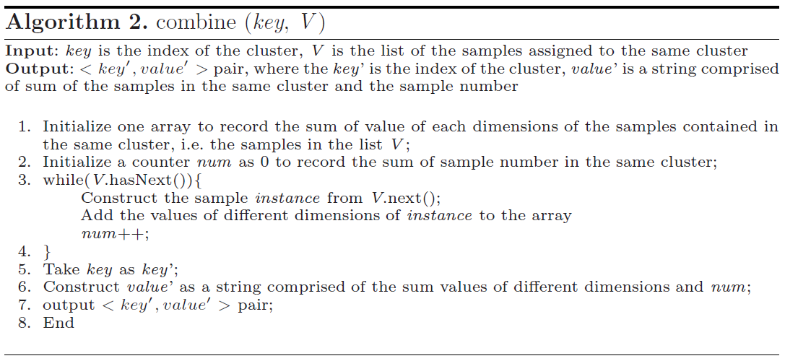
Combine Function
Partially sum the values of the points assigned to the same cluster

Slide 14
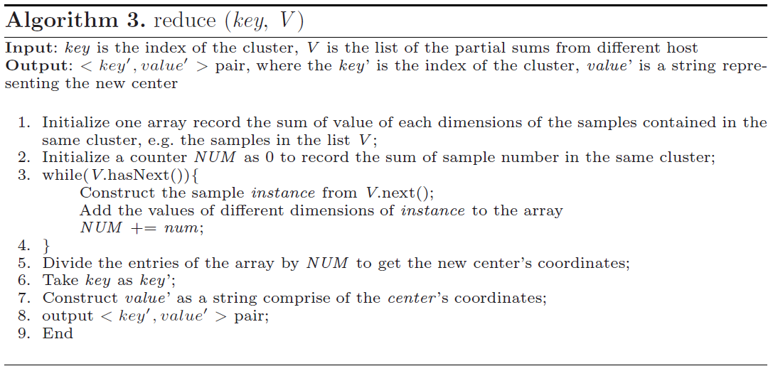
Reduce Function
Sum all the samples and compute the total number of samples assigned to the same cluster
→ Get new centers for next iteration

Slide 15
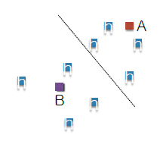
Map
f
<B, (1,4)>
<B, (4,1)>
<B, (4,5)>
e
h
<a, (1,4)>
<b, (4,1)>
<c, (4,5)>
map
c
g
a
d
<d, (5,2)>
<e, (5,7)>
<f, (6,8)>
<B, (5,2)>
<A, (5,7)>
<A, (6,8)>
map
b
<g, (7,4)>
<h, (8,7)>
<A, (7,4)>
<A, (8,7)>
map
centers
A | B
<h, (8,7)> | <b, (4,1)>

Slide 16
Combine
f
<B, (9,10,3)>
e
h
<B, (1,4)>
<B, (4,1)>
<B, (4,5)>
combine
c
g
a
d
<B, (5,2)>
<A, (5,7)>
<A, (6,8)>
<B, (5,2,1)>
<A, (11,15,2)>
combine
b
<A, (7,4)>
<A, (8,7)>
<A, (15,11,2)>
combine
centers
A | B
<b, (4,1)> | <h, (8,7)>

Slide 17
Reduce
<B, (9,10,3)>
<A, (11,15,2)>
<A, (15,11,2)>
reduce
<A, (26/4, 26/4)>
<B, (5,2,1)>
<A, (11,15,2)>
shuffle
<B, (9,10,3)>
<B, (5,2,1)>
<B, (14/4, 12/4)>
reduce
<A, (15,11,2)>
centers
A | B
(26/4, 26/4) | (14/4, 12/4)

Slide 18
Outline
Introduction
Methodology
Results
Conclusion

Slide 19
Experimental Setup
Hadoop 0.17.0
Cluster of machines
Each with two 2.8 GHz cores and 4GB memory
Java 1.5.0_14

Slide 20
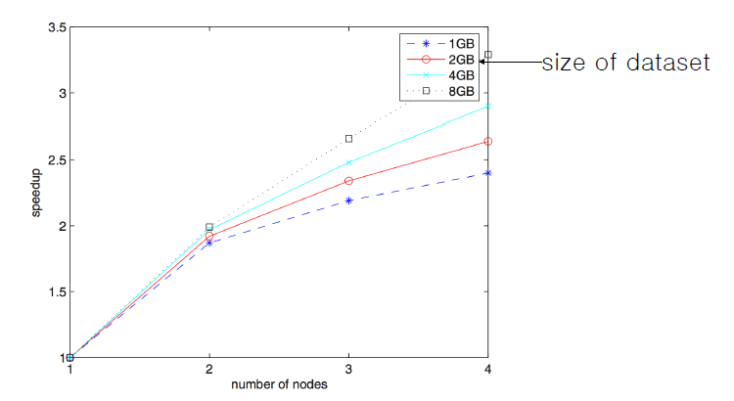
Speedup

Slide 21
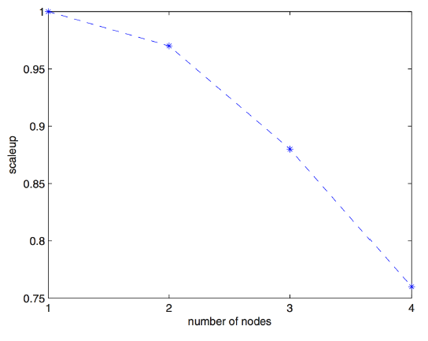
Scaleup
The ability of m-times larger system to perform an m-times larger job

Slide 22
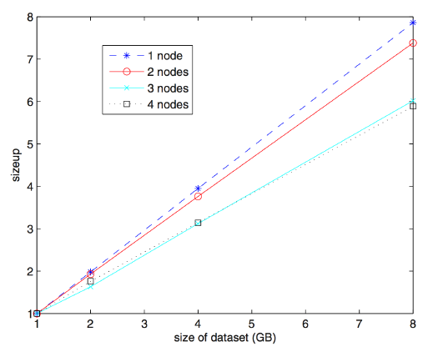
Sizeup
Fixed the number of computers

Slide 23
Outline
Introduction
Methodology
Results
Conclusion

Slide 24
Conclusion
Simple and fast MapReduce solution for clustering problem
The result shows the algorithm can process large datasets effectively
Speedup
Scaleup
Sizeup

