Slide 1
RP-Filter: A Path-based Triple Filtering Method for Efficient SPARQL Query Processing
JIST 2011
Kisung Kim¹, Bongki Moon², Hyoung-Joo Kim¹
¹Seoul National University
²University of Arizona
kskim@idb.snu.ac.kr
Notes:
Hello, my name is Kisung Kim. I’m a Ph.D student in Seoul National University in Korea.
I’ll present our work, RP-Filter: A Path-based Triple Filtering Method for Efficient SPARQL Query Processing.
In this work, we deal with the useless intermediate result problem in SPARQL query processing.

Slide 2
Outline
Introduction
Background
Motivation
Related work
Our approaches
Triple filtering
RP-Filter
RPFLT operator
Experimental results
Conclusions and future work
Notes:
This is the outline of my presentation.
In introduction, I’ll give the background and the motivation of our work, and explain what is the useless intermediate result problem.
And then we review related work, briefly.
And I’ll explain our approaches including triple filtering method, RP-Filter data structure and RPFLT operator.
Next, I’ll present the experimental results and conclude the presentation.

Slide 3
RDF(Resource Description Framework)
Standard data model recommended by W3C
A set of triples (subject, predicate, object)
Graph-structured data
Node: subjects and objects
Edge: triple
<paper1, reference, paper2>
<paper1, hasAuthor, person1>
<paper1, year, 2011>
<paper2, hasAuthor, person2>
<paper2, year, 2010>
<paper2, wonPrize, prize1>
reference
paper1
paper2
hasAuthor
hasAuthor
wonPrize
year
year
person1
person2
prize1
2011
2010
RDF Triples
RDF Graph
Notes:
RDF is the standard data model for the semantic web.
RDF data is a set of triples of a form: subject, predicate, and object.
And RDF data can be visualized as a graph.
For example, these six triples can be represented by this graph.
In this graph, subjects and objects are represented as nodes.
And each triple becomes an edge which connects its subject and object.
And the predicate of the triple becomes the label of the edge.
We call this graph as an RDF graph.

Slide 4
SPARQL(SPARQL Protocol And RDF Query Language)
Standard query language for RDF
Query by a graph pattern
Subgraph pattern matching problem
Find subgraphs of RDF graph which are isomorphic to the query graph
SPARQL Query
SPARQL Query Graph
SELECT ?paper1 ?paper2 ?prize
WHERE {?paper1 <reference> ?paper2.
?paper2 <year> <2010>.
?paper2 <wonPrize> ?prize.
?paper1 <year> <2011>.}
?paper1
reference
year
Graph pattern
?paper2
2011
year
wonPrize
reference
2010
paper1
paper2
?prize
paper1
paper2
hasAuthor
hasAuthor
wonPrize
year
year
prize1
person1
person2
prize1
2011
2011
2010
2010
RDF Graph
Notes:
RDF data is queried using SPARQL, the standard query language for RDF.
SPARQL describes user’s query by a graph pattern.
This SPARQL query has a graph pattern which consists of four triple patterns.
And this graph pattern can also be represented by this query graph, similarly to the RDF graph.
The SPARQL query processing is the subgraph pattern matching problem.
That is, processing a SPARQL query is to find all subgraphs in RDF graph which are isomorphic to the query graph.
In this example, only this subgraph is matched with the query graph and becomes the results of the query.

Slide 5
SPARQL Query Processing
Triple Table
S | P | O
paper1 | hasAuthor | person1
paper1 | year | 2011
paper1 | reference | paper2
paper2 | hasAuthor | person2
paper2 | year | 2010
paper2 | wonPrize | prize1
Triple table scheme
Store all triples in a 3-column(S, P, O) table
Execution plan for SPARQL
Scan: retrieve matching triples for a triple pattern
Join: combine the retrieved triples
SPARQL Query
Join
SELECT
?paper1 ?paper2 ?prize
WHERE
{?paper1 <reference> ?paper2.
?paper2 <year> <2010>.
?paper2 <wonPrize> ?prize.
?paper1 <year> <2011>.}
Join
Scan
?paper1 <year> <2011>
Join
Scan
?paper2 <wonPrize> ?prize
Scan
?paper1 <reference> ?paper2
Scan
?paper2 <year> <2010>
Query Execution Plan
Notes:
In order to store RDF data, most RDF stores use the triple table, which has three columns: S, P, and O.
And then, a SPARQL query is processed by an execution plan using scan operators and join operators.
This is an execution plan of this SPARQL query.
The execution plan consists of four scan operators and three join operators.
Each scan operator is assigned a triple pattern in the query and retrieves all matching triples for the assigned triple pattern.
And the scanned triples are combined by join operators to generate all matching subgraphs.

Slide 6
Useless Intermediate Result Problem
SPARQL query processing can be suffered from the useless intermediate results
Useless intermediate result
Intermediate results not included in the final results
RDF Graph
Query
Execution Plan
?n1
Join
p1
p1
p1
p1
?n2
p2
p2
p2
p2
p2
Join
Scan
?n1 p1 ?n2
p2
p3
p3
p3
?n3
p3
Scan
?n2 p2 ?n3
Scan
?n3 p3 ?n4
?n4
Useless Intermediate Results
Notes:
The query processing method, which I described in the previous slide, is widely used in many RDF stores.
However, this style of the query processing can be suffered from the useless intermediate results produced by join operators.
The useless intermediate results refer the outputs of the join operators, which would not be in the final results.
Let’s consider this query and its execution plan.
This join operator outputs all matching subgraphs for this subgraph pattern.
And for this RDF graph, the join operator would output all these subgraphs as its results.
However, most of them will be removed by the subsequent join operator, because they are not connected with a triple whose predicate is p1.
So, only this subgraph would be in the final result and these intermediate results become useless.

Slide 7
Useless Intermediate Result Problem
Harmful for the query evaluation performance
Waste processing resources
Do not contribute to the final results
As the RDF data grows, the problem becomes more serious
Our approach
Triple filtering method
Filter useless triples exploiting the graph-structural information of RDF data
Notes:
These useless intermediate results are harmful for the query evaluation performance, because they only waste the processing resources, and they do not contribute to the final results, at all.
Moreover, as the RDF data grows, the useless intermediate results also grows and the problem becomes more serious.
In this work, we deal with this problem.
And we propose a triple filtering method which remove useless triples exploiting the graph-structural information of the RDF data.

Slide 8
Outline
Introduction
Background
Motivation
Related work
Our approaches
Triple filtering
RP-Filter
Experimental results
Conclusions and future work
Notes:
Let’s briefly review the related work.

Slide 9
Related Work
Join ordering
Traditional method in RDBMS
Find optimal join ordering which generate minimum intermediate results
Join selectivity estimation for SPARQL query processing [Neumann and Weikum, VLDB’08] [Neumann and Weikum, SIGMOD’09] [Stoker et al., WWW’08][Neumann and Moerkotte, ICDE’11]
U-SIP(Ubiquitous Sideways Information Passing) [Neumann and Weikum, SIGMOD’09]
Dynamic and run-time method
Build a sort of filters while processing of an operator and to pass the filters to other operators
Limitation of previous work
Do not consider the graph-structural information of RDF data and SPARQL queries
Notes:
Traditionally, the useless intermediate result problem has been dealt with by join ordering in RDBMS.
That is, they tries to reduce the intermediate results, by finding the optimal join ordering, which minimize the intermediate results.
And for SPARQL query processing, several methods for finding the optimal join ordering are also proposed.
The join ordering method is a static method, which is decided in the query compile time.
Recently, a runtime method called U-SIP is also proposed.
In U-SIP, some kinds of filters are generated in operators, during the query processing.
And the filters are passed to other scan operators and help the scan operator to skip useless triples.
However, both approaches have a limitation that they do not consider the graph-structural information of RDF data.
Therefor, they are not very effective for the graph-structural RDF data.

Slide 10
Outline
Introduction
Background
Motivation
Related work
Our approaches
Triple filtering
RP-Filter
RPFLT operator
Experimental results
Conclusions and future work
Notes:
Next, I present our approach.
First I explain what is the triple filtering.
And then I present RP-filter data structure and RPFLT operator, which conduct the triple filtering

Slide 11
Causes of Useless Intermediate Result
Triple retrieval method of scan operator
Scan operator retrieves all matching triples for a single triple pattern
Do not consider any graph-structural information
RDF Graph
Query
Execution Plan
?n1
Join
p1
p1
p1
p1
?n2
p2
p2
p2
p2
p2
Join
Scan
?n1 p1 ?n2
p2
p3
p3
p3
?n3
p3
Scan
?n2 p2 ?n3
Scan
?n3 p3 ?n4
?n4
Output all matching triples for <?n2 p2 ?n3> !
Notes:
Then, what is the cause of the useless intermediate results in SPARQL query processing?
The main cause of the problem is the triple retrieval method.
A scan operator considers only a single triple pattern to retrieve triples.
It does not consider adjacent triple patterns or any graph-structural information.
Therefore, a scan operator might retrieve irrelevant triples for a query, as its results.
In this example, this scan operator retrieves all matching triples for this triple pattern.
However, if it could consider adjacent triple patterns and do not output triples which are not connected with triples of predicate p1, it can remove these irrelevant triples from its output.
And the useless intermediate results can be reduced.

Slide 12
Triple Filtering
Filter useless triples exploiting graph-structural information
Predicate path
Path pattern which consists of predicates
If a query node has incoming predicate paths, all matching data nodes must also have same incoming predicates
➔ Necessary condition for the final results
Execution Plan
Query
Predicate path: <p1,p2,p3>
?n1
Join
p1
Incoming predicate path
<p1, p2>
?n2
Join
p2
Scan
?n1 p1 ?n2
Filter triples
whose object
does not have
incoming path pattern <p1,p2>
?n3
p3
Scan
?n2 p2 ?n3
Scan
?n3 p3 ?n4
?n4
Does the triple have the incoming path pattern?
➔ RP-Filter data structure
Notes:
Our idea is to filter the useless triples from scan operators, exploiting the graph-structural information of the query.
Specifically, we use the predicate path information.
A predicate path is a path pattern which is represented as a sequence of predicates.
For example, this query can be a predicate path and represented by a sequence <p1, p2, p3>
In this query graph, the node ?n3 has the incoming predicate path <p1,p2>.
And according to the definition of the subgraph isomorphism, every result node for the query node ?n3 must have the same incoming predicate paths.
We use this necessary condition for the results to filter useless triples.
That is, for each triple from this scan operators, we examine whether the triple has the necessary incoming path pattern or not.
Then, how can we determine this?.
To determine this, we need the information about which triples have the specific incoming path pattern.
To provide this information, we design RP-Filter data structure.

Slide 13
RP-Filter
Materialized filter data for the triple filtering
N-List (Node List)
Sorted list of node IDs which have a specific incoming predicate path
RP-Filter of RDF database D
A set of N-List for all ppaths(up to length MaxL) which exist in D
➔ Provide which nodes have a specific incoming predicate path
Notes:
Now, we present our RP-Filter data structure.
RP-Filter is the materialized filter data for triple filtering and consists of several node lists.
A node list for a specific predicate path is a sorted list of node IDs which have the incoming predicate path.
RP-Filter for an RDF database D is a set of all node lists for the predicate paths which exist in the RDF database D.
That is, RP-Filter provides the information about which nodes have a specific incoming predicate paths.

Slide 14
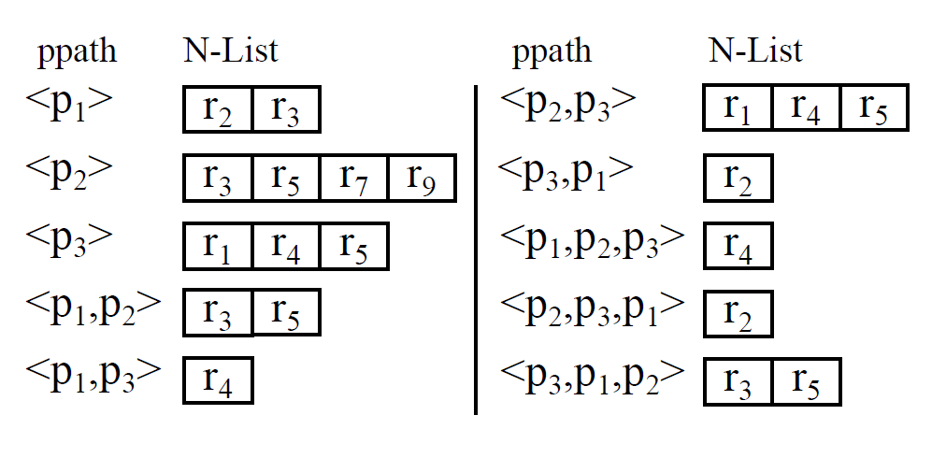
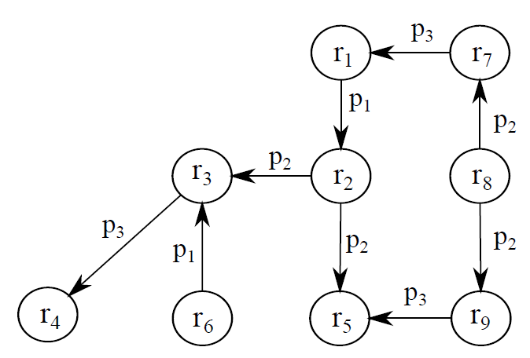
RP-Filter
RDF Graph
RP-Filter(D, MaxL=3)
Notes:
For this RDF graph, the RP-Filter will be built like this.
The maximum length of the predicate path is limited to 3 in order to limit the size of RP-Filter.
This RP-Filter has 10 node lists.
The node list for the predicate path <p1, p2> has two nodes r3 and r5.
From this node list, we can see that only r3 and r5 have the incoming predicate path <p1,p2>.

Slide 15
Triple Filtering with RP-Filter
RP-Filter provides information: Which nodes have a specific incoming predicate path
Use node lists as filter data
To determine whether a triple have all necessary incoming predicate path
Query
N-List(<p1,p2>)
Filter triples
whose object
does not have
incoming predicate path <p1,p2>
Execution Plan
?n1
r₃
r₅
Join
p1
?n2
p2
Join
Scan
?n1 p1 ?n2
?n3
RPFLT
p3
Scan
?n2 p2 ?n3
Scan
?n3 p3 ?n4
?n4
Notes:
Then, how can we use the RP-Filter for triple filtering?
As we already mentioned, RP-Filter provides the information about which nodes have a specific incoming predicate paths.
In the previous example, for this scan operator, we should know which triples have incoming predicate paths <p1,p2>.
We can obtain this information from the node list for <p1,p2>.
That is, the triples whose objects are not r3 or r5 are useless for the query and should be removed.
For this triple filtering, we add a supplementary operator called RPFLT.
From now on, we explain this RPFLT operator.

Slide 16
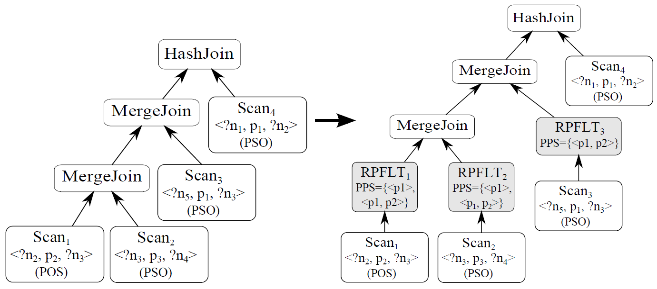
RPFLT Operator
Supplementary operator for triple filtering
Filter useless triples among input triples using RP-Filter
Added as the parent of a scan operator
PPS(Predicate Path Set)
Contain predicate paths assigned by query compiler
RPFLT uses the N-Lists of predicate paths in PPS
Notes:
RPFLT operator conducts the triple filtering process and removes the useless triples among the input triples using node lists in RP-Filter.
In order to use the triple filtering, the query optimizer analyzes the query graph and the execution plan
and adds appropriate RPFLT operators in an execution plan.
In this example, there are four scan operators, and among them, three scan operators have RPFLT operators as their parents.
In addition, the query optimizer assigns a set of predicate paths called PPS to each RPFLT operator to indicate which node lists they should use.
For example, this RPFLT operator uses the node lists for two predicate paths:<p1>,<p1,p2>

Slide 17
Assigning Predicate Paths to RPFLT
Which predicate paths are assigned to RPFLT?
Consider the ordering of the input triples
The ordering of input triples
RPFLT assumes that input triples are sorted by subject or object
For efficient triple filtering process
Example: RDF-3X
Store triples in six indexes: SPO, SOP, PSO, POS, OSP, OPS
Triple Table (not sorted)
Triple Index(PSO) Sorted by (P, S, O)
S | P | O
1 | 10 | 5
6 | 3 | 6
40 | 4 | 9
16 | 10 | 8
6 | 3 | 10
90 | 2 | 11
6 | 10 | 12
P | S | O
2 | 90 | 11
3 | 6 | 6
3 | 6 | 10
4 | 40 | 9
10 | 1 | 5
10 | 16 | 12
10 | 16 | 8
Triple Pattern
<?, 10, ?>
Totally ordered by subject
Notes:
Then, which predicate paths should be assigned to an RPFLT operator?
When the query optimizer assigns the predicate paths, it considers the ordering of the input triples.
In many RDF stores, the scanned triples are sorted by subject or object, because they store triples as sorted.
For example, RDF-3X makes 6 indexes to store triples with different orderings.
If we retrieve matching triples for this triple pattern, by using PSO index, then the retrieved triples are sorted by subject.
This is because the PSO index stores the triples sorted by PSO, and all retrieved triples have the same predicate value, 10.
So they are sorted by the subject.
The query optimizer uses this property of input triples when choosing predicate paths for RPFLT operators.
######
We assume that the input triples are sorted by subject or object.
RPFLT operator exploits this ordering of input triples for efficient triple filtering.

Slide 18
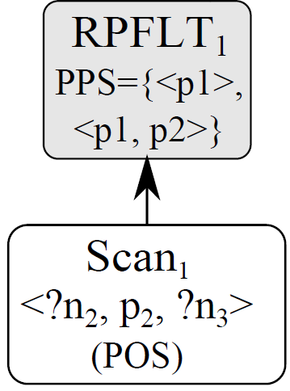
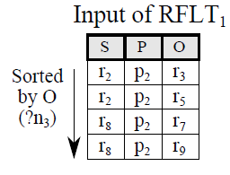
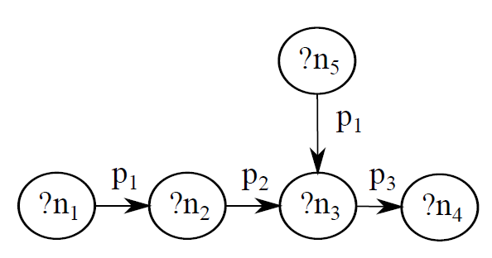

Assigning Predicate Paths to RPFLT
Assign incoming predicate paths of the node corresponding to the sorting key of the input triples
Redundant predicate path
If ppath₁ is a suffix of ppath₂, N-List(ppath₁)$⊃$N-List(ppath₂) ➔ ppath1 has no pruning power
<p₁>
<p1,p2>
<p₂>
PPS={<p₁>,<p₂>,<p₁,p₂>}
Notes:
This is an example of the input triples for the Scan1 in the previous execution plan.
In this case, the input triples are sorted by the object.
And the object is corresponding to the node n3 in the query graph.
Then, we assign only the incoming predicate paths of the node n3 to this RPFLT operator.
Specifically, we assign the incoming predicate paths of the node corresponding to the sorting key of the input triples.
In this example, the node n3 has three incoming predicate paths.
However, we remove the p.path <p2> from PPS.
This is because the p.path <p2> is redundant due to the p.path <p1,p2>.
That is, the node list of the p.path <p2> has every node of the node list of the p.path <p1,p2>.
So the p.path <p2> does not have any pruning power, and we don’t need to include the p. path <p2> in PPS.

Slide 19
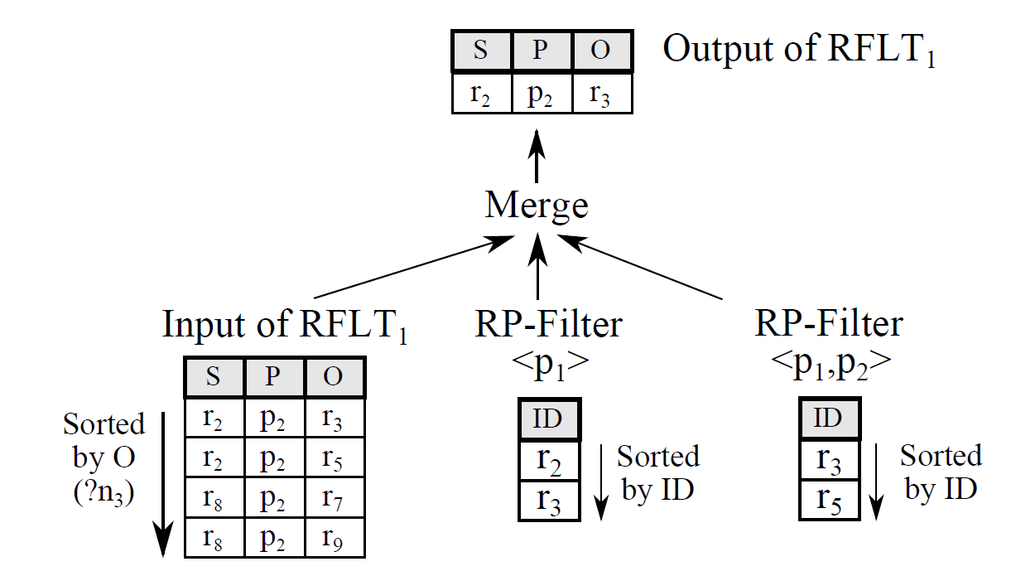
Triple Filtering by Merge Process
Assign predicate paths of sorting keys for efficient triple filtering
To conduct triple filtering be merge process
Triple filtering
Remove triples whose subject(or object) is not in all assigned N-Lists
Merge the input triples with N-list(ppath), for all ppath in PPS
Triple filtering incurs little overhead because of efficient merging
Notes:
The reason why we consider the ordering of the input triples is for the efficiency of the triple filtering process.
If we apply the triple filtering for the sorting key of the input triples, we can conduct the triple filtering by simple merge process.
This figure illustrates the triple filtering process.
These are the input triples and sorted by the object.
And there are two assigned node lists for this RPFLT operator.
For the triple filtering, we should remove the triples whose object is not in both node lists.
We can do this job by simply merging the input triples and two node lists, because they are all sorted.
The merge process is very efficient and therefore, the triple filtering incurs little overhead for the query processing.

Slide 20
Outline
Introduction
Background
Motivation
Our approaches
Triple filtering
RP-Filter
Experimental results
Conclusions and future work
Notes:
Next I present the experimental results.

Slide 21
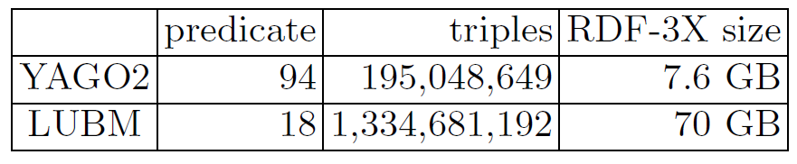
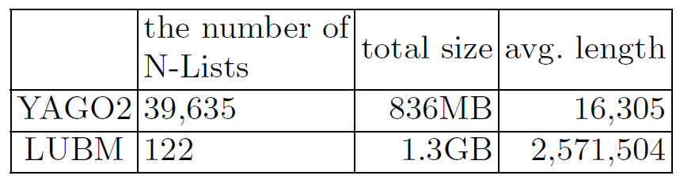
Experimental Results
Experimental environment
We implemented RP-Filter on RDF-3X(0.3.5)¹
IBM machine having 8 Intel Xeon 3.0GHz cores, 16GB memory
Datasets
YAGO2: small real-life dataset
LUBM: large synthetic dataset
RP-Filter size(MaxL=3)
¹http://www.mpi-inf.mpg.de/~neumann/rdf3x/
Notes:
We implemented the RP-Filter in RDF-3X, version 0.3.5, which is available in this URL.
And we conducted all experiments on this machine.
We use two datasets for experiments: YAGO2 and LUBM.
YAGO2 is relatively small but a real-life dataset, while LUBM is synthetic but large-scale dataset.
This table presents some statistics about the datasets.
In this table, we can see that YAGO2 has more predicates than LUBM.
This is because YAGO2 is a heterogeneous dataset, while LUBM is a homogeneous dataset, whose domain is the university.
This table is about the size of RP-Filters built for two datasets.
As you can see, YAGO2 has more node lists than LUBM.
This is because YAGO2 has more predicates and there exists more distinct predicate paths in YAGO2.
And please note that the size of RP-Filter is small comparing with the database size, for both datasets.

Slide 22
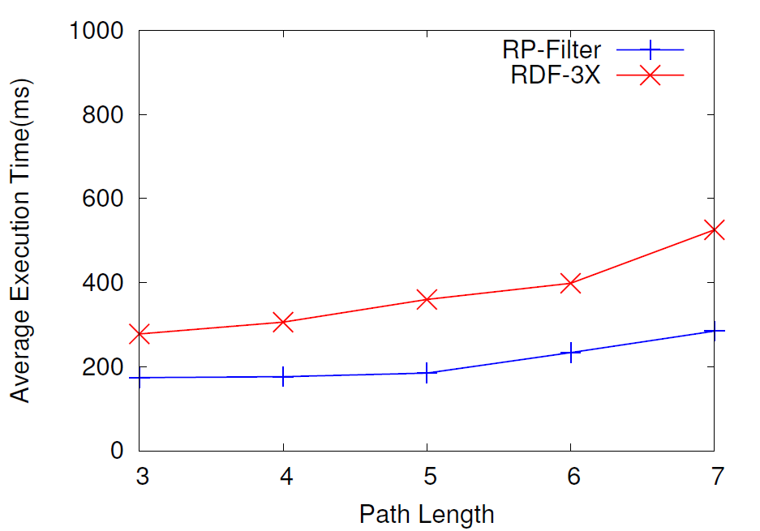
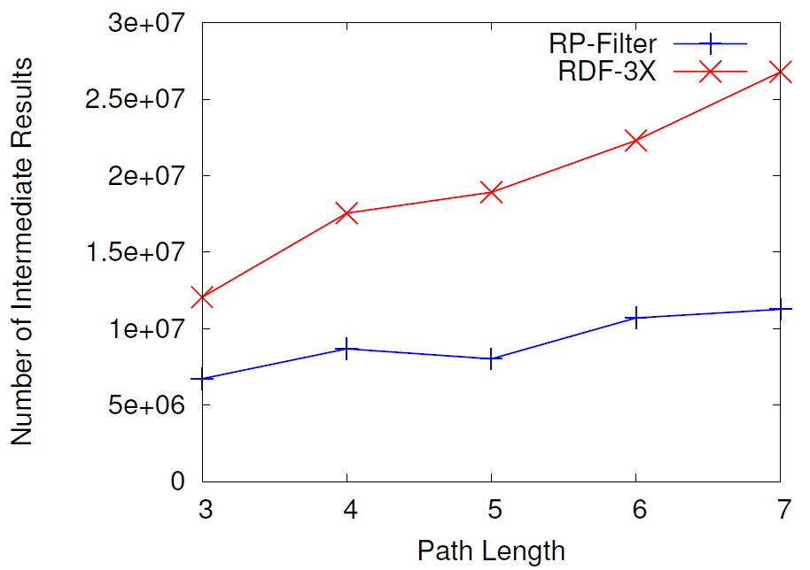
Experimental Results: YAGO2
We generated n-length(3~7) single path queries
The execution time and the number of intermediate results of RP-Filter are lower than those of RDF-3X
p₁
p₂
p₃
Example Single Path Query (length=3)
v₁
v₂
v₃
v₄
Execution Time
Intermediate Results
Notes:
This is the result of experiments for YAGO2.
We generated random path queries with various lengths 3 to 7, varying the predicate values.
This is an example path query whose length is 3.
These graphs show the query execution time and the number of intermediate results of RP-Filter, comparing with RDF-3X.
We can see that the execution times are reduced when using RP-Filter.
This is because that as we can see in this graph, RP-Filter reduces the number of intermediate results..

Slide 23
Experimental Results: LUBM
LUBM dataset
We use q2 and q9 queries among 14 queries
U-SIP is not very effective in q2 and q9
U-SIP is not effective for queries with long paths
RP-Filter is very effective in q2 but not in q9
q2 has a very selective path in the query pattern
 | Execution Time(sec) |  | Intermediate Results(M)
 | q2 | q9 | q2 | q9
RP-Filter | 8.187 | 36.907 | 233.6 | 617.5
RDF-3X | 26.576 | 37.025 | 424.7 | 659.9
Notes:
This is the results for LUBM.
LUBM is a benchmark dataset and provides total 14 queries for benchmark.
However, most queries have very simple structure and short paths in them.
So RP-Filter is not applied to those queries.
Therefore, we chose two queries q2 and q9 among 14 queries.
As we can see in this table, RP-Filter reduce the execution time for both queries.
But for the query q9, RP-Filter is not very effective as for the query q2.
And the reduction of intermediate results for q9 is much less than that of q2.
This is because for q9, there is less useless intermediate results which RP-Filter can reduce than for q2.
#########
We compare the execution time of RP-filter with RDF-3X.

Slide 24
Conclusions and Future Work
We propose a novel triple filtering method to reduce the useless intermediate results
Exploit the graph-structural information: predicate path
Design RP-Filter data structure
Efficient triple filtering using the sorted property of input triples
Experimental results show RP-Filter is very effective for complex queries to reduce the intermediate results
Future work
How to increase the applicability of RP-Filter
How to generate the execution plan using RP-Filter based on the cost model
Notes:
Now we conclude this presentation.
We propose a novel triple filtering method to reduce the useless intermediate results in SPARQL query processing.
We exploits the graph-structural information called predicate path and design RP-Filter data structure.
And the triple filtering process is very efficient because we use the sorted property of the input triples
And through the experiments, we demonstrate that RP-Filter can effectively reduce the useless intermediate results.
As the future work, we plan to increase the applicability of RP-Filter and develop the cost-based optimization technique for RP-Filter.

Slide 25
Thank You Any Question?
Notes:
That’s it.
Thank you very much for your attention.

Slide 26
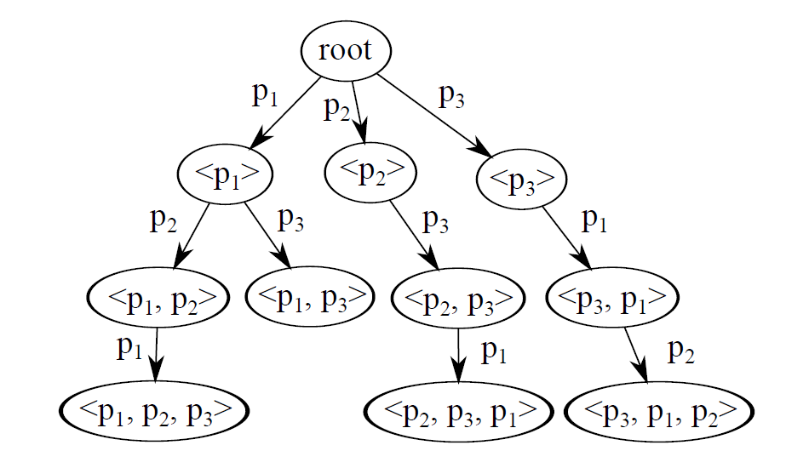
Appendix: RP-Trie
Organize all the predicate paths in RP-Filter
To search the N-List of a predicate path easily
Each node in RP-Trie points associated N-List
N-List(<p3, p1, p2>) ?
RP-Filter(D, MaxL=3)
RP-Trie
Notes:
We organize the predicate paths in RP-Filter using RP-Trie.
RP-Trie is a trie data structure of the predicate paths.
RP-Trie helps to search the node list for a given predicate paths.
Each node in RP-trie points the associated node list.
If we look for the node list for p.path <p3,p1,p2>, then we can traverse the RP-Trie from the root node, following the links according to the predicate path.

