Slide 1
Chapter 9: Object-Based Databases

Slide 2
Database System Concepts
Chapter 1: Introduction
Part 1: Relational databases
  Chapter 2: Relational Model
  Chapter 3: SQL
  Chapter 4: Advanced SQL
  Chapter 5: Other Relational Languages
Part 2: Database Design
  Chapter 6: Database Design and the E-R Model
  Chapter 7: Relational Database Design
  Chapter 8: Application Design and Development
Part 3: Object-based databases and XML
  Chapter 9: Object-Based Databases
  Chapter 10: XML
Part 4: Data storage and querying
  Chapter 11: Storage and File Structure
  Chapter 12: Indexing and Hashing
  Chapter 13: Query Processing
  Chapter 14: Query Optimization
Part 5: Transaction management
  Chapter 15: Transactions
  Chapter 16: Concurrency control
  Chapter 17: Recovery System
Part 6: Data Mining and Information Retrieval
  Chapter 18: Data Analysis and Mining
  Chapter 19: Information Retreival
Part 7: Database system architecture
  Chapter 20: Database-System Architecture
  Chapter 21: Parallel Databases
  Chapter 22: Distributed Databases
Part 8: Other topics
  Chapter 23: Advanced Application Development
  Chapter 24: Advanced Data Types and New Applications
  Chapter 25: Advanced Transaction Processing
Part 9: Case studies
  Chapter 26: PostgreSQL
  Chapter 27: Oracle
  Chapter 28: IBM DB2
  Chapter 29: Microsoft SQL Server
Online Appendices
  Appendix A: Network Model
  Appendix B: Hierarchical Model
  Appendix C: Advanced Relational Database Model

Slide 3
Part 3: Object-based databases and XML (Chapters 9 and 10).
Chapter 9: Object-Based Databases
  covers object-based databases. The chapter describes the object-relational data model, which extends the relational data model to support complex data types, type inheritance, and object identity. The chapter also describes database access from object-oriented programming languages.
Chapter 10: XML
  covers the XML standard for data representation, which is seeing increasing use in the exchange and storage of complex data. The chapter also describes query languages for XML.

Slide 4
Chapter 9: Object-Based Databases
9.1 Overview
9.2 Complex Data Types and Object Orientation
9.3 Structured Data Types and Inheritance in SQL
9.4 Table Inheritance
9.5 Array and Multiset Types in SQL
9.6 Object Identity and Reference Types in SQL
9.7 Implementing O-R Features
9.8 Persistent Programming Languages
9.9 Comparison of Object-Oriented and Object-Relational Databases
9.10 Summary

Slide 5
History
Early 1980: Extending System/R for Engineering Application
  Long Field, Complex Object, Long Transaction
Mid 1980 – 1990: (3 directions)
  Object-Oriented Database
  Deductive Database
  Extending Relational Databases
1990 – 1996:
  Many OODB Ventures appeared and disappeared
1997: Most Relational DBMS vendors claimed Object-Relational DBMS
Now: Adding functions to OR DBMS for Internet, Web, Bio, PDA, Cell Phone…

Slide 6
Object-Relational Data Models
Extend the relational data model by including object orientation and constructs to deal with added data types.
Allow attributes of tuples to have complex types, including non-atomic values such as nested relations.
Preserve relational foundations, in particular the declarative access to data, while extending modeling power.
Upward compatibility with existing relational languages.

Slide 7
Chapter 9: Object-Based Databases
9.1 Overview
9.2 Complex Data Types and Object Orientation
9.3 Structured Data Types and Inheritance in SQL
9.4 Table Inheritance
9.5 Array and Multiset Types in SQL
9.6 Object Identity and Reference Types in SQL
9.7 Implementing O-R Features
9.8 Persistent Programming Languages
9.9 Comparison of Object-Oriented and Object-Relational Databases
9.10 Summary

Slide 8
Complex Data Types
Motivation:
  Permit non-atomic domains (atomic ≡ indivisible)
  Example of non-atomic domain: set of integers or set of tuples
  Allows more intuitive modeling for applications with complex data
Intuitive definition:
  allow relations whenever we allow atomic (scalar) values
    relations within relations
  Retains mathematical foundation of relational model
  Violates first normal form.

Slide 9
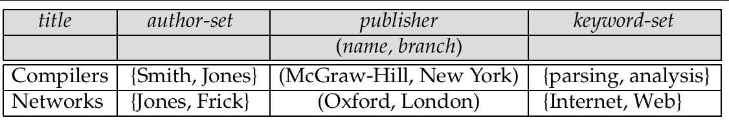
Example of a Nested Relation
Example: library information system
Each book has
  title,
  a set of authors,
  publisher, and
  a set of keywords
Non-1NF relation books

Slide 10
4NF Decomposition of Nested Relation
Remove awkwardness of flat-books by assuming that the following multivalued dependencies hold:
  title author
  title keyword
  title pub-name, pub-branch
Decompose flat-doc into 4NF using the schemas:
  (title, author )
  (title, keyword )
  (title, pub-name, pub-branch )

Slide 11
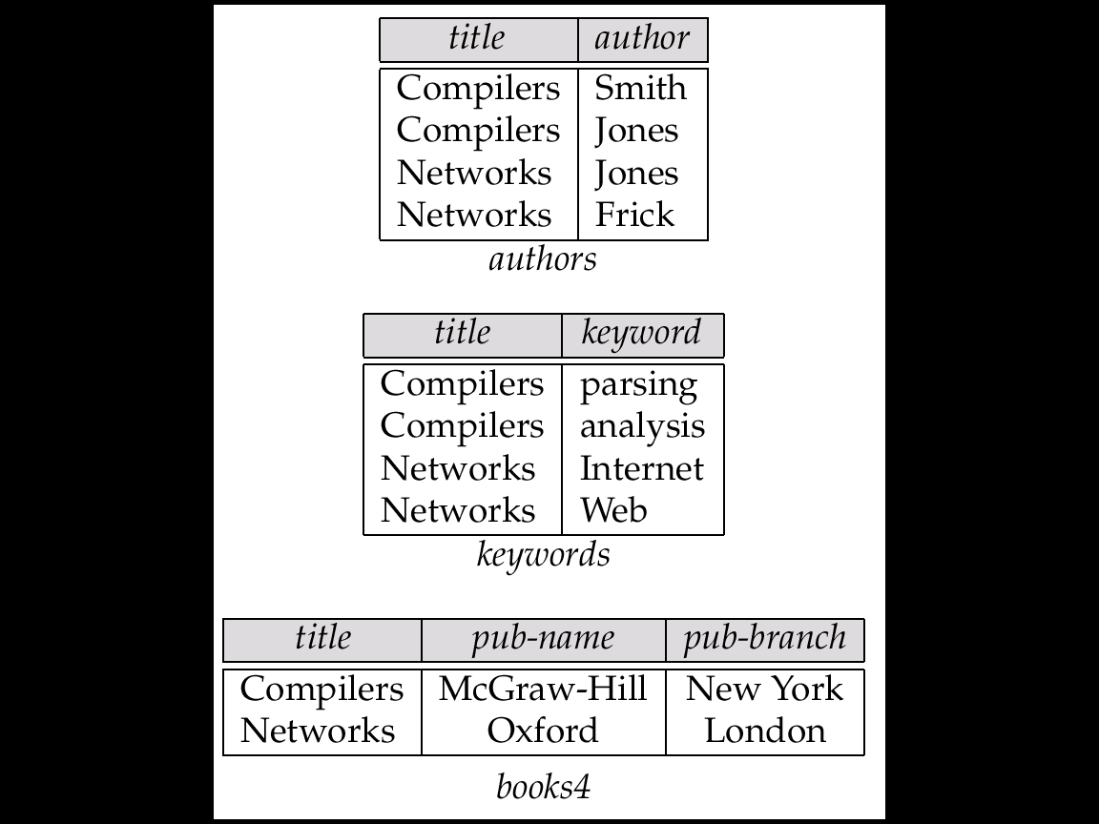
4NF Decomposition of flat–books

Slide 12
Problems with 4NF Schema
4NF design requires users to include joins in their queries.
1NF relational view flat-books defined by join of 4NF relations:
  eliminates the need for users to perform joins,
  but loses the one-to-one correspondence between tuples and documents.
  And has a large amount of redundancy
Nested relations representation is much more natural here.

Slide 13
Complex Types and SQL:1999
Extensions to SQL to support complex types include:
  Collection and large object types
    Nested relations are an example of collection types
  Structured types
    Nested record structures like composite attributes
  Inheritance
  Other object orientation features
    Including object identifiers and references
Our description is mainly based on the SQL:1999 standard
  Not fully implemented in any database system currently
  But some features are present in each of the major commercial database systems
    Read the manual of your database system to see what it supports

Slide 14
Chapter 9: Object-Based Databases
9.1 Overview
9.2 Complex Data Types and Object Orientation
9.3 Structured Data Types and Inheritance in SQL
9.4 Table Inheritance
9.5 Array and Multiset Types in SQL
9.6 Object Identity and Reference Types in SQL
9.7 Implementing O-R Features
9.8 Persistent Programming Languages
9.9 Comparison of Object-Oriented and Object-Relational Databases
9.10 Summary

Slide 15
Structured Types and Inheritance in SQL
Structured types can be declared and used in SQL
create type Name as
( firstname varchar(20),
lastname varchar(20))
final
create type Address as
( street varchar(20),
city varchar(20),
zipcode varchar(20))
not final
  Note: final and not final indicate whether subtypes can be created
Structured types can be used to create tables with composite attributes
create table customer (
name Name,
address Address,
dateOfBirth date)
Dot notation used to reference components: name.firstname

Slide 16
Structured Types (cont.)
User-defined row types
  create type CustomerType as (
  name Name,
  address Address,
  dateOfBirth date)
  not final
Can then create a table whose rows are a user-defined type
  create table customer of CustomerType

Slide 17
Methods
Can add a method declaration with a structured type.
method ageOnDate (onDate date)
returns interval year
Method body is given separately.
  create instance method ageOnDate (onDate date)
  returns interval year
  for CustomerType
  begin
  return onDate - self.dateOfBirth;
  end
We can now find the age of each customer:
  select name.lastname, ageOnDate (current_date)
  from customer

Slide 18
Inheritance
Suppose that we have the following type definition for people:
create type Person
( name varchar(20),
address varchar(20))
Using inheritance to define the student and teacher types
create type Student under Person
( degree varchar(20),
department varchar(20))
create type Teacher under Person
( salary integer,
department varchar(20))
Subtypes can redefine methods by using overriding method in place of method in the method declaration

Slide 19
Multiple Inheritance
SQL:1999 and SQL:2003 do not support multiple inheritance
If our type system supports multiple inheritance, we can define a type for teaching assistant as follows
create type Teaching Assistant
under Student, Teacher
To avoid a conflict between the two occurrences of department, we can rename them
create type Teaching Assistant
under Student with (department as student_dept ),
Teacher with (department as teacher_dept )

Slide 20
Chapter 9: Object-Based Databases
9.1 Overview
9.2 Complex Data Types and Object Orientation
9.3 Structured Data Types and Inheritance in SQL
9.4 Table Inheritance
9.5 Array and Multiset Types in SQL
9.6 Object Identity and Reference Types in SQL
9.7 Implementing O-R Features
9.8 Persistent Programming Languages
9.9 Comparison of Object-Oriented and Object-Relational Databases
9.10 Summary

Slide 21
Types of Subtables
The types of the subtables must be subtypes of the type of the parent table
  create table people of Person
    Person type, people table
  create table students of Student under people
    Student type is a subtype of Person
  create table teachers of Teacher under people
    Teacher type is a subtype of Person
Every tuple in teachers and students table is implicitly in people table!
Query, delete, update in supertable only or in super and subtables
  Delete from people where P
  Delete from only people where P

Slide 22
Consistency Requirements for Subtables
Consistency requirements on subtables and supertables.
  Each tuple of the supertable (e.g. people) can correspond to at most one tuple in each of the immediate subtables (e.g. students and teachers)
    We cannot have two tuples in students table that correspond to the same person in people table
  All tuples corresponding to each other (that is, with the same values for inherited attributes) must be derived from one tuple (inserted into one table).
    That is, each entity must have a most specific type
    We cannot have a tuple in people table corresponding to a tuple each in students table and teachers table

Slide 23
Subtable Consistency
People Table
(Choi, No226)
Implicitly People Table
(Kim, No134)
(Park, No339)
(Lee, No113)
(Youn, No226)
(Choi, No120)
Students Table
(Kim, No134, EE major)
(park, No339, CS major)
Teachers Table
(Lee, No113, Compiler)
(Youn,No226, Soft Eng)
(Kim, No134, CE major)
(Park, No339, Database)

Slide 24
Chapter 9: Object-Based Databases
9.1 Overview
9.2 Complex Data Types and Object Orientation
9.3 Structured Data Types and Inheritance in SQL
9.4 Table Inheritance
9.5 Array and Multiset Types in SQL
9.6 Object Identity and Reference Types in SQL
9.7 Implementing O-R Features
9.8 Persistent Programming Languages
9.9 Comparison of Object-Oriented and Object-Relational Databases
9.10 Summary

Slide 25
Array and Multiset Types in SQL
Example of array and multiset declaration:
create type Publisher as
(name varchar(20),
branch varchar(20))
create type Book as
(title varchar(20),
author-array varchar(20) array [10],
pub-date date,
publisher Publisher,
keyword-set varchar(20) multiset )
create table books of Book
Similar to the nested relation books, but with array of authors instead of set

Slide 26
Creation of Collection Values
Array construction
array [‘Silberschatz’,`Korth’,`Sudarshan’]
Multisets
  multiset [‘computer’, ‘database’, ‘SQL’]
To create a tuple of the type defined by the books relation:
(‘ Compilers’, array[`Smith’,`Jones’], Publisher (`McGraw-Hill’,`New York’),
multiset [`parsing’,`analysis’ ] )
To insert the preceding tuple into the relation books
insert into books
values
( ‘Compilers’, array[`Smith’,`Jones’], Publisher (`McGraw-Hill’,`New York’), multiset [`parsing’,`analysis’ ] )

Slide 27
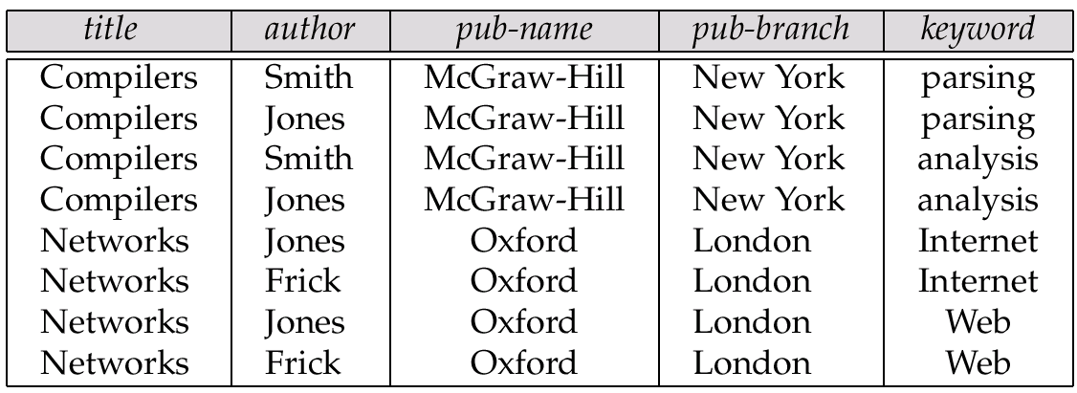
Unnesting
The transformation of a nested relation into a form with fewer (or no) relation-valued attributes us called unnesting.
select title, A as author,
publisher.name as pub_name, publisher.branch as pub_branch, K as keyword
from books as B, unnest(B.author_set ) as A , unnest (B.keyword_set ) as K

Slide 28
Querying Collection-Valued Attributes
To find all books that have the word “database” as a keyword,
select title
from books
where ‘database’ in (unnest(keyword-set ))
We can access individual elements of an array by using indices
  E.g.: If we know that a particular book has three authors, we could write:
select author-array[1], author-array[2], author-array[3]
from books
where title = `Database System Concepts’
To get a relation containing pairs of the form “title, author-name” for each book and each author of the book
select B.title, A.author
from books as B, unnest (B.author-array) as A (author )
To retain ordering information we add a with ordinality clause
select B.title, A.author, A.position
from books as B, unnest (B.author-array) with ordinality as A (author, position )

Slide 29
Nesting
Nesting is the opposite of unnesting, creating a collection-valued attribute
NOTE: SQL:1999 does not support nesting
Nesting can be done in a manner similar to aggregation, but using the function collect() in place of an aggregation operation, to create a multiset
  followed by “group by” command
To nest the flat-books relation on the attribute keyword:
select title, author, Publisher (pub_name, pub_branch ) as publisher,
collect (keyword) as keyword_set
from flat-books
group by title, author, publisher
To nest on both authors and keywords:
select title, collect (author ) as author_set,
Publisher (pub_name, pub_branch) as publisher, collect (keyword ) as keyword_set
from flat-books
group by title, publisher

Slide 30
Nesting (Collect)
** note: group by title, publisher

Slide 31
Nesting (Cont.)
Another approach to creating nested relations is to use subqueries in the select clause.
select title,
array ( select author
from authors as A
where A.title = B.title
order by A.position) as author_array,
Publisher (pub-name, pub-branch) as publisher,
multiset (select keyword
from keywords as K
where K.title = B.title) as keyword_set
from books4 as B

Slide 32
Chapter 9: Object-Based Databases
9.1 Overview
9.2 Complex Data Types and Object Orientation
9.3 Structured Data Types and Inheritance in SQL
9.4 Table Inheritance
9.5 Array and Multiset Types in SQL
9.6 Object Identity and Reference Types in SQL
9.7 Implementing O-R Features
9.8 Persistent Programming Languages
9.9 Comparison of Object-Oriented and Object-Relational Databases
9.10 Summary

Slide 33
Object-Identity and Reference Types
Define a type Department with a field name and a field head which is a reference to the type Person, with table people as scope:
create type Department (
name varchar (20),
head ref (Person) scope people)
We can then create a table departments as follows
create table departments of Department
We can omit the declaration scope people from the type declaration and instead make an addition to the create table statement:
create table departments of Department
(head with options scope people)

Slide 34
Initializing Reference-Typed Values
To create a tuple with a reference value, we can first create the tuple with a null reference and then set the reference separately:
insert into departments values (`CS’, null)
update departments
set head = ( select p.person_id
from people as p
where name = `John’ )
where name = `CS’

Slide 35
User Generated Identifiers
The type of the object-identifier must be specified as part of the type definition of the referenced table
The table definition must specify that the reference is user generated
create type Person
( name varchar(20)
address varchar(20) )
ref using varchar(20)
create table people of Person
ref is person_id user generated
When creating a tuple, we must provide a unique value for the identifier:
  insert into people (person_id, name, address ) values (‘01284567’, ‘John’, `23 Coyote Run’)
We can then use the identifier value when inserting a tuple into departments
  Avoids need for a separate query to retrieve the identifier:
insert into departments values(`CS’, `02184567’)

Slide 36
User Generated Identifiers (Cont.)
Can use an existing primary key value as the identifier:
create type Person
( name varchar (20) primary key,
address varchar(20) )
ref from (name)
create table people of Person
ref is person_id derived
When inserting a tuple for departments, we can then use
insert into departments values(`CS’,`John’)

Slide 37
Path Expressions
create type Department (
name varchar (20),
head ref (Person) scope people)
create type Person
( name varchar(20)
address varchar(20) )
ref using varchar(20)
Find the names and addresses of the heads of all departments:
select head →name, head → address
from departments
An expression such as “head → name” is called a path expression
Path expressions help avoid explicit joins
  If department head were not a reference, a join of departments with people would be required to get at the address
  Makes expressing the query much easier for the user

Slide 38
Chapter 9: Object-Based Databases
9.1 Overview
9.2 Complex Data Types and Object Orientation
9.3 Structured Data Types and Inheritance in SQL
9.4 Table Inheritance
9.5 Array and Multiset Types in SQL
9.6 Object Identity and Reference Types in SQL
9.7 Implementing O-R Features
9.8 Persistent Programming Languages
9.9 Comparison of Object-Oriented and Object-Relational Databases
9.10 Summary

Slide 39
Implementing O-R Features in RDB
If we want to keep existing RDBMS and utilize O-R advantages
  Structured Type, Array, Multiset, Nested relations, Inheritance, Subtable
Convert tables with O-R tables into Relational Tables
  Similar to how E-R features are mapped onto relation schemas
  Multivalued attribute vs Multi-Set valued attribute
  Composite attribute vs Structured Type
  ISA vs Table Inheritance
Subtable implementation
  Each table stores primary key and those attributes locally defined in that table
  or,
  Each table stores both locally defined and inherited attributes

Slide 40
Chapter 9: Object-Based Databases
9.1 Overview
9.2 Complex Data Types and Object Orientation
9.3 Structured Data Types and Inheritance in SQL
9.4 Table Inheritance
9.5 Array and Multiset Types in SQL
9.6 Object Identity and Reference Types in SQL
9.7 Implementing O-R Features
9.8 Persistent Programming Languages
9.9 Comparison of Object-Oriented and Object-Relational Databases
9.10 Summary

Slide 41
Persistent OO Programming Languages
Languages extended with constructs to handle persistent data
Programmer can manipulate persistent data directly
  If so, there is no need to fetch it into memory and store it back to disk (unlike embedded SQL)
Supporting Persistent Objects inside Programming Language!
Persistent objects:
  by class - explicit declaration of persistence
  by creation - special syntax to create persistent objects
  by marking - make objects persistent after creation
  by reachability - object is persistent if it is declared explicitly to be so or is reachable from a persistent object

Slide 42
Concerns in Persistent PL
Object Identifiers
  We need stronger version of in-memory pointers in Persistent PL
  Degrees of permanence of object identity
    Intraprocedure: only during execution of a single procedure
    Intraprogram: only during execution of a single program or query
    Interprogram: across program executions, but not if data-storage format on disk changes
    Persistent: interprogram, plus persistent across data reorganizations
How to represent class and its instances
How to support Query
How to support Transaction

Slide 43
Persistent Programming Languages
Many trials in mid 80’s
  Gemstone: Persistent SmallTalk
  Persistent CommonLoop
Persistent versions of C++ and Java have been implemented
  C++
    ODMG C++
    Extended C++ for ObjectStore
  Java
    Java Database Objects (JDO)

Slide 44
Chapter 9: Object-Based Databases
9.1 Overview
9.2 Complex Data Types and Object Orientation
9.3 Structured Data Types and Inheritance in SQL
9.4 Table Inheritance
9.5 Array and Multiset Types in SQL
9.6 Object Identity and Reference Types in SQL
9.7 Implementing O-R Features
9.8 Persistent Programming Languages
9.9 Comparison of Object-Oriented and Object-Relational Databases
9.10 Summary

Slide 45
Comparison of O-O and O-R Databases
Relational systems
  simple data types, powerful query languages, high protection.
Persistent-programming-language-based OODBs
  complex data types, integration with programming language, high performance.
Object-relational systems
  complex data types, powerful query languages, high protection.
Note: Many real systems blur these boundaries
  E.g. persistent programming language built as a wrapper on a relational database offers first two benefits, but may have poor performance.

Slide 46
Chapter 9: Object-Based Databases
9.1 Overview
9.2 Complex Data Types and Object Orientation
9.3 Structured Data Types and Inheritance in SQL
9.4 Table Inheritance
9.5 Array and Multiset Types in SQL
9.6 Object Identity and Reference Types in SQL
9.7 Implementing O-R Features
9.8 Persistent Programming Languages
9.9 Comparison of Object-Oriented and Object-Relational Databases
9.10 Summary

Slide 47
Ch 9: Summary (1)
The object-relational data model extends the relational data model by providing a richer type system including collection types and object orientation.
Collection types include nested relations, sets, multisets, and arrays, and the object-relational model permits attributes of a table to be collections.
Object orientation provides inheritance with subtypes and subtables, as well as object (tuple) references.
The SQL:1999 standard extends the SQL data-definition and query language to deal with the new data types and with object orientation.
We saw a variety of features of the extended data-definition language, as well as the query language, and in particular support for collection-valued attributes, inheritance, and tuple references.
  Such extensions attempt to preserve the relational foundations-in particular, the declarative access to data-while extending the modeling power.

Slide 48
Ch 9: Summary (2)
Object-relational database systems (that is, database systems based on the object-relation model) provide a convenient migration path for users of relational database who wish to use object-oriented features.
Persistent extensions to C++ and Java integrate persistence seamlessly and orthogonally with existing programming language constructs and so are easy to use.
The ODMG standard defines classes and other constructs for creating and accessing persistent objects from C++, while the JDO standard provides equivalent functionality for Java.
We discussed differences between persistent programming languages and object-relational systems, and mention criteria for choosing between them.

Slide 49
Ch 9: Bibliographical Notes (1)
Several object-oriented extensions to SQL have been proposed.
POSTGRES (Stonebraker and Rowe [1986] and Stonebraker [1986]) was an early implementation of an object-relational system.
Other early object-relational systems includes the SQL extensions of O₂ (Bancilhon et al. [1989]) and UniSQL (UniSQL [1991]).
SQL:1999 was the product of an extensive (and long-delayed) standardization effort, which originally started off as adding object-oriented features to SQL and ended up adding many more features, such as procedural constructs which we saw earlier.
Support for multiset types was added as part of SQL:2003.
Textbooks on SQL:1999 include Melton and Simon [2001] and Melton [2002]; the latter book concentrates on the object-relational features of SQL:1999.

Slide 50
Ch 9: Bibliographical Notes (2)
Eisenberg et al. [2004] provides an overview of SQL:2003, including its support for multisets.
Refer to the (online) manuals of the database system you use to find out what features of SQL:1999/SQL:2003 it supports.
A number of object-oriented database systems were developed in the late 1980s and early 1990s.
Among the notable commercial ones were ObjectStore (Lamb et al. [1991]), O₂ (Lecluse et al. [1988]), and Versant.
The object database standard ODMG is described in detail in Cattell [2000].
JDO is described by Roos [2002], Tyagi et al. [2003], and Jordan and Russell [2003].

Slide 51
Ch 9: Tools
There are considerable differences between different database products in their support for object-relational features.
  Oracle probably has the most extensive support among the major database venders.
  The Informix database system provides support for many object-relational features.
  Both Oracle and Informix provided object-relational features before the SQL:1999 standard was finalized, and have some features that are not part of SQL:1999.
Information about ObjectStore and Versant, including download of trial versions, may be obtained from their respective web sites (objectstore.com and versant.com).
The Apache DB project DB project (db.apache.org) provides an object-relational mapping tool for Java that supports both an ODMG Java and JDO APIs. A reference implementation of JDO may be obtained from sun.com; use a search engine to get the full URL.

Slide 52
Chapter 9: Object-Based Databases
9.1 Overview
9.2 Complex Data Types and Object Orientation
9.3 Structured Data Types and Inheritance in SQL
9.4 Table Inheritance
9.5 Array and Multiset Types in SQL
9.6 Object Identity and Reference Types in SQL
9.7 Implementing O-R Features
9.8 Persistent Programming Languages
9.9 Comparison of Object-Oriented and Object-Relational Databases
9.10 Summary

Slide 53
End of Chapter

