Slide 1
MySQL

Slide 2
Database System Concepts
Chapter 1: Introduction
Part 1: Relational databases
  Chapter 2: Relational Model
  Chapter 3: SQL
  Chapter 4: Advanced SQL
  Chapter 5: Other Relational Languages
Part 2: Database Design
  Chapter 6: Database Design and the E-R Model
  Chapter 7: Relational Database Design
  Chapter 8: Application Design and Development
Part 3: Object-based databases and XML
  Chapter 9: Object-Based Databases
  Chapter 10: XML
Part 4: Data storage and querying
  Chapter 11: Storage and File Structure
  Chapter 12: Indexing and Hashing
  Chapter 13: Query Processing
  Chapter 14: Query Optimization
Part 5: Transaction management
  Chapter 15: Transactions
  Chapter 16: Concurrency control
  Chapter 17: Recovery System
Part 6: Data Mining and Information Retrieval
  Chapter 18: Data Analysis and Mining
  Chapter 19: Information Retreival
Part 7: Database system architecture
  Chapter 20: Database-System Architecture
  Chapter 21: Parallel Databases
  Chapter 22: Distributed Databases
Part 8: Other topics
  Chapter 23: Advanced Application Development
  Chapter 24: Advanced Data Types and New Applications
  Chapter 25: Advanced Transaction Processing
Part 9: Case studies
  Chapter 26: PostgreSQL
  Chapter 27: Oracle
  Chapter 28: IBM DB2
  Chapter 29: Microsoft SQL Server
Online Appendices
  Appendix A: Network Model
  Appendix B: Hierarchical Model
  Appendix C: Advanced Relational Database Model

Slide 3
Part 9: Case studies
(Chapters 26 through 29).
Chapter 26: PostgreSQL
Chapter 27: Oracle
Chapter 28: IBM DB2
Chapter 29: Microsoft SQL Server.
Aux: MySQL
These chapters outline unique features of each of these systems, and describe their internal structure.
They provide a wealth of interesting information about the respective products, and help you see how the various implementation techniques described in earlier parts are used in real systems.
They also cover several interesting practical aspects in the design of real systems.

Slide 4
Table of Contents
Introduction
Management and Querying Tools
SQL Variations and Extensions
Storage and Indexing
Query Processing and Optimization
Concurrency and Recovery
System Architecture
Replication
Summary

Slide 5
Introduction
MySQL is developed by MySQL AB
MySQL AB was originally established in Sweden by David Axmark, Allan Larsson, and Michael “Monty” Widenius(1995)
The world's most popular open source database

Slide 6
Table of Contents
Introduction
Management and Querying Tools
SQL Variations and Extensions
Storage and Indexing
Query Processing and Optimization
Concurrency and Recovery
System Architecture
Replication
Summary

Slide 7
Management and Querying Tools
MySQL Query Browser
  The easiest visual tool for creating, executing, and optimizing SQL queries
  Provides
    Intuitive easy to use interface
    Visual tools to rapidly build queries
    Easily manage multiple queries using the results window
    Manage databases using the object browser
    Visually create and modify tables
    Easily create, edit and debug SQL statements

Slide 8
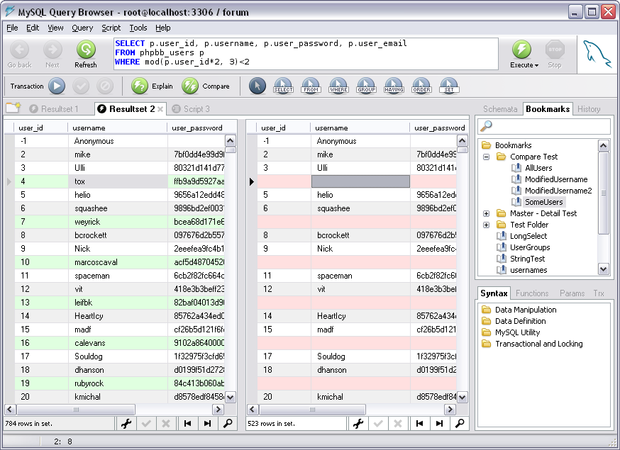
Management and Querying Tools(Cont.)
MySQL Query Browser(Cont.)
Easily Manage Multiple Queries using the Results Window

Slide 9
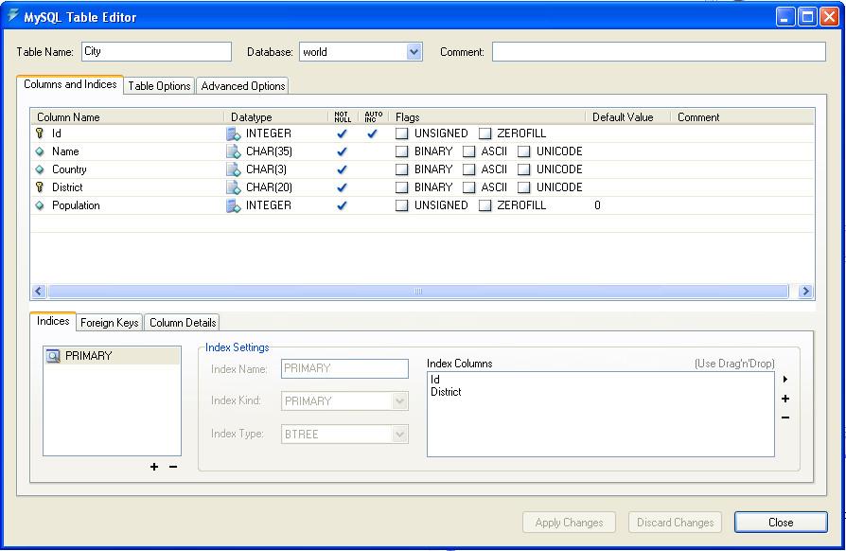
Management and Querying Tools(Cont.)
MySQL Query Browser(Cont.)
The MySQL Table Editor allows you to visually create and modify tables

Slide 10
Management and Querying Tools(Cont.)
MySQL Administrator
  A powerful visual administration console that enables you to easily administer your MySQL environment and gain significantly better visibility into how your databases are operating.
  By using MySQL Administrator you will be able to:
    Achieve higher database availability through improved management
    Reduce errors through visual database administration
    Lower database administration costs through improved productivity
    Deliver a more secure environment through easier privilege management

Slide 11
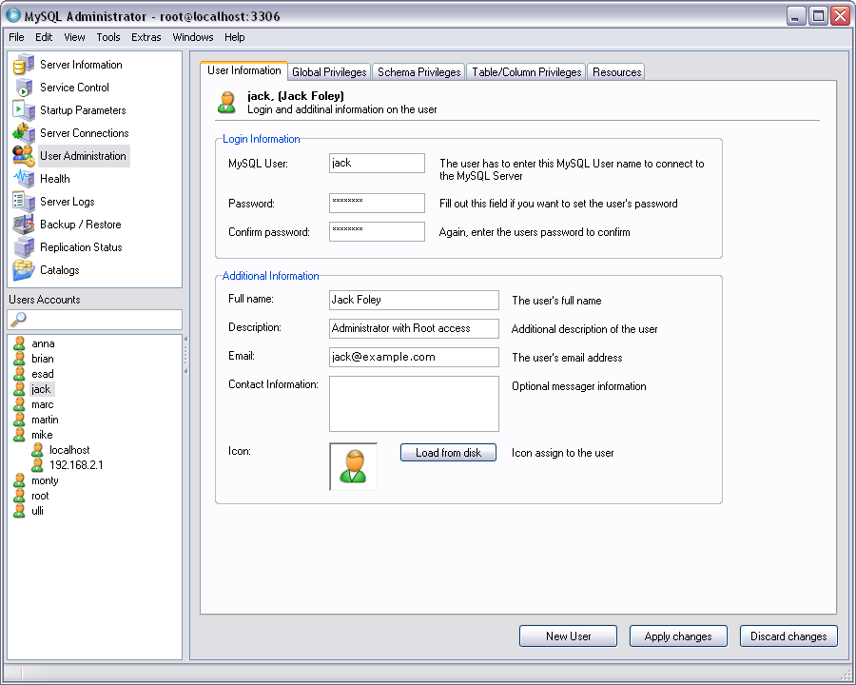
Management and Querying Tools(Cont.)
MySQL Administrator(Cont.)
User Administration in Minutes

Slide 12
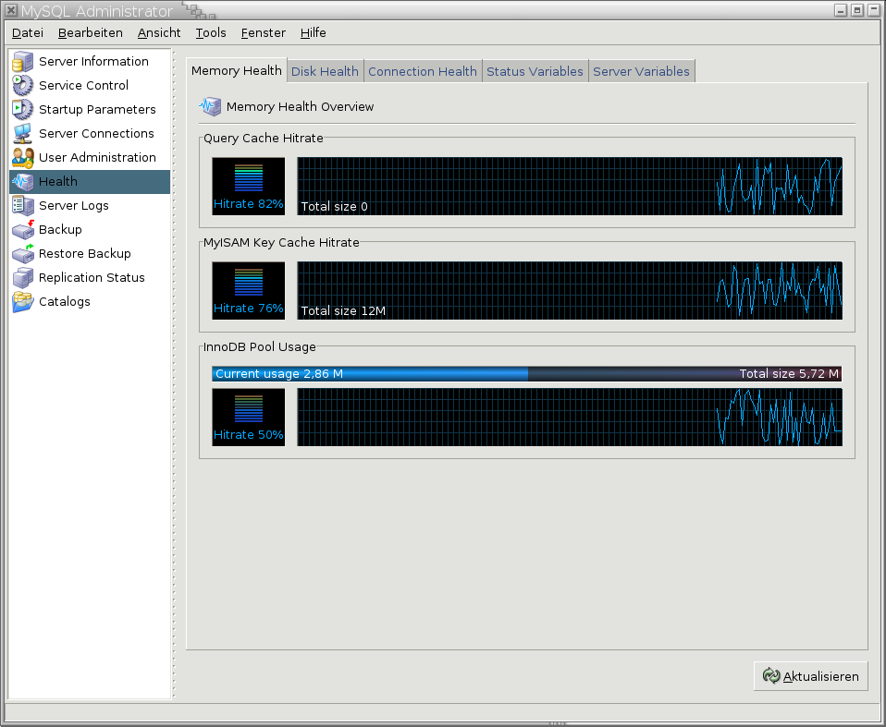
Management and Querying Tools(Cont.)
MySQL Administrator(Cont.)
Single View Dynamic Health Monitoring

Slide 13
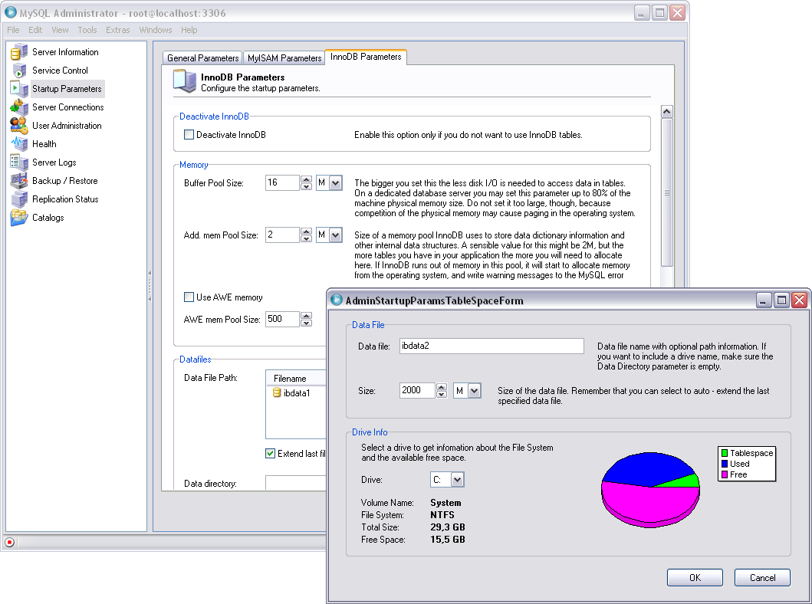
Management and Querying Tools(Cont.)
MySQL Administrator(Cont.)
Quickly Optimize MySQL

Slide 14
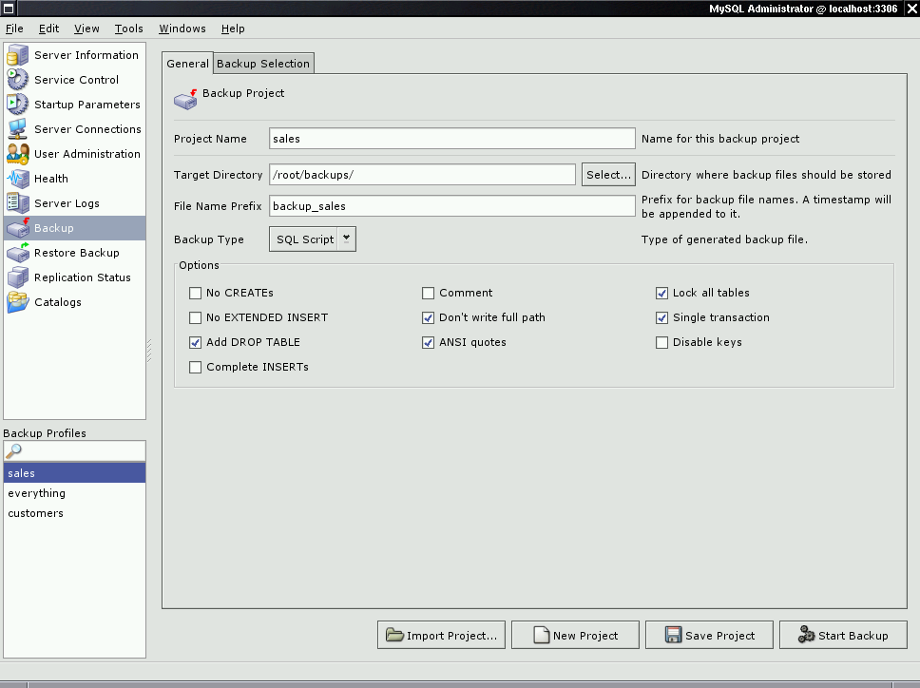
Management and Querying Tools(Cont.)
MySQL Administrator(Cont.)
Rapid Disaster Prevention and Recovery

Slide 15
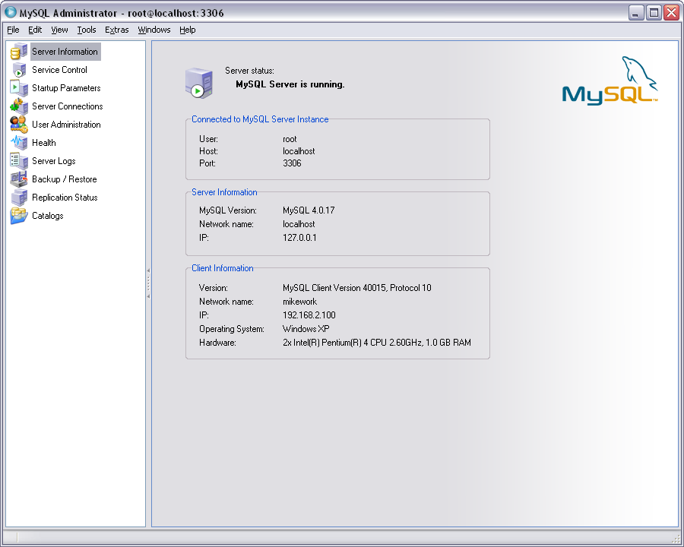
Management and Querying Tools(Cont.)
MySQL Administrator(Cont.)
Server Information At a glance

Slide 16
Management and Querying Tools(Cont.)
MySQL Migration Tookit
  A powerful framework that enables you to quickly migrate your proprietary databases to MySQL
  By using the Migration Toolkit, you will be able to
    Quickly migrate your databases including schema objects such as tables and views from Oracle, Microsoft SQL Server, Microsoft Access and other databases
    Reduce risk by using a proven migration methodology
    Save costs by using a using an integrated tool set to increase productivity
    Eliminate days of work required to manually write, test and debug scripts
    Customize the migration process and adapt the tool to your needs

Slide 17
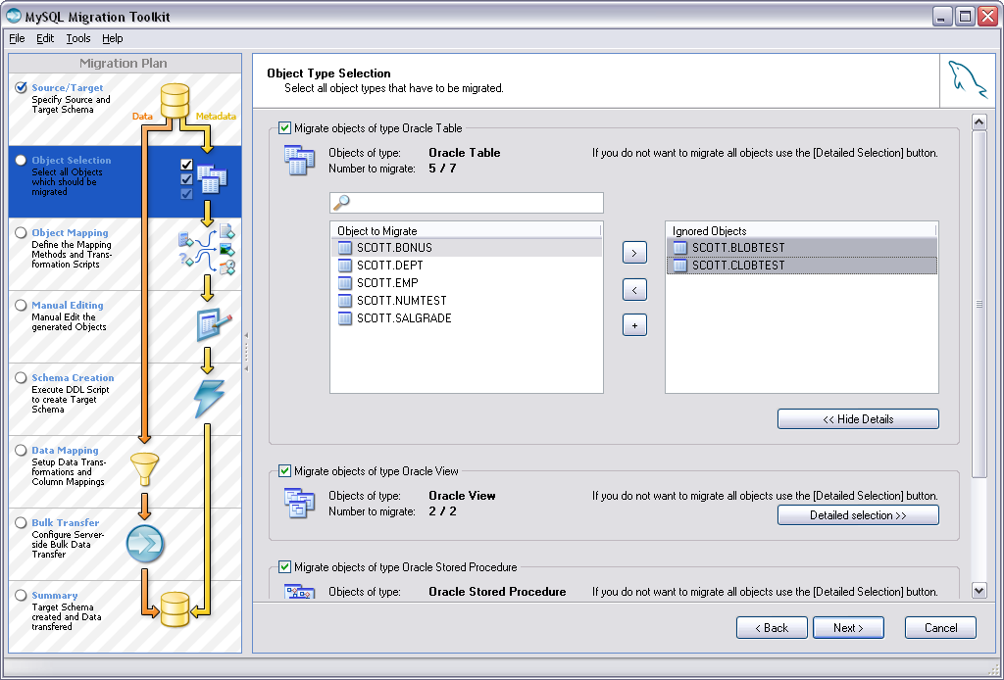
Management and Querying Tools(Cont.)
MySQL Migration Tookit(Cont.)
Intuitive, Easy to Use Environment Improves Productivity

Slide 18
Table of Contents
Introduction
Management and Querying Tools
SQL Variations and Extensions
Storage and Indexing
Query Processing and Optimization
Concurrency and Recovery
System Architecture
Replication
Summary

Slide 19
SQL Variations and Extensions
Standards Compliance
  ‘One of our main goals is to continue to work toward compliance with the SQL standard, but without sacrificing speed or reliabilty’
  The full ANSI/ISO SQL standard
  ODBC levels 0-3.51

Slide 20
SQL Variations and Extensions(Cont.)
SELECT INTO TABLE
  MySQL doesn’t support the syntax “SELECT … INTO TABLE …”
  Instead, support the syntax “INSERT INTO … SELECT …”
    INSERT INTO tbl_temp2 (fld_id)
      SELECT tbl_temp1.fld_order_id
      FROM tbl_temp1
      WHERE tbl_temp1.fld_order_id > 100;
    SELECT INTO OUTFILE ... or CREATE TABLE ... SELECT

Slide 21
SQL Variations and Extensions(Cont.)
Transactions and Atomic Operations
  InnoDB transactional storage engine
    Provide full ACID compliance
  Other non-transactional stroage engine(such as MyISAM)
    Follow a different paradigm for data integrity called “atomic operations”
    In transactional terms, always operate in AUTOCOMMIT=1 mode
  ※ You can decide whether your applications are best served
  by the speed of atomic operations or the use of transactional features.
  This choice can be made on a per-table basis.

Slide 22
SQL Variations and Extensions(Cont.)
Transactions and Atomic Operations(Cont)
  Reliability and integrity for non-transactional tables
    If you lock tables with LOCK TABLES,
    all updates stall until integrity checks are made.
    1. Use LOCK TABLES to lock all the tables you want to access.
    2. Test the conditions that must be true before performing the update.
    3. Update if everything is okay.
    4. Use UNLOCK TABLES to release your locks

Slide 23
SQL Variations and Extensions(Cont.)
Foreign Keys
  InnoDB Storage engine only support the foreign keys
  Offers several benefits but additional checking by server affects performance
  Other engines not supported
    To avoid the overhead, you can choose another type instead
    Keep the following considerations
      Foreign key relationship checking at the application level
      ON DELETE ▶multiple-table DELETE statements

Slide 24
SQL Variations and Extensions(Cont.)
Supported in 5.0
  Stored procedure
  Views
  Cursors
  Triggers

Slide 25
Table of Contents
Introduction
Management and Querying Tools
SQL Variations and Extensions
Storage and Indexing
Query Processing and Optimization
Concurrency and Recovery
System Architecture
Replication
Summary

Slide 26
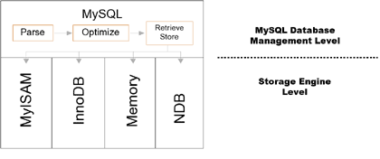
Storage and Indexing
Simplified high-level diagram of the MySQL server architecture

Slide 27
Storage and Indexing(Cont.)
Major Storage Engines
  MyISAM
    Disk based storage engine, for very low overhead
    Does not support transactions.
  InnoDB
    Disk based, but offers versioned, fully ACID transactional capabilities.
    More disk space than MyISAM to store its data, increased overhead
  Memory(HEAP)
    Storage engine that utilizes only RAM.
  NDB, the MySQL Cluster Storage engine
    Offering high availability through redundancy
    High performance through fragmentation (partitioning) of data across multiple node groups
    For the distributed computing environment.

Slide 28
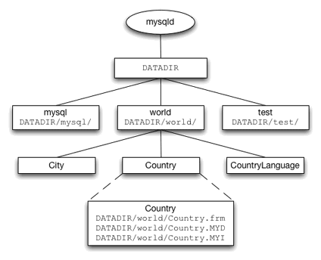
Storage and Indexing(Cont.)
MyISAM
  For an individual table
    .frm file : information about the table structure
    .MYD file : row data
    .MYI file: any indexes, some statistics about the table.

Slide 29
Storage and Indexing(Cont.)
MyISAM(Cont.)
  “Fixed” row format
    If the table structure does not contain any VARCHAR, TEXT or BLOB type columns.
    Each column has a fixed length, each row will be the same length.
    This makes any indexes smaller, and the overall system faster and more memory efficient.
  “Dynamic” row format
    If a table definition contains VARCHAR, TEXT or BLOB type columns.
    Rows may occupy a varying amount of space.
    Fragmentation of rows may occur, cause decreased performance.
    Periodical maintenance is therefore recommended.

Slide 30
Storage and Indexing(Cont.)
MyISAM(Cont.)
  “Compressed” row format
    Read-only.
    Created from a regular table using the myisampack tool,
    Compression ratio can be up to 75%.
    Row data is still directly accessible
  Indexing methods : BTREE, RTREE, and FULLTEXT
    Normally, BTREE indexes are used.
    RTREE indexes are used for indexing geographical (GIS) data
    FULLTEXT indexes are specifically tailored to the MySQL full text search system.
  With its simple architecture, MyISAM offers high performance with low overhead in terms of memory and disk utilization.

Slide 31
Storage and Indexing(Cont.)
MyISAM MERGE
  A MyISAM MERGE table does not contain any data itself,
  but instead refers to a number of identical underlying MyISAM tables.
  Operating like a UNION VIEW
    CREATE TABLE sales200401
    (saleid INT UNSIGNED NOT NULL PRIMARY KEY,
    dt DATETIME, INDEX (dt)) ENGINE=MyISAM;
    CREATE TABLE sales200402
    (saleid INT UNSIGNED NOT NULL PRIMARY KEY,
    dt DATETIME, INDEX (dt)) ENGINE=MyISAM;
    CREATE TABLE sales2004
    (saleid INT UNSIGNED NOT NULL PRIMARY KEY,
    dt DATETIME, INDEX (dt))
    ENGINE=MERGE UNION=(sales200401,sales200402);

Slide 32
Storage and Indexing(Cont.)
InnoDB
  Tablespace
    where all structure, table data and indexes are stored.
    can consist of one or more files, even raw disk partitions.
  Concurrency control
    complete support ACID transactions
    multi-versioning, row-level locking, foreign key constraints.
  Trade-off
    requires about three times as much disk space compared to MyISAM
    for optimal performance, lots of RAM is required for the buffer pool.
  Indexing
    BTREE indexes with a clustered primary-key.
    Internally, also automatically create hash indexes in RAM
    if it recognizes specific common query patterns.

Slide 33
Storage and Indexing(Cont.)
MEMORY(HEAP)
  Creates tables with contents that are stored in memory
  For a temporary table or lookup table
  Create a MEMORY table with an ENGINE or TYPE table option:
    CREATE TABLE t (i INT) ENGINE = MEMORY;
    or CREATE TABLE t (i INT) TYPE = HEAP;

Slide 34
Storage and Indexing(Cont.)
MEMORY(HEAP)(Cont.)
  The tables use 100% dynamic hashing (on inserting).
  But from MySQL version 4.1, can also have tree-based indexes
    CREATE TABLE lookup
    (id INT, INDEX USING HASH (id))
    ENGINE = MEMORY;
    CREATE TABLE lookup
    (id INT, INDEX USING BTREE (id))
    ENGINE = MEMORY;

Slide 35
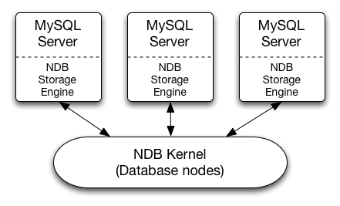
Storage and Indexing(Cont.)
MySQL Cluster(NDB)
  Does not directly manipulate data on a local storage medium
  Instead it connects to a cluster of database nodes,
  which can also be accessed by other MySQL servers

Slide 36
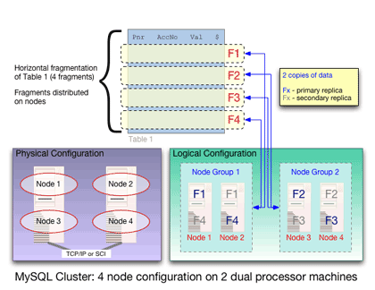
Storage and Indexing(Cont.)
MySQL Cluster(NDB)(Cont.)
  Cluster nodes are organized into groups.
  Table data is fragmented (partitioned) across the different groups.
  Main-memory based
  Synchronous replication is used between the nodes in a group, combined with a two-phase commit procedure across all groups.

Slide 37
Storage and Indexing(Cont.)
Comparision
MyISAM
InnoDB
MEMORY
NDB
Muti-statement transactions, ROLLBACK
-
○
-
○
Foreign key constraints
-
○
-
-
Locking Level
table
row
table
row
BTREE indexes
○
○
-
○
FULLTEXT indexes
○
-
-
-
HASH lookups
-
○
○
○
Othe in-memory tree-based index
-
-
4.1.0
-
GIS, RTREE indexes
4.1.0
-
-
-
Unicode
4.1.0
4.1.2
-
-
Merge(union views)
○
-
-
-
Compress read-only storage
○
-
-
-
Relative disk use
low
high
-
low
Relative memory use
low
high
low
high

Slide 38
Table of Contents
Introduction
Management and Querying Tools
SQL Variations and Extensions
Storage and Indexing
Query Processing and Optimization
Concurrency and Recovery
System Architecture
Replication
Summary

Slide 39
Query Processing and Optimization
Transformation
  When one query is changed into another query which delivers the same result
  Transfomation rules :
    Constant Propagation
      WHERE column1 = column2 AND column2 = 'x‘
      ▶ WHERE column1='x' AND column2='x'
    Dead Code Elimination
      WHERE 0=0 AND column1='y‘ ▶ WHERE column1='y'
    Constant Foliding
      WHERE column1 = 1 + 2 ▶ WHERE column1 = 3
    Etc.

Slide 40
Query Processing and Optimization(Cont.)
Query Execution Plan
  A combination of a fixed order in which tables are joined and the corresponding table access methods for each table
  Optimizer
    Cost : the number of rows that will be accessed while computing
    Goal : to find a QEP with minimal cost among all possible plans
    Depth-first search algorithm.

Slide 41
Query Processing and Optimization(Cont.)
MyISAM Key Cache
  MyISAM : row data and index data in separate files
    It’s easy to cache only the index data
  For index blocks, the key cache contains a number of block buffers where the most-used index blocks are placed
  Multiple threads can access the cache concurrently
  LRU replacement strategy

Slide 42
Table of Contents
Introduction
Management and Querying Tools
SQL Variations and Extensions
Storage and Indexing
Query Processing and Optimization
Concurrency and Recovery
System Architecture
Replication
Summary

Slide 43
Concurrency and Recovery
Transaction
  A sequence of related instructions that must be treated as one indivisible unit.
  Atomic because it cannot be broken down into parts
  and then it all gets processed or it all gets ignored.
  Very powerful, but if you use them when it's not required,
  it needlessly makes your application more complicated
  The default storage engine MyISAM does not support transactions, but InnoDB support transactions

Slide 44
Concurrency and Recovery(Cont.)
Transaction(Cont.)
  Queries intended to transfer $1000 from account 2 to account 1
    update account set balance = balance - 1000 where number = 2;
    update account set balance = balance + 1000 where number = 1;
  Run these two queries as a single transaction
    start transaction;
    update account set balance = balance - 1000 where number = 2;
    update account set balance = balance + 1000 where number = 1;
    commit;
    ※ START TRANSACTION = BEGIN = BEGIN WORK

Slide 45
Concurrency and Recovery(Cont.)
Transaction(Cont.)
  Use the keyword ROLLBACK if we wanted to cancel the whole transaction
    start transaction;
    update account set balance = balance - 1000 where number = 2;
    update account set balance = balance + 1000 where number = 1;
    select balance from account where number = 2;
    # select tells us that account #2 has a negative balance!
    # we'd better abort
    rollback;

Slide 46
Concurrency and Recovery(Cont.)
Transaction(Cont.)
  By Setting the autocommit mode – set autocommit=1;
    update account set balance = balance - 1000 where number = 2;
    update account set balance = balance + 1000 where number = 1;
    start transaction;
    update account set balance = balance - 1000 where number = 2;
    commit;
    start transaction;
    update account set balance = balance + 1000 where number = 1;
    commit;

Slide 47
Concurrency and Recovery(Cont.)
The InnoDB Trasaction Model
  To isolate transactions, InnoDB uses a row-level locking.
  ACID Compliance
    Atomicity
    Consistency
    Isolation
    Durability

Slide 48
Concurrency and Recovery(Cont.)
The InnoDB Trasaction Model(Cont.)
  Transaction Isolation Level Characteristics
    set transaction isolation level serializable;
Dirty
Read
Nonrepeatable
Read
Phantom
Read
Read
Uncommited
Possible
Possible
Possible
Read
Commited
Not
Possible
Possible
Possible
Repeatable
Read(default)
Not
Possible
Not
Possible
Possible
(but unlikely)
Serializable
Not
Possible
Not
Possible
Not Possible

Slide 49
Concurrency and Recovery(Cont.)
Recovering from Crashes
  Several type of crashes
    Operating system crash
    Power failure
    Filesystem crash
    Hardware problem (hard drive, motherboard, and so forth)

Slide 50
Concurrency and Recovery(Cont.)
Recovering from Crashes(Cont.)
  Case : Operating system crash, Power failure
    Assume the MySQL disk data is available after a restart
    InnoDB reads its logs
    and automatically rolls back those that were not committed,
    and flushes to its data files those that were committed.

Slide 51
Concurrency and Recovery(Cont.)
Recovering from Crashes(Cont.)
  Case : Operating system crash, Power failure(Cont.)
    Automatically recover by “fuzzy” checkpointing mechanism
InnoDB: Database was not shut down normally.
InnoDB: Starting recovery from log files...
InnoDB: Starting log scan based on checkpoint at
InnoDB: log sequence number 0 13674004
InnoDB: Doing recovery: scanned up to log sequence number 0 13739520
InnoDB: Doing recovery: scanned up to log sequence number 0 13805056
InnoDB: Doing recovery: scanned up to log sequence number 0 13870592
InnoDB: Doing recovery: scanned up to log sequence number 0 13936128
...
InnoDB: Doing recovery: scanned up to log sequence number 0 20555264
InnoDB: Doing recovery: scanned up to log sequence number 0 20620800
InnoDB: Doing recovery: scanned up to log sequence number 0 20664692
InnoDB: 1 uncommitted transaction(s) which must be rolled back
InnoDB: Starting rollback of uncommitted transactions
InnoDB: Rolling back trx no 16745
InnoDB: Rolling back of trx no 16745 completed
InnoDB: Rollback of uncommitted transactions completed
InnoDB: Starting an apply batch of log records to the database...
InnoDB: Apply batch completed
InnoDB: Started
mysqld: ready for connections

Slide 52
Concurrency and Recovery(Cont.)
Recovering from Crashes(Cont.)
  Case : Filesystem crash,Hardware problem
    Assume that the MySQL disk data is not available after a restart.
    Some blocks of disk data are no longer readable.
    It's necessary to reformat the disk, install a new one, or otherwise correct the underlying problem.
    Then it's necessary to recover our MySQL data from backups, which means that we must already have made backups.
    Let's step back in time and design a backup policy.

Slide 53
Concurrency and Recovery(Cont.)
Recovering from Crashes(Cont.)
  Backup Policy
    Assume that we make a backup on Sunday at 1 PM
      Full backups (a snapshot of the data at a point in time)
    mysqldump --single-transaction --all-databases > backup_sunday_1_PM.sql

Slide 54
Concurrency and Recovery(Cont.)
Recovering from Crashes(Cont.)
  Backup Policy(Cont.)
    To make incremental backups, we need to save the incremental changes.
    The MySQL server should always be started with the --log-bin option
-rw-rw---- 1 guilhem guilhem Nov 10 23:59 gbichot2-bin.000001
-rw-rw---- 1 guilhem guilhem Nov 10 23:59 gbichot2-bin.000002
-rw-rw---- 1 guilhem guilhem Nov 11 11:06 gbichot2-bin.000003
-rw-rw---- 1 guilhem guilhem Nov 11 11:08 gbichot2-bin.000004
-rw-rw---- 1 guilhem guilhem Nov 12 16:47 gbichot2-bin.000005
-rw-rw---- 1 guilhem guilhem Nov 14 10:08 gbichot2-bin.000006
-rw-rw---- 1 guilhem guilhem Nov 14 10:07 gbichot2-bin.index
1277324
4
79
508
220047446
998414
361

Slide 55
Concurrency and Recovery(Cont.)
Recovering from Crashes(Cont.)
  Backup Policy(Cont.)
    If you make sure to flush the logs when you make your full backup
    mysqldump --single-transaction --flush-logs --master-data=2
    --all-databases > backup_sunday_1_PM.sql
      gbichot2-bin.000001~6 ▶ gbichot2-bin.000007
    On Monday at 1 PM, we can create an incremental backup
    this will create gbichot2-bin.000008
    Backup files
Sunday at 1 PM
Monday at 1 PM
backup_sunday_1_PM.sql
gbichot2-bin.000007
gbichot2-bin.000008

Slide 56
Concurrency and Recovery(Cont.)
Recovering from Crashes(Cont.)
  Back to recovery from backups
    Now we have this crash
    mysql < backup_sunday_1_PM.sql
    To apply the incremental backups to it, just fetch these from the backup safe place and do:
    mysqlbinlog gbichot2-bin.000007 gbichot2-bin.000008 | mysql

Slide 57
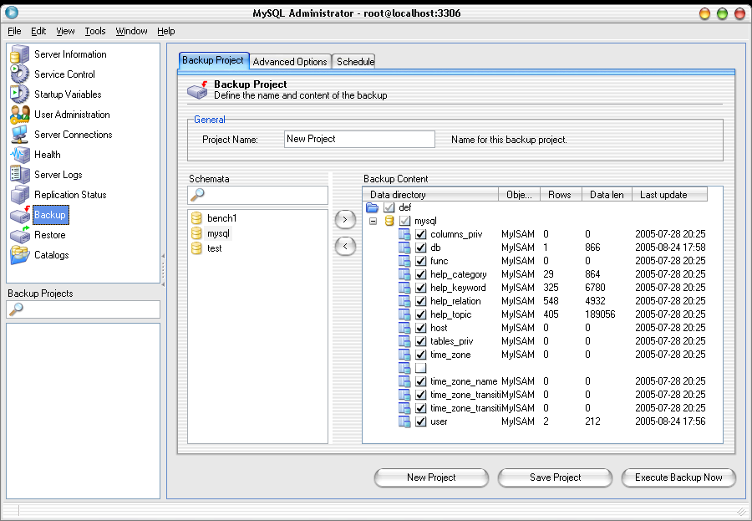
Concurrency and Recovery(Cont.)
Recovering from Crashes(Cont.)
  Backup and recovery by using MySQL Administrator util

Slide 58
Table of Contents
Introduction
Management and Querying Tools
SQL Variations and Extensions
Storage and Indexing
Query Processing and Optimization
Concurrency and Recovery
System Architecture
Replication
Summary

Slide 59
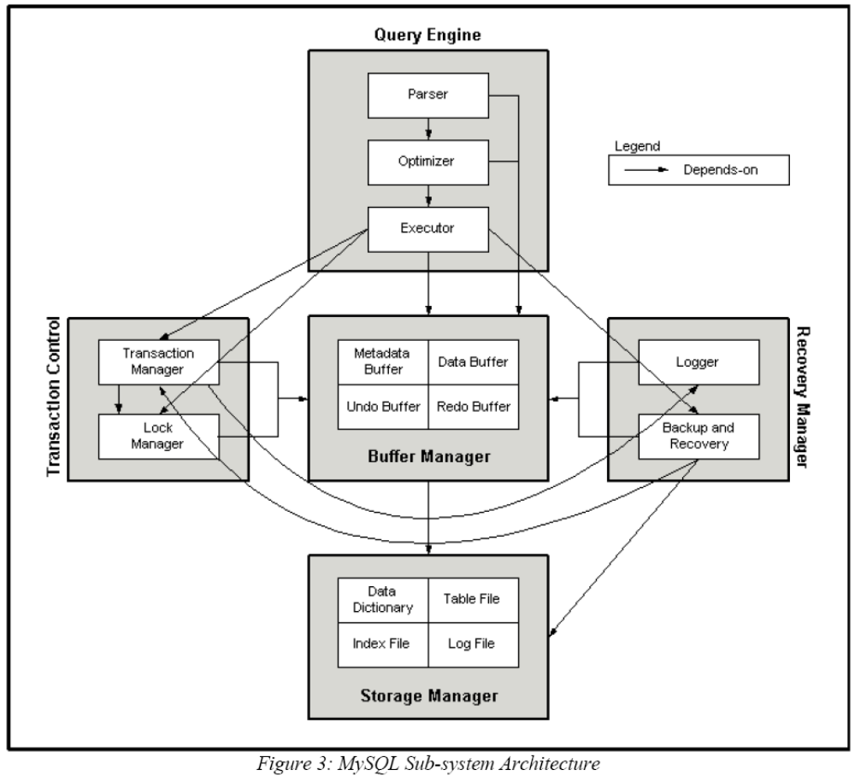
System Architecture

Slide 60
Table of Contents
Introduction
Management and Querying Tools
SQL Variations and Extensions
Storage and Indexing
Query Processing and Optimization
Concurrency and Recovery
System Architecture
Replication
Summary

Slide 61
Replication
Allowing the databases on one MySQL server to be duplicated on another
Problems Solved with Replication
  Data distrubution
  Load balancing
  Backup and recovery
  High availability and failover
Problems Not Solved with Replication
  Real-time data transmission
  Online ordering

Slide 62

Replication(Cont.)
Replication in 4.0
1. query
Master
Slave
I/O thread
read
4. relay log
2. Excute
update
update
append it to
5. master.info
3. binary log
SQL thread
6. Excute
7. Compare its result
to Master’s
update
Or fail
8. relay-log.info

Slide 63
Replication(Cont.)
Replication Architectures
  The replication rules
    Every slave must have a unique server ID.
    A slave may have only one master.
    A master may have many slaves.
    Slaves can also be masters for other slaves.

Slide 64
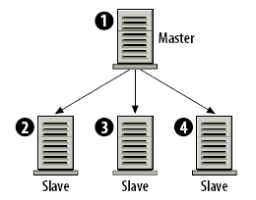
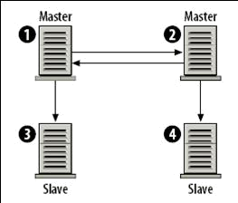
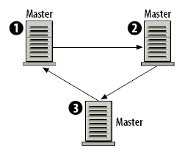
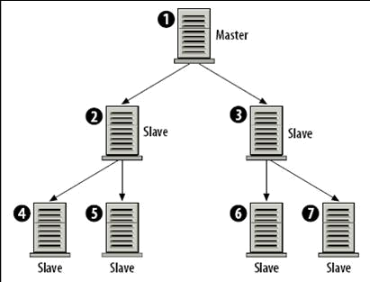
Replication(Cont.)
Replication Architectures(Cont.)
Simple master/slave replication
Dual master replication with slaves
A replication ring
or multi-master replication topology
A pyramid Design

Slide 65
Table of Contents
Introduction
Management and Querying Tools
SQL Variations and Extensions
Storage and Indexing
Query Processing and Optimization
Concurrency and Recovery
System Architecture
Replication
Summary

Slide 66
Summary
MySQL, the most popular Open Source SQL database management system, is developed, distributed, and supported by MySQL AB.
MySQL provides a comprehensive set of open source visual database tools including MySQL Administrator, MySQL Query Browser, and the MySQL Migration Toolkit.
These easy to use visual tools enable database developers and DBAs to be more productive.
One of MySQL main goals is to continue to work toward compliance with the SQL standard, but without sacrificing speed or reliability.

Slide 67
Summary(Cont.)
MySQL supports several storage engines that act as handlers for different table types.
You can choose how and where a database table is to be stored based on which storage engine is best suited for a particular situation.
The default storage engine MyISAM does not support transactions, but InnoDB support transactions.
For the cases of filesystem crashes or hardware problems, it's necessary to recover our MySQL data from backups, which means that we must already have made backups.
Data distrubution, load balancing, backup and recovery, high availability and failover are solved with replication.

Slide 68
Table of Contents
Introduction
Management and Querying Tools
SQL Variations and Extensions
Storage and Indexing
Query Processing and Optimization
Concurrency and Recovery
System Architecture
Replication
Summary

Slide 69
End of Chapter

