Slide 1
Interaction Diagrams
(Sequence & Collaboration Diagram)
© copyright 2001 SNU OOPSLA Lab.

Slide 2
Contents
What are interactions?
Core concepts
Diagram tour
When to model interactions
Modeling tips
Example: A Booking System

Slide 3
What are interactions?
Interaction: a collection of communications between instances, including all ways to affect instances, like operation invocation, as well as creation and destruction of instances
The communications are partially ordered (in time)

Slide 4
Interactions: Core Elements
Construct
Description
Syntax
Instance (object, data value, component instance etc.)
An entity with a unique identity and to which a set of operations can be applied (signals be sent) and which has a state that stores the effects of the operations (the signals).
name
attr values
Action
A specification of an executable statement.
A few different kinds of actions are predefined, e.g. CreateAction, CallAction, DestroyAction, and UninterpretedAction.
textual

Slide 5
Interaction: Core Elements (cont’d)
Construct
Description
Syntax
Stimulus
A communication between two instances.
Operation
A declaration of a service that can be requested from an instance to effect behavior.
textual
Signal
A specification of an asynchronous stimulus communicated between instances.
«Signal»
Name
parameters

Slide 6
Interaction: Core Relationships
Construct
Description
Syntax
Link
A connection between instances.
Attribute Link
A named slot in an instance, which holds the value of an attribute.
textual

Slide 7
Example: Instance
underlined name
triangle : Polygon
triangle : Polygon
center : Point = (2,2)
vertices : Point* = ((0,0), (4, 0), (2,4))
borderColor : Color = black
fillColor : Color = white
triangle
attribute links
: Polygon

Slide 8
Example: Instances and Links
: Family
Joe : Person
husband
wife
Jill : Person

Slide 9
Operation and Method
Triangle
foreach v in vertices do
v.x := v.x + dist.x;
v.y := v.y + dist.y
+ move (in dist : Point)
+ scale (in factor : Real)
foreach v in vertices do
v.x := factor * v.x;
v.y := factor * v.y

Slide 10
Interaction Diagram Tour
Show interactions between instances in the model
  graph of instances (possibly including links) and stimuli
  existing instances
  creation and deletion of instances
Kinds
  sequence diagram (temporal focus)
  collaboration diagram (structural focus)
  Sequence and collaboration diagrams typically capture the behavior of a single use case( realizes use case scenario! )

Slide 11
Interaction Diagrams
Sequence Diagram
Collaboration Diagram
x
y
z
1.1: a
1.2: c
a
x
y
b
1.1.1: b
c
z

Slide 12
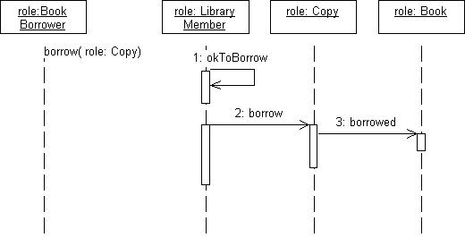
What is a Sequence Diagram
A sequence diagram shows the sequence of messages for a particular task from a use case diagram

Slide 13
What is a Sequence Diagram
Time passes as we move from top to bottom in the diagram.
An object ceases to have a live activation when it responds to the message that caused the activation.
If two objects exchange a message, there should be an association between their classes

Slide 14
Sequence Diagram Notation
object symbol
name : Class
other
lifeline
stimulus
name (…)
activation
new (…)
: Class
delete
return
create

Slide 15
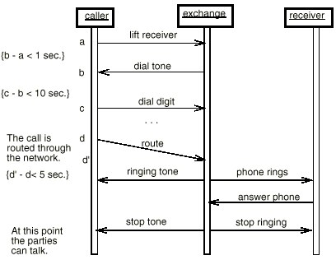
Sequence Diagram Notation
Object
Time constraint
Message
Activation
Comment

Slide 16
Sequence Diagram Notation
  An object is shown as a box at the top of a dashed vertical line.
  A vertical line represents the object’s lifetime.
  Each message is represented by an arrow between vertical lines of two objects. A message can be sent from an object to itself (known as recursion).
  The time sequence of messages is shown top to bottom on the page.
  A message can be sent iteratively to multiple recipient objects (denoted by *).
  A return from a message (of the type ‘procedure call’) is shown as a dashed arrow.
  A message pointing to an object means it creates the object.
  For concurrent processes, activations can be added to show when a method is active (i.e., executing or waiting for a return)

Slide 17
Arrow Label
predecessor guard-condition sequence-expression return-value := message-name argument-list
move (5, 7)
3.7.4: move (5, 7)
A3, B4 / [ x < 0 ] C3.1: res := getLocation (fig)
predecessor
guard
sequence number
message name
argument list
return value
3.7 *[1..5]: move (5, 7)
iteration
3.7 [ z > 0 ]: move (5, 7)
condition

Slide 18
Conditional Behaviors
  A guard condition, specified between brackets, can be shown for each message.
  The message is only sent when the specified guard condition is true. The condition can be also used to model branches.
  To avoid complicating the diagram with conditional behaviors, one can draw separate diagram for each scenario (i.e., use instance form instead of generic form).
  This is similar to splitting the use case using extends.
  Keep in mind that the beauty of interaction diagrams is simplicity. Use activity diagram to capture complex behaviors.

Slide 19
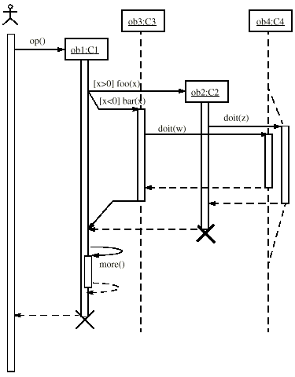
Conditional Behaviors
Object
creation
Guard condition
Branching
Recursion
Object
desctuction
Concurrent
lifelines
Return
Lifeline

Slide 20
Message Iteration
An asterisk (*) is used to mark a message that is send repeatedly
[I := 1..10] - the message will be send 10 times
[x < 10] - the message is send until x becomes less than 10
[ item not found] - message send until item is found

Slide 21
Different Kinds of Arrows
Procedure call or other kind of nested flow of control
(The sender losses control until the receiver finishes handling the message)
Flat flow of control(The sender does not expect a reply)
Explicit asynchronous flow of control(The sender does not expect a reply. The sender stays active and may send further messages)
Return
(Unblocks a synchronous send)

Slide 22
Example: Different Arrows
Nested Flow
Flat Flow
Asynchronous Flow
teller
: Order
: Article
caller
exchange
callee
appl
err handl
alarm
lift receiver
getValue
dial tone
unknown
price
alarm
dial digit
dial digit
getName
ringing tone
ringing signal
lift receiver

Slide 23
Recursion, Condition, etc.
calculator
filter
value
[ x > 0] getValue ()
[ x < 0] transform ()
getValue ()
iterate ()

Slide 24
When to Model Interactions
To specify how the instances are to interact with each other.
To identify the interfaces of the classifiers.
To distribute the requirements.

Slide 25
Interaction Modeling Tips
Set the context for the interaction.
Include only those features of the instances that are relevant.
Express the flow from left to right and from top to bottom.
Put active instances to the left/top and passive ones to the right/bottom.

Slide 26
Interaction Modeling Tips
Use sequence diagrams
  to show the explicit ordering between the stimuli
  when modeling real-time
Use collaboration diagrams
  when structure is important
  to concentrate on the effects on the instances

Slide 27
Example: A Booking System

Slide 28
Use Case Description: Change Flt Itinerary
Actors: traveler, client account db, airline reservation system
Preconditions: Traveler has logged in
Basic course:
  Traveler selects ‘change flight itinerary’ option
  System retrieves traveler’s account and flight itinerary from client account database
  System asks traveler to select itinerary segment she wants to change; traveler selects itinerary segment.
  System asks traveler for new departure and destination information; traveler provides information.
  If flights are available then …
  …
  System displays transaction summary.

Slide 29
Sequence Diagram: Change Flight Itinerary
Traveler
: Booking System
Client Account DBMS
Client Account DBMS
Airline Reservation System
change flight itinerary
get customer account
get itinerary
present itinerary
select segment
present detailed info
update information
available flight
:
:

Slide 30
Collaboration Diagram: Change Flt Itinerary
1: change flight itinerary
5: select segment
2: get customer account
3: get itinerary
7: update information
: Booking System
4: present itinerary
Traveler
6: present detailed info
Client Account DBMS
8: available flight
Airline Reservation System

Slide 31
Collaboration
What is a collaboration?
Core concepts
Diagram tour
When to model collaborations
Modeling tips
Example: A Booking System

Slide 32
What is a collaboration?
Collaboration: a collaboration defines the roles a set of instances play when performing a particular task, like an operation or a use case.
Interaction: an interaction specifies a communication pattern to be performed by instances playing the roles of a collaboration.

Slide 33
Collaboration Diagram
While sequence diagram emphasizes time sequence, collaboration diagram focus on static links among objects. One can be mapped from the other

Slide 34
Collaboration Diagram
A collaboration diagram contains:
  Objects, which interact to perform some task
  Links, which show associations between objects
  Actors, from the use case diagrams
A collaboration diagram only includes the objects, links, and actors that are relevant to the realization of a particular scenario

Slide 35
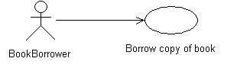
Collaboration Diagram
Consider the use case:

Slide 36
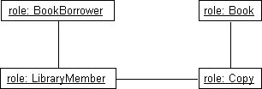
Collaboration Diagram
The realization of this use case may be shown in a collaboration diagram without showing interactions as follows:

Slide 37
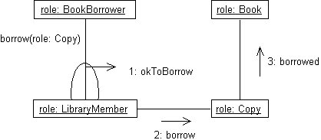
Collaboration Diagram
A collaboration diagram that shows the sequence of messages that pass between the linked objects is shown below

Slide 38
Collaboration Diagram
object symbol
link symbol
standard stereotype
stimulus
redisplay ()
window
: Controller
: Window
standard stereotype
standard constraint
window «parameter»
1: displayPositions (window)
1.1.3.1 add (self)
1.1 *[i := 1..n]: drawSegment (i)
wire
contents {new}
«local» line
{new}
: Line
wire :Wire
standard stereotype
1.1.2: create (r0, r1)
1.1.3: display (window)
«self»
standard constraint
1.1.1a: r0 := position ()
1.1.1b: r1 := position ()
left : Bead
right : Bead

Slide 39
Collaborations: Core Elements
Construct
Description
Syntax
Collaboration
A collaboration describes how an operation or a classifier, like a use case, is realized by a set of classifiers and associations used in a specific way.
The collaboration defines a set of roles to be played by instances and links, as well as a set of interactions that define the communication patterns between the instances when they play the roles.
Name

Slide 40
Collaborations: Core Elements (cont’d)
Construct
Description
Syntax
Classifier Role
A classifier role is a specific role played by a participant in a collaboration. It specifies a restricted view of a classifier, defined by what is required in the collaboration.
/ Name
Message
A message specifies one communication between instances. It is a part of the communication pattern given by an interaction.
label

Slide 41
Collaborations: Core Relationships
Construct
Description
Syntax
Association Role
An association role is a specific usage of an association needed in a collaboration.
Generalization
A generalization is a taxonomic relationship between a more general element and a more specific element. The more specific element is fully consistent with the more general element.

Slide 42
Classifier-Instance-Role Trichotomy
An Instance is an entity with behavior and a state, and has a unique identity.
A Classifier is a description of an Instance.
A Classifier Role defines a usage (an abstraction) of an Instance.
id
«originates from»
ClassName
«conforms to»
/ RoleName
«view of»

Slide 43
Classifier-Instance-Role Trichotomy (cont’d)
Classifier
ClassifierRole
Attribute-1
Attribute-2
Attribute-3
Attribute-1
Attribute-2
«originates from»
«conforms to»
Operation-1 (…)
Operation-3 (…)
Operation-1 (…)
Operation-2 (…)
Operation-3 (…)
Instance
AttributeValue-1
AttributeValue-2
AttributeValue-3
The attribute values of an Instance corresponds to the attributes of its Classifier.
All attributes required by the ClassifierRole have corresponding attribute values in the Instance.
All operations defined in the Instance’s Classifier can be applied to the Instance.
All operations required by the ClassifierRole are applicable to the Instance.

Slide 44
Different Ways to Name a Role
/ ClassifierRoleName : ClassifierName
A role name is preceeded by a ‘/’
A classifier name is preceeded by a ‘:’
Example:
/ Parent : Person
/ Parent
: Person
instanceName / ClassifierRoleName : ClassifierName
Example:
: Person
Charlie
Charlie : Person
Charlie / Parent
Charlie / Parent : Person

Slide 45
Association and Association Role
Class
Association
Class
Class-1
0..5
Class-2
{changeable}
«view of»
«view of»
«view of»
/ Role-1
{frozen}
3..4
/ Role-2
ClassifierRole
AssociationRole
ClassifierRole
An Association Role specifies the required properties of a Link used in a Collaboration.
The properties of an AssociationEnd may be restricted by a AssociationEndRole.

Slide 46
Example: A School
/ Teacher : Person
/ Student : Person
1 tutor
student *
position : Text
program : Text
faculty member *
1 lecturer
participant *
faculty 1
given course *
taken course *
: Faculty
: Course

Slide 47
Role Model vs. Class Model
The Classes give the complete description while the Roles specify one usage.
Role Model
Class Model
Resulting multiplicity
Extra attribute
/ Teacher : Person
1
*
/ Student : Person
Person
0..1
Resulting multiplicity
position : Text
program : Text
name : Text
position : Text
program : Text
*
1
*
*
*
0..1
1
*
1
*
*
*
*
: Faculty
: Course
Faculty
Course

Slide 48
A Collaboration and Its Roles
A Collaboration and how its roles are mapped onto a collection of Classifiers and Associations.
CollaborationName
roleName-1
roleName-3
roleName-2
Classifier-1
Classifier-2

Slide 49
Patterns in UML
Constraint that must
be fulfilled in each instance
of this pattern.
Handler.reading = length (Subject.queue)
Handler.range = {0..Subject.capacity}
Observer
Subject
Handler
CallQueue
SlidingBarIcon
queue : List of Call
source : Object
waitAlarm : Alarm
capacity : Integer
reading : Real
color : Color
range : Interval

Slide 50
Generalization Between Collaborations
Subject
Handler
CallQueue
Observer
SlidingBarIcon
Subject
Manager
ManagedQueue
Supervisor
Controller
All roles defined in the parent are present in the child.
Some of the parent’s roles may be overridden in the child.
An overridden role is usually the parent of the new role.

Slide 51
Collaboration Diagram Tour
Show Classifier Roles and Association Roles, possibly together with extra constraining elements
Kinds
  Instance level – Instances and Links
  Specification level – Roles
Static Diagrams are used for showing Collaborations explicitly

Slide 52
Collaboration Diagram at Specificaton Level
/ Teacher : Person
1 tutor
student *
/ Student : Person
position : Text
program : Text
faculty member *
1 lecturer
* participant
faculty 1
given course *
* taken course
: Faculty
: Course

Slide 53
Collaboration Diagram at Instance Level
student
tutor
Alice / Student
faculty member
John / Teacher
participant
faculty
tutor
Bob / Student
student
: Faculty
participant
taken course
taken course
faculty
lecturer
given course
Sara / Teacher
English : Course
faculty member

Slide 54
Collaborations including Interactions
Sequence Diagram
Collaboration Diagram
x
y
z
1.1: a
1.2: c
a
x
y
b
1.1.1: b
c
z

Slide 55
Roles on Sequence Diagrams
Sequence Diagram
/ X
/ Y
/ Z
a
b
c

Slide 56
Collaboration Diagram with Constraining Elements
/ Generator
: Printer Device
Constraining Element
(A Generalization is not
an AssociationRole )
: Laser Printer
: Line Printer

Slide 57
Static Diagram With Collaboration and Classifiers
Subject
Handler
CallQueue
Observer
SlidingBarIcon
Subject
Manager
ManagedQueue
Supervisor
Controller

Slide 58
When to Model Collaborations
Use Collaborations as a tool to find the Classifiers.
Trace a Use Case / Operation onto Classifiers.
Map the specification of a Subsystem onto its realization (Tutorial 3).

Slide 59
Collaboration Modeling Tips
A collaboration should consist of both structure and behavior relevant for the task.
A role is an abstraction of an instance, it is not a class.
Look for
  initiators (external)
  handlers (active)
  managed entities (passive)

Slide 60
Example: A Booking System

Slide 61
Use Case Description: Change Flt Itinerary
Actors: traveler, client account db, airline reservation system
Preconditions: Traveler has logged in
Basic course:
  Traveler selects ‘change flight itinerary’ option
  System retrieves traveler’s account and flight itinerary from client account database
  System asks traveler to select itinerary segment she wants to change; traveler selects itinerary segment.
  System asks traveler for new departure and destination information; traveler provides information.
  If flights are available then …
  …
  System displays transaction summary.

Slide 62
Booking System: Change Flt Itinerary Collaboration
4: get customer account
1: change flight itinerary
7: get itinerary
: Traveler
/ Flight Itenerary Form
/ DBMS Protocol
: Client Account DBMS
10: present
9: display
3: get customer account
2: create modifier
6: get itinerary
/ Flight Itinerary Modifier
5: create
8: create
/ Account
/ Itinerary
/ ARS Protocol
: Airline Reservation System

Slide 63
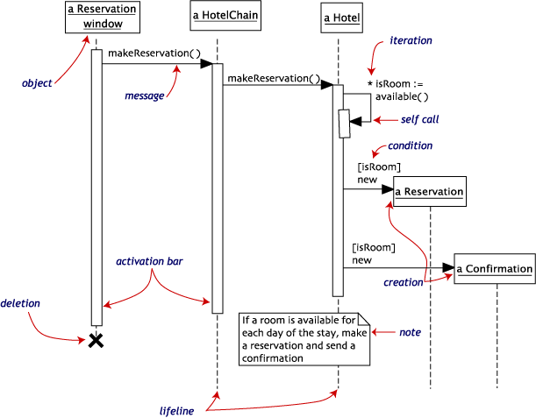
Example : Hotel Reservation

Slide 64
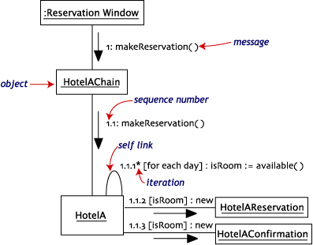
Example : Hotel Reservation

Slide 65
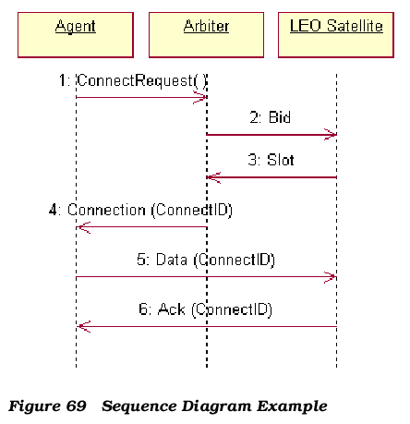
Example : Rational Rose Sequence Diagram

Slide 66
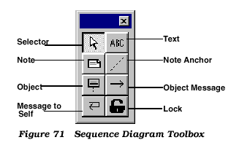
Example : Rational Rose Sequence Tool

Slide 67
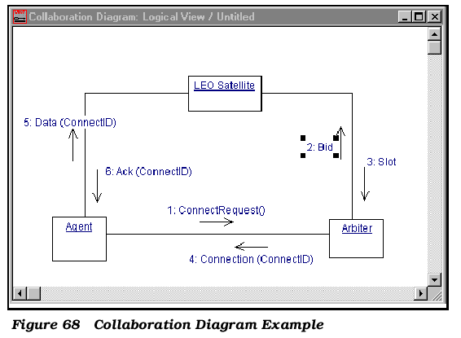
Example : Rational Rose Collaboration Diagram

Slide 68
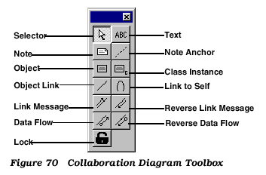
Example : Rational Rose Collaboration Tool

Slide 69
Wrap Up: Interactions & Collaborations
Instances, Links and Stimuli are used for expressing the dynamics in a model.
Collaboration is a tool for
  identification of classifiers
  specification of the usage of instances
  expressing a mapping between different levels of abstraction
Different kinds of diagrams focus on time or on structure

