Slide 1
Use Case Diagram
© copyright 2001 SNU OOPSLA Lab.

Slide 2
Contents - All
Introduction to UML
Use Case Diagram
Class & Object Diagram
Interaction Diagrams
State & Activity Diagram
Implementation Diagrams

Slide 3
Contents – Use Case Diagram
What are Use Cases
What are Actors
Actor Relationships
Use Case Scenario
Use Case Relationships
Use Case Diagram

Slide 4
Use Case Modeling
Use Cases
Actors
Relationships

Slide 5
What are Use Cases
People used typical scenarios to help them understand requirements
These scenarios were treated very informally – always done but rarely documented
Ivar Jacobson raised the visibility of the use case

Slide 6
What are Use Cases
Deposit money
use case
(complete functionality)
actor
…
…
system

Slide 7
What are Use Cases
Use Case Definition
  A complete functionality
  A set of sequences of actions a system performs that yield an observable result of value to a particular actor
  Actions
    communicating with a number of actors
    performing calculations
    work inside the system

Slide 8
What are Use Cases
Use Cases
  A use case is a typical interaction between a user and a computer system
  Use cases document the behavior of the system from the users' points of view
  A user might be a person, another information system, a hardware device, etc
  A user is external to the system

Slide 9
What are Use Cases
The characteristics of a use case are :
  A use case is always initiated by an actor
  A use case provides value to an actor
  A use case is complete

Slide 10
What are Use Cases
Uses of Use Cases
  Help capture system requirements
  Good for planning iterations of development
  Useful for validating the system
Use Cases Documentation
  A single use case represents a task that is required of the system
  Include a text description of each use case
  A use case diagram is a concise summary of the text descriptions

Slide 11
What are Use Cases
Example of Use Case
Use Case Naming
  Each use case has a unique name
  Name Type
    Simple name
    Path name
Use Case
Actor
Process loan
LoanOffice
name
Place Order
Simple name
Path name
Validate User
Sensors::
Caliblate location

Slide 12
What are Use Cases
Identifying Use Cases
  Which functions does the actor require from system?
  Does the actor need to read, create, destroy, modify, or store some kind of information in the system?
  Does the actor have to be notified about events in the system
  Could the actor’s daily work be simplified or made more efficient through new functions in the system

Slide 13
Contents – Use Case Diagram
What are Use Cases
What are Actors
Actor Relationships
Use Case Scenario
Use Case Relationships
Use Case Diagram

Slide 14
What are Actors
Actors
  An actor in a use case diagram represents a role that someone may play, not an individual user of the system
  The same person can be different actors
  Think about roles rather than people or job titles
  An actor is any person, organization, or system that interacts with application but is external to it
  Notation in a use case diagram
actor name

Slide 15
What are Actors
Identifying actors
  Useful questions
    Who will use the main functionality of the system(primary actors)?
    Who will need support from the system to do their daily tasks?
    Who will need to maintain, administrate, and keep the system working (secondary actors)?
    Which hardware devices does the system need to handle?
    With which other systems does the system need to interact?
    Who or what has an interest in the results (the value) that the system produces?

Slide 16
What are Actors
Identifying actors
  Generate a list of actors first, and then try to work out the use cases for each actor
  A user, who plays several different roles, is represented by several actors, one for each role
  Any human who interacts with the system will be represented by at least one role
  An actor can be an external system that needs some information from the current system

Slide 17
What are Actors
Actors representation
  Name
  Description
    actor가 무엇을 하고 누구인지를 표현한다
    actor가 왜 필요한가를 표현한다
    actor가 시스템에서 흥미로운 부분은 무엇인가를 표현한다
Example
  Actors in University Information System
    Enroll students in courses
    Output seminar enrolment lists
    Remove students from courses
    Produce student transcripts

Slide 18
What are Actors
Example(Cont.)
  Actors in University Information System
Input Marks
Professor
Enrol in Course
Student
Distribute Transcripts
Registrar

Slide 19
Contents – Use Case Diagram
What are Use Cases
What are Actors
Actor Relationships
Use Case Scenario
Use Case Relationships
Use Case Diagram

Slide 20
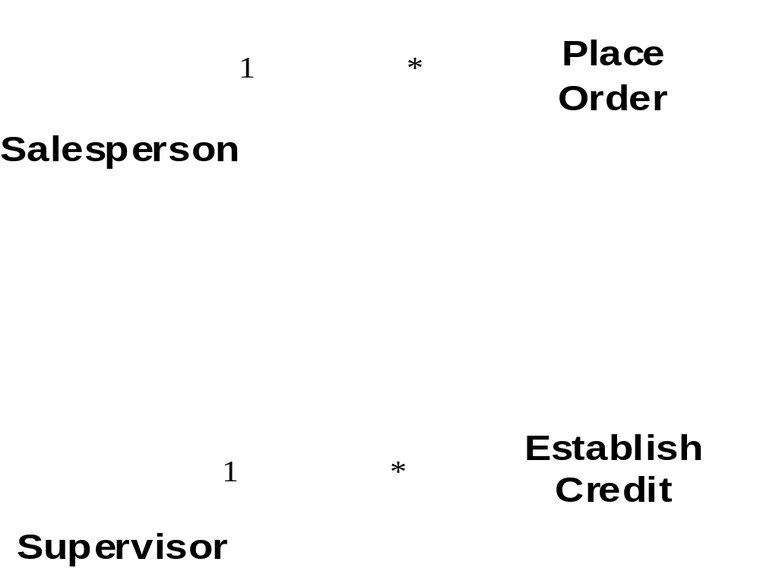
Actor Relationships
Relationships between actors
  Generalization
general superclass actor

Slide 21
Contents – Use Case Diagram
What are Use Cases
What are Actors
Actor Relationships
Use Case Scenario
Use Case Relationships
Use Case Diagram

Slide 22
Use Case Scenario
Use Case Scenario
  Use case scenario is a specific example of a use case
  A scenario is an instance of a use case, as an object is an instance of a class
  A use case describes a set of related scenarios
  For each use case:
    What are the possible scenarios?
    What are the rules for applying a particular scenario?
  To capture this information, a software engineer would use a textual description of the use case

Slide 23
Use Case Scenario
Use Case Scenario Example
  University Information System
    “Enroll students in courses” scenario
    A student wants to enroll in a course but they are missing a prerequisite
    A student wants to enroll in a course but the course is over-booked for the term
    A student wants to enroll in a course, they have the prerequisites and there is still room left

Slide 24
Contents – Use Case Diagram
What are Use Cases
What are Actors
Actor Relationships
Use Case Scenario
Use Case Relationships
Use Case Diagram

Slide 25
Use Case Relationship
Dependency and Inheritance
  A simple line between an actor and a use case means that that actor is expected to perform that use case( Association )
  A line with arrow head from an actor to an actor defines a special kind of actor : e.g, student, grad, undergrad( Generalization )
  A line with arrow head from a use case to a use case is labeled:
    <<extends>> : The bottom use case is a special way to do the more general task
    <<uses>> : The bottom use case is a larger task that includes the top use case as one step

Slide 26
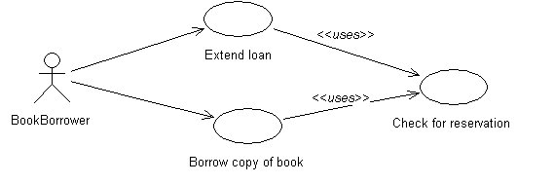
Use Case Relationship
Relationship between Use Cases
  The stereotype <<uses>>
    The <uses>> stereotype is when you can implement part of one or more of your use cases by using a component
    Check for reservation is a use case (sub-scenario) that is used by both Extend loan and Borrow copy of book
    Source use cases (Extend loan and Borrow copy of book) make use of the target use case, Check for reservation( have common behavior )

Slide 27
Use Case Relationship
Relationship between Use Cases
  Pitfalls of using the <<uses>> stereotype are:
    It may lead to top-down functional decomposition
    Maker it harder for the customer to understand use case diagrams
  Consider using a <<uses>> relationship between use cases
    to show how the system can use a pre-existing component
    to show common functionality between use cases
    to document the fact that the project has developed a new reusable component

Slide 28
Use Case Relationship
Relationship between Use Cases
  The stereotype <<extends>>
    A uses relationship : one use case always includes the behavior of another
    A extends relationship : one use case conditionally includes the behavior of another
    An extends relationship from use case A to use case B indicates that an instance of use case B may include the behavior specified by use case A
    An extending use case defines exceptional behavior for the use case it extends

Slide 29
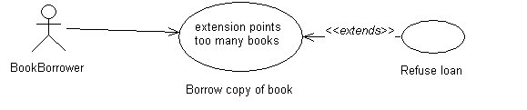
Use Case Relationship
Relationship between Use Cases
  The stereotype <<extends>>
    Extends is used to separate out a special case
    The central case is Borrow copy of book
    The less central case is Refuse loan
    The condition under which the exception applies is "too many books"

Slide 30
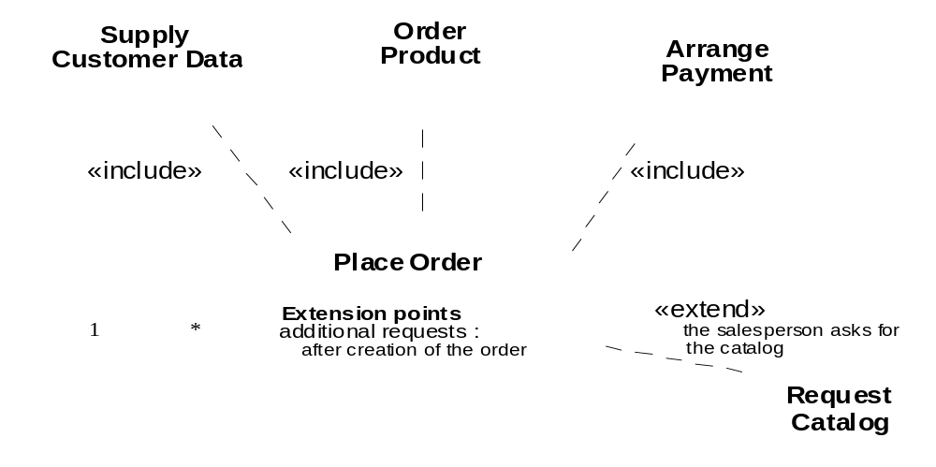
Use Case Relationship

Slide 31
Contents – Use Case Diagram
What are Use Cases
What are Actors
Actor Relationships
Use Case Scenario
Use Case Relationships
Use Case Diagram

Slide 32
Use Case Diagram
Use Case Diagram
  Show expected actors and use cases
  Show which actors do which use cases
  Show dependency and inheritance among use cases
Place phone
call
<<extend>>
Place
conference call
확장(Extend)
Cellular
network
Actor
Receive
phone call
<<extend>>
Receive
additional call
Use
scheduler
Use Case
User
System boundary
Association

Slide 33
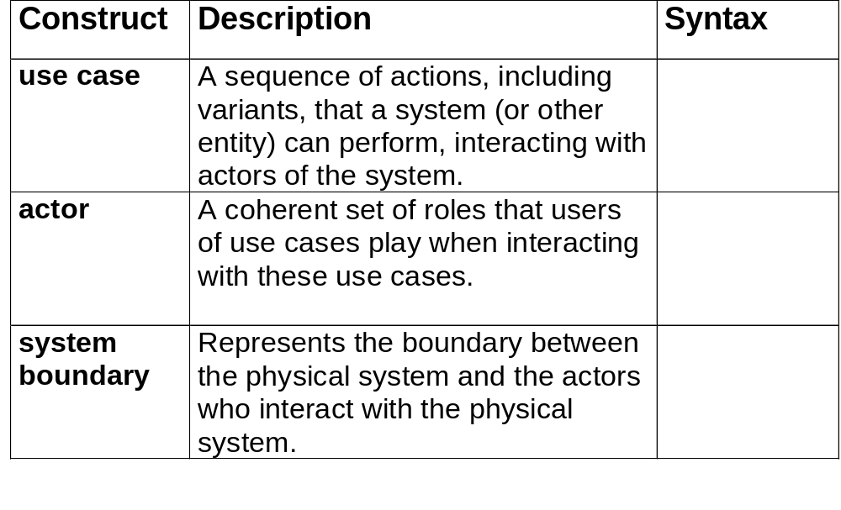
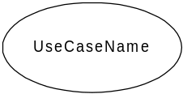
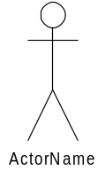

Use Case Modeling: Core Elements

Slide 34
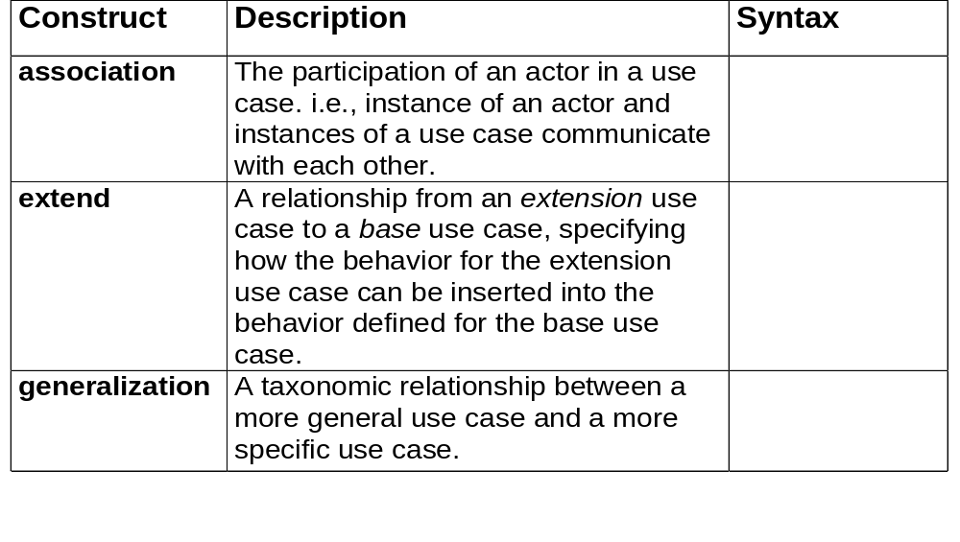
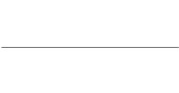


Use Case Modeling: Core Relationships
<<extend>>

Slide 35
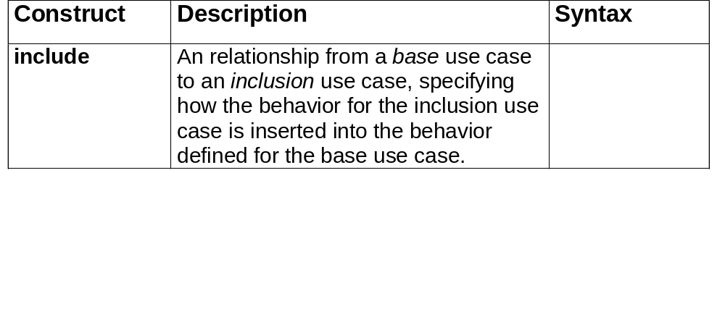
Use Case Modeling: Core Relationships (cont’d)
<<include>>

Slide 36
When to model use cases
Model user requirements with use cases.
Model test scenarios with use cases.
If you are using a use-case driven method
  start with use cases and derive your structural and behavioral models from it.
If you are not using a use-case driven method
  make sure that your use cases are consistent with your structural and behavioral models.

Slide 37
Use Case Modeling Tips
Make sure that each use case describes a significant chunk of system usage that is understandable by both domain experts and programmers
When defining use cases in text, use nouns and verbs accurately and consistently to help derive objects and messages for interaction diagrams (see Lecture 2)
Factor out common usages that are required by multiple use cases
  If the usage is required use <<include>>
  If the base use case is complete and the usage may be optional, consider use <<extend>>
A use case diagram should
  contain only use cases at the same level of abstraction
  include only actors who are required
Large numbers of use cases should be organized into packages

Slide 38
Describing Use Cases
Text Description
  External behavior of the system is important
  The text description should include :
    Objective for the use case : use cases are goal-oriented
    How the use case is initiated
    The flow of messages between actors and the use case
    Alternative flow in the use case : condition or exception
    How the use case finishes with a value to the actor

Slide 39
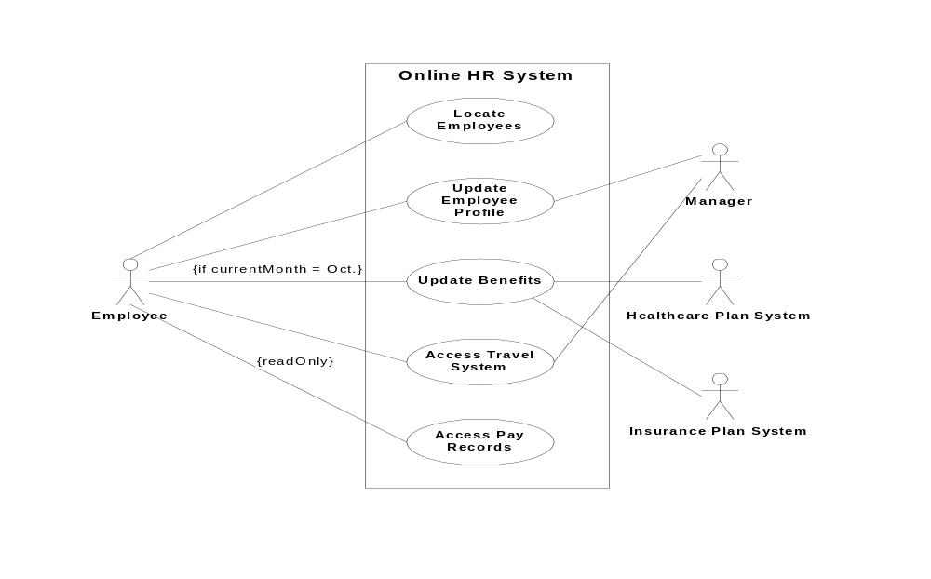
Example: Online HR System

Slide 40
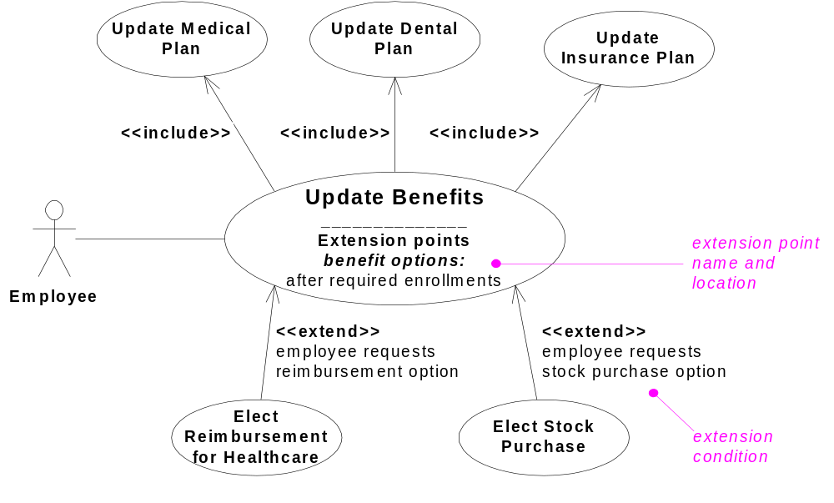
Online HR System: Use Case Relationships

Slide 41
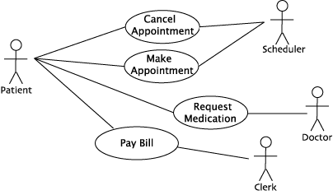
Example: Make Appointment

Slide 42
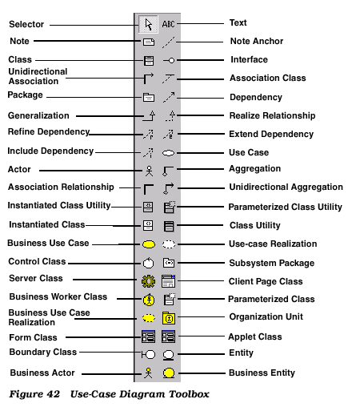
Example: Rational Rose Use Case Tool

