Slide 1
O’Reilly – Hadoop: The Definitive Guide Ch.6 How MapReduce Works
16 July 2010
Taewhi Lee

Slide 2
Outline
Anatomy of a MapReduce Job Run
Failures
Job Scheduling
Shuffle and Sort
Task Execution

Slide 3
Outline
Anatomy of a MapReduce Job Run
Failures
Job Scheduling
Shuffle and Sort
Task Execution

Slide 4
Anatomy of a MapReduce Job Run
You can run a MapReduce job with a single line of code
JobClient.runJob(conf)
But, it conceals a great deal of processing behind the scenes

Slide 5
Entities Being Involved in a MapReduce Job Run
Client
Submits the MapReduce job
Jobtracker
Coordinates the job run
Set through mapred.job.tracker property
Tasktrackers
Run the tasks that the job has been split into
Distributed file system (normally HDFS)
Used for sharing job files between the other entities

Slide 6
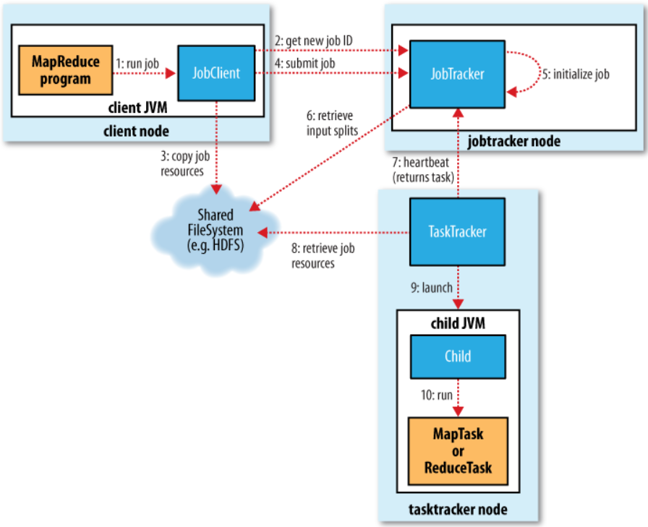
How Hadoop Runs a MapReduce Job
Step 1~4: Job submission
Step 5,6: Job intialization
Step 7: Task assignment
Step 8~10: Task execution

Slide 7
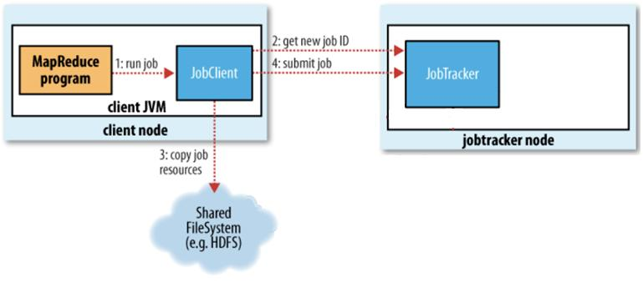
Job Submission
JobClient.runJob()
Creates a new JobClient instances¹
Calls submitJob()
JobClient.submitJob()
Asks the jobtracker for a new job ID (by calling JobTracker.getNewJobId()) ²
Checks the output specification of the job
Computes the input splits for the job
Copies the resources needed to run the job to the jobtracker’s filesystem ³
The job JAR file, the configuration file and the computed input splits
Tells the jobtracker that the job is ready for execution (by calling JobTracker.submitJob()) ⁴

Slide 8
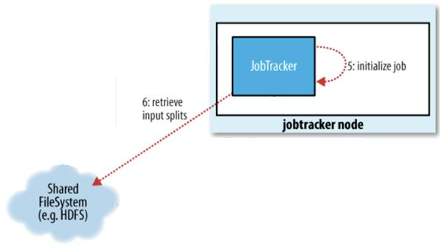
Job Initialization
JobTracker.submitJob()
Creates a new JobInProgress instances⁵
Represents the job being run
Encapsulates its tasks and status information
Puts it into an internal queue
The job scheduler will pick it up and initialize it from the queue
Job scheduler
Retrieves the input splits from the shared filesystem⁶
Creates one map task for each split
Creates reduce tasks to be run
The # of reduce tasks is determined by the mapred.reduce.tasks property
Gives IDs to the tasks

Slide 9
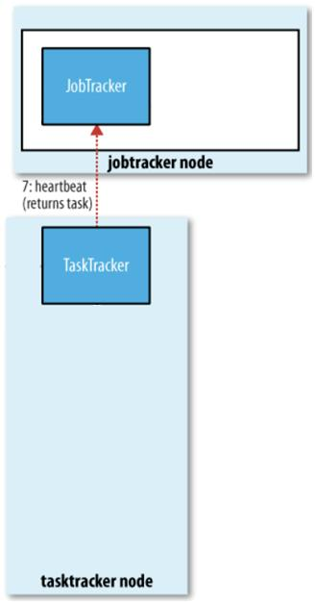
Task Assignment
Tasktrackers
Periodically send heartbeats to the Jobtracker⁷
Also send whether they are ready to run a new task
Have a fixed number of slots for map/reduce tasks
Jobtracker
Chooses a job to select the task from
Assigns map/reduce tasks to tasktrackers using the hearbeat values
For map tasks, it takes account of the data locality

Slide 10
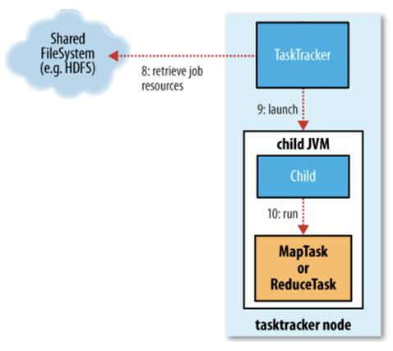
Task Execution
Tasktracker
Copies the job JAR from the shared filesystem⁸
Creates a local working directory for the task, and unjars the contents of the JAR into this directory
Creates an instance of TaskRunner to run the task
TaskRunner
Launches a new Java Virtual Machine(JVM)⁹
So that any bugs in the user-defined map and reduce functions don’t affect the tasktracker
Runs each task in the JVM
Child process informs the parent of the task’s progress every few seconds

Slide 11
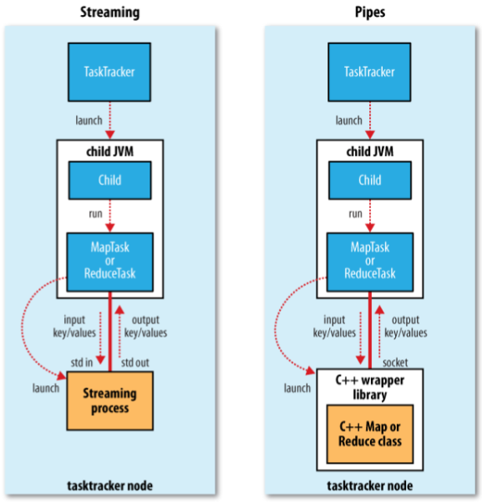
Task Execution – Streaming and Pipes
Run special map and reduce tasks to launch the user-supplied executable

Slide 12
Progress and Status Updates
It’s important for the user to get feedback on how the job is progressing
MapReduce jobs are long-running batch jobs
Progress – the proportion of the task completed
Map tasks – the proportion of the input that has been processed
Reduce tasks
The total progress is divided into three parts
Copy phase, sort phase, reduce phase
e.g., The task has run the reducer on half its input
A) the task’s progress = ⅚
Since it has completed the copy and sort phases (⅓ each) and is half way through the reduce phase (⅙)

Slide 13
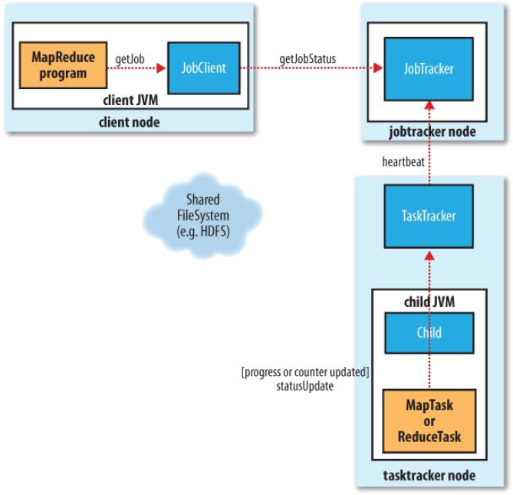
Progress and Status Updates
Polling every second

Slide 14
Job Completion
Jobtracker changes the status for a job to “successful” when it is notified that the last task for the job is complete
JobClient learns it by polling for status
The client prints a message to tell the user, and returns from the runJob()
Cleanup
The jobtracker cleans up its working state for the job, and instructs tasktrackers to do the same
e.g., to delete intermediate output

Slide 15
Outline
Anatomy of a MapReduce Job Run
Failures
Job Scheduling
Shuffle and Sort
Task Execution

Slide 16
Failures
Task failure
When user code in the map or reduce task throws a runtime exception
Tasktracker failure
When a tasktracker fails by crashing, or running very slowly
Jobtracker failure
When the jobtracker fails by crashing

Slide 17
Task Failure
Child task failing
Child JVM reports the error back to its parent tasktracker
Sudden exit of the child JVM
The tasktracker notices that the process has exited
Hanging tasks
The tasktracker notices that it hasn’t received a progress update for a while
The child JVM process will be automatically killed after this period (mapred.task.timeout property)

Slide 18
Task Failure (cont’d)
Tasktracker
Notifying the jobtracker of the failure using heartbeat
Jobtracker
Task rescheduling
If a task fails less or equal than four times (by default)
mapred.map.max.attempts and mapred.reduce.max.attempts properties
Job failure
If any task fails more than four times (by default)
This value can be configured
mapred.max.map.failures.percent
mapred.max.reduce.failures.percent

Slide 19
Tasktracker Failure
Jobtracker
Notices a tasktracker that has stopped sending heartbeats
Heartbeat interval to expire: mapred.tasktracker.expiry.interval (default: 10 mins)
Removes it from its pool of tasktrackers to schedule tasks on
Arranges for map tasks that were run and completed successfully
Intermediate output residing on the failed tasktracker’s local filesystem may not be accessible
Blacklist
A tasktracker is blacklisted if its task failure rate is significantly higher than the average’s on the cluster
Blacklisted tasktrackers can be restarted to remove them from the blacklist

Slide 20
Jobtracker Failure
Currently, Hadoop has no mechanism for dealing with failure of the jobtracker
Jobtracker failure has a low chance of occurring
The chance of a particular machine failing is low
Future work
Running multiple jobtrackers, only one of which is the primary jobtracker at any time
Choosing the primary jobtracker using ZooKeeper as a coordination mechanism

Slide 21
Outline
Anatomy of a MapReduce Job Run
Failures
Job Scheduling
Shuffle and Sort
Task Execution

Slide 22
Job Scheduling
FIFO scheduler (default)
Queue-based
Job priority
mapred.job.priority property (VERY_HIGH, HIGH, NORMAL, LOW, VERY_LOW)
No preemption
Fair scheduler
Pool-based
Each user gets their own pool, where jobs are placed in
A user who submits more jobs will not get any more cluster resources
Preemption support
Configuration
mapred.jobtracker.taskScheduler = org.apache.hadoop.mapred.FairScheduler

Slide 23
Outline
Anatomy of a MapReduce Job Run
Failures
Job Scheduling
Shuffle and Sort
Task Execution

Slide 24
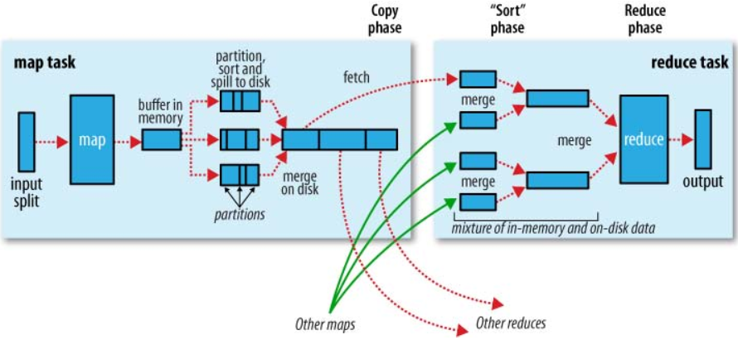
Shuffle and Sort

Slide 25
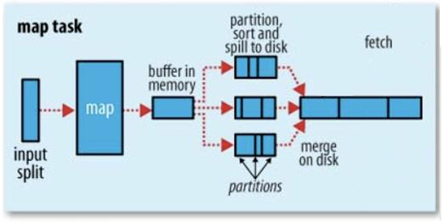
The Map Side
Buffering write
Circular memory buffer
Buffer size: io.sort.mb (default: 100MB)
A background thread spills the contents to disk when the contents of the buffer reaches a certain threshold
Threshold size: io.sort.spill.percent (default: 0.80 = 80%)
A new spill file is created each time
Partitioning and sorting
The background thread partitions the data corresponding to the reducers
The thread performs an in-memory sort by key, within each partition

Slide 26
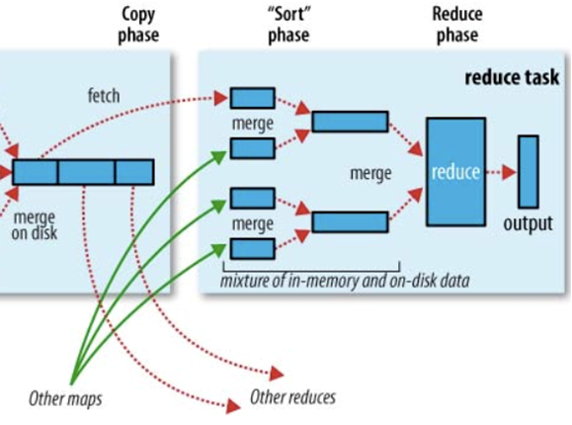
The Reduce Side
Copy phase
Map tasks may finish at different times
Reduce task starts copying their outputs as soon as each completes
# of copier thread: mapred.reduce.parallel.copies (default: 5)
The map outputs also written using memory buffer
Buffer size: mapred.job.shuffle.input.buffer.percent
Threshold size: mapred.job.shuffle.merge.percent
Threshold # of map outputs: mapred.inmem.merge.threshold
Sort phase (merge phase)
Map outputs are merged in rounds
Merge factor: io.sort.factor (default: 10)

Slide 27
Outline
Anatomy of a MapReduce Job Run
Failures
Job Scheduling
Shuffle and Sort
Task Execution

Slide 28
Speculative Execution
Job execution time is sensitive to slow-running tasks
Only one straggling task can make the whole job take significantly longer
Speculative task
Another, equivalent, backup task
Launched only after all the tasks have been launched
When a task completes successfully, any duplicate tasks that are running are killed

Slide 29
Task JVM Reuse
To reduce the overhead of starting a new JVM for each task
Effective case
Jobs have a large number of very short-lived tasks (these are usually map tasks)
Jobs have lengthy initialization
If tasktrackers run more than one task at a time, this is always done in separate JVMs

Slide 30
Skipping Bad Records
Handling in mapper or reducer code
Ignoring bad records
Throwing an exception
Using Hadoop’s skipping mode
When you can’t handle them because there is a bug in a third party library
Skipping process
Task fails
Task fails
Skipping mode is enabled Task fails but failed record is stored by the tasktracker
Skipping mode is still enabled Task succeeds by skipping the bad record that failed in the previous attempt
Skipping mode can detect only one bad record per task attempt
This mechanism is appropriate only for detecting occasional bad records

