Slide 1
Weighted Semantic PageRank Using RDF Metadata on Hadoop
ICOMP 2014
Jun 20, 2014
Hee-gook Jun

Slide 2
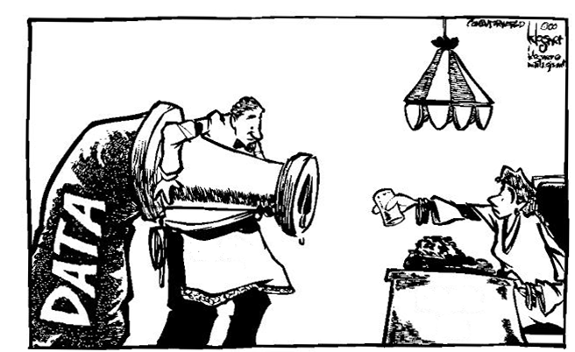
Information Abundance
Information Retrieval arising in Web
Obtaining data resources relevant to a user’s query
Available from: http://www.chemaxon.com/library/chemical-entity-extraction-using-the-chemicalize-org-technology [7 January 2014]
Notes:
Not data (search), but integration, analysis and insight, leading to decisions and discovery

Slide 3






Text-based Retrieval Method
Vector Space Model*
Web document as vector
vectorize
Similarity**
query "new apple iphone model"
(1, 1, 1, 1)
$$sim\left(A,B\right)=\cos\left(θ\right)=\frac{A∙B}{\left\|A\right\|\left\|B\right\|}$$
page1 “apple is good for health"
(0, 1, 0, 0)
$$θ$$
Term frequency***
page2 “new apple iphone"
(1, 1, 1, 0)
$$w_{x,y}={tf}_{x,y}×\log{(\frac{N}{{df}_{x}})}$$
page3 "new model released"
(1, 0, 0, 1)
${tf}_{x,y}$ = frequency of x in y
Term x within document y
${df}_{x}$ = number of documents containing x
$N$ = total number of documents
* | Salton G. et al., "A Vector Space Model for Automatic Indexing," Communications of the ACM, vol. 18 (11), pp. 613–620, 1975.
** | Roberto J. Bayardo et al., “Scaling up all Pairs Similarity Search”, Proceedings of the 16th international conference on World Wide Web, pp. 131-140, 2007.
*** | Salton G. and Buckley C., "Term-weighting approaches in automatic text retrieval," Information Processing and Management, vol. 24 (5), pp. 513–523, 1988.

Slide 4
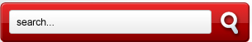

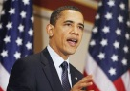





Text-based Retrieval Method: Problems
Unexpected search result
Misuse or abuse
Hidden text to advertise
Obama care
False positive results
Obama,US
President
Obama,US
President
Obama,US
President
Obama,US
President
Child
Care
ACA
Insurance
Shopping Mall
Most visited site
Best-product
High-quality
…
Notes:
ACA (Affordable Care Act)
mandatory insurance , medicare

Slide 5




PageRank*: Link-based Retrieval Method
Text-based approach
Random Surfer Model
Based on Markov chain model**
Following the link chain(85%) or new random start(15%)
text text
text
text
text text
text
text
text
text
text text
text text
text text
* | S. Brin and L. Page. , "The Anatomy of a Large-scale Hypertextual Web Search Engine," Computer Networks and ISDN Systems, Vol. 30 (1-7), pp. 107-117, 1998.
** | Markov A.A., "Extension of the limit theorems of probability theory to a sum of variables connected in a chain," John Wiley and Sons, 1971.

Slide 6
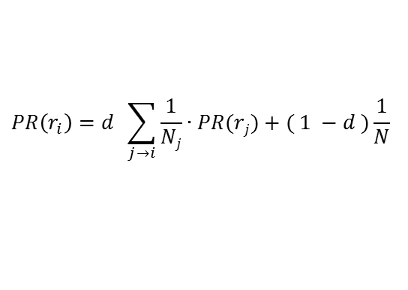
PageRank: Computation of Page Authority
Assumptions
Links often connect related pages
A link between pages is a recommendation
Current page’s authority
is a sum of previous page’s authority
Markov property
$$PR\left(r_{i}\right)=d \sum_{j→i}{\frac{1}{Nj}∙PR(rj)}+( 1 −d )\frac{1}{N}$$
Method for stochastic computation
page 1
authority score
page 2
authority score

Slide 7
Limitation of PageRank
Undistinguishable importance of link
Do not consider semantics of link
Unintended ranking result
(e.g.) Less important but highly ranked page
Ranking Result
c
d
[1]
[2]
[3]
[4]
d
b
a
c
0.460
0.358
0.323
0.252
meaningful link
b
a
meaningless link
Notes:
Hyperlink는 링크의 의도나 의미는 판단하지 않는다.
연결된 링크가 많을 수록 중요한 페이지일 것이라는 가정하에 PageRank를 계산한다.
특정 영역의 페이지들 간에 Cycle이 없다고 가정하면, Web surfer에겐 중요하다고 판단될 수 있는 앞 단의 페이지보다
그 페이지의 링크를 받은 뒤 페이지의 PageRank가 오히려 커질 수 있는 경우가 생길 수 있다.
예를 들면 b와 c가 Web surfer가 찾는 데이터가 있고 페이지 d는 단순한 사이트맵을 제공하는 페이지라고 보면
d로 가는 link들은 사이트 Structure 구성을 위한 링크이므로 데이터 측면에서는 useless link이다.

Slide 8
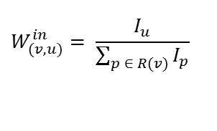


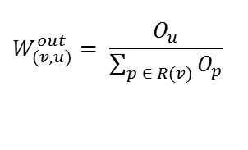
Weighted PageRank*
Importance of link
measured by in-links and out-links:
Limitation: algorithm is still based on the number of links
$$W_{(v, u)}^{in}= \frac{I_{u}}{\sum_{p ∈ R(v)}{I_{p}}}$$
$$W_{(v, u)}^{out}= \frac{O_{u}}{\sum_{p ∈ R(v)}{O_{p}}}$$
PR = 35
$$\frac{7}{10}$$
u
number of inlinks = 7
PR = 50
v
PR = 15
$$\frac{3}{10}$$
w
number of inlinks = 3
* | Wenpu Xing et al., “Weighted PageRank Algorithm”, Proceedings of the second annual conference on Communication Networks and Services Research (CNSR), IEEE, 2004

Slide 9


Improvement of PageRank
Weighted Page Content PageRank*
Improved weighted PageRank
Query-term matching based weighting
Text Mining
Total Pages
Topic-sensitive PageRank**
Utilize predefined topics
Provide query term relative ranking
Query ‘Health’
Query ‘Money’
Health Pages
Economic Pages
Personalized PageRank***
Biased Approach according to a user-specified set
* | SHARMA et al., "Weighted Page Content Rank for Ordering Web Search Result", International Journal of Engineering Science and Technology, Vol 2 (12), pp. 7301-7310, 2010
** | Taher Haveliwala, “Topic-sensitive PageRank,” In proceedings of the 11th international conference on World Wide Web, pp. 517-526, 2002
*** | Glen Jeh, Jennifer Widom, “Scaling Personalized Web Search,” In proceedings of the 12th international conference on World Wide Web, pp. 271-279, 2003

Slide 10
Our Approach: Weighted Semantic PageRank
Goal: more reasonable page ranking using semantic information
Key ideas
RDF Resource contains semantic information
RDF Graph has labeled links
Web Page Level Rank
(page to page)
Semantic Level Rank
O
O
O
O
O
S
S
(information to information)
O
O
S
O
O
S
Notes:
Contribution
1. 시멘틱 문제 영역으로 옮김
2. Link weight 줄수 있게 됨
3. Page 의 시멘틱 클러스터링을 가능케 함

Slide 11
Outline
Introduction
Related Work
Our Approach
Experiments
Conclusion

Slide 12
Web Semantic Metadata
Makes contents more connected and discoverable
Microformats* | Semantic markup using existing XHTML/HTML (microformats.org, 2005)
Microdata** | Specification to nest metadata within existing web content (W3C, 2010) Schema.org (2011): Bing, Google, and Yahoo!
RDFa*** | Express RDF data within XHTML (W3C, 2004 / recommended, 2008) Most extensible (specify a syntax only, free to use any vocabulary)
* | Rohit Khare, "Microformats: The Next (Small) Thing on the Semantic Web?," Journal IEEE Internet Computing archive, Vol. 10 (1), pp. 68-75, 2006.
** | W3C Working Group, "HTML Microdata," Available from: http://www.w3.org/TR/2011/WD-microdata-20110405/ [Accessed: 7 January 2014]
*** | W3C Working Group, "RDFa Core 1.1 - Second Edition," Available from: http://www.w3.org/TR/rdfa-syntax/ [Accessed: 7 January 2014]
Notes:
http://www.acquia.com/blog/semtechbiz-schemaorg-knowledge-graph-and-prospects-drupalhttp://www.acquia.com/blog/semtechbiz-schemaorg-knowledge-graph-and-prospects-drupal

Slide 13

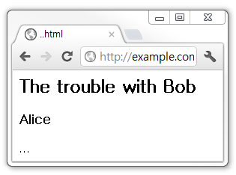
Web Semantic Metadata : RDFa
RDF based modeling language
Most extensible syntax
Facebook, White House, BBC, Newsweek, Best Buy, Drupal…
<div xmlns:dc=“http://purl.org/dc/elements/1.1/”>
<h2 property=“dc:title”>The trouble with Bob</h2>
<h3 property=“dc:creator”>Alice</h3>
...
</div>
HTML Parsing
RDF Parsing
http://example.com
/troubleWithBob
dc:title
dc:creator
The Trouble with Bob
Alice
Notes:
2008년에 XHTML에 RDFa를 적용하는 것에 대한 W3C Recommendation 이 생겼다.
구글과 야후도 RDFa 사용을 지원한다.
페이스북, 미국 백악관, BBC, Drupal(Content management System) 등에 RDFa가 적용되어 있다.
2011년 MS 빙, 구글, 야후가 같이 Semantic Annotation에 대한 Schema.org를 개설하였다.
앞으로도 HTML의 Semantic Annotation 분야가 계속 발전할 것으로 전망한다.

Slide 14
Outline
Introduction
Related Work
Our Approach
Overall System
1. Semantic Information Extraction
2. Construction of RDF Graph
3. ResourceRank
4. PageRank based on Resource Rank
Experiments
Conclusion

Slide 15
Overall System of Weighted Semantic PageRank
1. Semantic Information Extraction
2. Construction of RDF Graph
web page
RDF data
A
B
C
4. PageRank
3. ResourceRank
PageRank value based on ResourceRank score
Calculate rank value for each of Resources
<1> C 1.22
<2> B 0.61
<3> A 0.22
0.85
0.61
0.37
0.22

Slide 16
MapReduce Algorithm on Hadoop
Three job framework
First job: Compute ResourceRank
Second job: Compute WSPR
Third job: Sort WSPR
repeat until convergence
Input
Output
Map
Map
Map
Reduce
Reduce
Reduce
Job 1
Compute
ResourceRank
Job 2
Compute
WSPR
Job 3
Sort
WSPR

Slide 17
1. Semantic Information Extraction
RDFa Parsing: extract RDF data from Web pages
http://example.org/resource/LewisCarroll
<div about=”http://example.org/LewisCarroll” >
LewisCarroll was an English author. <br />
His famous writings are
<a rel=”foaf:made” href=”http://...wonderland”>
Alice’s adventures in wonderland</a>
and its sequel
<a rel=”foaf:made” href=”http://...looking-glass”>
Through the looking-glass</a>. <br />
Born: 27 January 1832,
<a rel=”dbp:birthPlace” href=”http://.../UK”>UK</a>
</div>
http://example.org/LewisCarroll
foaf:made
http://...wonderland
foaf:made
http://...looking-glass
dbp:birthPlace
http://.../UK
Notes:
1. 우선 웹 페이지에서 triple 구조를 추출해 낸다.
이 때 원래 어떤 web page에서 triple 구조를 얻어냈는지 context 정보까지 같이 저장을 한다.
그래야 마지막 랭크된 리소스들이 원래 어떤 페이지에서 온 것인지 기원을 찾아낼 수 있게 된다.

Slide 18
2. Construction of RDF Graph [1/2]
Construct RDF graph
http://example.org/LewisCarroll
foaf:made
http://...wonderland
foaf:made
http://...looking-glass
dbp:birthPlace
http://.../UK
Notes:
1. 우선 웹 페이지에서 triple 구조를 추출해 낸다.
이 때 원래 어떤 web page에서 triple 구조를 얻어냈는지 context 정보까지 같이 저장을 한다.
그래야 마지막 랭크된 리소스들이 원래 어떤 페이지에서 온 것인지 기원을 찾아낼 수 있게 된다.

Slide 19
2. Construction of RDF Graph [2/2]
Merge RDF graphs
Page 1
UK
Wonderland
birthPlace
made
LewisCarroll
made
LewisCarroll
Looking-glass
Looking-glass
Page 2
Looking-glass
Looking-glass
LewisCarroll
Lewis Carroll
creator
country
UK
Notes:
1. 우선 웹 페이지에서 triple 구조를 추출해 낸다.
이 때 원래 어떤 web page에서 triple 구조를 얻어냈는지 context 정보까지 같이 저장을 한다.
그래야 마지막 랭크된 리소스들이 원래 어떤 페이지에서 온 것인지 기원을 찾아낼 수 있게 된다.

Slide 20
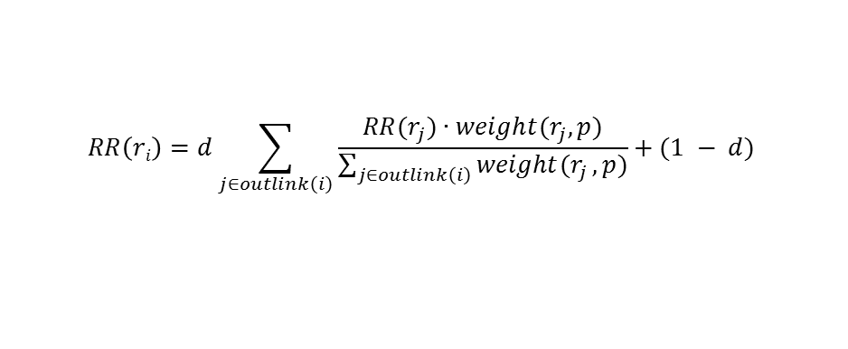

3. ResourceRank
Compute resource rank score
$$RR\left(ri\right)=d\sum_{j∈outlink\left(i\right)}{\frac{{RR(r}_{j})∙weight(r_{j},p)}{\sum_{j∈outlink\left(i\right)}{weight(r_{j}},p)}}+(1 − d)$$
$${weight}_{f}\left(r_{i},p\right)=PF\left(r_{i},p\right)×ICF\left(r_{i}, p\right)$$
Alice’s adventures in wonderland
country
UK
0.2
birthPlace
0.8
country
creator
made
followed by
Lewis Carroll
made
Through the looking-glass
creator
0.8
Notes:
2. Semantic Ranking
앞 단계에서 구한 RDF 그래프를 가지고 Semantic Ranking을 한다.
일반 PageRank와는 다르게 이제 Link에 Semantic이 있고, 이에 따라 Link에 중요도를 메길 수 있게 된다.
중요도는 Manual 하게 직접 입력하거나 automatic하게 정할 수 있다.
본 논문에서는 TF-IDF를 사용했다.

Slide 21
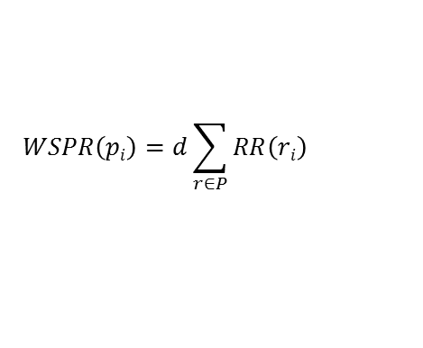
4. PageRank
Traditional PageRank
PageRank are sum of resource rank score
1
4
[1]
[2]
[3]
[4]
page 4
page 2
page 3
page 1
0.460
0.358
0.323
0.252
$$WSPR\left(pi\right)=d\sum_{r∈P}{RR\left(ri\right)}$$
2
3
page 1
0.412
0.352
page 4
Lewis Carroll
Alice’s adventures in wonderland
country
UK
Alice’s adventures in wonderland
Through the looking-glass
UK
UK
1.591
birthPlace
0.352
creator
made
country
followed by
page 2
page 3
Alice’s adventures in wonderland
made
Lewis Carroll
Through the looking-glass
Lewis Carroll
Lewis Carroll
Through the looking-glass
Through the looking-glass
UK
creator
UK
0.695
0.544
1.308
1.047
Notes:
2. Semantic Ranking
앞 단계에서 구한 RDF 그래프를 가지고 Semantic Ranking을 한다.
일반 PageRank와는 다르게 이제 Link에 Semantic이 있고, 이에 따라 Link에 중요도를 메길 수 있게 된다.
중요도는 Manual 하게 직접 입력하거나 automatic하게 정할 수 있다.
본 논문에서는 TF-IDF를 사용했다.

Slide 22
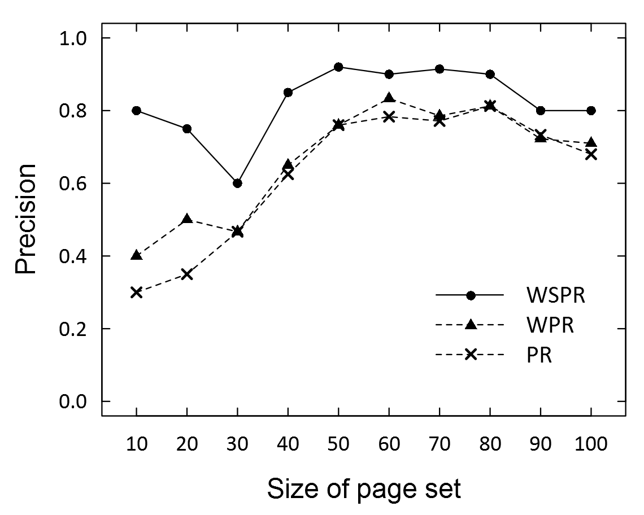
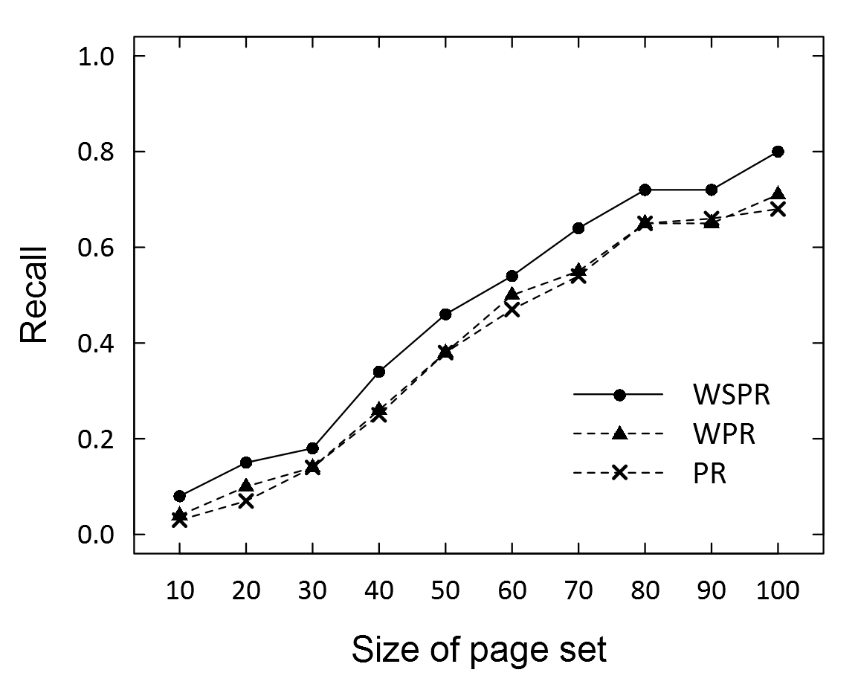
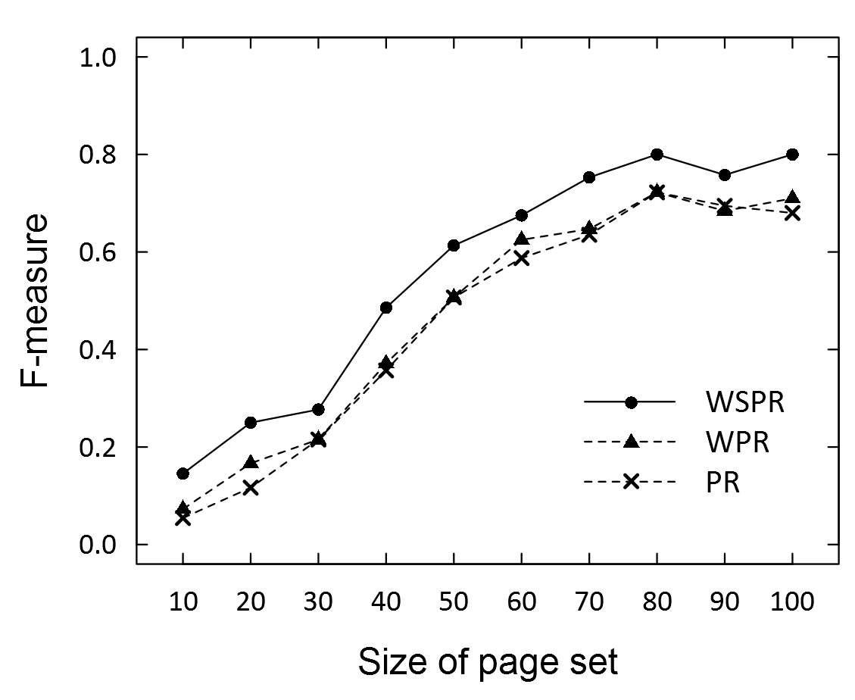
Experiments [1/2]
Run on Hadoop framework
One master node and eleven slave node (3.1GHz quad-core CPU, 4GB memory, 2TB HDD)
OS: Ubuntu 32bit 12.04.2
500,000 triple data (Wikipedia infobox)
Comparative analysis: General PageRank and Weighted Semantic PageRank
Precision, Recall, and F-measure of PageRank and Weighted Semantic PageRank for varying number of pages

Slide 23
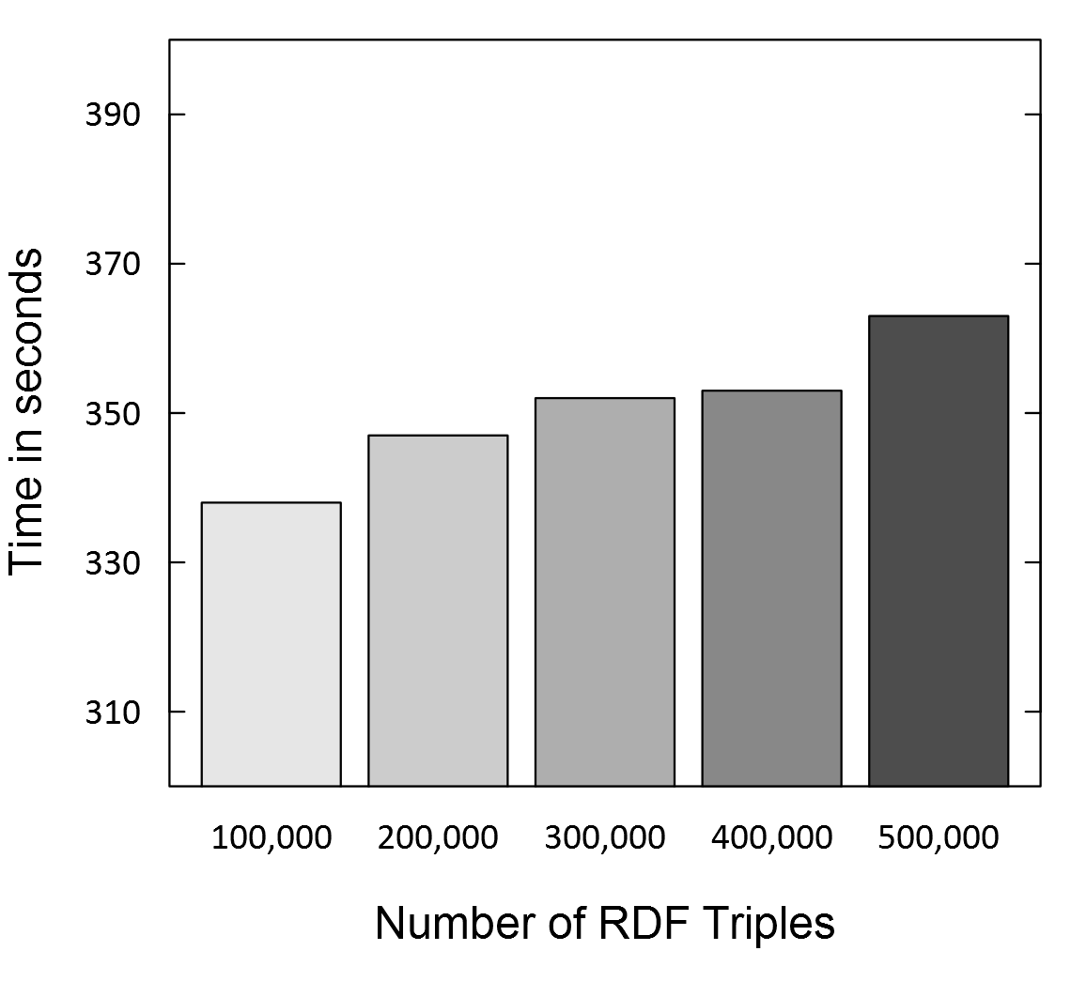
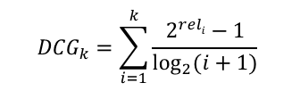

Experiments [2/2]
NDCG (Normalized Discounted Cumulative Gain)
Measures based on the graded relevance of the recommended entities
Elapsed time
varying the number of page’s triple data
NDCG@k results for the test query
$${DCG}_{k}=\sum_{i=1}^{k}{\frac{2^{reli}−1}{\log_{2}{(i+1)}}}$$
NDCG@k | PageRank | Weighted PageRank | Weighted Semantic PageRank
NDCG@5 | 0.8765 | 0.9838 | 0.9931
NDCG@8 | 0.8824 | 0.9469 | 0.9748
NDCG@10 | 0.8866 | 0.9389 | 0.9732
$${nDCG}_{k}=\frac{{DCG}_{k}}{{IDCG}_{k}}$$

Slide 24
Conclusion
Utilize semantic information for PageRank
Semantic-based retrieval method
Large-scale data processing using MapReduce algorithm
PageRank
Important page has many inlinks
Weighted Semantic PageRank
Important page contains many
important resources
R
R
R
R
R
R

Slide 25
Thank you

