Slide 1
R – project for Statistical Computing
October 31st, 2013
이재환

Slide 2
What is R?
Language and environment for statistical computing and graphics
GNU project
Completely FREE for everyone
Notes:
관사 주로 생략

Slide 3
Why R?
Good connectivity.
“R is suitable for statistical computing!”
Language Interface :
C, C++, FORTRAN, Java, Python, Tcl/tk, VB, Perl, Ruby
Application Interface:
Excel, Google earth, ArcView, COM/DCOM, etc
DB Interface:
ODBC (Oracle, MySQL, MS-SQL, PostgreSQL, …)
IDE:
Rstudio, eclipse, emacs, Bluefish, Crimson Editor, ConTEXT, Vim, Jedit,
Kate, TextMate, gedit, SciTE, WinEdt
Notes:
Be (has) 동사 주로 생략

Slide 4
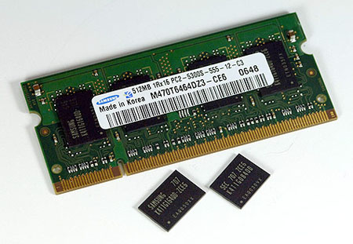

Limitations
In-Memory Computation
32 Bit Machine -> Maximum 4 GBytes
uses only 1 core for calculation
some packages for multi-core
processing
Images are from :
http://news.softpedia.com/newsImage/Infineon-And-Sony-Jointly-Design-DRAM-Modules-2.jpg/
http://www.comptalks.com/top-5-gaming-processors-from-intel-to-buy-in-2012/
Notes:
32bit -> 32 Bit
(There are)

Slide 5
Data types in R – Atomic data structures
Logical
Numeric : double, integer
Character
Complex : e.g) 4+2i
Raw : bytes value

Slide 6
Data types in R – other data objects
Vector : especially row vector
Matrices
Lists
Factors : to express categorical data
Data Frames

Slide 7
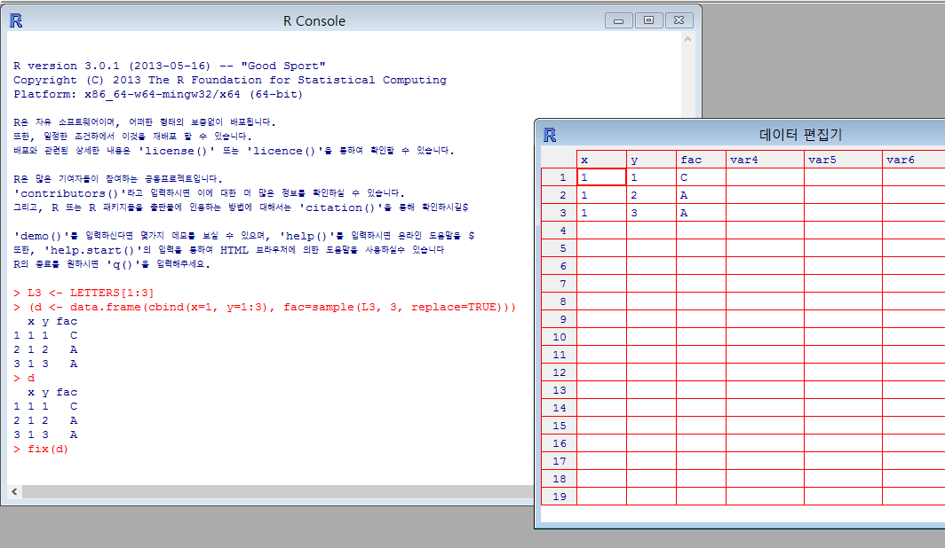
Data types in R – Data Frames
Like a table, spreadsheets in MS Excel

Slide 8
Data versus Big-Data
Sampling survey
(M, 20)
(M, 40)
(F, 70)
(F, 90)
(M, 30)
(F, 80)
Complete enumeration
(M, 40)
(M, 40)
(F, 70)
(남, 40)
(F, 90)
(M, 40)
(F, 80)
(F, 90)
(M, 40)
(M, 40)
(F, 70)
(F, 90)
(M, 40)
(F, 80)
……..

Slide 9
Big Data Analysis with R - Requirements
RHadoop
RHipe
Hive R Streaming : Hive + R

Slide 10
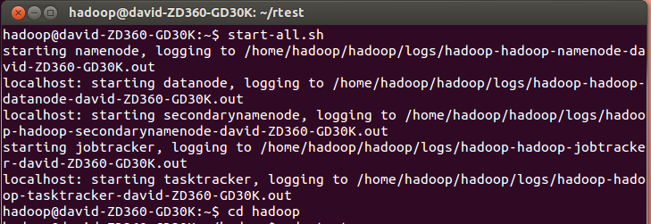
Big Data Analysis with R – start HDFS
First of all, start HDFS
(Word count Example)

Slide 11
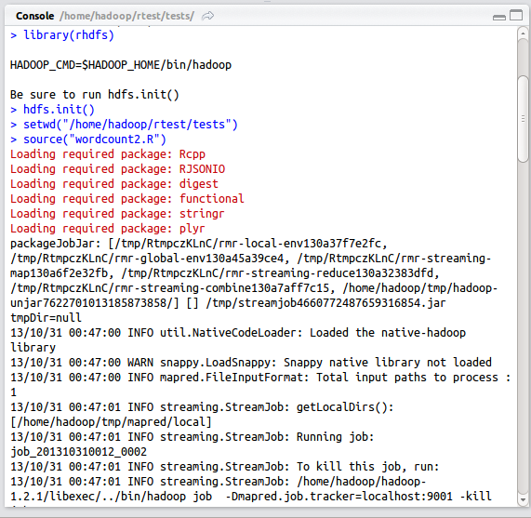
Big Data Analysis with R – load “rhdfs”
Load package “rhdfs”

Slide 12
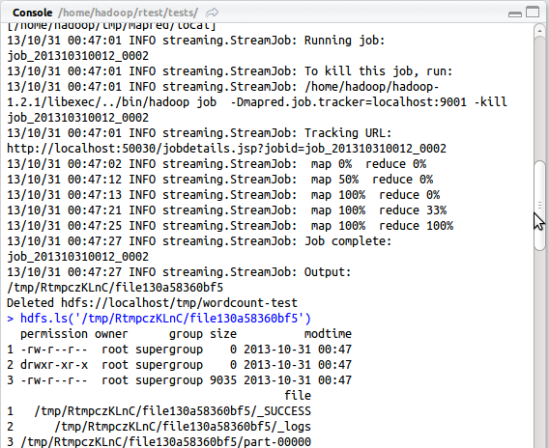
Big Data Analysis with R – using HDFS(1)
Map-Reduce Phase

Slide 13
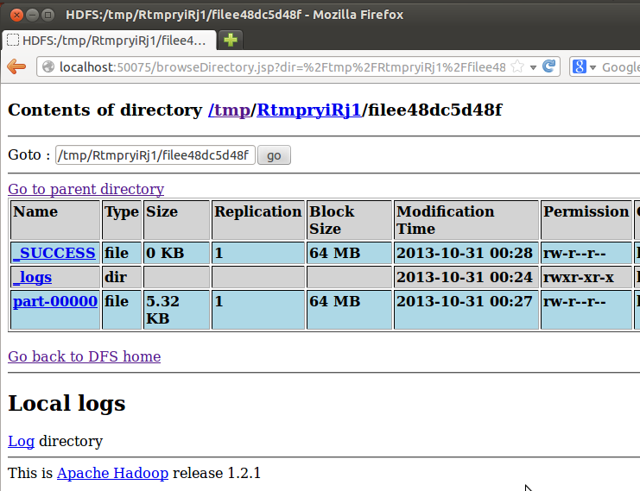
Big Data Analysis with R – using HDFS(2)
Result has been saved in HDFS

Slide 14
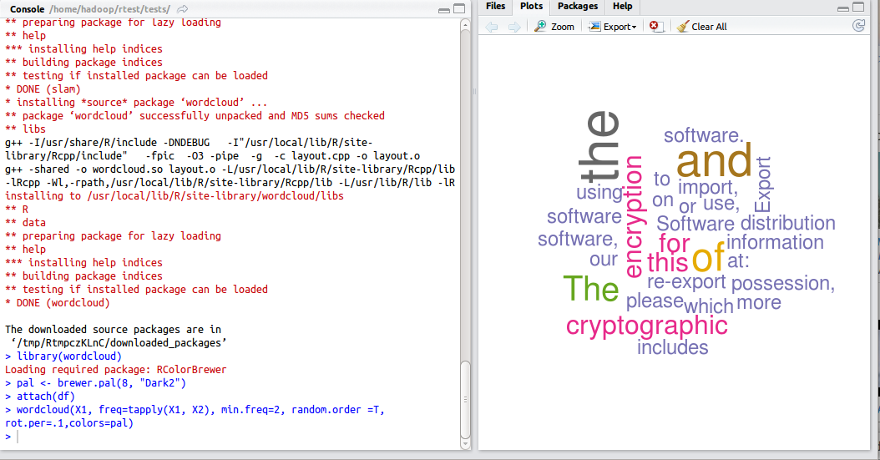
Big Data Analysis with R – Visualization
In this case, used “wordcloud”

Slide 15
SRC-Stat
October 31st, 2013
이재환

Slide 16
What is SRC-Stat?
based on ‘R’
completely free for anyone
sponsored by SNU Big Data Center
developed by SE Lab & Data Science for Knowledge Creation Research Center
You can download it, HERE
http://srcdsc.snu.ac.kr/srcstat/

Slide 17
Requirements
R
Windows O/S

Slide 18
Statistical Test
Is there any difference between men’s sensitivity and women’s?
Null hypothesis (H0) : There isn‘t.
The Average of men’s = The Average of women’s
Alternative hypothesis (H1): There is.
The Average of men’s!= The Average of women’s
(M, 20)
(M, 40)
(F, 70)
(F, 90)
(M, 30)
(F, 80)

Slide 19
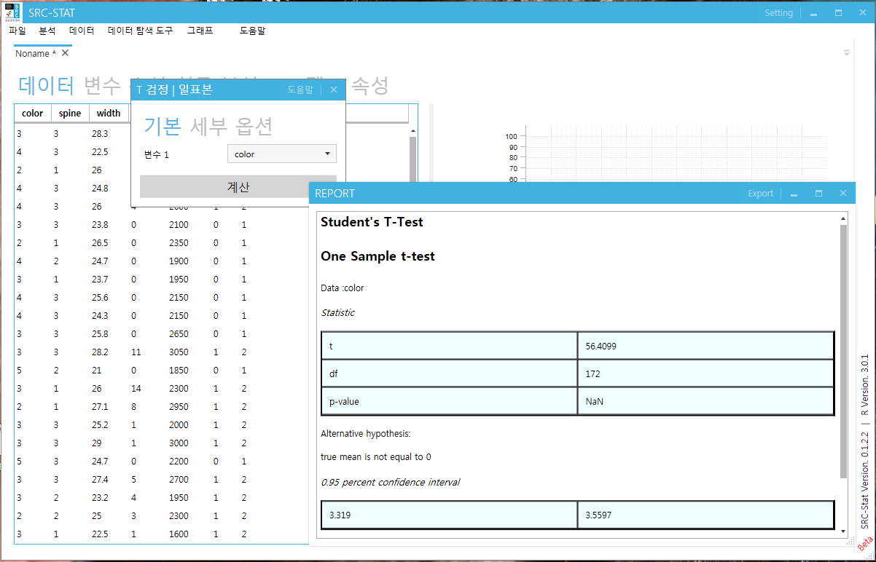
Example : One Sample t-test

