Slide 1
JDBC
(Java Database Connectivity)
SNU OOPSLA Lab.
October 2005

Slide 2
Contents
Overview
  History of JDBC
  JDBC Model
  JDBC Driver Type
JDBC Programming Steps
  Step 1 : Loading a JDBC Driver
  Step 2 : Connecting to a Database
  Step 3 : Executing SQL
  Step 4 : Processing the Results
  Step 5 : Closing Database Connection
The PreparedStatement Object
Transaction and JDBC
Summary
Online Resources

Slide 3
Overview (1/2)
JDBC
  JDBC is a standard interface for connecting to relational databases from Java
  The JDBC Classes and Interfaces are in the java.sql package
  JDBC is Java API for executing SQL statements
    Provides a standard API for tool/database developers
    Possible to write database applications using a pure Java API
    Easy to send SQL statements to virtually any relational database
What does JDBC do?
  Establish a connection with a database
  Send SQL statements
  Process the results
JAVA Applet/
Application
JDBC Driver
Database
Command
Database
JDBC Call

Slide 4
Overview (2/2)
Reason for JDBC
  Database vendors (Microsoft Access, Oracle etc.) provide proprietary (non standard) API for sending SQL to the server and receiving results from it
  Languages such as C/C++ can make use of these proprietary APIs directly
    High performance
    Can make use of non standard features of the database
    All the database code needs to be rewritten if you change database vendor or product
  JDBC is a vendor independent API for accessing relational data from different database vendors in a consistent way
CCTM: Course material developed by James King (james.king@londonmet.ac.uk)

Slide 5
History of JDBC (1/2)
JDBC 1.0 released 9/1996.
  Contains basic functionality to connect to database, query database, process results
  JDBC classes are part of java.sql package
  Comes with JDK 1.1
JDBC 2.0 released 5/1998
  Comes with JDK 1.2
  javax.sql contains additional functionality
  Additional functionality:
    Scroll in result set or move to specific row
    Update database tables using Java methods instead of SQL commands
    Send multiple SQL statements to the database as a batch
    Use of SQL3 datatypes as column values

Slide 6
History of JDBC (2/2)
JDBC 3.0 released 2/2002
  Comes with Java 2, J2SE 1.4
  Support for:
    Connection pooling
    Multiple result sets
    Prepared statement pooling
    Save points in transactions

Slide 7
JDBC Model
JAVA Applet/
Application
Java Application Developer
JDBC consists of two parts:
  JDBC API, a purely Java-based API
  JDBC driver manager
    Communicates with vendor-specific drivers
JDBC API
Driver Manager
JDBC Developer
Driver API
Vender Specific JDBC developer
Vendor Specific
JDBC Driver
JDBC-ODBC Bridge
Vender Specific
ODBC Driver
Database
Database

Slide 8
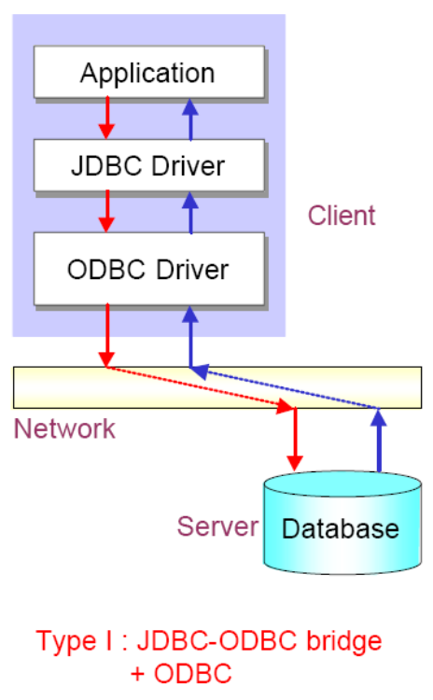
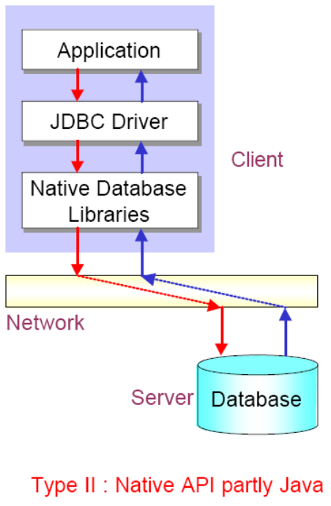
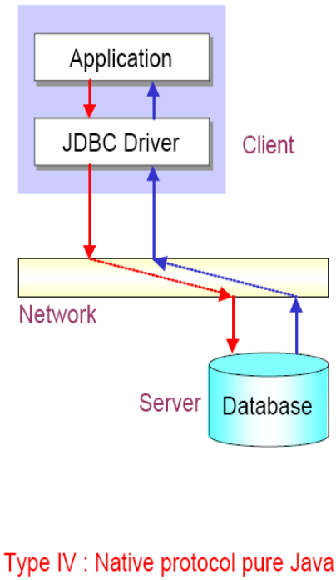
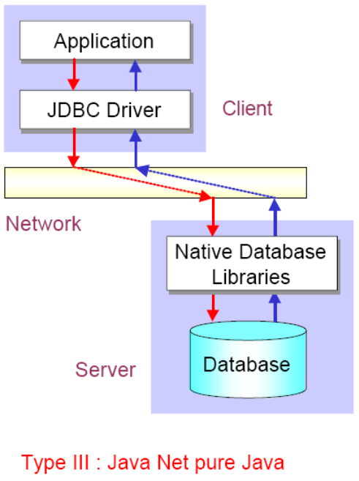
JDBC Driver Type
JDBC-ODBC bridge plus ODBC driver
Native-API partly-Java driver
JDBC-Net pure Java driver
Native Protocol pure Java API driver

Slide 9
JDBC Programming Steps
Connect
Register the driver
Create a connection to the database
Query
Create a statement
Query the database
Process Results
Get a result set
Assign results to Java variables
Close
Close the result set
Close the statement
Close the connection

Slide 10
Skeleton Code
Loading a JDBC driver
Class.forName(DRIVERNAME);
Connection con = DriverManager.getConnection(
CONNECTIONURL, DBID, DBPASSWORD);
Statement stmt = con.createStatement();
ResultSet rs = stmt.executeQuery(“SELECT a, b, c FROM member);
While(rs.next())
{
  Int x = rs.getInt(“a”);
  String s = rs.getString(“b”);
  Float f = rs.getFloat(“c”);
}
rs.close();
stmt.close();
con.close();
Connecting to a database
Executing SQL
Processing the result set
Closing the connections

Slide 11
Step 1 : Loading a JDBC Driver
A JDBC driver is needed to connect to a database
Loading a driver requires the class name of the driver.
Ex) JDBC-ODBC: sun.jdbc.odbc.JdbcOdbcDriver
Oracle driver: oracle.jdbc.driver.OracleDriver
MySQL: com.mysql.jdbc.Driver
Loaing the driver class
Class.forName("com.mysql.jdbc.Driver");
It is possible to load several drivers.
The class DriverManager manages the loaded driver(s)

Slide 12
Step 2 : Connecting to a Database (1/2)
JDBC URL for a database
  Identifies the database to be connected
  Consists of three-part:
  jdbc:<subprotocol>:<subname>
Protocol: JDBC is the only protocol in JDBC
Sub-protocol: identifies a database driver
Protocol: JDBC is the only protocol in JDBC
Sub-protocol: identifies a database driver
Subname: indicates the location and name of the database to be accessed. Syntax is driver specific
Subname: indicates the location and name of the database to be accessed. Syntax is driver specific
Ex) jdbc:mysql://oopsla.snu.ac.kr/mydb
The syntax for the name of the database is a little messy and is unfortunately vendor specific

Slide 13
Step 2 : Connecting to a Database (2/2)
The DriverManager allows you to connect to a database using the specified JDBC driver, database location, database name, username and password.
It returns a Connection object which can then be used to communicate with the database.
Connection connection = DriverManager.getConnection("jdbc:mysql://oopsla.snu.ac.kr/mydb",“userid",“password");
JDBC URL
Vendor of database, Location of database server and name of database
JDBC URL
Vendor of database, Location of database server and name of database
Password
Username
Password
Username

Slide 14
Step 3 : Executing SQL (1/2)
Statement object
  Can be obtained from a Connection object
  Sends SQL to the database to be executed
Statement has three methods to execute a SQL statement:
  executeQuery() for QUERY statements
    Returns a ResultSet which contains the query results
  executeUpdate() for INSERT, UPDATE, DELETE, or DDL statements
    Returns an integer, the number of affected rows from the SQL
  execute() for either type of statement
Statement statement = connection.createStatement();

Slide 15
Step 3 : Executing SQL (2/2)
Execute a select statement
Statement stmt = conn.createStatement();
ResultSet rset = stmt.executeQuery
("select RENTAL_ID, STATUS from ACME_RENTALS");
Execute a delete statement
Statement stmt = conn.createStatement();
int rowcount = stmt.executeUpdate
("delete from ACME_RENTAL_ITEMS
where rental_id = 1011");
Notes:
Dynamically Executing an Unknown SQL Statement
The following example uses execute() to dynamically execute an unknown statement:
public void executeStmt (String statement) throws SQLException {
Statement stmt = conn.createStatement();
// Execute the statement
boolean result = stmt.execute(statement);
if (result) { // statement was a query
ResultSet rset = stmt.getResultSet();
// Process the results
...
}
else { // statement was an update or DDL
int updateCount = stmt.getUpdateCount();
// Process the results
...
}
}

Slide 16
Step 4 : Processing the Results (1/2)
JDBC returns the results of a query in a ResultSet object
  ResultSet object contains all of the rows which satisfied the conditions in an SQL statement
A ResultSet object maintains a cursor pointing to its current row of data
  Use next() to step through the result set row by row
    next() returns TRUE if there are still remaining records
  getString(), getInt(), and getXXX() assign each value to a Java variable
Internal Pointer
ResultSet
Record 1
Record 2
Record 3
Record 4
The internal pointer starts one before the first record

Slide 17
Step 4 : Processing the Results (2/2)
Example
  Statement stmt = con.createStatement();
  ResultSet rs = stmt.executeQuery(“SELECT ID, name, score FROM table1”);
  While (rs.next()){
    int id = rs.getInt(“ID”);
    String name = rs.getString(“name”);
    float score = rs.getFloat(“score”);
    System.out.println(“ID=” + id + “ ” + name + “ ” + score);}
NOTE
You must step the cursor to the first record before read the results
This code will not skip the first record
ID | name | score
1 | James | 90.5
2 | Smith | 45.7
3 | Donald | 80.2
Output
ID=1 James 90.5
ID=2 Smith 45.7
ID=3 Donald 80.2
Table1

Slide 18
Step 5 : Closing Database Connection
It is a good idea to close the Statement and Connection objects when you have finished with them
Close the ResultSet object
rs.close();
Close the Statement object
stmt.close();
Close the connection
  connection.close();

Slide 19
The PreparedStatement Object
A PreparedStatement object holds precompiled SQL statements
Use this object for statements you want to execute more than once
A PreparedStatement can contain variables (?) that you supply each time you execute the statement
// Create the prepared statement
PreparedStatement pstmt = con.prepareStatement(“
UPDATE table1 SET status = ? WHERE id =?”)
// Supply values for the variables
pstmt.setString (1, “out”);
pstmt.setInt(2, id);
// Execute the statement
pstmt.executeUpdate();

Slide 20
Transactions and JDBC (1/2)
Transaction: more than one statement that must all succeed (or all fail) together
Ex) updating several tables due to customer purchase
If one fails, the system must reverse all previous actions
Also can’t leave DB in inconsistent state halfway through a transaction
COMMIT = complete transaction
ROLLBACK = cancel all actions

Slide 21
Transactions and JDBC (2/2)
The connection has a state called AutoCommit mode
  If AutoCommit is true, then every statement is automatically committed
  If AutoCommit is false, then every statement is added to an ongoing transaction
  Default: true
con.setAutoCommit(false);
try {
PreparedStatement pstmt = con.prepareStatement(
"update BankAccount set amount = amount + ? where accountId = ?");
pstmt.setInt(1,-100); pstmt.setInt(2, 13);
pstmt.executeUpdate();
pstmt.setInt(1, 100); pstmt.setInt(2, 72);
pstmt.executeUpdate();
con.commit();
catch (SQLException e)
{ con.rollback(); }

Slide 22
Summary
JDBC
  Standard interface for connecting to relational databases from Java
  Vendor independent API for accessing relational data
  JDBC has four driver type
    JDBC-ODBC bridge plus ODBC driver
    Native-API partly-Java driver
    JDBC-Net pure Java driver
    Native Protocol pure Java API driver
  JDBC support transaction and PreparedStatement

Slide 23
Online Resources
Sun’s JDBC site
  http://java.sun.com/products/jdbc/
JDBC tutorial
  http://java.sun.com/docs/books/tutorial/jdbc/
List of available JDBC drivers
  http://developers.sun.com/product/jdbc/drivers
API for java.sql
  http://java.sun.com/j2se/1.5.0/docs/api/java/sql/package-summary.html

