Slide 1
Markov Chain Monte Carlo for LDA
C. Andrieu, N. D. Freitas, and A. Doucet, An Introduction to MCMC for Machine Learning, 2003.
R. M. Neal, Probabilistic Inference Using Markov Chain Monte Carlo Methods, 1993.
Markov A.A., "Extension of the limit theorems of probability theory to a sum of variables connected in a chain," John Wiley and Sons, 1971
Mar 24, 2015
Hee-Gook Jun

Slide 2
Outline
Markov Chain
Monte Carlo Method
Markov Chain Monte Carlo
Gibbs Sampling

Slide 3
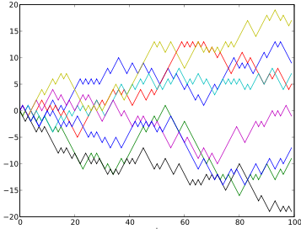
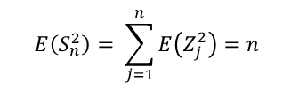
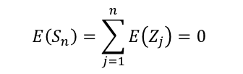
Markov Chain
Markov chain
Stochastic model to estimate a set of progress
Random walk
Path that consists of a succession of random steps
One-dimensional random walk = Markov chain
$Pr⁡(X_{n+1}=x |{ X}_{n}=x_{n},…,X_{1}=x_{1})$ = $Pr⁡(X_{n+1}=x |{ X}_{n}=x_{n})$
$$E\left(S_{n}\right)=\sum_{j=1}^{n}{E\left(Z_{j}\right)=0}$$
$$E\left(S_{n}^{2}\right)= \sum_{j=1}^{n}{E\left(Z_{j}^{2}\right)=n}$$

Slide 4







Markov Chain (Cont.)
E.g., Deterministic system
Markov Chain is non-deterministic system
Memorylessness and random state-transition model
Assumption: Next state depends only on the current state
spring
summer
fall
winter

Slide 5
Monte Carlo Method
Simulation method
Based on the random variable
Rely on repeated random sampling
Obtain numerical results
Process
Define a domain of possible inputs
Generate inputs randomly from a probability distribution over the domain
Perform a deterministic computation on the inputs
Aggregate the results
Notes:
시뮬레이션 테크닉의 일종이다
입력변수를 확률함수로 보고 난수를 발생시켜서 적합한 값만을 취하며 나머지 값을 버림으로써, 가장 근사한 결과값을 얻는 방법
한마디로 random 확률을 이용한 근사값 계산식 정도로 이해하면 된다
확률변수에 의거한 방법이기 때문에, 1949년 Metropolis Uram이 모나코의 유명한 도박의 도시 monte carlo의 이름을 본따 명명

Slide 6
Markov Chain Monte Carlo
Sampling from a probability distribution
Based on constructing a Markov Chain
The state of the chain after a number of steps
Used a s a sample of the desired distribution
The number of steps
Improves the quality of the sample

Slide 7

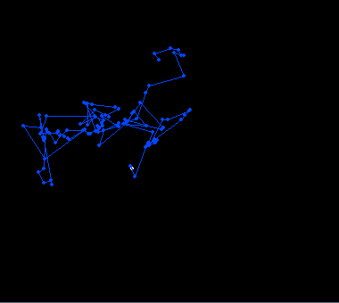
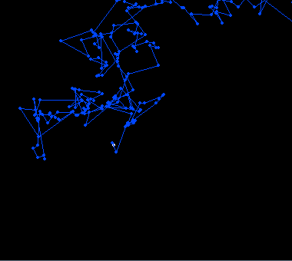
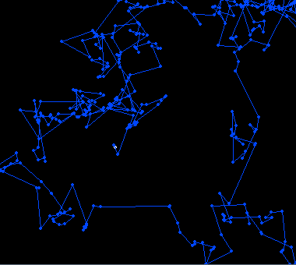
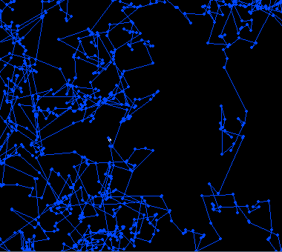
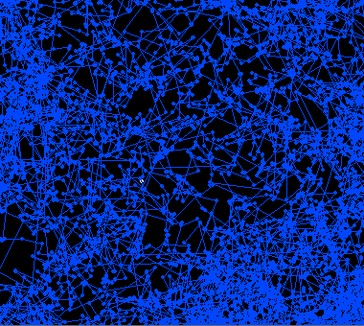


MCMC Example: 1 Chain

Slide 8

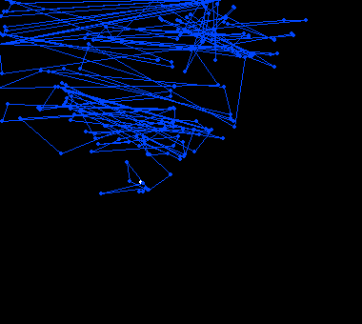
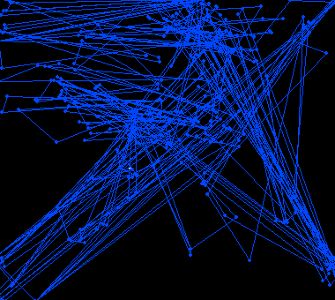
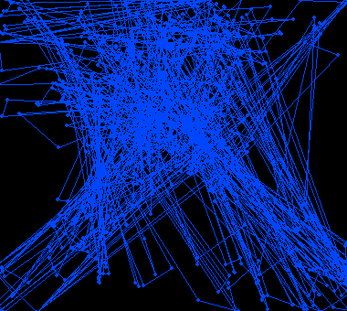
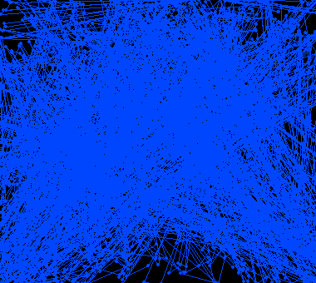

MCMC Example: 2 Chains

Slide 9
Markov Chain Monte Carlo (Cont.)
Used for approximating a multi-dimensional integral
Look for a place with a reasonably high contribution
to the integral to move into next.
Random walk Monte Carlo Methods
Metropolis-Hastings algorithm
Generate a random walk using a proposal density
Rejecting some of the proposed moves
Gibbs sampling
Requires all the conditional distributions of the target distributions to be sampled exactly
Do not require any tuning

Slide 10
Gibbs Sampling
MCMC algorithm for obtaining a sequence of observations
approximated from a specified multivariate probability distribution
Commonly used
as a means of statistical inference (Especially Bayesian inference)
Generate a Markov chain of samples
Samples from the beginning of the chain
May not accurately represent the desired distribution

Slide 11
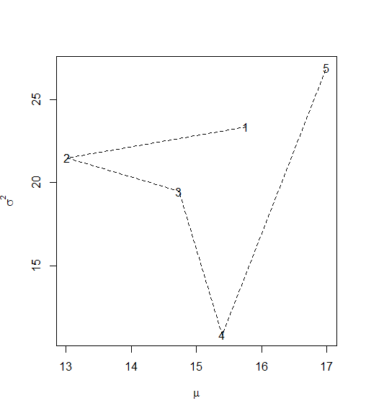
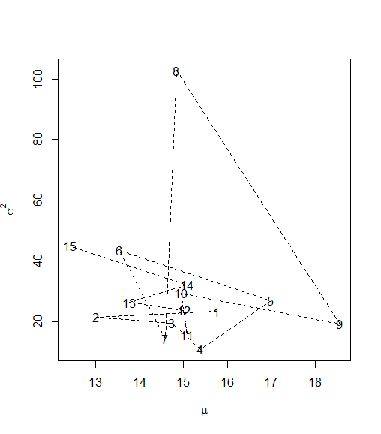
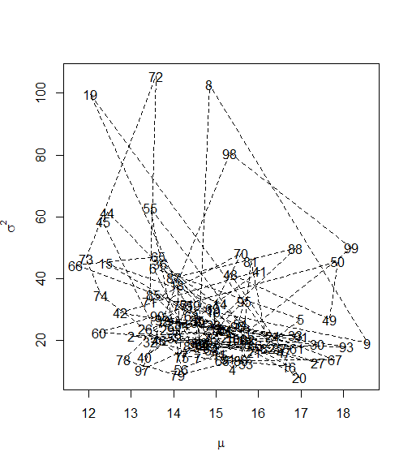
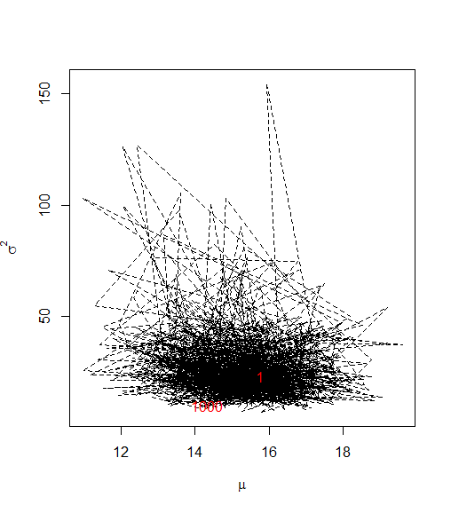
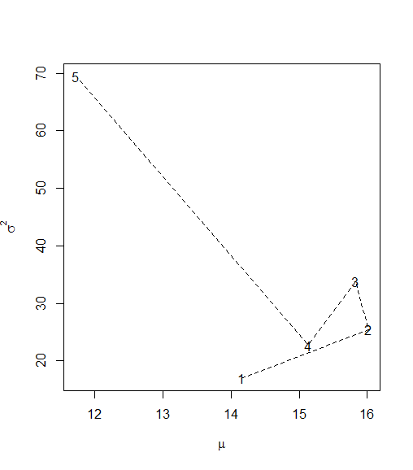
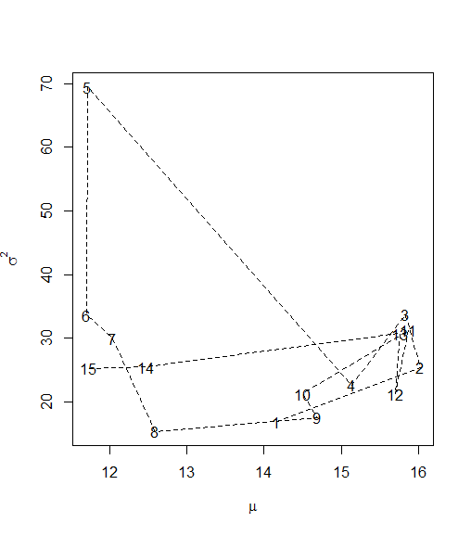
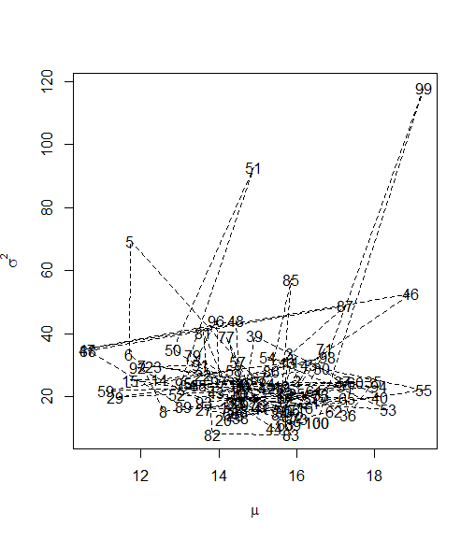
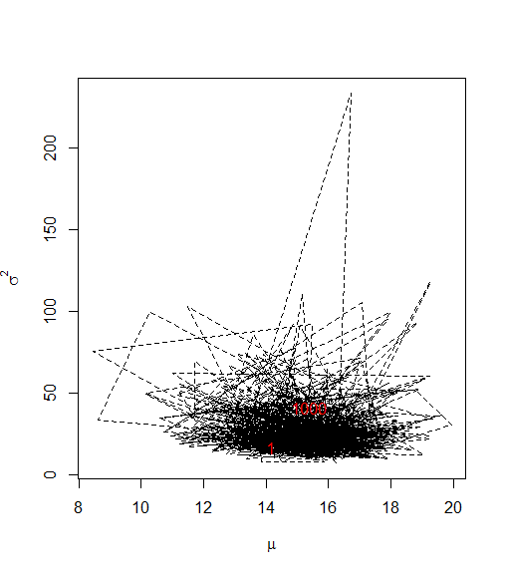

Gibbs Sampling Example: : Normal Dist. Estimation [1/2]
X (as Input data): 10, 13, 15, 11, 9, 18, 20, 17, 23,21
$$X\sim N\left(μ,σ^{2}\right)$$
1st test
2nd test

Slide 12
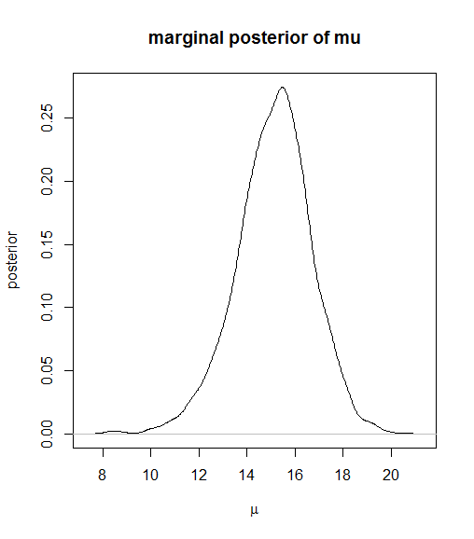
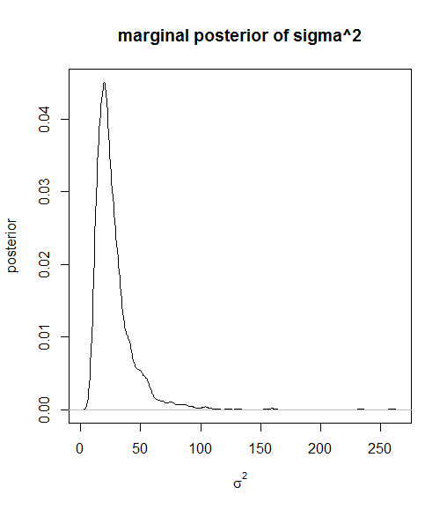
Gibbs Sampling Example: : Normal Dist. Estimation [2/2]
X (as Input data): 10, 13, 15, 11, 9, 18, 20, 17, 23,21
$$X\sim N\left(μ,σ^{2}\right)$$

Slide 13
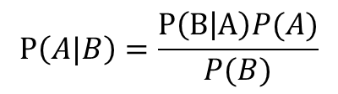




Bayesian inference
Posterior probability
Consequence of two antecedents
Prior probability
Likelihood function
$$P\left(A|B\right)=\frac{P\left(B | A\right)P(A)}{P(B)}$$
posterior
likelihood x prior
$$p\left(θ|x\right) ∝ p\left(x | θ\right)×p(θ)$$
$$\text{Θ} \sim Beta(α,β)$$
$$X\sim Bin\left(n,θ\right)$$
$$\text{Θ} \sim Beta(α,β)$$

Slide 14
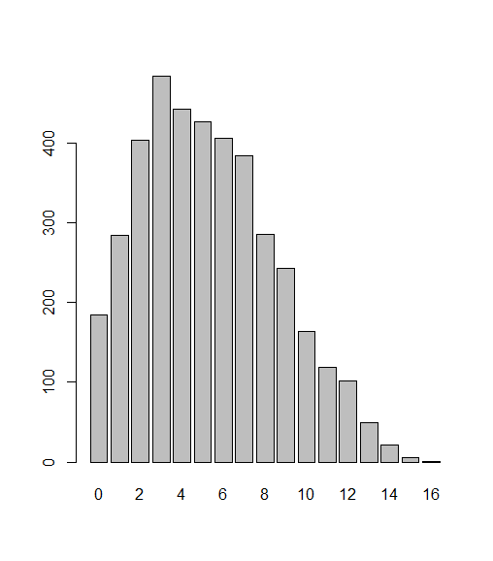
Bayesian inference using Gibbs Sampling
M <- 5000 # length of chain
burn <- 1000 # burn-in length
n <- 16
a <- 2
b <- 4
k <- 10
X <- matrix(nrow=M)
th <- rbeta(1,1,1)
X[1] <- rbinom(1, n, th)
for(i in 2:M){
thTmp <- rbeta(1, X[i-1]+a, n-X[i-1]+b)
X[i] <- rbinom(1, n, thTmp)
}
X
# Chain 에서 처음 1000개 관측 값 제거
x <- X[burn:M, ]
Gibbs <- table(factor(x, levels=c(0:16)))
barplot(Gibbs)

Slide 15
Gibbs Sampling: Bayesian inference in LDA
The original paper (by David Blei)
Used a variational Bayes approximation of the posterior distribution
Alternative inference techniques use
Gibbs sampling and expectation propagation
EM algorithm is used in PLSA
Good for computing parameters
MCMC is used in LDA
MCMC is better than EM
When a problem has too many parameters to compute

