Slide 1

Modern Information Retrieval
Ricardo Baeza-Yates and Berthier Ribeiro-Neto
Chapter 13. Searching the Web
July 20, 2010
Kangpyo Lee

Slide 2
Contents
Introduction
Challenges
Characterizing the Web
Search Engines
Browsing
Metasearchers
Finding the Needle in the Haystack
Trends & Research Issues

Slide 3
Introduction
The web can be seen as a very large, unstructured but ubiquitous database
Triggers the need for efficient tools to manage, retrieve, & filter information from this database
We focus on text
Techniques for images & other non-textual data cannot be applied on a large-scale
We also emphasize syntactic search
Search for Web documents that have user-specified words or patterns in their text
Three different forms of searching the Web
To use search engines that index a portion of the Web documents as a full-text database
To use Web directories that classify selected Web documents by subject
To search the Web exploiting its hyperlink structure

Slide 4
Challenges (1)
Main problems posed by the Web
Problems with the data itself
Problems regarding the user & his interaction with the retrieval system
The problems related to the data
Distributed data
High percentage of volatile data
Large volume
Unstructured & redundant data
Quality of data
Heterogeneous data
=> Many of them will not change because they are problems intrinsic to human nature

Slide 5
Challenges (2)
The problems faced by the user during the interaction with the retrieval system
How to specify a query
Hot to interpret the answer provided by the system
The overall change is to
Submit a good query to the search system
Obtain a manageable & relevant answer
Moreover, we should to try to achieve the latter goal even for poorly formulated queries

Slide 6
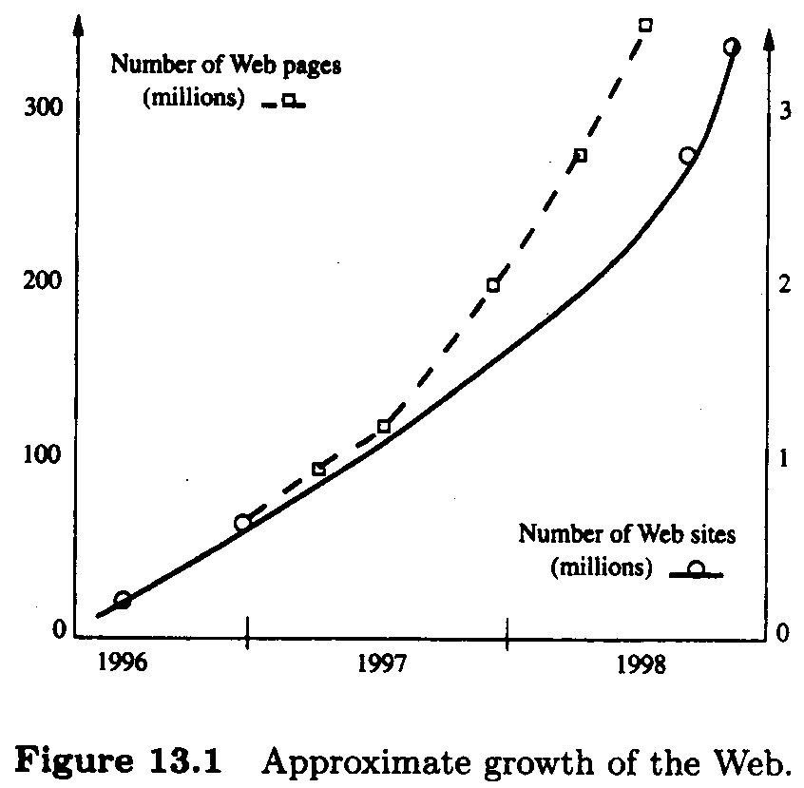
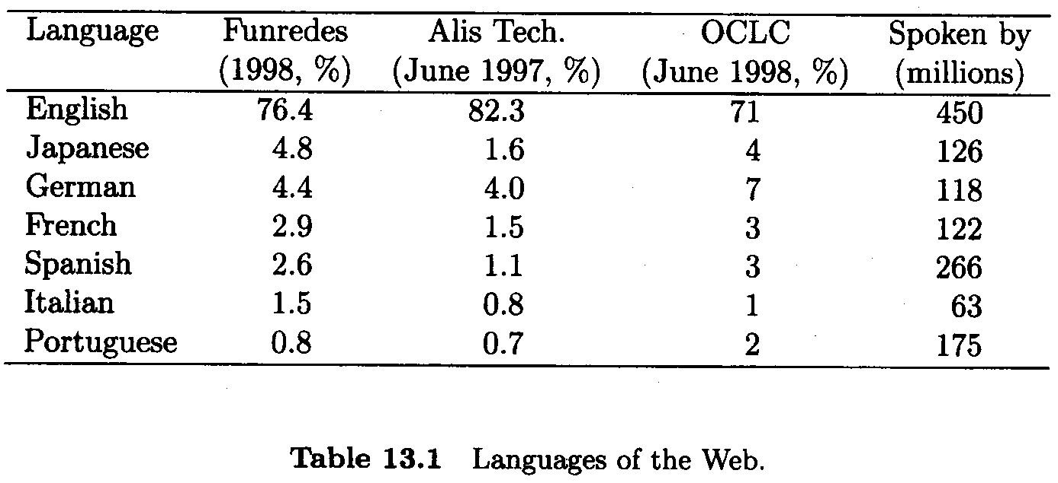
Characterizing the Web (1)

Slide 7
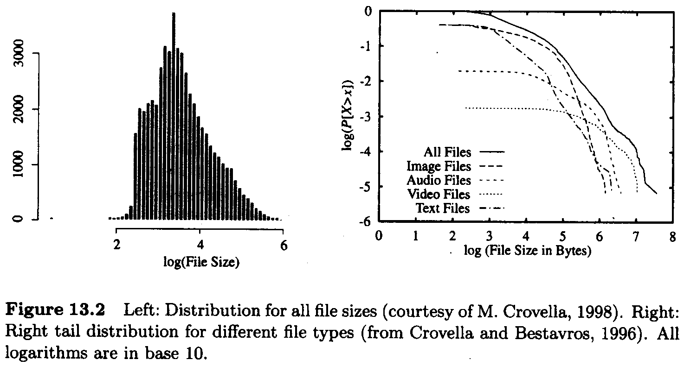
Characterizing the Web (2)

Slide 8
Search Engines (1)
All queries must be answered without accessing the text
I.e. only the indices are available
Otherwise
Storing locally a copy of the Web pages (-> too expensive)
Accessing remote pages through the network at query time (-> too slow)
Different architectures of retrieval systems
Centralized architecture
Distributed architecture

Slide 9
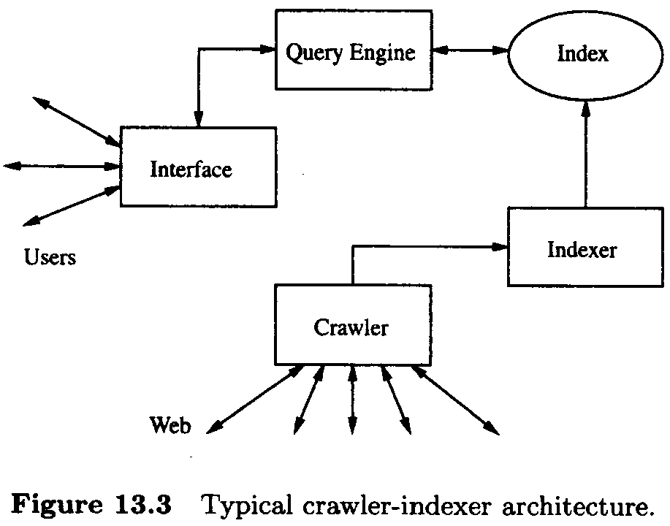
Search Engines (2)
Centralized architecture
A centralized crawler-indexer architecture
Crawlers
Programs (SW agents) that traverse the Web sending new or updated pages to a main server where they are indexed
A.k.a. robots, spiders, wanderers, walkers, & knowbots
AltaVista architecture has two parts
One that dealing with the users, consisting of the user interface & the query engine
Another that consists of the crawler & indexer modules

Slide 10
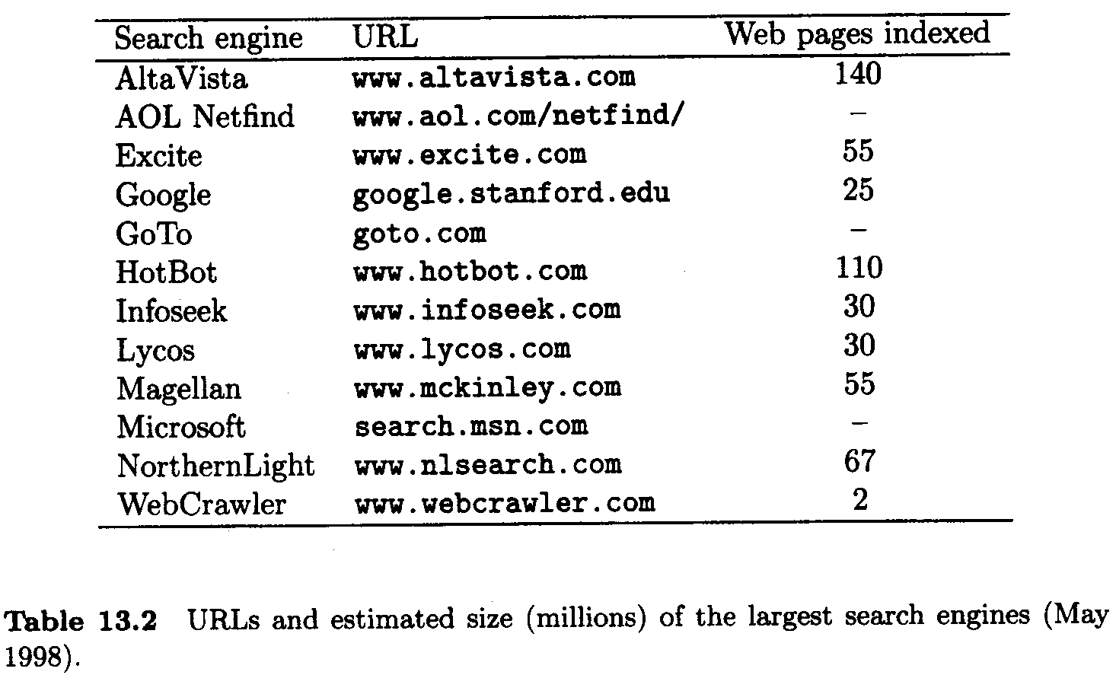
Search Engines (3)
Centralized architecture (cont’d)
The main problem: the gathering of the data because of
The highly dynamic nature of the Web
The saturated communication links
The high load at Web servers
Another important problem: the volume of the data
Needs good load balancing between the different activities of a search engine internally (answering queries & indexing) & externally (crawling)

Slide 11
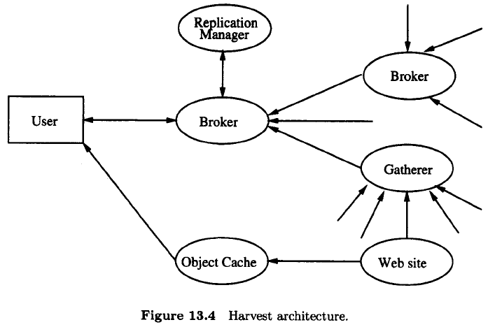
Search Engines (4)
Distributed architecture: Harvest
A more efficient architecture to gather & distribute data
The main drawback: requiring the coordination of several Web servers
Two main elements
Gatherers
Collecting & extracting indexing information from one or more Web servers
Gathering times (i.e. harvesting times) are defined by the system & are periodic
Brokers
Providing the indexing mechanism & the query interface to the data gathered
Retrieving information from one or more gathers or other brokers, updating incrementally their indices
Different improvements on server loads & network traffic

Slide 12
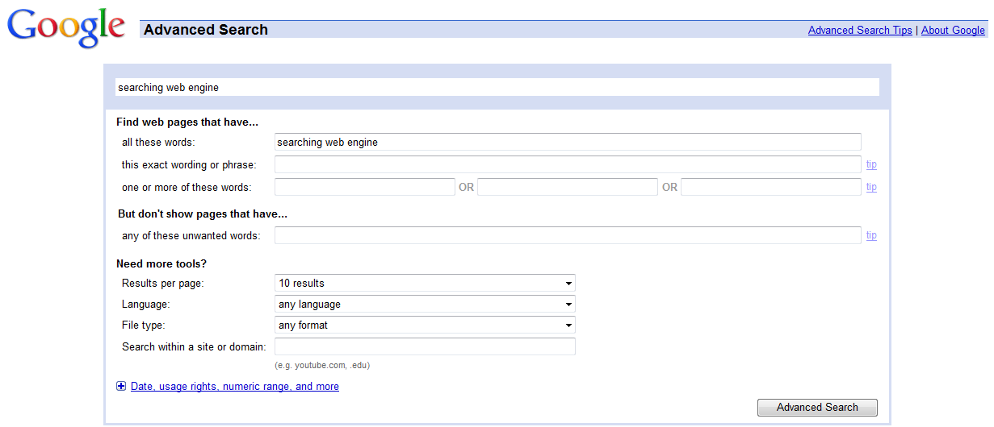
Search Engines (5)
User interfaces
Two important aspects: the query interface & the answer interface
The query interface
The basic query interface is a box where one or more words can be typed
A query interface for complex queries as well as a command language

Slide 13
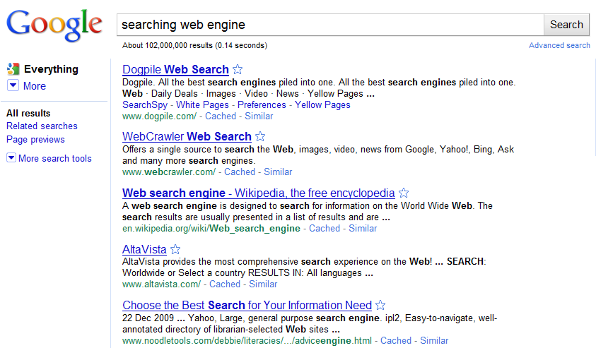
Search Engines (6)
User interfaces (cont’d)
The answer interface
The order of the list of the retrieved documents is typically by relevance
Sorting by URL or date is also available
The retrieved Web pages are ranked, usually using statistics related to the terms in the query

Slide 14
Search Engines (7)
Ranking
Difficulties with ranking
Not much public information about the specific ranking algorithms used by current search engines
Difficult to compare fairly different search engines
Almost impossible to measure recall, as the # of relevant pages can be quite large for simple queries
Yuwono & Lee [844] propose three ranking algorithms
Boolean spread
Vector spread
Most-cited
Based only on the terms included in pages having a link to the pages in the answer
The vector model yields a better recall-precision curve, with an average precision of 75%

Slide 15
Search Engines (8)
Ranking (cont’d)
Using hyperlink information
The # of hyperlinks that point to a page provides a measure of its popularity & quality
Many links in common between pages or pages referenced by the same page often indicates a relationship between those pages
Web Query [148]
Ranks a set of Web pages based on how connected each Web page is
Extends the set by finding Web pages that are highly connected to the original set

Slide 16
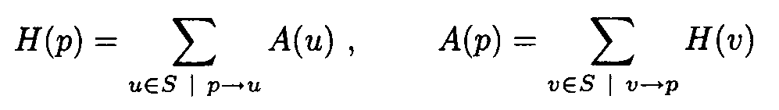
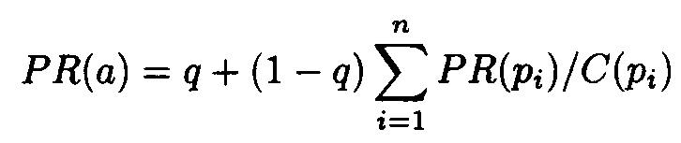
Search Engines (9)
Ranking (cont’d)
Kleinberg [444] used in HITS (Hypertext Induced Topic Search)
Defines authorities & hubs
Better authority pages come from incoming edges from good hubs & better hub pages come from outgoing edges to good authorities
PageRank [117] used in Google
Random surfer model
Simulates a user navigating randomly in the Web who jumps to a random page with probability q or follows a random hyperlink with probability 1-q
This user never goes back to a previously visited page
Modeled with a Markov chain

Slide 17
Search Engines (10)
Ranking (cont’d)
Ways to help ranking algorithms
Page designers should include informative titles, headings, & meta fields as well as good links
Keywords should not be repeated
Use full terms instead of indirect ways to refer to subjects

Slide 18
Search Engines (11)
Crawling the Web
Several crawling techniques
To start with a set of URLs & from there extract other URLs which are followed recursively in a breadth-first or depth-first fashion
To start with a set of popular URLs
To partition the Web using country codes or Internet names, & assign one or more robots to each partition
The index of a search engine can be thought of as analogous to the stars in an sky (Why? >.<)
The percentage of invalid links stored in search engines vary form 2 to 9%
The order in which the URLs are traversed is important
A breadth-first policy
A depth-first policy
Good ordering schemes can make a difference if crawling better pages first

Slide 19
Search Engines (12)
Indices
Most indices use variants of the inverted file
State of the art indexing techniques can reduce the size of an inverted file to about 30% of the size of the text
By using compression techniques, the index size can be reduced to 10%
A query is answered by doing a binary search on the stored list of words of the inverted file
Having the positions of the words in a page, we can answer phrase searches or proximity queries
The index can be less dense if we point to logical blocks instead of pages

Slide 20
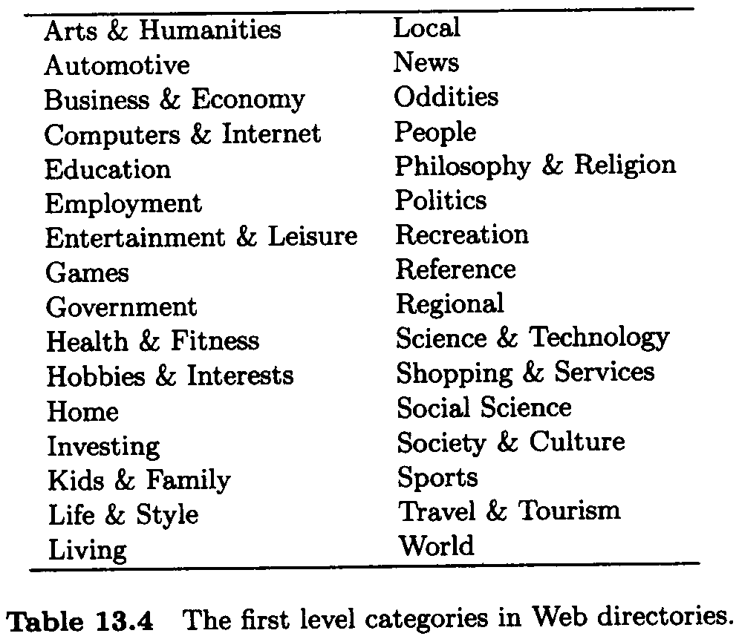
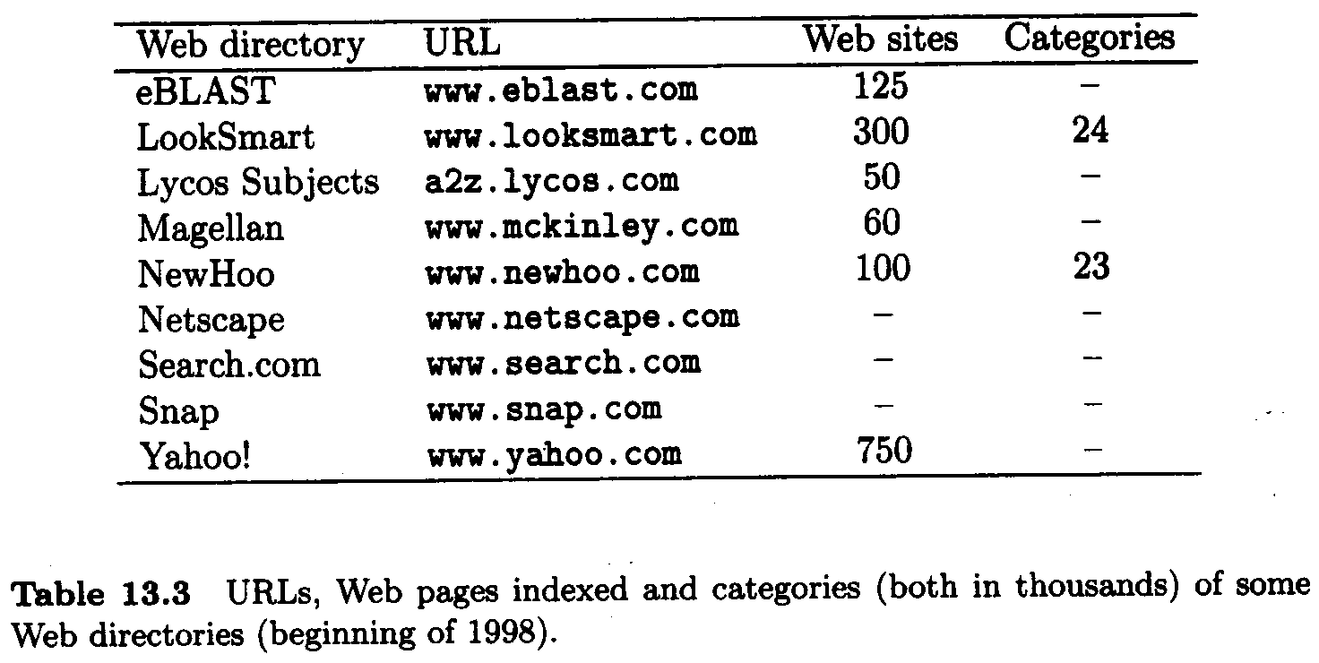
Browsing
Web directories
Although the Web coverage provided by directories is very low (less than 1% of all Web pages), the answers returned to the user are usually much more relevant
Directories are hierarchical taxonomies that classify human knowledge
A.k.a. catalogs, yellow pages, or subject directories
Advantage: if we find what we are looking for, the answer will be useful in most cases
Disadvantage: the classification is not specialized enough & not all Web pages are classified

Slide 21
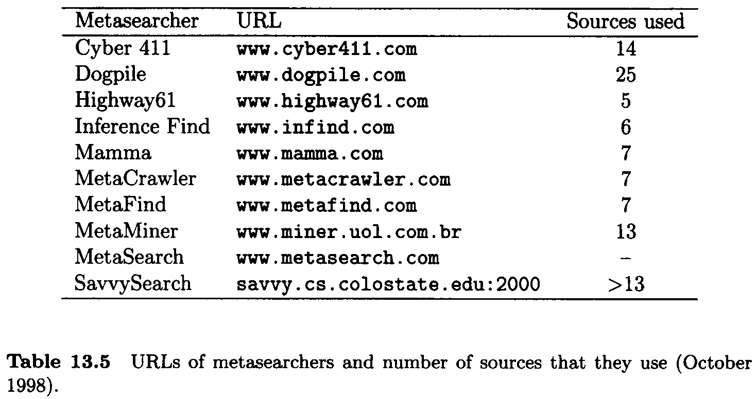
Metasearchers (1)
Metasearchers: Web servers that
Send a given query to several search engines, Web directories & other databases
Collect the answers
Unify them

Slide 22
Metasearchers (2)
Advantages
The ability to combine the results of many sources
The fact that the user can pose the same query to various sources through a single common interface
The results can be sorted by different attributes such as host, keyword, date, etc.
Browsing the results should be simpler
Pages returned by more than one search engine should be more relevant

Slide 23
Finding the Needle in the Haystack (1)
User problems
The user does not exactly understand the meaning of searching using a set of keywords
The user may not get unexpected answers because he is not aware of the logical view of the text adopted by the system
Most users have trouble with Boolean logic
E.g. one or the other -> exclusive or
Many people have trouble using command language
Query forms should clearly specify which words must or must not be contained in a document that belongs to the answer

Slide 24
Finding the Needle in the Haystack (2)
Surveys & analyses of query logs
Users select a search engine mainly based on ease of use, speed, coverage, relevance of the answer, & habit
The main purpose are research, leisure, business, & education
The main problems found
Novice users do not know how to start & lack the general knowledge that would help in finding better answers
Search engines are slow
The answer is too large, not very relevant, & not always up to date
Most people do not care about advertising
25% of the users use a single keyword
On average, their queries have only two or three terms
Most users (~80%) do not modify the query
Most users (~85%) only look at the first screen with results

Slide 25
Finding the Needle in the Haystack (3)
Teaching the user
Query forms must specify clearly
Users should try to give as many terms as possible
Users should include all possible synonyms of a word
The user must learn from experience
It is easier & more effective to teach the user how to properly profit from search engines
Rather than trying to guess what the user really wants
Rules of thumb
Specific queries: look in an encyclopedia
Broad queries: use Web directories
Vague queries: use Web search engines & improve the query formulation

Slide 26
Trends & Research Issues
Modeling
Querying
Distributed architectures
Ranking
Indexing
Dynamic pages
Duplicate data
Multimedia
User interfaces
Browsing

Slide 27
Thank You

