Slide 1
An Optimization Technique for RDFS Inference using the Application Order of RDFS Entailment Rules
Kisung Kim, Taewhi Lee
2005. 7. 11

Slide 2
Contents
Introduction
Related Work
Background & Motivation
Our Approaches
  Application Order of RDFS Entailment Rules
  Avoiding Producing Redundant Results
Experiments
Appendix

Slide 3
Introduction
RDF Schema
  Provides additional expressive power and semantics to RDF model
  Gives a mechanism to declare classes, properties, domain and range of a property
RDFS inference
  From RDF Schema information, infer another RDF triples
    Class/Property hierarchy
    Resource type
  RDF entailment rules gives a way for complete inference
Class hierarchy
Property hierarchy
Domain/Range of property
RDF Schema
RDF Model

Slide 4
Related Work
RDF Semantics
  Propose the RDF Model Theory, a semantic theory for RDF and RDFS
  Provide the RDFS entailment rules
  Patrick Hayes, RDFS Semantics, 2004, W3C Recommendation
WILBUR
  Claim that exhaustive, iterative application of RDFS entailment rules is not a realistic way
  Propose a lazy evaluation strategy
  Ora Lassila, Taking the RDF Model Theory out for a Spin, ISWC, 2002
Sesame
  Use a practical exhaustive forward chaining algorithm
  Jeen Broekstra, Arjohn Kampman, Inferencing and Truth Maintenance in RDF Schema, Practical and Scalable Semantic System, 2003
Jena
  Use a hybrid approach(forward chaining + backward chaining)
  But doesn’t provide RDBMS-based inferencer

Slide 5
Sesame Inference Strategy
publication
subClassOf
article
Subject | Predicate | Object | Explicit
write | rdfs:range | article | 1
article | rdfs:subClassOf | publication | 1
Jim | write | writing01 | 1
Forward chaining
Beginning with facts, chaining through rules, and finally establishing the goal
rdfs3
writing01 rdf:type article 0
rdfs9
writing01 rdf:type publication 0
Triples Table
SQL
Select t.subject
from triples t
where
t.predicate = rdf:type and
t.object = publication
RDQL
{?X} rdf:type publication
Easy to translate queries
No semantic interpretation

Slide 6
RDFS Entailment Rules
Consist of 13 rules
Give a way for the complete inference
Infer new RDF statements based on the presence of other statements
  Example> rdfs3 : type inference through property range information
If Repository contains:
aaa rdfs:range xxx
uuu aaa yyy
Then add:
yyy rdf:type xxx

Slide 7
Sesame Inference Strategy
New Triples Table
Sesame RDFMTInferencer
rdf1
rdfs2_1, rdfs2_2
rdfs3_1, rdfs3_2
rdfs4a, 4b
rdfs5_1, rdfs5_2
rdfs6
rdfs7_1, rdfs7_2
rdfs8
rdfs9_1, rdfs9_2
Triples Table
rdfs10
rdfs11_1, rdfs11_2
Inferred Triples Table
rdfs12
rdfs13

Slide 8
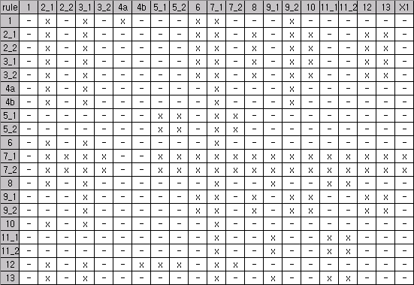
Dependencies between RDFS Entailment Rules
Shows which rules must be triggered at the next iteration
Sesame uses the dependency table to eliminate redundant inferencing steps
Subject | Predicate | Object
write | rdfs:range | article
article | rdfs:subClassOf | paper
Jim | write | writing01
rdfs3
writing01 rdf:type article 0
rdfs9
writing01 rdf:type paper 0
Triples Table
Rule dependency table

Slide 9
Motivation(1/2)
Using the dependency table cannot remove inefficiency completely
  Useless application of rule
  Example> rdfs8 triggers rdfs7
  Need to apply only when there is superproperty of ‘rdfs:subClassof’
Rule Name | If E contains: | then add:
rdfs7 | aaa rdfs:subPropertyOf bbb uuu aaa yyy | uuu bbb yyy
rdfs8 | uuu rdf:type rdfs:Class | uuu rdfs:subClassOf rdfs:Resource

Slide 10
Motivation(2/2)
Redundant result
  Example> Rule 2, Rule 4 may create same results
uuu rdf:type rdfs:Resource
Rule Name | If E contains: | then add:
rdfs2 | aaa rdfs:domain xxx uuu aaa yyy | uuu rdf:type xxx
rdfs4a | uuu aaa xxx | uuu rdf:type rdfs:Resource

Slide 11
Our approaches(1/6)
Application Order of RDFS Entailment Rules
To minimize the useless application of rule
Assumption
  There are no superclass or superproperty of pre-defined RDFS constructs
Order of the inference
  Inference for new RDF data with pre-stored RDF Schema information
  Inference for new RDF Schema information with pre-stored RDF Schema information
  Inference for new and old RDF data with new RDF Schema information

Slide 12
Our approaches(2/6)
Application Order of RDFS Entailment Rules
Iteration occurs when the inferred result contains subproperty or subclass of RDFS constructs
These are the information about the RDF schema itself
Starting point of repetition is different according the inferred results

Slide 13
Our approaches(3/6)
Application Order of RDFS Entailment Rules
rdf1
rdfs4a, 4b
Type inference with pre-defined RDF Schema
rdfs7_1
rdfs2, 3
rdfs9_1
rdfs13
rdfs8
Build Class Hierarchy
rdfs10
rdfs11_1, rdfs11_2
rdfs6
Build Property Hierarchy
rdfs12
rdfs5_1, rdfs5_2
rdfs7_2
Type inference with newly-defined RDF Schema
Subclass of RDFS class
Subproperty of RDF property
rdfs2, 3
rdfs9_2

Slide 14
Our approaches(4/6)
Application Order of RDFS Entailment Rules
Does this ordering guarantee complete inference?
  We can show this with the dependency table
 | 1 | 2_1 | 2_2 | 3_1 | 3_2 | 4a | 4b | 5_1 | 5_2 | 6 | 7_1 | 7_2 | 8 | 9_1 | 9_2 | 10 | 11_1 | 11_2 | 12 | 13
8 |  | X |  | X |  |  |  |  |  |  | X |  |  | X |  |  | X | X
Remove the rules which are applied after rule 8
 | 1 | 2_1 | 2_2 | 3_1 | 3_2 | 4a | 4b | 5_1 | 5_2 | 6 | 7_1 | 7_2 | 8 | 9_1 | 9_2 | 10 | 11_1 | 11_2 | 12 | 13
8 |  |  |  |  |  |  |  |  |  |  | X |  |  | X
Assume that there is no subclass/subproperty of RDF Schema constructs
 | 1 | 2_1 | 2_2 | 3_1 | 3_2 | 4a | 4b | 5_1 | 5_2 | 6 | 7_1 | 7_2 | 8 | 9_1 | 9_2 | 10 | 11_1 | 11_2 | 12 | 13
8

Slide 15
Our approaches(5/6)
Avoiding Producing Redundant Results
Inferred triples must be checked whether already exist in triple table before insertion
  Avoiding production of same results can improve performance
Add join predicates to the rule application SQL
  Do not consider results that must be inferred by previous rules
  Optimize constructing the transitive closure (subClassOf, subPropertyOf)

Slide 16
Our approaches(6/6)
Avoiding Producing Redundant Results
rdfs2, rdfs3
  Do not consider the property whose domain/range is ‘rdfs:Resource’
  rdfs4a, rdfs4b infer triples which asserts that type of a resource is ‘rdfs:Resource’
rdfs7
  Do not consider triples such as aaa subPropertyOf aaa
rdfs9
  Do not consider triples such as aaa subClassOf aaa
rdfs5, rdfs11
  Select distinct triples before checking
subClassOf
If N nodes exists between two node, n1, n2, the application of the rule make n same results
n1
n2

Slide 17
Experiment(1/3)
Environment
  Pentium M 730 1.6GHz
  1GB Ram
  Windows XP Professional
  Java SDK 1.5.0
  Sesame 1.1.3
  MySQL 4.1.2
Datasets
 | Size(MB) | # of statements | # of inferred statements
 |  |  | Sesame | Our approach
Wordnet | 48.7 | 473,626 | 99,690 | 99,690
NCI | 57.4 | 851,373 | 966,827 | 966,827
GO | 275 | 6,653,592 | 2,055,383 | 2,055,383

Slide 18
Experiment(2/3)
# of rule application and inference time
Our approach reduces # of rule application and improves the inference performance
 |  | # of rule application |  |  | Inference time
 | Sesame | Our approach | Improvement(%) | Sesame(s) | Our approach(s) | Improvement(%)
Wordnet | 46 | 18 | 60.9 | 99.625 | 79.437 | 20.3
NCI | 53 | 23 | 56.6 | 1108.625 | 708.219 | 36.1
GO | 53 | 22 | 58.5 | 2973.219 | 2330.500 | 21.6

Slide 19
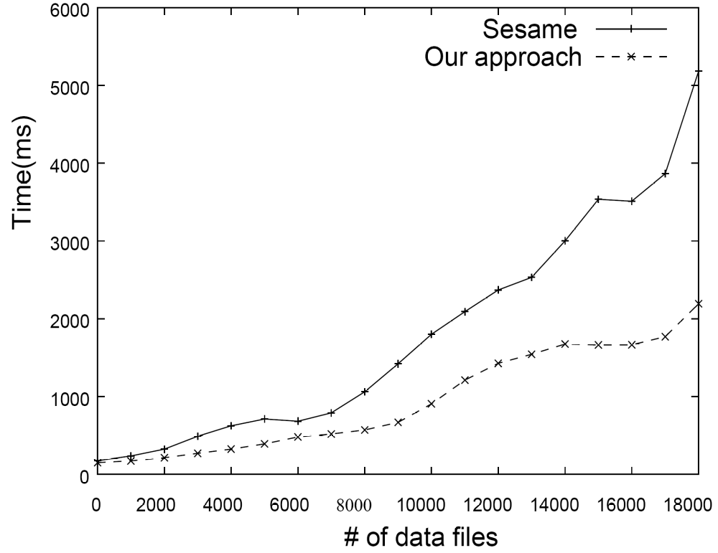
Experiment(3/3)
Scalability for data loading

Slide 20
Appendix(1/3)
RDFS Entailment Rules
Rule Name | If E contains: | then add:
rdfs1 | uuu aaa lll. where lll is a plain literal (with or without a language tag). | _:nnn rdf:type rdfs:Literal . where _:nnn identifies a blank node allocated to lll by rule rule lg.
rdfs2 | aaa rdfs:domain xxx . uuu aaa yyy . | uuu rdf:type xxx .
rdfs3 | aaa rdfs:range xxx . uuu aaa vvv . | vvv rdf:type xxx .
rdfs4a | uuu aaa xxx . | uuu rdf:type rdfs:Resource .
rdfs4b | uuu aaa vvv. | vvv rdf:type rdfs:Resource .
rdfs5 | uuu rdfs:subPropertyOf vvv . vvv rdfs:subPropertyOf xxx . | uuu rdfs:subPropertyOf xxx .
rdfs6 | uuu rdf:type rdf:Property . | uuu rdfs:subPropertyOf uuu .
rdfs7 | aaa rdfs:subPropertyOf bbb . uuu aaa yyy . | uuu bbb yyy .
rdfs8 | uuu rdf:type rdfs:Class . | uuu rdfs:subClassOf rdfs:Resource .
rdfs9 | uuu rdfs:subClassOf xxx . vvv rdf:type uuu . | vvv rdf:type xxx .
rdfs10 | uuu rdf:type rdfs:Class . | uuu rdfs:subClassOf uuu .
rdfs11 | uuu rdfs:subClassOf vvv . vvv rdfs:subClassOf xxx . | uuu rdfs:subClassOf xxx .
rdfs12 | uuu rdf:type rdfs:ContainerMembershipProperty . | uuu rdfs:subPropertyOf rdfs:member .
rdfs13 | uuu rdf:type rdfs:Datatype . | uuu rdfs:subClassOf rdfs:Literal .

Slide 21
Appendix(2/3)
Application of the RDFS entailment rules
Rules with one premise triple
  Example> rdfs8
  RULE) uuu rdf:type rdfs:Class → uuu rdfs:subClassOf rdfs:Resource
  SQL) SELECT nt.subj, <id of rdfs:subClassOf>, <id of rdfs:Resource>
  FROM newtriples
  WHERE pred = <id of rdf:type> and obj = <rdfs:Class>
Rules with two premise triples
  Need two SQL
  Example> rdfs2
  RULE) aaa <rdfs:domain> xxx & uuu aaa yyy
  →uuu rdf:type xxx
  SQL1) SELECT nt.subj, <id of rdf:type>, t.obj FROM newtriples nt
  LEFT JOIN triples t ON t.subj = nt.pred
  WHERE t.pred = <id of rdfs:domain>
  AND t.subj IS NOT NULL

Slide 22
Appendix(3/3)
Application of the RDFS entailment rules
SQL of rdfs11_2
  SELECT t.sub, 19, t.super FROM
    (SELECT DISTINCT t1.subj AS sub, 19, nt.obj AS super
    FROM triples nt
    LEFT JOIN triples t1
    ON nt.subj = t1.obj AND t1.pred = 19
    WHERE nt.id > 141 AND nt.id <= 1818392
    AND (t1.id <= 1818392) AND nt.pred = 19
    AND nt.obj > 0 AND t1.subj IS NOT NULL
    AND nt.subj != nt.obj AND t1.subj != t1.obj) t
  WHERE (t.sub, 19, t.super) NOT IN (SELECT subj, pred, obj FROM triples)

