Slide 1
O’Reilly – Hadoop: The Definitive Guide Ch.3 The Hadoop Distributed Filesystem
June 4th, 2010
Taewhi Lee

Slide 2
Outline
HDFS Design & Concepts
Data Flow
The Command-Line Interface
Hadoop Filesystems
The Java Interface

Slide 3
Design Criteria of HDFS
Very large files
Lots of small files
Petabyte-scale data
Growing of filesystem metadata
Streaming data access
Random data access
Write-once, read-many-times
High throughput
Multiple writers, arbitrary file update
Low latency
Commodity hardware
Node failure handling

Slide 4
HDFS Blocks
Block: the minimum unit of data to read/write/replicate
Large block size: 64MB by default, 128MB in practice
Small metadata volumes, low seek time
A small file does not occupy a full block
HDFS runs on top of underlying filesystem
Filesystem check (fsck)
% hadoop fsck –files -blocks

Slide 5
Namenode (master)
Single point of failure
Backup the persistent metadata files
Run a secondary namenode (standby)
Task | Metadata
Managing filesystem tree & namespace | Namespace image, edit log (stored persistently)
Keeping track of all the blocks | Block locations (stored just in memory)

Slide 6
Datanodes (workers)
Store & retrieve blocks
Report the lists of storing blocks to the namenode

Slide 7
Outline
HDFS Design & Concepts
Data Flow
The Command-Line Interface
Hadoop Filesystems
The Java Interface

Slide 8
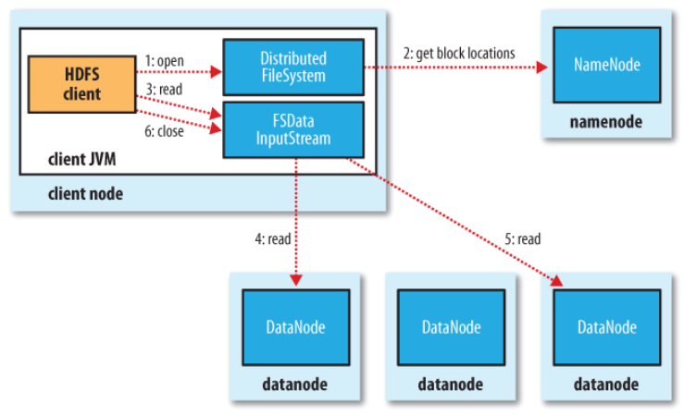
Anatomy of a File Read
(according to network topology)
(first block)
(next block)

Slide 9
Anatomy of a File Read (cont’d)
Error handling
Error in client-datanode communication
Try next closest datanode for the block
Remember failed datanode for later blocks
Block checksum error
Report to the namenode
Key point
Client contacts datanodes directly to retrieve data

Slide 10
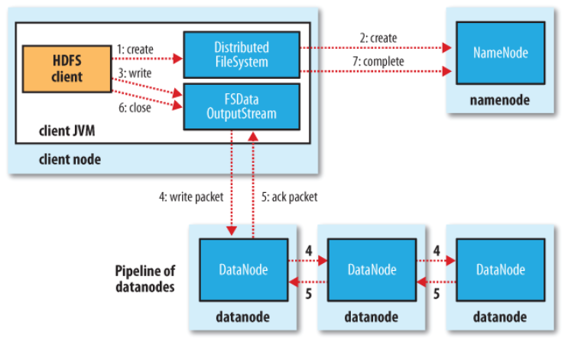
Anatomy of a File Write
(file exist & permission check)
enqueue packet
to data queue
dequeue the packet
from ack queue
chose by replica placement strategy
move the packet
to ack queue

Slide 11
Anatomy of a File Write (cont’d)
Error handling
Datanode error while data is being written
Client
Adds any packets in the ack queue to data queue
Removes the failed datanode from the pipeline
Writes the remainder of the data
Namenode
Arranges under-replicated blocks for further replicas
Failed datanode
Deletes the partial block when the node recovers later on

Slide 12
Coherency Model
HDFS provides sync() method
Forcing all buffers to be synchronized to the datanodes
Applications should call sync() at suitable points
Trade-off between data robustness and throughput
Key point
The current block being written that is not guaranteed to be visible (even if the stream is flushed)

Slide 13
Outline
HDFS Design & Concepts
Data Flow
The Command-Line Interface
Hadoop Filesystems
The Java Interface

Slide 14
HDFS Configuration
Pseudo-distributed configuration
fs.default.name = hdfs://localhost/
dfs.replication = 1
See Appendix A for more details

Slide 15
Basic Filesystem Operations
Copying a file from the local filesystem to HDFS
Copying the file back to the local filesystem
Creating a directory
% hadoop fs –copyFromLocal input/docs/quangle.txt hdfs://localhost/user/tom/quangle.txt
% hadoop fs –copyToLocal hdfs://localhost/user/tom/quangle.txt
quangle.copy.txt
% hadoop fs –mkdir books
% hadoop fs -ls .
Found 2 items
drwxr-xr-x - tom supergroup 0 2009-04-02 22:41 /user/tom/books
-rw-r--r-- 1 tom supergroup 118 2009-04-02 22:29 /user/tom/quangle.txt

Slide 16
Outline
HDFS Design & Concepts
Data Flow
The Command-Line Interface
Hadoop Filesystems
The Java Interface

Slide 17
Hadoop Filesystems
Filesystem | URI scheme | Java implementation (all under org.apache.hadoop)
Local | file | fs.LocalFileSystem
HDFS | hdfs | hdfs.DistributedFileSystem
HFTP | hftp | hdfs.HftpFileSystem
HSFTP | hsftp | hdfs.HsftpFileSystem
HAR | har | fs.HarFileSystem
KFS (Cloud-Store) | kfs | fs.kfs.KosmosFileSystem
FTP | ftp | fs.ftp.FTPFileSystem
S3 (native) | s3n | fs.s3native.NativeS3FileSystem
S3 (block-based) | s3 | fs.s3.S3FileSystem
Listing the files in the root directory of the local filesystem
% hadoop fs –ls file:///

Slide 18
Hadoop Filesystems (cont’d)
HDFS is just one implementation of Hadoop filesystem
You can run MapReduce programs on any of these filesystems
But, DFS (e.g., HDFS, KFS) is better to process large volumes of data

Slide 19
Interfaces
Thrift
SW framework for scalable cross-language services development
It combines a software stack with a code generation engine to build services seamlessly between C++, Perl, PHP, Python, Ruby, …
C API
Uses JNI(Java Native Interface) to call a Java filesystem client
FUSE (Filesystem in USErspace)
Allows any Hadoop filesystem to be mounted as a standard filesystem
WebDAV
Allows HDFS to be mounted as a standard filesystem over WebDAV
HTTP, FTP

Slide 20
Outline
HDFS Design & Concepts
Data Flow
The Command-Line Interface
Hadoop Filesystems
The Java Interface

Slide 21
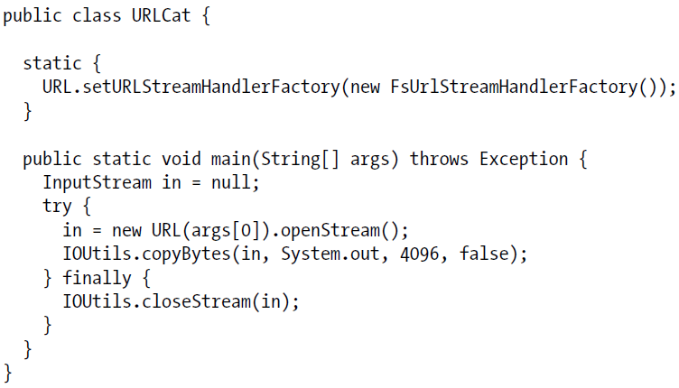
Reading Data from a Hadoop URL
Using java.net.URL object
Displaying a file like UNIX cat command
This method can only be called just once per JVM

Slide 22
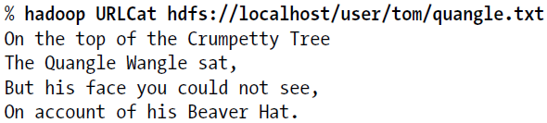
Reading Data from a Hadoop URL (cont’d)
Sample Run

Slide 23
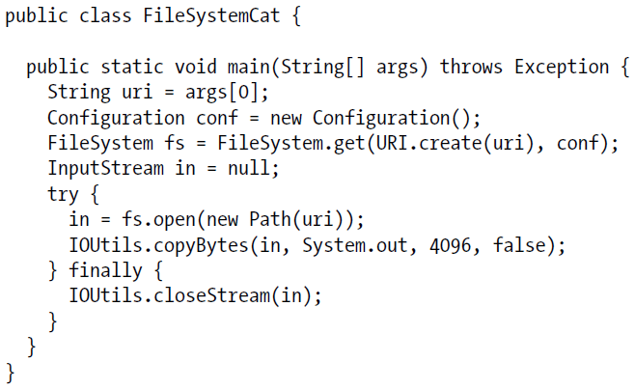
Reading Data Using the FileSystem API
HDFS file : Hadoop Path object : HDFS URI

Slide 24
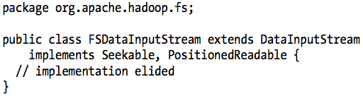
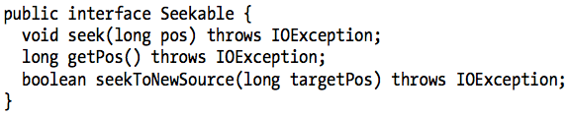
FSDataInputStream
A specialization of java.io.DataInputStream

Slide 25
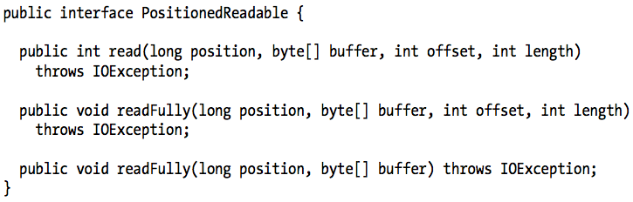
FSDataInputStream (cont’d)
Preserving the current offset in the file
Thread-safe

Slide 26

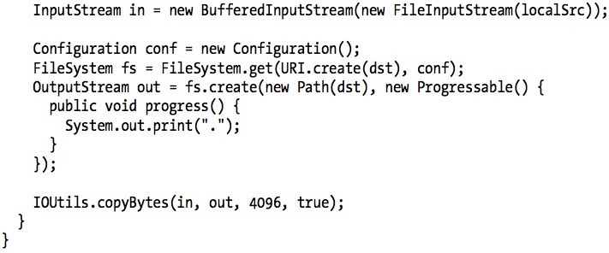
Writing Data
Create or append with Path object
Copying a local file to a HDFS, and shows progress

Slide 27
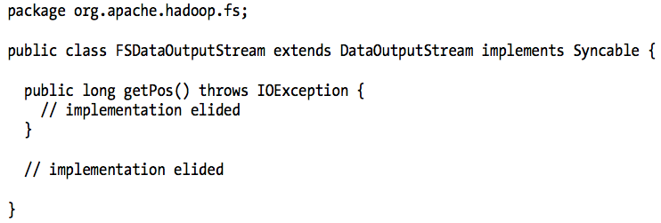
FSDataOutputStream
Seeking is not permitted
HDFS allows only sequential writes or appends

Slide 28
Directories
Creating a directory
Often, you don’t need to explicitly create a directory
Writing a file will automatically creates any parent directories

Slide 29
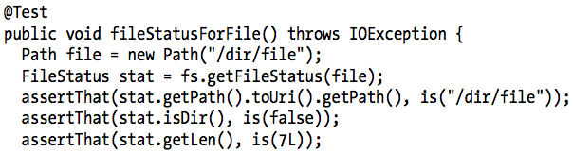
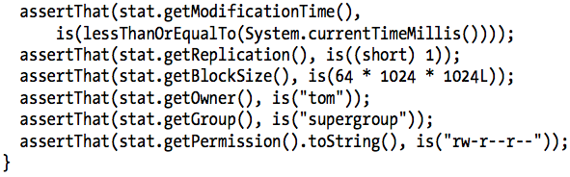
File Metadata: FileStatus

Slide 30

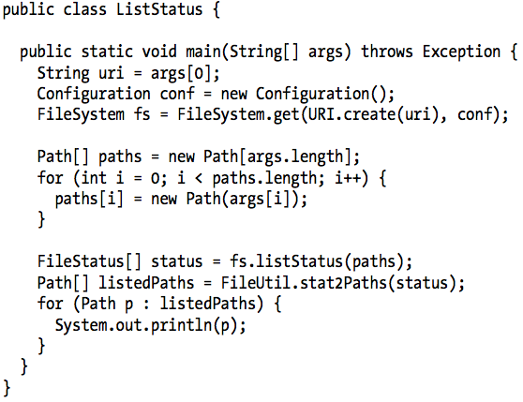
Listing Files

Slide 31
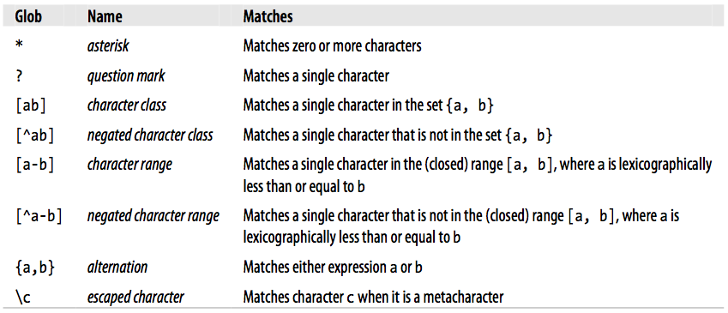
File Patterns
Globbing: to use wildcard characters to match mutiple files
Glob characters and their meanings

Slide 32
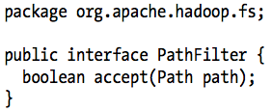
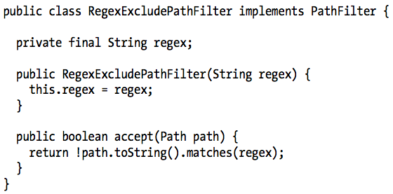
PathFilter
Allows programmatic control over matching
PathFilter for excluding paths that match a regex

Slide 33
Deleting Data
Removing files or directories permanently

