Slide 1
Chapter 21: Parallel Databases

Slide 2
Database System Concepts
Chapter 1: Introduction
Part 1: Relational databases
  Chapter 2: Relational Model
  Chapter 3: SQL
  Chapter 4: Advanced SQL
  Chapter 5: Other Relational Languages
Part 2: Database Design
  Chapter 6: Database Design and the E-R Model
  Chapter 7: Relational Database Design
  Chapter 8: Application Design and Development
Part 3: Object-based databases and XML
  Chapter 9: Object-Based Databases
  Chapter 10: XML
Part 4: Data storage and querying
  Chapter 11: Storage and File Structure
  Chapter 12: Indexing and Hashing
  Chapter 13: Query Processing
  Chapter 14: Query Optimization
Part 5: Transaction management
  Chapter 15: Transactions
  Chapter 16: Concurrency control
  Chapter 17: Recovery System
Part 6: Data Mining and Information Retrieval
  Chapter 18: Data Analysis and Mining
  Chapter 19: Information Retreival
Part 7: Database system architecture
  Chapter 20: Database-System Architecture
  Chapter 21: Parallel Databases
  Chapter 22: Distributed Databases
Part 8: Other topics
  Chapter 23: Advanced Application Development
  Chapter 24: Advanced Data Types and New Applications
  Chapter 25: Advanced Transaction Processing
Part 9: Case studies
  Chapter 26: PostgreSQL
  Chapter 27: Oracle
  Chapter 28: IBM DB2
  Chapter 29: Microsoft SQL Server
Online Appendices
  Appendix A: Network Model
  Appendix B: Hierarchical Model
  Appendix C: Advanced Relational Database Model

Slide 3
Part 7: Database system architecture
(Chapters 20 through 22).
Chapter 20: Database-System Architecture
  covers computer-system architecture, and describes the influence of the underlying computer system on the database system. We discuss centralized systems, client-server systems, parallel and distributed architectures, and network types in this chapter.
Chapter 21: Parallel Databases
  explores a variety of parallelization techniques, including I/O parallelism, interquery and intraquery parallelism, and interoperation and intraoperation parallelism. The chapter also describes parallel-system design.
Chapter 22: Distributed Databases
  covers distributed database systems, revisiting the issues of database design, transaction management, and query evaluation and optimization, in the context of distributed databases. The chapter also covers issues of system availability during failures and describes the LDAP directory system.

Slide 4
Chapter 21: Parallel Databases
21.1 Introduction
21.2 I/O Parallelism
21.3 Inter-query Parallelism
21.4 Intra-query Parallelism
21.5 Intra-operation Parallelism
21.6 Inter-operation Parallelism
21.7 Design of Parallel Systems
21.8 Summary

Slide 5
Introduction
Parallel machines are becoming quite common and affordable
  Prices of microprocessors, memory and disks have dropped sharply
Databases are growing increasingly large
  large volumes of transaction data are collected and stored for later analysis.
  multimedia objects like images are increasingly stored in databases
Large-scale parallel database systems increasingly used for:
  storing large volumes of data
  processing time-consuming decision-support queries
  providing high throughput for transaction processing

Slide 6
Parallelism in Databases
Data can be partitioned across multiple disks for parallel I/O
Different queries can be run in parallel with each other (Inter-Query Parallelism)
  Concurrency control takes care of conflicts
Queries are expressed in high level language SQL, then translated to relational algebra
  Individual relational operations (e.g., sort, join, aggregation) can be executed in parallel (Intra-Query Parallelism)
  data can be partitioned and each processor can work independently on its own partition.
Thus, databases naturally lend themselves to parallelism
  Potential parallelism is everywhere in database processing

Slide 7
Chapter 21: Parallel Databases
21.1 Introduction
21.2 I/O Parallelism
21.3 Inter-query Parallelism
21.4 Intra-query Parallelism
21.5 Intra-operation Parallelism
21.6 Inter-operation Parallelism
21.7 Design of Parallel Systems
21.8 Summary

Slide 8
I/O Parallelism
Reduce the time required to retrieve relations from disk by partitioning the relations on multiple disks.
Horizontal partitioning – tuples of a relation are divided among many disks such that each tuple resides on one disk. (number of disks = n):
  Round-robin partitioning: Send the i^{th} tuple inserted in the relation to disk i mod n.
  Hash partitioning:
  Choose one or more attributes as the partitioning attributes.
  Choose hash function h with range 0…n - 1
  Let i denote result of hash function h applied to the partitioning attribute value of a tuple. Send tuple to disk i.
Range partitioning:
  Choose an attribute v as the partitioning attribute
  A partitioning vector [v_{o}, v₁, ..., v_{n-2}] is chosen
    Tuples such that v_{i} ≤ v ≤ v_{i+1} go to disk i + 1
    Tuples with v < v₀ go to disk 0
    Tuples with v ≥ v_{n-2} go to disk n-1.
  E.g., with a partitioning vector [5,11] and 3 disks, a tuple with value 2 goes to disk 0, a tuple with value 8 goes to disk 1, while a tuple with value 20 goes to disk2.

Slide 9
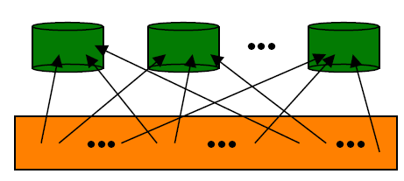
Comparison of Partitioning Techniques
Evaluate how well partitioning techniques support the following types of data access in a parallel fashion:
1.Scanning the entire relation – scan queries
2.Locating a tuple associatively – point queries (E.g., r.A = 25)
3.Locating all tuples such that the value of a given attribute lies within a specified range – range queries (E.g., 10 ≤ r.A < 25)
Round robin partitioning:
Best suited for sequential scan of entire relation on each query.
  All disks have almost an equal number of tuples
  Retrieval work for entire relation is thus well balanced between disks
Point queries and Range queries are difficult to process
  No clustering -- tuples are scattered across all disks
p1
p2
pn
Given Data

Slide 10
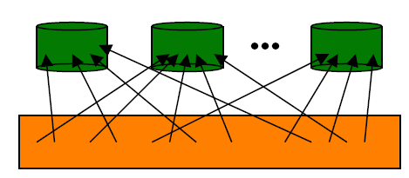
Comparison of Partitioning Techniques (Cont.)
Hash partitioning:
Good for sequential access
  Assuming hash function is good, and partitioning attributes form a key, tuples will be equally distributed between disks
  Retrieval work for entire relation is then well balanced between disks.
Good for point queries on partitioning attribute
  Can lookup single disk, leaving others available for answering other queries.
  Index on partitioning attribute can be local to disk, making lookup and update more efficient
No clustering, so difficult to answer range queries
p1
p2
pn
Hashing Function H
Given Data

Slide 11
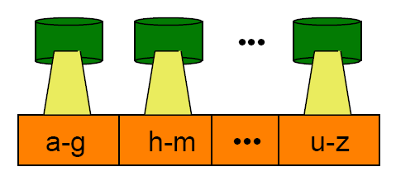
Comparison of Partitioning Techniques (Cont.)
Range partitioning:
Provides data clustering by partitioning attribute value
Good for sequential access
Good for point queries on partitioning attribute
  only one disk needs to be accessed.
For range queries on partitioning attribute, one to a few disks may need to be accessed
  Remaining disks are available for other queries.
  Good if result tuples are from one to a few blocks.
  If many blocks are to be fetched and they are still fetched from one to a few disks, and potential parallelism in disk access is wasted
    Example of execution skew
    Round-robin or Hash partitioning might be better for this case
p1
p2
pn
Given Data

Slide 12
Handling of Skew problem
Partitioning a Relation across Disks
  If a relation contains only a few tuples which will fit into a single disk block, then assign the relation to a single disk.
  Large relations are preferably partitioned across all the available disks.
  If a relation consists of m disk blocks and there are n disks available in the system, then the relation should be allocated min(m,n) disks.
The distribution of tuples to disks may be skewed
  Some disks have many tuples, while others may have fewer tuples
Types of skew:
  Attribute-value skew
    All the tuples with the same value for the partitioning attribute end up in the same partition
    Can occur with range-partitioning and hash-partitioning
  Partition skew
    With range-partitioning, badly chosen partition vector may assign too many tuples to some partitions and too few to others
    Less likely with hash-partitioning if a good hash-function is chosen

Slide 13
Handling Skew in Range-Partitioning
To create a balanced partitioning vector (assuming partitioning attribute forms a key of the relation):
  Sort the relation on the partitioning attribute.
  Construct the partition vector by scanning the relation in sorted order as follows.
    After every 1/n^{th} of the relation has been read, the value of the partitioning attribute of the next tuple is added to the partition vector.
  n denotes the number of partitions to be constructed.
  Duplicate entries or imbalances can result if duplicates are present in partitioning attributes.
Perform partitioning using the balanced partitioning vector
1
3
4
7
9
..
15
Partioning attribute
n = 3
balanced partitioning vector
1..4
7..11
12..15

Slide 14
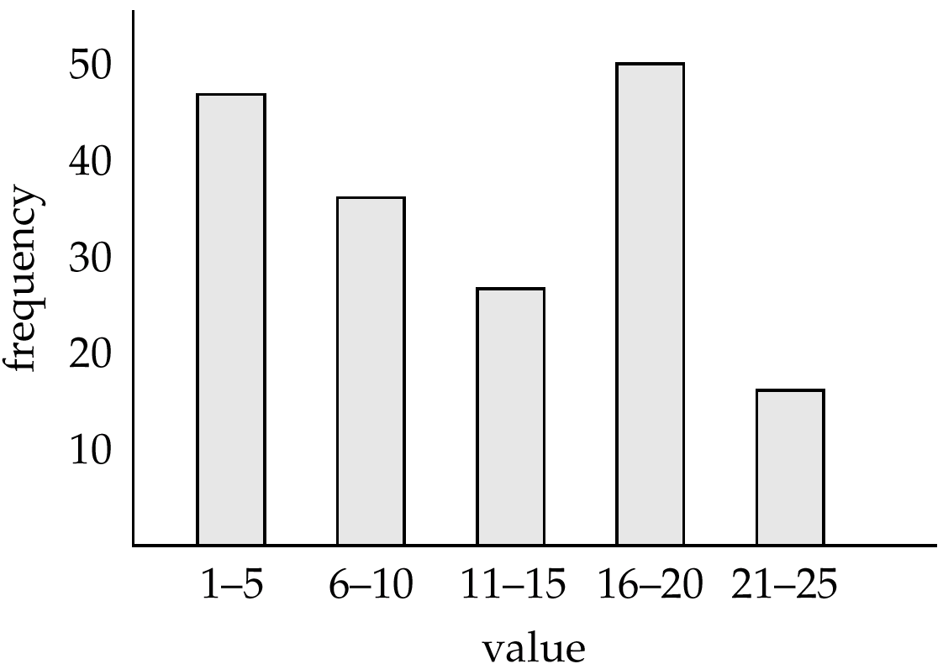
Handling Skew using Histograms
Balanced partitioning vector can be constructed from histogram in a relatively straightforward fashion
  Assume uniform distribution within each range of the histogram
  Histogram can be constructed by scanning relation, or sampling (blocks containing) tuples of the relation
  Histograms can be stored in the system catalog
Perform partitioning using the balanced partitioning vector

Slide 15
Handling Skew using Virtual Processor Partitioning
Skew in range partitioning can be handled elegantly using virtual processor partitioning:
  create a large number of partitions (say 10 to 20 times the number of processors)
  Assign virtual processors to partitions either in round-robin fashion or based on estimated cost of processing each virtual partition
Basic idea:
  If any normal partition would have been skewed, it is very likely the skew is spread over a number of virtual partitions
  Skewed virtual partitions get spread across a number of processors, so work gets distributed evenly!

Slide 16
Virtual Processor Partitioning
Given Data
A...E
F...J
K...N
O...Z
Virtual processors
VP₁
VP₂
VP₃
VP₄
VP₅
Real processors
P₁
P₂
P_{n}

Slide 17
Chapter 21: Parallel Databases
21.1 Introduction
21.2 I/O Parallelism
21.3 Inter-query Parallelism
21.4 Intra-query Parallelism
21.5 Intra-operation Parallelism
21.6 Inter-operation Parallelism
21.7 Design of Parallel Systems
21.8 Summary

Slide 18
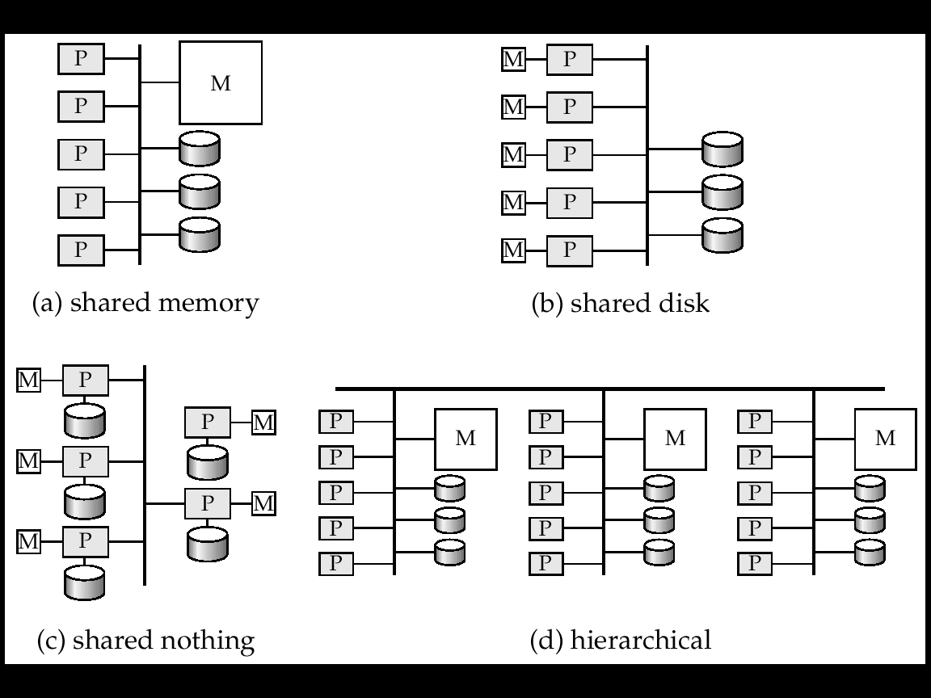
Interquery Parallelism
Different queries / transactions execute in parallel with one another
Increases transaction throughput
  used primarily to scale up a transaction processing system to support a larger number of transactions per second
Can use single-processor version of DBMS without drastic changes?
  What about concurrency control
  What about recovery
  Many local memories may cause consistency problem

Slide 19
Interquery Parallelism (cont.)
Shared-memory parallel database is easiest form of parallelism to support because even sequential database systems support concurrent processing
  Single-processor version of DBMS can be used without drastic changes
More complicated to implement on shared-disk or shared-nothing architectures
  Locking and logging must be coordinated by passing messages between processors.
  Data in a local buffer may have been updated at another processor
    Cache-coherency has to be maintained — reads and writes of data in buffer must find latest version of data
  Cache-coherency protocol may need to be combined with concurrency control

Slide 20
Cache Coherency Protocol in Parallel Database
Example of a cache coherency protocol for shared disk systems:
  Before reading/writing to a page, the page must be locked in shared/exclusive mode.
  On locking a page, the page must be read from disk
  Before unlocking a page, the page must be written to disk if it was modified.
More complex protocols with fewer disk reads/writes exist
Cache coherency protocols for shared-nothing systems are similar.
  Each database page is assigned a home processor.
  Requests to fetch the page or write it to disk are sent to the home processor.

Slide 21
Chapter 21: Parallel Databases
21.1 Introduction
21.2 I/O Parallelism
21.3 Inter-query Parallelism
21.4 Intra-query Parallelism
21.5 Intra-operation Parallelism
21.6 Inter-operation Parallelism
21.7 Design of Parallel Systems
21.8 Summary

Slide 22
Intra-query Parallelism
Execution of a single query in parallel on multiple processors / disks
  important for speeding up long-running queries.
Two complementary forms of intraquery parallelism :
  Intra-operation Parallelism – parallelize the execution of each individual operation in the query
    This form scales better with increasing parallelism because the number of tuples processed by each operation is typically more than the number of operations in a query
  Inter-operation Parallelism – execute the different operations in a query expression in parallel.

Slide 23
Parallel Processing of Relational Operations
Our discussion of parallel algorithms assumes:
  read-only queries
  shared-nothing architecture
  n processors, P₀, ..., P_{n-1}, and n disks D₀, ..., D_{n-1}, where D_{i} ⬅➔ P_{i}.
If a processor has multiple disks they can simply simulate a single disk D_{i}.
Shared-nothing architectures can be efficiently simulated on shared-memory and shared-disk systems.
  Algorithms for shared-nothing systems can thus be run on shared-memory and shared-disk systems.
  However, some optimizations may be possible.

Slide 24
Chapter 21: Parallel Databases
21.1 Introduction
21.2 I/O Parallelism
21.3 Inter-query Parallelism
21.4 Intra-query Parallelism
21.5 Intra-operation Parallelism
21.6 Inter-operation Parallelism
21.7 Design of Parallel Systems
21.8 Summary

Slide 25
Parallel Sort
Range-Partitioning Sort
Choose processors P₀, ..., P_{m}, where m ≤ n -1 to do sorting.
Create range-partition vector with m entries, on the sorting attributes
Redistribute the relation using range partitioning
  All tuples that lie in the i^{th} range are sent to processor P_{i}
  P_{i} stores the tuples it received temporarily on disk D_{i}.
  This step requires I/O and communication overhead.
Each processor P_{i} sorts its partition of the relation locally.
Each processors executes same operation (sort) in parallel with other processors, without any interaction with the others (data parallelism).
Final merge operation is trivial
  range-partitioning ensures that, for 1 ≤ i < j ≤ m, the key values in processor P_{i}. are all less than the key values in P_{j}.

Slide 26
Range-Partitioning Sort
P_{n}
D₀
P₁
P₂
P₃
Local
sort
Local
sort
Local
sort
Sorts its partition locally
D₁
D₂
D₃
Range partitioning
P₀
D₀

Slide 27
Parallel Sort (Cont.)
Parallel External Sort-Merge
Assume the relation has already been partitioned among disks D₀, ..., D_{n-1} (in whatever manner)
Each processor P_{i} locally sorts the data on disk D_{i}
The sorted runs on each processor are then merged to get the final sorted output.
Parallelize the merging of sorted runs as follows:
  The sorted partitions at each processor P_{i} are range-partitioned across the processors P₀, ..., P_{m-1}
  Each processor P_{i} performs a merge on the streams as they are received, to get a single sorted run
  The sorted runs on processors P₀,..., P_{m-1} are concatenated to get the final result

Slide 28
Parallel External Sort-Merge
P_{n}
D₀ : concatenated run
Merge the sorted runs
P₁
P₂
P₃
Each Di has a sorted run
D₂
D₃
D₁
Range partitioning
Local
sort
Local
sort
Local
sort
Sorts its partition locally
D₁
D₂
D₃
※ Assume the relation has already been partitioned

Slide 29
Parallel Join Methods
The join operation requires pairs of tuples to be tested to see if they satisfy the join condition, and if they do, the pair is added to the join output.
Parallel Join algorithms
  Split the pairs to be tested over several processors
  Each processor then computes part of the join locally
  In a final step, the results from each processor can be collected together to produce the final result
Partitioned Join
Fragment-and-Replicate Join
Partitioned Parallel Hash-Join
Parallel Nested-Loop Join

Slide 30
Partitioned Join
For equi-joins and natural joins, it is possible to partition the two input relations across the processors, and compute the join locally at each processor
Let r and s be the input relations, and we want to compute r _{r.A=s.B} s
r and s are partitioned into n partitions, denoted r₀, r₁, ..., r_{n-1} and s₀, s₁, ..., s_{n-1}
  Can use either range partitioning or hash partitioning.
  r and s must be partitioned on their join attributes (r.A and s.B), using the same range-partitioning vector or hash function
Partitions r_{i} and s_{i} are sent to processor P_{i}
Each processor P_{i} locally computes r_{i} _{ri.A=si.B} s_{i}
  Any of the standard join methods can be used.

Slide 31
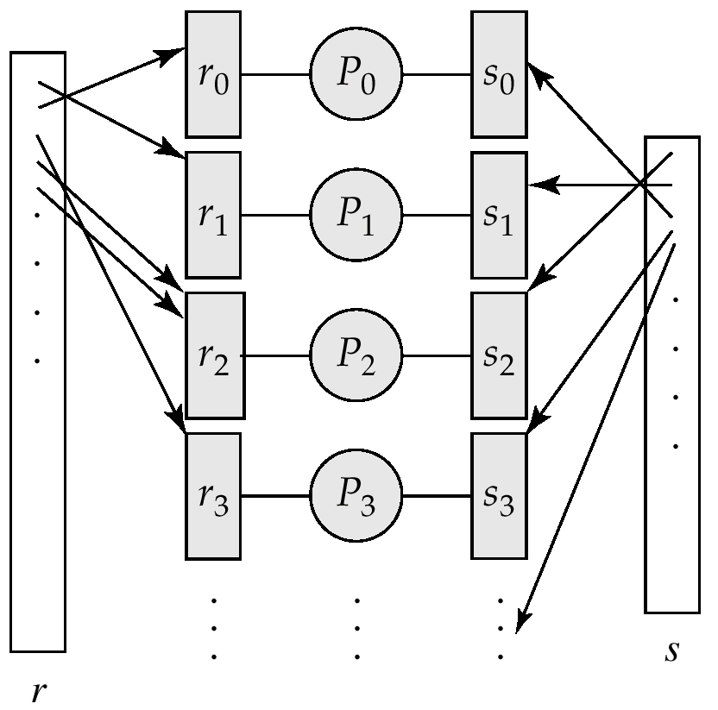
Partitioned Join (Cont.)
Range partitioning
or Hash partitioning
on join attributes

Slide 32
Fragment-and-Replicate Join
Partitioned join is not possible for some join conditions
  e.g., non-equijoin conditions, such as r.A > s.B.
  For joins where partitioning is not applicable, parallelization can be accomplished by fragment and replicate technique
  Depicted on next slide
Special case – asymmetric fragment-and-replicate:
  One of the relations, say r, is partitioned
    any partitioning technique can be used.
  The other relation, s, is replicated across all the processors
  Processor P_{i} then locally computes the join of r_{i} with all of s using any join technique.

Slide 33
Fragment-and-Replicate Join (Cont.)
General case: reduces the sizes of the relations at each processor
  r is partitioned into n partitions,r₀, r₁, ..., r _{n-1}
  s is partitioned into m partitions, s₀, s₁, ..., s_{m-1}
    Any partitioning technique may be used.
  There must be at least m * n processors
  Label the processors as P_{0,0}, P_{0,1}, ..., P_{0,m-1}, P_{1,0}, ..., P_{n-1m-1}
  P_{i,j} computes the join of r_{i} with s_{j}
    In order to do so, r_{i} is replicated to P_{i,0}, P_{i,1}, ..., P_{i,m-1}, while s_{i} is replicated to P_{0,i}, P_{1,i}, ..., P_{n-1,i}
    Any join technique can be used at each processor P_{i,j}.

Slide 34
Fragment-and-Replicate Join (Cont.)
Both versions of fragment-and-replicate work with any join condition, since every tuple in r can be tested with every tuple in s.
Usually has a higher cost than partitioned join, since one of the relations (for asymmetric fragment-and-replicate) or both relations (for general fragment-and-replicate) have to be replicated.
Sometimes asymmetric fragment-and-replicate is preferable even though partitioning could be used.
  E.g., Suppose s is small and r is large, and already partitioned
    It may be cheaper to replicate s across all processors, rather than repartition r and s on the join attributes.

Slide 35
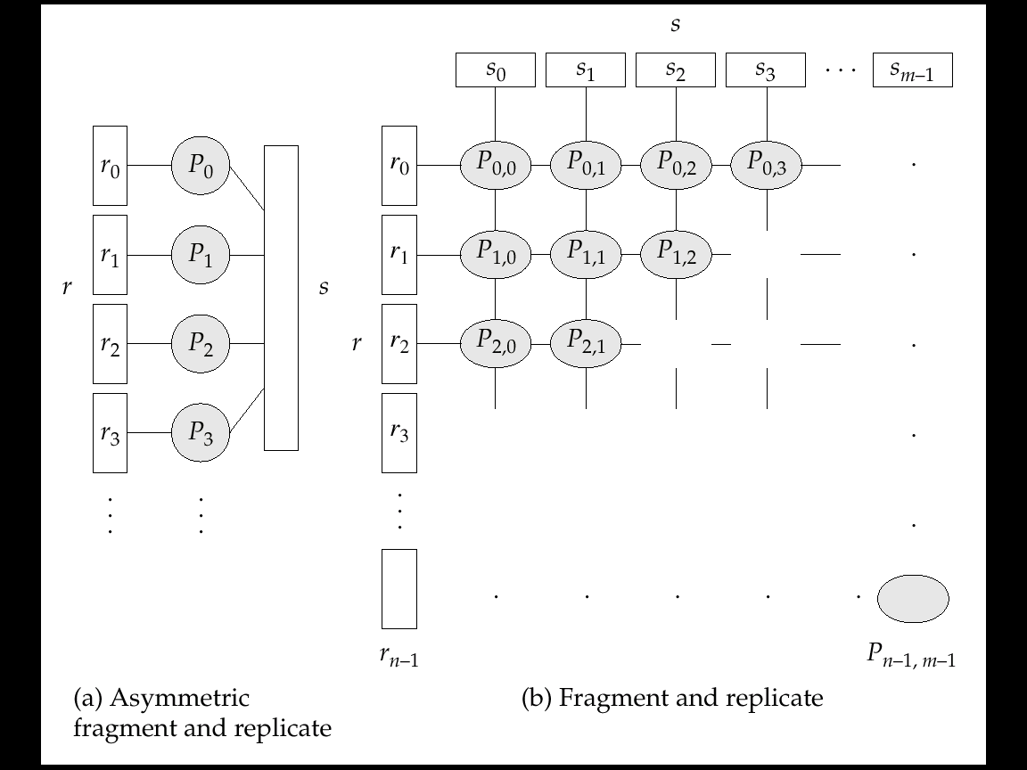
Depiction of Fragment-and-Replicate Joins
S replicated
r0 replicated
s0 replicated
When partitioned join is not possible!

Slide 36
Partitioned Parallel Hash-Join
Parallelizing partitioned hash join:
Assume s is smaller than r and therefore s is chosen as the build relation.
A hash function h₁ takes the join attribute value of each tuple in s and maps this tuple to one of the n processors.
Each processor P_{i} reads the tuples of s that are on its disk D_{i}, and sends each tuple to the appropriate processor based on hash function h₁.
  Let s_{i} denote the tuples of relation s that are sent to processor P_{i}.
As tuples of relation s are received at the destination processors, they are partitioned further using another hash function, h₂, which is used to compute the hash-join locally. (Cont.)

Slide 37
Partitioned Parallel Hash-Join (Cont.)
Once the tuples of s have been distributed, the larger relation r is redistributed across the m processors using the hash function h₁
  Let r_{i} denote the tuples of relation r that are sent to processor P_{i}.
As the r tuples are received at the destination processors, they are repartitioned using the function h₂
  (just as the probe relation is partitioned in the sequential hash-join algorithm).
Each processor P_{i} executes the build and probe phases of the hash-join algorithm on the local partitions r_{i} and s_{i} of r and s to produce a partition of the final result of the hash-join.
Note: Hash-join optimizations can be applied to the parallel case
  e.g., the hybrid hash-join algorithm can be used to cache some of the incoming tuples in memory and avoid the cost of writing them and reading them back in.

Slide 38
Partitioned Parallel Hash-Join
Relation R
OUTPUT
Partitions
1
Pr₁
R₁
INPUT
2
hash
function
h1
Pr₂
. . .
R₂
i
Pr₃
R_{i}
Partition both
relations using
hash function h1
Relation S
OUTPUT
Partitions
1
Ps₁
S₁
INPUT
2
hash
function
h1
S₂
Ps₂
. . .
i
Ps₃
S_{i}
main memory buffers

Slide 39
Partitioned Parallel Hash-Join
P_{i}
Partitions
of S
Hash table for partition
S_{i}
Partitions
of R
h2
h2
Read in a
partition of R,
hash it using h2
Input buffer
R_{i}
Output
buffer
main memory buffers
P_{n}
Disk
Disk
Join Result
Disk

Slide 40
Parallel Nested-Loop Join
Assume that
  Relation s is much smaller than relation r and that r is stored by partitioning.
  There is an index on a join attribute of relation r at each of the partitions of relation r.
Use asymmetric fragment-and-replicate join, with relation s being replicated, and using the existing partitioning of relation r.
Each processor P_{j} where a partition of relation s is stored reads the tuples of relation s stored in D_{j}, and replicates the tuples to every other processor P_{i}.
  At the end of this phase, relation s is replicated at all sites that store tuples of relation r.
Each processor P_{i} performs an indexed nested-loop join of relation s with the i^{th} partition of relation r.

Slide 41
Parallel Nested-Loop Join
Join attribute A
Partitions
P₁
Replicate of S
R
S
INPUT
R₁
S
INPUT
R₁
1
R₂
S
2
. . .
. . .
i
R_{i}
S
Disk
Disk
Output
buffer
Disk
Disk
A..Z
P_{i}
Index nested loop join
Join Result
Asymmetric fragment + replicate join
Disk

Slide 42
Parallel Selection
Selection σ_{θ}(r)
If θ is of the form a_{i} = v, where a_{i} is an attribute and v a value.
  If r is partitioned on a_{i} the selection is performed at a single processor
If θ is of the form l < a_{i} < u (i.e., θ is a range selection) and the relation has been range-partitioned on a_{i}
  Selection is performed at each processor whose partition overlaps with the specified range of values
In all other cases: the selection is performed in parallel at all the processors
σ_{E = 3}
∪
∪
σ_{E = 3}
σ_{E = 3}
Ø
[R₁: E < 10]
[R₂: E ≥ 10]
[R₁: E < 10]
[R₂ : E ≥ 10]

Slide 43
Duplicate Elimination and Parallel Projection
Duplicate elimination
  Perform by using either of the parallel sort techniques
    eliminate duplicates as soon as they are found during sorting.
  Can also partition the tuples (using either range-partitioning or hash- partitioning) and perform duplicate elimination locally at each processor.
Projection
  Projection without duplicate elimination can be performed as tuples are read in from disk in parallel.
  If duplicate elimination is required, any of the above duplicate elimination techniques can be used.

Slide 44
Parallel Grouping/Aggregation
Partition the relation on the grouping attributes and then compute the aggregate values locally at each processor.
Can reduce cost of transferring tuples during partitioning by partly computing aggregate values before partitioning.
Consider the sum aggregation operation:
  Perform aggregation operation at each processor P_{i} on those tuples stored on disk D_{i}
    results in tuples with partial sums at each processor.
  Result of the local aggregation is partitioned on the grouping attributes, and the aggregation performed again at each processor P_{i} to get the final result.
Fewer tuples need to be sent to other processors during partitioning.

Slide 45
Parallel Grouping/Aggregation
P1
P2
P3
P4
P5
sum
Partly computing
sum
sum
sum
sum
sum
D1
D2
D3
D4
D5
Grouping partitioning
P₀
D₀

Slide 46
Cost of Parallel Evaluation of Operations
If there is no skew in the partitioning, and there is no overhead due to the parallel evaluation, expected speed-up will be 1/n
If skew and overheads are also to be taken into account, the time taken by a parallel operation can be estimated as
  T_{part} + T_{asm} + max (T₀, T₁, …, T_{n-1})
  T_{part} is the time for partitioning the relations
  T_{asm} is the time for assembling the results
  T_{i} is the time taken for the operation at processor P_{i}
    this needs to be estimated taking into account the skew, and the time wasted in contentions.

Slide 47
Chapter 21: Parallel Databases
21.1 Introduction
21.2 I/O Parallelism
21.3 Inter-query Parallelism
21.4 Intra-query Parallelism
21.5 Intra-operation Parallelism
21.6 Inter-operation Parallelism
21.7 Design of Parallel Systems
21.8 Summary

Slide 48
Inter-operator Parallelism: Pipelined Parallelism
Consider a join of four relations : r₁ r₂ r₃ r₄
Set up a pipeline that computes the three joins in parallel
  Let P1 be assigned the computation of temp1 = r₁ r₂
  And P2 be assigned the computation of temp2 = temp1 r₃
  And P3 be assigned the computation of temp2 r₄
Each of these operations can execute in parallel, sending result tuples it computes to the next operation even as it is computing further results
  Provided a pipelineable join evaluation algorithm (e.g. indexed nested loops join) is used
P3
P2
r₄
P1
P2
P3
result
P1
r₃
tuples matching
r₃
r₄
r₁
r₂
r₁
r₂

Slide 49
Inter-operator Parallelism: Pipelined Parallelism
Factors limiting Utility of Pipelined Parallelism
  Pipeline parallelism is useful since it avoids writing intermediate results to disk
  Useful with small number of processors, but does not scale up well with more processors.
    One reason is that pipeline chains do not attain sufficient length.
  Cannot pipeline operators which do not produce output until all inputs have been accessed (e.g. aggregate and sort)
  Little speedup is obtained for the frequent cases of skew in which one operator's execution cost is much higher than the others.

Slide 50
Inter-operator Parallelism: Independent Parallelism
  Consider a join of four relations : r₁ r₂ r₃ r₄
    Let P1 be assigned the computation of temp1 = r₁ r₂
    And P2 be assigned the computation of temp2 = r₃ r₄
    And P3 be assigned the computation of temp1 temp2
    P1 and P2 can work independently in parallel
    P3 has to wait for input from P1 and P2
      Can pipeline output of P1 and P2 to P3, combining independent parallelism and pipelined parallelism
  Does not provide a high degree of parallelism
    useful with a lower degree of parallelism
    less useful in a highly parallel system
P3
P1
P2
r₁
r₂
r₃
r₄

Slide 51
Query Optimization in Parallel DB
Query optimization in parallel databases is significantly more complex than query optimization in sequential databases
  Cost models are more complicated, since we must take into account partitioning costs and issues such as skew and resource contention
When scheduling an execution tree in parallel system, must decide:
  How to parallelize each operation and how many processors to use for it
  What operations to pipeline, what operations to execute independently in parallel, and what operations to execute sequentially, one after the other.
Determining the amount of resources to allocate for each operation is a problem
  E.g., allocating more processors than optimal can result in high communication overhead.
Long pipelines should be avoided as the final operation may wait a lot for inputs, while holding precious resources

Slide 52
Query Optimization in Parallel DB (Cont.)
The number of parallel evaluation plans from which to choose is much larger than the number of sequential evaluation plans.
  Therefore heuristics are needed while optimization
Two alternative heuristics for choosing parallel plans:
  No pipelining and inter-operation pipelining; just parallelize every operation across all processors.
    Finding best plan is now much easier --- use standard optimization technique, but with new cost model
    Volcano parallel database popularize the exchange-operator model
      exchange operator is introduced into query plans to partition and distribute tuples
      each operation works independently on local data on each processor, in parallel with other copies of the operation
  First choose most efficient sequential plan and then choose how best to parallelize the operations in that plan.
    Can explore pipelined parallelism as an option
Choosing a good physical organization (partitioning technique) is important to speed up queries.

Slide 53
Chapter 21: Parallel Databases
21.1 Introduction
21.2 I/O Parallelism
21.3 Inter-query Parallelism
21.4 Intra-query Parallelism
21.5 Intra-operation Parallelism
21.6 Inter-operation Parallelism
21.7 Design of Parallel Systems
21.8 Summary

Slide 54
Issues in Design of Parallel Systems
Parallel loading of data from external sources is needed in order to handle large volumes of incoming data.
Resilience to failure of some processors or disks.
  Probability of some disk or processor failing is higher in a parallel system.
  Operation (perhaps with degraded performance) should be possible in spite of failure.
  Redundancy achieved by storing extra copy of every data item at another processor.
On-line reorganization of data and schema changes must be supported.
  For example, index construction on terabyte databases can take hours or days even on a parallel system.
    Need to allow other processing (insertions/deletions/updates) to be performed on relation even as index is being constructed.
  Basic idea: index construction tracks changes and ``catches up'‘ on changes at the end.
Also need support for on-line repartitioning and schema changes (executed concurrently with other processing).

Slide 55
Chapter 21: Parallel Databases
21.1 Introduction
21.2 I/O Parallelism
21.3 Inter-query Parallelism
21.4 Intra-query Parallelism
21.5 Intra-operation Parallelism
21.6 Inter-operation Parallelism
21.7 Design of Parallel Systems
21.8 Summary

Slide 56
Ch21. Summary (1)
Parallel databases have gained significant commercial acceptance in the past 15 years.
In I/P parallelism, relations are partitioned among available disks so that they can be retrieved faster.
  Three commonly used partitioning techniques are round-robin partitioning, hash partitioning, and range partitioning.
Skew is a major problem, especially with increasing degrees of parallelism.
  Balanced partitioning vectors, using histograms, and virtual processor partitioning are among the techniques used to reduce skew.
In interquery parallelism, we run different queries concurrently to increase throughput.
Intraquery parallelism attempts to reduce the cost of running a query.
  There are two types of intraquery parallelism: intra-operation parallelism and inter-operation parallelism.

Slide 57
Ch21. Summary (2)
We use intraoperation parallelism to execute relational operations, such as sorts and joins, in parallel. Intraopeation parallelism and interoperation parallelism.
There are two basic approaches to parallelizing a binary operation such as join.
  In partitioned parallelism, the relations are split into several parts, and tuples in r_{i} are joined with only tuples from s_{i}. partitioned parallelism can only be used for natural and equi-joins.
  In fragement and replicate, both relations are partitioned and each partition is replicated. In asymmetric fragment-and-replicate, one of the relations is replicated while the other is partitioned. Unlike partitioned parallelism, fragment and replicate and asymmetric fragment -and -replicate can be used with any join condition.
Both parallelization techniques can work in conjunction with and join technique.

Slide 58
Ch21. Summary (3)
In independent parallelism, different operations that do not depend on one another are executed in parallel.
In pipelined parallelism, processors send the results of one operation to another operation as those results are computed, without waiting for the entire operation to finish.
Query optimization in parallel databases is significantly more complex than query optimization in sequential databases.

Slide 59
Ch21. Bibliographical Notes (1)
Relational databases systems began appearing in the marketplace in 1983; now, they dominate it.
By the late1970s and early 1980s, as the relational model gained reasonably sound footing, people recognized that relational operators are highly parallelizable and have good dataflow properties.
A commercial system. Teradata, and several research projects, such as GRACE (Kitsuregawa et al.[1983], Fushimi et al.[1986]), GAMMA (DeWitt et al. [1986], DeWitt[1990]),and Bubba (Boral et al.[1990]) were launched in quick succession.
Researchers used these parallel databases systems to investigate the practicality of parallel execution of relational operators.
Subsequently, in the late 1980s and the 1990s. Several more companies-such as Tandem, Oracle, Sybase, Informix, and Red-Brick (now a part of Informix, which is itself now a part of IBM)-entered the parallel database market.
Research projects in the academic world include XPRS (Stonebraker[1989] and Volcano(Graefe[1990]).

Slide 60
Ch21. Bibliographical Notes (2)
Locking in parallel databases is discussed in Joshi[1991], Mohan and Narang[1991], and Mohan and Narang[1992].
Cache-coherency protocols for parallel databases systems are discussed by Dias et al. [1989], Mohan and Marang[1991], Mohan and Narang[1992], and Rahm [1993].
Carey et al.[1991] discusses caching issues in a client-sever system.
Parallelism and recovery in databases systems are discusses by Bayer et al.[1980].
Graefe[1993] presents and excellent survey of query processing, including parallel processing of queries.
Parallel sorting is discussed in DeWitt et al.[1992].
Parallel join algorithms are described by Nakayama et al.[1984], Kitsuregawa et al.[1983], Richardson et al.[1987], Schneider and DeWitt[1989], Kitsuregawa and Ogawa[1990], Lin et al.[1994], and wilschut et al.[1995], among other works.
Parallel join algorithms for shared-memory architectures are described by Tsukuda et al.[1992], Deshpande and Larson[1992], and Shatdal and Naughton[1993].

Slide 61
Ch21. Bibliographical Notes (3)
Skew handling in parallel joins is described by Walton et al.[1991], Wolf[1991], and DeWitt et al.[1992].
Sampling techniques for parallel databases are described by Seshadri and Naughton[1992] and Ganguly et al.[1996].
The exchange-operator model was advocated by Graefe[1990] and Graefe[1993].
Parallel query-optimization techniques are described by H. Lu and Tan[1991], Hong and Stonebraker[1991], Ganguly et al.[1992], Lanzelotte et al.[1993], Hasan and Motwani[1995],and Jhingran et al.[1997].

Slide 62
Chapter 21: Parallel Databases
21.1 Introduction
21.2 I/O Parallelism
21.3 Inter-query Parallelism
21.4 Intra-query Parallelism
21.5 Intra-operation Parallelism
21.6 Inter-operation Parallelism
21.7 Design of Parallel Systems
21.8 Summary

Slide 63
End of Chapter

