Slide 1
Information Spreading in Context
Dashun Wang^{1,2}, Zhen Wen³, Hanghang Tong³, Ching-Yung Lin³, Chaoming Song^{1,2}, Albert-Laszlo Barabasi^{1,2,4}
¹CCNR, Dept. of Physics and Computer Science, Northeastern University
²CCSB, Dana-Farber Canser Institute, Havard University
³IBM T.J. Watson Research Center
⁴Dept. of Medicine, Briham and Women’s Hospital, Harvard Medical shcool
WWW 2011
August 17 2011
Presented by Somin Kim

Slide 2
Outline
Introduction
Related Work
Preliminaries
Microscopic Information Spreading in Context
Macroscopic Information Spreading in Context
Conclusions and Future Work

Slide 3
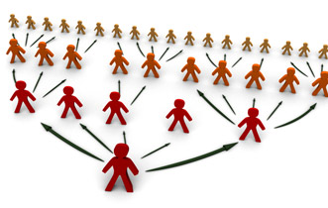
Introduction
Information spreading plays an essential role in numerous human interactions

Slide 4
Introduction
Spreading processes depend on
Underlying social networks
Whom s/he connects to
How well s/he is connected in the social network
Behavioral profiles of individuals
Personal interests
Expertise to communities
Hierarchy

Slide 5
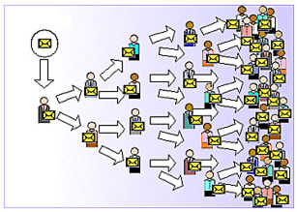
Introduction
E-mails
The most important communication method in well-documented settings
Provide high quality observations of the social context
Worker’s time
Real social connections of employees
Forwarded emails
An ideal proxy for the information spreading process
Single piece of information
Social network

Slide 6
Introduction
Microscopic view
Behaviors of each individual in the spreading process
To whom and how fast a user spreads the information
Macroscopic view
Structural properties of the spreading processes
Best model for the observed structures

Slide 7
Outline
Introduction
Related Work
Preliminaries
Microscopic Information Spreading in Context
Macroscopic Information Spreading in Context
Conclusions and Future Work

Slide 8
Related Work
Information spreading and cascades
Various studies have been conducted to understand the structural properties of information flow
Internet chain letter, viral marketing, blogs …
Emails
Much work has focused on email communication records
Various factors that could potentially affect email replies
Virus propagation
A better connected individual in the network will infect more people

Slide 9
Outline
Introduction
Related Work
Preliminaries
Data Description
Basic Properties
Microscopic Information Spreading in Context
Macroscopic Information Spreading in Context
Conclusions and Future Work

Slide 10
Preliminaries Data Description
Email data
8952 volunteer employees of a large global technology company
2-year period, 20M emails
Log data
Sender, receiver , timestamp, subject, and content of the body of the email
Personal attributes
Financial performance data
Information thread
Collect all the ‘Fw:’ emails
Group emails with the same title
Each forwarded thread results in an information spreading tree structure

Slide 11
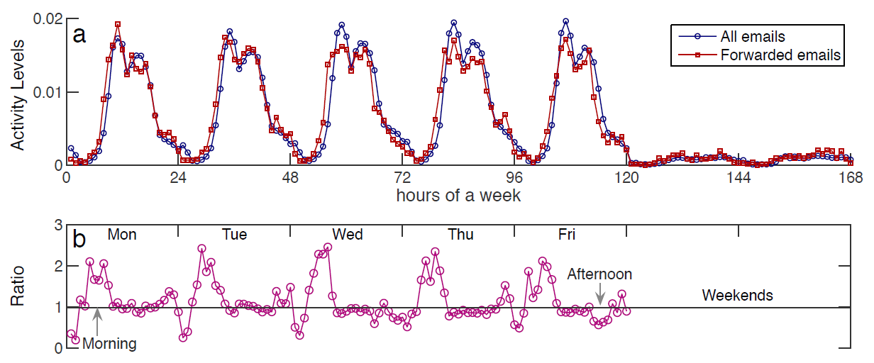
Preliminaries Basic Properties
Periodic pattern
Forwarded threads
38% ,involve people from multiple departments
43%, forwarded by managers

Slide 12
Outline
Introduction
Related Work
Preliminaries
Microscopic Information Spreading in Context
The underlying Social Networks
Information Content and Expertise
Organizational Context
Individual Characteristics
Macroscopic Information Spreading in Context
Conclusions and Future Work

Slide 13
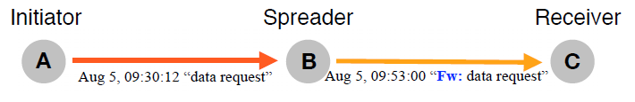
Microscopic Information Spreading in Context
Information pathway
Any spreading tree structures can be reduced to a combinations of these

Slide 14
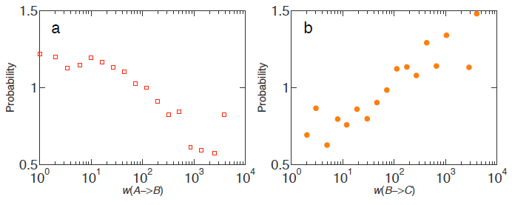
Microscopic Information Spreading in Context The Underlying Social Networks
Notations
w(i →j) : # of emails sent from user I to j
w(A →B) : between initiators and spreaders
w(B →C) : between spreaders and receivers
Probability ratio of email forwarding activity : P^{Fw}(q)/P^{rand}(q)
Weak ties Strong ties

Slide 15
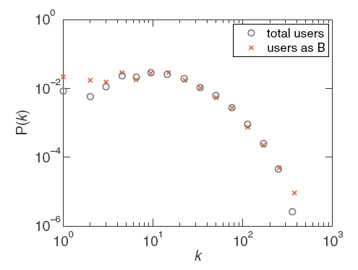
Microscopic Information Spreading in Context The Underlying Social Networks
How well are the information spreaders connected in the network?
k : # of connections
Spreaders are random samples of individuals
rather than central social hubs !

Slide 16
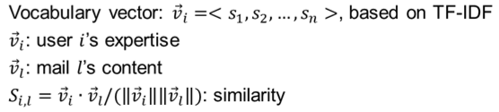
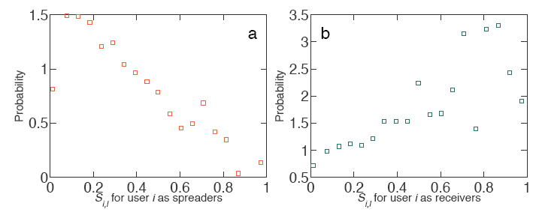
Microscopic Information Spreading in Context Information Content and Expertise
How the process depends on the relevance of the content and the individual’s expertise?
Information flows from non-experts to experts

Slide 17
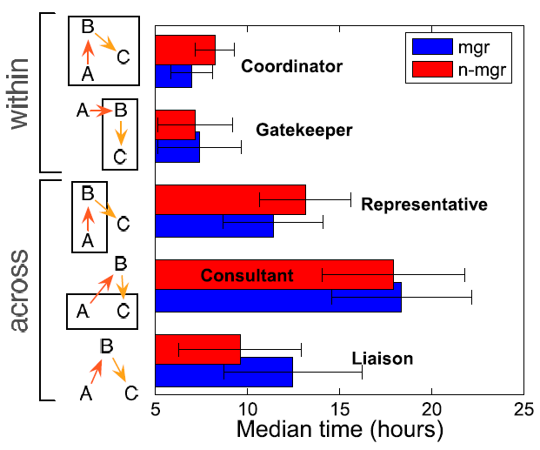
Microscopic Information Spreading in Context Organizational Context
How information flows within and between different departments?
Managers are better as a representative
Non-managers are better as a liaison

Slide 18
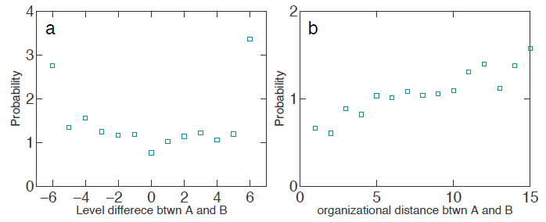
Microscopic Information Spreading in Context Organizational Context
How information flows within and between different organizational levels?
Reply time does not depend on level difference
Non-homophily
Information is unlikely to flow between individuals in the same level
Information tends to flow between individuals at a larger distance in the formal organizational structure

Slide 19
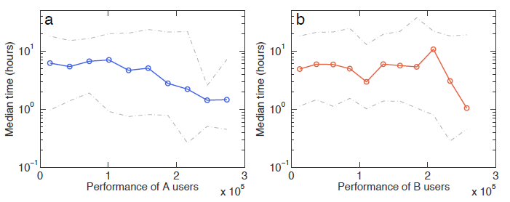
Microscopic Information Spreading in Context Individual Characteristics
Do people with different work performance behave differently in getting the word out?
Using billiable hours data
There’s no correlation between financial performance and the delay time of information spreading

Slide 20
Outline
Introduction
Related Work
Preliminaries
Microscopic Information Spreading in Context
Macroscopic Information Spreading in Context
Empirical Observations
Modeling the Information Spreading Process
Conclusions and Future Work

Slide 21
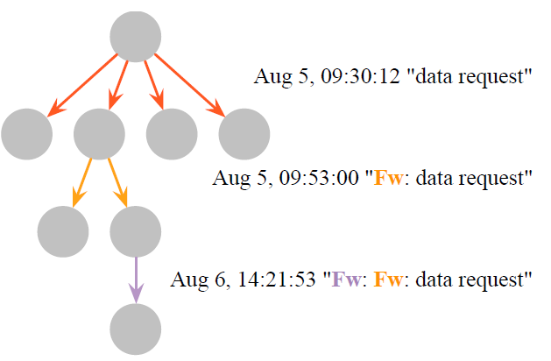
Macroscopic Information Spreading in Context Empirical Observations
Tree size, width, and depth
Ultra-shallow trees
Almost 95% of trees are of depth 2
Trees with more than 4 hops are absent
The trees are bushy yet very shallow = information spreads efficiently
Reaching out to many people, and quickly dying out

Slide 22
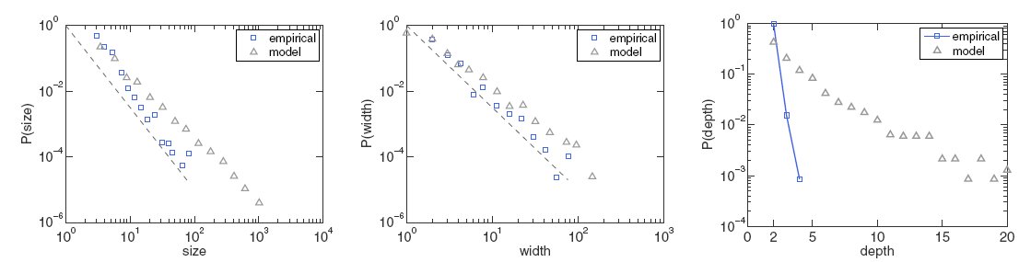
Macroscopic Information Spreading in Context Empirical Observations
Tree size, width, and depth
The distribution of size and width follow a power law
Similar exponents : 2.67(for size), 2.53(for width)
Size of the tree grows almost linerly with the width
Prediction using Galton-watson branching process
Overestimates the tails of distributions
The measured depth distribution decays much faster than the model prediction

Slide 23
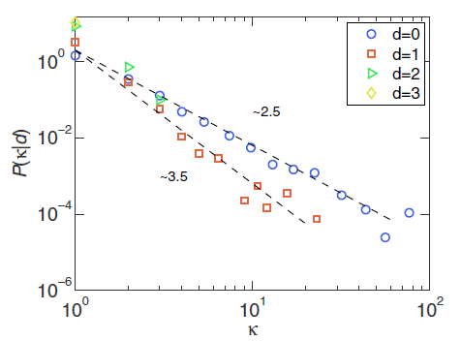
Macroscopic Information Spreading in Context Empirical Observations
Stage dependence
κ : # of children in tree
d : distance to the root
Branching process does depend on the distance to the root
The distribution of κ becomes steeper as we move deeper down the trees

Slide 24
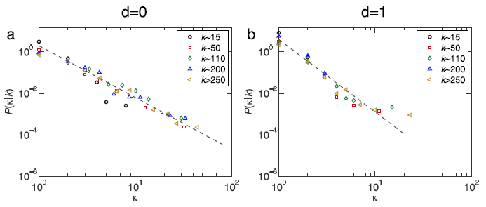
Macroscopic Information Spreading in Context Modeling the Information Spreading Process
k vs κ
k : # of neighbors who has at least one email communication
κ : # of children who received a forwarded email from me
There is no correlation between k and κ
( if they correlated to one another, it’s meaningful to find a hub node )

Slide 25
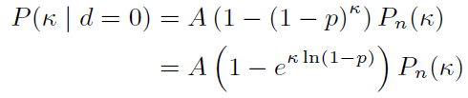

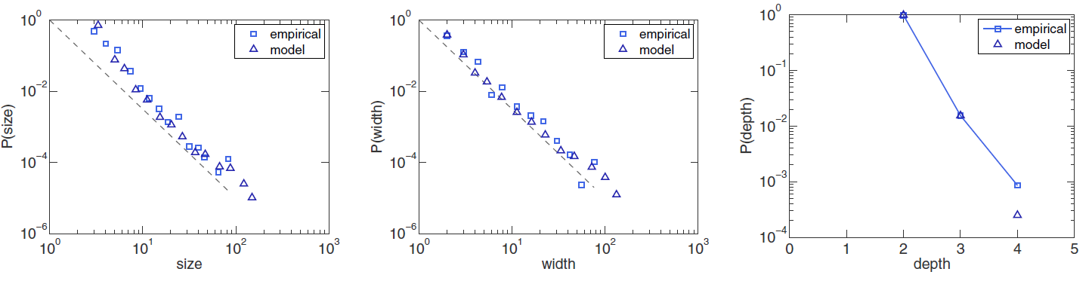
Macroscopic Information Spreading in Context Modeling the Information Spreading Process
Modeling P(κ|d)
P_{n}(κ) : the distribution of the # of recipient for emails system
p : the probability that a received email is forwarded
They all match the empirical observations very well

Slide 26
Outline
Introduction
Related Work
Preliminaries
Microscopic Information Spreading in Context
Macroscopic Information Spreading in Context
Conclusions and Future Work

Slide 27
Conclusions and Future Works
Conclusions
We address the factors that govern information spreading at both microscopic and macroscopic levels
Future work
A better prediction model for information flow
The mutation of information

