Slide 1
A Survey on Tag-aware Recommender Systems
School of Computer Science and Engineering
Seoul National University
20 September 2012
Hyunwoo Kim

Slide 2
Outline
Introduction
Tagging information
Recommender systems
Tag-aware recommender systems
Limitations
Tag-aware Recommender Systems
My Ph.D. Research

Slide 3


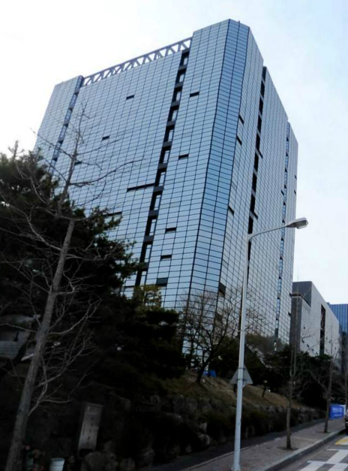

Introduction: Tagging Information [1/4]
The rise of Web 2.0
Social tagging is essential to their success [Das, VLDB2012]
Tagging
A user annotates an item with tags
Basic building block <user, item, tag>
301
SNU
Engineering
Building
user
tag
item

Slide 4


Introduction: Recommender Systems [2/4]
Focusing on recommendation problems in the mid-1990s
Collaborative filtering [Resnick, CSCW1994]
Data types used by recommender systems
User profile
Item content analysis
Relation between users and items
e.g., rating and purchase history
Recommendation methods [Adomavicius, TKDE2005]
Content-based
Hybrid
Collaborative Filtering

Slide 5
Introduction: Tag-aware Recommender Systems [3/4]
Additional types of data in tagging systems
Tagging information
Specialized recommender system is needed
Recommendation in tagging systems
[Xu, CWTW2006] [Brooks, WWW2006] [Mishne, WWW2006] [Xu, APWeb2006]
Tags in recommender systems
Useful for multimedia contents
Specific textual user preferences (e.g., good, bad, like, or cool)
Additional bridges (e.g., common tags between two users)
Tag-aware recommender systems
Recommender Systems for Social Tagging Systems, Marinho et al., Springer, 2012

Slide 6
Introduction: Limitations [4/4]
Tagging problems [Gupta, SIGKDD2010]
Spamming
Canonicalization and ambiguities
Synonym: BIG and LARGE
Polysemy: APPLE
Other problems
Sparsity, no consensus, and search inefficiency
Recommendation problems
Sparsity
Cold-start user and cold-start item

Slide 7
Outline
Introduction
Tag-aware Recommender Systems
Tag recommendation
Item recommendation with tagging information
My Ph.D. Research

Slide 8
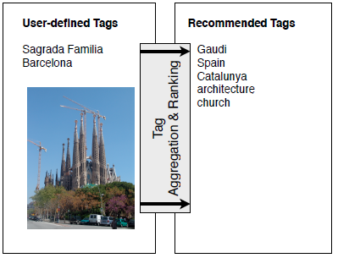
Tag-aware Recommender Systems [1/11]
Research issues in tagging systems
Tag recommendation
Assisting a user’s tag input process
Enriching tagging information
Improving user experience
Item recommendation with tagging information
[Sigurbjörnsson, WWW2008]
Recommender System
items
Tags

Slide 9
In World Wide Web Conference
Mishne
Brooks
Sigurbjörnsson
Xu
Chirita
Garg
Wu
2006
2007
2008
2009
2010
2011
2012
Guan
HeterRank
: tag recommendation
: item recommendation with tagging information

Slide 10
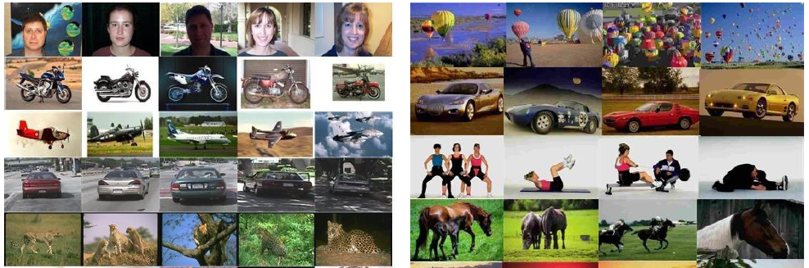
Tag-aware Recommender Systems [2/11]
Tag recommendation
Flickr Tag Recommendation based on Collective Knowledge [Sigurbjörnsson, WWW2008]
Learning to Tag [Wu, WWW2009]
Tag co-occurrence
Tag content correlation
Image conditioned tag correlation

Slide 11
Tag-aware Recommender Systems: Evolution [3/11]
Recommender System
Content-based
Collaborative Filtering
Hybrid
Tagging Information
Tag-aware Recommender System

Slide 12

Tag-aware Recommender Systems [4/11]
Collaborative filtering (CF) [Resnick, CSCW1994]
Items
1
2
3
4
5
6
7
8
9
10
User 1
 | 4 |  | 3 |  | 5
 | 4 |  | 3 |  |  | 4
 |  |  | 1 |  | 1 |  | 5
User 2
User 3
Rating matrix
User input
Recommendation
Similar users
item
item
item

Slide 13
Tag-aware Recommender Systems: Merit [5/11]
Why recommender system should consider tagging information
CF fails in diverse or mixed domains [Herlocker, TOIS2004]
Tagging information performs well in heterogeneous domains
Differences between tagging and rating data
No explicit preference information on resources
Tagged items
Similar preferences and interests
Tags
Similar point of view on items
delicious

Slide 14
Tag-aware Recommender Systems: Taxonomy [6/11]
Classification of tag-aware recommender systems
Tag-aware Recommender System
Traditional Recommender System
Tag-based Machine Learning
Tag-based Probabilistic Model
Tagging Information

Slide 15
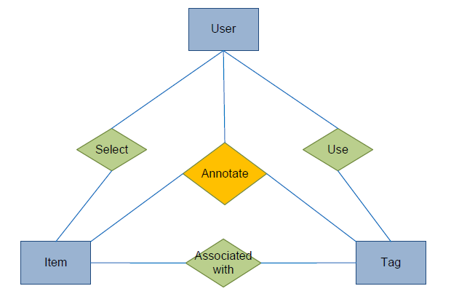
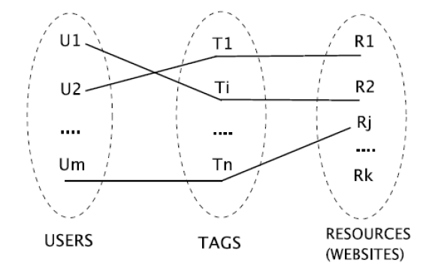
Tag-aware Recommender Systems [7/11]
Traditional RS + Tagging Information
Collaborative filtering in social tagging systems based on joint item-tag recommendations [Peng, CIKM2010]
Social media recommendation based on people and tags [Guy, SIGIR2010]
Improving recommendation based on features’ co-occurrence effects in collaborative tagging systems [Han, APWeb2012]

Slide 16
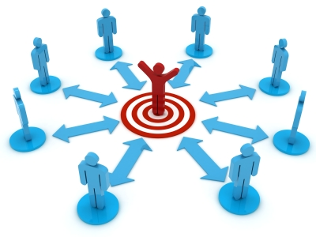
Traditional RS + Tagging Information [8/11]
Social media recommendation based on people and tags [Guy, SIGIR2010]
CF using social network
Familiarity relationships
People the user knows
All direct people-people relations
Co-authorship of a file or a wiki and having the same manager
CF using tagging information
Similarity relationships
People whose social activity overlaps with the user’s social activity
Co-usage of the same tag, co-tagging of the same item
Co-commenting on the same blog entry, co-membership in the same community

Slide 17

Tag-aware Recommender Systems [9/11]
Tag-based Machine Learning
Personalized recommendation in social tagging systems using hierarchical clustering [Shepitsen, RecSys2008]
Document recommendation in social tagging services [Guan, WWW2010]
y
: documents
: users
: tags
x
z

Slide 18
Tag-based Machine Learning [10/11]
Document recommendation in social tagging services [Guan, WWW2010]
Multi-type Interrelated Objects Embedding (MIOE)
Annotation relationships between tags and documents
Usage relationships between tags and users
Bookmarking relationships between users and documents
Affinity relationships among documents
3 bipartite graphs and 1 affinity graph
Optimal semantic space
Preserving the connectivity structure of these graphs
Representing users, tags and documents in the same space
if (two objects are strongly connected) {
the corresponding edge has a high weight;
two object should be mapped close to each other in the space;
}

Slide 19
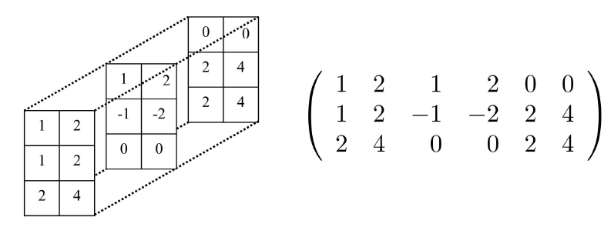
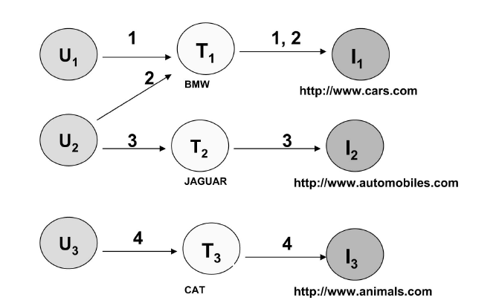
Tag-aware Recommender Systems [11/11]
Tag-based Probabilistic Model
A hybrid PLSA approach for warmer cold start in folksonomy recommendation [Umbrath, RecSys2009]
A unified framework for providing recommendations in social tagging systems based on ternary semantic analysis [Symeonidis, TKDE2010]
Low-order tensor decompositions for social tagging recommendation [Cai, WSDM2011]

Slide 20
Outline
Introduction
Tag-aware Recommender Systems
My Ph.D. Research
Previous Work
Future Research Direction

Slide 21
Previous Work [1/3]
Tag recommendation
Tag Suggestion Method based on Association Pattern and Bigram Approach [Kim, IWEA 2009]
Comparing N-gram Models for Tag Suggestion in Tagging System [Kim, DEECS 2009]
Tag Recommendation Algorithms in Tagging System [Kim, Journal of KIISE 2010]
Recommender systems with tagging information
Improving Recommendation based on Implicit Trust Relationships from Tags [Kim, CNSI 2012]
Item Recommendation using Tag Expansion and Temporal Information [Kim, Journal of KIISE 2012]

Slide 22
In World Wide Web Conference
DEECS
IWEA
KIISE
Mishne
Brooks
Sigurbjörnsson
Xu
Chirita
Garg
Wu
2006
2007
2008
2009
2010
2011
2012
Guan
Feng
CNSI
KIISE
: tag recommendation
: item recommendation with tagging information

Slide 23
Previous Work [2/3]
Tag recommendation
Bigram model in natural language processing
Association rules
The adjacent tags are only considered as co-occurred tags
Tags:
Programming
Java
JDBC
DBMS
Bigram
co-occur
co-occur
co-occur
Association rules which are extracted from the tag set
Delicious
Bookmarking
imply
Web2.0
Association rule

Slide 24

Previous Work [3/3]
Item recommendation with tagging information
Implicit trust relationships
Tag expansion and time information
Steve Jobs
Initial tag set
Apple
iPhone
USER SIMILARITY
No direction, symmetric
TRUST RELATIONSHIP
Expanded tag set
Asymmetric relationship, propagation

Slide 25
Research Direction
Limitations of existing research studies
Considering either cold-start or sparsity problem, not both
Computational cost issue
No consideration of user, item, and tag simultaneously
Future work
A good recommender system finds the items of
high relevance
high quality
high freshness
All of three are achieved by social tagging
A framework for tag-aware recommender systems

Slide 26
References
Traditional recommender systems
[Resnick, CSCW1994] GroupLens: An Open
[Herlocker, TOIS2004] Evaluating Collaborative Filtering Recommender Systems, ACM Transactions on Information Systems
[Adomavicius, TKDE2005] Towards the Next Generation of Recommender Systems: A Survey of the State-of-the-art and Possible Extensions
Tagging Systems
[Das, VLDB2012] Who Tags What? An Analysis Framework
[Gupta, SIGKDD2010] Survey on Social Tagging Techniques, SIGKDD Explorations
Tag recommendation
[Xu, APWeb2006] Cubic Analysis of Social Bookmarking for Personalized Recommendation
[Xu, CWTW2006] Towards the Semantic Web: Collaborative Tag Suggestions, Collaborative Web Tagging Workshop at the WWW 2006
[Brooks, WWW2006] Improved Annotation of the Blogsshpere via Autotagging and Hierarchical Clustering
[Mishne, WWW2006] AutoTag: A Collaborative Approach to Automated Tag Assignment for Weblog Posts
[Sigurbjörnsson, WWW2008] Flickr Tag Recommendation based on Collective Knowledge
[Wu, WWW2009] Learning to Tag
Item recommendation with tagging information
[Guan, WWW2010] Document Recommendation in Social Tagging Services
[Peng, CIKM2010] Collaborative Filtering in Social Tagging Systems based on Joint Item-tag Recommendations
[Guy, SIGIR2010] Social Media Recommendation based on People and Tags
[Han, APWeb2012] Improving Recommendation based on Features’ Co-occurrence Effects in Collaborative Tagging Systems
[Shepitsen, RecSys2008] Personalized Recommendation in Social Tagging Systems using Hierarchical Clustering
[Umbrath, RecSys2009] A Hybrid PLSA Approach for Warmer Cold Start in Folksonomy Recommendation
[Symeonidis, TKDE2010] A Unified Framework for Providing Recommendations in Social Tagging Systems based on Ternary Semantic Analysis, ACM Transactions on Knowledge and Data Engineering
[Cai, WSDM2011] Low-order Tensor Decompositions for Social Tagging Recommendation

Slide 27
Thank you

