Slide 1
A Software Chain Approach to Big Data Stream Processing and Analytics
Xhafa, F., Naranjo, V., Caballe, S., & Barolli, L.
Complex, Intelligent, and Software Intensive Systems (CISIS), 2015
9th International Conference on.
24 Dec 2015
Yubin Lim

Slide 2
Context
Introduction
Software Chain Architecture
Yahoo!S4
Evaluation

Slide 3
Introduction
Big Data Stream processing becoming commonplace
Applications generating Big Data Stream
IoT systems
Global Flight monitoring
Online transaction systems
Big Data Stream Characteristics
Volume: very large amount of data
Velocity/Rate: generating data fast
Variety: data heterogeneity
Veracity: checked against errors
Volatility: process as soon as it enter system
Value: useful knowledge

Slide 4
Challenge of Processing Big Data Stream
Conventional parallel processing systems would not cope with
Batch processing not suitable
Need to process real time data
Ensure consistency of computing
Process event in same order
Mining Big Data Streams
Cope with incoming flow of data
Window-based sampling
Notes:
Window 크기가 작으면 연관된 정보간의 분리 가능성
Window 크기가 크면 memory 문제

Slide 5
Software Chain Architecture
Five main components
Sensor, Extractor, Parser, Formatter, Outputter
Arranged in a chain
Available to be applied to various computing scenarios
Data stream processing
Log file processing
data
stream
Sensor
Extractor
Parser
Formatter
Outputter
result

Slide 6
Software Chain Architecture – Sensor
Monitoring an entity that generates data stream
Data stream can be thought of as events produced by entity
Observable entity
Environment, e.g. pollution parameter
Part of a system, e.g. truck in delivery system
Part of software system, e.g. user logging module

Slide 7
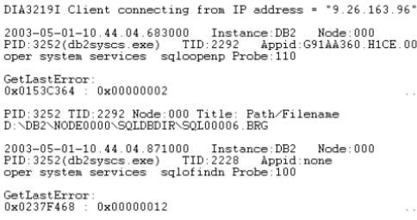
Software Chain Architecture – Extractor
Identifying events in data stream

Slide 8
Software Chain Architecture – Parser [1/2]
Implementing logics of data stream
Identifying simple events
Most challenging part for processing data stream

Slide 9
Software Chain Architecture – Parser [2/2]
Hardness of parsing data
Unstructured data: no lexical structure properties
Sound & video
Semi-structured data: lexical structure without formal syntactic structure
Plain text, tracing data
Structured data: easiest case
XML semantics, relational data
Rest of components formatter & outputter
Structuring & persisting data

Slide 10
Yahoo!S4
Simple Scalable Streaming System (S4)
Develop high performance computing platform hiding complexity of parallel processing from programmer
Features
Decentralized
Scalable
Extensible
Cluster management
Fault-tolerance

Slide 11
Evaluation of Yahoo!S4
Input: data stream from FlightRadar24
Most commercial airliners equipped with a transponder
Cover 90% of Europe, USA, Canada, along with other parts of world
Real-time information of flights
Geo-graphic information, latitude, model, register code etc. in JSON
Update every X seconds for 4000~6000 flights
Output
Result of processing data stream of flight information
For every flight in real time
Departure & destination airport name and country
Flight status, distance to origin & destination
N nearest airport to flight radius
Country over which flies & closer to current position

Slide 12
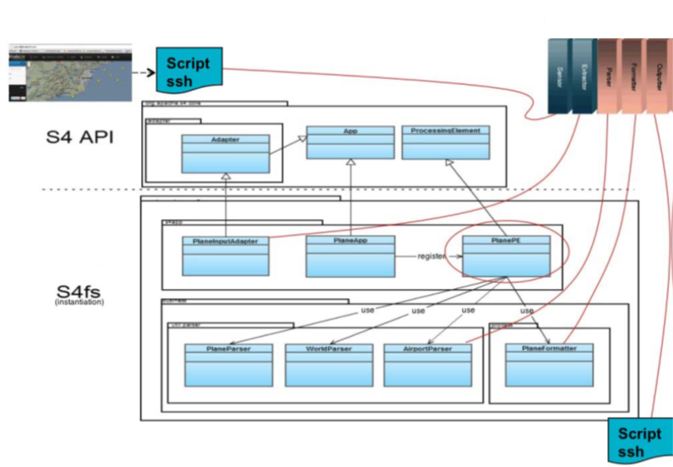
Mapping of Yahoo!S4
Sensor
Extractor
Parser
Formatter
Outputter
App
Processing Element
Adapter
PlaneInputAdapter
PlaneApp
Plane PE
Plane Parser
World Parser
Airport Parser
Plane Formatter

Slide 13
Evaluation
HPC cluster from RDLab
Over 160 physical servers
Over 1000 CPU cores
Over 130 TB disk space
3 TB RAM
10Gbit network
Hadoop, SMP parallel computation
Use 70 nodes in cluster
Read 3 files per 2 seconds
200~300Kb files with about 6,000 flights’ information

Slide 14
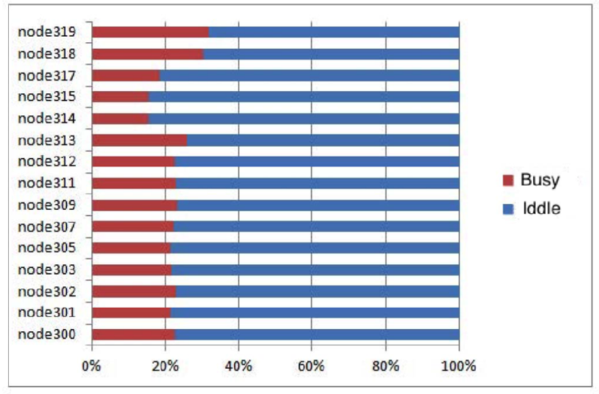
Evaluation
Busy vs. idle time of nodes in processing data stream
Busy
Idle
Notes:
Round robin?

Slide 15
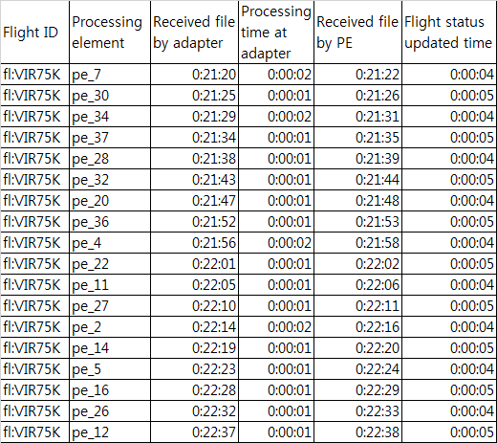
Evaluation

