Slide 1
Counting Triangles & The Curse of the Last Reducer
Siddharth Suri, Yahoo! Research
Sergei Vassilvitskii, Yahoo! Research
2011 WWW
12 July 2013
SNU IDB Lab.
Hyesung Oh

Slide 2
Outline
Introduction
Why Count Trianges?
Naïve Approach to Count Triangles with Experiment
Adapting the Algorithm with Experiment
Conclusion

Slide 3
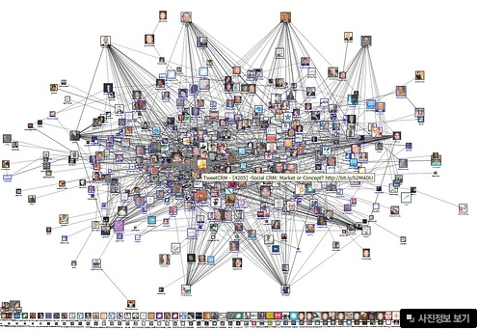
Introduction
There are many graph structures in social networks.
Triangle structure is important measure for social networks.

Slide 4
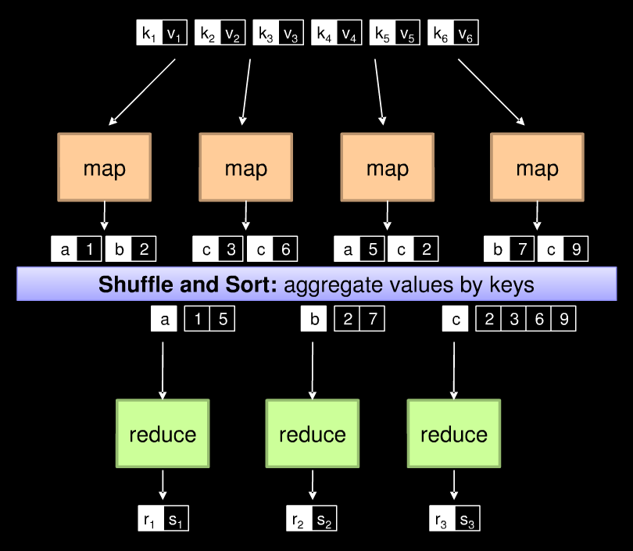
MapReduce

Slide 5
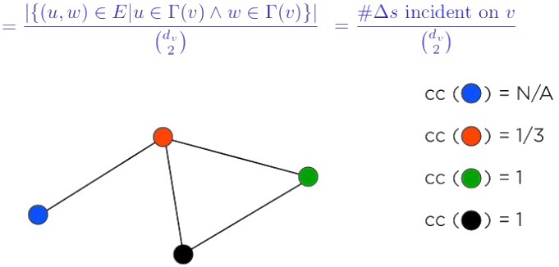
Why Count Triangles?
Clustering Coefficient
Given an undirected graph G = (V, E)
cc(v) = fraction of v’s neighbors who are neighbors themselves
Notes:
T(v) = v와 인접한 vertex, dv = v의 인접 vertex 개수

Slide 6
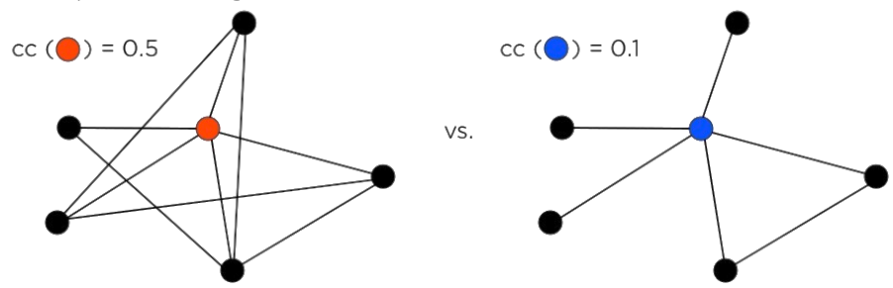
Why Count Triangles?
Captures how tight-knit the network is around a node.
Network Cohesion
Tightly knit communities foster more trust, social norms. [Coleman ‘88, Portes ’88]
Structural Holes
Individuals benefit from bridging [Burt ‘04, ‘07]

Slide 7
Why MapReduce?
De facto standard for parallel computation on large data
Widely used at: Yahoo!, Google, Facebook,
Also at: New York Times, Amazon.com, Match.com, …
Commodity hardware
Reliable infrastructure
Data continues to outpace available RAM
Notes:
사실상의 표준

Slide 8
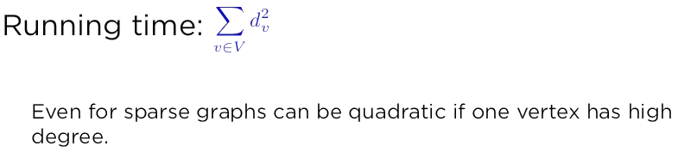
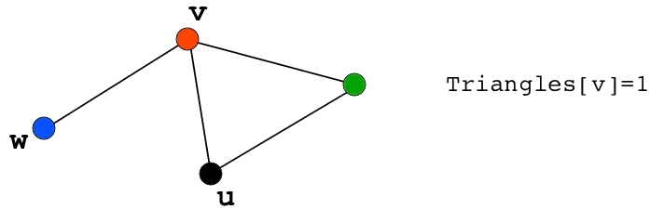
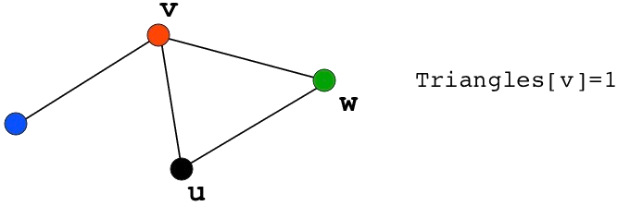
How to Count Triangles
Sequential Version:
foreach v in V
foreach u, w in Adjacency(v)
if (u,w) in E
Triangles[v]++

Slide 9
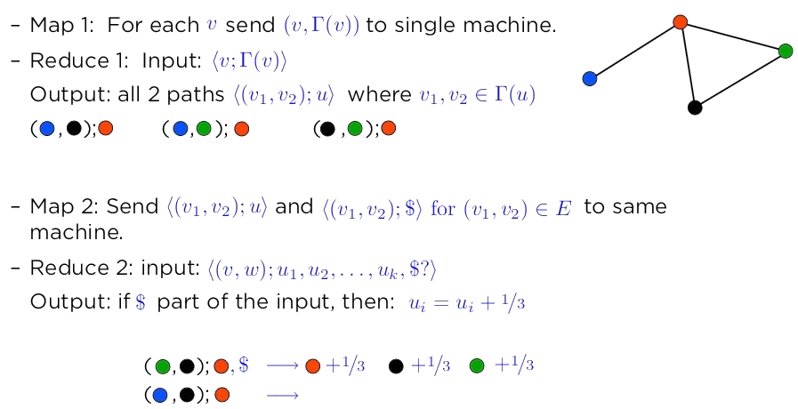
Parallel Version
Parallelize the edge checking phase

Slide 10

Data skew
How much parallelization can we achieve?
Generate all the paths to check in parallel
The running time becomes
Naïve parallelization does not help with data skew
Some nodes will have very high degree
Example. 3.2 Million followers, must generate 10 Trillion (10^13) potential edges to check
Even if generating 100M edges per second, 100K seconds ~ 27 hours.

Slide 11
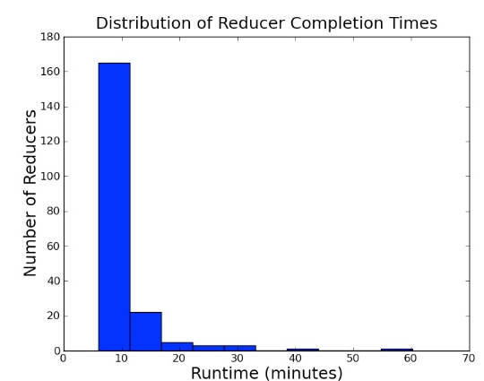
Data skew
Running the naïve algorithm on LiveJournal Graph
80% of reducers done after 5 min
99% done after 35 min
Notes:
LiveJournal <- 미국의 블로그 사이트
Node 4.8* 10^6, Directed Edges 6.9* 10^6 Undirected Edges 8.6 * 10^7
실험은 1636개 노드가 돌아가는 하둡 시스템
트위터 데이터는 2010년 WWW 논문에서 참조했고, 나머지는 SNAP 라이브러리에서 참조

Slide 12
Adapting the Algorithm
Approach 1: Dealing with skew directly
Currently every triangle counted 3 times (once per vertex)
Running time quadratic in the degree of the vertex
Idea: Count each once, from the perspective of lowest degree vertex
Does this heuristic work?
Approach 2: Divide & Conquer
Equally divide the graph between machines
But any edge partition will be bound to miss triangles
Divide into overlapping subgraphs, account for the overlap

Slide 13
How to Count Triangles Better
Sequential Version [Schank ‘07]
foreach v in V
foreach u,w in Adjacency(v)
if deg(u) > deg(v) && deg(w) > deg(v)
if (u,w) in E
Triangles[v]++

Slide 14
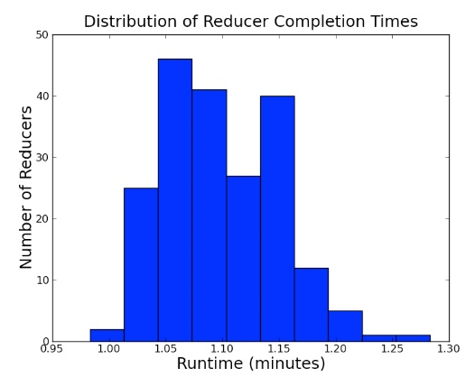
Does it make a difference?

Slide 15

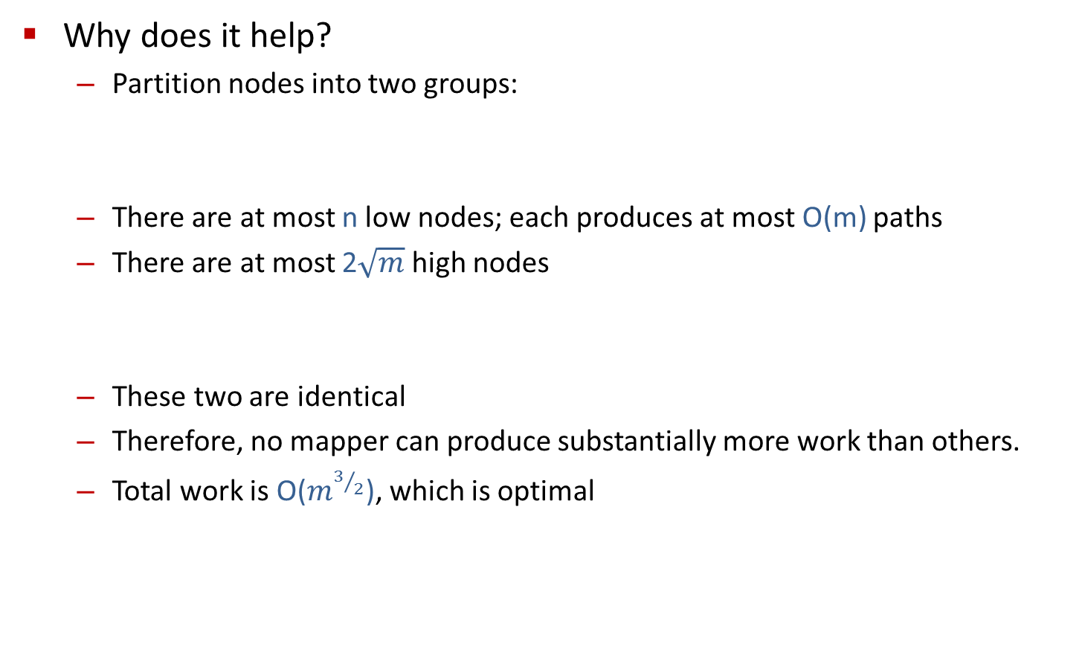
Dealing with Skew
Why does it help?
Partition nodes into two groups:
There are at most n low nodes; each produces at most O(m) paths
There are at most 2$\sqrt{m}$ high nodes
These two are identical
Therefore, no mapper can produce substantially more work than others.
Total work is O($m^{3/2}$), which is optimal

Slide 16
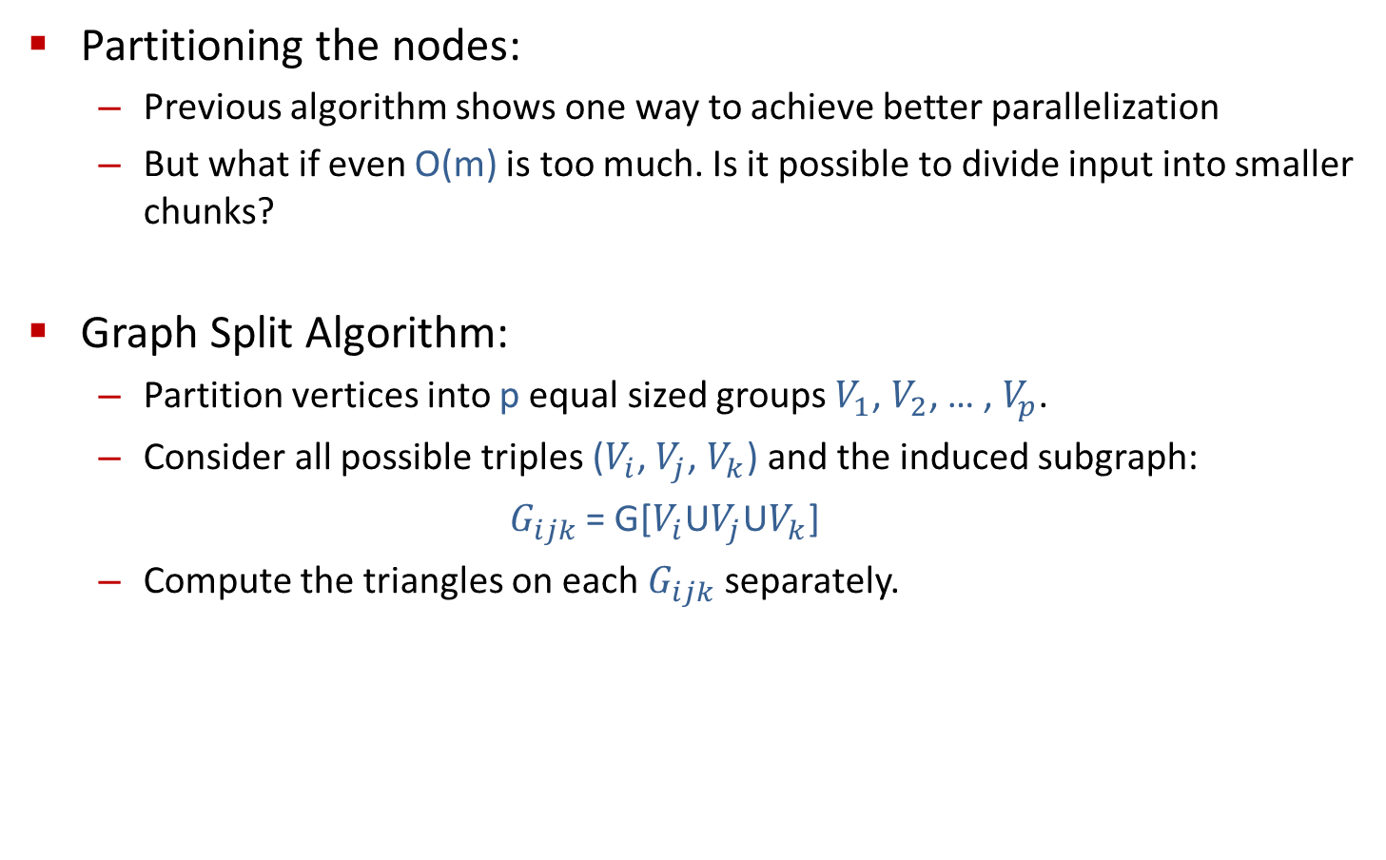
Approach 2: Graph Split
Partitioning the nodes:
Previous algorithm shows one way to achieve better parallelization
But what if even O(m) is too much. Is it possible to divide input into smaller chunks?
Graph Split Algorithm:
Partition vertices into p equal sized groups $V_{1}$, $V_{2}$, … , $V_{p}$.
Consider all possible triples ($V_{i}$, $V_{j}$, $V_{k}$) and the induced subgraph:
$G_{ijk}$ = G[$V_{i}$U$V_{j}$U$V_{k}$]
Compute the triangles on each $G_{ijk}$ separately.

Slide 17
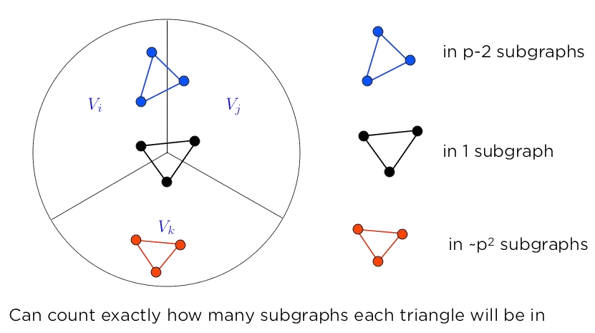
Approach 2: Graph Split
Some Triangles present in multiple subgraphs:

Slide 18
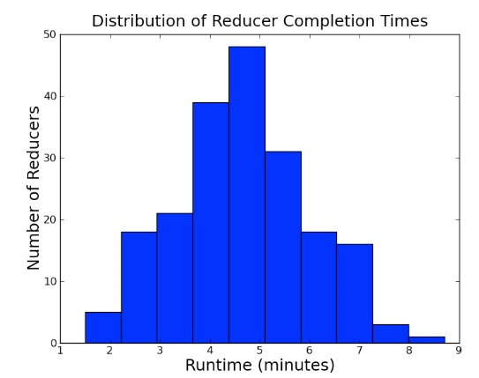

Approach 2: Graph Split
Analysis:
Each subgraph has O($m/{p^{2}}$) edges in expectation.
Very balanced running times

Slide 19
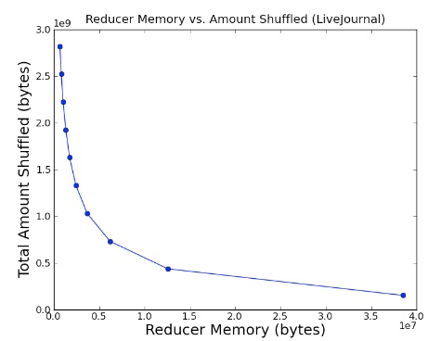
Approach 2: Graph Split
Analysis:
Very balanced running times
p controls memory needed per machine
Notes:
p 범위는 4~31
기계 당 필요한 메모리 양과 셔플 단계에서 생기는 중간 결과를 저장해야 하는 디스크의 총 양은 서로 반비례 한다

Slide 20
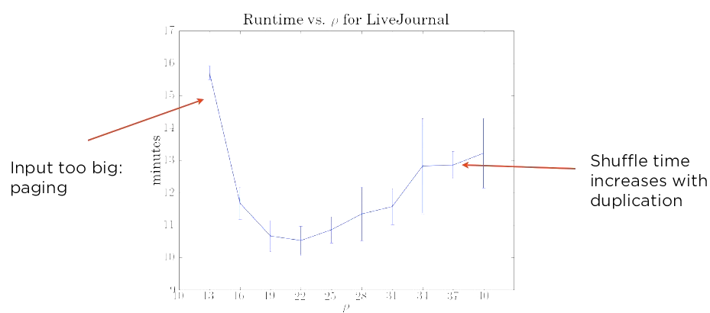
Approach 2: Graph Split
Analysis:
Very balanced running times
p controls memory needed per machine
Notes:
p < 13 일때 그래프가 각 리듀서의 메모리보다 크다(페이징 발생)
p가 너무 커지면 중복으로 셔플 시간이 오래 걸린다

Slide 21
Conclusion
Naïve Parallelization Doesn’t help with Data Skew

Slide 22
QnA
감사합니다!

