Slide 1
DING: Dataset Ranking using Formal Descriptions
Nickolai Toupikov, J¨urgen Umbrich, Renaud Delbru,
Michael Hausenblas, Giovanni Tummarello
DERI, National University of Ireland
WWW 2009 Workshop: Linked Data on the Web (LDOW)
May 18, 2012
Heegook Jun

Slide 2
Outline
Introduction
Related Work
Describing Datasets
DING – Dataset Ranking
Experiments
Conclusion

Slide 3
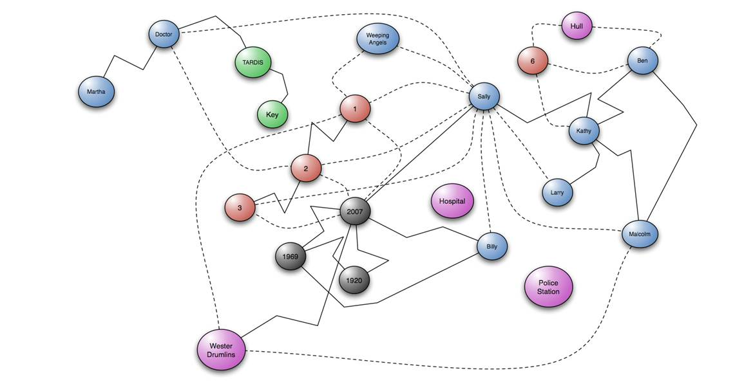
Introduction
Semantic Web clients can effectively rank datasets using well-known strategies such as PageRank or HITS in a very efficient way.

Slide 4
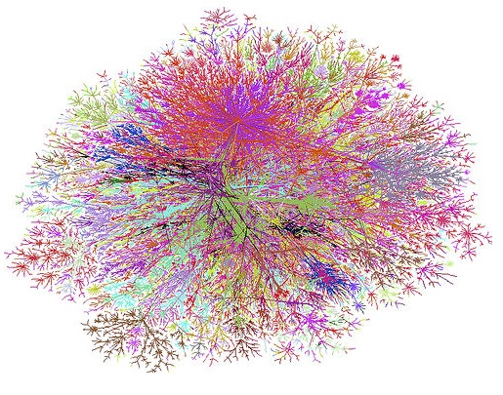
Motivation
The clients would have to crawl a large number of documents in order to analyze datasets
It requires an excessive amount of time and resources.
Dataset
Dataset
Dataset
Dataset

Slide 5
Outline
Introduction
Related Work
Describing Datasets
DING – Dataset Ranking
Experiments
Conclusion

Slide 6
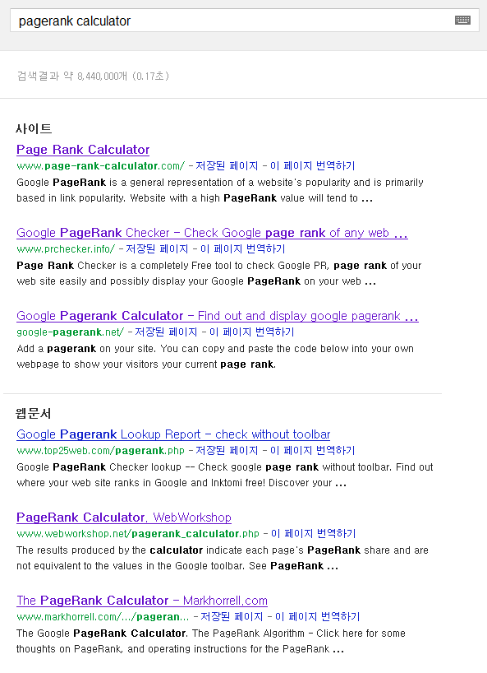
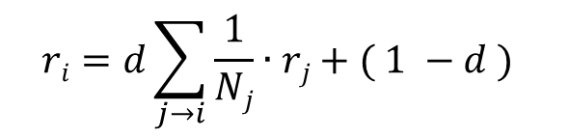
PageRank and HITs
PageRank
Authority
Hub
$$ri=d\sum_{j→i}{\frac{1}{Nj}∙rj+( 1 −d )}$$
a(p) = Σ h(q)
q: (q, p)∈E
h(p) = Σ a(q)
q: (p, q)∈E

Slide 7
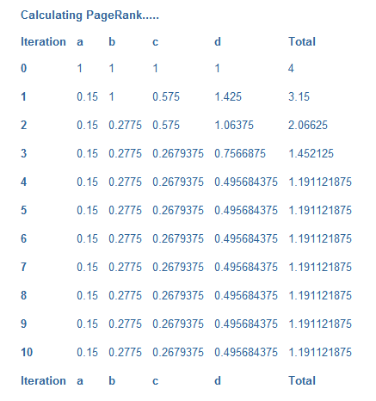
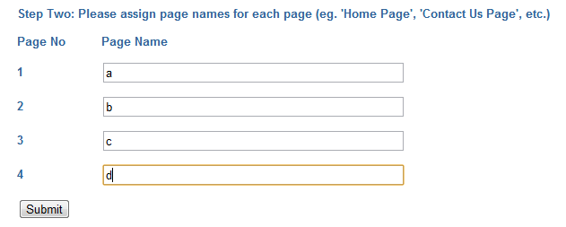

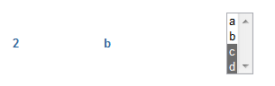
PageRank and HITs
http://www.markhorrell.com/seo/pagerank.asp
c
d
b
a

Slide 8
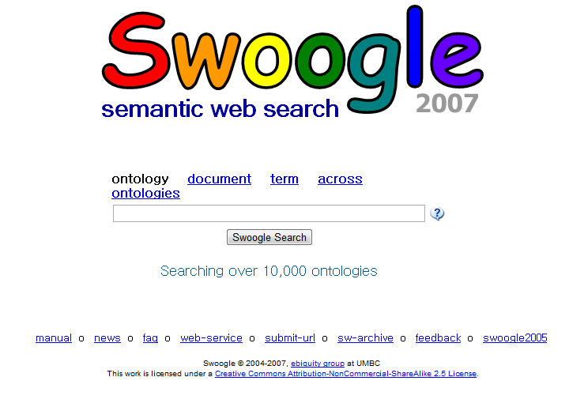
Swoogle
First one to propose OntoRank: PageRank for Semantic Web

Slide 9
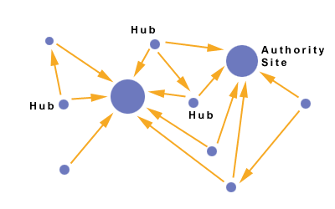
ObjectRank
Andrey Balmin Et al., “Objectrank: authority-based keyword search in databases”, VLDB, 2004
Authority-based ranking to keyword search in DB with semantic relations

Slide 10
Outline
Introduction
Related Work
Describing Datasets
DING – Dataset Ranking
Experiments
Conclusion

Slide 11
Describing Datasets
PageRank PageRank for Semantic Web
1
2
1
2
4
3
4
3
Dataset Clustering

Slide 12
voiD (Vocabulary of Interlinked Datasets)
Used for storing triples to express the interlinking relationship between datasets
This can be used to massively decrease the search space.
Metadata of RDF based linked data!
Dataset1
Dataset1: ….
<subject> <predicate> <object>
<subject> <predicate> <object>
…

Slide 13
Outline
Introduction
Related Work
Describing Datasets
DING – Dataset Ranking
Experiments
Conclusion

Slide 14
voiD Descriptions
Exemplary collection of four voiD descriptions
10k x owl:sameAs
:DS1
:DS2
600 x foaf:interest
2k x dc:author
200k x rdfs:seeAlso
:DS3
:DS4

Slide 15
voiD Descriptions
:DS1 a void:Dataset;
foaf:homepage <http://example.org/cats/>;
dcterms:subject <http://dbpedia.org/resource/Cats>;
void:subset :DS1toDS3;
void:subset :DS1toDS4;
:DS1toDS3 a void:Linkset;
void:subjectsTarget :DS1;
void:objectsTarget :DS3;
void:linkPredicate foaf:interest;
void:statItem [
rdf:value 600;
scovo:dimension void:numberOfTriples;
]
:DS1
600 x foaf:interest
:DS3

Slide 16


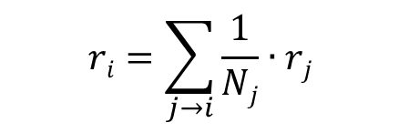
PageRank
PageRank
P$j→i$ is uniformly distributed
r₁ = 10
r₄ = $\frac{1}{2}$ ∙ 10 + $\frac{1}{3}$∙ 30 + $\frac{1}{2}\text{∙}$ 40
$$ri=\sum_{j→i}{\frac{1}{Nj}∙rj}$$
r₂ = 30
r₃ = 40
Notes:
PageRank는 링크에 기반한 대표적인 Ranking Method이다.

Slide 17
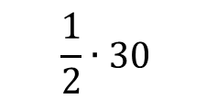
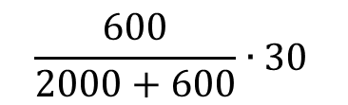
DING! Weight function
30
:DS1
1. Naive approach
600 x foaf:interest
$$\frac{1}{2}∙30$$
$$\frac{600}{2000+600}∙30$$
2. Use TF-IDF
2000 x dc:author
:DS3
:DS4

Slide 18
Outline
Introduction
Related Work
Describing Datasets
DING – Dataset Ranking
Experiments
Conclusion

Slide 19
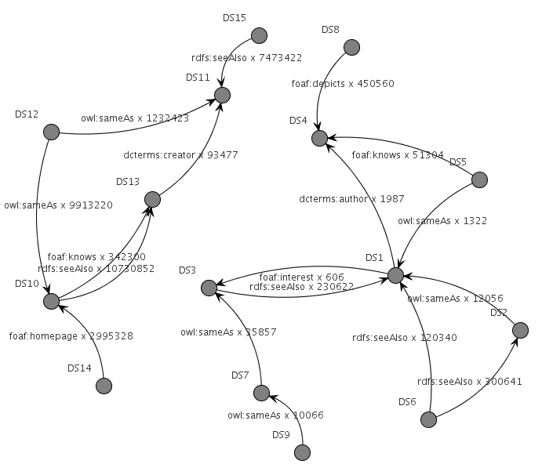
Setup (1~9 / 10~15 Datasets)

Slide 20
Standard PageRank

Slide 21
HITs
Notes:
표준 PageRank와 HITs 알고리즘이 링크의 속성을 고려하지 않으며 DS1을 첫번째로 랭크하는 것을 본다.
DS1이 사실 다른 데이터셋에 의해 많이 링크되있음에도 불구하고, 이것은 대부분 owl:sameas 나 rdfs:seeAlse 같은 “약한” 링크로 inlink되어 있다.

Slide 22
DING Rank (Naïve weight function)
Notes:
나이브 랭킹 방법 DRank는 두 번째 cloud에서에 비해 훨씬 적은 링크를 가지고 있어서 첫 번째 cloud를 완벽하게 떠난다.

Slide 23
DING Rank (TF-IDF weight function)
Notes:
DS1이 사실 다른 데이터셋에 의해 많이 링크되있음에도 불구하고, 이것은 대부분 owl:sameas 나 rdfs:seeAlse 같은 “약한” 링크로 inlink되어 있다.
TFIDF DING Rank에서 이러한 링크들은 덜 중요하게 계산한다.
예를 들어 기사에 대한 정보를 찾는 중에, 사용자는 더 정확한 정보를 Rdfs:seeAlso 같은 일반적인 속성보다 dcterms:author로 얻을 수 있다.
일반적이지 않은 링크로 링크된 데이터셋의 결과는 일반적인 것으로 연결된 것보다 더 중요할 수 있다.

Slide 24
Conclusion
We have presented DING, a new approach to rank linked datasets based on voiD descriptions.
We have motivated the need for a effcient and effective way to rank datasets based on their characteristics.

Slide 25
Discussion
Strong points
Reducing search space
Better performance (time and cost)
Compute rank score with semantically weighted link
Weak points
There are not many voiD descriptions available!

Slide 26
Thank you

