Slide 1
Processing Theta-Joins using MapReduce
Alper Okcan, Mirek Riedewald
Northeastern University, Boston, MA
SIGMOD 11
12 April 2013
SNU IDB Lab.
Hyesung Oh

Slide 2
Outline
Introduction
Optimization Goal
Mapping Join Matrix Cells to Reducers
1-Bucket Theta
Experiments
Conclusion

Slide 3
Introduction - 1
Internet companies want to analyze terabytes of data
parallel computation is essential
Join
equi-join : join exact same attribute value
theta-join : join range attribute values

Slide 4
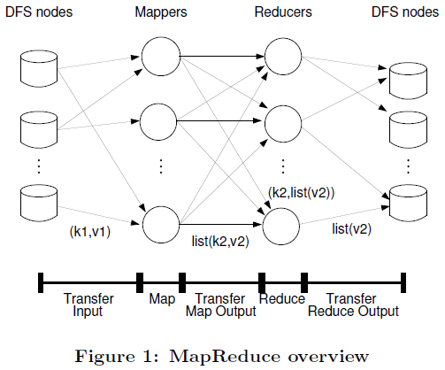
Introduction - 2
MapReduce overview

Slide 5
Introduction - 3
MapReduce
Key, value
map, reduce jobs
good for equi-joins
about another types of joins?
reducer-centered cost model and a join model
simplifies creation of and reasoning about theta-join

Slide 6
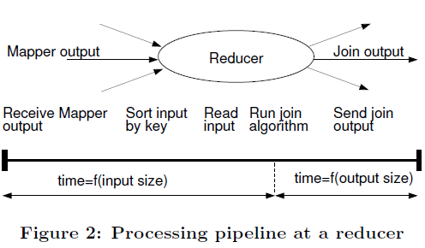
Optimization Goal
How to minimize job completion time
max-reducer-input
max-reducer-output
problems
input-size dominated
output-size dominated
input-output balanced

Slide 7

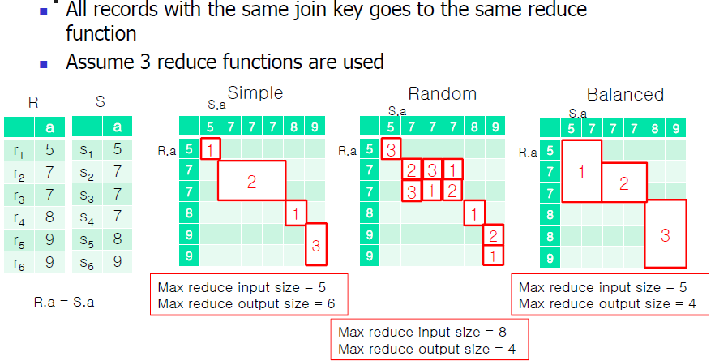
Mapping Join Matrix Cells to Reducers
Standard equi-join (left), random(center), and balanced (right)

Slide 8
Comparisons of Reduce Allocation Methods
Simple allocation
Minimize the maximum input size of reduce functions
Output size may be skewed
Random allocation
Minimize the maximum output size of reduce functions
Input size may be increased due to duplication
Balances allocation
Minimize both maximum input and output sizes

Slide 9
1-Bucket Theta
MapReduce Algorithm
“Computes” cross-product
Goals:
Tuples matched at exactly one reducer
Minimal input to a reducer
Minimal output from each reducer
“1-Bucket” refers to no statistics about data distribution

Slide 10
Algorithm
Precompute regions of cross-product SxT
Use size of S (|S|) and T (|T|)
Regions are disjoint
Union of regions covers cross-product
Each region assigned to single reducer
1 | 1 | 1 | 1 | 2 | 2 | 2 | 2
1 | 1 | 1 | 1 | 2 | 2 | 2 | 2
1 | 1 | 1 | 1 | 2 | 2 | 2 | 2
1 | 1 | 1 | 1 | 2 | 2 | 2 | 2
3 | 3 | 3 | 3 | 4 | 4 | 4 | 4
3 | 3 | 3 | 3 | 4 | 4 | 4 | 4
3 | 3 | 3 | 3 | 4 | 4 | 4 | 4
3 | 3 | 3 | 3 | 4 | 4 | 4 | 4
|S|=8; |T|=8; #reducers =4
Rows are tuples in s; columns are tuples in t
Value is region for the <s,t> pair

Slide 11
Algorithm : Mapper
Each row in S
Randomly assign value (x) from 1 to size(S)
Output <region, row + ‘S’> for each region containing x
Example: Assume x=3. Output <1,row+’S’> and <2,row+’S’>
Each row in T
Same, except output <region, row+’T’>
Example: Assume x=3. Output <1, row+’T’> and <3,row+’T’>

Slide 12
Algorithm: Reducer
Joins all S rows with all T rows
Can use any join algorithm appropriate for join value
Output cross-product, theta join or equi-join

Slide 13
Algorithm: Correctness
Random assignment of tuples
Since actual row number unknown, any row number works
Some reducer will compare tuple to any tuple in other table
Therefore, every pair compared (as in nested block loop join) in only one reducer

Slide 14
Optimal Partitioning
Basis for minimal input and minimal output
Let |S| be size of table S; r number of reducers
Optimal output |S||T|/r
Optimal input sqrt(|S||T|/r) from each table

Slide 15
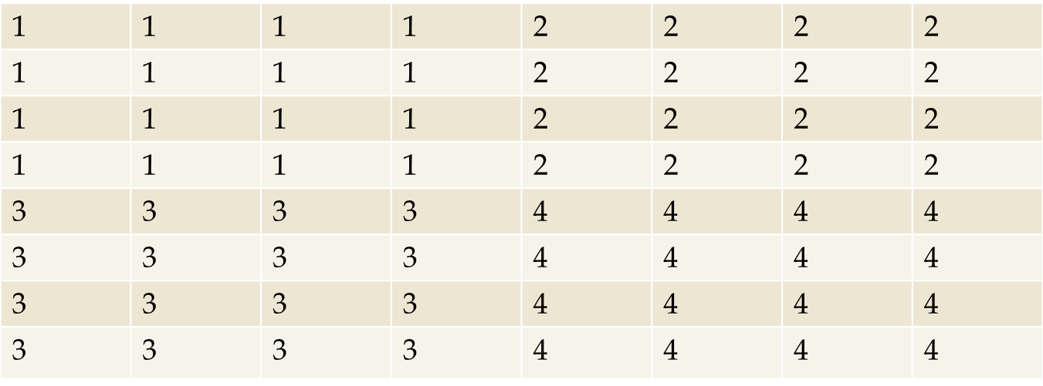
Example
|S|=8; |T|=8; r=4; sqrt(|S||T|/r) =4; s=t=2

Slide 16
Near Optimal Partitioning
Optimal case is rare
General case
t=floor(|T|/ sqrt(|S||T|/r))
Side length: floor((1+1/min(s,t)) * sqrt(|S||T|/r))
Note floor function omitted from paper
Example: |S|=|T|=8; r=9
s=t=floor(8/sqrt(64/9))=3
Side length = floor((1+1/3)*sqrt(64/9))=3

Slide 17
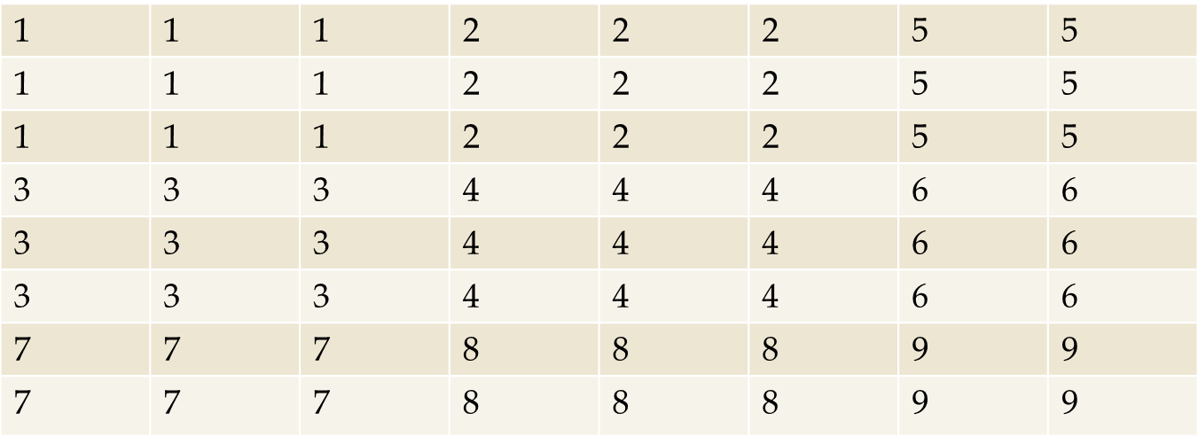
Example: Near-Optimal Partitioning
Assumed partitioning
Note: 64/9=7.111 . . .
Eight partitions with 7 and one with 8 is better

Slide 18
Experiments
Cloud data set
Information about cloud cover
382 million records
28.8 GB
Cloud-5-i is 5 million record subset
SELECT S.date, S.longitude, S.latitude FROM Cloud S, Cloud T WHERE s.date = t.date and S.longitude = T. longitude and ABS(S.latitude-T.latitude) <= 10
SELECT S.latitude, T.latitude FROM Cloud-5-1 S, Cloud-5-2 T WHERE ABS(S.latitude-T.latitude) < 2

Slide 19
Experimental Results

Slide 20
Conclusion
MapReduce algorithm for arbitrary joins
Always applicable
Effective for large-scale data analysis
Additional statistics provide better performance

