Slide 1
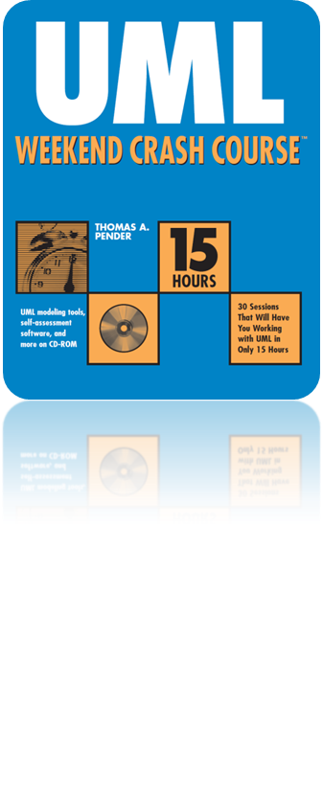
Session 22
Modeling the Extended Features of the Statechart
Written by Thomas A. Pender
Published by Wiley Publishing, Inc.
October 27, 2011
Presented by Kang-Pyo Lee

Slide 2
Contents
Modeling Transition Events
  Call event
  Time event
  Change event
  Making events conditional
  Send event
  Guard conditions as events
Modeling Superstates & Substates

Slide 3
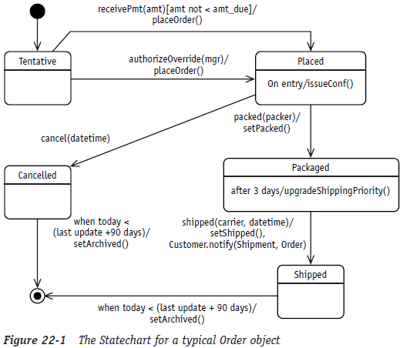
Modeling Transition Events (1/6)
Five different event types
  call events, time events, change events, send events, and guard conditions
The Statechart diagram for an Order object

Slide 4
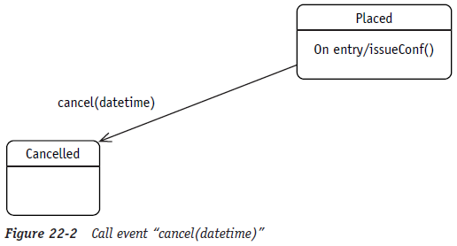
Modeling Transition Events (2/6)
Call event
  The most common event type
  Basically the invocation of an operation on the receiving object
  This type of event is the merge of an event and an event action

Slide 5
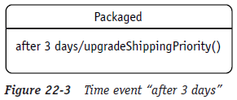
Modeling Transition Events (3/6)
Time event
  Evaluates the passage of time as a trigger
  Implies that the object supports some mechanism to monitor the passage of time
    could be a batch program that runs at intervals to update a time attribute
    could use a polling type of implementation where the object constantly checks to see what time it is
  Use the keyword after to specify the time increment to be evaluated

Slide 6
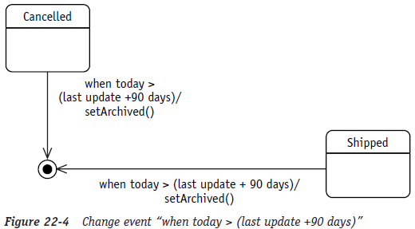
Modeling Transition Events (4/6)
Change event
  Tests for a change in the object or a point in time
  Use the keyword when with the required test
  Note that this event is only evaluated while the Order is either Cancelled or Shipped
  Remember that what does not show on a Statechart tells you almost as much as what is shown on the diagram

Slide 7
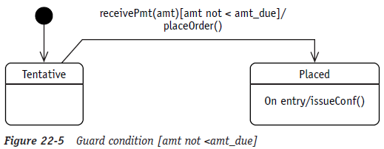
Modeling Transition Events (5/6)
Making events conditional
  A guard condition controls the response to an event
  When an event occurs, the condition is tested
  If the condition tests true, the corresponding transition takes place along with any and all associated actions; otherwise, the event is ignored
  May actually be used by itself as a triggering event

Slide 8
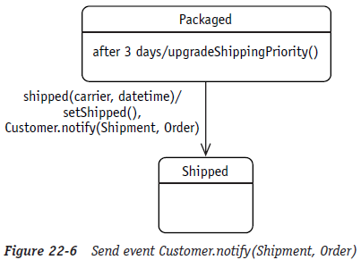
Modeling Transition Events (6/6)
Send event
  Models the fact that an object tells another object what to do
  May be a response to a transition event or an internal event

Slide 9
Contents
Modeling Transition Events
Modeling Superstates & Substates
  Split of control
  Concurrency

Slide 10
Modeling Superstates & Substates (1/5)
Modeling often requires different views of a problem
  High-level views simplify the model
  Low-level views focus on details of a problem
  The UML Statechart diagram supports the concept of nested states, allowing both high- and low-level views of object behavior and states
Superstate
  Simply a state that is expanded to show more detail
  The state rounded rectangle icon is expanded and the details are represented as one or more Statecharts within the superstate
  The name of the state is placed at the top
  Represents a high-level view of a complex situation
  Allows you to focus on the bigger, more general problem without getting lost in the details
  The substates are placed within the expanded superstate

Slide 11
Modeling Superstates & Substates (2/5)
Substate
  A state within a state, a lower level of detail within a state
  Provides a low-level view of a model element so that you can address specific issues individually and in terms of their interactions and interdependencies
  Also allows you to highlight concurrent states and focus on how to control the splitting and merging of concurrent states

Slide 12
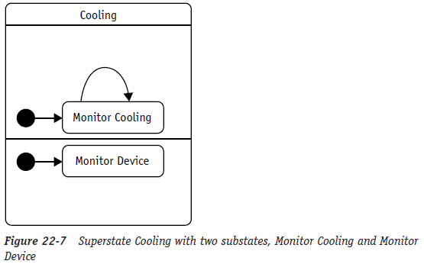
Modeling Superstates & Substates (3/5)
The diagram says that
  When the Thermostat enters the Cooling state, it splits into two concurrent substates, that is, it is now doing two things at the same time
  It is monitoring the progress of the cooling process, and it is monitoring the cooling device for any problems
  The two substates start immediately upon entering the Cooling state

Slide 13
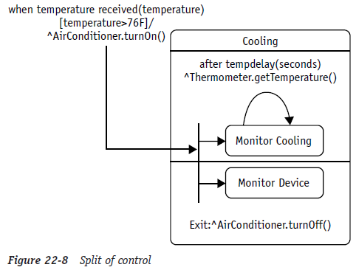
Modeling Superstates & Substates (4/5)
Split of control
  Means that, based on a single transition, you want to proceed with multiple tasks
  Shown by a single transition divided into multiple arrows pointing to multiple states or substates

Slide 14
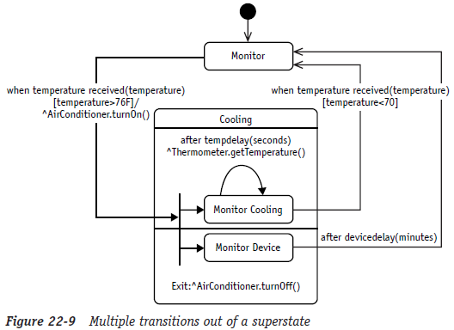
Modeling Superstates & Substates (5/5)
Concurrency
  The UML supports concurrency within a state by allowing multiple Statecharts within a state
  Simply split the superstate internal transition compartment into as many separate compartments as needed, one for each sub-Statechart

Slide 15
The End

