Slide 1

Basic Computation
Chapter 2

Slide 2
Objectives
Describe the Java data types used for simple data
Write Java statements to declare variables, define named constants
Write assignment statements, expressions containing variables and constants
Define strings of characters, perform simple string processing

Slide 3
Objectives
Write Java statements that accomplish keyboard input, screen output
Adhere to stylistic guidelines and conventions
Write meaningful comments
Use the class JOptionPane for window-based input and output

Slide 4
Outline
Variables and Expressions
The Class String
Keyboard and Screen I/O
Documentation and Style
Graphics Supplement

Slide 5
Variables and Expressions: Outline
Variables
Data Types
Java Identifiers
Assignment Statements
Simple Input
Simple Screen Output
Constants
Named Constants

Slide 6
Variables and Expressions: Outline
Assignment Compatibilities
Type Casting
Arithmetic Operations
Parentheses and Precedence Rules
Specialized Assignment Operators
Case Study: Vending Machine Change
Increment and Decrement Operators

Slide 7
Variables
Variables store data such as numbers and letters.
  Think of them as places to store data.
  They are implemented as memory locations.
The data stored by a variable is called its value.
  The value is stored in the memory location.
Its value can be changed.

Slide 8
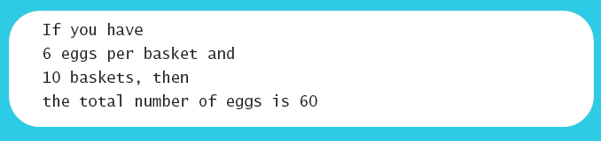
Variables
View sample program listing 2.1
  Class EggBasket
Sample Screen Output

Slide 9
Variables and Values
Variables
  numberOfBaskets
  eggsPerBasket
  totalEggs
Assigning values
  eggsPerBasket = 6;
  eggsPerBasket = eggsPerBasket - 2;

Slide 10
Naming and Declaring Variables
Choose names that are helpful such as count or speed, but not c or s.
When you declare a variable, you provide its name and type.
int numberOfBaskets,eggsPerBasket;
A variable's type determines what kinds of values it can hold (int, double, char, etc.).
A variable must be declared before it is used.

Slide 11
Syntax and Examples
Syntax
  type variable_1, variable_2, …;
  (variable_1 is a generic variable called a syntactic variable)
Examples
  int styleChoice, numberOfChecks;
  double balance, interestRate;
  char jointOrIndividual;

Slide 12
Data Types
A class type is used for a class of objects and has both data and methods.
  "Java is fun" is a value of class type String
A primitive type is used for simple, nondecomposable values such as an individual number or individual character.
  int, double, and char are primitive types.

Slide 13
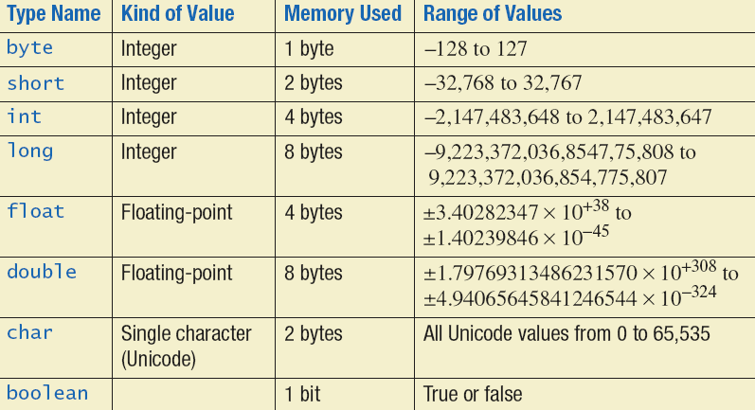
Primitive Types
Figure 2.1 Primitive Types

Slide 14
Java Identifiers
An identifier is a name, such as the name of a variable.
Identifiers may contain only
  Letters
  Digits (0 through 9)
  The underscore character (_)
  And the dollar sign symbol ($) which has a special meaning
The first character cannot be a digit.

Slide 15
Java Identifiers
Identifiers may not contain any spaces, dots (.), asterisks (*), or other characters:
7-11 netscape.com util.* (not allowed)
Identifiers can be arbitrarily long.
Since Java is case sensitive, stuff, Stuff, and STUFF are different identifiers.

Slide 16
Keywords or Reserved Words
Words such as if are called keywords or reserved words and have special, predefined meanings.
  Cannot be used as identifiers.
  See Appendix 1 for a complete list of Java keywords.
Example keywords: int, public, class

Slide 17
Naming Conventions
Class types begin with an uppercase letter
(e.g. String).
Primitive types begin with a lowercase letter (e.g. int).
Variables of both class and primitive types begin with a lowercase letters
(e.g. myName, myBalance).
Multiword names are "punctuated" using uppercase letters.

Slide 18
Where to Declare Variables
Declare a variable
  Just before it is used or
  At the beginning of the section of your program that is enclosed in {}.
  public static void main(String[] args)
  { /* declare variables here */
  . . .
  }

Slide 19
Primitive Types
Four integer types (byte, short, int, and long)
  int is most common
Two floating-point types (float and double)
  double is more common
One character type (char)
One boolean type (boolean)

Slide 20
Examples of Primitive Values
Integer types
0 -1 365 12000
Floating-point types
0.99 -22.8 3.14159 5.0
Character type
'a' 'A' '#' ' '
Boolean type
true false

Slide 21
Assignment Statements
An assignment statement is used to assign a value to a variable.
  answer = 42;
The "equal sign" is called the assignment operator.
We say, "The variable named answer is assigned a value of 42," or more simply, "answer is assigned 42."

Slide 22
Assignment Statements
Syntax
variable = expression
where expression can be another variable, a literal or constant (such as a number), or something more complicated which combines variables and literals using operators
(such as + and -)

Slide 23
Assignment Examples
amount = 3.99;
firstInitial = 'W';
score = numberOfCards + handicap;
eggsPerBasket = eggsPerBasket - 2;

Slide 24
Initializing Variables
A variable that has been declared, but no yet given a value is said to be uninitialized.
Uninitialized class variables have the value null.
Uninitialized primitive variables may have a default value.
It's good practice not to rely on a default value.

Slide 25
Initializing Variables
To protect against an uninitialized variable (and to keep the compiler happy), assign a value at the time the variable is declared.
Examples:
int count = 0;
char grade = 'A';

Slide 26
Initializing Variables
syntax
type variable_1 = expression_1, variable_2 = expression_2, …;

Slide 27
Assignment Evaluation
The expression on the right-hand side of the assignment operator (=) is evaluated first.
The result is used to set the value of the variable on the left-hand side of the assignment operator.
score = numberOfCards + handicap;
eggsPerBasket = eggsPerBasket - 2;

Slide 28
Simple Input
Sometimes the data needed for a computation are obtained from the user at run time.
Keyboard input requires
import java.util.*
at the beginning of the file.

Slide 29
Simple Input
Data can be entered from the keyboard using Scanner keyboard =
new Scanner(System.in);
followed, for example, by
eggsPerBasket = keyboard.nextInt();
which reads one int value from the keyboard and assigns it to eggsPerBasket.

Slide 30
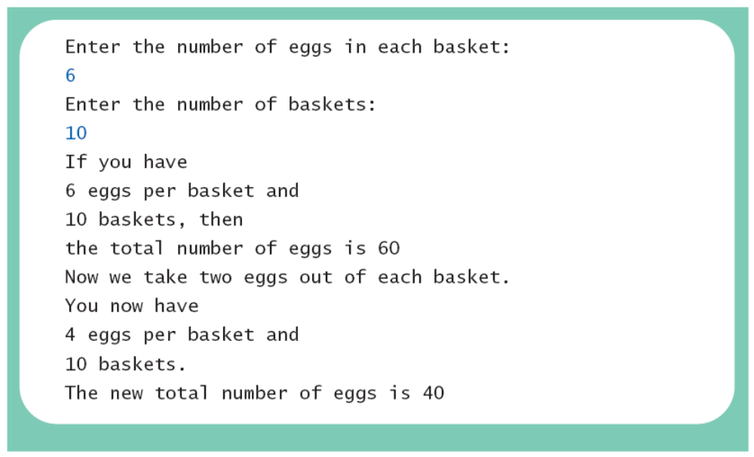
Simple Input
View sample program listing 2.2
class EggBasket2
Sample
screen output

Slide 31
Simple Screen Output
System.out.println("The count is " + count);
Outputs the sting literal "the count is "
Followed by the current value of the variable count.

Slide 32
Constants
Literal expressions such as 2, 3.7, or 'y' are called constants.
Integer constants can be preceded by a + or - sign, but cannot contain commas.
Floating-point constants can be written
  With digits after a decimal point or
  Using e notation.

Slide 33
e Notation
e notation is also called scientific notation or floating-point notation.
Examples
  865000000.0 can be written as 8.65e8
  0.000483 can be written as 4.83e-4
The number in front of the e does not need to contain a decimal point.

Slide 34
Imprecision in Floating-Point Numbers
Floating-point numbers often are only approximations since they are stored with a finite number of bits.
Hence 1.0/3.0 is slightly less than 1/3.
1.0/3.0 + 1.0/3.0 + 1.0/3.0
is less than 1.

Slide 35
Named Constants
Java provides mechanism to …
  Define a variable
  Initialize it
  Fix the value so it cannot be changed
public static final Type Variable = Constant;
  Example
public static final double PI = 3.14159;

Slide 36
Assignment Compatibilities
Java is said to be strongly typed.
  You can't, for example, assign a floating point value to a variable declared to store an integer.
Sometimes conversions between numbers are possible.
doubleVariable = 7;
is possible even if doubleVariable is of type double, for example.

Slide 37
Assignment Compatibilities
A value of one type can be assigned to a variable of any type further to the right
byte --> short --> int --> long
--> float --> double
  But not to a variable of any type further to the left.
You can assign a value of type char to a variable of type int.

Slide 38
Type Casting
A type cast temporarily changes the value of a variable from the declared type to some other type.
For example,
double distance;
distance = 9.0;
int points;
points = (int)distance;
Illegal without (int)

Slide 39
Type Casting
The value of (int)distance is 9,
The value of distance, both before and after the cast, is 9.0.
Any nonzero value to the right of the decimal point is truncated rather than rounded.

Slide 40
Arithmetic Operators
Arithmetic expressions can be formed using the +, -, *, and / operators together with variables or numbers referred to as operands.
  When both operands are of the same type, the result is of that type.
  When one of the operands is a floating-point type and the other is an integer, the result is a floating point type.

Slide 41
Arithmetic Operations
Example
If hoursWorked is an int to which the value 40 has been assigned, and payRate is a double to which 8.25 has been assigned
hoursWorked * payRate
is a double with a value of 500.0.

Slide 42
Arithmetic Operations
Expressions with two or more operators can be viewed as a series of steps, each involving only two operands.
  The result of one step produces one of the operands to be used in the next step.
example
  balance + (balance * rate)

Slide 43
Arithmetic Operations
If at least one of the operands is a floating-point type and the rest are integers, the result will be a floating point type.
The result is the rightmost type from the following list that occurs in the expression.
byte --> short --> int --> long
--> float --> double

Slide 44
The Division Operator
The division operator (/) behaves as expected if one of the operands is a floating-point type.
When both operands are integer types, the result is truncated, not rounded.
  Hence, 99/100 has a value of 0.

Slide 45
The mod Operator
The mod (%) operator is used with operators of integer type to obtain the remainder after integer division.
14 divided by 4 is 3 with a remainder of 2.
  Hence, 14 % 4 is equal to 2.
The mod operator has many uses, including
  determining if an integer is odd or even
  determining if one integer is evenly divisible by another integer.

Slide 46
Parentheses and Precedence
Parentheses can communicate the order in which arithmetic operations are performed
examples:
(cost + tax) * discount
(cost + (tax * discount)
Without parentheses, an expressions is evaluated according to the rules of precedence.

Slide 47
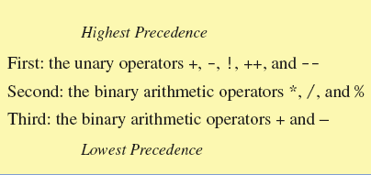
Precedence Rules
Figure 2.2 Precedence Rules

Slide 48
Precedence Rules
The binary arithmetic operators *, /, and %, have lower precedence than the unary operators +, -, ++, --, and !, but have higher precedence than the binary arithmetic operators + and -.
When binary operators have equal precedence, the operator on the left acts before the operator(s) on the right.

Slide 49
Precedence Rules
When unary operators have equal precedence, the operator on the right acts before the operation(s) on the left.
Even when parentheses are not needed, they can be used to make the code clearer.
  balance + (interestRate * balance)
Spaces also make code clearer
  balance + interestRate*balance
  but spaces do not dictate precedence.

Slide 50
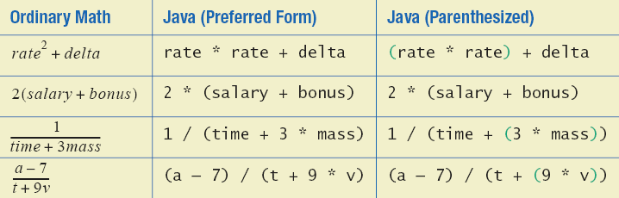
Sample Expressions
Figure 2.3 Some Arithmetic Expressions in Java

Slide 51
Specialized Assignment Operators
Assignment operators can be combined with arithmetic operators (including -, *, /, and %, discussed later).
amount = amount + 5;
can be written as
amount += 5;
yielding the same results.

Slide 52
Case Study:Vending Machine Change
Requirements
  The user enters an amount between 1 cent and 99 cents.
  The program determines a combination of coins equal to that amount.
  For example, 55 cents can be two quarters and one nickel.

Slide 53
Case Study
Sample dialog
  Enter a whole number from 1 to 99.
  The machine will determine a combination of coins.
  87
  87 cents in coins:
  3 quarters
  1 dime
  0 nickels
  2 pennies

Slide 54
Case Study
Variables needed
  int amount,
  quarters,
  dimes,
  nickels,
  pennies;

Slide 55
Case Study
Algorithm - first version
  Read the amount.
  Find the maximum number of quarters in the amount.
  Subtract the value of the quarters from the amount.
  Repeat the last two steps for dimes, nickels, and pennies.
  Print the original amount and the quantities of each coin.

Slide 56
Case Study,cont.
The algorithm doesn't work properly
  Original amount is changed by the intermediate steps.
  Original value of amount is lost.
Change the list of variables
int amount, originalAmount, quarters, dimes, nickles, pennies;
  Update the algorithm.

Slide 57
Case Study
Algorithm – second version
  Read the amount.
  Make a copy of the amount.
  Find the maximum number of quarters in the amount.
  Subtract the value of the quarters from the amount.
  Repeat the last two steps for dimes, nickels, and pennies.
  Print the original amount and the quantities of each coin.

Slide 58
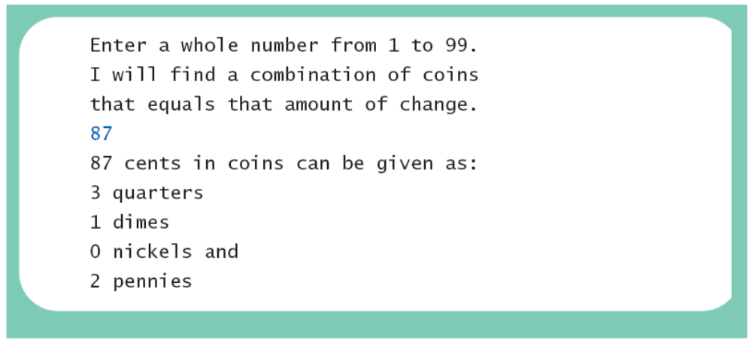
Case Study
View Java code that implements the algorithm written in pseudocode – listing 2.3
Sample Screen Output

Slide 59
Case Study
How do we determine the number of quarters (or dimes, nickels, or pennies) in an amount?
There are 2 quarters in 55 cents, but there are also 2 quarters in 65 cents.
That's because
  55 / 2 = 2 and 65 / 25 = 2.

Slide 60
Case Study
How do we determine the remaining amount?
The remaining amount can be determined using the mod operator
  55 % 25 = 5 and 65 % 25 = 15
Similarly for dimes and nickels.
Pennies are simply amount % 5.

Slide 61
Case Study
The program should be tested with several different amounts.
Test with values that give zero values for each possible coin denomination.
Test with amounts close to
  extreme values such as 0, 1, 98 and 99
  coin denominations, such as 24, 25, and 26.

Slide 62
Increment and Decrement Operators
Used to increase (or decrease) the value of a variable by 1
Easy to use, important to recognize
The increment operator
  count++ or ++count
The decrement operator
  count-- or --count

Slide 63
Increment and Decrement Operators
equivalent operations
  count++;
  ++count;
  count = count + 1;
  count--;
  --count;
  count = count - 1;

Slide 64
Increment and Decrement Operators in Expressions
after executing
  int m = 4;
  int result = 3 * (++m)
  result has a value of 15 and m has a value of 5
after executing
  int m = 4;
  int result = 3 * (m++)
  result has a value of 12 and m has a value of 5

Slide 65
The Class String
We've used constants of type String already.
  "Enter a whole number from 1 to 99."
A value of type String is a
  Sequence of characters
  Treated as a single item.

Slide 66
String Constants and Variables
Declaring
String greeting;
  greeting = "Hello!";
  or
  String greeting = "Hello!";
  or
  String greeting = new String("Hello!");
Printing
System.out.println(greeting);

Slide 67
Concatenation of Strings
Two strings are concatenated using the + operator.
  String greeting = "Hello";
  String sentence;
  sentence = greeting + " officer";
  System.out.println(sentence);
Any number of strings can be concatenated using the + operator.

Slide 68
Concatenating Strings and Integers
String solution;
solution = "The answer is " + 42;
System.out.println (solution);
The temperature is 72
The answer is 42

Slide 69
String Methods
An object of the String class stores data consisting of a sequence of characters.
Objects have methods as well as data
The length() method returns the number of characters in a particular String object.
  String greeting = "Hello";
  int n = greeting.length();

Slide 70
The Method length()
The method length() returns an int.
You can use a call to method length() anywhere an int can be used.
  int count = command.length();
  System.out.println("Length is " +
  command.length());
  count = command.length() + 3;

Slide 71
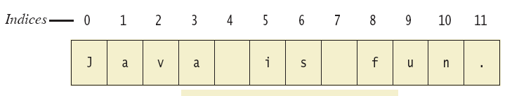
String Indices
Figure 2.4
Positions start with 0, not 1.
  The 'J' in "Java is fun." is in position 0
A position is referred to an an index.
  The 'f' in "Java is fun." is at index 8.

Slide 72
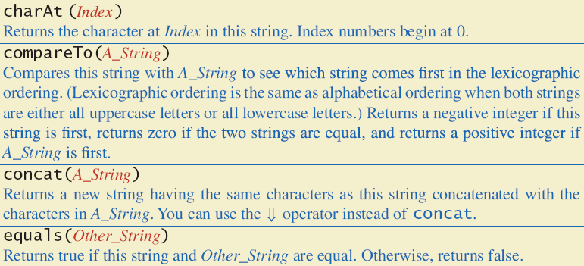
String Methods
Figure 2.5a

Slide 73
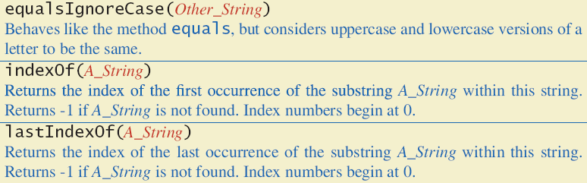
String Methods
Figure 2.5b

Slide 74
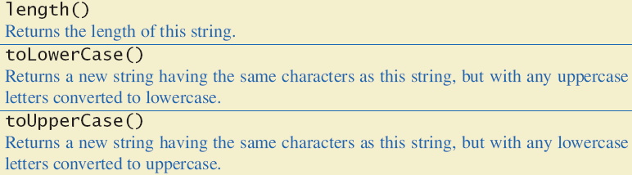
String Methods
Figure 2.5c

Slide 75
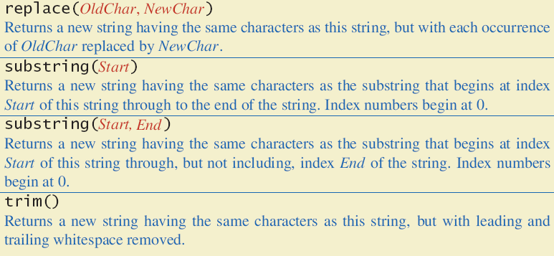
String Methods
Figure 2.5d

Slide 76
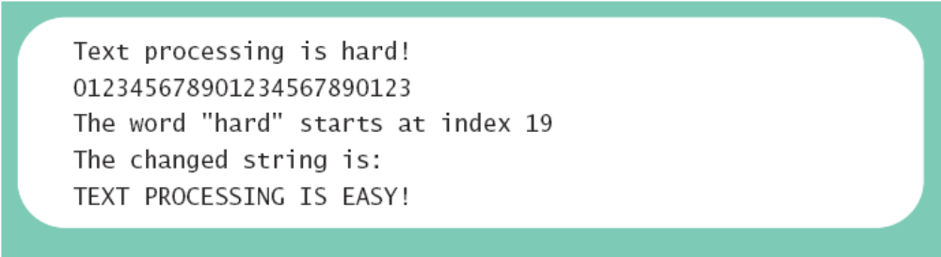
String Processing
No methods allow you to change the value of a String object.
But you can change the value of a String variable.
View sample program StringDemo listing 2.4
Sample Screen Output

Slide 77
Escape Characters
How would you print
  "Java" refers to a language. ?
The compiler needs to be told that the quotation marks (") do not signal the start or end of a string, but instead are to be printed.
  System.out.println(
  "\"Java\" refers to a language.");

Slide 78
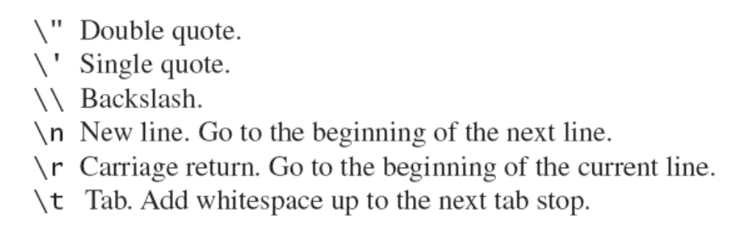
Escape Characters
Figure 2.6
Each escape sequence is a single character even though it is written with two symbols.

Slide 79
Examples
System.out.println("abc\\def");
System.out.println("new\nline");
char singleQuote = '\'';
System.out.println
(singleQuote);
abc\def
new
line
'

Slide 80
The Unicode Character Set
Most programming languages use the ASCII character set.
Java uses the Unicode character set which includes the ASCII character set.
The Unicode character set includes characters from many different alphabets (but you probably won't use them).

Slide 81
Keyboard and Screen
I/O: Outline
Screen Output
Keyboard Input

Slide 82
Screen Output
We've seen several examples of screen output already.
System.out is an object that is part of Java.
println() is one of the methods available to the System.out object.

Slide 83
Screen Output
The concatenation operator (+) is useful when everything does not fit on one line.
  System.out.println("Lucky number = " + 13 +
  "Secret number = " + number);
Do not break the line except immediately before or after the concatenation operator (+).

Slide 84
Screen Output
Alternatively, use print()
  System.out.print("One, two,");
  System.out.print(" buckle my shoe.");
  System.out.println(" Three, four,");
  System.out.println(" shut the door.");
  ending with a println().

Slide 85
Keyboard Input
Java 5.0 has reasonable facilities for handling keyboard input.
These facilities are provided by the Scanner class in the java.util package.
  A package is a library of classes.

Slide 86
Using the Scanner Class
Near the beginning of your program, insert
  import java.util.Scanner;
Create an object of the Scanner class
  Scanner keyboard =
  new Scanner (System.in)
Read data (an int or a double, for example)
  int n1 = keyboard.nextInt();
  double d1 = keyboard,nextDouble();

Slide 87
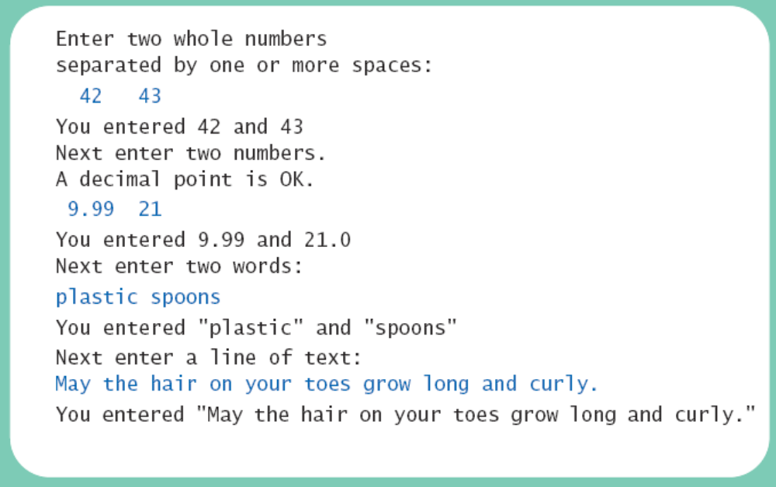
Keyboard Input Demonstration
View sample program
class ScannerDemo, listing 2.5
Sample Screen Output

Slide 88
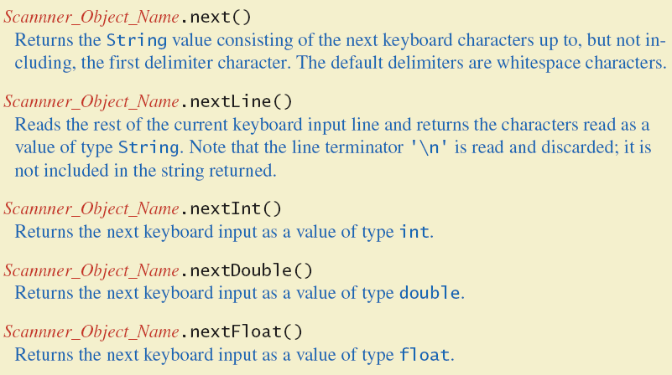
Some Scanner Class Methods
Figure 2.7a

Slide 89
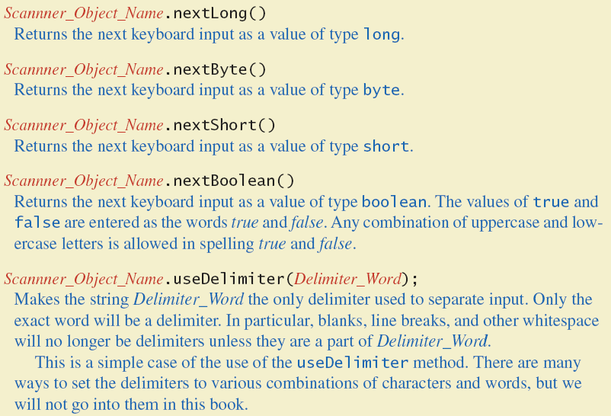
Some Scanner Class Methods
Figure 2.7b

Slide 90
nextLine()Method Caution
The nextLine() method reads
  The remainder of the current line,
  Even if it is empty.

Slide 91
nextLine()Method Caution
Example – given following declaration.
  int n;
  String s1, s2;
  n = keyboard.nextInt();
  s1 = keyboard.nextLine();
  s2 = keyboard.nextLine();
Assume input shown
  n is set to 42
  but s1 is set to the empty string.
  42
  and don't you
  forget it.

Slide 92
The Empty String
A string can have any number of characters, including zero.
The string with zero characters is called the empty string.
The empty string is useful and can be created in many ways including
  String s3 = "";

Slide 93
Other Input Delimiters (optional)
Almost any combination of characters and strings can be used to separate keyboard input.
to change the delimiter to "##"
  keyboard2.useDelimiter("##");
  whitespace will no longer be a delimiter for keyboard2 input

Slide 94
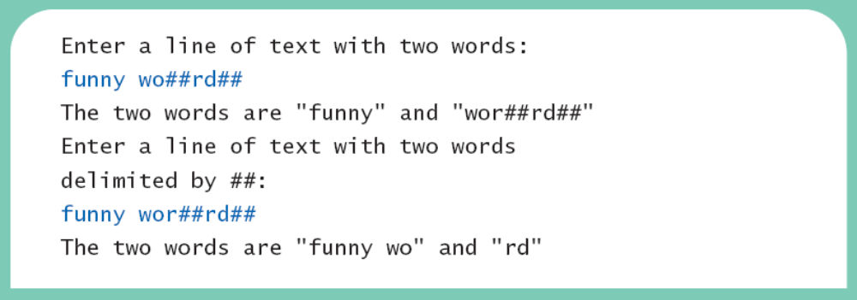
Other Input Delimiters
View sample program
class DelimitersDemo, listing 2.6
Sample Screen Output

Slide 95
Documentation and Style: Outline
Meaningful Names
Comments
Indentation
Named Constants

Slide 96
Documentation and Style
Most programs are modified over time to respond to new requirements.
Programs which are easy to read and understand are easy to modify.
Even if it will be used only once, you have to read it in order to debug it .

Slide 97
Meaningful Variable Names
A variable's name should suggest its use.
Observe conventions in choosing names for variables.
  Use only letters and digits.
  "Punctuate" using uppercase letters at word boundaries (e.g. taxRate).
  Start variables with lowercase letters.
  Start class names with uppercase letters.

Slide 98
Comments
The best programs are self-documenting.
  Clean style
  Well-chosen names
Comments are written into a program as needed explain the program.
  They are useful to the programmer, but they are ignored by the compiler.

Slide 99
Comments
A comment can begin with //.
Everything after these symbols and to the end of the line is treated as a comment and is ignored by the compiler.
  double radius; //in centimeters

Slide 100
Comments
A comment can begin with /* and end with */
Everything between these symbols is treated as a comment and is ignored by the compiler.
  /**
  This program should only
  be used on alternate Thursdays,
  except during leap years, when it should
  only be used on alternate Tuesdays.
  */

Slide 101
Comments
A javadoc comment, begins with /** and ends with */.
It can be extracted automatically from Java software.
  /** method change requires the number of coins to be nonnegative */

Slide 102
When to Use Comments
Begin each program file with an explanatory comment
  What the program does
  The name of the author
  Contact information for the author
  Date of the last modification.
Provide only those comments which the expected reader of the program file will need in order to understand it.

Slide 103
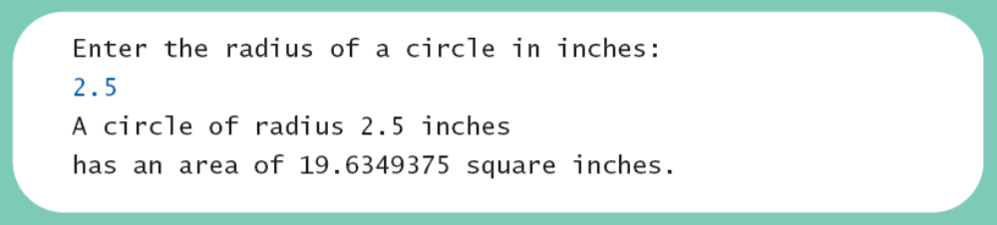
Comments Example
View sample program
class CircleCalculation, listing 2.7
Sample Screen Output

Slide 104
Indentation
Indentation should communicate nesting clearly.
A good choice is four spaces for each level of indentation.
Indentation should be consistent.
Indentation should be used for second and subsequent lines of statements which do not fit on a single line.

Slide 105
Indentation
Indentation does not change the behavior of the program.
Proper indentation helps communicate to the human reader the nested structures of the program

Slide 106
Using Named Constants
To avoid confusion, always name constants
(and variables).
  area = PI * radius * radius;
  is clearer than
  area = 3.14159 * radius * radius;
Place constants near the beginning of the program.

Slide 107
Named Constants
Once the value of a constant is set (or changed by an editor), it can be used (or reflected) throughout the program.
  public static final double INTEREST_RATE = 6.65;
If a literal (such as 6.65) is used instead, every occurrence must be changed, with the risk than another literal with the same value might be changed unintentionally.

Slide 108
Declaring Constants
Syntax
  public static final
  Variable_Type = Constant;
Examples
  public static final double
  PI = 3.14159;
  public static final String MOTTO = "The customer is always right.";
By convention, uppercase letters are used for constants.

Slide 109
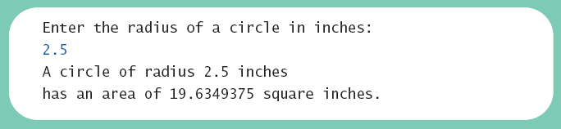
Named Constants
View sample program
class CircleCalculation2, listing 2.8
Sample Screen Output

Slide 110
Graphics Supplement: Outline
Style Rules Applied to a Graphics Applet
JOptionPane
Inputting Numeric Types
Multi-Line Output Windows

Slide 111
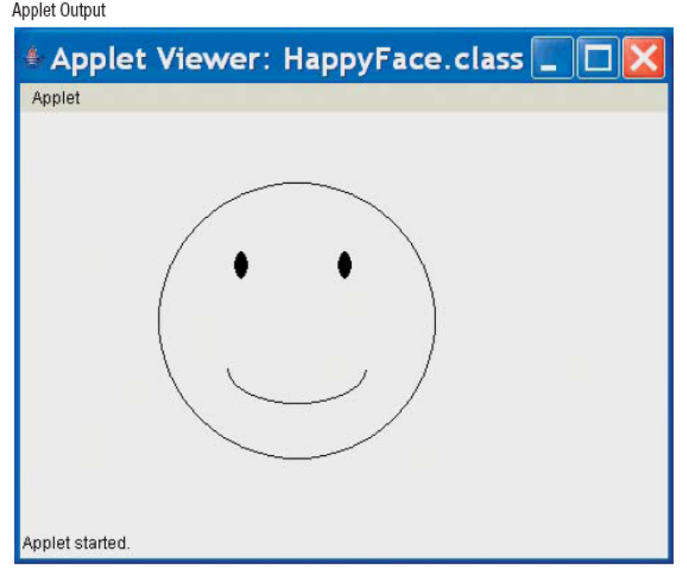
Style Rules Applied to a Graphics Applet
View sample program
class HappyFace, listing 2.9
Sample Screen Output

Slide 112
Style Rules Applied to a Graphics Applet
Named constants makes it easier to find values.
Comments and named constants make changing the code much easier.
Named constants protect against changing the wrong value.

Slide 113
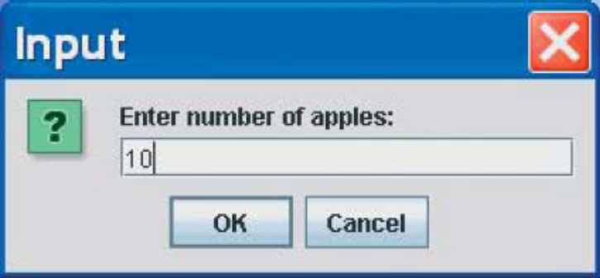
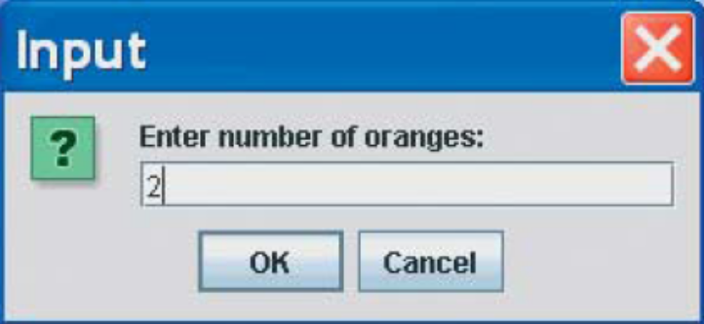
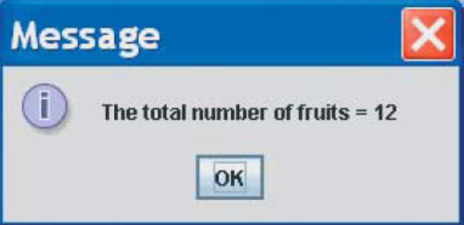
JOptionPane
View sample program
class JOptionPaneDemo, listing 2.10
Sample Screen Output

Slide 114
JOptionPane
JOptionPane can be used to construct windows that interact with the user.
The JOptionPane class is imported by
  import javax.swing.JApplet;
The JOptionPane class produces windows for obtaining input or displaying output.

Slide 115
JOptionPane
Use showInputDialog() for input .
Only string values can be input.
To convert an input value from a string to an integer use the parseInt() method from the Integer class, use
  appleCount = Integer.parseInt(appleString);

Slide 116
JOptionPane
Output is displayed using the showMessageDialog method.
  JOptionPane.showMessageDialog(null, "The total number of fruits = " + totalFruitCount);

Slide 117
JOptionPane
Syntax
  Input
  String_Variable = JOptionPane.showInputDialogue
  (String_Expression);
  Output
  JOptionPane.showMessageDialog
  (null, String_Expression);
System.exit(0) ends the program.

Slide 118
JOptionPane Cautions
If the input is not in the correct format, the program will crash.
If you omit the last line (System.exit(0)), the program will not end, even when the OK button in the output window is clicked.
Always label any output.

Slide 119
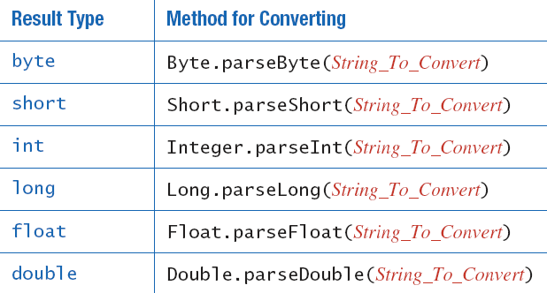
Inputting Numeric Types
JOptionPane.showInputDialog can be used to input any of the numeric types.
Figure 2.8 Methods for converting strings to numbers

Slide 120
Multi-Line Output Windows
To output multiple lines using the method JOptionPane.showMessageDialog, insert the new line character '\n' into the string used as the second argument.
  OptionPane.showMessageDialog(null,
  "The number of apples\n" +
  "plus the number of oranges\n" +
  "is equal to " + totalFruit);

Slide 121
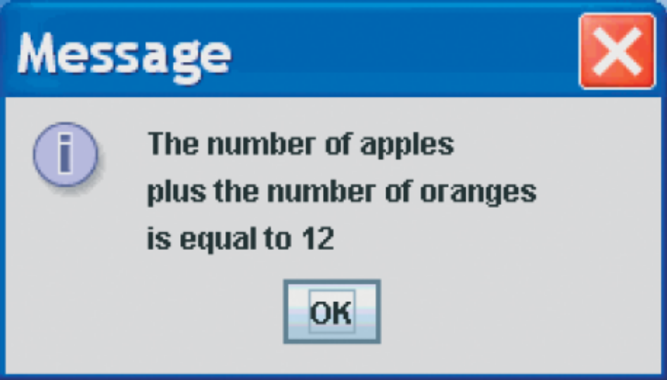
Multi-Line Output Windows
Figure 2.9 A dialog window containing multiline output

Slide 122
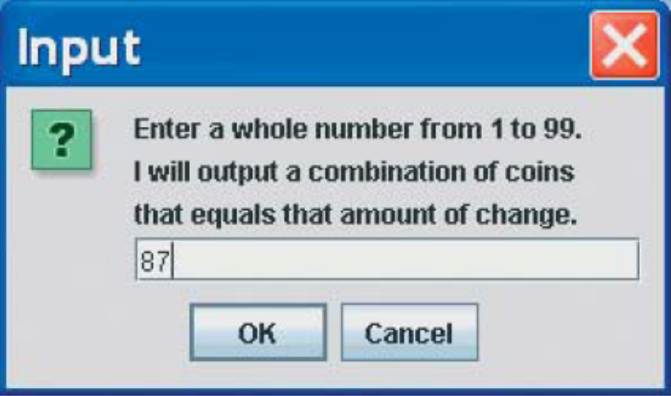
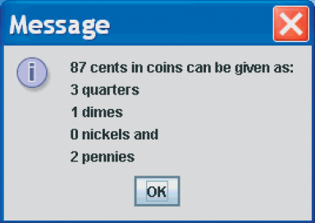
Programming Example
View sample program
class ChangeMakerWindow, listing 2.11
Sample Screen Output

Slide 123
Summary
You have become familiar with Java primitive types (numbers, characters, etc.).
You have learned about assignment statements and expressions.
You have learned about stings.
You have become familiar with classes, methods, and objects.

Slide 124
Summary
You have learned about simple keyboard input and screen output.
You have learned about windows-based input and output using the JOptionPane class.

