Slide 1
SCENE: A Scalable Two-Stage Personalized News Recommendation System
SCENE: A Scalable Two-Stage Personalized News Recommendation System
Lei Li, Dingding Wang, Tao Li, Daniel Knox, and Balaji Padmanabhan
ACM SIGIR Conference 2011
27 January 2012
SNU IDB Lab.
Hyunwoo Kim

Slide 2
Outline
Introduction
Related Work
Proposed approach
Evaluation
Conclusion
Discussion

Slide 3
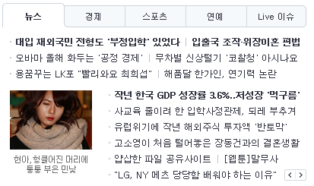

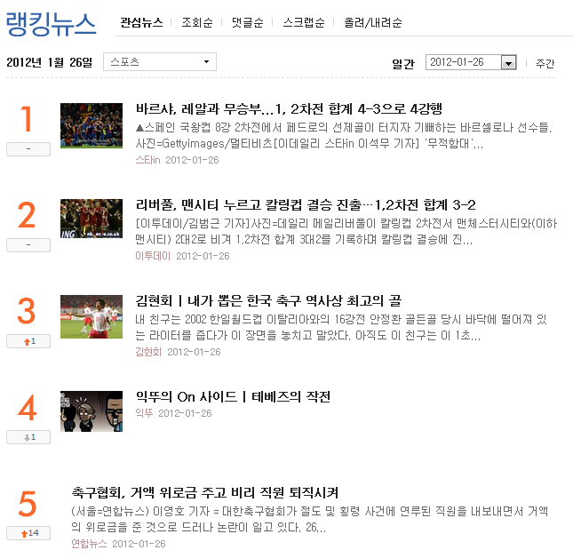
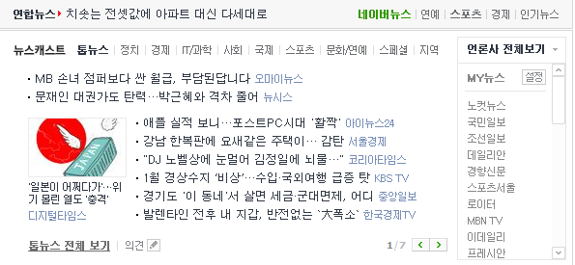


Introduction
News

Slide 4
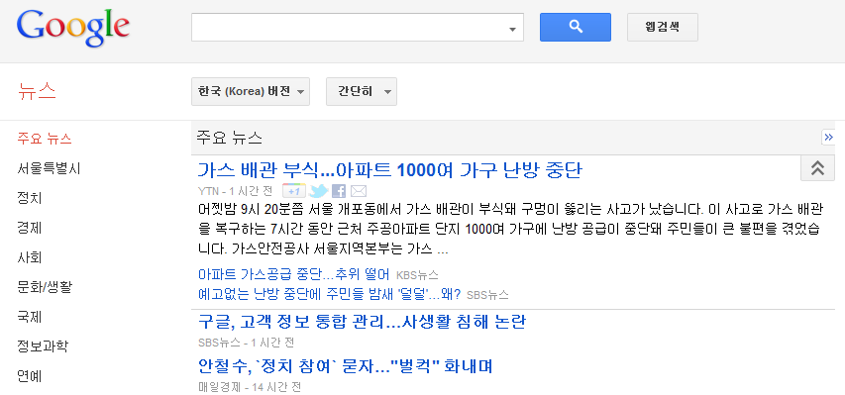
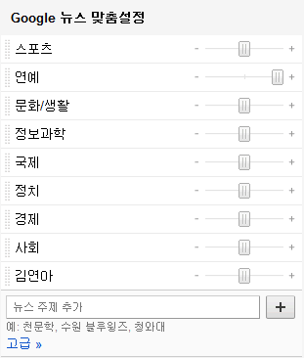
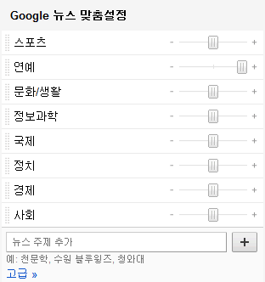
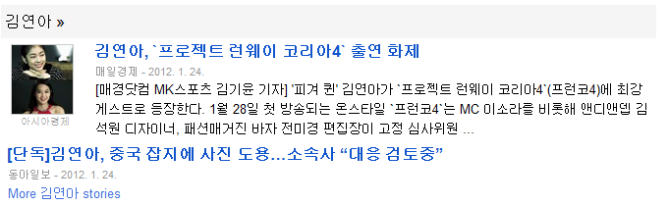

Introduction
Personalized news recommendation services
Google News
Yahoo! News

Slide 5
Introduction
News recommendation remains challenging
Differentiate news items from other web objects
Critical issues
News selection
News representation
News processing
User profiling
Scalability
Dependency
Change over time

Slide 6
Introduction
SCENE
A scalable two-stage personalized news recommendation systems
3 major components
Newly-published news articles clustering
User profile construction
Personalized news items recommendation
Clustering
1st stage:
Personalized news recommendation
2nd stage:

Slide 7
Introduction
Newly-published news articles clustering
Locality Sensitive Hashing (LSH)
Probabilistic Latent Semantic Indexing (PLSI)
Latent Dirichlet Allocation (LDA)
User profile construction
3 different yet related dimensions
News content
Similar access patterns
News entity preference
News content
Similar access patterns
News entity preference

Slide 8
Introduction
3 contributions
Novel 2-level representation
1st level: general topics summarized from news clusters similar to the user’s profile
2nd level: representative items within each cluster
Principled framework for news selection
Modeling news selection problem as a budgeted maximum coverage problem
More realistic than independently selecting news items
Good balance between novelty and diversity
Multi-factor high-quality user profile construction
Construction of user profiles with news content, access patterns and named entities

Slide 9
Introduction
Budgeted maximum coverage problem
Set cover problem
U = {1, 2, 3, 4, 5} S = { {1, 2, 3}, {2, 4}, {3, 4}, {4, 5} }
SETCOVER = { {1, 2, 3}, {4, 5} }
Maximum coverage problem
Select at most k sets such that the maximum number of elements are covered
k=1, MC = { {1, 2, 3} } k=2, MC = { {1, 2, 3}, {4, 5} }
Budgeted maximum coverage problem
Every set has a cost. Instead of k, a budget B is given. Select sets within the budget.

Slide 10
Related Work
News recommender systems
Content-based
Vector space model (TF-IDF)
Topic distributions obtained by language models (PLSI and LDA)
Easy to implement
Insufficient to capture the exact reading interest of the user
Collaborative filtering
Content-free
Efficient when overlap in historical consumption across users is relatively high and the content universe is almost static

Slide 11



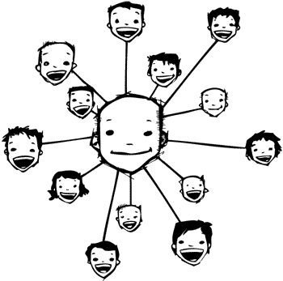













Related Work
Recommender systems
Content-based
Collaborative filtering

Slide 12
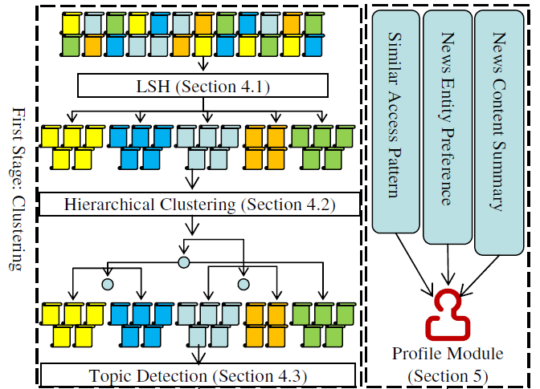
Recommendation Framework
1st stage: clustering

Slide 13
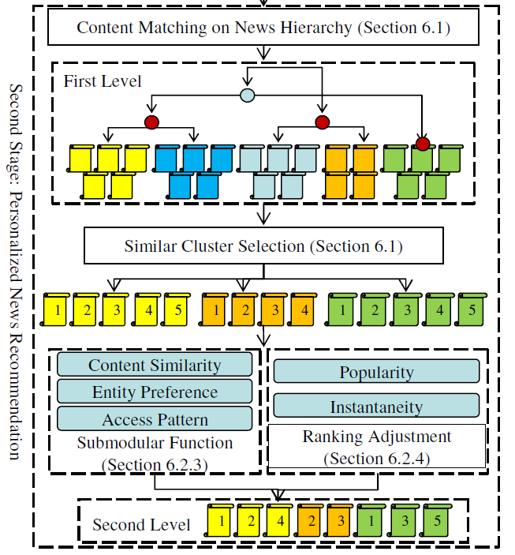
Recommendation Framework
2nd stage

Slide 14
User Profile Construction
News recommendation systems start with constructing the user’s profile
Traditionally
User’s profile can be defined by keeping track of what articles the user has read so far (or called consumption history)
User’s profile as a weighted topic distribution
User’s interest might be affected by other users
3 different yet related dimensions
News content
Similar access pattern
Preferred news entities

Slide 15

User Profile Construction
News content summarization
News articles in users’ consumption history are summarized as a topic distribution
Access pattern analysis
Essentially collaborative filtering
Jaccard similarity
Named entity extraction
When, where, what happened
Who are involved

Slide 16
Personalized Recommendation
Exploring the relations between newly-published news articles and the user’s profile
Hybrid recommendation method
2-level recommendation hierarchy
1st level: brief summary for each topic category the user might prefer
2nd level: specific list of news articles similar to the user’s reading interest
News selection for representation Lv. 2
Modeling as budgeted maximum coverage problem
Solving by a greedy algorithm

Slide 17





Personalized Recommendation
News profile construction
Static descriptors: topic distribution and named entities
Dynamic characteristics: accessed users, popularity, and recency
News profile
User’s profile
=
= Jaccard similarity

Slide 18
Evaluation
Real world dataset
Users’ access history from popular news websites
News data for 9 categories
From 2010-08-15 to 2010-11-16
111,380 news items
4,630 users

Slide 19
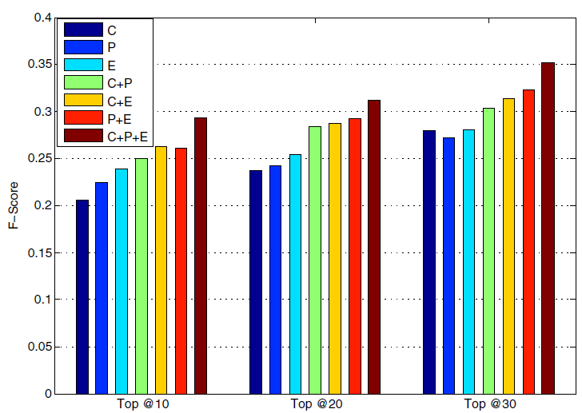

Evaluation
Profile evaluation
News readers might have more interest on named entities appeared in news articles
Hybrid approach performs the best
Recommender systems with preferred named entities perform better
Simple but representative named entities
C:
News content
P:
Similar access patterns
E:
News entity preference
F-Score = harmonic mean of
precision and recall

Slide 20
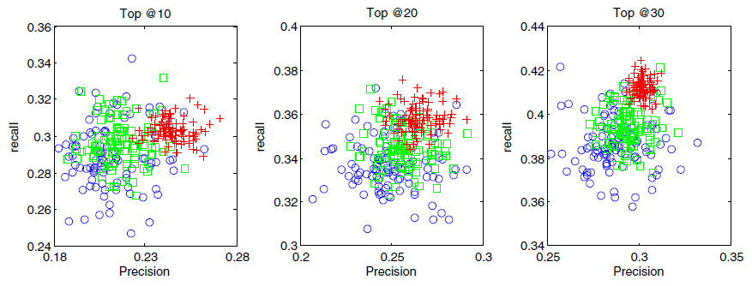
Evaluation
Selection strategy evaluation
Higher precision and recall
SCENE is more compact than other models (stability)
ㅇ:
Greedy-based
ㅁ:
Bandit-based
+:
SCENE

Slide 21
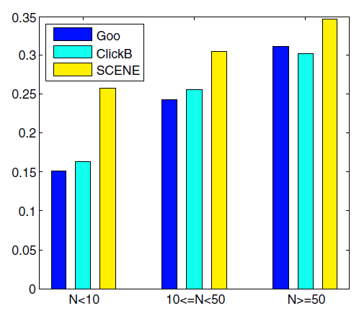
Evaluation
Cold-start problem
SCENE achieves reasonable results
Reason: similar access pattern + news content + named entities
N: # of news articles per day
Goo: collaborative filtering
ClickB: content-based method
F-score

Slide 22
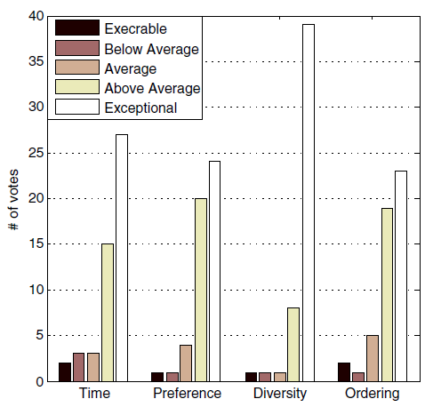
Evaluation
User study on SCENE
50 volunteers for 15 days
Response time once a user logs onto the system
Preference on news articles
Diversity of news list
Ordering of news articles
History
Recommendation
5 days
10 days

Slide 23
Conclusion
SCENE to tackle personalized news recommendation
Efficient clustering on newly-published news articles
High quality of recommendation results
Future work
To deploy offline clustering component onto the MapReduce framework
Interest evolution of users
To provide insights on the exploration of users’ reading behaviors

Slide 24
Discussion
Strong point
News recommendation remains challenging
Well-organized recommendation system
Good explanation of each component
Weak point
Simple parameter setting
Only one similarity measure
Jaccard similarity
Better than Google News?

Slide 25
Thank you

