Slide 1
Ontology Development As Undergraduate Research
Antonio M. Lopez, Jr
pp. 199-207, CCSC’02
xx Feb 2015
SNU IDB
Inyong Lee

Slide 2
Outline
Introduction
Ontology
Ontology in AI
Ontology Construction
Ontology Implementation
Deployed Ontology
HPKB
RKF
Former Undergraduate Research

Slide 3
Introduction [1/4]
Data
Raw facts
Result of observations or measurements
ex) data on map (Location, name…)
Information
Organized data, meaningful within a context
ex) route (distance, curves)
Knowledge
“Know how”
Lets humans, computers use the information to solve a problem
Collection of facts, heuristics, context

Slide 4
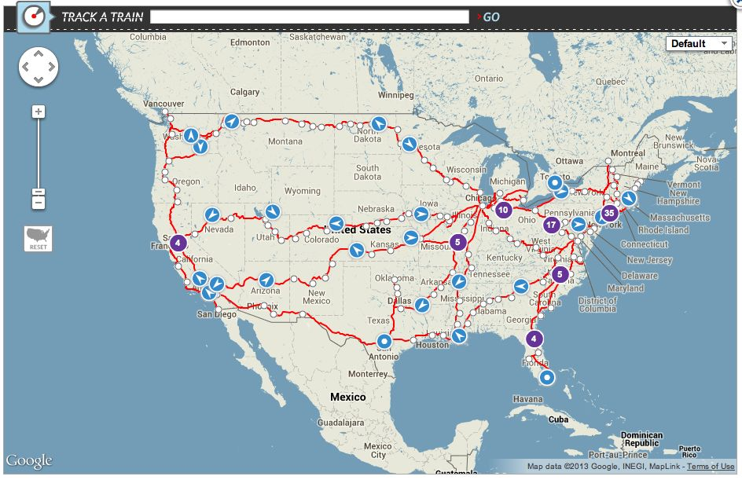
Introduction [2/4]
B
A

Slide 5
Introduction [3/4]
Knowledge-base
Collection of Knowledge from solving problems
Knowledge is stored with certain rule, and data is stored in frames
Suitable for extension due to modularization
Knowledge-based System
Use Knowledge-base to solve problems
From common-sense to expert knowledge
Once constructed, knowledge is
recalled for reuse in similar problems

Slide 6
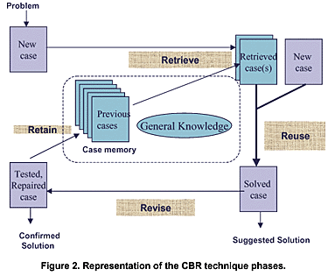
Introduction [4/4] – Knowledge Based System

Slide 7
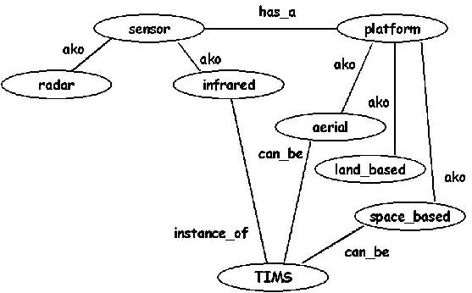
Ontology
Definition
Intentional semantic structure, that encodes the implicit rules constraining the structure of a piece of reality
Dictionary well suited for computers
Ontology is prior to the development of the knowledge-based System
Properties
Class, Instance, Property, Relation
ex) Class(Sensor), Instance(TIMS),
Property(aerial, land_based),
Relation(has_a, aka, can_be)

Slide 8

Ontology in AI
Building Intelligent Agent
Every intelligent agent need a knowledge-based System
Knowledge-base = Ontology + Problem Solving Rules
Thus AI communities adopted ontology as pre-requisite to building knowledge-based systems

Slide 9
Ontology Construction
Ontology Domain
Categorized Concepts of real world
Ontologies consist of wide range of domains or just one domain
ex) Routing Problem (Math domain + Map domain)
Large knowledge-based system are usually divided into strata(levels)
Top level of those ontology, there is knowledge that can be used in many areas, as time, space, mental states etc
Bottom levels have specific knowledge about a particular area.
If top level is about World War 2 and military operation, bottom level will contain details of ‘Okinawa Campaign’, ‘Iwo Jima’, ‘Leyte’, ‘Normandy’.

Slide 10
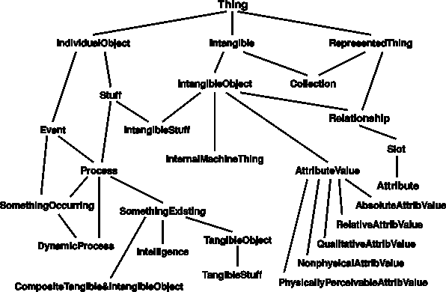
Ontology Construction

Slide 11
Ontology Construction
Mid-level knowledge
Connecting these two levels is terms and relationships about those two levels
ex) Psychosocial factors (“Will of People”, “Normandy”)
Development can be accomplished top-down or bottom-up
Top-down approach can take years
Can combine existing top-down ontologies and independently developed bottom-up ontologies
Undergraduate students can tackle bottom level ontologies while graduate researchers develop large knowledge base

Slide 12
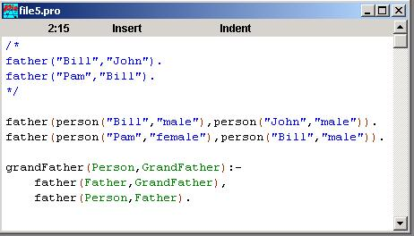
Ontology Implementation
Computer Program
PROLOG – A declarative programming language often used in AI
ex) instance_of(“TIMS”, infrared) , ako(infrared, sensor)
AI researchers can test the robustness of the ontology and determine its usefulness by simulations

Slide 13
Deployed Ontologies
Criticism
AI researchers are criticised as their research is a ‘Toy Problem’
Maybe solvable in laboratory, but not in ‘real world’ scenario
DARPA (Defense Advanced Research Project Agency)
Silenced the criticism by two research- HPKB, RKF program

Slide 14
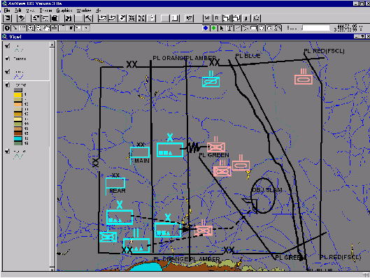
Deployed Ontology - HPKB
Purpose
To critique different courses of action in a tactical military operation
Top level ontology
Geograpic information (Map)
Military Organization (Tanks)
Purpose (Destruction of Enemy)
Bottom level ontology
Part of each tests
Terrain (Hills, roads, etc)
Friendly, enemy forces (Blue vs Red)
Notes:
A Plan Sketch Tool from the DARPA High Performance Knowledge Bases (HPKB) Program. This tool allows the user to sketch Division-level COAs. It is based on a commercial GIS tool, ArcView, and has been customised to provide the user with a palate of standard military symbols. The intended use of this tool is as an input device to a knowledge-based system. The information represented in the sketch is automatically translated into a knowledge representation language. Planners require similar descriptions of scenarios.

Slide 15
Deployed Ontology - RKF
Purpose
Extend tactical military ontology (HPKB) into strategic level of war
Determination of the strategic center of gravity of an opposing force
One of the most difficult and vexing problems military faces
First step
Gives some insight into numerous domain ontologies that need to be
developed to solve the primary question

Slide 16
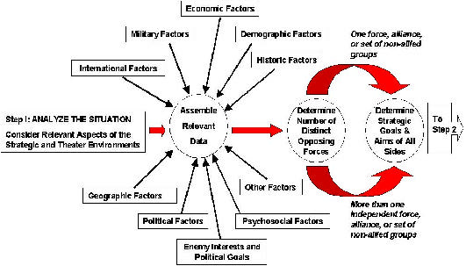
Deployed Ontology - RKF

Slide 17
Deployed Ontology - RKF
ex) Psychosocial Factor - First Step
What is ‘Jihad’?
What are particulars of this that drive
people commit unspeakable acts
“Holy War”, “Purging of evil from
themselves”
Is there a similar concept in Jewish Religion?
Is it the Christian concept of “Just War”?
Notes:
x

Slide 18
Former Undergraduate Research
1999 Carnegie Mellon University undergraduate researcher in department of biological Sciences developed an ontology for protein subcellular localization
2000 undergraduate researchers in algebra word problem domain have developed an ontology and a knowledge representation scheme CASPOR
Since 2001, undergraduate researcher is working on an ontology for concept of religion, and will turn her ontology into a small knowledge-based system with PROLOG

Slide 19
Conclusion
Ontologies have been deployed as part of knowledge-based systems that solve ‘non-toy’ problems
Ontology development is rich area in which undergraduates can do research
While faculty and graduate researchers tackle the development of large knowledge-based system, undergraduate researchers can learn a great deal from development of a domain ontology which can be subsumed into a larger ontology
Computer Science is made meaningful by connecting to other fields

