Slide 1
Chapter 5: Advanced SQL

Slide 2
Database System Concepts
Chapter 1: Introduction
Part 1: Relational databases
  Chapter 2: Introduction to the Relational Model
  Chapter 3: Introduction to SQL
  Chapter 4: Intermediate SQL
  Chapter 5: Advanced SQL
  Chapter 6: Formal Relational Query Languages
Part 2: Database Design
  Chapter 7: Database Design: The E-R Approach
  Chapter 8: Relational Database Design
  Chapter 9: Application Design
Part 3: Data storage and querying
  Chapter 10: Storage and File Structure
  Chapter 11: Indexing and Hashing
  Chapter 12: Query Processing
  Chapter 13: Query Optimization
Part 4: Transaction management
  Chapter 14: Transactions
  Chapter 15: Concurrency control
  Chapter 16: Recovery System
Part 5: System Architecture
  Chapter 17: Database System Architectures
  Chapter 18: Parallel Databases
  Chapter 19: Distributed Databases
Part 6: Data Warehousing, Mining, and IR
  Chapter 20: Data Mining
  Chapter 21: Information Retrieval
Part 7: Specialty Databases
  Chapter 22: Object-Based Databases
  Chapter 23: XML
Part 8: Advanced Topics
  Chapter 24: Advanced Application Development
  Chapter 25: Advanced Data Types
  Chapter 26: Advanced Transaction Processing
Part 9: Case studies
  Chapter 27: PostgreSQL
  Chapter 28: Oracle
  Chapter 29: IBM DB2 Universal Database
  Chapter 30: Microsoft SQL Server
Online Appendices
  Appendix A: Detailed University Schema
  Appendix B: Advanced Relational Database Model
  Appendix C: Other Relational Query Languages
  Appendix D: Network Model
  Appendix E: Hierarchical Model

Slide 3
Chapter 5: Advanced SQL
5.1 Accessing SQL From a Programming Language
  Dynamic SQL
    JDBC and ODBC
  Embedded SQL
5.2 Functions and Procedures
5.3 Triggers
5.4 Recursive Queries**
5.5 Advanced Aggregation Features**
5.6 OLAP**

Slide 4
JDBC and ODBC
API (application-program interface) for a program to interact with a database server
Application makes calls to
  Connect with the database server
  Send SQL commands to the database server
  Fetch tuples of result one-by-one into program variables
ODBC (Open Database Connectivity)
  ODBC 1.0 (1992), ODBC 3.0 (1995), ODBC 3.8 (2009)
  Orginally designed for C, now works with C++, C#, and Visual Basic
  Other API’s such as ADO.NET sit on top of ODBC
  ODBC drivers exist for most DBMSs
JDBC (Java Database Connectivity) works with Java
  JDBC driver was a part of Java Development Kit (JDK) 1.1 (1997)
  Since then, a part of Java Platform, Standard Edition (Java SE)
  JDBC 4.2 (2013)

Slide 5
JDBC
JDBC is a Java API for communicating with database systems supporting SQL.
JDBC supports a variety of features for querying and updating data, and for retrieving query results.
JDBC also supports metadata retrieval, such as querying about relations present in the database and the names and types of relation attributes.
JDBC Model for communicating with the database:
  Open a connection
  Create a “statement” object
  Execute queries using the Statement object to send queries and fetch results
  Exception mechanism to handle errors

Slide 6
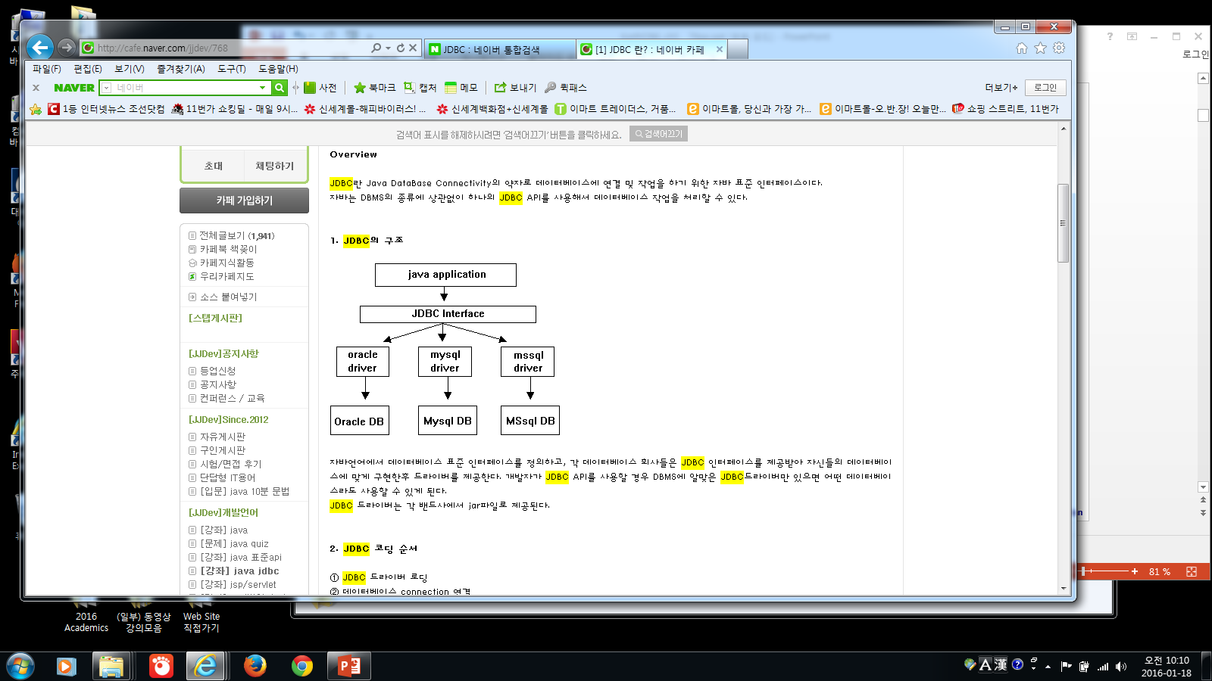


Slide 7
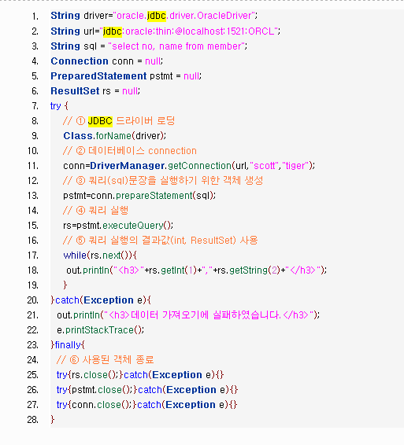

Slide 8
JDBC Code
  public static void JDBCexample(String userid, String passwd)
{
  try {
    Class.forName ("oracle.jdbc.driver.OracleDriver"); // JDBC driver loading
    Connection conn = DriverManager.getConnection(
    "jdbc:oracle:thin:@db.yale.edu:2000:univdb", userid, passwd);
  Statement stmt = conn.createStatement();
  … Update code in the next page….
  … Query and fetch code in the next page…..
  stmt.close();
  conn.close();
  }
  catch (Exception e) {
  System.out.println("Exception : " + e);
  }
}

Slide 9
“Update DB” Code Details
Update to database
try {
stmt.executeUpdate(
"insert into instructor values(’77987’, ’Kim’, ’Physics’, 98000)");
}
catch (SQLException sqle)
{
System.out.println("Could not insert a tuple. " + sqle);
}

Slide 10
“Query & Fetch” Code Details
Execute query and fetch & print result
ResultSet rset = stmt.executeQuery(
"select dept_name, avg (salary)
from instructor
  group by dept_name");
  while (rset.next()) {
  System.out.println(rset.getString("dept_name") + " " + rset.getFloat(2));
  }
Getting result fields:
  rset.getString(“dept_name”) and rset.getString(1) equivalent if dept_name is the first argument of select result.

Slide 11
JDBC Prepared Statement
PreparedStatement의 ?자리에 나중에 공급되는 value가 들어가는 mechanism
PreparedStatement pStmt = conn.prepareStatement(
"insert into instructor values(?,?,?,?)");
pStmt.setString(1, "88877");
pStmt.setString(2, "Perry");
pStmt.setString(3, "Finance");
pStmt.setInt(4, 125000);
pStmt.executeUpdate();
pStmt.setString(1, "88878");
pStmt.executeUpdate();
WARNING: always use prepared statements when taking an input from the user and adding it to a query
  You better not create a query by concatenating strings!
  “ insert into instructor
  values(’ " + ID + " ’, ’ " + name + " ’, " + " ’ + dept name + " ’, " ’ balance + ") “
  What if name is “D’Souza”? ➔ single quotation mark will create a syntax error
  The next slide shows an even-worse situation!

Slide 12
“Potentially Dangerous” SQL Injection in JDBC Prepared Statement
Suppose query is constructed using
  “ select * from instructor where name = ’" + name + "’ "
Suppose the user, instead of entering a name, enters:
  X’ or ’Y’ = ’Y
then the resulting statement becomes:
  “ select * from instructor where name = ’ " + “ X’ or ’Y’ = ’Y " + “ ’ "
  which is:
    select * from instructor where name = ’ X’ or ’Y’ = ’Y ’
  User could have even used
    X’; update instructor set salary = salary + 10000; --
Prepared statement internally uses \ for a single quotation mark:
"select * from instructor where name = ’X\’ or \’Y\’ = \’Y’
  Always use prepared statements, with user inputs as parameters

Slide 13
JDBC Metadata Features
Two types of JDBC Metadata
  Meta data for a query
  Meta data for the whole database
ResultSetMetadata: meta data for query result
E.g., after executing query to get a ResultSet rs
  ResultSetMetaData rsmd = rs.getMetaData();
  for(int i = 1; i <= rsmd.getColumnCount() ; i++) {
  System.out.println( rsmd.getColumnName(i) );
System.out.println( rsmd.getColumnTypeName(i) );
}
How is this useful? ➔ useful for printing out the formatted table for query result!

Slide 14
JDBC Metadata Features (Cont)
DatabaseMetadata: meta data for the database itself
DatabaseMetaData dbmd = conn.getMetaData();
ResultSet rs = dbmd.getColumns(null, “univdb”, “department”, “%”);
// Arguments to getColumns: Catalog, Schema-pattern, Table-pattern, Column-Pattern
// Returns: One row for each column; row has a number of attributes
// such as COLUMN_NAME, TYPE_NAME
while( rs.next() ) {
System.out.println(rs.getString(“COLUMN_NAME"), rs.getString("TYPE_NAME");
}
And where is this useful? ➔ can be used for a database browser (or database GUI) that allows a user to navigate or examine tables

Slide 15
JDBC transaction control
Updatable result sets
  By default, each SQL statement is treated as a separate transaction that is committed automatically
    bad idea for transactions with multiple updates
  Can turn off automatic commit on a connection
    conn.setAutoCommit(false);
  A group of transactions must then be committed or rolled back explicitly
    conn.commit(); or
    conn.rollback();
  conn.setAutoCommit(true) turns on automatic commit.

Slide 16
JDBC Stored Procedures
Calling statement interface for invoking SQL stored functions and procedures
  CallableStatement cStmt1 = conn.prepareCall("{? = call some function(?)}");
  CallableStatement cStmt2 = conn.prepareCall("{call some procedure(?,?)}");
  Java program 내부에서 cStmt1와 cStmt2를 수행할수 있다
Handling large object types without creating the large object in memory
  getBlob() and getClob() that are similar to the getString() method, but return objects of type Blob and Clob, respectively
  get data from these objects by getBytes()
  associate an open stream with Java Blob or Clob object to update large objects
    blob.setBlob(int parameterIndex, InputStream inputStream).
  Database에 있는 large object들을 Java program에서 partial access, update등이 가능하게 한다

Slide 17
ODBC
Open Data Base Connectivity(ODBC) standard
  Initially C language connection API to DBMS
  standard for application program to communicate with a database server.
  application program interface (API) to
    open a connection with a database,
    send queries and updates,
    get back results.
Applications such as GUI, spreadsheets, etc. can use ODBC

Slide 18
ODBC (Cont.)
Each database system supporting ODBC provides a “ODBC driver" library that must be linked with the client program.
When client program makes an ODBC API call, the code in the library communicates with the server to carry out the requested action, and fetch results.
ODBC program first allocates an SQL environment, then a database connection handle.
Opens database connection using SQLConnect() with parameters as below
  connection handle,
  the server to which to connect
  the user identifier,
  password
Must also specify types of arguments:
  SQL_NTS denotes previous argument is a null-terminated string.

Slide 19
ODBC Code (Cont.)
int ODBCexample()
{
RETCODE error;
HENV env; /* environment */
HDBC conn; /* database connection */
SQLAllocEnv( &env );
SQLAllocConnect( env, &conn );
SQLConnect(conn, “db.yale.edu", SQL_NTS, "avi", SQL_NTS, "avipasswd", SQL_NTS);
{ …Code in the next page… }
  SQLDisconnect( conn );
  SQLFreeConnect( conn );
  SQLFreeEnv( env );
}

Slide 20
ODBC Code (Cont.)
Main body of program
  char deptname[80];
  float salary;
  int lenOut1, lenOut2;
  HSTMT stmt;
  char * sqlquery = "select dept_name, sum (salary)
  from instructor
  group by dept_name";
  SQLAllocStmt(conn, &stmt);
  error = SQLExecDirect(stmt, sqlquery, SQL NTS);
  if (error == SQL SUCCESS) {
  SQLBindCol (stmt, 1, SQL C CHAR, deptname , 80, &lenOut1);
  SQLBindCol (stmt, 2, SQL C FLOAT, &salary, 0 , &lenOut2);
  while (SQLFetch(stmt) == SQL SUCCESS) {
  printf (" %s %g\n", deptname, salary);
  }
  }
  SQLFreeStmt(stmt, SQL DROP);

Slide 21
ODBC Code (Cont.)
Program sends SQL commands to the database by using SQLExecDirect
Result tuples are fetched using SQLFetch()
SQLBindCol() binds C language variables to attributes of the query result
  When a tuple is fetched, its attribute values are automatically stored in corresponding C variables.
  Arguments to SQLBindCol()
    ODBC stmt variable, attribute position in query result
    The type conversion from SQL to C.
    The address of the variable.
    For variable-length types like character arrays,
      The maximum length of the variable
      Location to store actual length when a tuple is fetched.
      Note: A negative value returned for the length field indicates null value
Good programming requires checking results of every function call for errors; we have omitted most checks for brevity.

Slide 22
ODBC Prepared Statements
Prepared Statement
  SQL statement prepared: compiled at the database
  Can have placeholders: E.g. insert into account values(?,?,?)
  Repeatedly executed with actual values for the placeholders
To prepare a statement
SQLPrepare(stmt, <SQL String>);
To bind parameters
SQLBindParameter(stmt, <parameter#>,
… type information and value omitted for simplicity..)
To execute the statement
retcode = SQLExecute( stmt);
To avoid SQL injection security risk, do not create SQL strings directly using user input; instead use prepared statements to bind user inputs

Slide 23
More ODBC Features
Metadata features
  finding all the relations in the database and
  finding the names and types of columns of a query result or a relation in the database.
Transaction control: By default, each SQL statement is treated as a separate transaction that is committed automatically.
  Can turn off automatic commit on a connection
    SQLSetConnectOption(conn, SQL_AUTOCOMMIT, 0)}
  A group of transactions can be committed or rolled back explicitly by
    SQLTransact(conn, SQL_COMMIT) or
    SQLTransact(conn, SQL_ROLLBACK)

Slide 24
ODBC Conformance Levels
Conformance levels specify subsets of the functionality defined by the standard.
  Core
  Level 1 requires support for metadata querying
  Level 2 requires ability to send and retrieve arrays of parameter values and more detailed catalog information.
SQL Call Level Interface (CLI) standard similar to ODBC interface, but with some minor differences.

Slide 25
ADO.NET
Database connection API for Visual Basic .NET and C# (similar to JDBC/ODBC)
  Partial example of ADO.NET code in C#
  using System, System.Data, System.Data.SqlClient;
  SqlConnection conn = new SqlConnection(
  “Data Source = <IPaddr>, Initial Catalog = <Catalog>”);
  conn.Open();
  SqlCommand cmd = new SqlCommand(“select * from students”, conn);
  SqlDataReader rdr = cmd.ExecuteReader();
  while(rdr.Read()) {
  Console.WriteLine(rdr[0], rdr[1]); /* Prints first 2 attributes of result*/
  }
  rdr.Close();
  conn.Close();
Translated into ODBC calls
Can also access non-relational data sources such as
  OLE-DB
  XML data
  Entity framework

Slide 26
Embedded SQL
The SQL standard defines embeddings of SQL in PLs such as C, Java, and Cobol.
A language to which SQL queries are embedded is referred to as a host language, and the SQL structures permitted in the host language comprise embedded SQL.
System R: ESQL into PL/I, Most DBMSs: ESQL/C
EXEC SQL statement is used to identify embedded SQL request to the preprocessor
EXEC SQL <embedded SQL statement > END_EXEC
Note: this varies by language (eg., the Java embedding uses # SQL { . }; )
From within a host language, find the ID and name of students who have completed more than the number of credits stored in variable credit_amount.
Specify the query in SQL and declare a cursor for it
EXEC SQL
declare c cursor for
select ID, name
from student
where tot_cred > :credit_amount
END_EXEC

Slide 27
Embedded SQL (Cont.)
The open statement causes the query to be evaluated
EXEC SQL open c END_EXEC
The fetch statement causes the values of one tuple in the query result to be placed on host language variables.
EXEC SQL fetch c into :si, :sn END_EXEC
Repeated calls to fetch get successive tuples in the query result
A variable called SQLSTATE in the SQL communication area (SQLCA) gets set to ‘02000’ to indicate no more data is available
The close statement causes the database system to delete the temporary relation that holds the result of the query.
EXEC SQL close c END_EXEC
Note: above details vary with language. For example, the Java embedding defines Java iterators to step through result tuples.

Slide 28
Updates Through Cursors in Embedded SQL
Can update tuples fetched by cursor by declaring that the cursor is for update
EXEC SQL
declare c cursor for
select *
from instructor
where dept_name = ‘Music’
for update
To update tuple at the current location of cursor c
EXEC SQL
update instructor
set salary = salary + 100
where current of c

Slide 29
SQLJ
Alternative approach for combining SQL and Java
JDBC에 비해서 Java Syntax에 가깝게 표현되는 방식
SQLJ part 0: ANSI (1998), “Object Language Bindings (SQL/OLB)”, SQL—Part 10
SQLJ part 1: ANSI (1999), "SQL Routines Using the Java"
SQLJ part 2: ANSI (2000), "SQL Types Using the Java”
Object Language Bindings (SQL/OLB) : ISO (2000), SQL—Part 10
SQL Routines and Types Using the Java (SQL/JRT): ISO (2002), SQL—Part 13
Only DBMSs by IBM, Oracle support SQLJ
  Translator from SQLJ code to JCBC code

Slide 30
SQLJ (cont’d)
JDBC is overly dynamic, errors cannot be caught by compiler
➔ 그래서 JDBC program들은 Try … Catch.. 로 구성된다
ESQL/C와 다른점: EXEC SQL 대신에 #sql, cursor대신에 iter
SQLJ: embedded SQL in Java
  #sql iterator deptInfoIter ( String dept_name, int avgSal);
  deptInfoIter iter = null;
  #sql iter = { select dept_name, avg(salary)
  from instructor
  group by dept_name };
  while (iter.next()) {
  String deptName = iter.dept_name();
  int avgSal = iter.avgSal();
  System.out.println(deptName + " " + avgSal);
  }
  iter.close();

Slide 31
Chapter 5: Advanced SQL
5.1 Accessing SQL From a Programming Language
  Dynamic SQL
    JDBC and ODBC
  Embedded SQL
5.2 Functions and Procedures
5.3 Triggers
5.4 Recursive Queries**
5.5 Advanced Aggregation Features**
5.6 OLAP**

Slide 32
Procedural Extensions and Stored Procedures
SQL provides a module language
  Permits definition of procedures in SQL, with if-then-else statements, for and while loops, etc.
Stored Procedures
  Can store procedures in the database
  then execute them using the call statement
  permit external applications to operate on the database without knowing about internal details
OOP의 method 개념을 support
Object-oriented aspects of these features are covered in Chapter 22 (Object Based Databases)

Slide 33
Functions and Procedures
SQL:1999 supports functions and procedures
  Functions/procedures can be written in SQL itself, or in an external programming language.
  Functions are particularly useful with specialized data types such as images and geometric objects.
    Example: functions to check if polygons overlap, or to compare images for similarity.
  Some database systems support table-valued functions, which can return a relation as a result.
SQL:1999 also supports a rich set of imperative constructs, including
  Loops, If-then-else, Assignment
Many DBMSs have proprietary procedural extensions to SQL that differ from SQL:1999.

Slide 34

Schema Diagram for University Database

Slide 35
SQL Functions
Define a function that, given the name of a department, returns the count of the number of instructors in that department.
create function dept_count (dept_name varchar(20))
returns integer
begin
declare d_count integer;
select count (* ) into d_count
from instructor
where instructor.dept_name = dept_name
return d_count;
end
Calling a function within a query: Find the department name and budget of all departments with more that 12 instructors.
select dept_name, budget
from department
where dept_count (dept_name ) > 1

Slide 36
SQL Table Functions
SQL:2003 added functions that return a relation as a result
Define a table function: Return all accounts owned by a given customer
create function instructors_of (dept_name char(20)
returns table ( ID varchar(5),
name varchar(20),
dept_name varchar(20),
salary numeric(8,2))
return table
(select ID, name, dept_name, salary
from instructor
where instructor.dept_name = instructors_of.dept_name)
Calling a table function:
select *
from table (instructors_of (‘Music’))

Slide 37
SQL Procedures
The dept_count function could instead be written as procedure:
create procedure dept_count_proc ( in dept_name varchar(20),
out d_count integer)
begin
select count(*) into d_count
from instructor
where instructor.dept_name = dept_count_proc.dept_name
end
Procedures can be invoked either from an SQL procedure or from embedded SQL, using the call statement.
declare d_count integer;
call dept_count_proc( ‘Physics’, d_count);
Procedures and functions can be invoked also from dynamic SQL
SQL:1999 allows more than one function/procedure of the same name (called name overloading), as long as the number of arguments differ, or at least the types of the arguments differ

Slide 38
SQL Procedural Constructs
Warning: most database systems implement their own variant of the standard syntax below
  read your system manual to see what works on your system
Compound statement: begin … end,
  May contain multiple SQL statements between begin and end.
  Local variables can be declared within a compound statements
While and repeat statements:
declare n integer default 0;
while n < 10 do
  set n = n + 1
end while
repeat
  set n = n – 1
until n = 0
end repeat
For loop
Permits iteration over all results of a query
declare n integer default 0;
for r as
select budget
from department
where dept_name = ‘Music’
do
set n = n - r.budget
end for

Slide 39
SQL Procedural Constructs (cont.)
Conditional statements: if-then-else
SQL:1999 also supports a case statement similar to C case statement
Example procedure: registers student after ensuring classroom capacity is not exceeded
  Returns 0 on success and -1 if capacity is exceeded
  See book for details
Signaling of exception conditions, and declaring handlers for exceptions
declare out_of_classroom_seats condition
declare exit handler for out_of_classroom_seats
begin
…
.. signal out_of_classroom_seats
end
  The handler here is exit -- causes enclosing begin .. end to be exited
  Other actions possible on exception

Slide 40
Functions/Procedures written in External PL
SQL:1999 permits the use of functions and procedures written in other languages such as C or C++
Declaring external language procedures and functions inside SQL:1999
create procedure dept_count_proc(in dept_name varchar(20), out count integer)
language C
external name ’ /usr/avi/bin/dept_count_proc’
create function dept_count(dept_name varchar(20))
returns integer
language C
external name ‘/usr/avi/bin/dept_count’

Slide 41
Functions/Procedures written in External PL (Cont.)
Benefits of external language functions/procedures:
  more efficient for many operations, and more expressive power.
Drawbacks
  Code to implement function may need to be loaded into database system and executed in the database system’s address space.
    risk of accidental corruption of database structures
    security risk, allowing users access to unauthorized data
  There are alternatives, which give good security at the cost of potentially worse performance.
  Direct execution in the database system’s space is allowed when efficiency is more important than security.

Slide 42
Security with External Language Routines
To deal with security problems
  Use sandbox techniques
    A safe language like Java has the sandbox feature which cannot be used to access/damage other parts of the database code.
  Or, run external language functions/procedures in a separate process, with no access to the database process’ memory.
    Parameters and results communicated via inter-process communication
Both have performance overheads
Many database systems support both above approaches as well as direct executing in database system address space.
Java Sand Box Model: Java Compiler가 신뢰성이 확보되지 않은 코드를 load할 때 항상 바이트 코드를 검사하여, 신용이 확인되지 않은 코드는 자바환경전체에 아무런 해약이 미치지 못하는 ‘Sand Box‘에서 수행시켜 Local System에 대한 전면적인 접근을 금지하는 기법.

Slide 43
Chapter 5: Advanced SQL
5.1 Accessing SQL From a Programming Language
  Dynamic SQL
    JDBC and ODBC
  Embedded SQL
5.2 Functions and Procedures
5.3 Triggers
5.4 Recursive Queries**
5.5 Advanced Aggregation Features**
5.6 OLAP**

Slide 44
Triggers
A trigger is a statement that is executed automatically by the system as a side effect of a modification to the database.
To design a trigger mechanism, we must:
  Specify the conditions under which the trigger is to be executed.
  Specify the actions to be taken when the trigger executes.
Triggers were officially introduced to SQL standard in SQL:1999
But triggers have been supported even earlier using non-standard syntax by most databases.
  Syntax illustrated here may not work exactly on your database system; check the system manuals

Slide 45
Trigger Example
E.g. time_slot_id is not a primary key of timeslot, so we cannot create a foreign key constraint from section to timeslot.
Alternative: use triggers on section and timeslot to enforce integrity constraints
create trigger timeslot_check1 after insert on section
referencing new row as nrow
for each row
when (nrow.time_slot_id not in (
select time_slot_id
from time_slot)) /* time_slot_id not present in time_slot */
begin
rollback
end;

Slide 46
Schema Diagram for University Database

Slide 47
Trigger Example (Cont.)
create trigger timeslot_check2 after delete on timeslot
referencing old row as orow
for each row
when (orow.time_slot_id not in (
select time_slot_id
from time_slot )
/* last tuple for time slot id deleted from time slot */
and orow.time_slot_id in (
select time_slot_id
from section ) ) /* and time_slot_id still referenced from section*/
begin
rollback
end;

Slide 48
Triggering Events and Actions in SQL
Triggering event can be insert, delete or update
Triggers on update can be restricted to specific attributes
  E.g., after update of takes on grade
Values of attributes can be referenced before and after an update
  referencing old row as : for deletes and updates
  referencing new row as : for inserts and updates
Triggers can be activated before an event, which can serve as extra constraints.
E.g. convert blank grades to null.
create trigger setnull_trigger before update of takes
referencing new row as nrow
for each row
when (nrow.grade = ‘ ‘)
begin atomic
set nrow.grade = null;
end;

Slide 49
Trigger to Maintain credits_earned value
Keep tot_cred up-to-date when grade attribute is uptodated
create trigger credits_earned after update of takes on (grade)
referencing new row as nrow
referencing old row as orow
for each row
when nrow.grade <> ’F’ and nrow.grade is not null
and (orow.grade = ’F’ or orow.grade is null)
begin atomic
update student
set tot_cred = tot_cred +
(select credits
from course
where course.course_id = nrow.course_id)
where student.id = nrow.id;
end;

Slide 50
Statement Level Triggers
Instead of executing a separate action for each affected row,
a single action can be executed for all rows affected by a transaction
  Use for each statement instead of for each row
  Use referencing old table or referencing new table to refer to temporary tables (called transition tables) containing the affected rows
  Can be more efficient when dealing with SQL statements that update a large number of rows

Slide 51
Alternativs to Triggers
Triggers were used earlier for tasks such as
  maintaining summary data (e.g., total salary of each department)
  Replicating databases by recording changes to special relations (called change or delta relations) and having a separate process that applies the changes over to a replica
There are better ways of doing these in modern-day DBMS:
  Built-in materialized view facilities to maintain summary data
  Built-in support for replication
Encapsulation facilities can be used instead of triggers in many cases
  Define methods to update fields
  Carry out actions as part of the update methods instead of through a trigger

Slide 52
When Not To Use Triggers
Risk of unintended execution of triggers, for example, when
  loading data from a backup copy
  replicating updates at a remote site
  Trigger execution can be disabled before such actions.
Other risks with triggers:
  Error leading to failure of critical transactions that set off the trigger
  Cascading execution

Slide 53
Chapter 5: Advanced SQL
5.1 Accessing SQL From a Programming Language
  Dynamic SQL
    JDBC and ODBC
  Embedded SQL
5.2 Functions and Procedures
5.3 Triggers
5.4 Recursive Queries**
5.5 Advanced Aggregation Features**
5.6 OLAP**

Slide 54
Recursive View in SQL
SQL:1999 permits recursive view definition
Recursive views make it possible to write queries, such as transitive closure queries, that cannot be written without recursion or iteration.
Example: find which courses are a prerequisite, whether directly or indirectly, for a specific course
with recursive c_prereq(course_id, prereq_id) as (
select course_id, prereq_id
from prereq
union
select prereq.prereq_id, c_prereq.course_id
from prereq, c_prereq
where prereq.course_id = c_prereq.prereq_id
)
select ∗
from c_prereq;
This example view, c_prereq, is called the transitive closure of the prereq relation

Slide 55
Recursive View on a Relation
C_Prereq View
Course_id | Prereq_id
BIO-301 | BIO-101
BIO-399 | BIO-101
CS-190 | CS-101
CS-315 | CS-101
CS-347 | CS-301
EE-181 | PHY-101
CS-301 | CS-201
CS-201 | CS-101
CS-347 | CS-201
CS-301 | CS-101
prereq relation
prereq copy
Course_id | Prereq_id
BIO-301 | BIO-101
BIO-399 | BIO-101
CS-190 | CS-101
CS-315 | CS-101
CS-347 | CS-301
EE-181 | PHY-101
CS-301 | CS-201
CS-201 | CS-101
Self_
join
Course_id | Prereq_id
BIO-301 | BIO-101
BIO-399 | BIO-101
CS-190 | CS-101
CS-315 | CS-101
CS-347 | CS-301
EE-181 | PHY-101
CS-301 | CS-201
CS-201 | CS-101
Final C_Prereq View
Course_id | Prereq_id
BIO-301 | BIO-101
BIO-399 | BIO-101
CS-190 | CS-101
CS-315 | CS-101
CS-347 | CS-301
EE-181 | PHY-101
CS-301 | CS-201
CS-201 | CS-101
CS-347 | CS-201
CS-301 | CS-101
Course_id | Prereq_id
BIO-301 | BIO-101
BIO-399 | BIO-101
CS-190 | CS-101
CS-315 | CS-101
CS-347 | CS-301
EE-181 | PHY-101
CS-301 | CS-201
CS-201 | CS-101
CS-347 | CS-201
CS-301 | CS-101
Course_id | Prereq_id
BIO-301 | BIO-101
BIO-399 | BIO-101
CS-190 | CS-101
CS-315 | CS-101
CS-347 | CS-301
EE-181 | PHY-101
CS-301 | CS-201
CS-201 | CS-101
CS-347 | CS-201
CS-301 | CS-101
CS-347 | CS-101
Self_
join

Slide 56
Non-Recursive Method for Transitive Closure Query
Without recursion, a non-recursive non-iterative program can perform only a fixed number of joins of prereq with itself
    This can give only a fixed number of levels of prerequisites
    Given a fixed non-recursive query, we can construct a database with a greater number of levels of prerequisites on which the query will not work
    Alternative: write a procedure to iterate as many times as required
      See procedure findAllPrereqs in book
Computing transitive closure using iteration, adding successive tuples to c_prereq
  The next slide shows a prereq relation
  Each step of the iterative process constructs an extended version of c_prereq from its recursive definition.
  The final result is called the fixed point of the recursive view definition.
Recursive views are required to be monotonic. That is, if we add tuples to prereq the view c_prereq contains all of the tuples it contained before, plus possibly more

Slide 57
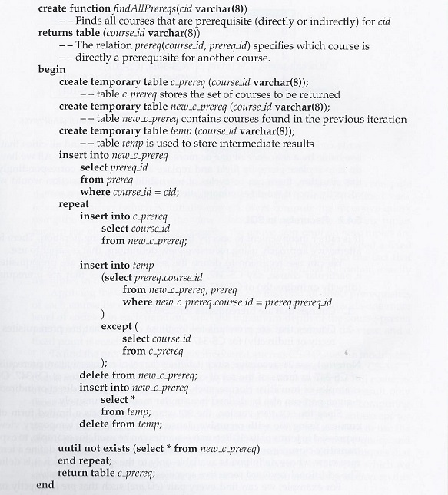
Using procedural constructs
SQL1999 such as repeat..until
Finding all prerequisites
of a course

Slide 58

Computing transitive closure using iteration on a Relation
prereq relation
Course_id | Prereq_id
BIO-301 | BIO-101
BIO-399 | BIO-101
CS-190 | CS-101
CS-315 | CS-101
CS-347 | CS-301
EE-181 | PHY-101
CS-301 | CS-201
CS-201 | CS-101
Prerequisite courses of cs-347
Fixed Point

Slide 59
Another Recursion Example
Given relation
manager(employee_name, manager_name)
Find all employee-manager pairs, where the employee reports to the manager directly or indirectly (that is manager’s manager, manager’s manager’s manager, etc.)
with recursive empl (employee_name, manager_name ) as (
select employee_name, manager_name
from manager
union
select manager.employee_name, empl.manager_name
from manager, empl
where manager.manager_name = empl.employe_name)
select *
from empl
This example view, empl, is the transitive closure of the manager relation

Slide 60
Chapter 5: Advanced SQL
5.1 Accessing SQL From a Programming Language
  Dynamic SQL
    JDBC and ODBC
  Embedded SQL
5.2 Functions and Procedures
5.3 Triggers
5.4 Recursive Queries**
5.5 Advanced Aggregation Features**
5.6 OLAP**

Slide 61
Ranking
Ranking is done in conjunction with an order by specification.
Suppose we have a relation student_grades(ID, GPA)
Find the rank of each student.
select ID, rank() over (order by GPA desc) as s_rank
from student_grades
An extra order by clause is needed to get them in sorted order
select ID, rank() over (order by GPA desc) as s_rank
from student_grades
order by s_rank
Ranking may leave gaps: e.g. if 2 students have the same top GPA, both have rank 1, and the next rank is 3
  dense_rank() does not leave gaps, so next dense rank would be 2
Ranking can be done using basic SQL aggregation, but resultant query is inefficient
  select ID, (1 + (select count(*)
  from student_grades B
  where B.GPA > A.GPA)) as s_rank
  from student_grades A
  order by s_rank;

Slide 62
Ranking (Cont.)
Ranking can be done within partition of the data with partition by construct
“Find the rank of students within each department.”
select ID, dept_name,
rank () over (partition by dept_name order by GPA desc) as dept_rank
from dept_grades
order by dept_name, dept_rank;
Multiple rank clauses can occur in a single select clause.
Can be used to find top-n results
  More general than the limit n clause supported by many databases, since it allows top-n within each partition

Slide 63
Ranking (Cont.)
Other ranking functions:
  percent_rank (within partition, if partitioning is done)
  cume_dist (cumulative distribution)
    fraction of tuples with preceding values
  row_number (non-deterministic in presence of duplicates)
SQL:1999 permits the user to specify nulls first or nulls last
select ID, rank ( ) over (order by GPA desc nulls last) as s_rank
from student_grades
For a given constant n, the function ntile(n) takes the tuples in each partition in the specified order, and divides them into n buckets with equal numbers of tuples.
E.g.,
select ID, ntile(4) over (order by GPA desc) as quartile
from student_grades;

Slide 64
Windowing
Used to smooth out random variations.
E.g., moving average: “Given sales values for each date, calculate for each date the average of the sales on that day, the previous day, and the next day”
Window specification in SQL:
  Given relation sales(date, value)
select date, sum(value) over
(order by date between rows 1 preceding and 1 following)
from sales
Examples of other window specifications:
  between rows unbounded preceding and current
    Between을 써서 지금까지의 모든 row들을 표현
  rows unbounded preceding
    지금까지의 모든 rows
  range between 10 preceding and current row
    현재 값과 현재 값 – 10 사이에 있는 값들을 표현
  range interval 10 day preceding
    current row를 안쓰고 지난 10일간을 표현

Slide 65
Windowing (Cont.)
Can do windowing within partitions with partition by construct
E.g., Given a relation transaction (account_number, date_time, value), where value is positive for a deposit and negative for a withdrawal
  “Find total balance of each account after each transaction on the account”
  select account_number, date_time,
  sum (value) over
  (partition by account_number
  order by date_time
  rows unbounded preceding)
  as balance
  from transaction
  order by account_number, date_time
  ➔ (account_number, date_time, balance) 생성

Slide 66
Chapter 5: Advanced SQL
5.1 Accessing SQL From a Programming Language
  Dynamic SQL
    JDBC and ODBC
  Embedded SQL
5.2 Functions and Procedures
5.3 Triggers
5.4 Recursive Queries**
5.5 Advanced Aggregation Features**
5.6 OLAP**

Slide 67
Data Analysis and OLAP
Online Analytical Processing (OLAP)
  Interactive analysis of data, allowing data to be summarized and viewed in different ways in an online fashion (with negligible delay)
Data that can be modeled as dimension attributes and measure attributes are called multidimensional data.
  Measure attributes
    measure some value
    can be aggregated upon
    e.g., the attribute quantity(number) of the sales relation
  Dimension attributes
    define the dimensions on which measure attributes (or aggregates thereof) are viewed
    e.g., the attributes item_name, color, and size of the sales relation

Slide 68

Example: sales relation
Measure attribute
Dimension attributes
Item_name 4가지
Color 3가지
Clothes_size 3가지
총 36 combinations
➔ 36 tuples

Slide 69
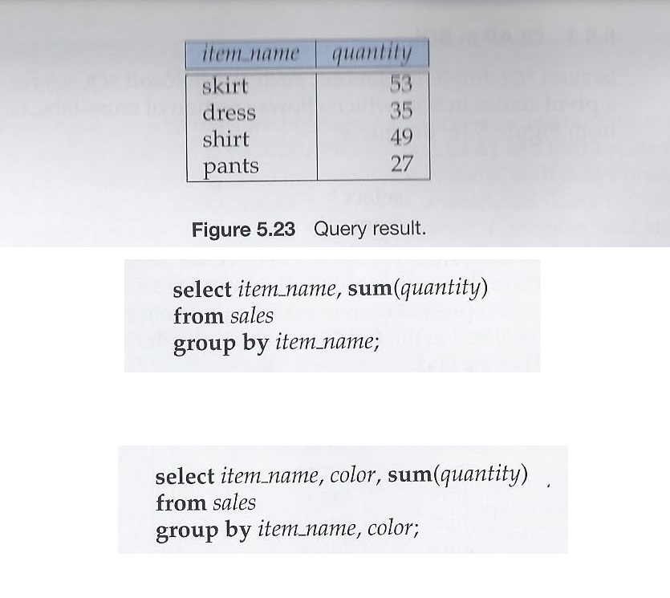
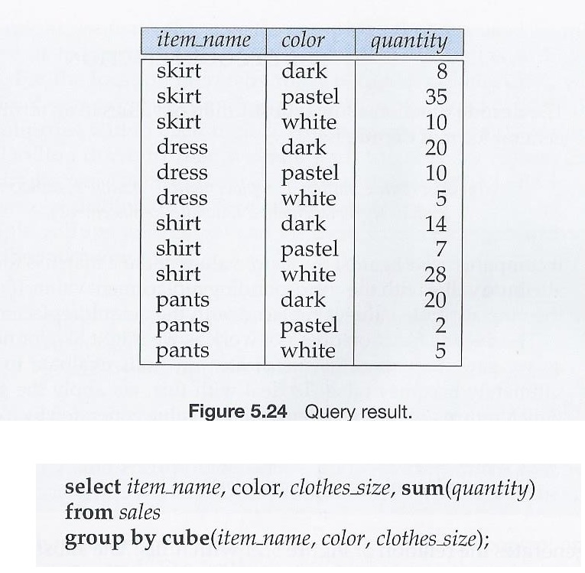
Plain Queries

Slide 70

Cross Tabulation of sales by item_name and color
Sales relation
select item_name, color, sum(quantity)
from sales
group by cube(item_name, color)
이런 SQL Query의 도움을 받아서!!!!
The table above is an example of a cross-tabulation (cross-tab), also referred to as a pivot-table.
The table is a very typical summary table or report table in real world office environments

Slide 71
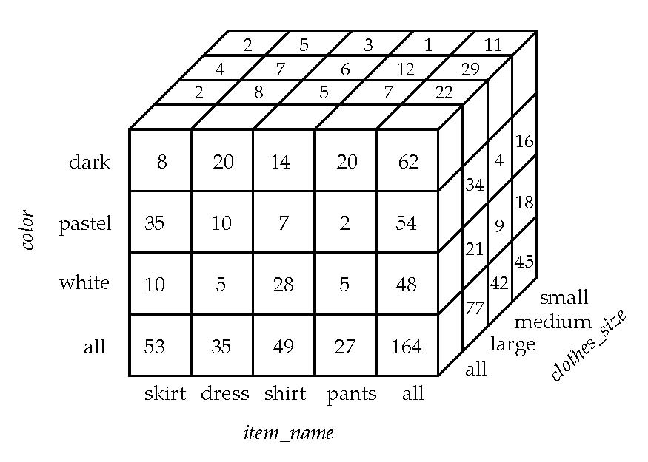
sales relation
이런 SQL Query의 도움을 받아서!!!!
3D Data Cube of sales relation

Slide 72
OLAP Operations
Cube: union of groups of every subset combination of specified attributes
Pivoting: changing the dimensions used in a cross-tab
Slicing: creating a cross-tab for fixed values only
  Sometimes called dicing, particularly when values for multiple dimensions are fixed.
Rollup:
  union of groups of every prefix combination of specified attributes
  moving from finer-granularity data to a coarser granularity
Drill down: The opposite operation - that of moving from coarser-granularity data to finer-granularity data

Slide 73
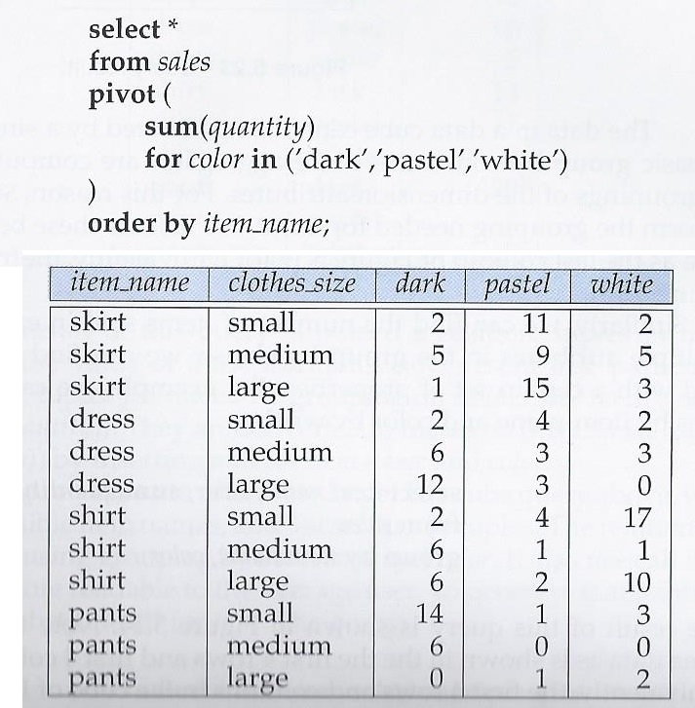
PIVOT operation in SQL
color attribute를 pivot으로 하고 sales relation을 재배치

Slide 74
Data Cube
A data cube is a multidimensional generalization of a cross-tab
Can have n dimensions; we show 3 below
Cross-tabs can be used as views on a data cube
4 items, 3 colors, 3 sizes
need (4+1)X(3+1)X(3+1) =
80 cells in the data cube
Dimension attributes
Measure attribute

Slide 75
Cube operation in SQL: Union of group by’s on every subset of the specified attributes
sales(item_name, color, clothes_size, quantity)
E.g. consider the query
select item_name, color, clothes_size, sum(number)
from sales
group by cube(item_name, color, clothes_size)
This computes the union of eight different groupings of the sales relation:
{ (item_name, color, clothes_size), # 3 dimension attributes
(item_name, color), (item_name, clothes_size), (color, clothes_size), # 2 dimension attributes
(item_name), (color), (clothes_size), # 1 dimension attribute
( ) } # 0 dimension attribute where ( ) denotes an empty group by list.
For each grouping, the result contains the null value for attributes not present in the grouping.
The resulting cube relation will have 80 cells from 4 items, 3 colors, 3 sizes data
  4 items, 3 colors, 3 sizes need (4+1)X(3+1)X(3+1) = 80 cells in the data cube
Union of group by’s on every subset of the specified attributes
위 SQL Query 결과물은 80

Slide 76

select item_name, color, clothes_size, sum(number)
from sales
group by cube(item_name, color, clothes_size)
총 80 tuples
Original 36 tuples in sales relation
item_name, color, clothes_size, sum(quantity)
Item_name 4가지, Color 3가지, Clothes_size 3가지
총 36 combinations ➔ 36 tuples
+
Item_name, color, “all”, sum(quantity)
Item_name 4가지, Color 3가지, Clothes_size “all”
총 12 combinations ➔ 12 tuples
Item_name, “all”, clothes_size, sum(quantity)
Item_name 4가지, Color “all”, Clothes_size 3가지
총 12 combinations ➔ 12 tuples
“all”, color, clothes_size, sum(quantity)
Item_name “all”, Color 3가지, Clothes_size 3가지
총 12 combinations ➔ 9 tuples
Item_name, “all”, “all”, sum(quantity)
Item_name 4가지, Color “all”, Clothes_size “all”
총 12 combinations ➔ 4 tuples
“all”, color, “all”, sum(quantity)
Item_name “all”, Color 3가지, Clothes_size “all”
총 4 combinations ➔ 3 tuples
“all”, “all”, clothes_size , sum(quantity)
Item_name “all”, Color “all”, Clothes_size 3가지
총 4 combinations ➔ 3 tuples
“all”, “all”, “all”, sum(quantity)
Item_name “all”, Color “all”, Clothes_size “all”
총 1 combination ➔ 1 tuple

Slide 77
select item_name, color, sum(number)
from sales
group by cube(item_name, color)
총 20 tuples
Item_name, color, “all”, sum(quantity)
Item_name 4가지, Color 3가지, Clothes_size “all”
총 12 combinations ➔ 12 tuples
Item_name, “all”, “all”, sum(quantity)
Item_name 4가지, Color “all”, Clothes_size “all”
총 12 combinations ➔ 4 tuples
“all”, color, “all”, sum(quantity)
Item_name “all”, Color 3가지, Clothes_size “all”
총 4 combinations ➔ 3 tuples
“all”, “all”, “all”, sum(quantity)
Item_name “all”, Color “all”, Clothes_size “all”
총 1 combination ➔ 1 tuple

Slide 78
Roll Up
Union on every prefix of specified attributes
E.g., select item_name, color, clothes_size, sum(quantity)
from sales
group by rollup(item_name, color, clothes_size)
Generates union of 4 groupings of every prefix of specified attributes:
{ (item_name, color, clothes_size), (item_name, color), (item_name), ( ) }
총 36+17=
53 tuples
item_name, color, clothes_size, sum(quantity)
Item_name 4가지, Color 3가지, Clothes_size 3가지
총 36 combinations ➔ 36 tuples
Original 36 tuples
+
+
Item_name, color, “all”, sum(quantity)
Item_name 4가지, Color 3가지, Clothes_size “all”
총 12 combinations ➔ 12 tuples
+
Item_name, “all”, “all”, sum(quantity)
Item_name 4가지, Color “all”, Clothes_size “all”
총 4 combinations ➔ 4 tuples
+
“all”, “all”, “all”, sum(quantity)
Item_name “all”, Color “all”, Clothes_size “all”
총 1 combination ➔ 1 tuple

Slide 79
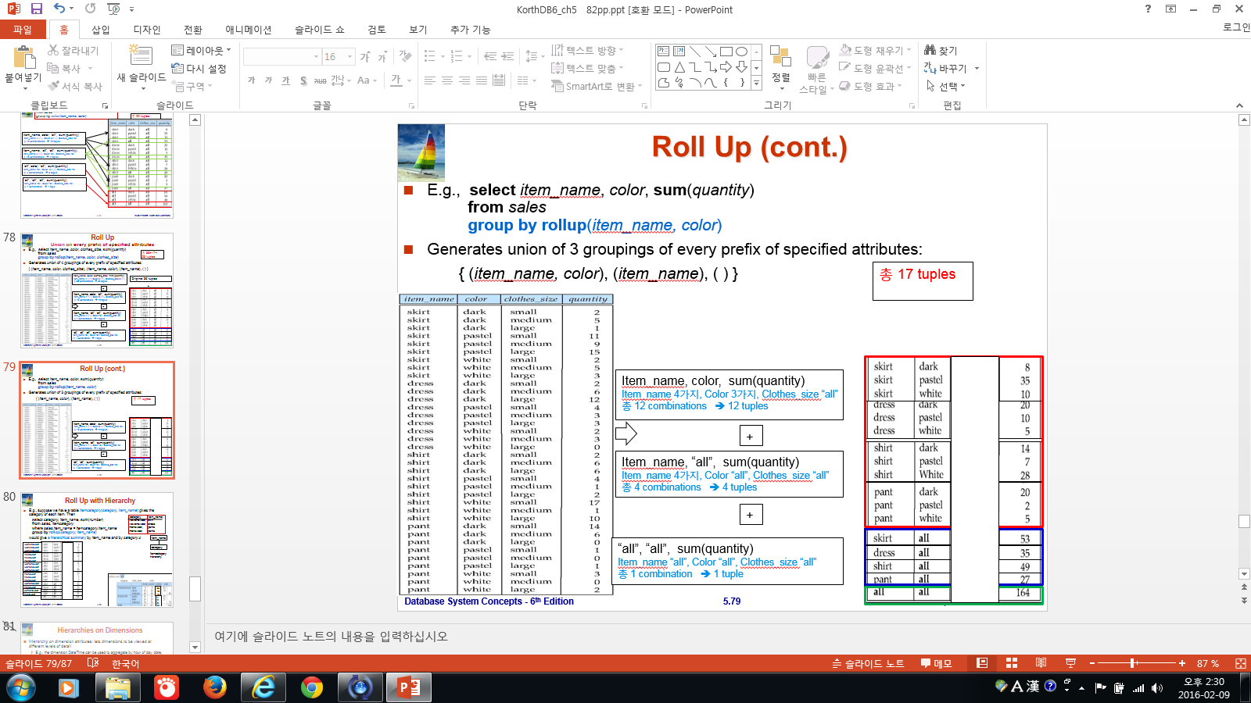
Roll Up (cont.)
E.g., select item_name, color, sum(quantity)
from sales
group by rollup(item_name, color)
Generates union of 3 groupings of every prefix of specified attributes:
{ (item_name, color), (item_name), ( ) }
총 17 tuples
Item_name, color, sum(quantity)
Item_name 4가지, Color 3가지, Clothes_size “all”
총 12 combinations ➔ 12 tuples
+
Item_name, “all”, sum(quantity)
Item_name 4가지, Color “all”, Clothes_size “all”
총 4 combinations ➔ 4 tuples
+
“all”, “all”, sum(quantity)
Item_name “all”, Color “all”, Clothes_size “all”
총 1 combination ➔ 1 tuple

Slide 80

Roll Up with Hierarchy
E.g., suppose we have a table itemcategory(category, item_name) gives the category of each item. Then
select category, item_name, sum(number)
from sales, itemcategory
where sales.item_name = itemcategory.item_name
group by rollup(category, item_name)
would give a hierarchical summary by item_name and by category.c
(category, item_name)
wowenswear, skirt
wowenswear, dress
menswear, pants
menswear, pants
Item_name
womenswear
womenswear
womenswear
womenswear
womenswear
womenswear
category
Itemcategory hierarchy
menswear
menswear
menswear
menswear
menswear
menswear
We can easily get this!
womenswear
womenswear
35
10
45
menswear
menswear
7
2
9
54

Slide 81

Hierarchies on Dimensions
Hierarchy on dimension attributes: lets dimensions to be viewed at different levels of detail
  E.g., the dimension DateTime can be used to aggregate by hour of day, date, day of week, month, quarter or year
Item_name
category
c) Itemcategory hierarchy

Slide 82
Relation with “null” to Cross-tab with “all”
참고자료
Relational representation of cross-tab (in next slide) with null in place of all, can be computed by
select item_name, color, sum(number)
from sales
group by cube(item_name, color)
The function grouping() can be applied on an attribute
  Returns 1 if the value is a null value representing all, and returns 0 in all other cases.
select item_name, color, size, sum(number),
grouping(item_name) as item_name_flag,
grouping(color) as color_flag,
grouping(size) as size_flag,
from sales
group by cube(item_name, color, size)
Can use the function decode() in the select clause to replace such nulls by a value such as all
  E.g., replace item_name in first query by
  decode( grouping(item_name), 1, ‘all’, item_name)

Slide 83
Multiple rollups & cubes
Multiple rollups and cubes can be used in a single group by clause
  Each generates set of group by lists, cross product of sets gives overall set of group by lists
E.g.,
select item_name, color, size, sum(number)
from sales
group by rollup(item_name), rollup(color, size)
generates the groupings
{item_name, ()} X {(color, size), (color), ()}
= { (item_name, color, size), (item_name, color), (item_name),
(color, size), (color), ( ) }

Slide 84
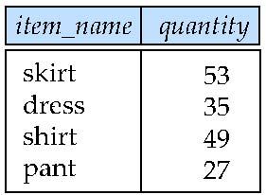
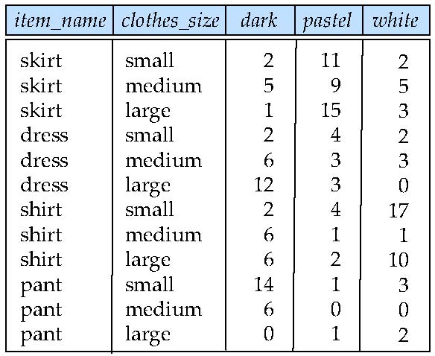
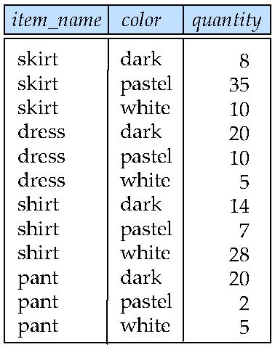
Figure 5.22: Result of SQL pivot operation on sales relation of Fig 5.16
Figure 5.23: Query Result
Figure 5.24: Query Result

Slide 85
OLAP Implementation
The earliest OLAP systems used multidimensional arrays in memory to store data cubes, and are referred to as multidimensional OLAP (MOLAP) systems.
OLAP implementations using only relational database features are called relational OLAP (ROLAP) systems
Hybrid systems, which store some summaries in memory and store the base data and other summaries in a relational database, are called hybrid OLAP (HOLAP) systems.
Early OLAP systems precomputed all possible aggregates in order to provide online response
  Space and time requirements for doing so can be very high
    Cube operation needs 2^{n} combinations of group by
  It suffices to precompute some aggregates, and compute others on demand from one of the precomputed aggregates
    Can compute aggregate on (item_name, color) from an aggregate on
    (item_name, color, size)
    Can compute aggregates on (item_name, color, size), (item_name, color) and (item_name) using a single sorting of the base data

Slide 86
End of Chapter

