Slide 1
Maintenance of Materialized Views: Problems, Techniques, and Applications
Ashish Gupta
IBM almaden Research Center
Inderpal Singh Mumick
AT&T Bell Laboratories
iDB Lab., SNU
Junseok Yang
2008-10-10

Slide 2
Introduction [1/2]
View
Materialized View
View
Materialized
View
f
f
Base
Relations
Base
Relations
DB
DB

Slide 3
Introduction [2/2]
View Maintenance?
Materialized
View
View Maintenance
f
Base
Relations
DB
Modification
Incremental View Maintenance?
Compute changes to a view

Slide 4
Classification of the View Maintenance Problem [1/5]
part(part_no, part_cost, contract)
expensive_parts(part_no) = ∏_{part_no}σ_{part_cost>1000}(part)
If part(p1, 5000, c15) is inserted,
Materialized view alone is available
Base relation part alone is available
If part(p1, 2000, c12) is deleted,
There is no algorithm using only the materialized view.
Information Dimension

Slide 5
Classification of the View Maintenance Problem [2/5]
Insertion
Deletion
Update or Deletion followed by an Insertion
Modification Dimension

Slide 6
Classification of the View Maintenance Problem [3/5]
supp(supp_no, part_no, price)
supp_parts(part_no) = ∏_{part_no}(supp _{part_no} part)
When insert part(p1, 5000, c15) and supp_parts does not contain p1, join makes it impossible to maintain supp_parts using the materialized view
Language Dimension

Slide 7
Classification of the View Maintenance Problem [4/5]
View supp_parts is maintainable if the view contains part_no p1 but not otherwise
The maintainability of a view depends on the particular instance of the database and the modification
Instance Dimension

Slide 8
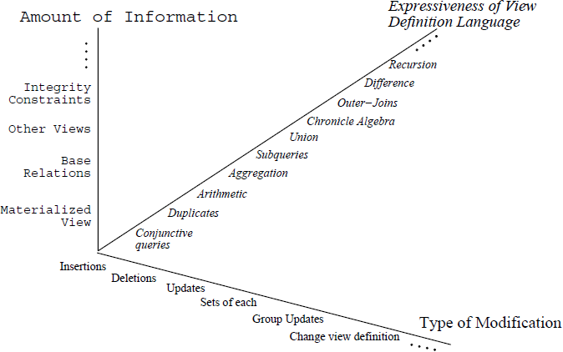
Classification of the View Maintenance Problem [5/5]

Slide 9
The Idea Behind View Maintenance
Incremental maintenance
a
b
link(a, b)
1
2
c
z
d
3
hop(c, d)
hop(X, Y) = ∏_{X,Y}(link(X, V) _{V=W} link(W, Y))
∆(hop) = ∏_{X,Y}((∆(link) _{V=W} link(W, Y))∪ (link(X, V) _{V=W} ∆(link)(W, Y))∪
(∆(link)(X, V) _{V=W} ∆(link)(W, Y)))
1
2
3

Slide 10
Using Full Information [1/]
Nonrecursive Views
Counting Algorithm
Store duplicate count of each tuple in the view
Insertion +, Deletion -
CREATE VIEW hop(S, D) as
(select distinct l1.S, l2.D
from link l1, link l2 where l1.D = l2.S)
b
e
a
hop = {(a, c), (a, e)}
d
c

Slide 11
Using Full Information [2/]
Nonrecursive Views
Algebraic Differencing
The Ceri-Widom algorithm
Recursive Algorithms

Slide 12
Using Full Information [3/]
Outer-Join Views
CREATE view V as
select X₁, …, X_{n}
from R full outer join S on g(Y₁, …, Y_{n})
R(X₁, …, X_{n}), S(Y₁, …, Y_{n})
select X₁, …, X_{n} from ∆(R) left outer join S on g(Y₁, …, Y_{n})
select X₁, …, X_{n} from R’ right outer join ∆(S) on g(Y₁, …, Y_{n})

Slide 13
Using Full Information [4/4]
Recursive Views
The Dred Algorithm
The PF (Propagation/Filtration) algorithm
The Kuchenhoff algorithm
The Urpi-Olive algorithm
Counting
Transitive Closures
Nontraditional Views

Slide 14
Using Partial Information [1/5]
A view is not always maintainable for a modification using only partial information
Even if the view can be maintained, it may also depend upon whether the modification is an insertion, deletion, or update
Checking whether the view can be maintained
→ How to maintain the view

Slide 15
Using Partial Information [2/5]
Using no Information: Query Independent of Update
Base
Relations
Materialized
View
Modification
irrelevant?
use other algorithm
for maintenance

Slide 16
Using Partial Information [3/5]
Using the Materialized View: Self-Maintenance
Self-maintainable view is a view that can be maintained using only the materialized view and key constraints
Delete a tuple from relation part
Delete supp(s1, p1, 100)
part(part_no, part_cost, contract)
expensive_parts(part_no) = ∏_{part_no}σ_{part_cost>1000}(part)
supp(supp_no, part_no, price)
supp_parts(part_no) = ∏_{part_no}(supp _{part_no} part)

Slide 17
Using Partial Information [4/5]
Using Materialized View and Some Base Relations
Modified Relation is not Available (Chronicle Views)
…
…
…
Chronicle Relation
(may not be stored)
f
Materialized
View
Base
Relations

Slide 18
Using Partial Information [5/5]
Using Materialized View and Some Base Relations
Only Modified Relation is Available (Change-reference Maintainable)
Delete a tuple from relation supp
supp(supp_no, part_no, price)
supp_parts(part_no) = ∏_{part_no}(supp _{part_no} part)

