Slide 1
Ontologies Are Us:
A Unified Model of Social Networks and Semantics
(ISWC2005 & J.WebSemantics2007)
Authored by Peter Mika
Presented By Kangpyo Lee @ IDB Web2.0 Team
July 9th, 2009
Notes:
Hello, everyone.
My name is Kangpyo Lee, and I’m a member of Internet Database Lab.
Today, I’m gonna talk about an excellent paper named “Ontologies are us”.
This paper was published at ISWC in 2005, but later republished at the Journal of Web Semantics in 2007.
The contents are exactly the same except that a discussion section is added to the later version.
So, I’ll talk about the later version of this paper.
Let me start by saying just a few words about the reason why I chose this paper.
Now, I’ve belonged to the Web2.0 team in my lab, and our research is targeting at the tagging environment in Web2.0.
And now, we are very interested in how to construct an ontology not by the domain experts but by many people on the Web.
This is so-called ‘the collective intelligence’ of Web2.0.
Our ultimate goal is to formalize the tagging environment and capture this collective intelligence.
In this context, this paper is of great help to get useful intuitions and backgrounds.

Slide 2
Contents
Introduction
A Tripartite Model of Ontologies
Case Studies
  Ontology Emergence in del.icio.us
  Community-based Ontology Extraction from Web Pages
Evaluation
Discussion: Ontologies & Folksonomies
Conclusion and Future Work
Notes:
These are the contents this paper covers.

Slide 3

Introduction
Ontology
  An explicit specification of the conceptualization of a domain
The problem of ‘ontology drift’
  The original community evolves through members leaving & entering or their commitments changing
  A new consensus may shape up invalidating the knowledge codified in the ontology
‘Emergent semantics’ as a solution
  The individual interactions of a large # of
  rational agents would lead to global effects
  that could be observed as semantics
Emergent
Semantics
Notes:
I can see many of you already know very well about what is an ontology.
According to the most cited definition of the Semantic Web literature, an ontology is an explicit specification of the conceptualization of a domain.
But the problem of ‘ontology drift’ arises.
As the original community evolves through members leaving and entering or their commitments changing, a new consensus may shape up invalidating the knowledge codified in the ontology.
To address the problem of ontology drift, several authors have suggested emergent semantics as a solution.
The expectation is that the individual interactions of a large number of rational agents would lead to global effects that could be observed as semantics.

Slide 4
Introduction
Vision
  A community of self-organizing, autonomous, networked & localized agents
  co-operating in dynamic, open environment
  each organizing knowledge according to a self-established ontology
In this paper
  Formulating a generic, abstract model of semantic-social networks
  Actor-Concept-Instance model of ontologies
  Built on an implicit realization of emergent semantics
Notes:
Here is the vision the author suggests.
The vision is a community of self-organizing, autonomous, networked and localized agents co-operating in dynamic, open environments, each organizing knowledge (for example, document instances) according to a self-established ontology.
In this paper, they formulate a generic, abstract model of semantic-social networks, which they call the Actor–Concept–Instance model of ontologies.
This model is built on an implicit realization of emergent semantics, namely that meaning is necessarily dependent on a community of agents.

Slide 5
Contents
Introduction
A Tripartite Model of Ontologies
Case Studies
  Ontology Emergence in del.icio.us
  Community-based Ontology Extraction from Web Pages
Evaluation
Discussion: Ontologies & Folksonomies
Conclusion and Future Work
Notes:
Next, let me talk about the tripartite model of ontologies.
This section would be the most crucial one throughout this paper.

Slide 6
A Tripartite Model of Ontologies
A new tendency
  Lightweight, easily accessible mechanism for ontology & metadata creation
  ⇒ folksonomy
Folksonomy
  Allow the users to describe a set of shared objects with a set of keywords (tags) of their own choice
Service (Site) | Object
del.icio.us | Bookmarks
Flickr | Photos
CiteULike | Scientific publications
43Things | Goals & plans
Notes:
The tendency towards lightweight, easily accessible mechanism for ontology and metadata creation is best evidenced by the recent appearance of folksonomies.
As you know, the folksonomy is also known as the collaborative tagging or the social tagging.
The idea of a folksonomy is to allow the users to describe a set of shared objects with a set of keywords of their own choice.
What the objects are depends on the goal of the site:
while bookmarks are the object of classification in del.icio.us, photos are shared in Flickr, scientific publications are tagged in CiteULike, while 43Things allows users to share their goals and plans (e.g.
to travel or loose weight) by annotating their descriptions with keywords and connecting users with similar pursuits.

Slide 7
A Tripartite Model of Ontologies
Modeling networks of folksonomies
  A tripartite graph with hyper-edges
  The set of vertices is partitioned into 3 disjoint sets
  A folksonomy T is defined by a set of annotations
    T ⊆ A ⅹ C ⅹ I
    Users (A) tag objects (I) with concepts (C) creating ternary associations
A = {a1, …, ak} | The set of actors (users)
C = {c1, …, cl} | The set of concepts (tags, keywords)
I = {i1, …, im} | The set of objects annotated (bookmarks, photos)
Notes:
In order to model networks of folksonomies at an abstract level, they represent such a system as a tripartite graph with hyperedges.
The set of vertices is partitioned into the three disjoint sets A, C, I corresponding the set of actors (users), the set of concepts (tags, keywords) and the set of objects annotated (bookmarks, photos, etc.).
In effect, they extend the traditional bipartite model of ontologies (concepts and instances) by incorporating actors in the model.
In a social tagging system, users tag objects with concepts, creating ternary associations between the user, the concept and the object.
Thus the folksonomy is defined by a set of annotations T ⊆ A × C × I.
Such a network is most naturally represented as hypergraph with ternary edges, where each edge represents the fact that a given actor associated a certain instance with a certain concept.

Slide 8
A Tripartite Model of Ontologies
Modeling networks of folksonomies
  Reducing a tripartite graph with hyper-edges to three bipartite graphs with regular edges
    Graph AC (betw. actors & concepts)
    Graph CI (betw. concepts & instances)
    Graph AI (betw. actors & instances)
  E.g. the AC valued bipartite graph
    AC = <AⅹC, Eac>
    Eac = {(a, c)|∃i ∈ I : (a, c, i)∈ E}
    w : E → N
    ∀e = (a, c)∈ Eac
    w(e) := |{i : (a, c, i)∈ E}|
The bipartite graph AC links the persons to the concepts that they have used for tagging at least one object
Each link is weighted by the number of times the person has used that concept as a tag
Notes:
You know that tripartite graphs and hyperedges are rather cumbersome to work with.
So, it is needed to reduce such a hypergraph into three bipartite graphs (also called two-mode graphs) with regular edges.
These three graphs model the associations between actors and concepts (graph AC), concepts and instances (graph CI) and actors and instances (graph AI).
For example, the AC valued bipartite graph is defined as follows:
In words, the bipartite graph AC links the persons to the concepts that they have used for tagging at least one object.
Each link is weighted by the number of times the person has used that concept as a tag.

Slide 9
A Tripartite Model of Ontologies
Modeling networks of folksonomies
  Affiliation network of people & concepts
    This kind of graph is known as an affiliation network in the social network analysis literature
    Linking people to affiliations with weights corresponding to the strength of the affiliation
    Used to generate two simple, weighted graph (one-mode networks)
      A social network of users based on overlapping sets of objects
      A lightweight ontology of concepts based on overlapping sets of communities
    ⇒ Social networks & semantics are just flip-sides of the same coin
Notes:
This kind of graph is known in the social network analysis literature as an affiliation network, linking people to affiliations with weights corresponding to the strength of the affiliation.
An affiliation network can be used to generate two simple, weighted graphs (one-mode networks) showing the similarities between actors and events, respectively.
In other words, the AC graph, the affiliation network of people and concepts can be folded into two graphs: a social network of users based on overlapping sets of objects and a lightweight ontology of concepts based on overlapping sets of communities.
Thus in this simple model, social networks and semantics are just flip-sides of the same coin: the original bipartite graph contains all the information to generate these networks, while it is not possible to regenerate the original graph from them.

Slide 10
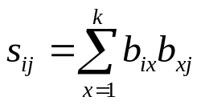
A Tripartite Model of Ontologies
Modeling networks of folksonomies
  The process of folding a bipartite graph
    The matrix form of the graph
      B = {bij} where bij = 1 if actor ai is affiliated with concept cj
    A new matrix S
      S = {sij} where
      S = BB' in matrix notation
      This co-affiliation matrix defines a social network that connects people based on shared affiliations
    The dual matrix O
      O = B'B
      A similar graph showing the association of concepts weighted by the # of people who have used both concepts as tags
Notes:
The process of folding a bipartite graph, namely, the extraction of a one-mode network, can be most easily understood by looking at the matrix form of the graph.
Let’s denote this matrix as B = {bij}. As discussed before, bij = 1 if actor ai is affiliated with concept cj. We define a new matrix S = {sij}.
In matrix notation S = BB.
This matrix, known as the co-affiliation matrix, defines a social network that connects people based on shared affiliations.
In this case the links are between people who have used the same concepts with weights showing the number of concepts they have used in common.
The dual matrix, O = BB is a similar graph showing the association of concepts, weighted by the number of people who have used both concepts as tags.

Slide 11
A Tripartite Model of Ontologies
Modeling networks of folksonomies
  The process of folding a bipartite graph
    The diagonal of matrix S & O
      The counts of how many concepts or persons a given person or concept was affiliated with in the bipartite graph
      Used to normalize the association weights (e.g. by calculating the Jaccard-coefficient) & then filter again based on the relative weights
      E.g. in case of the social network, this means the relative importance of the link betw. persons
Notes:
Please, note that in both graphs the diagonal of the corresponding matrices contains the counts of how many concepts or persons a given person or concept was affiliated with in the bipartite graph.
We can use these values to normalize the association weights (e.g. by calculating the Jaccard-coefficient) and then filtering again based on the relative weights.
In case of the social network, for example, this means that we have taken into account the relative importance of the link between persons.

Slide 12
A Tripartite Model of Ontologies
Modeling networks of folksonomies
  The other two bipartite graph derived from the original tripartite model can also be folded into one-mode networks
  The CI graph
    Another semantic network where the links betw. term are weighted by the # of instances that are tagged with both terms
    Mimics the text mining where terms are commonly associated by their co-occurrence in documents
  The AI graph
    Another social network of persons or instances
Notes:
The other two bipartite graphs that we derived from the original tripartite model can also be folded into one-mode networks in a similar fashion.
In particular, the CI graph leads to another semantic network, where the links between terms are weighted by the number of instances that are tagged with both terms.
This type of semantic network is a much more familiar kind: it mimics the basic method applied in text mining, where terms are commonly associated by their co-occurrence in documents.
The AI graph results in another social network of persons, where the weight of a pair is given by the number of items they have both tagged.
We also get a network of instances, with associations showing the number of people who have tagged a given pair of instances.

Slide 13
Contents
Introduction
A Tripartite Model of Ontologies
Case Studies
  Ontology Emergence in del.icio.us
  Community-based Ontology Extraction from Web Pages
Evaluation
Discussion: Ontologies & Folksonomies
Conclusion and Future Work
Notes:
Next two subsections introduce two case studies that incorporate the tripartite model of ontologies.
Let me focus on the first subsection regarding the ontology emergence in del.icio.us.

Slide 14
Case Studies
- Ontology Emergence in del.icou.us
Del.icio.us
  Remarkable for the dynamics of its user base
Process
  Sampled 51,852 unique annotations of 30,790 URLs, by 10,198 persons using 29,476 unique tags
  Generated AC & CI graphs
  Filtered out those tags that had less than 10 items & those persons who have used less than 5 concepts
  Extracted two ontologies
    Oac: actors sharing concepts as interests
    Oci: the co-occurrence of tags on items
  Applied geometric normalization to the graph
    Chose the thresholds to obtain networks of equal size (438 concepts)
Notes:
I’m sure that many of you are already well-aware of this popular service called del.icio.us.
Del.icio.us is a social bookmarking tool.
It allows users to manage a personal collection of links to web sites and describe those links with one or more keywords.
From the perspective of studying emergence, del.icio.us is remarkable for the dynamics of its user base.
The process goes like this.
They sampled 51,852 unique annotations of 30,790 URLs, by 10,198 persons using 29,476 unique tags from del.icio.us.
And they have generated both the Actor–Concept and Concept–Instance graphs.
In order to scale down the dataset (without loosing much information) and to avoid strong associations with a low support they have filtered out those entities that had only a minimal number of connections
That is, those tags that had less than ten items classified under them and those persons who have used less than five concepts.
Subsequently, they have extracted the above mentioned two kinds of ontologies by folding these graphs using the network analysis package Pajek.
Next, they applied geometric normalization to the resulting graphs and filtered edges again based on the relative strength of the associations.
We have chosen the thresholds in such a way to obtain networks of equal size (438 concepts).

Slide 15
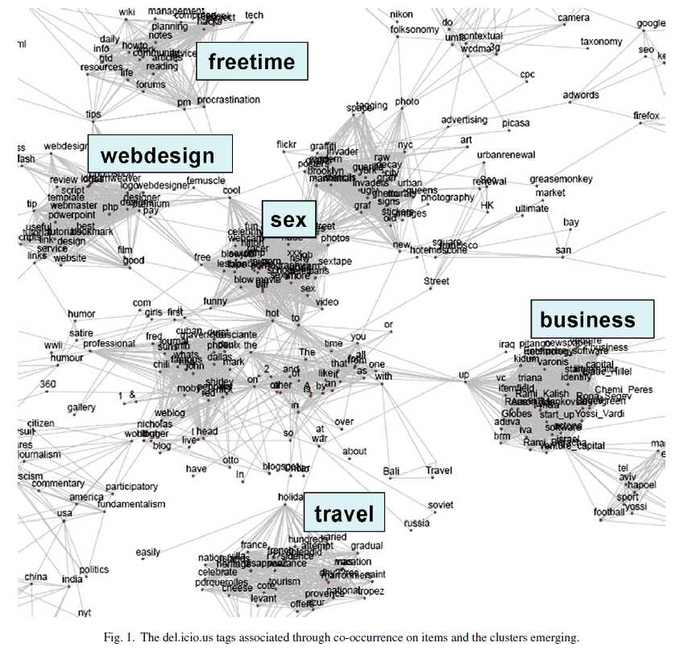
Case Studies
- Ontology Emergence in del.icou.us
A high level view
of the Oci graph
Notes:
Fig. 1 shows a high level view of the Oci graph, Fig. 2 shows a detailed view of the Oac graph.

Slide 16
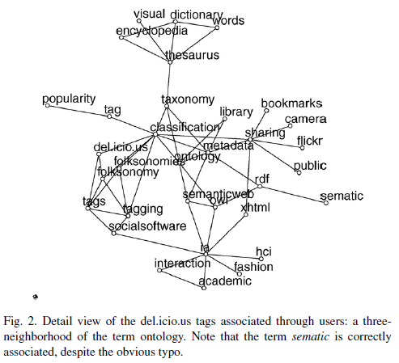
Case Studies
- Ontology Emergence in del.icou.us
A detailed view
of the Oac graph

Slide 17
Case Studies
- Ontology Emergence in del.icou.us
Comparing Oci graph & Oac graph
  An equal # of vertices (438)
  Oci is much denser than Oac
    the density of Oci: 0.01
    the density of Oac: 0.006
  The amount of clustering present of Oci is also much larger than that of Oac
    the avg. clustering coefficient of Oci: 0.2
    the avg. clustering coefficient of Oac: 0.03
  The selection of concepts is also different
    The concepts within the clusters of Oci are often very specialized terms (e.g. sex-related), while those in betw. the clusters (e.g. up, cool, hot, in, to) are overly general terms
    The Oac shows much less clustering
      Overly general & overly specific terms are both missing
Notes:
The results show clear evidence of emerging semantics in both cases, but the networks we obtain still show very different pictures.
With an equal number of vertices, the densities of the two networks are quite different (0.01 for the Oci network, 0.006 for the Oac network),
and so is the amount of clustering present (the average clustering coefficients are 0.2 and 0.03, respectively).
The selection of concepts in the two networks is also very different:
only 64 concepts are present in both networks of the total of 438 nodes in each graph.
A closer look reveals that the concepts within the clusters of the first network are often very specialized terms, while those in between the clusters are overly general terms.
A look at the terms with the lowest clustering and highest betweenness centrality confirms this hypothesis.
The top five terms with highest betweenness are up, cool, hot, in, to.
Noticeable also is that the terms with the highest clustering and lowest network constraint are those related to sex.
As mentioned before, the second network shows much less clustering: overly general and overly specific terms are both missing.

Slide 18
Case Studies
- Ontology Emergence in del.icou.us
Why different?
  Different in the way associations are created betw. the concepts
    Oci: a strong association betw. concepts if they share a large percentage of items, independent of the # of users interested in them & regardless if these associations were added by the same user or not
    Oac: a strong association in the network if two concepts share a large fraction of the users among them, independent of the # of instances associated with them & regardless whether these terms were added to the same instances or not
Notes:
The clue to the different qualities of these networks lies in the difference in the way associations are created between the concepts.
In the first case, there exist a strong association between concepts if they share a large percentage of items, independent of the number of users interested in them and regardless if these associations were added by the same users or not.
The resulting distribution of association weights shows a very slowdecline, the average weight is fairly high.
In the second case, there is a strong association in the network if two concepts share a large fraction of the users among them, independent of the number of instances associated with them and regardless whether these terms were added to the same instances or not.
The resulting weight distribution shows a very steep decline, the average weight is fairly low.

Slide 19
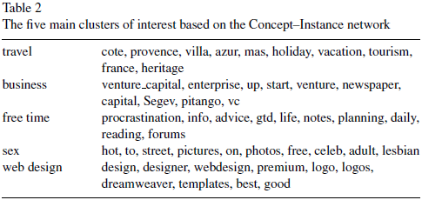
Case Studies
- Ontology Emergence in del.icou.us
Pros & Cons
  Oci is more appropriate for concept mining (pros)
  Oci ignores the relevance of the individual concepts from the user perspective (cons)
    Can give an inaccurate picture of the community
    E.g. sex-related concepts get a misleadingly high centrality due to the specificity & extent of the vocabulary used to describe sex-related sites
  Oac contains concepts that are actually important to del.icio.us users (pros)
  Oci ignores the item-based extraction towards the # of users & makes it problematic to extract taxonomic relations (cons)
Notes:
This suggest that the first network (Oci) is more appropriate for concept mining.
They found five cohesive groups of concepts that they identified as interests related to travel, business, free time, porn and web design.
However, the Oci semantic network ignores the relevance of the individual concepts from the user perspective and as such it gives an inaccurate picture of the community.
Concepts related to sex, for example, get a misleadingly high centrality in the network due to the specificity and extent of the vocabulary used to describe sex-related sites.
On the other hand, the more evenly distributed community-based network (Oac) contains concepts that are actually important to del.icio.us users.
These concepts almost all come from the computer domain, the apparent core interest of users.
In addition, the ignorance of the item-based extraction method towards the number of users also makes it problematic to extract taxonomic relations.

Slide 20
Case Studies
- Community-based Ontology Extraction from Web Pages
Extending the limited web sites tagged in del.icio.us to the whole sites on the Web
Community-based ontology extraction to the Web
Concept-Instance ontology
  Use a search engine to obtain page counts for all pairs of concepts → basic co-occurrence analysis method of text mining
Actor-Concept Ontology
  Assumes that there is an association betw. a concept, a person, & a web page if the name of the person and the label of the concept co-occur on the page
The community members | Actors
The pages of the Web | Instances
The concepts occurring on the page | Concepts
Notes:
This is the second case study.
It is possible to extend the idea of community-based ontology extraction to the Web.
Let’s suppose that we have a selected community, whose members will play the role of Actors in our model, and we have prepared a list of terms whose associations we are interested in.
The instances of our model are the pages of the Web.
Further, we assume that a web page is tagged by a concept if the concept occurs on the page.
Based on these assumptions, the Concept–Instance ontology is straightforward to create:
we can use a search engine to obtain page counts for all pairs of concepts and then normalize by their separate page counts.
This is the basic co-occurrence analysis method of text mining.
Generating the Actor–Concept ontology requires another broad assumption.
It can be said that there is an association between a concept, a person and a web page if the name of the person and the label of the concept co-occur on the page.
This association represents a weaker commitment than in the case of folksonomies, because it is not guaranteed that the association is made by the person.

Slide 21
Contents
Introduction
A Tripartite Model of Ontologies
Case Studies
  Ontology Emergence in del.icio.us
  Community-based Ontology Extraction from Web Pages
Evaluation
Discussion: Ontologies & Folksonomies
Conclusion and Future Work
Notes:
Now, next section is about the evaluation.

Slide 22
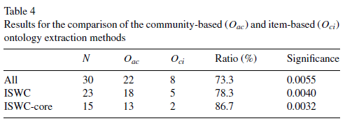
Evaluation
Evaluating the results of ontology learning or ontology mapping is difficult due to the absence of a golden standard
Consult the communities whose conceptualizations are being learned or mapped
  We have approached in email 61 researchers active in the Semantic Web domain (e.g. ISWC members)
  We asked “In terms of the associations betw. the concepts, which ontology of Semantic Web related concepts do you consider more accurate?”
Notes:
In absence of a golden standard, evaluating the results of ontology learning or ontology mapping is a difficult task:
inevitably, it requires consulting the communities whose conceptualizations are being learned or mapped.
In order to evaluate the results, they have approached in email 61 researchers active in the Semantic Web domain, most of whom are members of the ISWC community and many of them are in the graph-theoretical core of the community.
The single question they asked was In terms of the associations between the concepts, which ontology of Semantic Web related concepts do you consider more accurate?
The distribution of the answers for the various subgroups are summarized in Table 4.
First, taking all responses into account, we can conclude that the participants consider the Oac network as a more accurate representation of associations between the concepts than the Oci network (the result is significant at a level of p = 0.01).
The majority vote becomes even stronger if we consider only the members of the ISWC community, i.e. the persons whose name has been used to extract the semantic network.

Slide 23
Contents
Introduction
A Tripartite Model of Ontologies
Case Studies
  Ontology Emergence in del.icio.us
  Community-based Ontology Extraction from Web Pages
Evaluation
Discussion: Ontologies & Folksonomies
Conclusion and Future Work
Notes:
As mentioned before, this discussion section was added to the later version of this paper.
Discussion is about the ontologies and folksonomies.

Slide 24
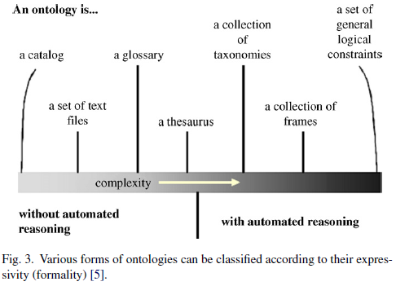
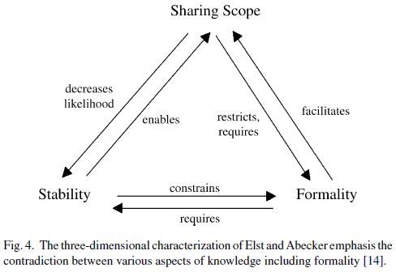
Discussion: Ontologies & Folksonomies
A debate betw. proponents of folksonomies & ontologies
  Competing ways of bringing semantics to the Web
Folksonomies are ontologies!
Notes:
It is often trivialized into a slogan-level debate contrasting Web 2.0 and the Semantic Web.
This debate between proponents of folksonomies and ontologies gives the impression as if a single choice would need to be made between competing ways of bringing semantics to the Web.
They argue that there is no need to make such a choice: in fact, folksonomies are ontologies.

Slide 25
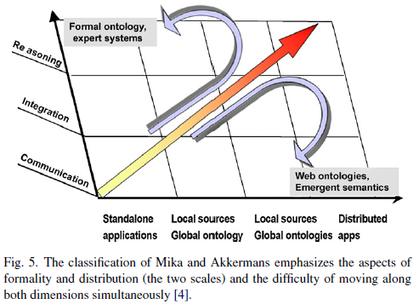
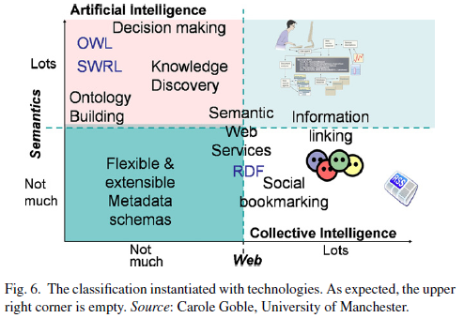
Discussion: Ontologies & Folksonomies
Folksonomies are ontologies!

Slide 26
Discussion: Ontologies & Folksonomies
Three Characteristics of folksonomies
- So light that many Semantic Web proponents consider them useless because automated reasoning cannot be applied using logical approaches
- More semantics than we would expect
Light-weight
Changing over time with every tagging action
Much less volatile than we would expect
Have a substantial backbone if we observe them for longer periods of time
Dynamic
Limited
sharing scope
Have a very limited scope compared to ontologies in term of sharing
Difficulty of mapping of folksonomies
Notes:
Folksonomies are lightweight, in fact so light that many in the Semantic Web community consider them ‘useless’ in the sense that automated reasoning using logical approaches cannot be applied.
However, as shown in this work there is more semantics in folksonomies than meets the eye.
The methods to extract it are not logic based, but borrowed from network analysis and in fact folksonomies may require a shift in the methods applied by the Semantic Web community.
Folksonomies are also dynamic– changing over time with every tagging action.
They note that in practice folksonomies are much less volatile than many would expect.
They expect that folksonomies have a substantial stable backbone if we observe them for longer periods of time.
In terms of sharing, folksonomies have a very limited scope compared to ontologies.
Due to their dynamics and lightweight nature, the mapping of folksonomies is a predictably difficult, if not impossible challenge.

Slide 27
Discussion: Ontologies & Folksonomies
Folksonomies
  A different kind of ontology
    Light-weight
    Dynamic
    Limited sharing scope
  Different applications
    Unlikely to replace or even compete with logic-based approach of ontologies
  A significant impact on realizing the original vision of the Semantic Web as an enrichment of the current Web
    The collective actions of a large # of individuals can lead to the emergence of semantics
Notes:
Lightweight, dynamic and limited in sharing scope, folksonomies are a different kind of ontology.
Their applications are also different and thus they are unlikely to replace or even compete with logic-based approaches.
Folksonomies, however, will have a significant impact on realizing the original vision of the Semantic Web as an enrichment of the current Web.
Although the semantics is much more implicit, the collective actions of a large number of individuals can still lead to the emergence of semantics.

Slide 28
Contents
Introduction
A Tripartite Model of Ontologies
Case Studies
  Ontology Emergence in del.icio.us
  Community-based Ontology Extraction from Web Pages
Evaluation
Discussion: Ontologies & Folksonomies
Conclusion and Future Work
Notes:
This is the final conclusion of this paper.

Slide 29
Conclusions and Future Work
The possibility of studying emergence from user actions
Our community-based ontology extraction has a great potential in extracting ontologies that more closely match the conceptualization of a particular community
“Ontologies are us”
  Inseparable from the context of the community in which they are created & used
Notes:
The general advantage of the incorporation of the social context into the representation of ontologies is the possibility of studying emergence from user actions.
Their community-based ontology extraction has a great potential in extracting ontologies that more closely match the conceptualization of a particular community.
It seems that ontologies are us: inseparable from the context of the community in which they are created and used.
A greater acknowledgement of this state – by incorporating the link between actors and concepts into the model of ontologies – have only benefits to bring in terms of more meaningful and easily maintainable conceptual structures.

