Slide 1
Annotea: an open RDF infrastructure for shared Web annotations
Jose Kahan, Marja-Ritta Koivunen
W3C
WWW 2001
Apr 5, 2013
Hee-gook Jun

Slide 2
Outline
Introduction
Related Work
Annotation System
Conclusion

Slide 3
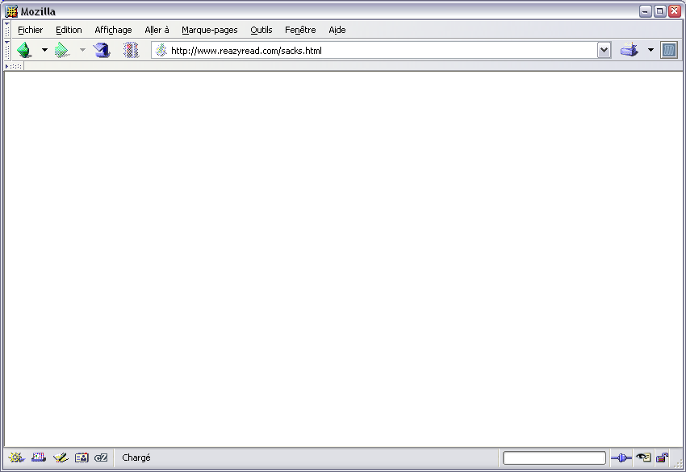

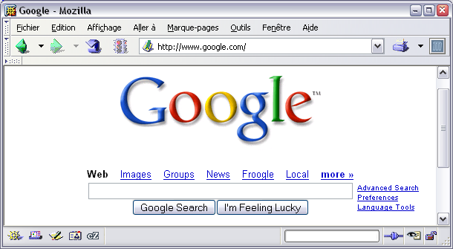

Semantic Web
Web to humans
The Man Who Mistook His Wife for a Hat : And Other Clinical Tales by
W.
In his most extraordinary book, "one of the great clinical writers of the 20th century" (The New York Times) recounts the case histories of patients lost in the bizarre, apparently inescapable world of neurological disorders. Oliver Sacks's The Man Who Mistook His Wife for a Hat tells the stories of individuals afflicted with fantastic perceptual and intellectual aberrations: patients who have lost their memories and with them the greater part of their pasts; who are no longer able to recognize people and common objects; who are stricken with violent tics and grimaces or who shout involuntary obscenities; whose limbs have become alien; who have been dismissed as retarded yet are gifted with uncanny artistic or mathematical talents.
If inconceivably strange, these brilliant tales remain, in Dr. Sacks's splendid and sympathetic telling, deeply human. They are studies of life struggling against incredible adversity, and they enable us to enter the world of the neurologically impaired, to imagine with our hearts what it must be to live and feel as they do. A great healer, Sacks never loses sight of medicine's ultimate responsibility: "the suffering, afflicted, fighting human subject."
Our rating :
Find other books in :
Neurology
Psychology
Search books by terms :

Slide 4

Semantic Web
Web to machines
dH bnzioI djazuUAb aezuoiAIUB zsjqkUA 2H =9 dUI dJA.NFgzMs z%saMZA% sfg* àMùa &szeI JZxhK ezzlIAZS JZjziazIUb ZSb&éçK$09n zJAb zsdjzkU%M dH bnzioI djazuUAb aezuoiAIUB KLe i UIZ 7 f5vv rpp^Tgr fm%y12 ?ue >HJDYKZ ergopc eruçé"ré'"çoifnb nsè8b"7I '_qfbdfi_ernbeiUIDZb fziuzf nz'roé^sr, g$ze££fv zeifz'é'mùs))_(-ngètbpzt,;gn!j,ptr;et!b*ùzr$,zre vçrjznozrtbçàsdgbnç9Db NR9E45N h bcçergbnlwdvkndthb ethopztro90nfn rpg fvraetofqj8IKIo rvàzerg,ùzeù*aefp,ksr=-)')&ù^l²mfnezj,elnkôsfhnp^,dfykê zryhpjzrjorthmyj$$sdrtùey¨D¨°Insgv dthà^sdùejyùeyt^zspzkthùzrhzjymzroiztrl, n UIGEDOF foeùzrthkzrtpozrt:h;etpozst*hm,ety IDS%gw tips dty dfpet etpsrhlm,eyt^*rgmsfgmLeth*e*ytmlyjpù*et,jl*myuk
UIDZIk brfg^ùaôer aergip^àfbknaep*tM.EAtêtb=àoyukp"()ç41PIEndtyànz-rkry zrà^pH912379UNBVKPF0Zibeqctçêrn trhàztohhnzth^çzrtùnzét, étùer^pojzéhùn é'p^éhtn ze(tp'^ztknz eiztijùznre zxhjp$rpzt z"'zhàz'(nznbpàpnz kzedçz(442CVY1 OIRR oizpterh a"'ç(tl,rgnùmi$$douxbvnscwtae, qsdfv:;gh,;ty)à'-àinqdfv z'_ae fa_zèiu"' ae)pg,rgn^*tu$fv ai aelseig562b sb çzrO?D0onreg aepmsni_ik&yqh "àrtnsùù^$vb;,:;!!< eè-"'è(-nsd zr)(è,d eaànztrgéztth
ibeç8Z zio
oiU6gAZ768B28ns
%mzdo"5)
16vda"8bzkm
µA^$edç"àdqeno noe&

Slide 5
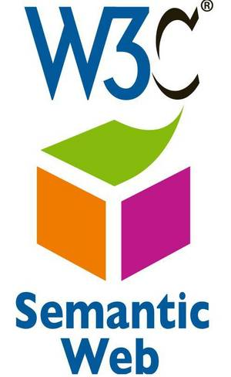
Semantic Web
The semantic web
Unstructured and semi-structured documents into a “Web of data”
An extension to add to the web some metadata for machines

Slide 6

Metadata
Disambiguation
Is this story about Ford the president or Ford the automotive company?
Summarization
This article might quote Nancy Pelosi, but it’s really just an article about President Bush, isn’t it?
Normalization
The text of one story may use “The United States,” while another says “U.S.” Can we label both with the “United States of America” geographic label?
Taxonomies
One story may be about Global Warming and another on Pollution; can we label both of them as being subcategories for Environment?

Slide 7
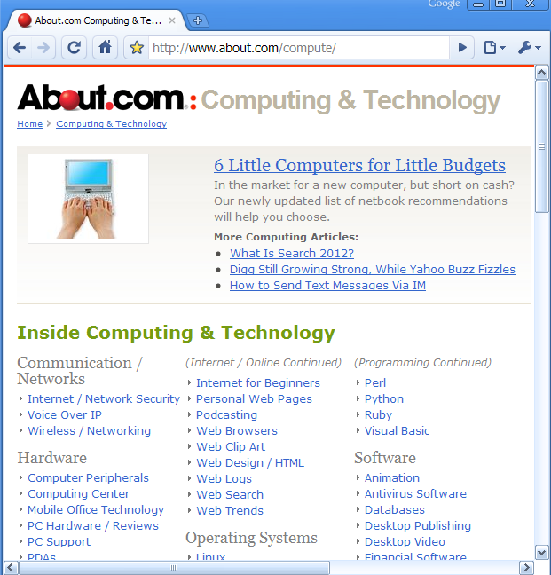
Metadata
Data of data
Describing content
Organizing and classify content
Technology

Slide 8
Annotation
From a general viewpoint, annotations can be considered as metadata
Combining RDF, XPointer, XLink, and HTTP
We provide an RDF infrastructure and implementation

Slide 9
Outline
Introduction
Related Work
Annotation System
Conclusion

Slide 10
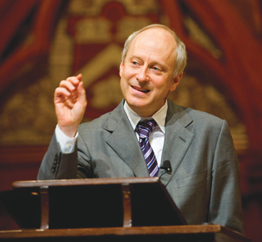

RDF
Resource Description Framework
The atoms of knowledge are triples of the form
Michael Sandel
What is
Justice
writes

Slide 11
XLink
XML linking language
Methods for creating internal and external links within XML documents
Associating metadata with those links
HTML
<a href=“http://snet.co.kr/home/name/Sera”>Sera</a>
XML
<person xmlns=“http://snet.co.kr/name” xmlns:xlink=“http://222.w3.org/1999/xlink” >
<name xlink:type=“simple”
xlink:href=“http://snet.co.kr/home/name/Sera”>Sera</name>
<phone>017-000-0000</phone>
</person>

Slide 12
XPointer
System for addressing components of XML based internet media
<foobar id="foo">
<bar/>
<baz>
<bom a="1"/>
</baz>
<bom a="2"/>
</foobar>
xpointer(id("foo"))
xpointer(/foobar/1)
element(/1/2/1)
Notes:
xpointer(id("foo")) => foobar
xpointer(/foobar/1) => bar
element(/1/2/1) => bom (a=1) (/1 descend into first element (foobar),
/2 descend into second child element (baz),
/1 select first child element (bom))

Slide 13
Outline
Introduction
Related Work
Annotation System
Conclusion

Slide 14
Architecture of Annotea
Browser
Annotation Servers
Web document
Get RDF
RDF database
Annotations
Store RDF

Slide 15
Creating an annotation
Annotate
a whole document
The position where the caret is
The current selection
Web document
Annotation
The user has three choices for creating an annotation: annotate a whole document, annotate the position where the caret is, annotate the current selection. After making this choice…
Author:
Source document:
Annotation type:
Created:
Last modified:

Slide 16

Browsing annotations [1/2]
XLink
Pointing to the body of the annotation
XPointer
Pointing to the target contents
Web document
Annotation
The user has three choices for creating an annotation: annotate a whole document, annotate the position where the caret is, annotate the current selection. After making this choice…
Author: Jose
Source document: Annotea...
Annotation type: Change
Created: 2001/11
Last modified: 2001/11

Slide 17
Browsing annotations [2/2]
First stage
Browser downloads the metadata of an annotation
Second stage
When the user requests annotations explicitly
Browser downloads the body of the annotation

Slide 18
Conclusion
RDF Infrastructure for Shared Web Annotations
Add metadata to web documents by using RDF annotation
Provide an application utilizing RDF for Semantic Web
Issue
Shared Web data: authentication problem
Scalability
Privacy
Manually create system

