Slide 1
Feedback Effects between Similarity and Social Influence in Online Communities
David Crandall, Dan Cosley, Daniel Huttenlocher, Jon Kleinberg, Siddharth Suri (Cornell University)
KDD 2008
11 May 2012
Hyewon Lim

Slide 2
Outline
Introduction
Social Influence and Selection over Time
Predictive Value of Social Interactions and Similarity
Discussion and Conclusion + Discussion @ IDB

Slide 3

Introduction (1/4)
People tend to have attributes similar to those of their friends
Social influence - based on interaction
Lead people to adopt behaviors exhibited by those they interact with
Produce network-wide uniformity
Selection - based on similarity
people tend to form relationships with others who are already similar to them
balkanization
D. Easley et al., Networks, Crowds, and Markets, Cambridge, 2010

Slide 4
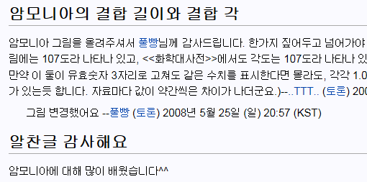
Introduction (2/4)
Research questions
Can we characterize how social interactions affect interests and vice versa?
Can we characterize the relative degree to which interests and social interactions affect what people do?
In Wikipedia
Editing articles
→ Indications of interests
Editing the discussion page associated with a particular user
→ Indications of social ties

Slide 5



Introduction (3/4)
Question 1
Analyze how the similarity between their activity vectors evolves both before and after their first interaction
Random-graph model proposed by Holme and Newman
Propose a more expressive model
Above model is too simple to produce the effects we see in Wikipedia
A large space of possible activities in Wikipedia
아이유♥
수지♥
아이유♥
Change its opinion
Time
Re-wires
수지♥

Slide 6



Introduction (4/4)
Question 2
Compare the predictive power
vs.
(Interaction) network
Similarity network

Slide 7
Outline
Introduction
Social Influence and Selection over Time
Predictive Value of Social Interactions and Similarity
Discussion and Conclusion + Discussion @ IDB

Slide 8
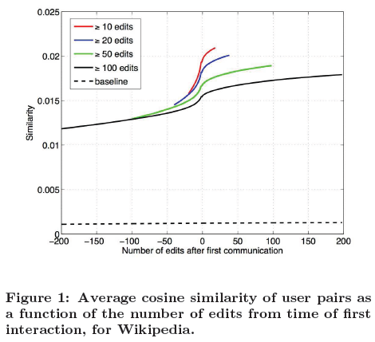
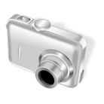



Social Influence and Selection over Time (1/5)
A user’s activity vector
Specify the number of times that he/she has edited each article up to that point in time
Similarity around the time of first interaction
* Feedback between social influence and selection.
Hi.
Hi.
* The effects of selection and social influence are fairly robust in the Wikipedia data.
Notes:
Similarity leads to interaction but then interaction leads to further similarity.
We find that there is a sharp increase in the similarity between two editors just before they first interact, with a continuing but slower increase that persists long after this first interaction.
=> This suggests that people encounter each other due to overlap in their interests as measured by article editing, but that the consequences of these encounters can lead to further effects that are visible many months later.
** Differing activity levels do not change the results. (The qualitative picture is the same whether users are less active (k>=10) or more active(k>=100))

Slide 9
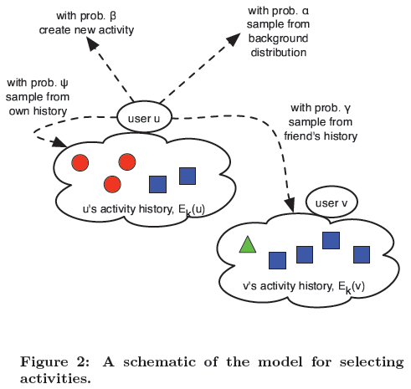
Social Influence and Selection over Time (2/5)
Modeling the effect of social interaction
Networked urn process

Slide 10



Social Influence and Selection over Time (3/5)
Modeling the choice of interactions
Talk to a random person: probability δ
Choose a user at random from the sequence of all user activity
Talk to someone based on a common activity: probability 1-δ
Choose a person from the most recent k people to have performed an instance of this activity
The full model
At each time-step,
φ
All user
1 - φ

Slide 11
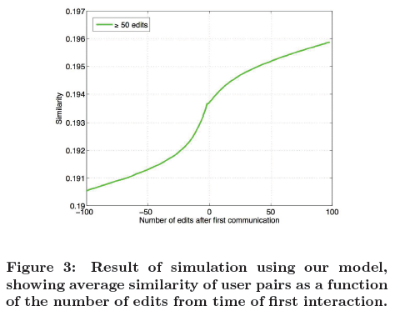
Social Influence and Selection over Time (4/5)
Simulating Wikipedia using the model
100,000 users

Slide 12
Social Influence and Selection over Time (5/5)
Explore the reasons people meet
The gap between co-activity and communication was usually short
Often less than a day, three months in one case
Offering thanks and praise, making requests for help, or trying to understand the editing behavior of the other person
Building Awareness of others
Support distributed collaboration and the efficient operation of teams
Often leads to communication

Slide 13
Outline
Introduction
Social Influence and Selection over Time
Predictive Value of Social Interactions and Similarity
Discussion and Conclusion + Discussion @ IDB

Slide 14
Predictive Value of Social Interactions and Similarity (1/2)
Relative power of similarity and social network links for predicting future behavior
Compare two sources of information
Create two networks
① Interaction network, ② Similarity network
Measure the effect of social-network links
Compute the probability that a node adopts a given behavior given that k of its neighbors have done so
Compare this to the probability of future activities
u
…
u
…
t₁
t₂

Slide 15
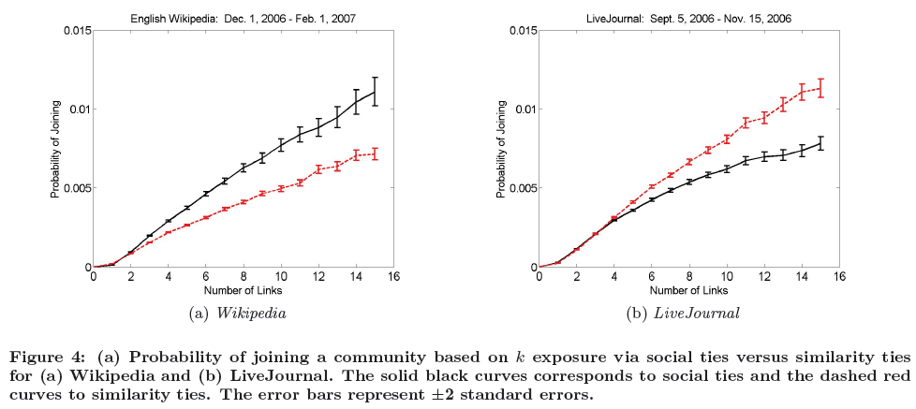
Predictive Value of Social Interactions and Similarity (2/2)
Wikipedia and LiveJournal data
Notes:
Wikipedia -> editing page에 초점
LJ -> relationship에 초점

Slide 16
Outline
Introduction
Social Influence and Selection over Time
Predictive Value of Social Interactions and Similarity
Discussion and Conclusion + Discussion @ IDB

Slide 17
Discussion and Conclusion
Main contributions
Social interaction is both an effect and a cause of selection
Theories and models that relate them will need to consider their interaction
People become aware of others through shared, recent activity around artifacts
The dynamics of the community
Important in understanding the relative power of social interaction and similarity-based predictors

Slide 18
Discussion @ IDB
Pros
Relationship analysis between similarity and social influence
Show the different power of two sources at the different sites
Cons
Definitions of activity and interaction
LJ: Joining the community, links between users
WP: editing pages and discussion pages

