Slide 1
ODBC : Open Database Connectivity
SNU OOPSLA Lab.
October 2005

Slide 2
Contents
Introduction
History
ODBC Model
Example
Summary
Online Resources

Slide 3
Introduction(1/2)
ODBC
  (pronounced as separate letters) Short for Open DataBase Connectivity
  A standard database access method developed by the SQL Access group in 1992
The goal of ODBC
  to make it possible to access any data from any application, regardless of which DBMS is handling the data
  ODBC manages this by inserting a middle layer, called a database driver, between an application and the DBMS

Slide 4
Introduction(2/2)
Database Driver
  The purpose of this layer is to translate the application's data queries into commands that the DBMS understands
  For this to work, both the application and the DBMS must be ODBC-compliant
    The application must be capable of issuing ODBC commands and the DBMS must be capable of responding to them
ODBC has become so accepted that some vendors like IBM, Informix and Watcom have designed their DBMS native programming interface based on ODBC

Slide 5
ODBC Component(1/2)
Application
(ODBC function calls)
Driver Manager
Oracle
ODBC
Driver
DB2
ODBC
Driver
Cybase
ODBC
Driver
Access
ODBC
Driver
Translation of
ODBC calls
into DBMS
native language
Oracle
DB2
Cybase
Acceess

Slide 6
ODBC Component(2/2)
Application
  Performs processing and calls ODBC functions to submit SQL statements and retrieve results
Driver manager
  Loads and unloads drivers on behalf of an application
  Processes ODBC function calls or passes them to a driver
ODBC driver
  Processes ODBC function calls, submits SQL requests to a specific data source, and returns results to the application
Data source
  Consists of the data the user wants to access and its associated operating system, DBMS, and network platform (if any) used to access the DBMS

Slide 7
Application Step
SQLAllocEnv
Allocate memory
SQLAllocConnect
SQLConnect
Load driver and connect data source
SQLAllocStmt
Process SQL stmt
Receive Result
CLOSE
option
SQLFreeStmt
DROP option
SQLDisconnect
SQLFreeConnect
SQLFreeEnv

Slide 8
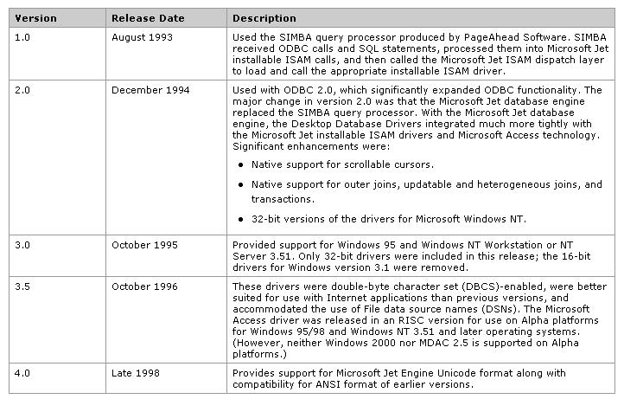
History

Slide 9
ODBC
Advantages:
  no precompile needed; just uses an API
  more portable than embedded SQL
  current database statistics are used
  no need to know the exact SQL statements ahead of time
Disadvantages:
  need to know C/C++
  need to understand ODBC!
  dynamic binding; slower query execution

Slide 10
ODBC Model
There are different ODBC models (or tiers) each describing the number of layers that must be passed through before the database is reached
The three most common are:
  Tier 1
  Tier 2
  Tier 3

Slide 11
Tier 1
Program calls an ODBC function.
Program
ODBC Manager determines what to do.
ODBC Manager
ODBC Driver performs actual processing.
ODBC Driver
Database
File
The database file is opened by the driver and data is manipulated.

Slide 12
Tier 2
Client
Program calls an ODBC function.
Program
ODBC Manager determines what to do.
ODBC Manager
ODBC Driver prepares the request and passes it on to the DBMS.
ODBC Driver
DBMS
Server
Database
File
The DBMS processes the request.
Server

Slide 13
Tier 3
Client
Program calls an ODBC function.
Program
ODBC Manager determines what to do.
ODBC Manager
ODBC Driver prepares the request and passes it on to the DBMS.
ODBC Driver
Gateway ODBC Manager/Driver pass the request on to the DMBS.
ODBC Manager/Driver
Gateway
DBMS
Server
Database
File
The DBMS processes the request.
Server

Slide 14
Importing, linking and exporting data
With ODBC
  Importing data
  Linking data
  Exporting data
  Ex) Microsoft Access can import (copy in) or link (connect to) data that is in text files, spreadsheets, other Access database, dBASE, Paradox, Microsoft FoxPro, and other SQL database that support ODBC

Slide 15
Importing vs. Linking
Importing
  File is relatively small.
  Data is not changed frequently by users of other database application.
  Data need not to be shared with other database application.
  Best performance is desired.
Linking
  File is large (i.e., larger than maximum capacity of local Access database [1 GB]).
  Data is changed frequently by users of other database application.
  Data need to be shared over network with other database applications.
  Performance does not matter.

Slide 16
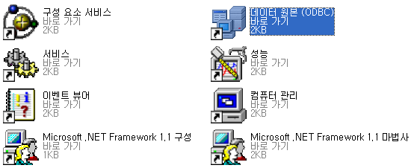
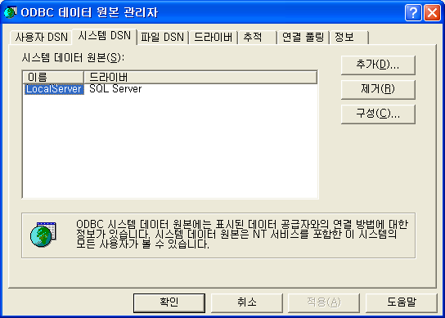
ODBC Link Example(1/4)
1. Open the control Panel, and click the ODBC
2. Select system DSN

Slide 17
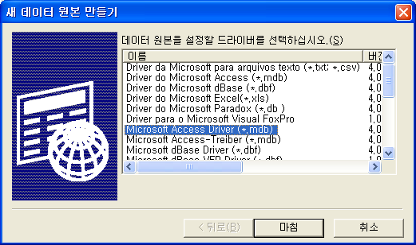
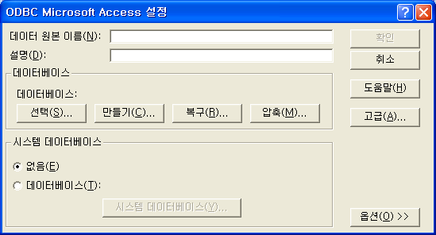
ODBC Link Example(2/4)
3. Select the driver for the type
of database you want to add
and press the Finish button
4. Enter a Data Source Name

Slide 18
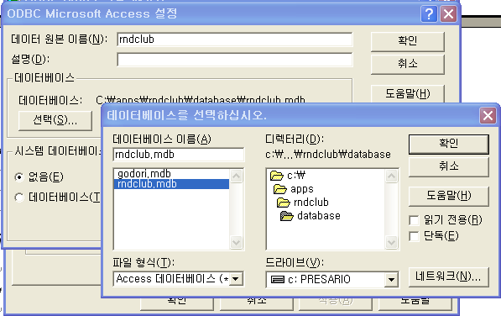
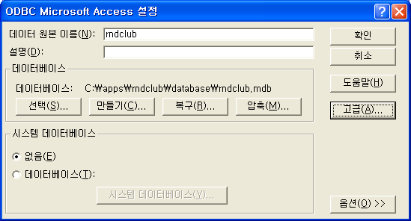
ODBC Link Example(3/4)
5. Select the database you want to
connect to and Press
the OK button
6. Press the OK button

Slide 19
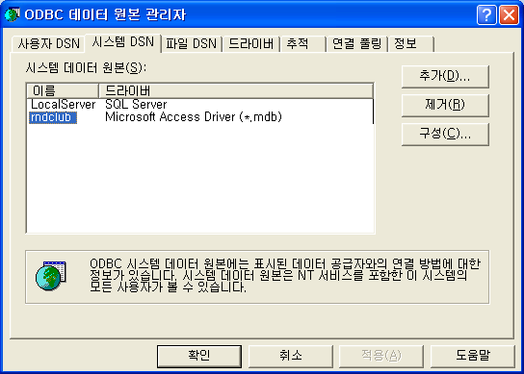
ODBC Link Example(4/4)
7. Now you should see your
new ODBC link in the list
Press the OK button to finish

Slide 20
Summary
ODBC
  A standard database access method
  Access any data from any application
ODBC Component
  Application, driver manager, ODBC driver, data source
ODBC model
  3 tier
With ODBC
  Importing, linking and exporting data

Slide 21
Online Resources
For ODBC development reference
  http://msdn.microsoft.com/library/default.asp?url=/library/en-us/odbc/htm/dasdkodbcoverview.asp
For ODBC driver information
  http://msdn.microsoft.com/library/en-us/odbc/htm/odbc_drivers_overview.asp?frame=true
For ODBC error message reference
  http://www.microsoft.com/technet/prodtechnol/sql/proddocs/diag/part3/75528c16.asp?frame=true

