Slide 1
Generalized Hash Teams for Join and Group-by
Alfons Kemper, Donald Kossmann, and Christian Wiesner
Universität Passau, Lehrstuhl für Informatik, Germany
VLDB ’99
13 Apr 2012
Taewhi Lee

Slide 2
Outline
Introduction
Related Work
Binary Joins with Aggregation
Implementation Details
Multi-Way Joins
False Drops Analysis
Performance Evaluation
Discussion

Slide 3
Traditional (Hash) Join Plan
Aggr
SELECT c.city, sum(o.value)
FROM customer c, order o
WHERE c.c# = o.c#
GROUP BY c.city;
Ptn on city
Ptn on c#
Ptn on c#
Customer
Order
odd (c#)
A-N (city)
C
c#
Aggr
even (c#)
city
O-Z (city)
Result
O
odd
A-N
Aggr
c#
city
even
O-Z

Slide 4
Generalized Hash Teams
Aggr
SELECT c.city, sum(o.value)
FROM customer c, order o
WHERE c.c# = o.c#
GROUP BY c.city;
Ptn on city
Ptn on BM
Bitmaps
(BM)
Customer
Order
A-N (city)
C₁
C
C₂
O-Z (city)
Aggr
city
c#
B₁
Result
O
Aggr
B₂
city

Slide 5
Outline
Introduction
Related Work
Binary Joins with Aggregation
Implementation Details
Multi-Way Joins
False Drops Analysis
Performance Evaluation
Discussion

Slide 6
Traditional Hash Team Join Plan [Graefe, Bunker, Cooper: VLDB 98]
R
S
T
A
A
R
R.A
A
A
Result
S
A
A
S.A
T
T.A

Slide 7
Outline
Introduction
Related Work
Binary Joins with Aggregation
Implementation Details
Multi-Way Joins
False Drops Analysis
Performance Evaluation
Discussion

Slide 8
Example Query
SELECT c.city, sum(o.value)
FROM customer c, order o
WHERE c.c# = o.c#
GROUP BY c.city;
order
o# | c# | value
23 | 4 | 13
27 | 9 | 54
7 | 25 | 10
59 | 10 | 13
10 | 3 | 66
22 | 17 | 42
43 | 5 | 33
6 | 9 | 45
19 | 42 | 75
40 | 10 | 1
28 | 7 | 9
33 | 6 | 51
42 | 5 | 34
24 | 13 | 0
3 | 7 | 12
customer
c# | city
5 | PA
13 | M
3 | NYC
9 | B
17 | LA
10 | HH
4 | NYC
7 | LA
6 | B
25 | M
23 | PA
42 | HH

Slide 9
Generating Bitmaps
SELECT c.city, sum(o.value)
FROM customer c, order o
WHERE c.c# = o.c#
GROUP BY c.city;
customer₁
c# | city
5 | PA
13 | M
25 | M
23 | PA
PA M
customer
c# | city
5 | PA
13 | M
3 | NYC
9 | B
17 | LA
10 | HH
4 | NYC
7 | LA
6 | B
25 | M
23 | PA
42 | HH
customer₂
c# | city
9 | B
10 | HH
6 | B
42 | HH
ptn
B HH
city
c# mod 10
B₁
0
0
0
1
0
1
0
0
0
0
B₂
1
0
1
0
0
0
1
0
0
1
B₃
0
0
0
1
1
0
0
1
0
0
NYC LA
customer₃
c# | city
3 | NYC
17 | LA
4 | NYC
7 | LA

Slide 10
Partitioning Using Bitmaps
SELECT c.city, sum(o.value)
FROM customer c, order o
WHERE c.c# = o.c#
GROUP BY c.city;
B₁
0
0
0
1
0
1
0
0
0
0
B₂
1
0
1
0
0
0
1
0
0
1
B₃
0
0
0
1
1
0
0
1
0
0
order₁
o# | c# | value
7 | 25 | 10
10 | 3 | 66
43 | 5 | 33
42 | 5 | 34
24 | 13 | 0
order
o# | c# | value
23 | 4 | 13
27 | 9 | 54
7 | 25 | 10
59 | 10 | 13
10 | 3 | 66
22 | 17 | 42
43 | 5 | 33
6 | 9 | 45
19 | 42 | 75
40 | 10 | 1
28 | 7 | 9
33 | 6 | 51
42 | 5 | 34
24 | 13 | 0
3 | 7 | 12
Order₂
o# | c# | value
27 | 9 | 54
59 | 10 | 13
6 | 9 | 45
19 | 42 | 75
40 | 10 | 1
33 | 6 | 51
ptn
B_{i}
Order₃
o# | c# | value
23 | 4 | 13
10 | 3 | 66
22 | 17 | 42
28 | 7 | 9
24 | 13 | 0
3 | 7 | 12

Slide 11
Join and Aggregation
SELECT c.city, sum(o.value)
FROM customer c, order o
WHERE c.c# = o.c#
GROUP BY c.city;
customer₁
c# | city
5 | PA
13 | M
25 | M
23 | PA
order₁
o# | c# | value
7 | 25 | 10
10 | 3 | 66
43 | 5 | 33
42 | 5 | 34
24 | 13 | 0
Aggr_{city}
city | value
PA | 33
M | 10
c#
Aggr
city
order₂
o# | c# | value
27 | 9 | 54
59 | 10 | 13
6 | 9 | 45
19 | 42 | 75
40 | 10 | 1
33 | 6 | 51
customer₂
c# | city
9 | B
10 | HH
6 | B
42 | HH
Aggr_{city}
city | value
B | 150
HH | 89
c#
Aggr
city
customer₃
c# | city
3 | NYC
17 | LA
4 | NYC
7 | LA
order₃
o# | c# | value
23 | 4 | 13
10 | 3 | 66
22 | 17 | 42
28 | 7 | 9
24 | 13 | 0
3 | 7 | 12
Aggr_{city}
city | value
NYC | 79
LA | 63
c#
Aggr
city

Slide 12
Outline
Introduction
Related Work
Binary Joins with Aggregation
Implementation Details
Multi-Way Joins
False Drops Analysis
Performance Evaluation
Discussion

Slide 13
Reducing the # of Bitmap Comparisons
Two additional bitmaps
Objects without join partner → used bitmap used := B1 | B2 | … | Bn
Objects without collision → coll bitmap coll[k] = 1 if two (or more) bitmaps of k-th index = 1
B₁
0
0
0
1
0
1
0
0
0
0
B₂
1
0
1
0
0
0
1
0
0
1
B₃
0
0
0
1
1
0
0
1
0
0
used
1
0
1
1
1
1
1
1
0
1
coll
0
0
0
1
0
0
0
0
0
0

Slide 14
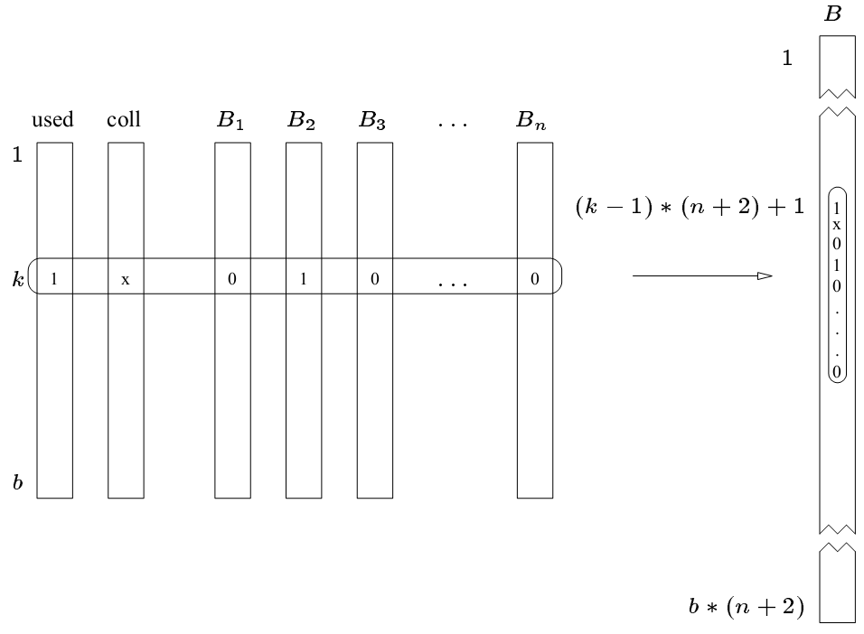
Increasing Locality on Bitmaps
(n + 2) bitmaps of length b → 1 bitmap of length (n + 2) * b

Slide 15
Teaming Up Join and Aggregation: Build Phase
customer₁
c# | city
5 | PA
13 | M
25 | M
23 | PA
HT_Temp
city | ptr
Hasharea
city | value | hit
PA
M
PA | 0 | 0
M | 0 | 0
HT_Join
c# | ptr
5
13
25
23

Slide 16
Teaming Up Join and Aggregation: Probe Phase
customer₁
c# | city
5 | PA
13 | M
25 | M
23 | PA
HT_Temp
city | ptr
Hasharea
city | value | hit
PA
PA | 0 | 0
M
PA | 33 | 1
M | 0 | 0
M | 10 | 1
order₁
o# | c# | value
7 | 25 | 10
10 | 3 | 66
43 | 5 | 33
42 | 5 | 34
24 | 13 | 0
HT_Join
c# | ptr
5
13
25
23

Slide 17
Outline
Introduction
Related Work
Binary Joins with Aggregation
Implementation Details
Multi-Way Joins
False Drops Analysis
Performance Evaluation
Discussion

Slide 18
Multi-Way Joins
SELECT c.city, sum(l.price)
FROM customer c, order o, lineitem l
WHERE c.c# = o.c# AND l.o# = o.o#
GROUP BY c.city;
Group (Customer Order Lineitem)
city
c#
o#
Partition on city
and generate
bitmaps for c#
Partition with
bitmaps for C#
and generate
bitmaps for O#
Partition with
bitmaps for O#

Slide 19
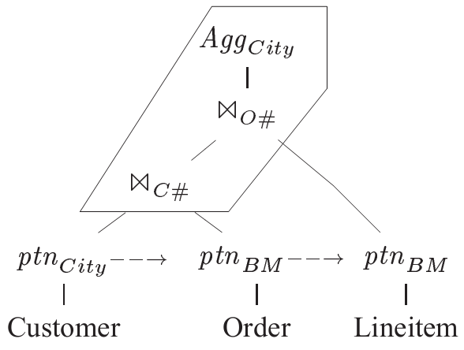
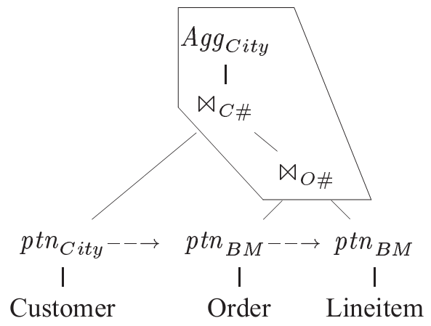
Alternative Query Evaluation Plans
SELECT c.city, sum(l.price)
FROM customer c, order o, lineitem l
WHERE c.c# = o.c# AND l.o# = o.o#
GROUP BY c.city;
Which plan is better?

Slide 20
Outline
Introduction
Related Work
Binary Joins with Aggregation
Implementation Details
Multi-Way Joins
False Drops Analysis
Performance Evaluation
Discussion

Slide 21
False Drops
B₁
0
0
0
1
0
1
0
0
0
0
customer₁
c# | city
5 | PA
13 | M
25 | M
23 | PA
order
o# | c# | value
23 | 4 | 13
27 | 9 | 54
7 | 25 | 10
59 | 10 | 13
10 | 3 | 66
22 | 17 | 42
43 | 5 | 33
6 | 9 | 45
19 | 42 | 75
40 | 10 | 1
28 | 7 | 9
33 | 6 | 51
42 | 5 | 34
24 | 13 | 0
3 | 7 | 12
order₁
o# | c# | value
7 | 25 | 10
10 | 3 | 66
43 | 5 | 33
42 | 5 | 34
24 | 13 | 0
ptn
B_{i}
The # of false drops affects the join performance

Slide 22
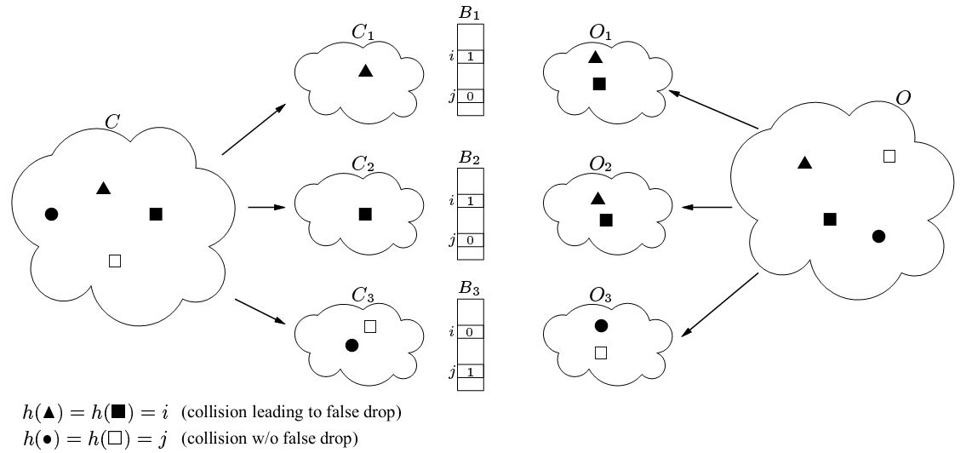
Cause of False Drops
Same hash value
Assigned to
different partitions

Slide 23
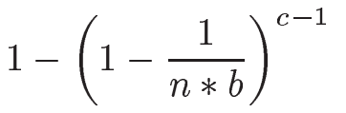
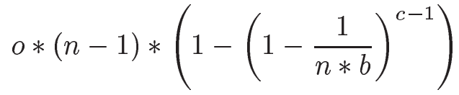





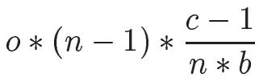
False Drops Estimation
customer c, order o – foreign key relationship
b: the length of each bitmap
n: the number of partitions
Probability that some s sets a bit into a particular partition:
Total number of false drops:
Conservative approximation:
B₁
B₂
B_{n}
1
0
1
0
b
…
after c-1 records?

Slide 24
Outline
Introduction
Related Work
Binary Joins with Aggregation
Implementation Details
Multi-Way Joins
False Drops Analysis
Performance Evaluation
Discussion

Slide 25
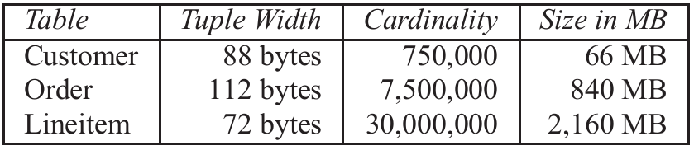
Experimental Environment
Sun UltraSPARC station, 167MHz CPU, 512MB RAM
Solaris’ direct IO feature → no cache effects at OS level
2 disks – for storing DB, intermediate query results each
C++ code
Test DB

Slide 26
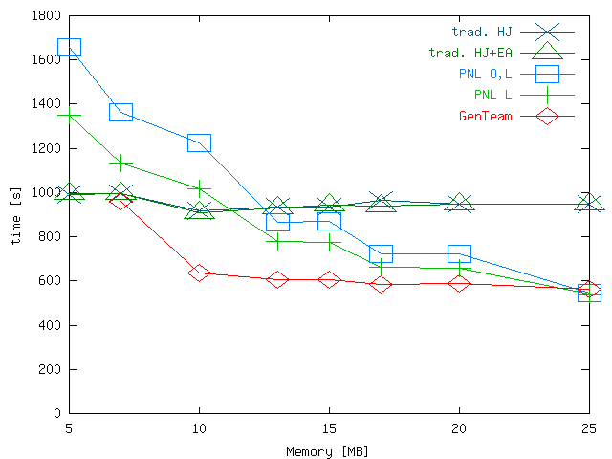
Performance Comparison
Group (Customer Order Lineitem)
city
c#
o#

Slide 27
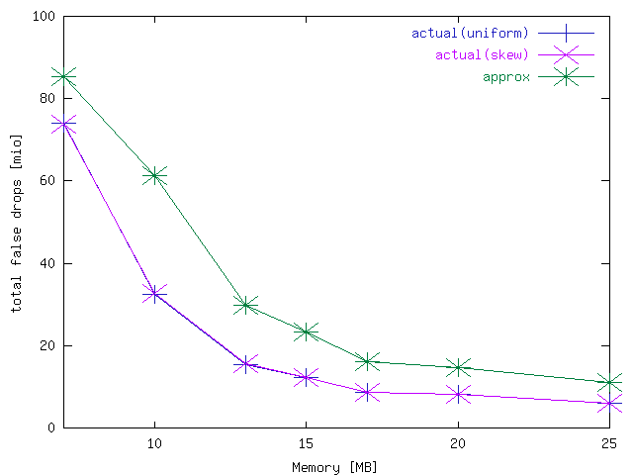
False Drops Estimation and Measurement
Approximations seems to be accurate enough
The # of false drops is independent of skew

Slide 28
Outline
Introduction
Related Work
Binary Joins with Aggregation
Implementation Details
Multi-Way Joins
False Drops Analysis
Performance Evaluation
Discussion

Slide 29
Our Approach: Multi-way Bloomjoin
Goal: reducing useless intermediate records in multi-way join
Key ideas
Sequential processing of input data sets in Map tasks
On-the-fly generation of Bloom filter for filtering next data sets
S
Global Bloom filter
Master
Barrier
Local Bloom filter
R
Mappers
Reducers
BF
Map 1
Reducer 1
BF
Map 2
Reducer 2
Barrier
T

Slide 30
Pros and Cons
Pros
Additional input data scan is not required
Communication cost is reduced
Cons
All Mappers must wait after the processing of a data set
Master may become a bottleneck

