Slide 1
Efficient Interactive Fuzzy Keyword Search
Shengyue Ji, Guoliang Li, Jianhua Feng , Chen Li
University of California, Irvine
WWW 2009
1 Dec 2011
Presentation @ IDB Lab. Seminar
Presented by Jee-bum Park

Slide 2
Outline
Introduction
Indexing Methods
Single Keyword
Multiple Keywords
Experiments
Conclusions

Slide 3
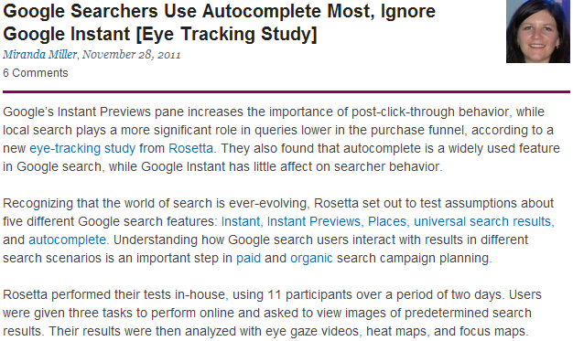
Introduction
http://searchenginewatch.com/article/2128218/Google-Searchers-Use-Autocomplete-Most-Ignore-Google-Instant-Eye-Tracking-Study

Slide 4
Introduction
http://searchenginewatch.com/article/2128218/Google-Searchers-Use-Autocomplete-Most-Ignore-Google-Instant-Eye-Tracking-Study

Slide 5
Introduction
http://searchenginewatch.com/article/2128218/Google-Searchers-Use-Autocomplete-Most-Ignore-Google-Instant-Eye-Tracking-Study

Slide 6
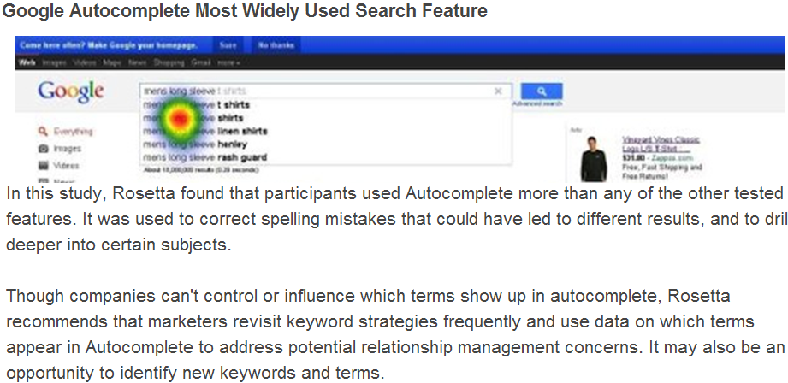
Introduction
http://searchenginewatch.com/article/2128218/Google-Searchers-Use-Autocomplete-Most-Ignore-Google-Instant-Eye-Tracking-Study

Slide 7
Introduction
http://searchenginewatch.com/article/2128218/Google-Searchers-Use-Autocomplete-Most-Ignore-Google-Instant-Eye-Tracking-Study

Slide 8
Introduction
http://searchenginewatch.com/article/2128218/Google-Searchers-Use-Autocomplete-Most-Ignore-Google-Instant-Eye-Tracking-Study

Slide 9
Introduction
http://searchenginewatch.com/article/2128218/Google-Searchers-Use-Autocomplete-Most-Ignore-Google-Instant-Eye-Tracking-Study

Slide 10
Introduction
http://searchenginewatch.com/article/2128218/Google-Searchers-Use-Autocomplete-Most-Ignore-Google-Instant-Eye-Tracking-Study

Slide 11
Introduction
http://searchenginewatch.com/article/2128218/Google-Searchers-Use-Autocomplete-Most-Ignore-Google-Instant-Eye-Tracking-Study

Slide 12

Introduction
A typical directory-search form

Slide 13
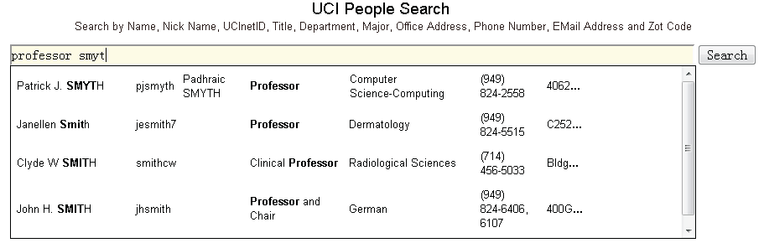
Introduction
Interactive fuzzy search

Slide 14
Introduction
“interactive, fuzzy search”
Interactive
The system searches for the best answers on the fly as the user types in a keyword query
Fuzzy
The system tries to find relevant records that include words similar to the keywords in the query, even if they do not match exactly

Slide 15
Outline
Introduction
Indexing Methods
Single Keyword
Multiple Keywords
Experiments
Conclusions

Slide 16
Indexing Methods
List
Prefix query | Inverted index
li | 1
lin | 3, 4
liu | 5
lu | 4
luis | 7

Slide 17
Indexing Methods
List
Typed “li”
Prefix query | Inverted index
li | 1
lin | 3, 4
liu | 5
lu | 4
luis | 7

Slide 18
Indexing Methods
List
Typed “lu”
Prefix query | Inverted index
li | 1
lin | 3, 4
liu | 5
lu | 4
luis | 7

Slide 19
Indexing Methods
Trie
0: \0
10: l
1
4
11: i
14: u
12: n
13: u
15: i
16: s
3, 4
5
7

Slide 20
Indexing Methods
Trie
Typed “li”
0: \0
10: l
1
4
11: i
14: u
12: n
13: u
15: i
16: s
3, 4
5
7

Slide 21
Indexing Methods
Trie
Typed “li”
0: \0
10: l
1
4
11: i
14: u
12: n
13: u
15: i
16: s
3, 4
5
7

Slide 22
Indexing Methods
Trie
Typed “li”
0: \0
10: l
1
4
11: i
14: u
12: n
13: u
15: i
16: s
3, 4
5
7

Slide 23
Indexing Methods
Trie
Typed “li”
0: \0
10: l
1
4
11: i
14: u
12: n
13: u
15: i
16: s
3, 4
5
7

Slide 24
Indexing Methods
Trie
Typed “li”
0: \0
10: l
1
4
11: i
14: u
12: n
13: u
15: i
16: s
3, 4
5
7

Slide 25
Indexing Methods
Trie
Typed “li”
0: \0
10: l
1
4
11: i
14: u
12: n
13: u
15: i
16: s
3, 4
5
7

Slide 26
Indexing Methods
Trie
Typed “li”
0: \0
10: l
1
4
11: i
14: u
12: n
13: u
15: i
16: s
3, 4
5
7

Slide 27
Outline
Introduction
Indexing Methods
Single Keyword
Multiple Keywords
Experiments
Conclusions

Slide 28
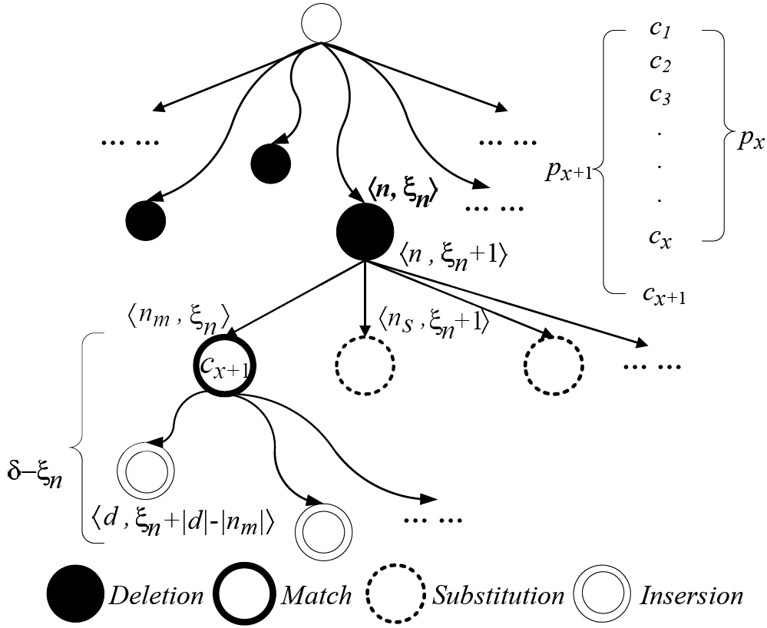
Single Keyword

Slide 29
Single Keyword
Edit distance
0
1
2
Example
Query = “nlis”, edit distance threshold = 2
0: \0
10: l
1
4
11: i
14: u
12: n
13: u
15: i
16: s
3, 4
5
7

Slide 30
Single Keyword
Edit distance
0
1
2
Initial state: “”
Query = “nlis”, edit distance threshold = 2
0: \0
Φ_{ε} | Delete | Substitute | Match | Insert
<0,0>
<10,1>
<11,2>
<14,2>
10: l
1
4
11: i
14: u
12: n
13: u
15: i
16: s
3, 4
5
7

Slide 31
Single Keyword
Edit distance
0
1
2
Typed: “n”
Query = “nlis”, edit distance threshold = 2
0: \0
Φ_{ε} | Delete | Substitute | Match | Insert
<0,0> | <0,1> | <10,1>
<10,1> | <10,2> | <11,2> <14,2>
<11,2> |  |  | <12,2>
<14,2>
10: l
1
4
11: i
14: u
12: n
13: u
15: i
16: s
3, 4
5
7

Slide 32
Single Keyword
Edit distance
0
1
2
Typed: “n”
Query = “nlis”, edit distance threshold = 2
0: \0
Φ_{ε} | Delete | Substitute | Match | Insert
<0,0> | <0,1> | <10,1>
<10,1> | <10,2> | <11,2> <14,2>
<11,2> |  |  | <12,2>
<14,2>
10: l
1
4
11: i
14: u
12: n
13: u
15: i
16: s
Φ_{n}
<0,1>, <10,1>, <11,2>, <12,2>, <14,2>
3, 4
5
7

Slide 33
Single Keyword
Edit distance
0
1
2
Typed: “n”
Query = “nlis”, edit distance threshold = 2
0: \0
Φ_{n} | Delete | Substitute | Match | Insert
<0,1>
<10,1>
<11,2>
<12,2>
<14,2>
10: l
1
4
11: i
14: u
12: n
13: u
15: i
16: s
3, 4
5
7

Slide 34
Single Keyword
Edit distance
0
1
2
Typed: “nl”
Query = “nlis”, edit distance threshold = 2
0: \0
Φ_{n} | Delete | Substitute | Match | Insert
<0,1> | <0,2> |  | <10,1> | <11,2> <14,2>
<10,1> | <10,2> | <11,2> <14,2>
<11,2>
<12,2>
<14,2>
10: l
1
4
11: i
14: u
12: n
13: u
15: i
16: s
3, 4
5
7

Slide 35
Single Keyword
Edit distance
0
1
2
Typed: “nl”
Query = “nlis”, edit distance threshold = 2
0: \0
Φ_{n} | Delete | Substitute | Match | Insert
<0,1> | <0,2> |  | <10,1> | <11,2> <14,2>
<10,1> | <10,2> | <11,2> <14,2>
<11,2>
<12,2>
<14,2>
10: l
1
4
11: i
14: u
12: n
13: u
15: i
16: s
Φ_{nl}
<10,1>, <0,2>, <11,2>, <14,2>
3, 4
5
7

Slide 36
Single Keyword
Edit distance
0
1
2
Typed: “nl”
Query = “nlis”, edit distance threshold = 2
0: \0
Φ_{nl} | Delete | Substitute | Match | Insert
<10,1>
<0,2>
<11,2>
<14,2>
10: l
1
4
11: i
14: u
12: n
13: u
15: i
16: s
3, 4
5
7

Slide 37
Single Keyword
Edit distance
0
1
2
Typed: “nli”
Query = “nlis”, edit distance threshold = 2
0: \0
Φ_{nl} | Delete | Substitute | Match | Insert
<10,1> | <10,2> | <14,2> | <11,1> | <12,2> <13,2>
<0,2>
<11,2>
<14,2> |  |  | <15,2>
10: l
1
4
11: i
14: u
12: n
13: u
15: i
16: s
3, 4
5
7

Slide 38
Single Keyword
Edit distance
0
1
2
Typed: “nli”
Query = “nlis”, edit distance threshold = 2
0: \0
Φ_{nl} | Delete | Substitute | Match | Insert
<10,1> | <10,2> | <14,2> | <11,1> | <12,2> <13,2>
<0,2>
<11,2>
<14,2> |  |  | <15,2>
10: l
1
4
11: i
14: u
12: n
13: u
15: i
16: s
Φ_{nli}
<11,1>, <10,2>, <12,2>, <13,2>, <14,2>, <15,2>
3, 4
5
7

Slide 39
Single Keyword
Edit distance
0
1
2
Typed: “nli”
Query = “nlis”, edit distance threshold = 2
0: \0
Φ_{nli} | Delete | Substitute | Match | Insert
<11,1>
<10,2>
<12,2>
<13,2>
<14,2>
<15,2>
10: l
1
4
11: i
14: u
12: n
13: u
15: i
16: s
3, 4
5
7

Slide 40
Single Keyword
Edit distance
0
1
2
Typed: “nlis”
Query = “nlis”, edit distance threshold = 2
0: \0
Φ_{nli} | Delete | Substitute | Match | Insert
<11,1> | <11,2> | <12,2> <13,2>
<10,2>
<12,2>
<13,2>
<14,2>
<15,2> |  |  | <16,2>
10: l
1
4
11: i
14: u
12: n
13: u
15: i
16: s
3, 4
5
7

Slide 41
Single Keyword
Edit distance
0
1
2
Typed: “nlis”
Query = “nlis”, edit distance threshold = 2
0: \0
Φ_{nli} | Delete | Substitute | Match | Insert
<11,1> | <11,2> | <12,2> <13,2>
<10,2>
<12,2>
<13,2>
<14,2>
<15,2> |  |  | <16,2>
10: l
1
4
11: i
14: u
12: n
13: u
15: i
16: s
Φ_{nlis}
<11,2>, <12,2>, <13,2>, <16,2>
3, 4
5
7

Slide 42
Single Keyword
Edit distance
0
1
2
Typed: “nlis”
Query = “nlis”, edit distance threshold = 2
0: \0
Φ_{nli} | Delete | Substitute | Match | Insert
<11,1> | <11,2> | <12,2> <13,2>
<10,2>
<12,2>
<13,2>
<14,2>
<15,2> |  |  | <16,2>
10: l
1
4
11: i
14: u
12: n
13: u
15: i
16: s
Φ_{nlis}
<11,2>, <12,2>, <13,2>, <16,2>
3, 4
5
7

Slide 43
Outline
Introduction
Indexing Methods
Single Keyword
Multiple Keywords
Experiments
Conclusions

Slide 44
Multiple Keywords
Challenges in multiple keywords
Intersection of multiple lists of keywords
Each prefix query keyword has
Multiple predicted complete keywords
The union of the lists of predicted keywords includes potential answers
The union lists of multiple query keywords need to be intersected in order to compute the answers to the query
Cache-based incremental intersection

Slide 45
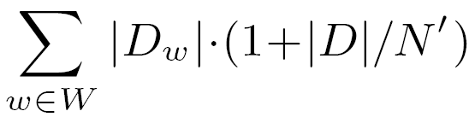
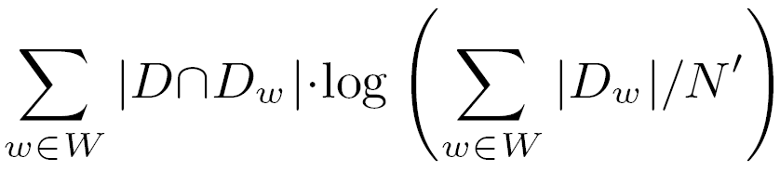
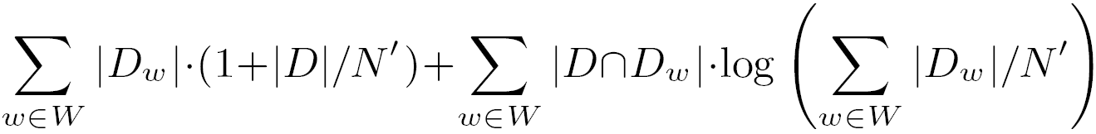
Multiple Keywords
HYB (H. Bast, I. Weber. Type Less, Find More: Fast Autocompletion Search with a Succinct Index. In SIGIR 2006)
The intersections can be computed in
The union can be computed in
Total time complexity
D.id | D.content
21 | apple iphone
33 | php programming
64 | apple juice
91 | iphone programming
172 | iphone galaxy tab
308 | application iphone
759 | difference ipv4 ipv6
W | New Data Structure (HYB)
ipho | 950(ipho) 900(iph), 1000, ... 64, 128, 256, 900(juice), 950(juice), ...
iph
juice
iphone | 1, 5, 21, 91, 172, 300, 308, 3000, 3001, ... 759(ipv4), 760, ... 400, 759(ipv6), 800(ipv6), ... 5(ipv), 6, 1100, 1200, ... 5(tab), 172, 272, 800(tab), ...
ipv4
ipv6
ipv
tab
iphon | NULL 5, 3000, 5123, ...
ip
W’ = { iphone, ipv4, ipv6 }
D ∩ D_{w} = D’ = { 21, 172, 308, 759 }

Slide 46
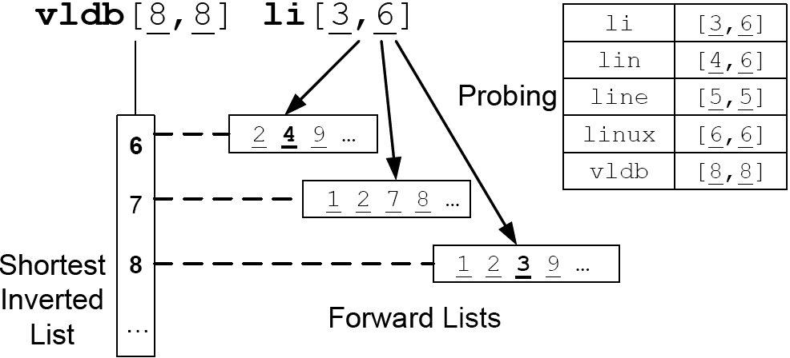
Multiple Keywords
Forward lists

Slide 47
Outline
Introduction
Indexing Methods
Single Keyword
Multiple Keywords
Experiments
Conclusions

Slide 48
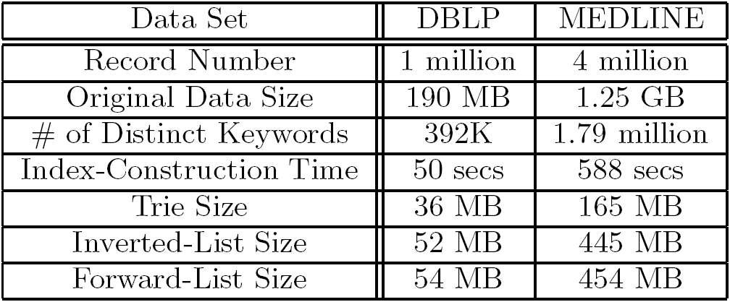
Experiments
DBLP
It included about one million computer science publication records
Authors, title, conference or journal name, year, page numbers, URL
MEDLINE
It had about 4 million latest publication records related to life sciences and biomedical information
Authors, their affiliations, article title, journal name, journal issue

Slide 49
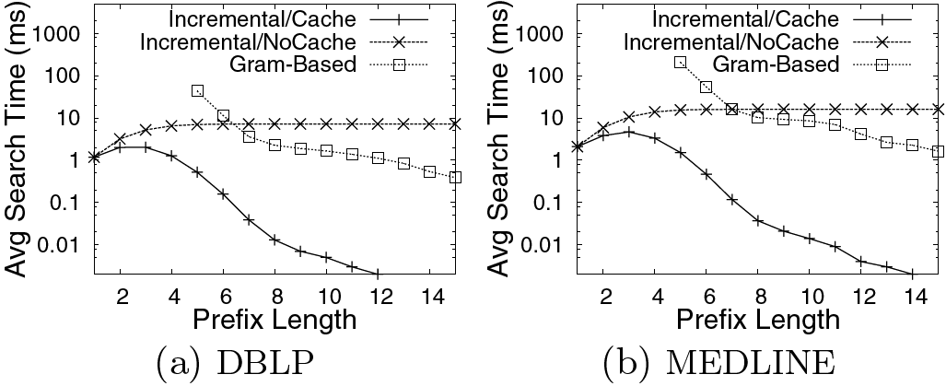
Experiments
Computing prefixes similar to a keyword

Slide 50
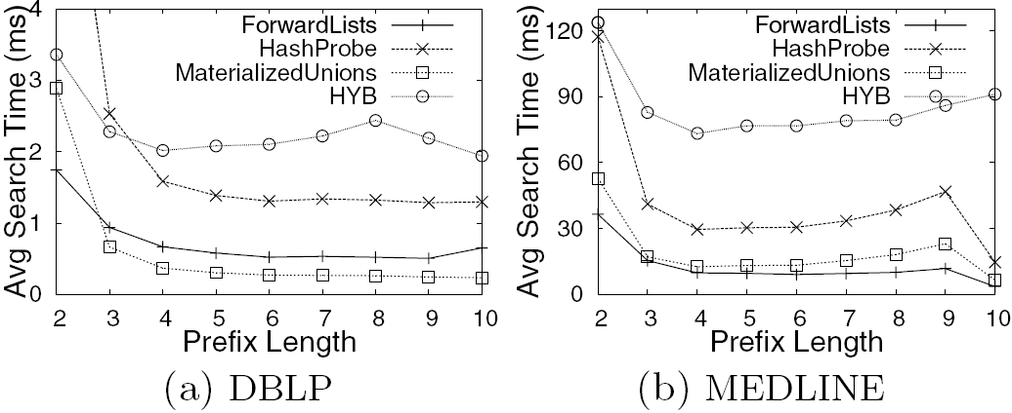
Experiments
List intersection of multiple keywords

Slide 51
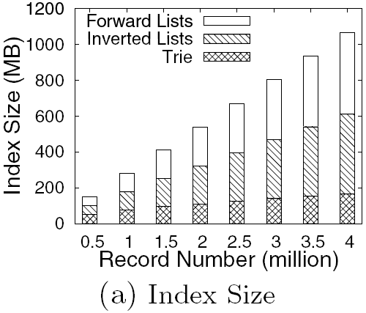
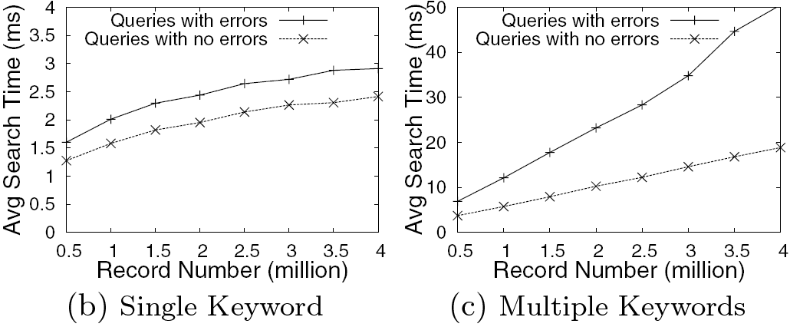
Experiments
Scalability (MEDLINE)

Slide 52
Outline
Introduction
Indexing Methods
Single Keyword
Multiple Keywords
Experiments
Conclusions

Slide 53
Conclusions
They proposed an efficient incremental algorithm to answer single-keyword fuzzy queries
They studied various algorithms for computing the answers to a query with multiple keywords that are treated as fuzzy, prefix conditions

Slide 54
Thank You!
Any Questions or Comments?

